Slide 1
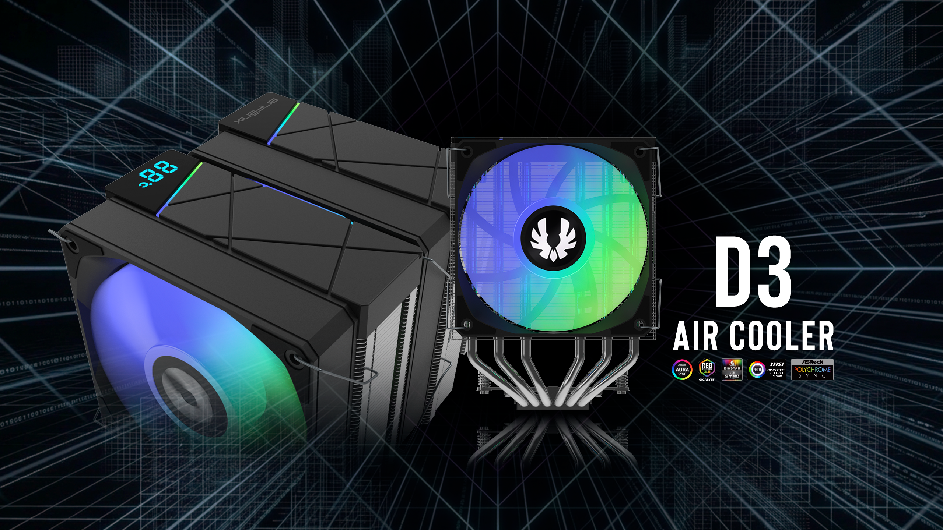

Slide 2
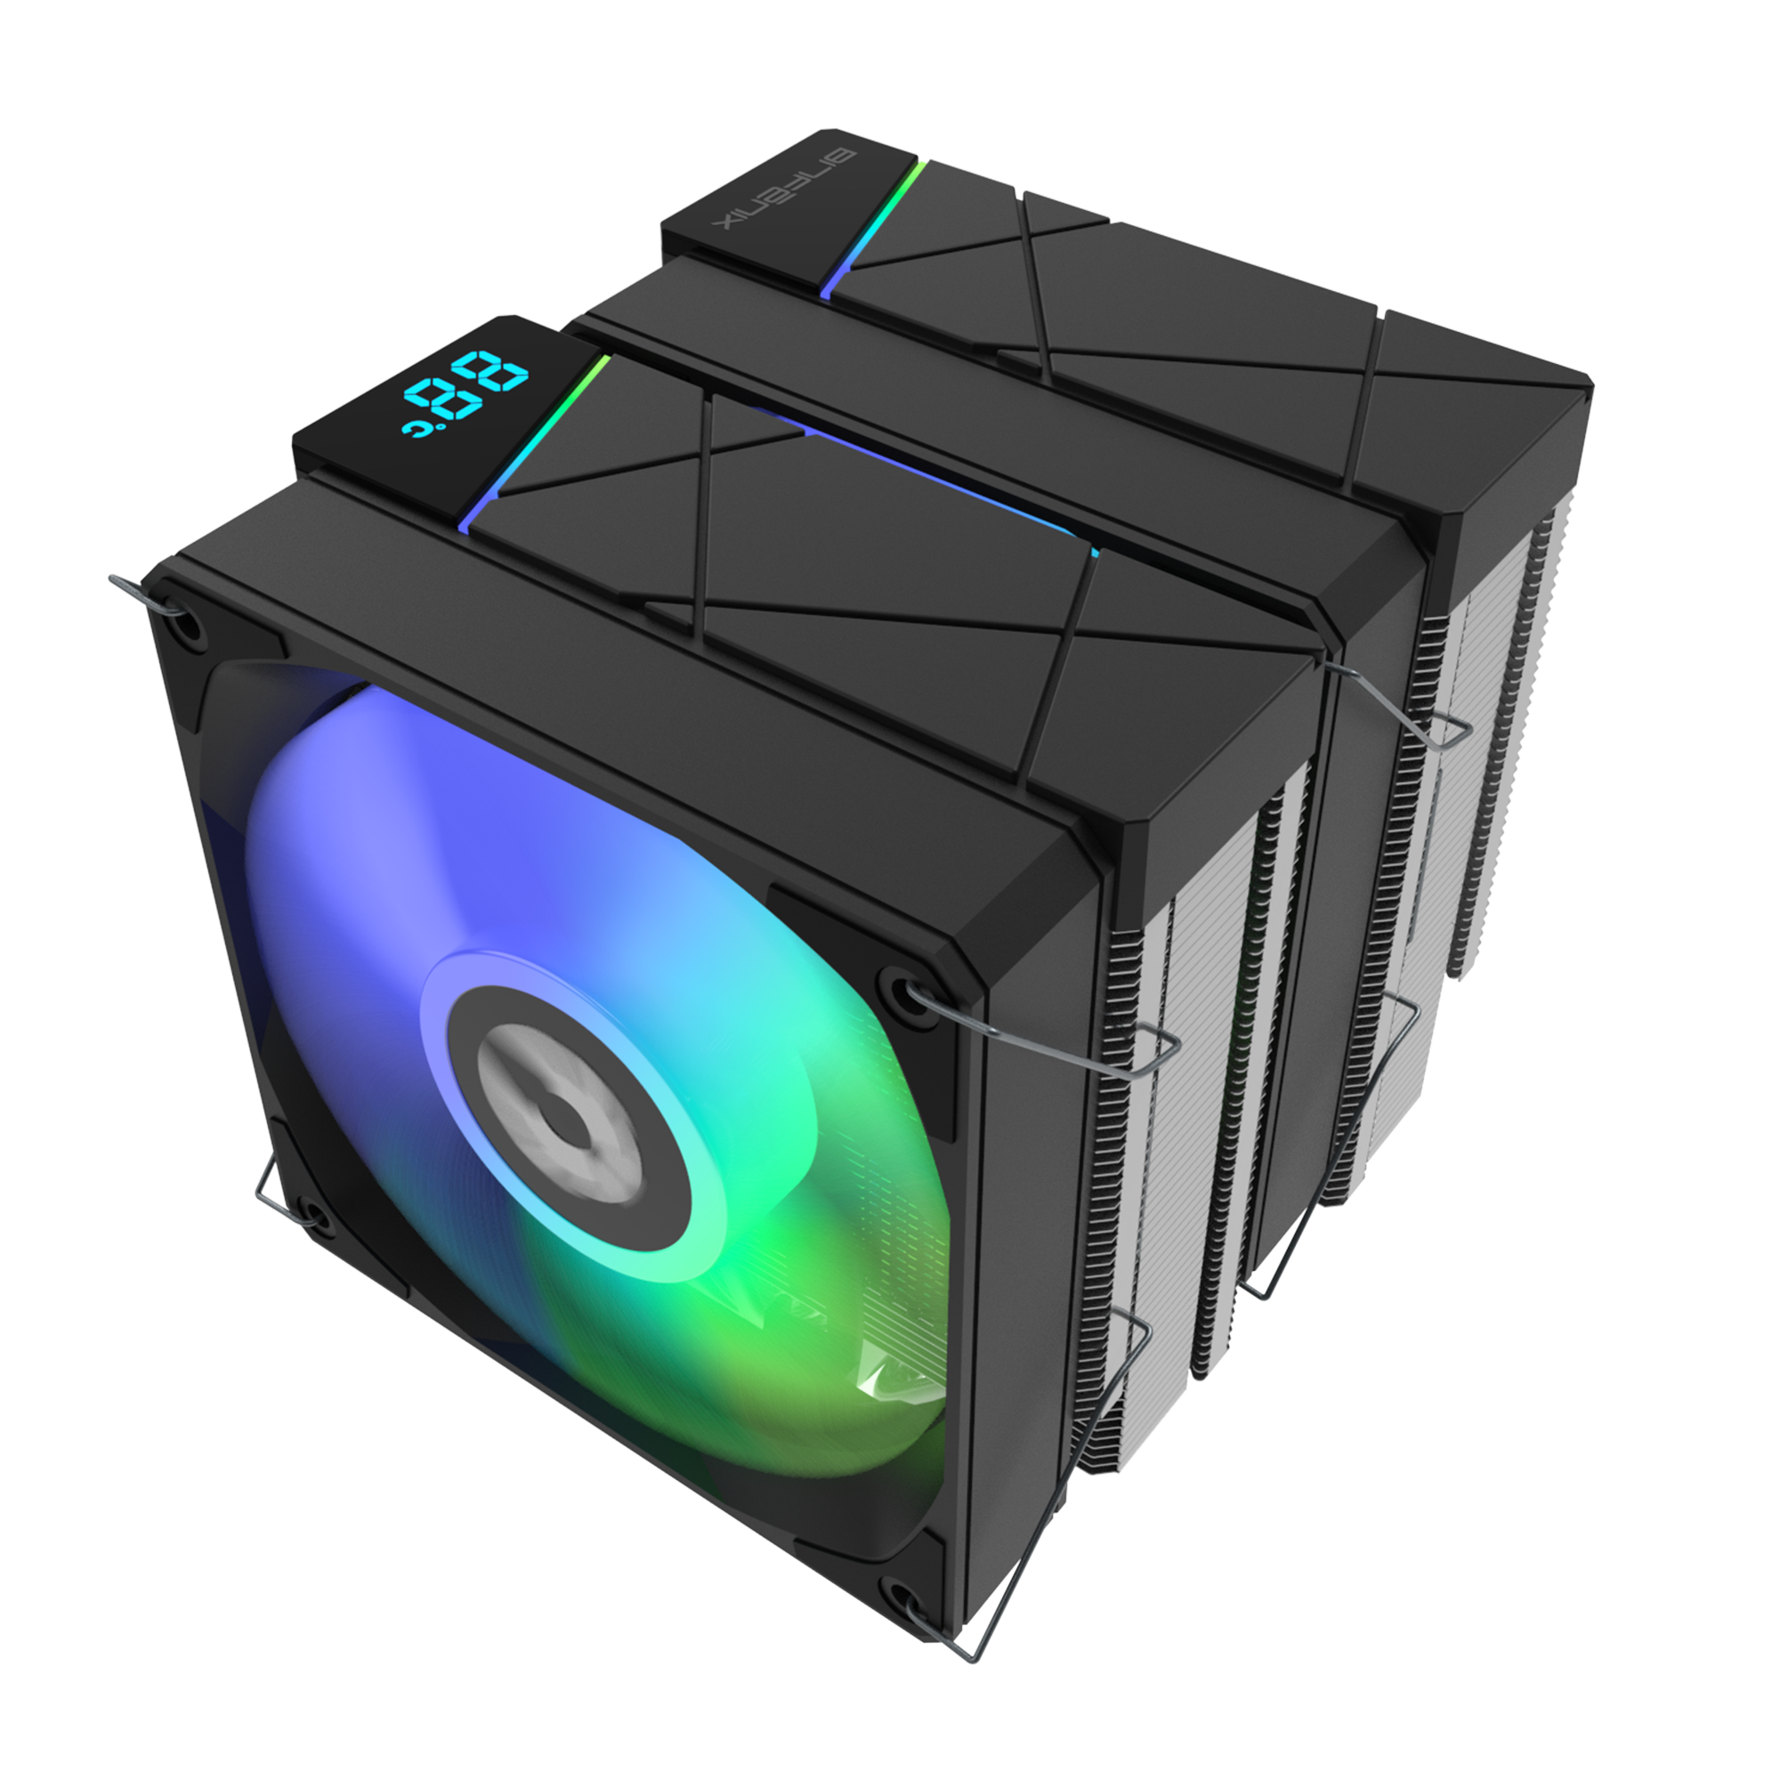

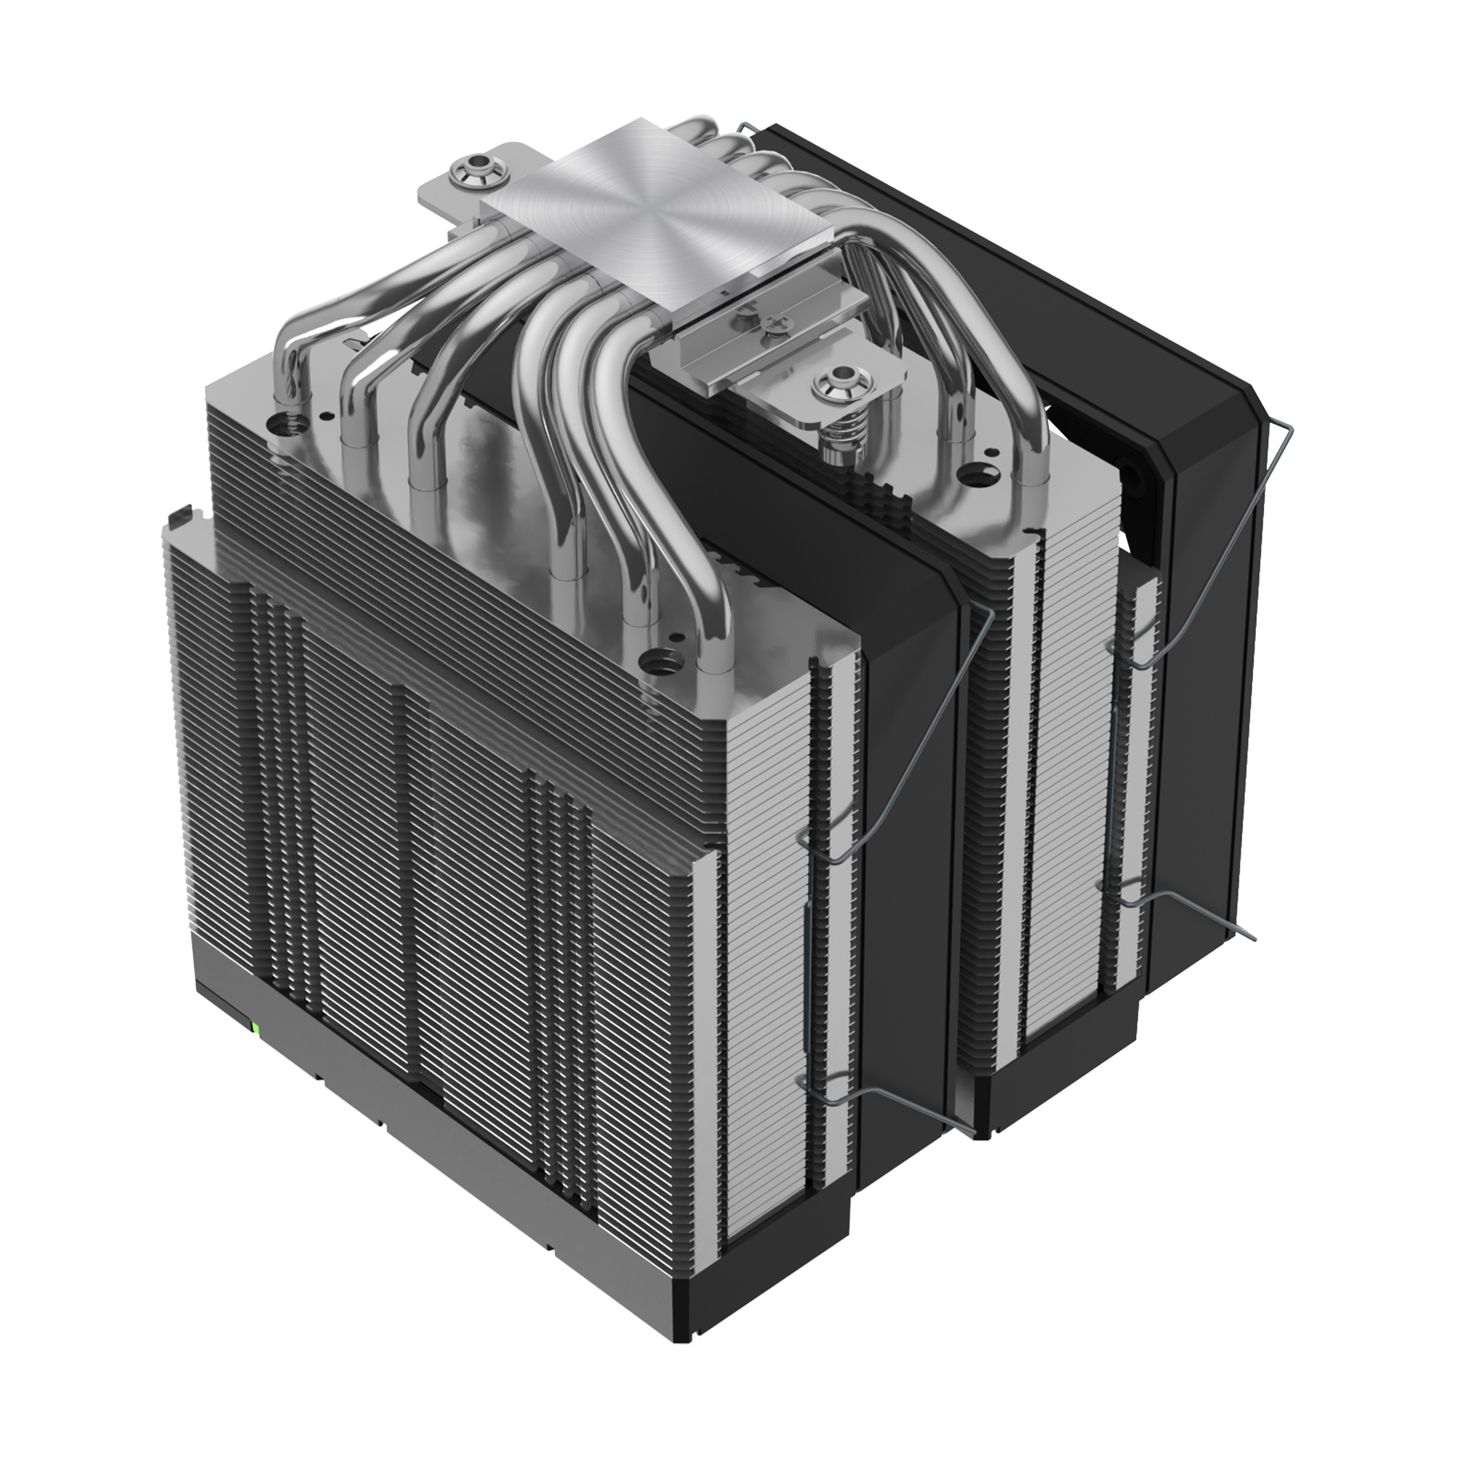

AGRB FAN
Copper-bottom welding
AGRB FAN

Slide 3
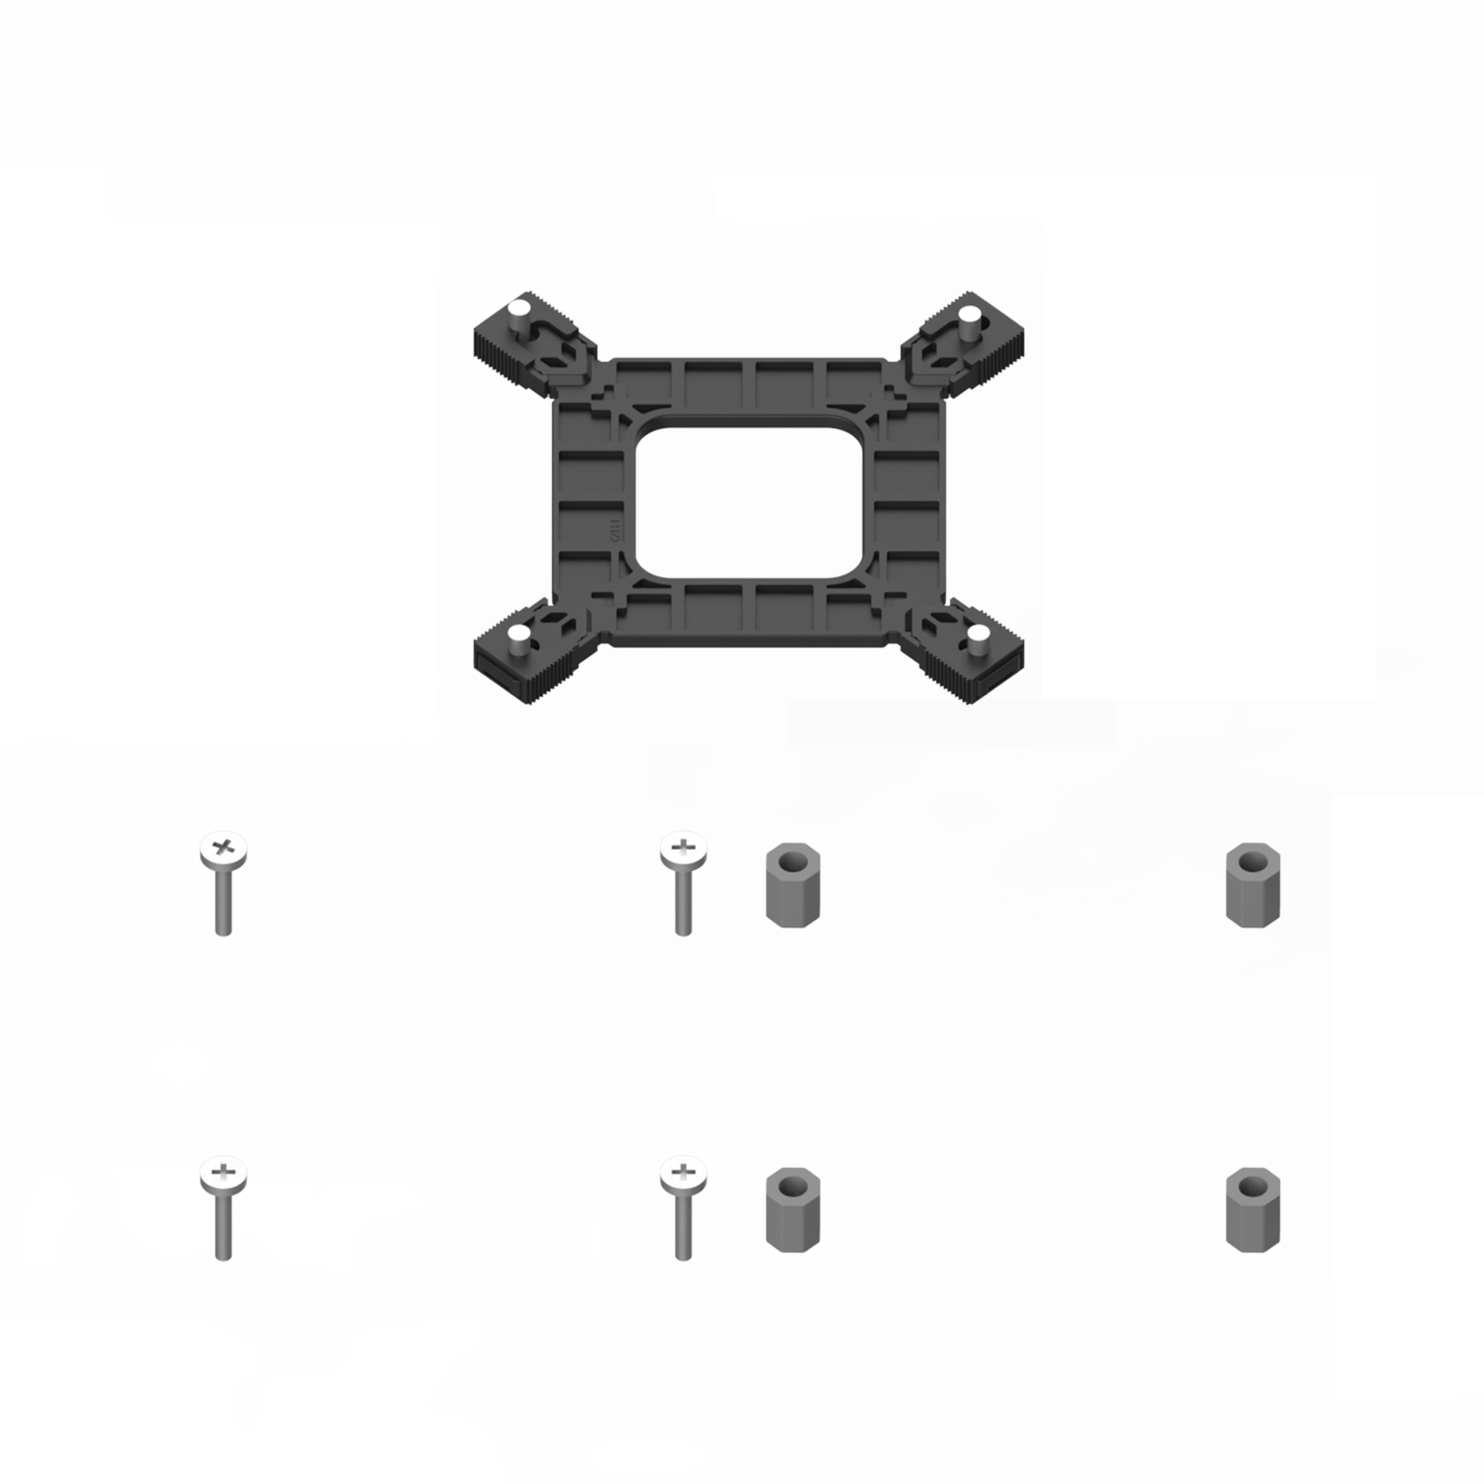
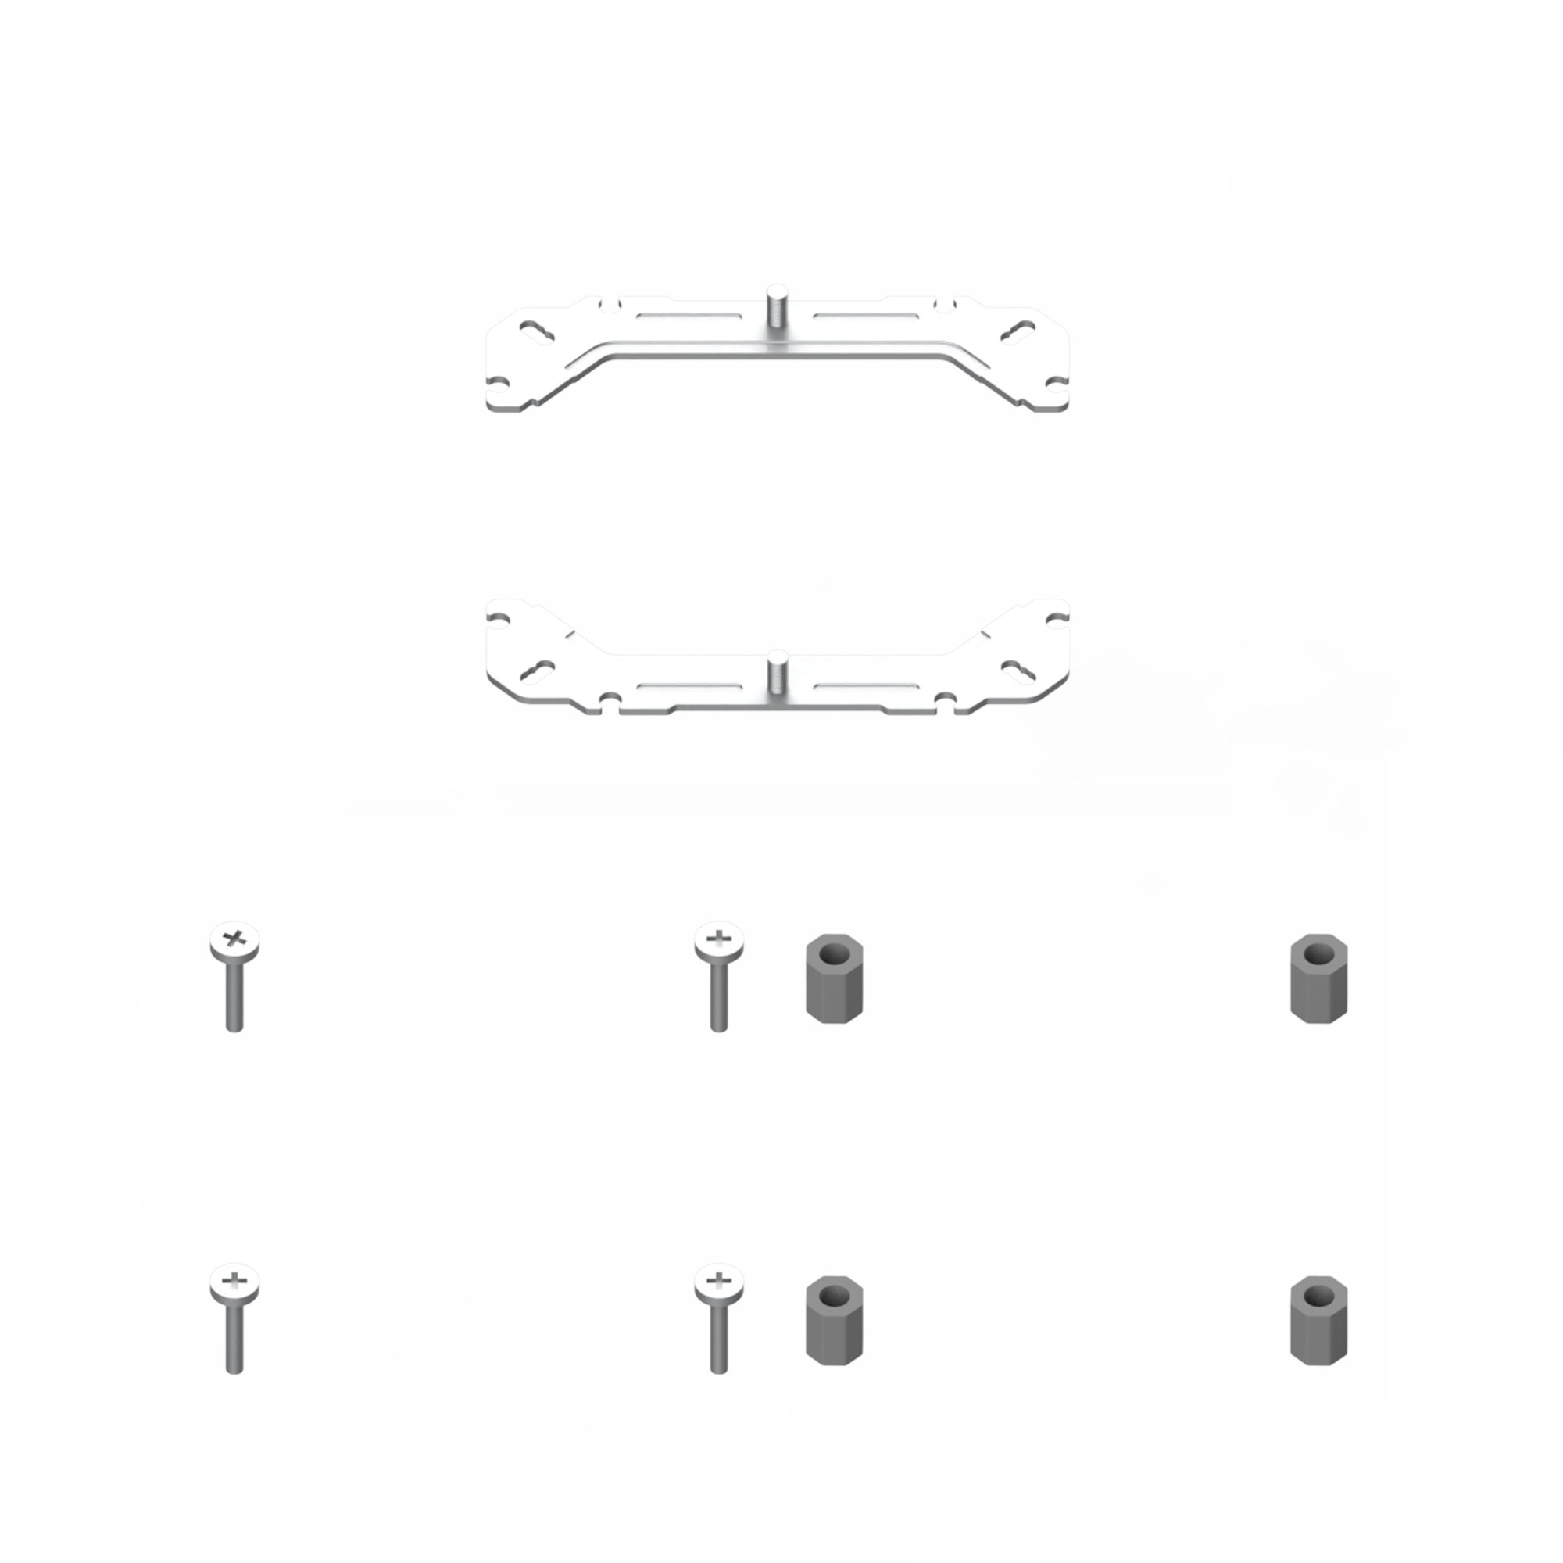
Compatible with
the latest AMD & INTEL CPU Platform
INTEL Socket
AMD Socket
LGA115X/ 1200/ 1700/ 1366/ 1851
AM4/ AM5

Slide 4
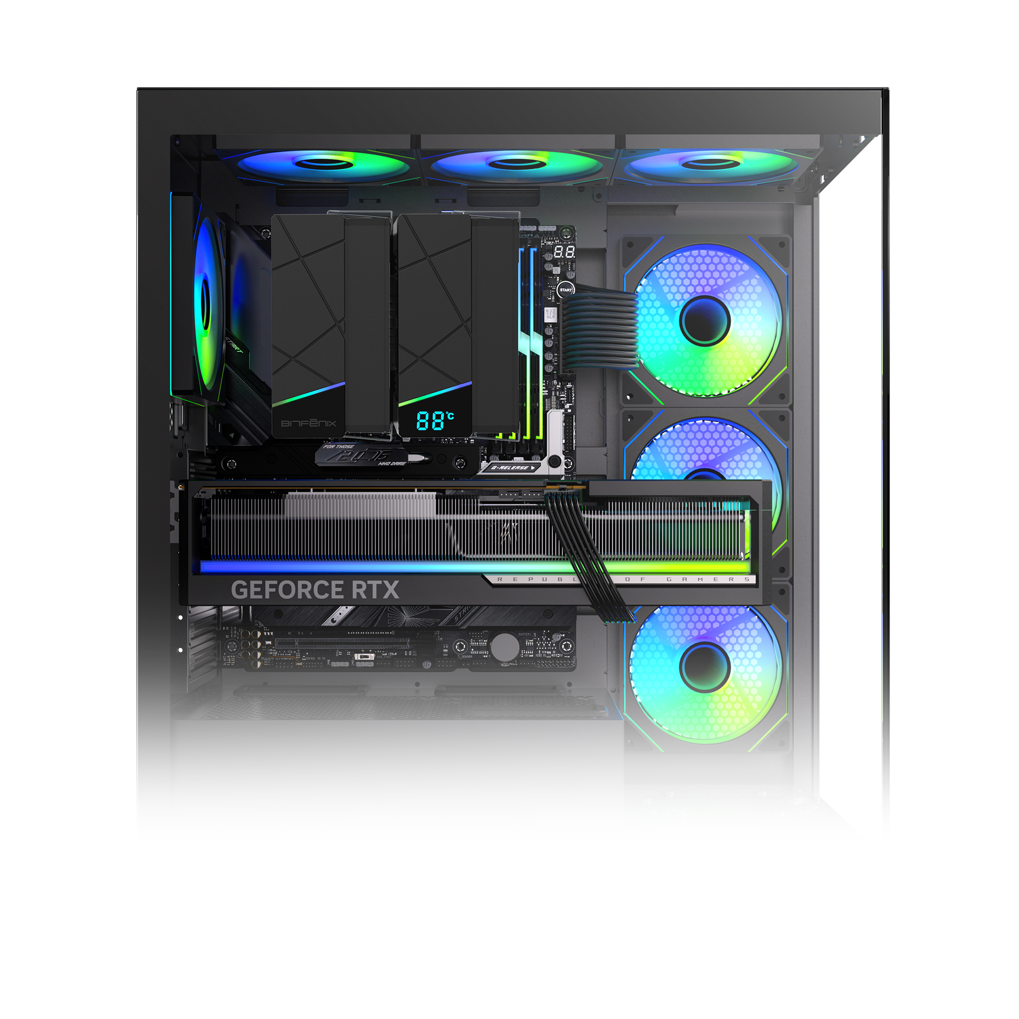
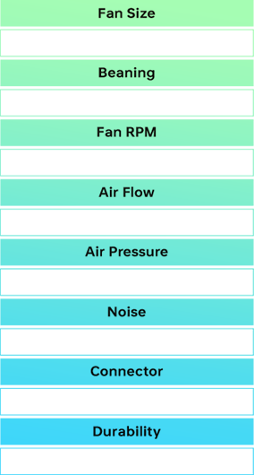
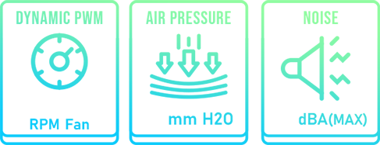
High-Quality Fan Delivers Powerful Airflow
120 x 120 x 25 mm
Hydro bearing
750~1900 RPM±10%
57.56±10%CFMCFM
2.48mmH2O±10%
38.21±10% dBA（MAX.）
4 Pin
750-1900
2.4
38
20000H

Slide 5
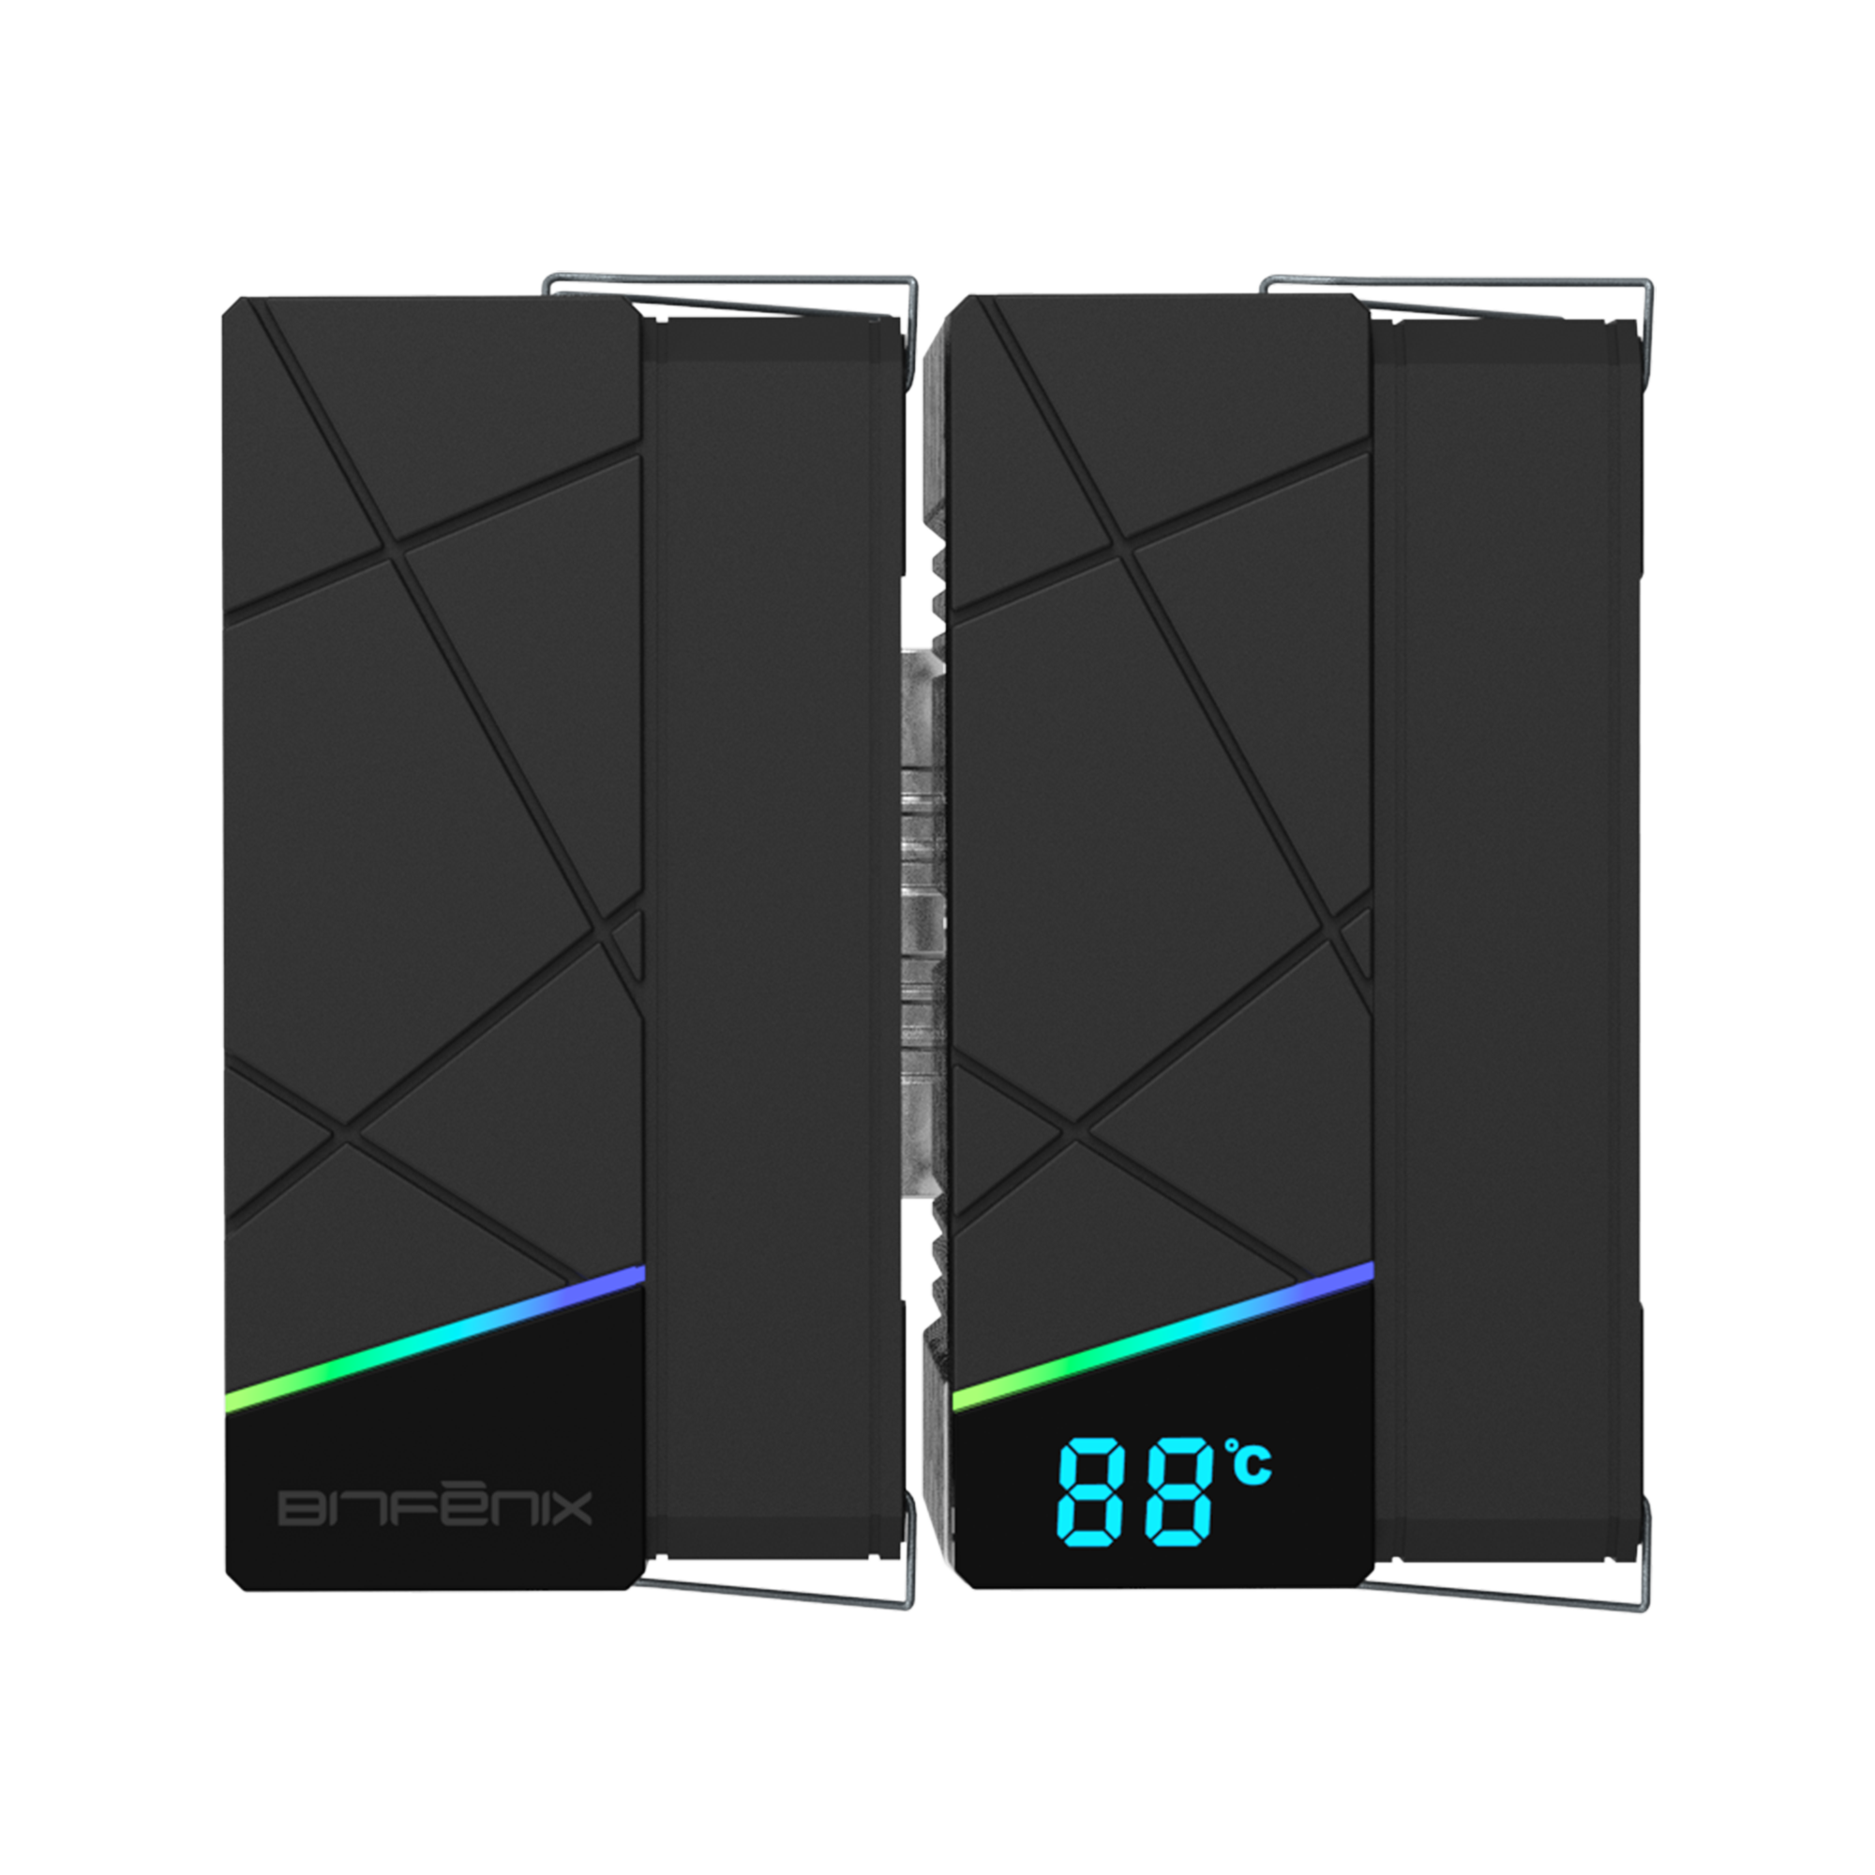
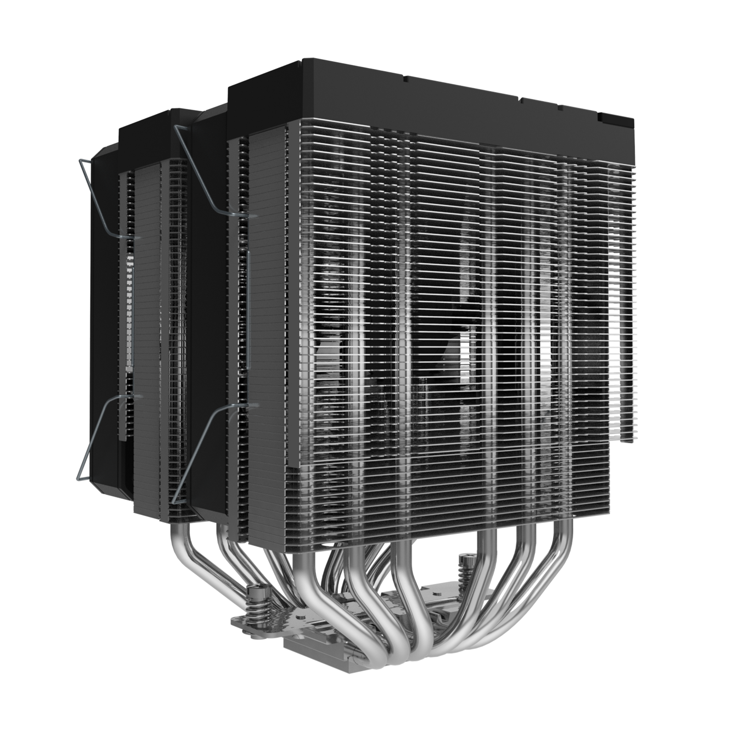

134mm
127mm
167mm

Slide 6
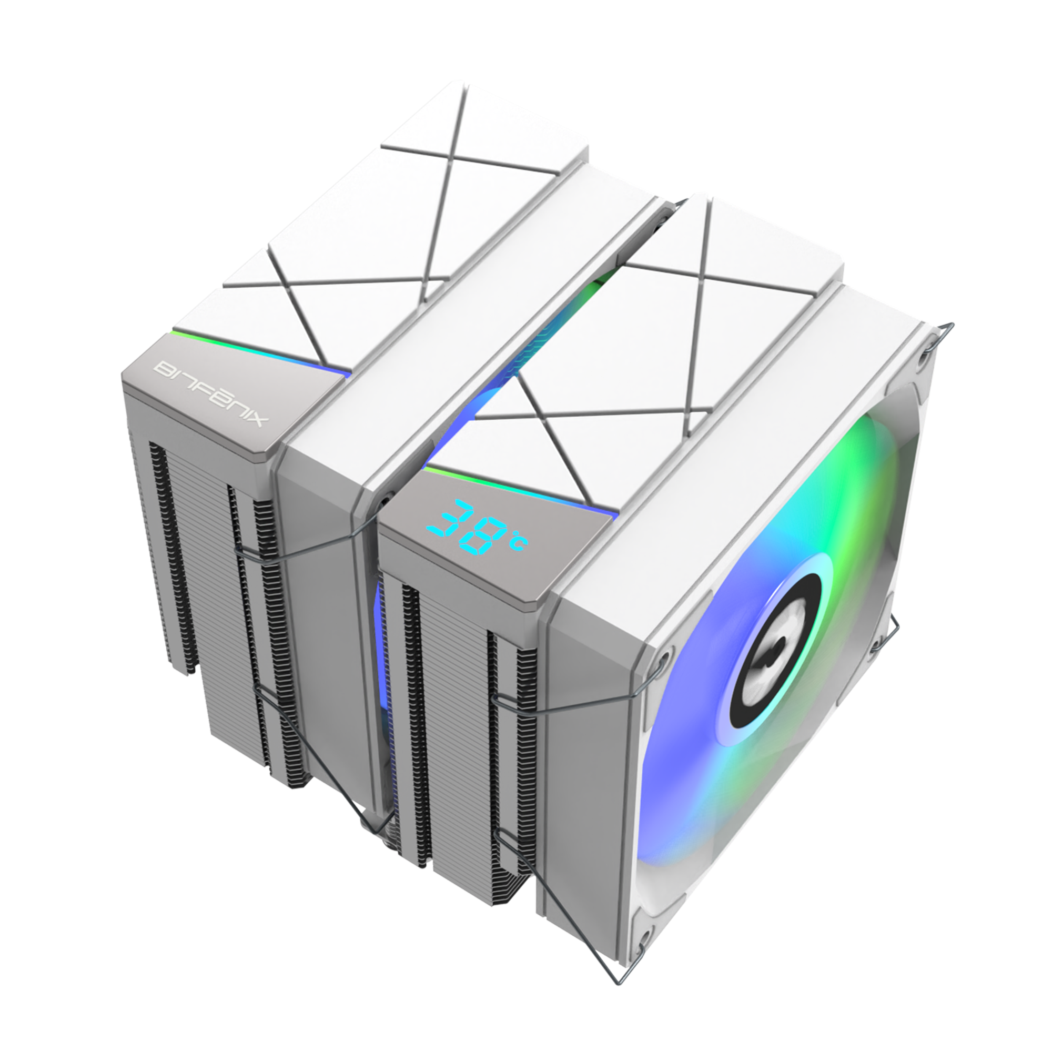
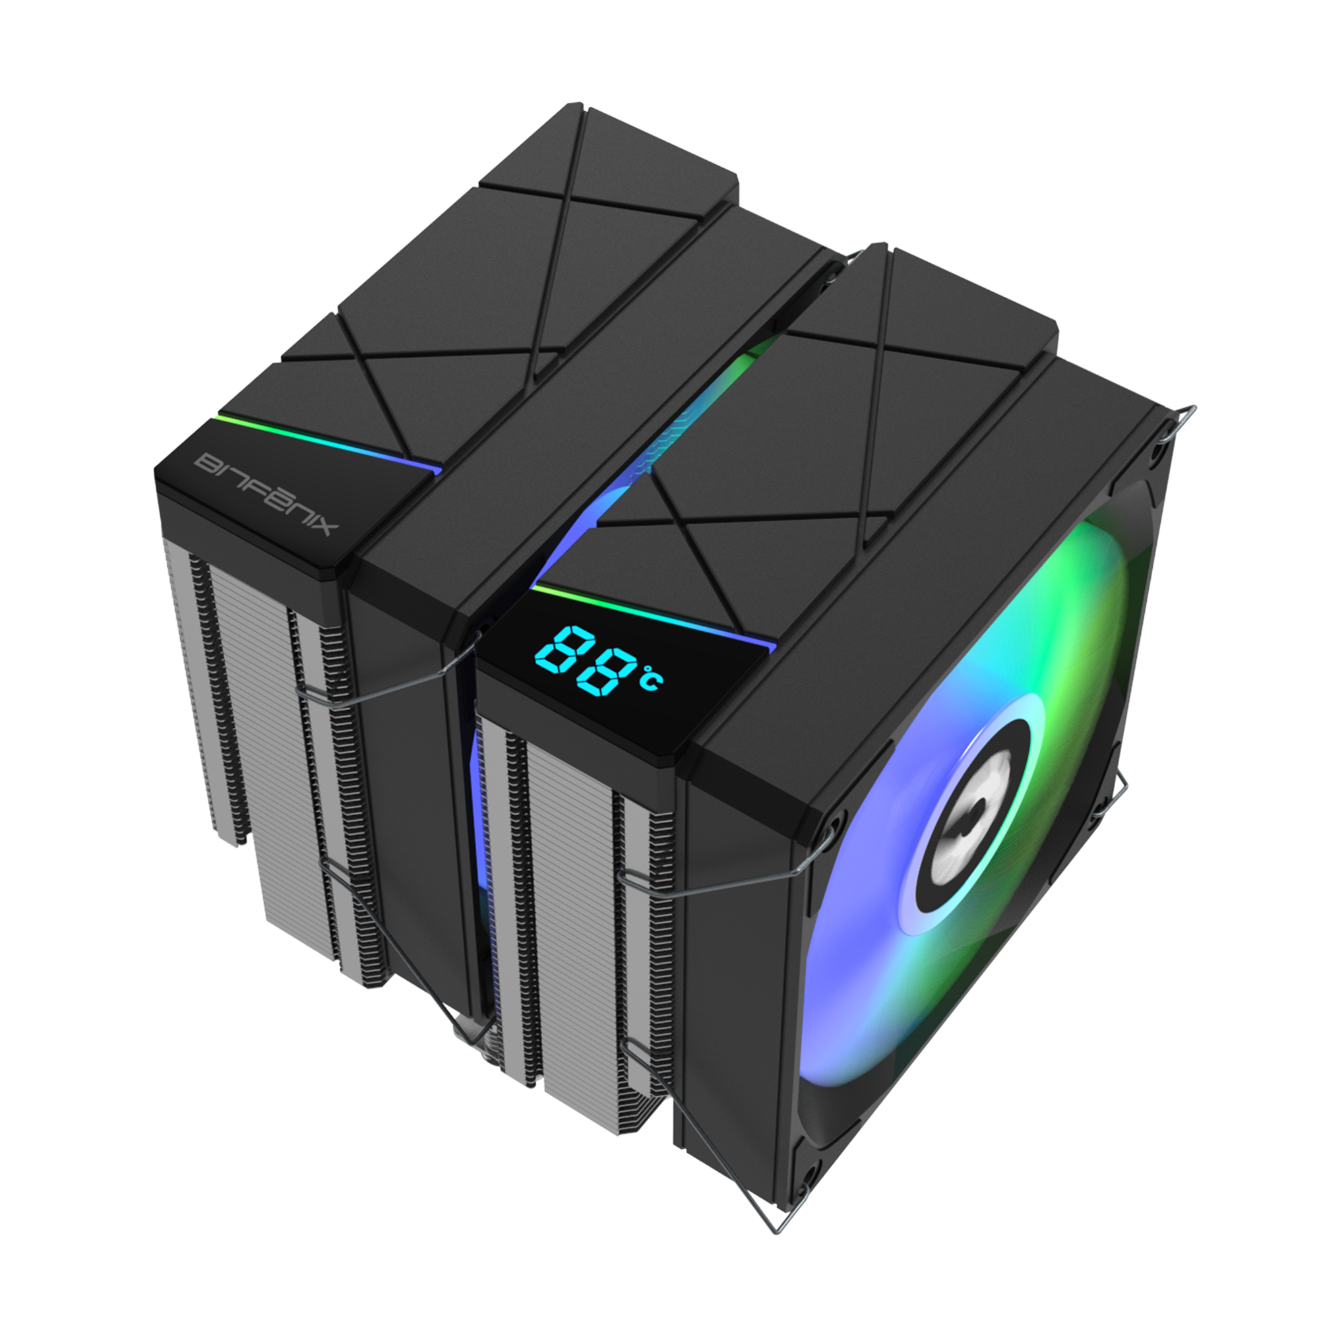
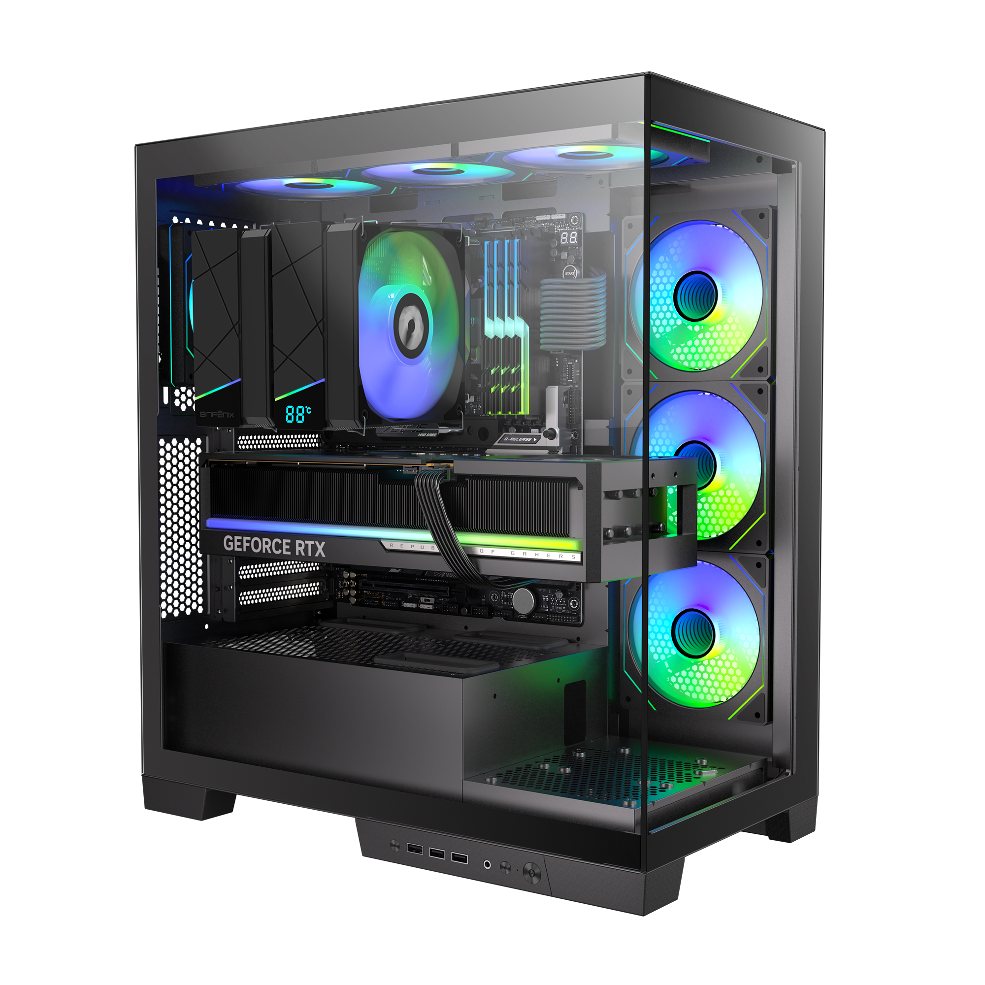
D3
AIR COOLER
D3 - Black
Part Number | BFA-D3-6P120-AK-RP
EAN / UPC | 4712883213434 / 886027007518
D3 - White
Part Number | BFA-D3-6P120-AW-RP
EAN / UPC | -

