Slide 1
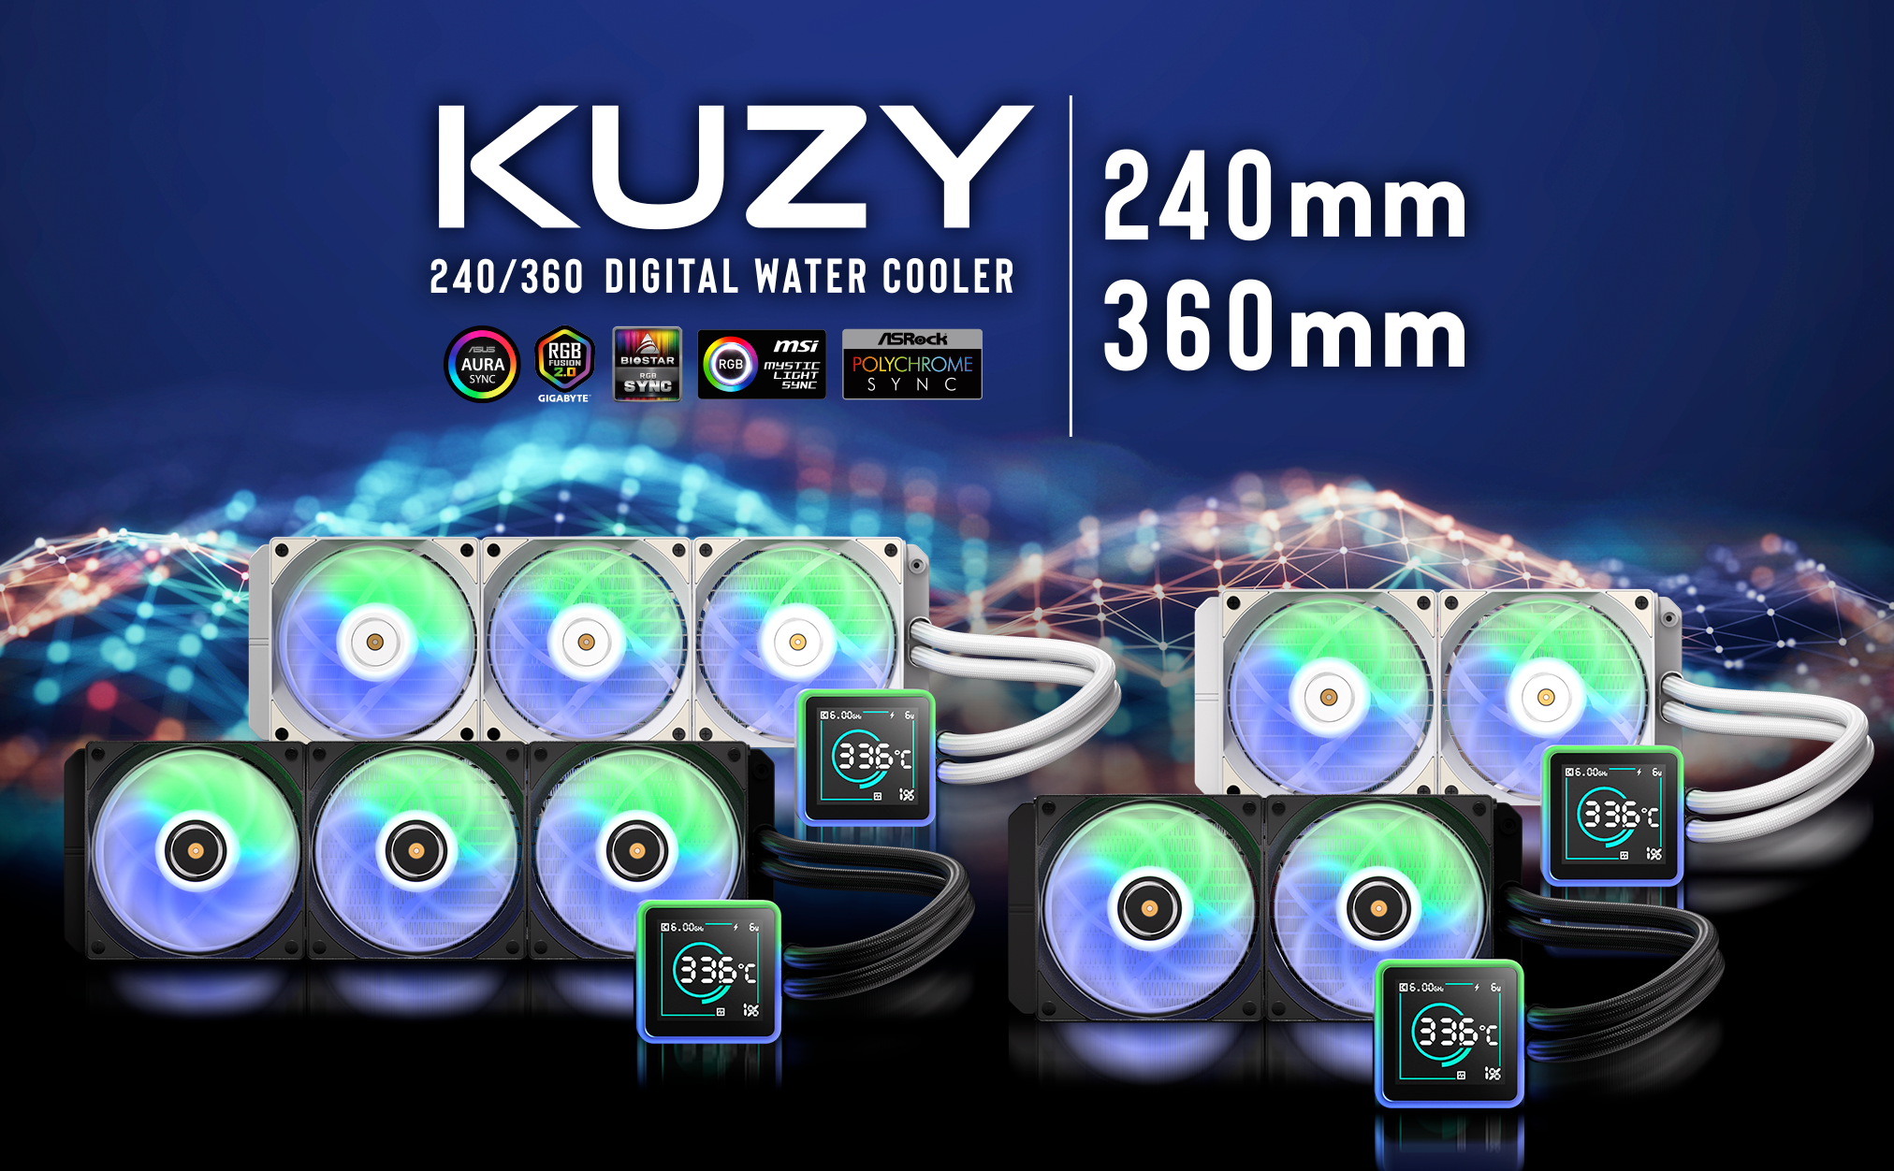

Slide 2
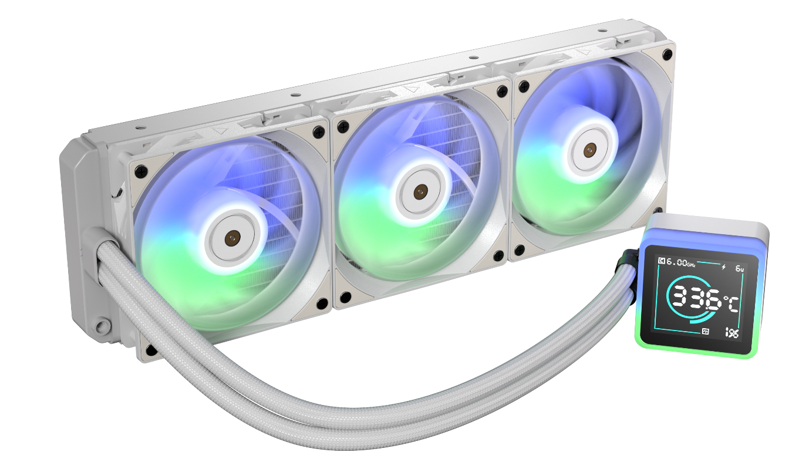
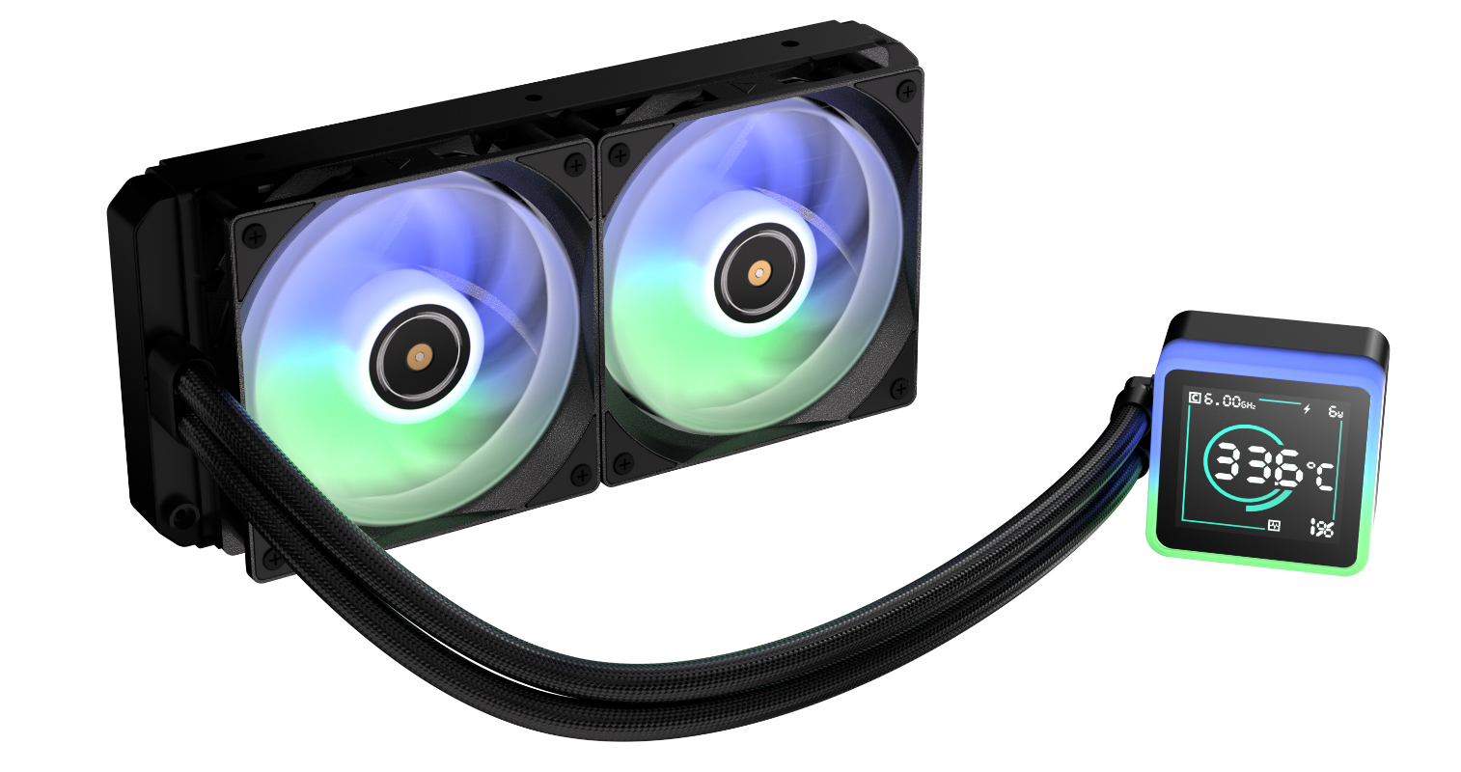

Bitfenix KUZY
The Kuzy display AIO is the newest addition to BitFenix's extensive line-up of chart-topping 3 generation liquid coolers. The translucent ARGB pump bezel encases a unique 7 segment LCD screen with some funny and useful features.
Support Motherboard-Brand Lighting Synchronization: Asus/Gigabyte/MSI/ASRock/Biostar...and other brands can support.

Slide 3
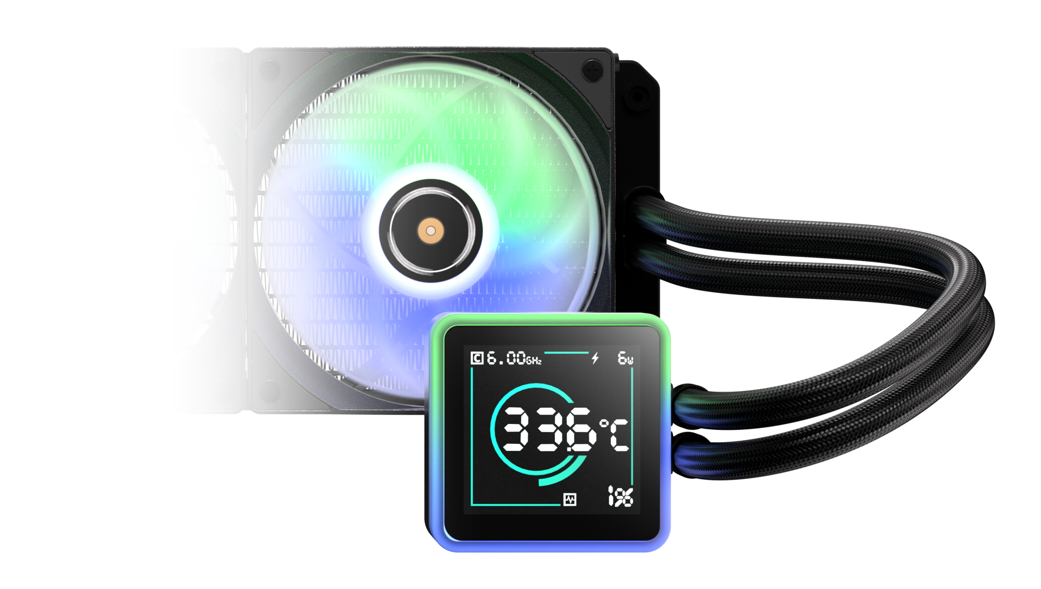

Practical And Interesting KUZY 7-segment LCD Screen
Bitfenix KUZY
Segment Display AIO Software
CPU TDP Wattage
CPU Frequency GHz
CPU Perfomance
Display: 20/40/60/80/100
CPU Usage Rate

Slide 4
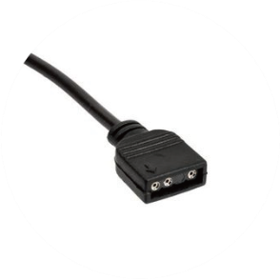
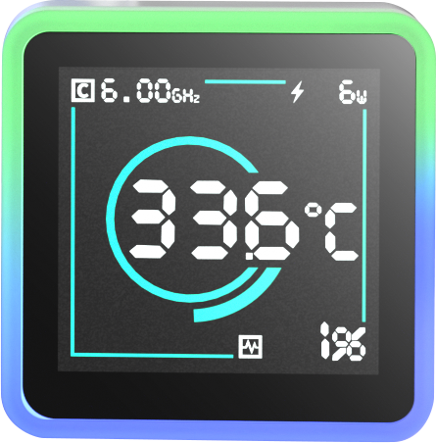
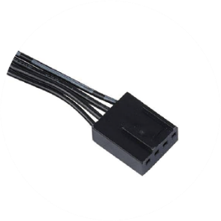
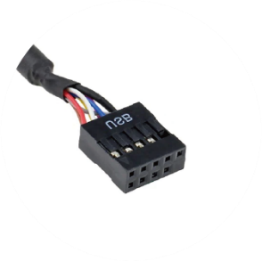
Introducing Water Block Connector Cables
ARGB Header
Connects to the motherboard's ARGB 3-pin socket
PUMP Header
Connects to the motherboard's pump/fan/extension cable Y-header
Monitor Header
Connects to the motherboard's USB 2.0 socket

Slide 5
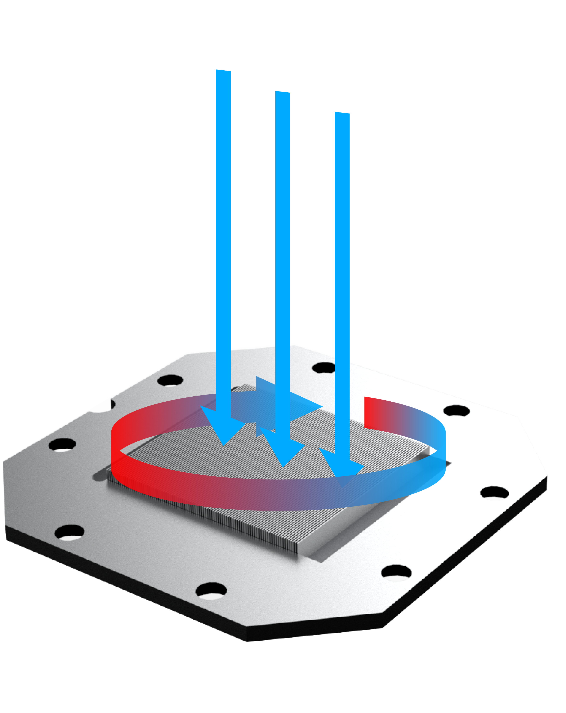
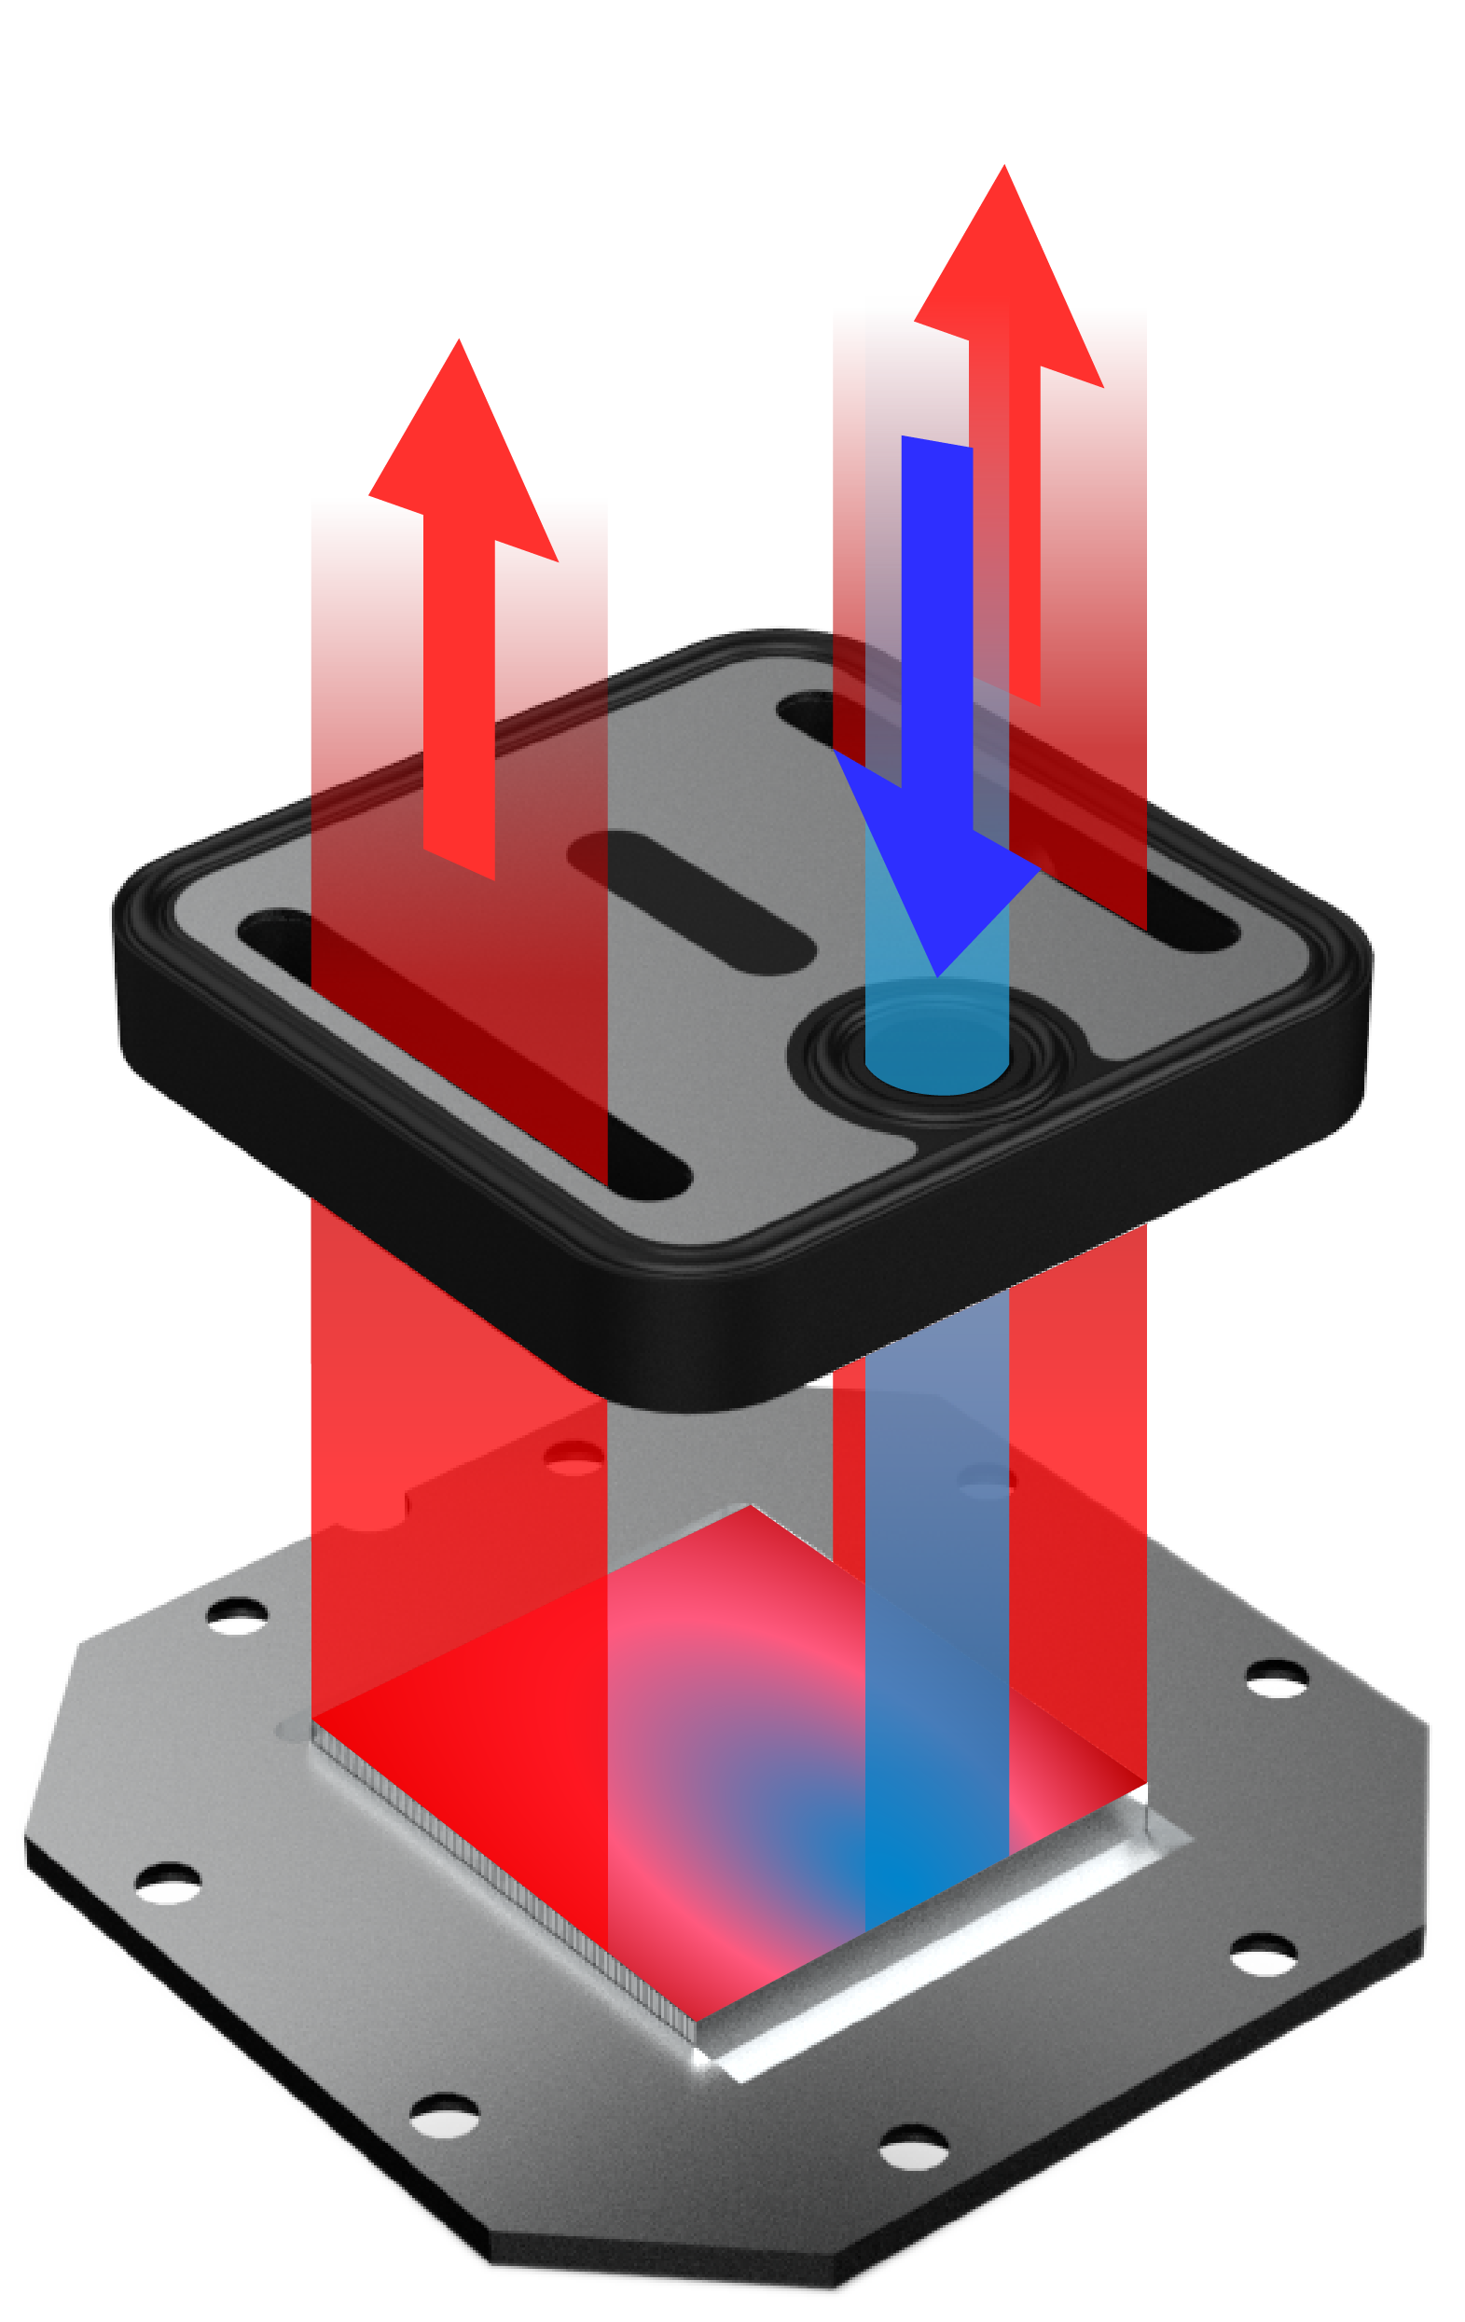
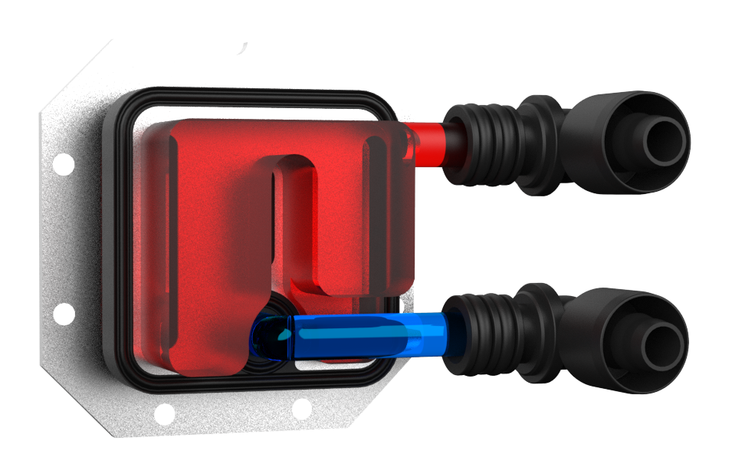
Central Inlet Design with Optimized 0.2mm Micro-Channel Structure
Bitfenix KUZY AIO’s Block features a central inlet design with a jet plate equipped in the middle of the water block contacting the CPU heat source directly accelerating the extraction of heat. In addition, it has optimized 0.2mm micro-channels on the copper plate, providing flawless distribution of coolant with superior heat transfer and durability
Hot Water Out
Hot Water Out
Water Mix
Other Brand
Hot Water Out
Cold Water In
Cold Water In
KUZY

Slide 6
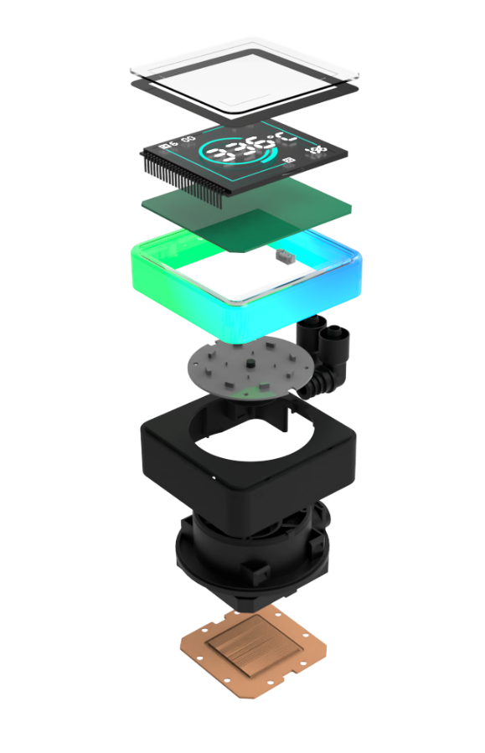
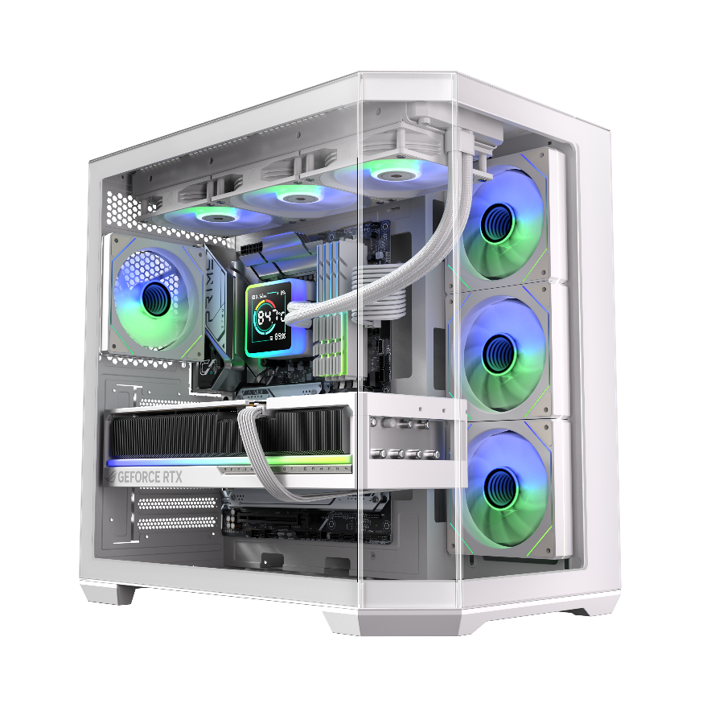

Third Generation Pump
Socket compatibility | Intel: 1851 / 1700 / 1200 / 1150 / 1151 / 1155 AMD: AM5 / AM4
Pump speed (rpm) | 5500 ±10 rpm
Pump adjustable | 9V - 12V
Pump connector | 4-pin
Tube length (mm) | Tube length (mm) 450
Noise level | 27dB
Refill port | ✓
In order to match the latest top-level CPUs, we have developed a brand new pump based on the popular pump architecture. It has the ultimate specifications of 5500RPM and vertical lift of up to 1.8m, while operating at only 15db.

Slide 7
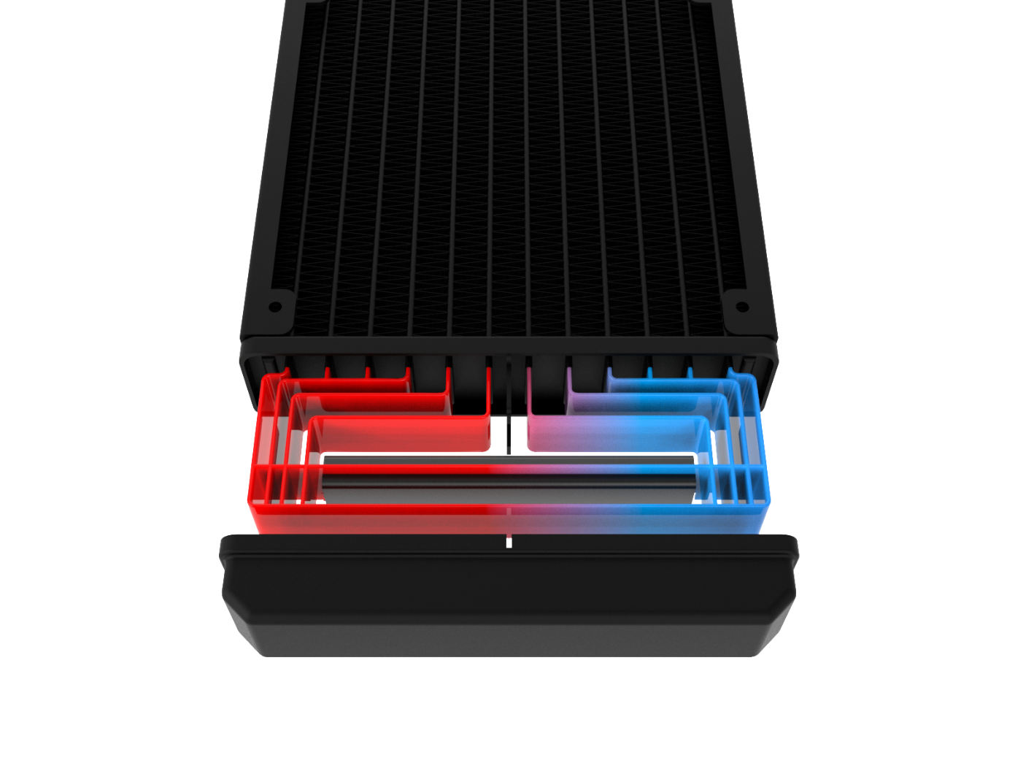

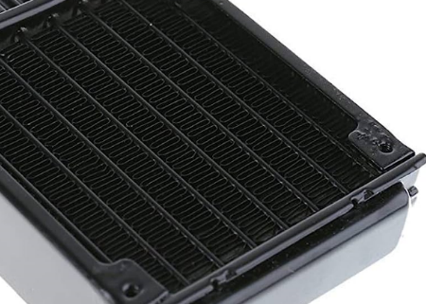
Radiator Features
12 heat sink water tunnel
Other brand
FPI: 20 high density fin radiator
Flow Distributor
High Density Radiator: The BitFenix Cube AIO sports a high density radiator with a FPI: of 20 which are connects to 12 tubes for better heat dissipation.
Radiator with special water channel design: The unique baffle design allows the circulating water to truly flow through all the water channels—not just the central ones, but also those on both sides—ensuring optimal heat dissipation.
High-density Radiator With Flow Distributor Design
The average temperature of using thick radiator get 3 °C lower than the thin one.
The max temperature of using thick radiator get 5 °C lower than the thin one.

Slide 8
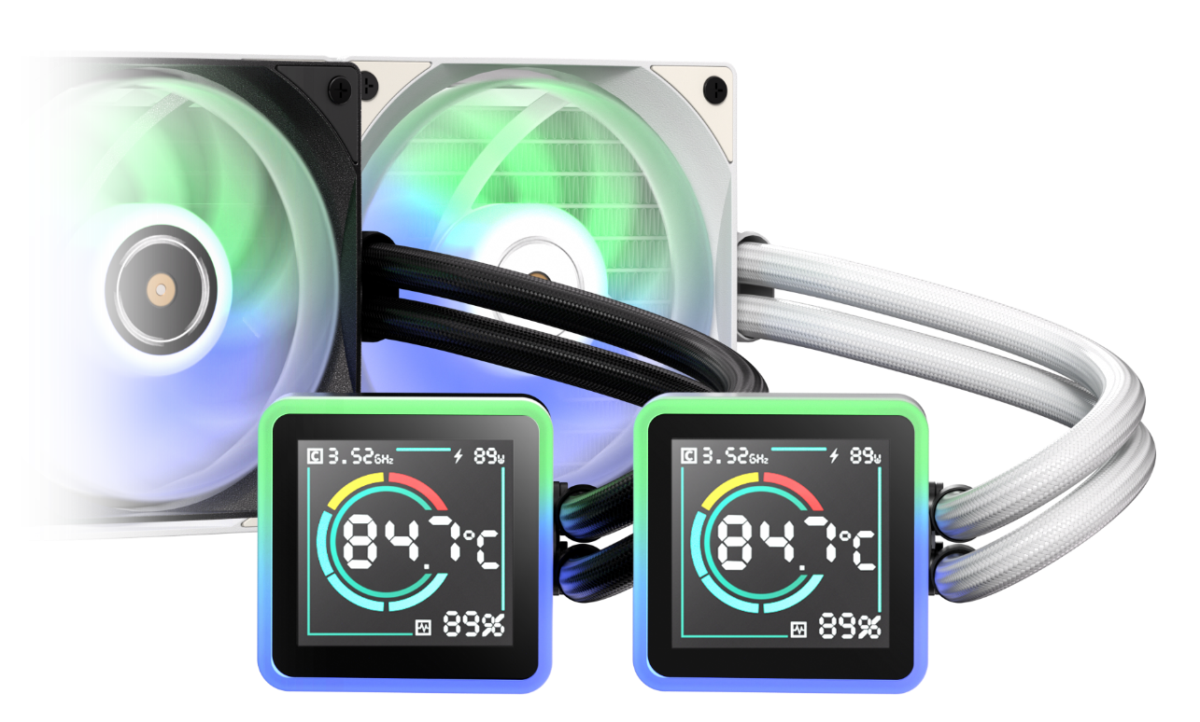
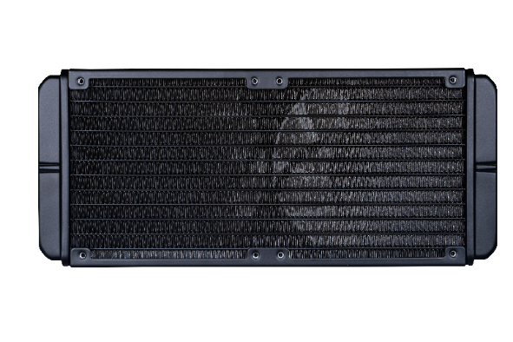
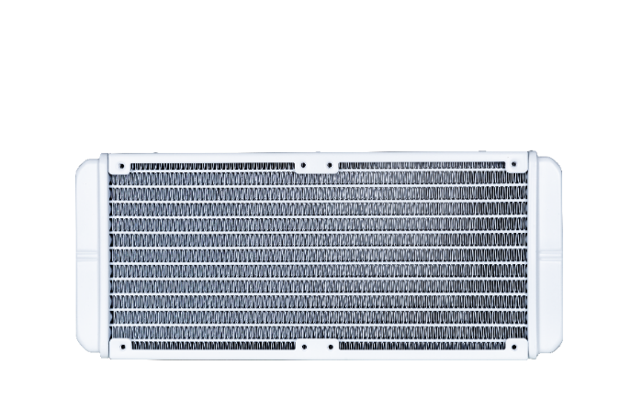
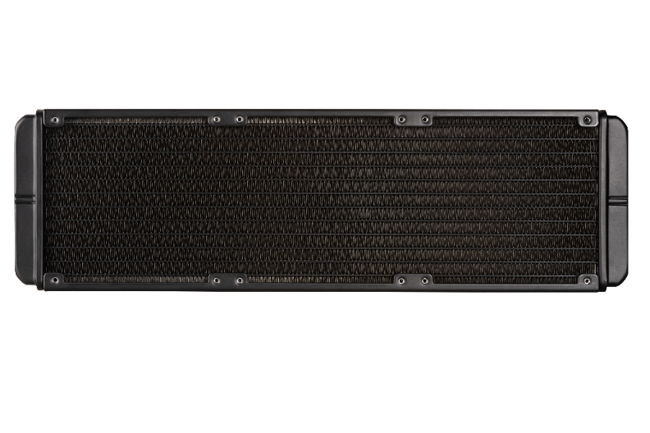
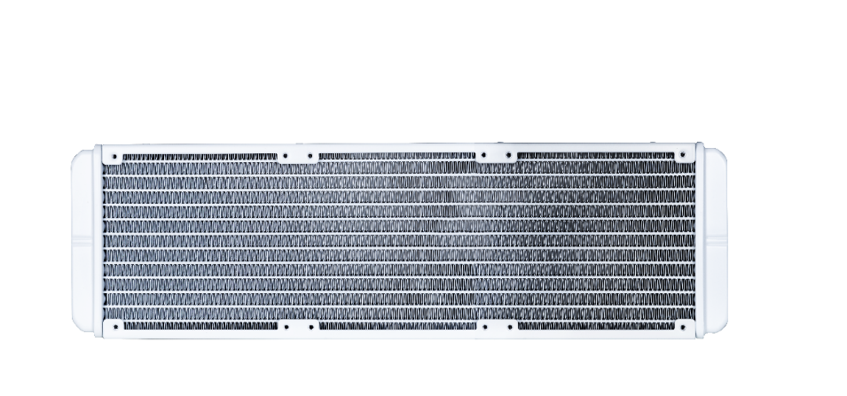
240mm
240 Radiator specifications
Dimensions (H x W x D), (mm) | 278 x 120 x 27
Radiator material / finish | aluminum / black or white spray painted
Base material / finish | copper / nickel plating
360mm
360 Radiator specifications
Dimensions (H x W x D), (mm) | 398 x 120 x 27
Radiator material / finish | aluminum / black or white spray painted
Base material / finish | copper / nickel plating

Slide 9
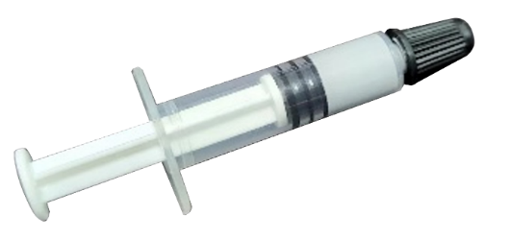
Thermal Paste - BITFENIX TF10 EXTREME
Our products are quipped with BITFENIX TF10 EXTREME thermal paste
* 13.8 W / m.k’s extremely high heat transfer capacity to meet the needs of the highest end users * No curing time means that the radiator will maintain the epic peak capacity once it is installed. * Long life means long-term trouble-free use * Not conductive means no need to worry about a short circuit
Specifications
Thermal Conductivity（W / m-k) | 13.8
Color | Gray
Thermal lmpedance (℃-cm2/W) | <0.01
Specific Gravity（25℃) | 2.7
Useable Temperature Range | -220℃ / + 300℃
Electrically Conductive | No
Harmless | Yes

Slide 10
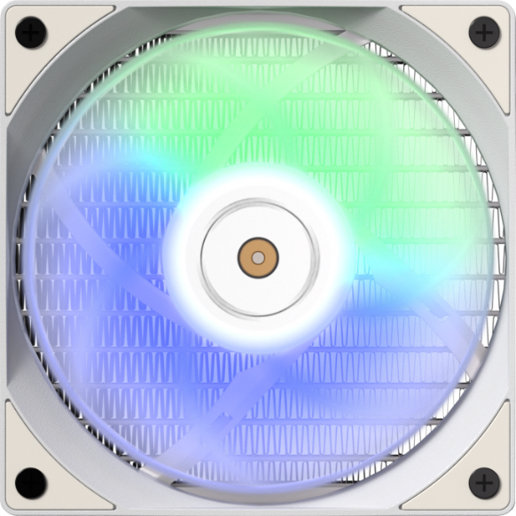

Newly Designed High Pressure Fan
Newly designed high pressure fan together with the specially designed radiator, BitFenix also launched a brand new fan design.
This newly designed seven-leaf fan has a CFM and DB that are not inferior to anyone, and the wind pressure generated outside is as high as 2.97MM-H2O. The high-pressure fan is used to penetrate the radiator with high-density and heightened heat dissipation fins. With the no noise design in 400DB mode, the whole AIO system can better meet the low noise level needs of the user.
Fan model | ARGB 120mm PWM high- pressure Fan
Fan dimensions (mm) | 120 x 120 x 25
Speed @ 100% PWM (rpm) | 2000 ±10% RPM
Bearing technology | Hydraulic Bearing
Rated Voltage (V) | 12 Start voltage(V) ≦5V (Power ON/OFF)
Rated current (A) | 0.2A / LED:0.30A
Power consumption (W) | 2.28W
Connector | 4-pin PWM
Max. air flow | 68CFM
Air Pressure | 2.2MM-H2ONoise 27.0dB-ARGB Fan
Extension Cble length (mm) | 400+200
Power Extension Cble length (mm) | 400
120mm

Slide 11
 | 240mm | 360mm
Bitfenix Kuzy segment display AIO - White | BFW-SKL-240-WW27A-RP | BFW-SKL-360-WW27A-RP
Bitfenix Kuzy segment display AIO - Black | BFW-SKL-240-BB27A-RP | BFW-SKL-360-BB27A-RP
Model | 240mm | 360mm
color box dimension(mm) | 321 X 240 X 140 | 461 X 206 X 138
color box weight(KG) | 1.94 | 2.34
carton dimension（mm） | 685 X 296 X 508 | 476 X 430 X 305
units per carton | 8 | 4
carton net weight(KG) | 15.52 | 9.36
carton gross weight(KG) | 17.09 | 10.65
pallet dimension | W 1200 X D 1000 X H 115 mm
Carton per pallet | 24 (6 X 4) | 36 (6 X 6)
units pet pallet | 144 | 144
full pallet Dimension | 1254 X 1000 X 1644 H | 1294 X 1000 X 1960 H
actual pallet Dimension | 1274 X 1000 X 1670 H | 1294 X 1000 X 2035 H
Weight of pallet(exclude) | 307.62 | 383.4
cuft | 3.49 | 2.2

