Slide 1
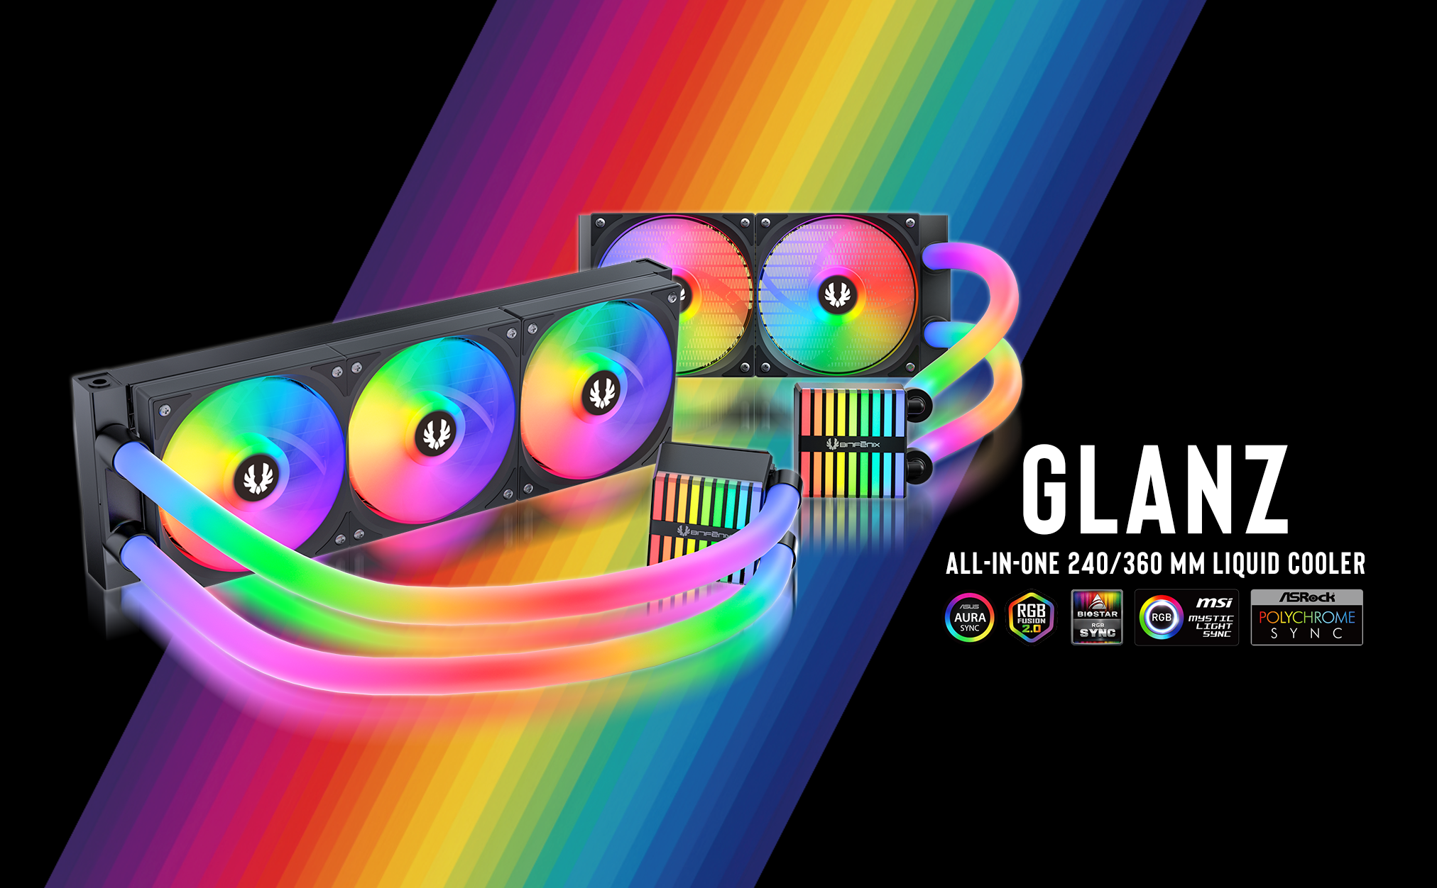

Slide 2

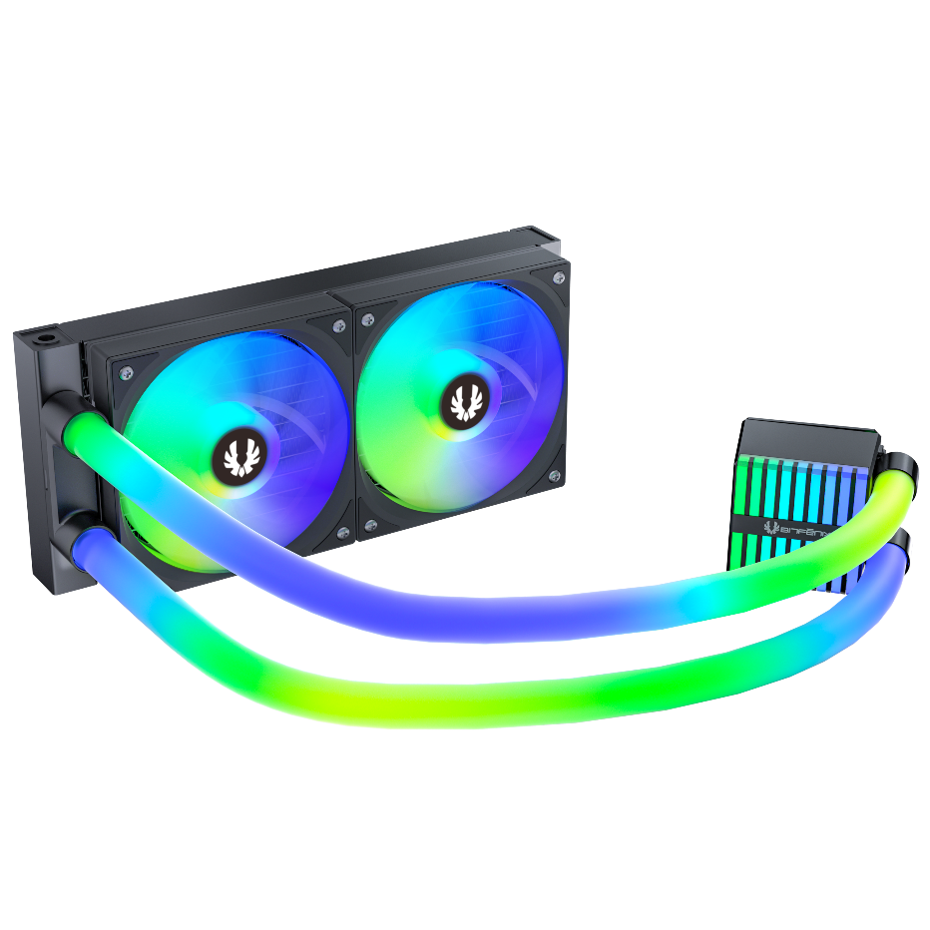

Bitfenix Glanz
"The Glanz AIO is the latest powerhouse in BitFenix’s acclaimed lineup of 4th-generation liquid coolers. Featuring a piano-key-inspired ARGB water block and striking LED-wrapped tubing, it combines high-tier performance with a cost-effective price point—perfect for gamers who demand both cooling efficiency and vibrant aesthetics.
Support Motherboard-Brand Lighting Synchronization: Asus/Gigabyte/MSI/ASRock/Biostar...and other brands can support.

Slide 3

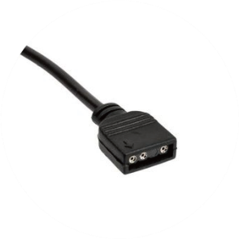
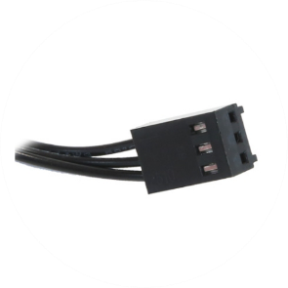
Introducing Water Block Connector Cables
ARGB Header
Connects to the motherboard's ARGB 3-pin socket
PUMP Header
Connects to the motherboard's pump/fan/extension cable Y-header
69.5 x 89 x 60mm

Slide 4
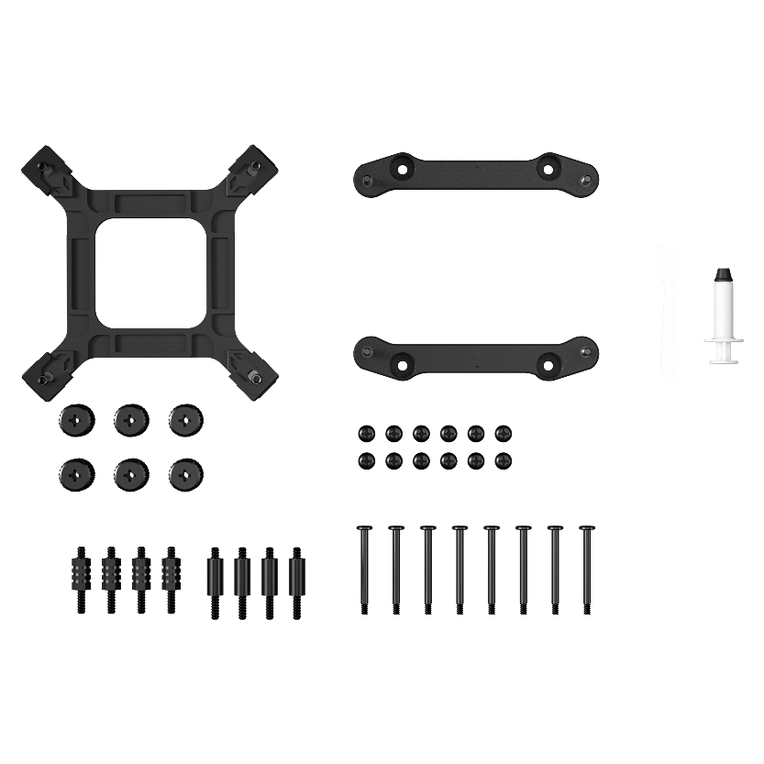
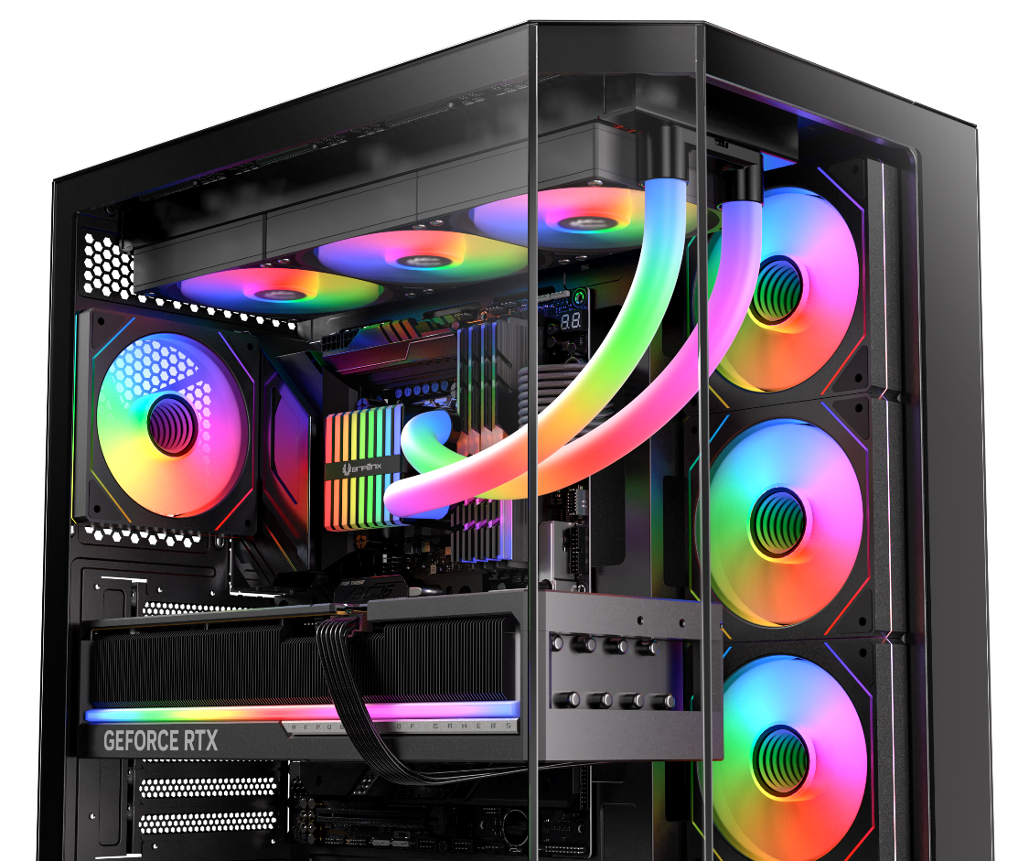
Third Generation Pump
In order to match the latest top-level CPUs, we have developed a brand new pump based on the popular pump architecture. It has the ultimate specifications of 2500RPM.
Socket compatibility | Intel: 1851 / 1700 / 1200 / 1150 / 1151 / 1155 AMD: AM5 / AM4
Pump speed (rpm) | 2500 ±10 rpm
Pump adjustable | 9V - 12V
Pump connector | 3-pin
Tube length (mm) | Tube length (mm) 390
Noise level | 30dB
Refill port | ✓

Slide 5
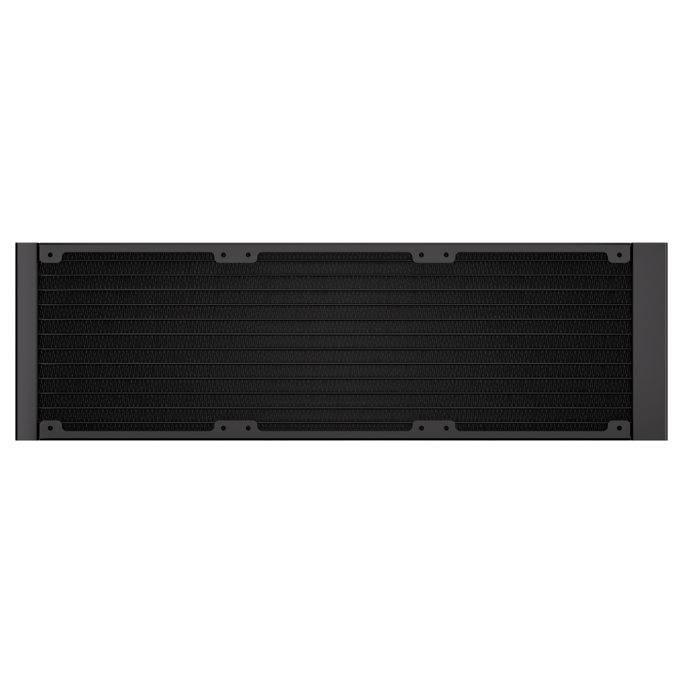
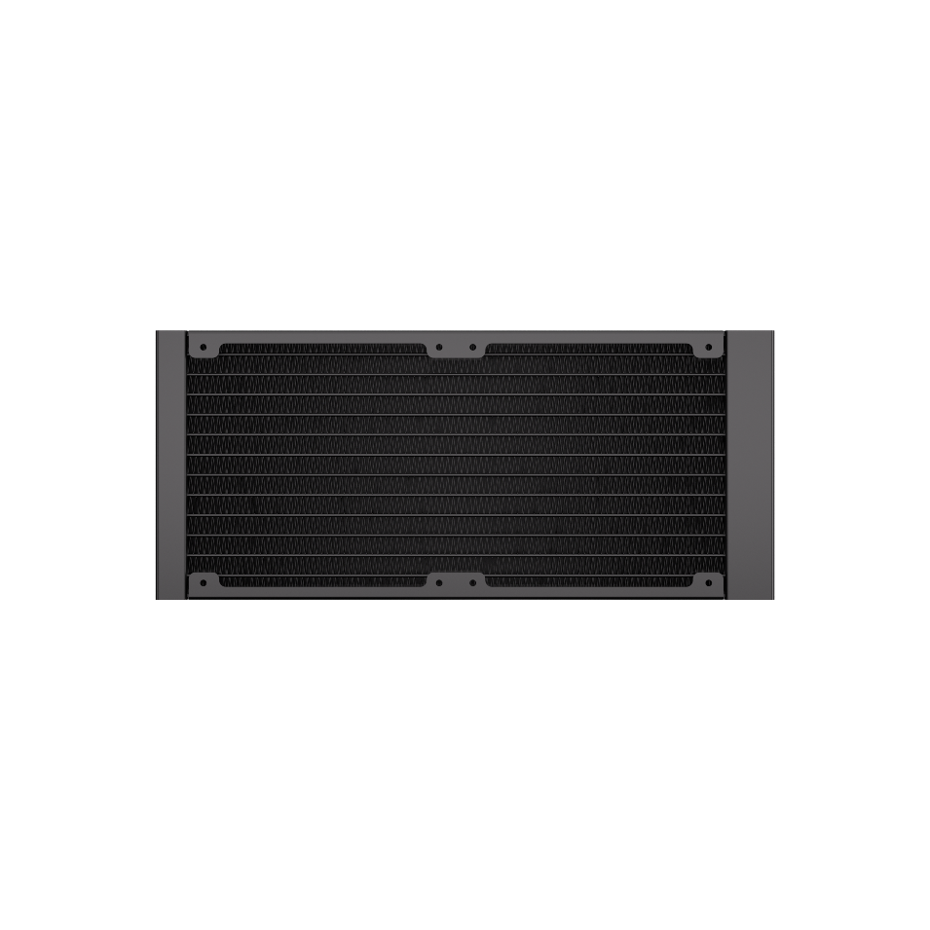
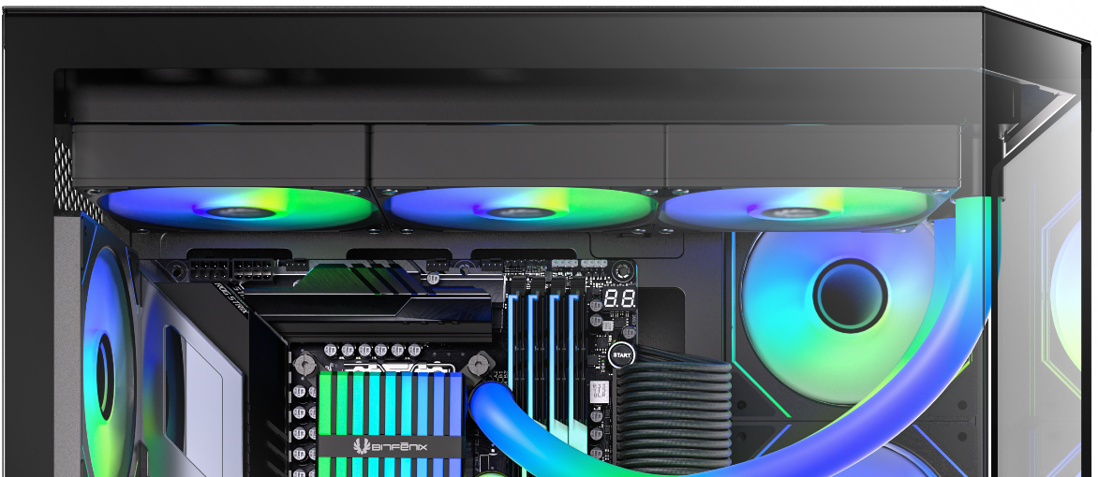
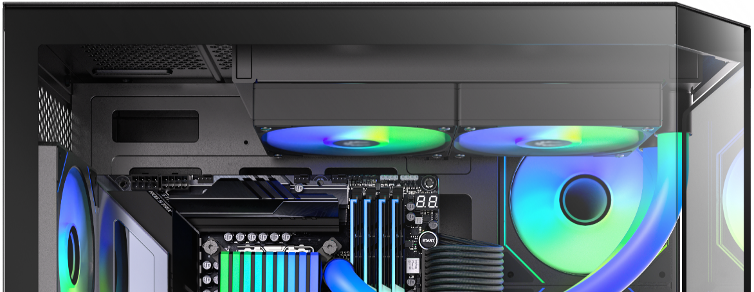
360 Radiator specifications
Dimensions (H x W x D), (mm) | 397 x 120 x 27
Radiator material / finish | aluminum / black or white spray painted
Base material / finish | copper / nickel plating
240 Radiator specifications
Dimensions (H x W x D), (mm) | 273 x 120 x 27
Radiator material / finish | aluminum / black or white spray painted
Base material / finish | copper / nickel plating
360mm
240mm

Slide 6

Newly Designed High Pressure Fan
Newly designed high pressure fan together with the specially designed radiator, BitFenix also launched a brand new fan design.
This newly designed seven-leaf fan has a CFM and DB that are not inferior to anyone, and the wind pressure generated outside is as high as 2.27MM-H2O. The high-pressure fan is used to penetrate the radiator with high-density and heightened heat dissipation fins. With the no noise design in 400DB mode, the whole AIO system can better meet the low noise level needs of the user.
120mm
Fan model | ARGB 120mm PWM high- pressure Fan
Fan dimensions (mm) | 120 x 120 x 25
Speed @ 100% PWM (rpm) | 800-1800 ±10% RPM
Bearing technology | Hydraulic Bearing
Rated Voltage (V) | 12 Start voltage(V) ≦5V (Power ON/OFF)
Rated current (A) | 0.35A
Power consumption (W) | 5.4W
Connector | 4-pin PWM
Max. air flow | 75.48CFM
Air Pressure | 2.27MM-H2O/ Noise 31.8dB/ ARGB Fan
Extension Cable length (mm) | 350/ 380 mm
Power Extension Cble length (mm) | 390mm ±10

Slide 7
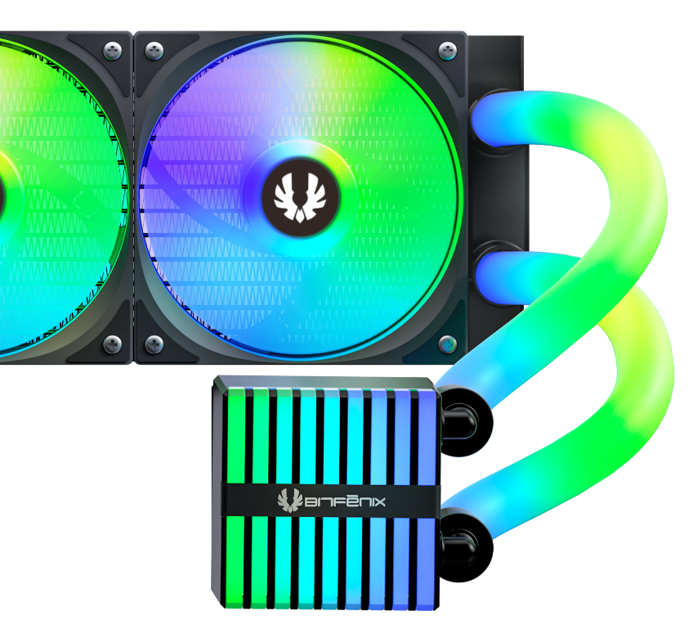
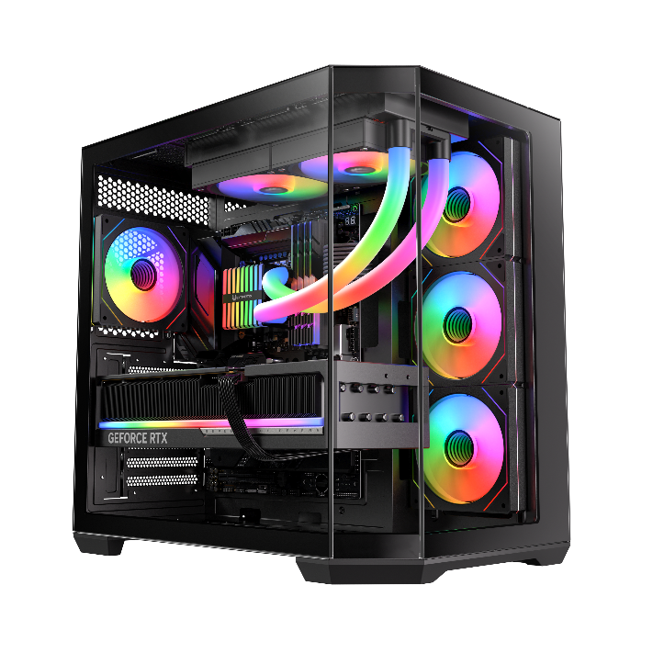
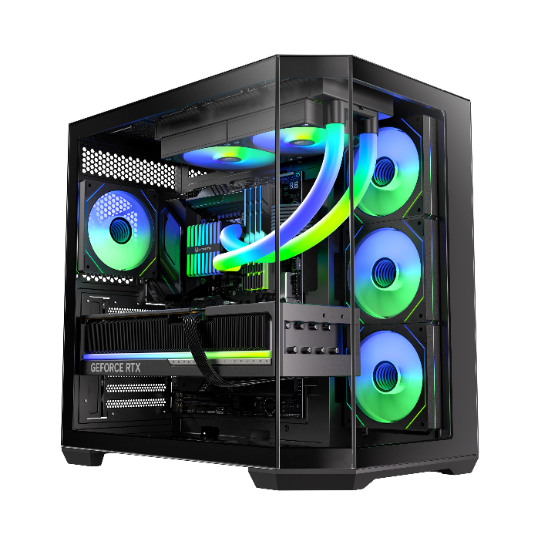
All-In-One 240 / 360mm
LIQUID COOLER
Glanz 240
Part Number | BFW-GLZ-240-BB27A-RP
EAN / UPC | 4716779449105 / 886027012987
GLANZ
Glanz 360
Part Number | BFW-GLZ-360-BB27A-RP
EAN / UPC | 4716779449112 / 886027013007

