Slide 2
240mm Average temperature
 | CPU MAX | CPU Average | CPU Package MAX | CPU Package average
BitFenix CUBE | 82.3 | 74.3 | 82.0 | 80.0
Galahad ii Trinity SL-INF | 83.3 | 73.7 | 83.7 | 81.0
iCUE H100i ELITE CAPELLIX XT | 86.7 | 79 | 87.3 | 84.3
CPU
13900KF
MB
ROG STRIX Z790-E GAMING
RAM
GeIL EVO V DDR5 RGB Hardcore Gaming Memory
VGA
GeForce RTX™ 3090 GAMING X TRIO 24G
Test Software
Prime95 - Small FFTs- 20 minutes
Remark
Indoor temperature 24 degrees (±1 degrees)

Slide 3
BitFenix CUBE 240mm
 | CPU MAX | CPU Average | CPU Package MAX | CPU Package average
T 1 | 82 | 74 | 82 | 80
T 2 | 82 | 75 | 82 | 80
T 3 | 83 | 74 | 82 | 80
Average temperature | 82.3 | 74.3 | 82.0 | 80.0
CPU
13900KF
MB
ROG STRIX Z790-E GAMING
RAM
GeIL EVO V DDR5 RGB Hardcore Gaming Memory
VGA
GeForce RTX™ 3090 GAMING X TRIO 24G
Test Software
Prime95 - Small FFTs- 20 minutes
Remark
Indoor temperature 24 degrees (±1 degrees)

Slide 4
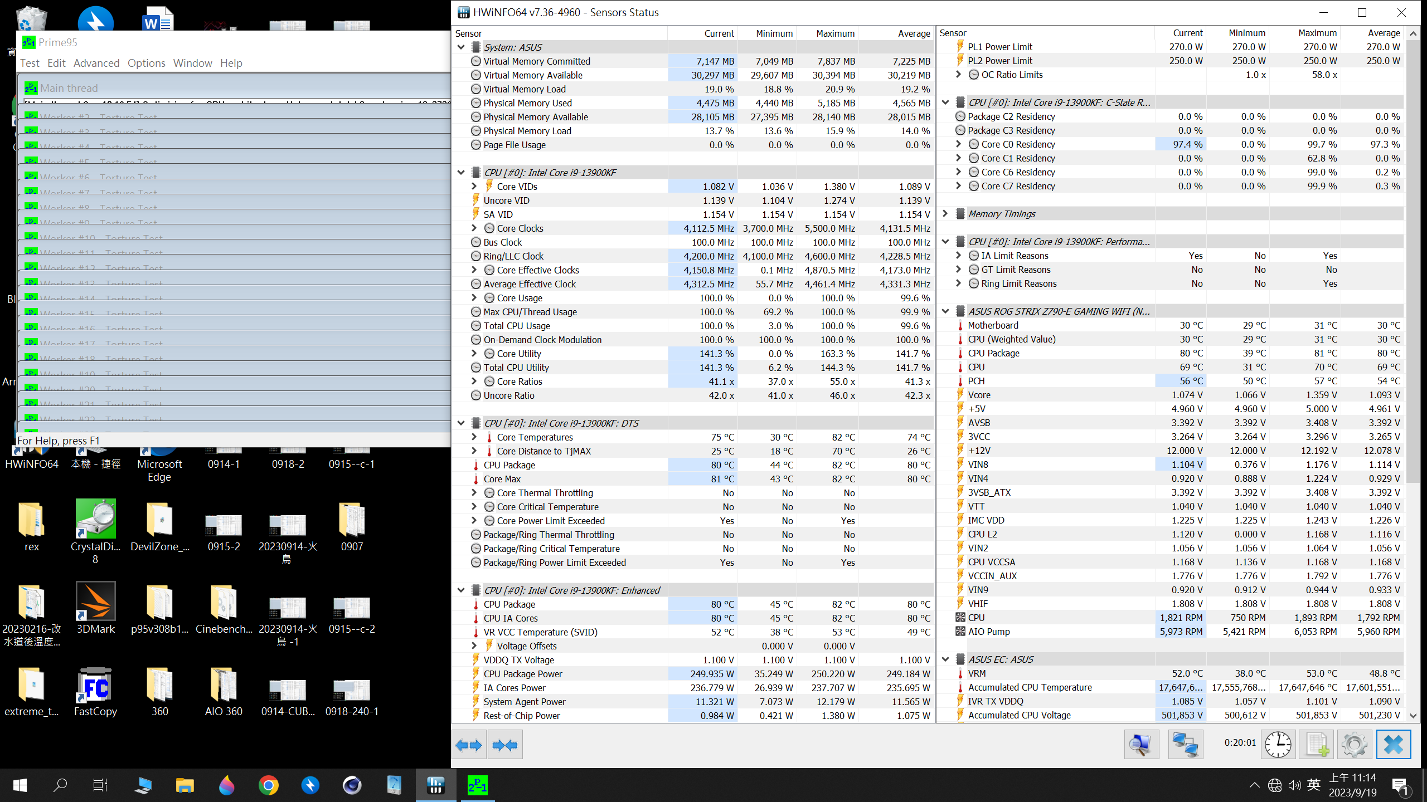
BitFenix CUBE 240mm T 1 Full Test Video https://youtu.be/4eMIkFlY28Y

Slide 5
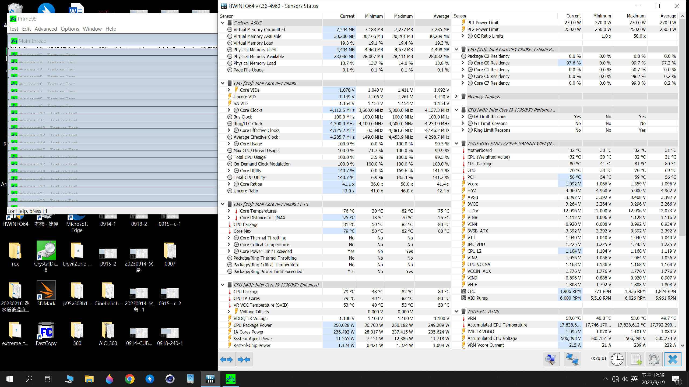
BitFenix CUBE 240mm T 2 Full Test Video https://youtu.be/m_-u_hf4wJs

Slide 6
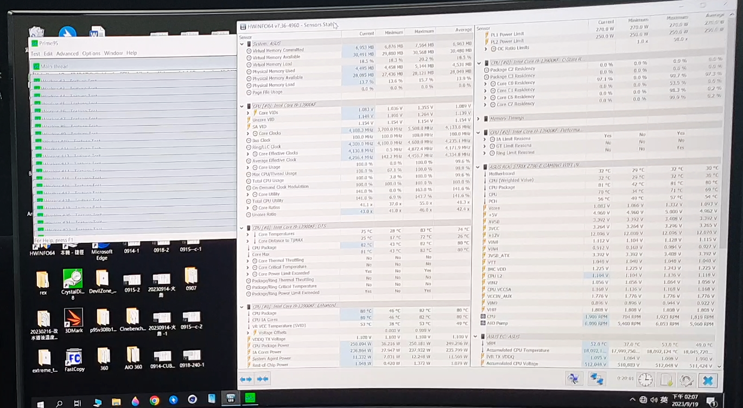
BitFenix CUBE 240mm T 3 Full Test Video
https://youtu.be/COcUeK6-Gp8

Slide 7
Galahad ii Trinity SL-INF 240
 | CPU MAX | CPU Average | CPU Package MAX | CPU Package average
T 1 | 83 | 74 | 83 | 81
T 2 | 83 | 73 | 83 | 81
T 3 | 84 | 74 | 85 | 81
Average temperature | 83.3 | 73.7 | 83.7 | 81.0
CPU
13900KF
MB
ROG STRIX Z790-E GAMING
RAM
GeIL EVO V DDR5 RGB Hardcore Gaming Memory
VGA
GeForce RTX™ 3090 GAMING X TRIO 24G
Test Software
Prime95 - Small FFTs- 20 minutes
Remark
Indoor temperature 24 degrees (±1 degrees)

Slide 8
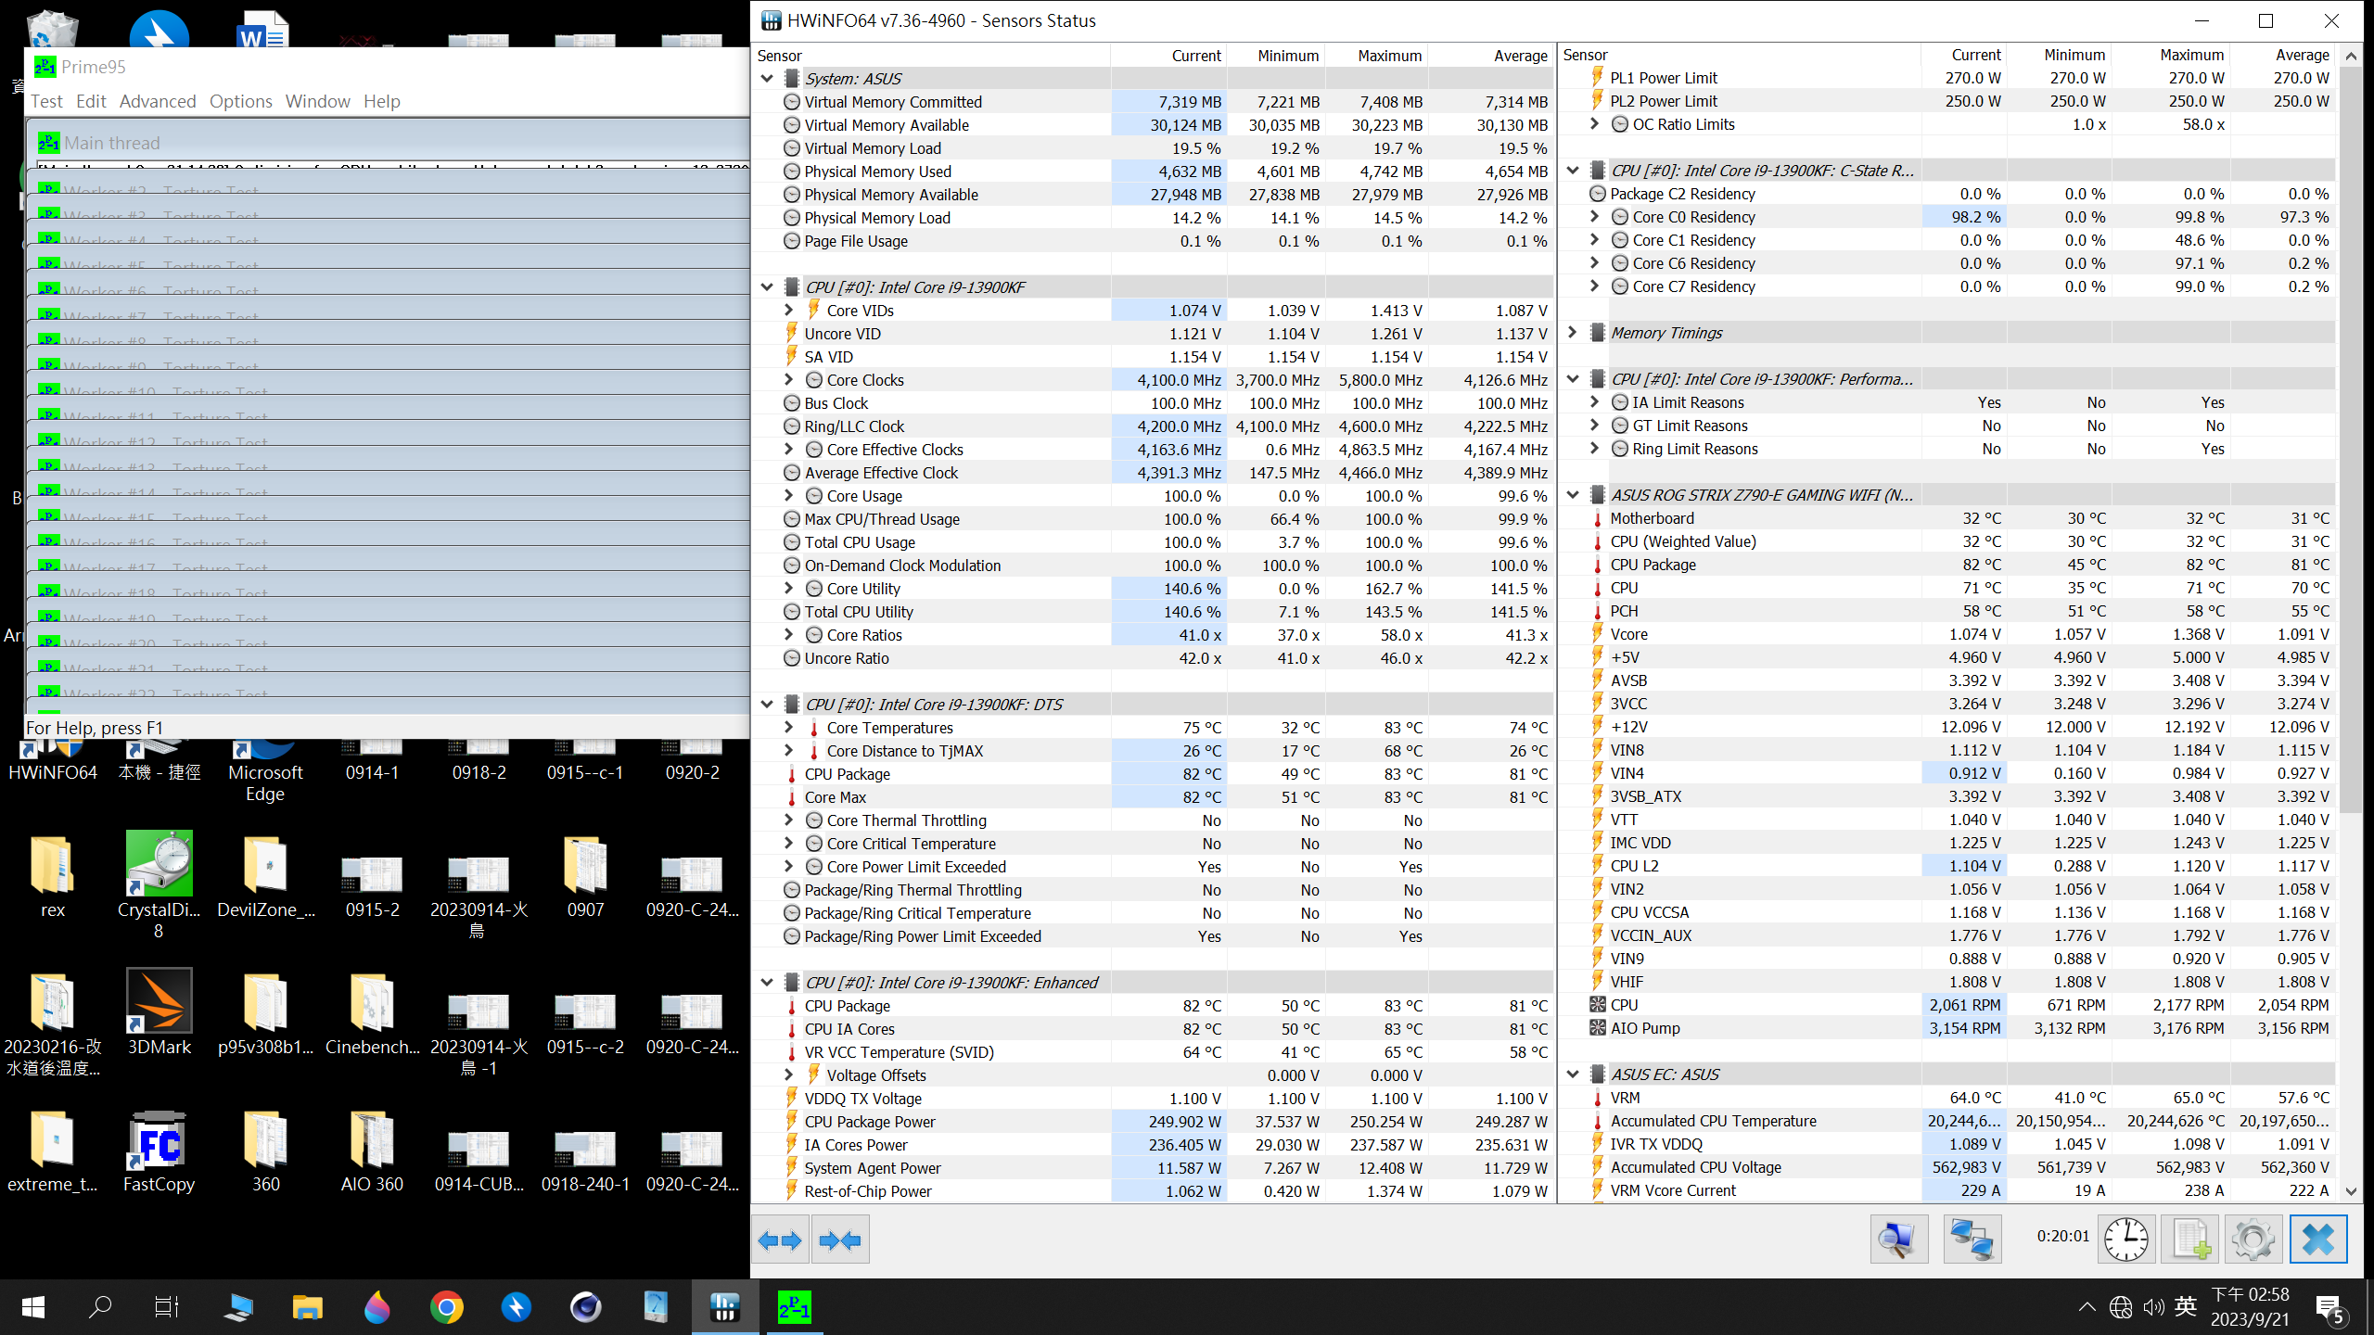
Galahad ii Trinity SL-INF 240 T 1 Full Test Video
https://youtu.be/Me-Zd0a3hno

Slide 9
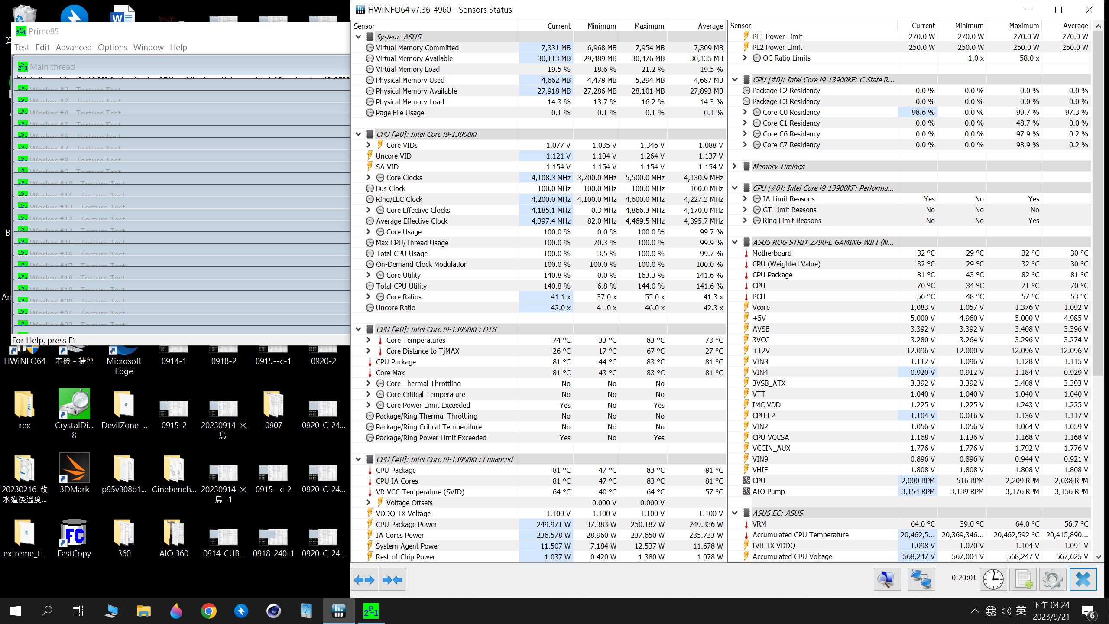
Galahad ii Trinity SL-INF 240 T 2 Full Test Video
https://youtu.be/d1NTX5CZf3s

Slide 10
Galahad ii Trinity SL-INF 240 T 3 Full Test Video
https://youtu.be/0x9U7C8fMXQ

Slide 11
iCUE H100i ELITE CAPELLIX XT 240
 | CPU MAX | CPU Average | CPU Package MAX | CPU Package average
T 1 | 87 | 79 | 87 | 84
T 2 | 87 | 79 | 88 | 85
T 3 | 86 | 79 | 87 | 84
Average temperature | 86.7 | 79 | 87.3 | 84.3
CPU
13900KF
MB
ROG STRIX Z790-E GAMING
RAM
GeIL EVO V DDR5 RGB Hardcore Gaming Memory
VGA
GeForce RTX™ 3090 GAMING X TRIO 24G
Test Software
Prime95 - Small FFTs- 20 minutes
Remark
Indoor temperature 24 degrees (±1 degrees)

Slide 12
iCUE H100i ELITE CAPELLIX XT 240 T 1 Full Test Video
https://youtu.be/p1W6NDlJ-FI

Slide 13
iCUE H100i ELITE CAPELLIX XT 240 T 2 Full Test Video
https://youtu.be/yidDNVTX_gA

Slide 14
iCUE H100i ELITE CAPELLIX XT 240 T 3 Full Test Video
https://youtu.be/Ls2txxDcASQ

Slide 15
360mm Average temperature
 | CPU MAX | CPU Average | CPU Package MAX | CPU Package average
BitFenix CUBE | 81.7 | 72.7 | 81.7 | 79.0
Galahad ii Trinity SL-INF | 87 | 73.7 | 84.7 | 80.7
iCUE H100i ELITE CAPELLIX XT | 83 | 76 | 82.7 | 81
CPU
13900KF
MB
ROG STRIX Z790-E GAMING
RAM
GeIL EVO V DDR5 RGB Hardcore Gaming Memory
VGA
GeForce RTX™ 3090 GAMING X TRIO 24G
Test Software
Prime95 - Small FFTs- 20 minutes
Remark
Indoor temperature 24 degrees (±1 degrees)

Slide 16
BitFenix CUBE 360
 | CPU MAX | CPU Average | CPU Package MAX | CPU Package average
T 1 | 82 | 73 | 82 | 80
T 2 | 82 | 73 | 82 | 78
T 3 | 82 | 72 | 81 | 79
Average temperature | 81.7 | 72.7 | 81.7 | 79.0
CPU
13900KF
MB
ROG STRIX Z790-E GAMING
RAM
GeIL EVO V DDR5 RGB Hardcore Gaming Memory
VGA
GeForce RTX™ 3090 GAMING X TRIO 24G
Test Software
Prime95 - Small FFTs- 20 minutes
Remark
Indoor temperature 24 degrees (±1 degrees)

Slide 17
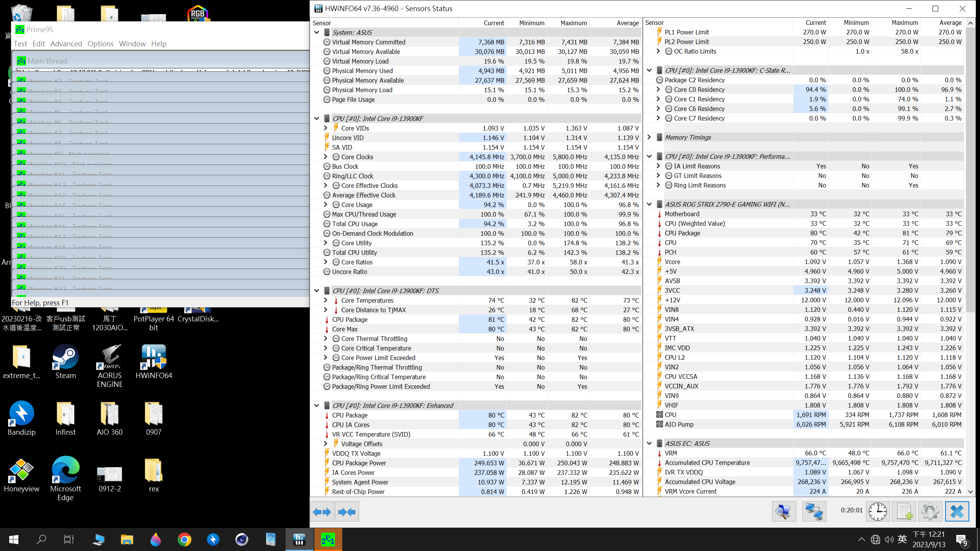
BitFenix CUBE 360 T 1 Full Test Video
https://youtu.be/2P7TTQksyXo

Slide 18
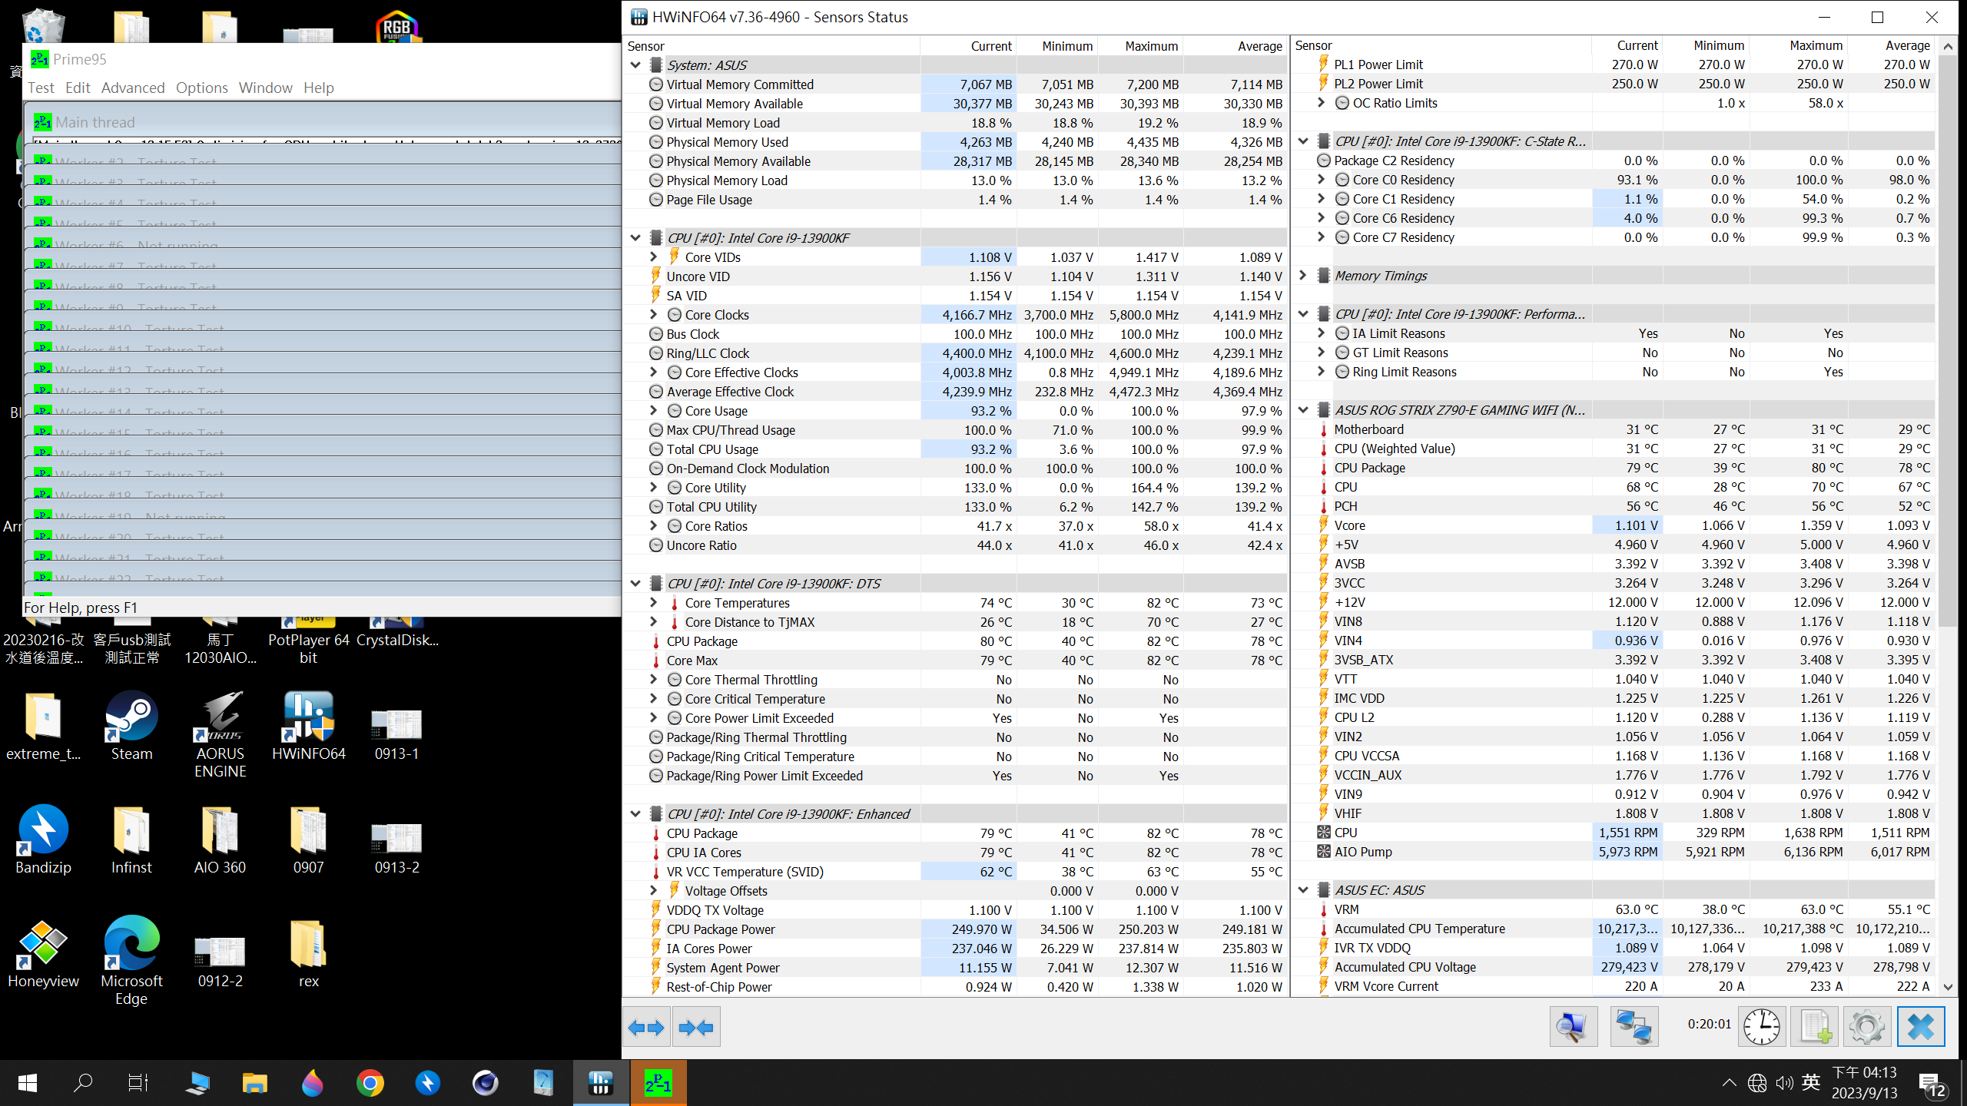
BitFenix CUBE 360 T 2 Full Test Video
https://youtu.be/NK5yGiujs8M

Slide 19
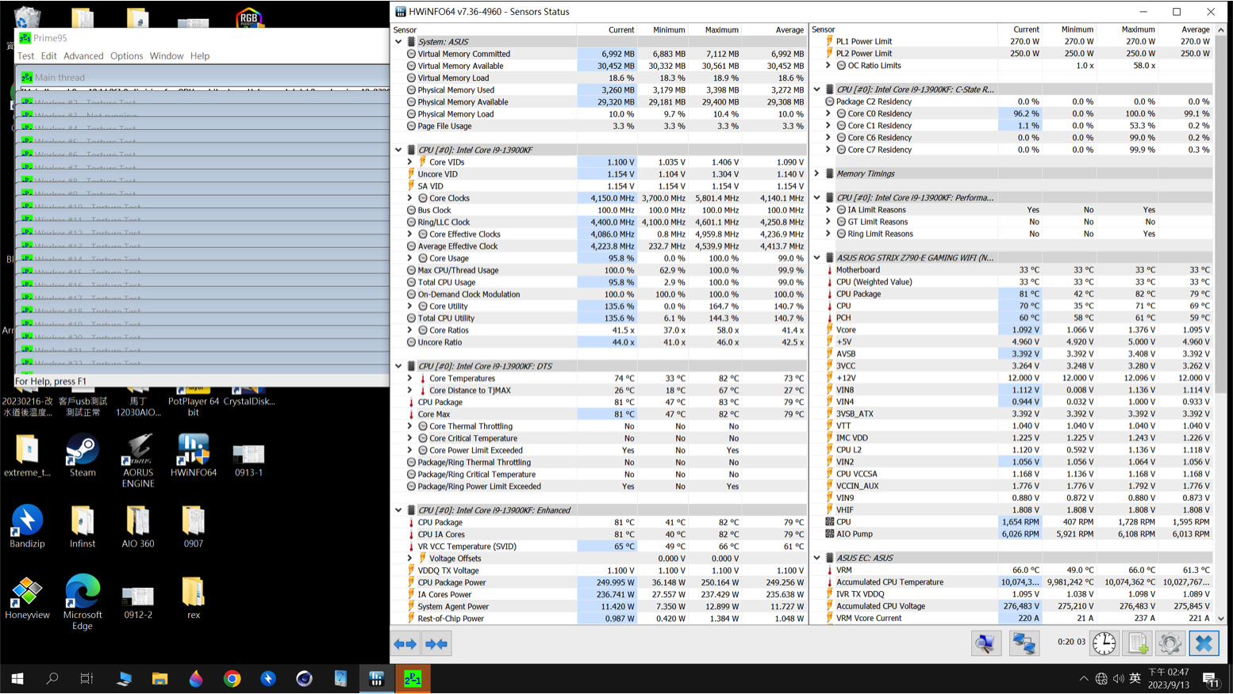
BitFenix CUBE 360 T 3 Full Test Video
https://youtu.be/vMtHKmCxR5I

Slide 20
Galahad ii Trinity SL-INF 360
 | CPU MAX | CPU Average | CPU Package MAX | CPU Package average
T 1 | 87 | 74 | 86 | 81
T 2 | 87 | 73 | 86 | 81
T 3 | 87 | 74 | 82 | 80
Average temperature | 87 | 73.7 | 84.7 | 80.7
CPU
13900KF
MB
ROG STRIX Z790-E GAMING
RAM
GeIL EVO V DDR5 RGB Hardcore Gaming Memory
VGA
GeForce RTX™ 3090 GAMING X TRIO 24G
Test Software
Prime95 - Small FFTs- 20 minutes
Remark
Indoor temperature 24 degrees (±1 degrees)

Slide 21
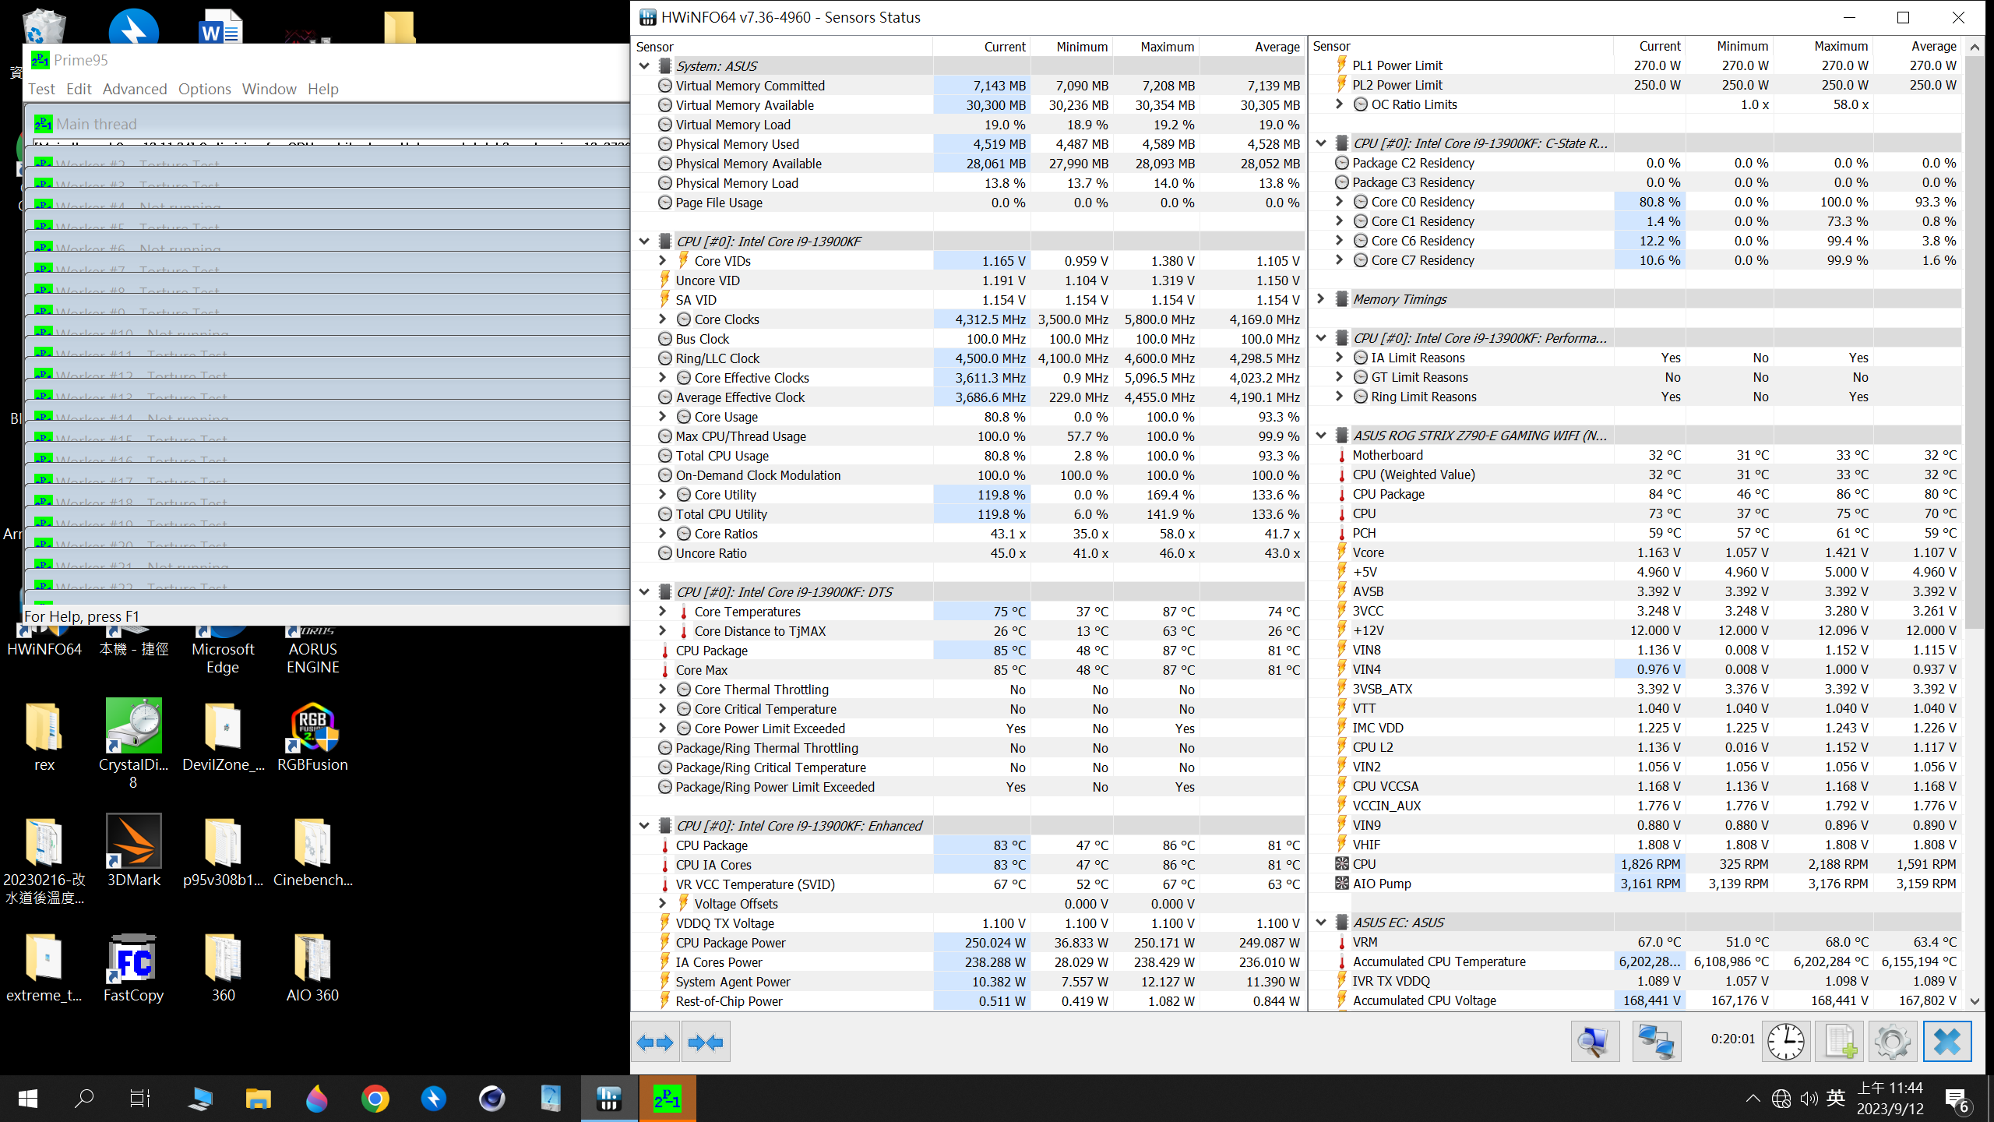
Galahad ii Trinity SL-INF 360 T 1 Full Test Video
https://youtu.be/94pBJ0_VbFI

Slide 22
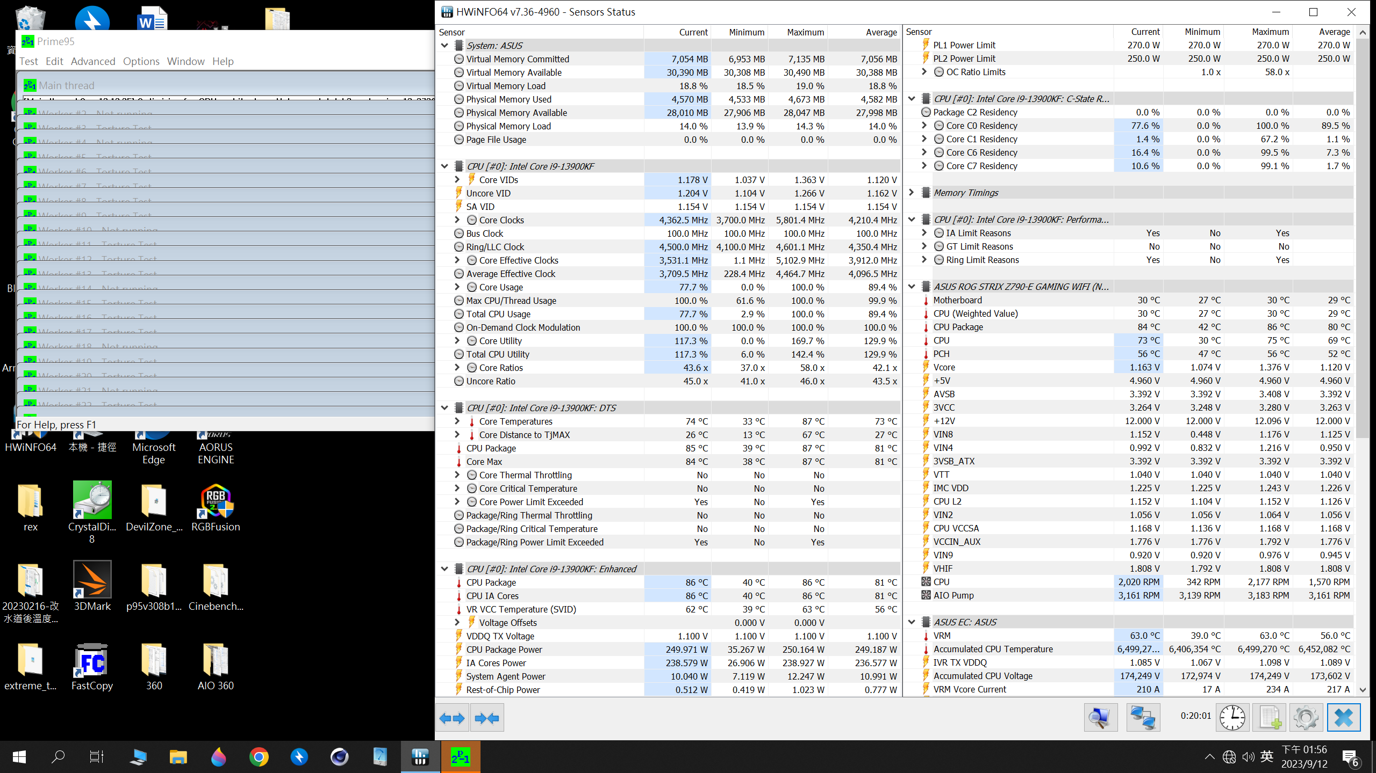
Galahad ii Trinity SL-INF 360 T 2 Full Test Video
https://youtu.be/mmYQhZW_EC0

Slide 23
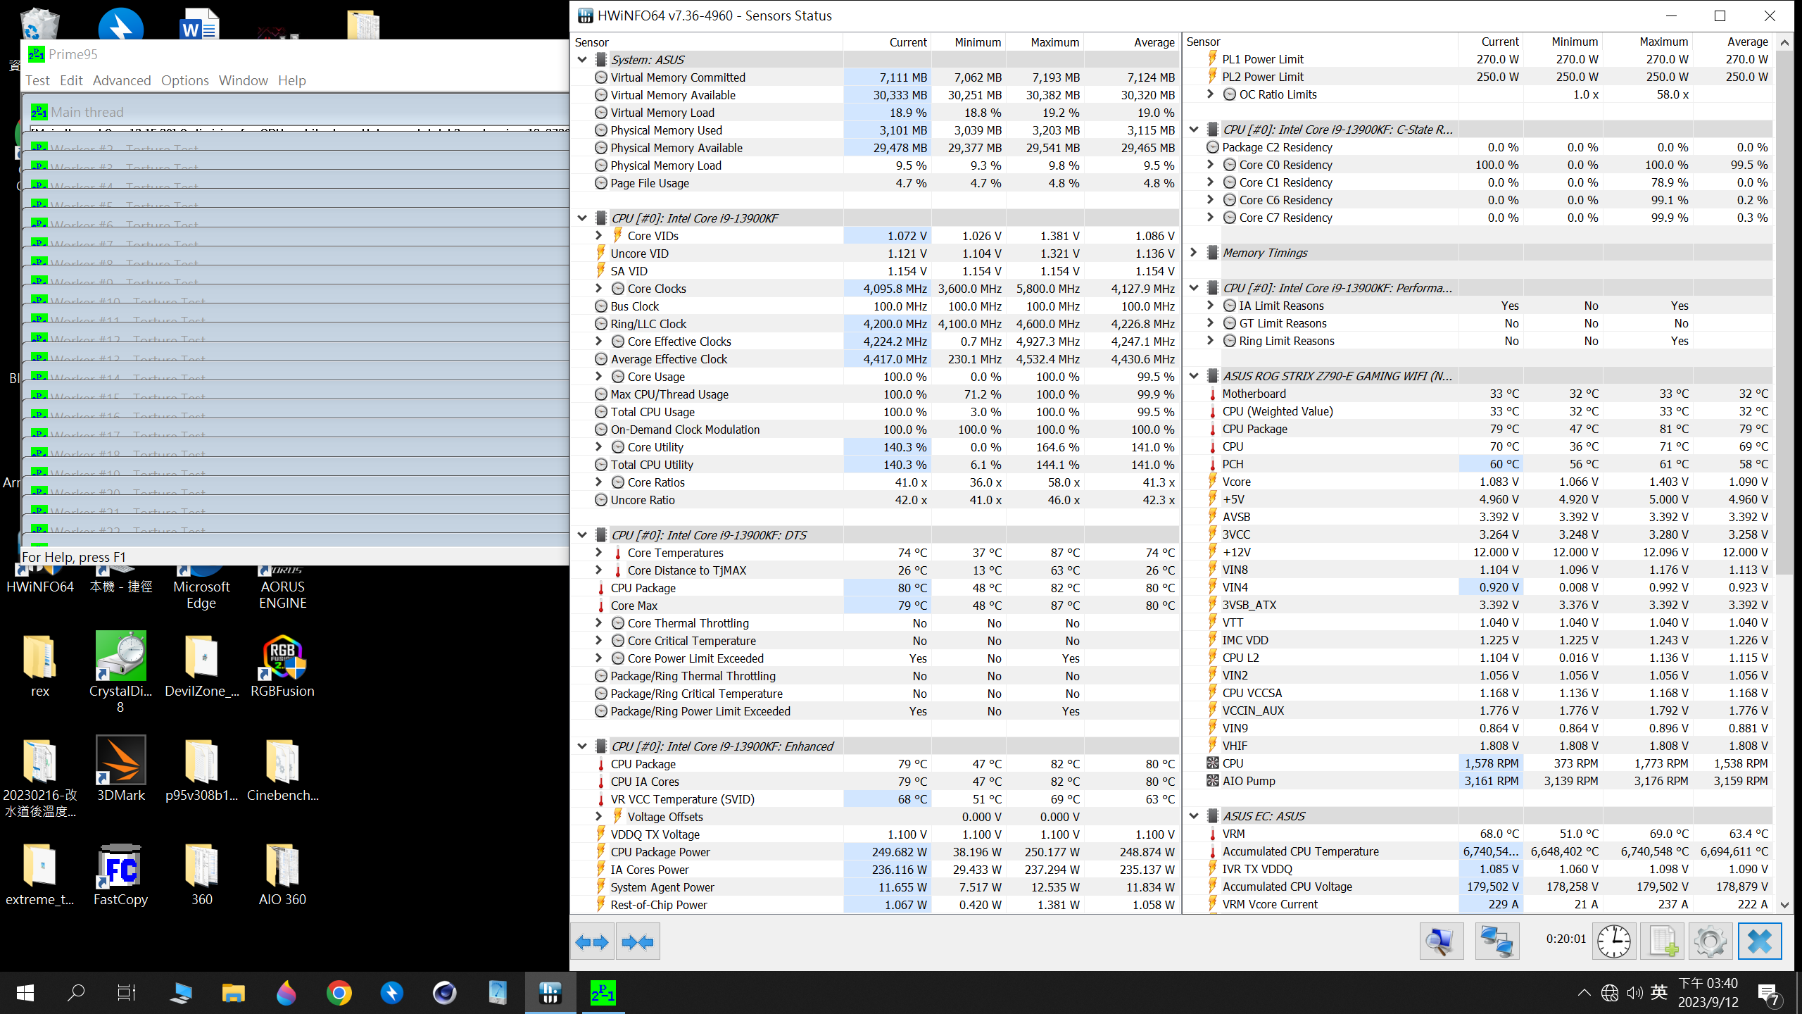
Galahad ii Trinity SL-INF 360 T 3 Full Test Video
https://youtu.be/aP3kAPTW61k

Slide 24
iCUE H150i ELITE CAPELLIX XT 360
 | CPU MAX | CPU Average | CPU Package MAX | CPU Package average
T 1 | 83 | 76 | 83 | 81
T 2 | 83 | 76 | 83 | 81
T 3 | 83 | 76 | 82 | 81
Average temperature | 83 | 76 | 82.7 | 81
CPU
13900KF
MB
ROG STRIX Z790-E GAMING
RAM
GeIL EVO V DDR5 RGB Hardcore Gaming Memory
VGA
GeForce RTX™ 3090 GAMING X TRIO 24G
Test Software
Prime95 - Small FFTs- 20 minutes
Remark
Indoor temperature 24 degrees (±1 degrees)

Slide 25
iCUE H150i ELITE CAPELLIX XT 360 T 1 Full Test Video
https://youtu.be/38hDfM2Iwg4

Slide 26
iCUE H150i ELITE CAPELLIX XT 360 T 2 Full Test Video
https://youtu.be/SkjUeo6V_g0

Slide 27
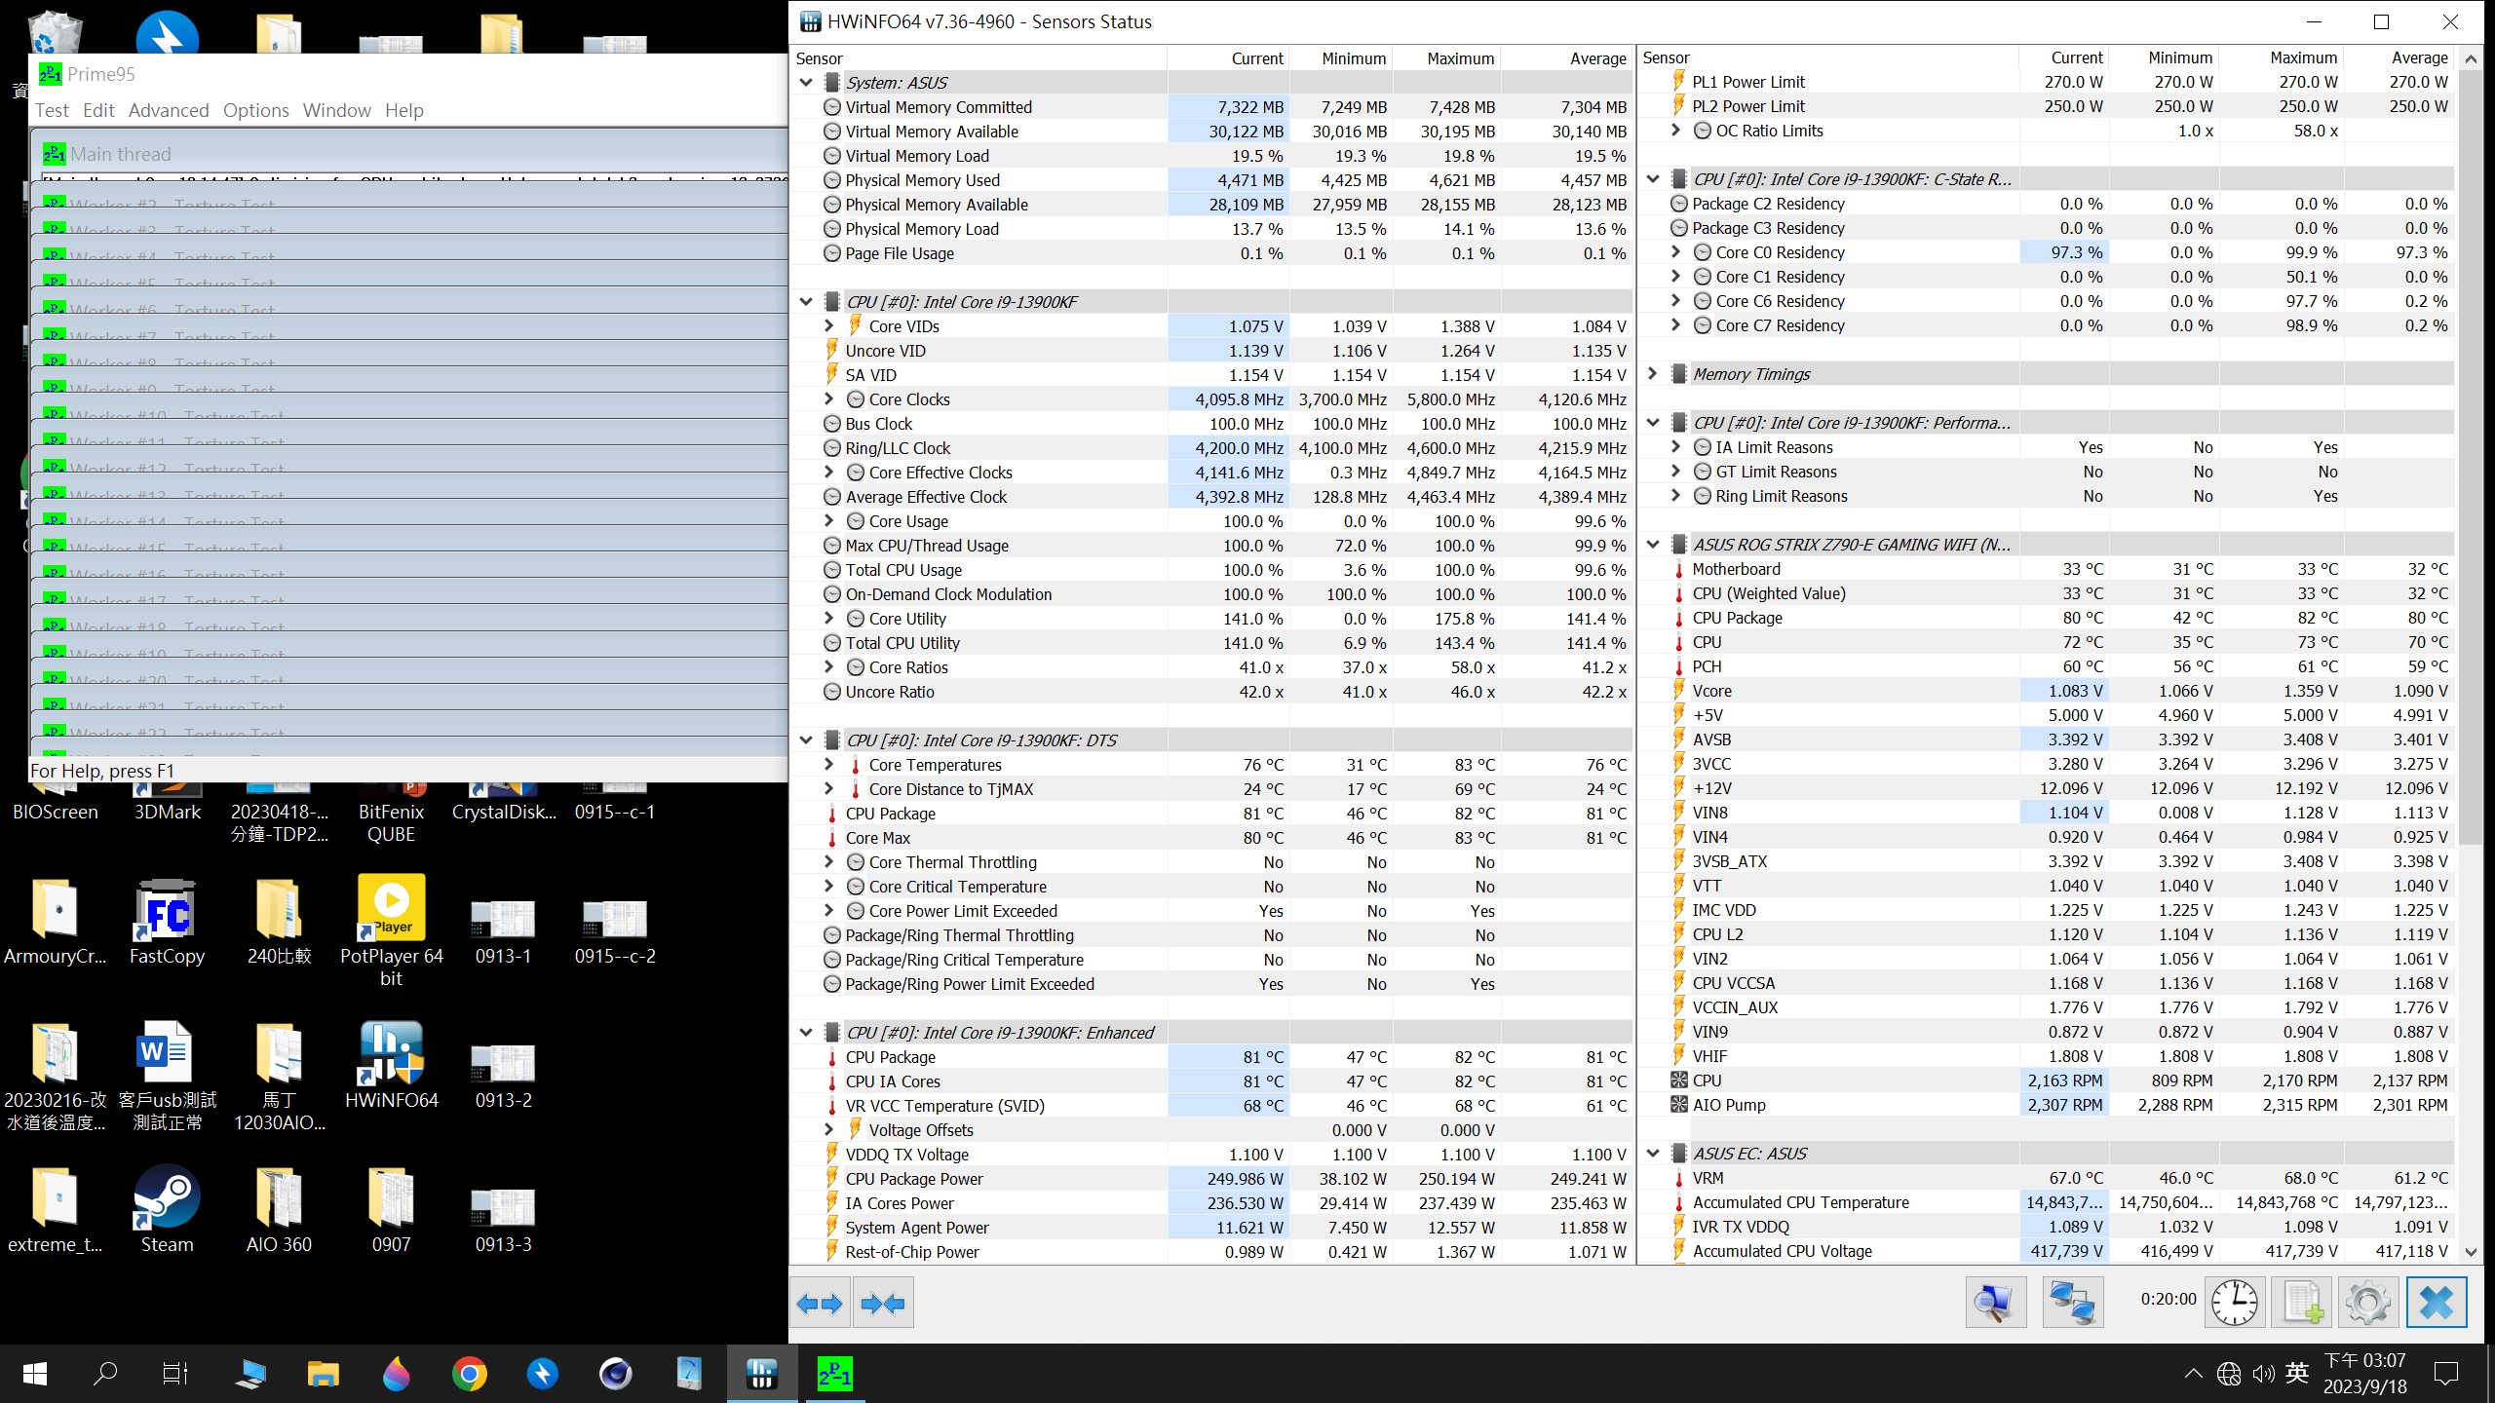
iCUE H150i ELITE CAPELLIX XT 360 T 3 Full Test Video
https://youtu.be/QeA3YiConw8

