Slide 2
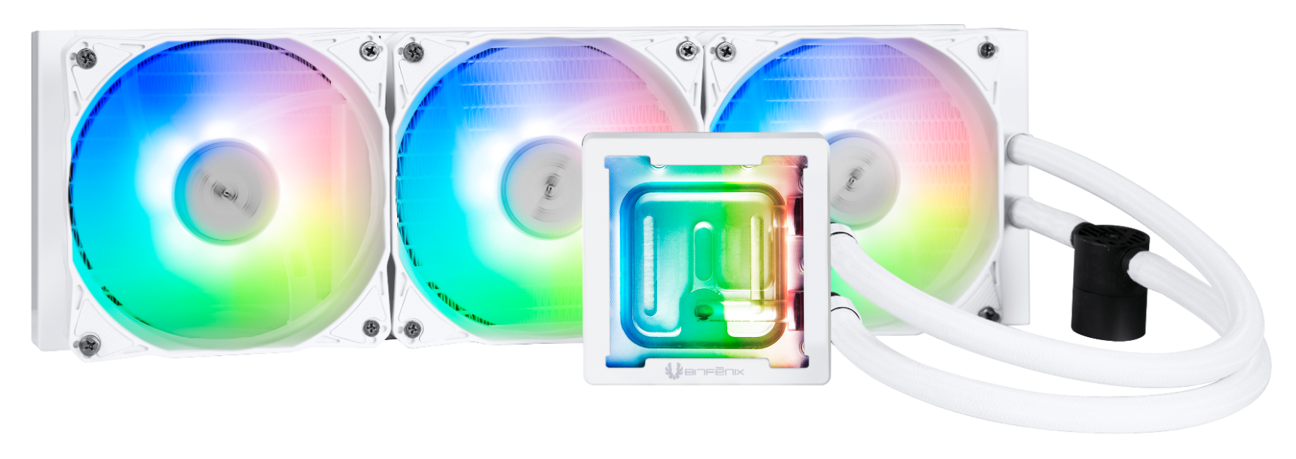
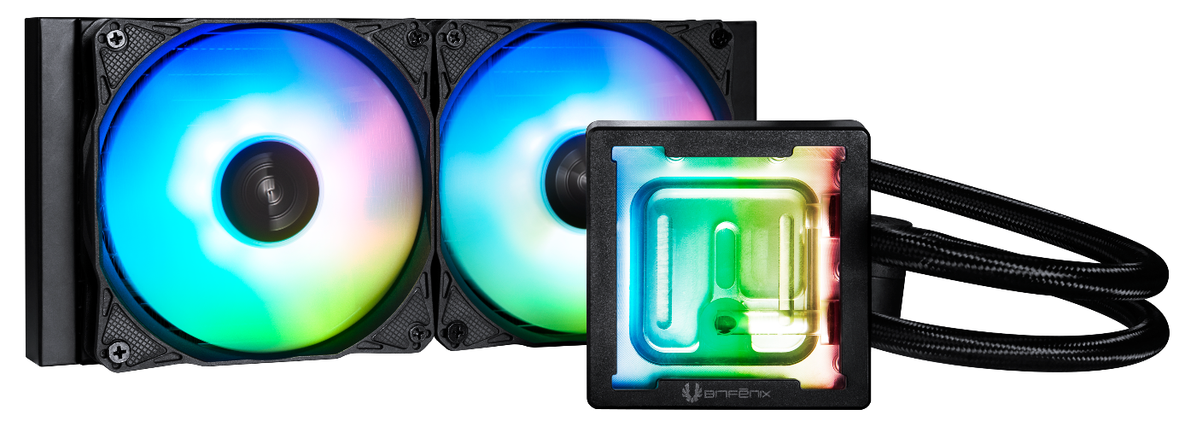
Bitfenix Cube AIO
Brand-new AIO pump: Derived from the widely trusted water pump by players, it has a lift of 1.8 M with a high efficiency of 5500RPM and only 15DB working noise. Crystal Clear Water Block: The fully transparent water block design allows players to quickly understand whether the device is working properly. ARGB Silent Fan with 0DB Mode: The custom-designed fan for the Heightened heat sink has a wind pressure of 3.0MM-H2O, so that the high-end CPU can also maintain the correct temperature.
Support Motherboard-Brand Lighting Synchronization: Asus/Gigabyte/MSI/ASRock/Biostar...and other brands can support.

Slide 3
Central Inlet Design with Optimized 0.2mm Micro-Channel Structure
Hot Water Out
Hot Water Out
Hot Water Out
Cold Water In
Cold Water In
Water Mix
Other Brand
Bitfenix Cube AIO’s Block features a central inlet design with a jet plate equipped in the middle of the water block contacting the CPU heat source directly accelerating the extraction of heat. In addition, it has optimized 0.2mm micro-channels on the copper plate, providing flawless distribution of coolant with superior heat transfer and durability

Slide 4
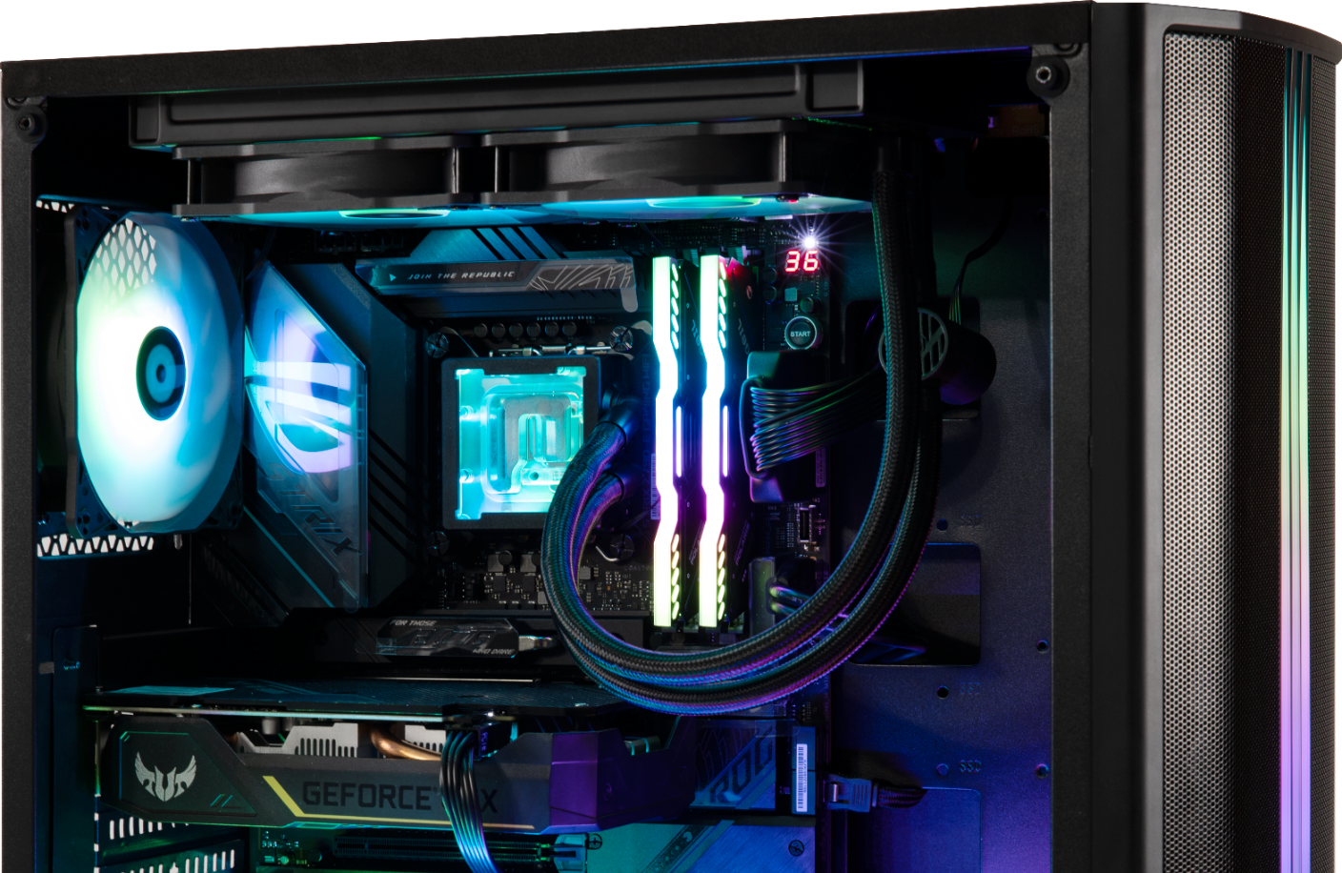
Pump
Socket compatibility | Intel: 1700 / 1200 / 1150 / 1151 / 1155 AMD: AM5 / AM4
Pump speed (rpm) | 5500 rpm
Pump adjustable | 9V - 12V
Pump connector | 4-pin
Tube length (mm) | Tube length (mm) 450
Noise level | 15dB
Refill port | ✓
In order to match the latest top-level CPUs, we have developed a brand new pump based on the popular pump architecture. It has the ultimate specifications of 5500RPM and vertical lift of up to 1.8m, while operating at only 15db.

Slide 5
Radiator features
12 heat sink water tunnel
25% higher cooling fin height While maintaining standard radiator thickness
FPI: 20 high density fin radiator
 | CPU Max | CPU Average | MAX Speed | Average Speed
Cooling Fin :20 | 84 | 67 | 5486.6 | 4398.3
Cooling Fin :16 | 89 | 70 | 5287.1 | 4393.4
High Density Radiator: The BitFenix Cube AIO sports a high density radiator with a FPI: of 20 which are connects to 12 tubes for better heat dissipation.
Heightened Radiator Fins: Heat dissipation fins raised from 16mm to 20mm increases the cooling efficiency while maintaining the same dimensions.
Other brand
The average temperature of using thick radiator get 3 °C lower than the thin one.
The max temperature of using thick radiator get 5 °C lower than the thin one.

Slide 6
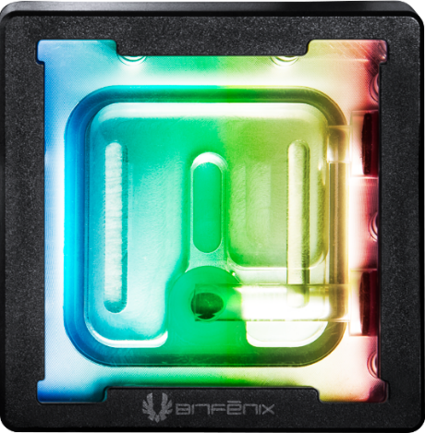
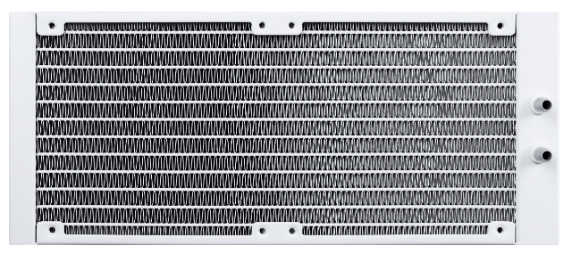
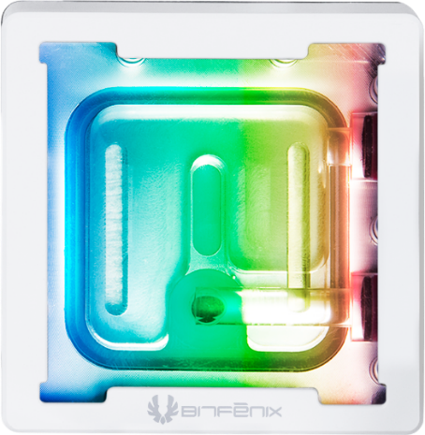
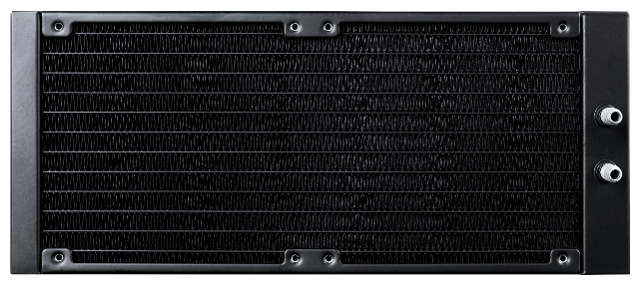
Water Block & RADIATOR
240mm
360mm
240 Radiator specifications
Dimensions (H x W x D), (mm) | 277 x 120 x 27
Radiator material / finish | aluminum / black or white spray painted
Base material / finish | copper / nickel plating
360 Radiator specifications
Dimensions (H x W x D), (mm) | 397 x 120 x 27
Radiator material / finish | aluminum / black or white spray painted
Base material / finish | copper / nickel plating
BLACK
27mm
120mm
120mm
120mm
120mm
27mm
277mm
397mm
WHITE

Slide 7
Copper Base
CUBE AIO features a copper base with mirror-finished anti-corrosive nickel plating.
The specialized plating technique of the copper base accelerates heat dissipation and extends the product's durability.
oxidation
Other Brand

Slide 8
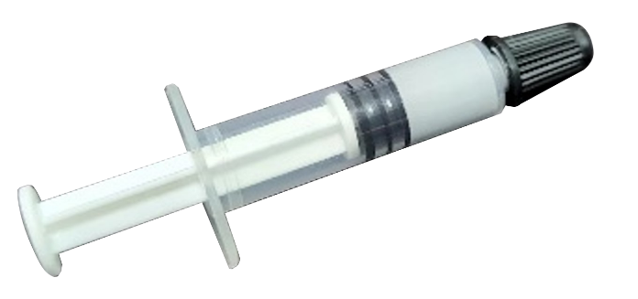
Thermal Paste - BITFENIX TF10 EXTREME
Our products are quipped with BITFENIX TF10 EXTREME thermal paste
* 13.8 W / m.k’s extremely high heat transfer capacity to meet the needs of the highest end users * No curing time means that the radiator will maintain the epic peak capacity once it is installed. * Long life means long-term trouble-free use * Not conductive means no need to worry about a short circuit
Specifications
Thermal Conductivity（W / m-k) | 13.8
Color | Gray
Thermal lmpedance (℃-cm2/W) | <0.01
Specific Gravity（25℃) | 2.7
Useable Temperature Range | -220℃ / + 300℃
Electrically Conductive | No
Harmless | Yes

Slide 9
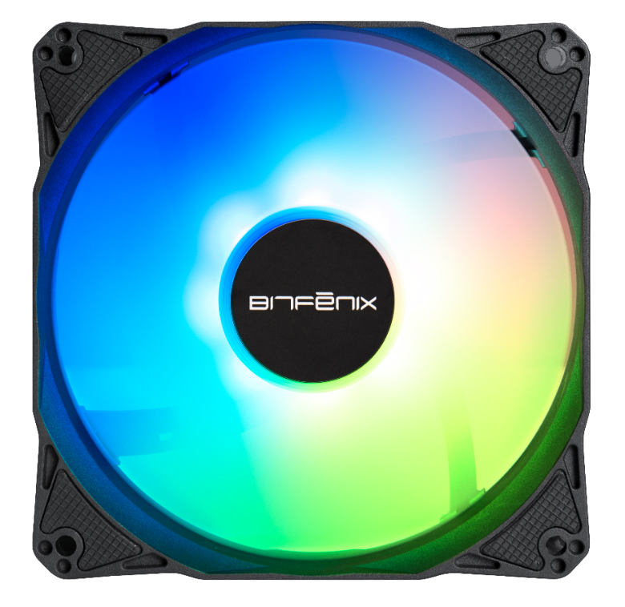
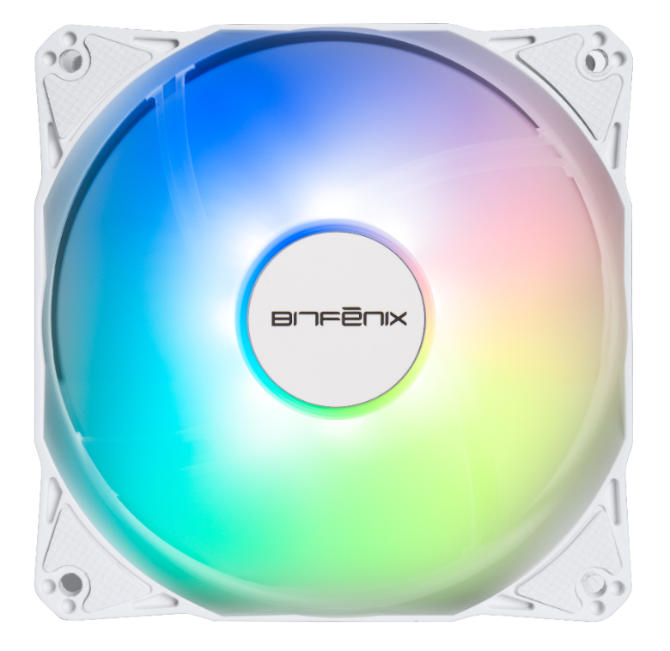
Newly Designed High Pressure Fan
Newly designed high pressure fan together with the specially designed radiator, BitFenix also launched a brand new fan design.
This newly designed seven-leaf fan has a CFM and DB that are not inferior to anyone, and the wind pressure generated outside is as high as 3.0MM-H2O. The high-pressure fan is used to penetrate the radiator with high-density and heightened heat dissipation fins. With the no noise design in 0DB mode, the whole AIO system can better meet the low noise level needs of the user.
Fan model | ARGB 120mm PWM high- pressure Fan
Fan dimensions (mm) | 120 x 120 x 25
Speed @ 100% PWM (rpm) | 2000 ±10% RPM
Bearing technology | Hydraulic Bearing
Rated Voltage (V) | 12 Start voltage(V) ≦5V (Power ON/OFF)
Rated current (A) | 0.19A / LED:0.30A
Power consumption (W) | 2.28W
Connector | 4-pin PWM
Max. air flow | 60CFM
Air Pressure | 3.0MM-H2ONoise 34.0dB-ARGB Fan
Extension Cble length (mm) | 400+200
Power Extension Cble length (mm) | 400
120mm

Slide 10
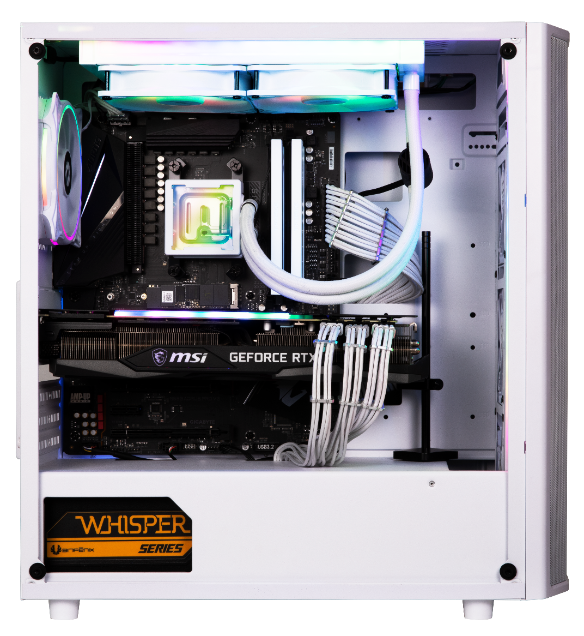

Slide 11
360mm radiator
CPU
13900KF
Indoor temperature 24 degrees (±1 degrees)
MB
ROG STRIX Z790-E GAMING
Brand | CPU MAX | CPU Average | CPU Package MAX | CPU Package average
BitFenix CUBE | 81.7 | 72.7 | 81.7 | 79.0
Galahad ii Trinity SL-INF 360 | 87 | 73.7 | 84.7 | 80.7
iCUE H150i ELITE CAPELLIX XT | 83 | 76 | 82.7 | 81
RAM
GeIL EVO V DDR5 RGB Hardcore Gaming Memory
VGA
GeForce RTX™ 3090 GAMING X TRIO 24G
Test Software
Prime95 - Small FFTs- 20 minutes
Remark
Indoor temperature 24 degrees
240mm radiator
CPU
13900KF
Indoor temperature 24 degrees (±1 degrees)
MB
ROG STRIX Z790-E GAMING
Brand | CPU MAX | CPU Average | CPU Package MAX | CPU Package average
BitFenix CUBE | 82.3 | 74.3 | 82.0 | 80.0
Galahad ii Trinity SL-INF 360 | 83.3 | 73.7 | 83.7 | 81.0
iCUE H150i ELITE CAPELLIX XT | 86.7 | 79.0 | 87.3 | 84.3
RAM
GeIL EVO V DDR5 RGB Hardcore Gaming Memory
VGA
GeForce RTX™ 3090 GAMING X TRIO 24G
Test Software
Prime95 - Small FFTs- 20 minutes
Remark
Indoor temperature 24 degrees

Slide 12
 | 240mm | 360mm
Cube - White | BFW-AIO-240-WW27A-RP | BFW-AIO-360-WW27A-RP
Cube - Black | BFW-AIO-240-BB27A-RP | BFW-AIO-360-BB27A-RP
Model | 240mm | 360mm
color box dimension(mm) | 321 X 240 X 140 | 461 X 206 X 138
color box weight(KG) | 1.94 | 2.34
carton dimension（mm） | 685 X 296 X 508 | 476 X 430 X 305
units per carton | 8 | 4
carton net weight(KG) | 15.52 | 9.36
carton gross weight(KG) | 17.09 | 10.65
pallet dimension | W 1200 X D 1000 X H 115 mm
Carton per pallet | 24 (6 X 4) | 36 (6 X 6)
units pet pallet | 144 | 144
full pallet Dimension | 1254 X 1000 X 1644 H | 1294 X 1000 X 1960 H
actual pallet Dimension | 1274 X 1000 X 1670 H | 1294 X 1000 X 2035 H
Weight of pallet(exclude) | 307.62 | 383.4
cuft | 3.49 | 2.2

