Slide 1
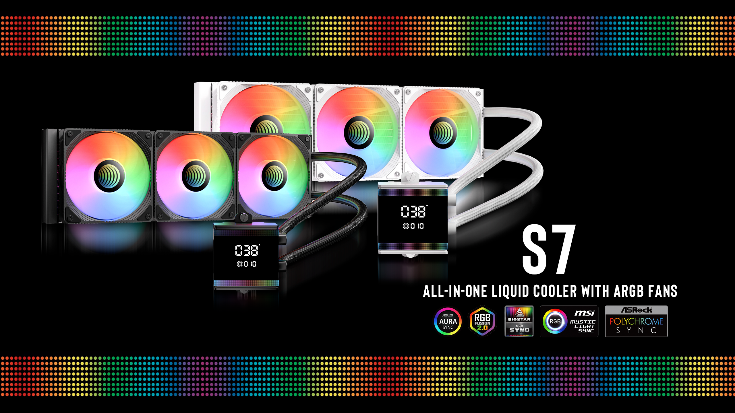

Slide 2
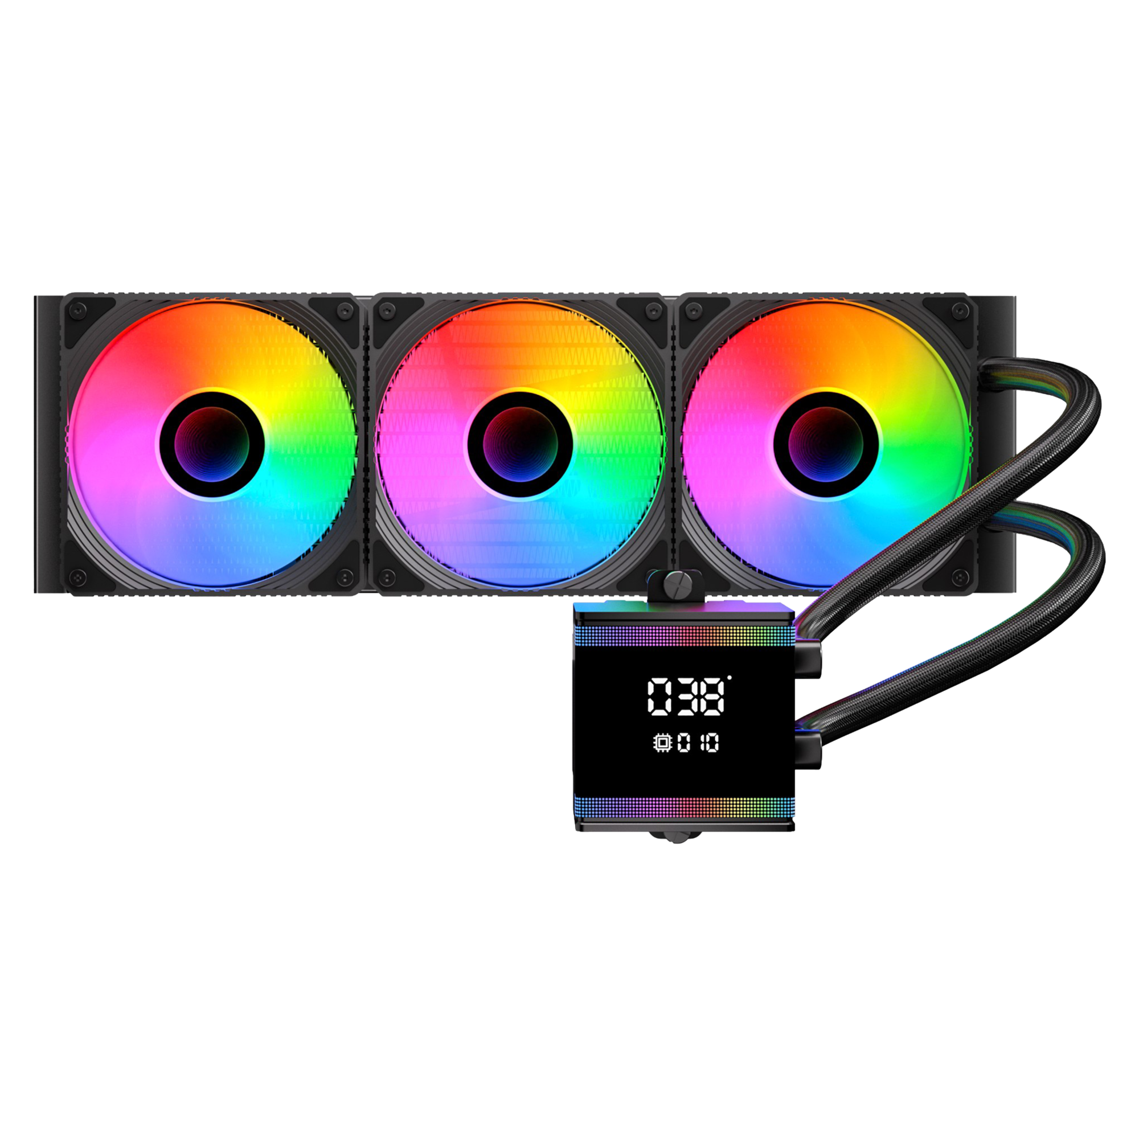
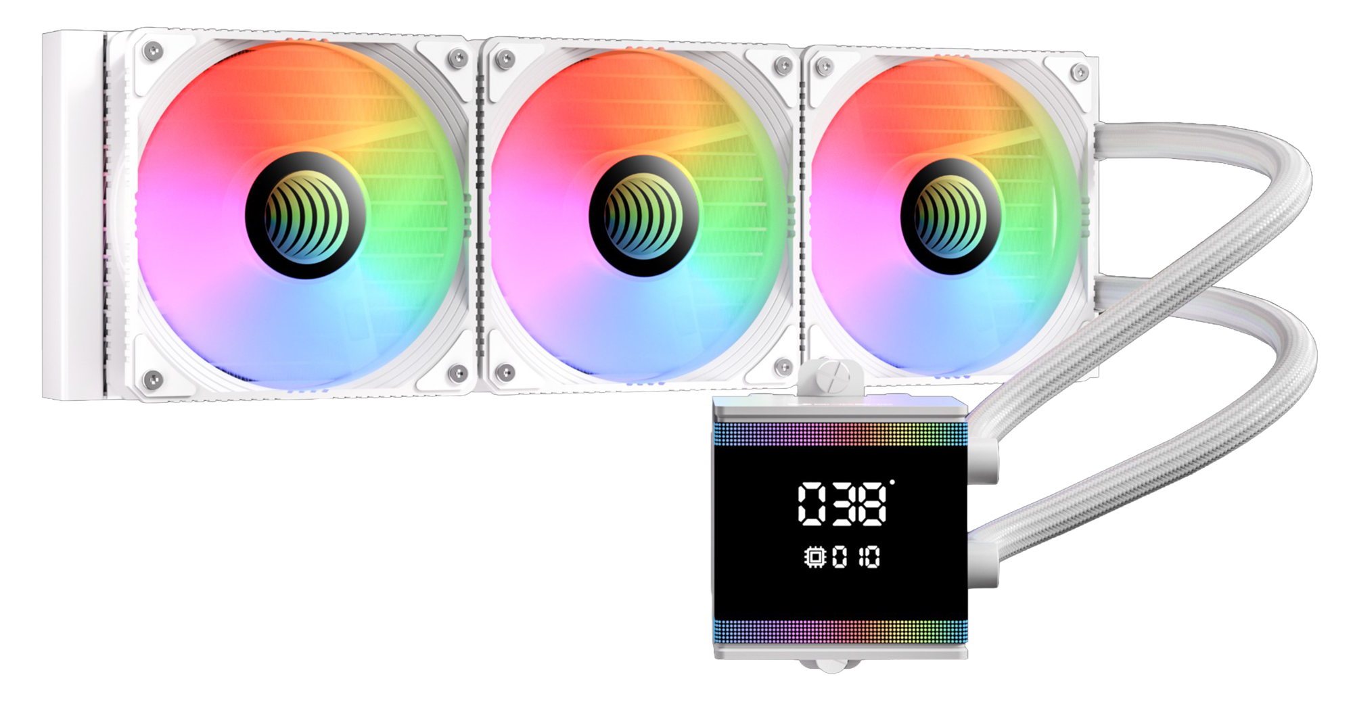

Bitfenix S7
Meet the S7: Where Performance Meets Style.
As the newest member of BitFenix’s legendary 4th-generation liquid cooling family, the S7 is built for gamers who demand more. With its sleek Segment LCD Screen, you can keep a close eye on your system’s vitals in real-time.
Level up your build’s look with the S7’s vibrant ARGB water block and custom high-performance fans—fully customizable to match your personal style. Why choose between power and looks? The S7 delivers flagship-level cooling and premium aesthetics at a price that makes sense.
Support Motherboard-Brand Lighting Synchronization: Asus/Gigabyte/MSI/ASRock/Biostar...and other brands can support.

Slide 3
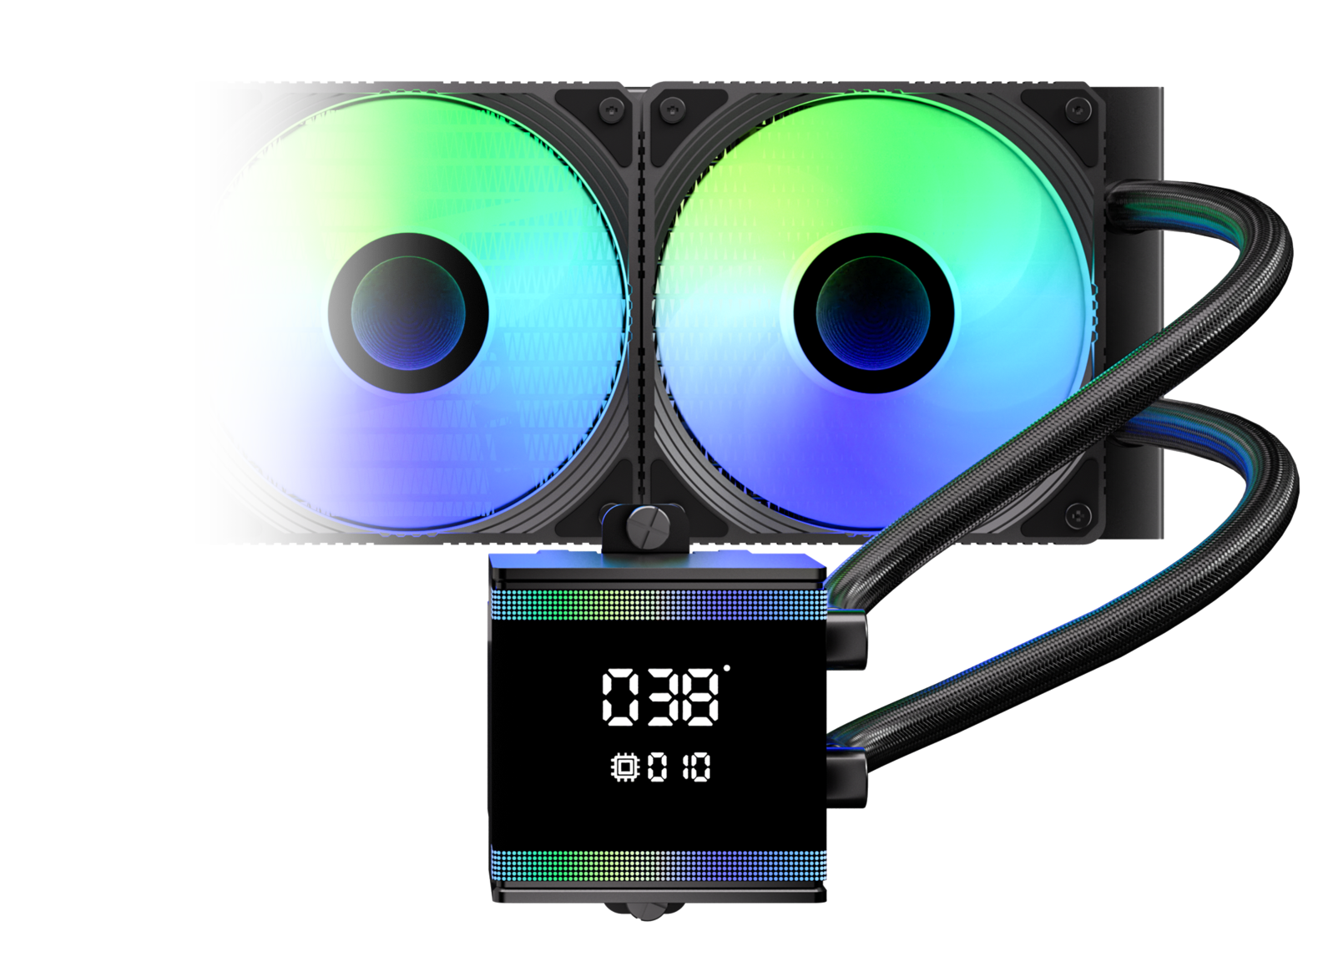
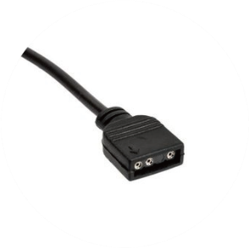
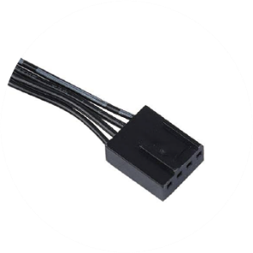
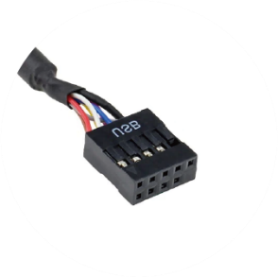
Introducing Water Block Connector Cables
ARGB Header
Connects to the motherboard's ARGB 3-pin socket
PUMP Header
Connects to the motherboard's pump/fan/extension cable Y-header
FAN Header
Monitor Header
Connected to the CPU FAN connector on the motherboard
Connects to the motherboard's USB 2.0 socket

Slide 4
Segment LCD Screen Introduction
CPU Temperature
CPU Utilization

Slide 5
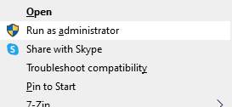

Bitfenix S7
Segment Display AIO Software
Welcome to the PC Monitor software installation.
Please follow these guidelines for a smooth setup:
Administrator Rights: The software must be installed using Administrator mode.
Clean Installation: If you have an older version installed, please uninstall it first and manually delete the original installation folder before proceeding.
Installation Path: We recommend using the default directory. Please ensure the installation path consists only of English characters.

Slide 6
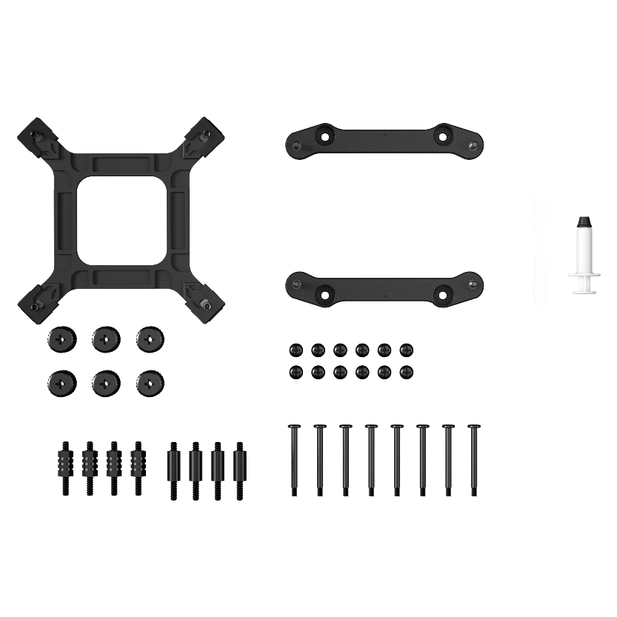
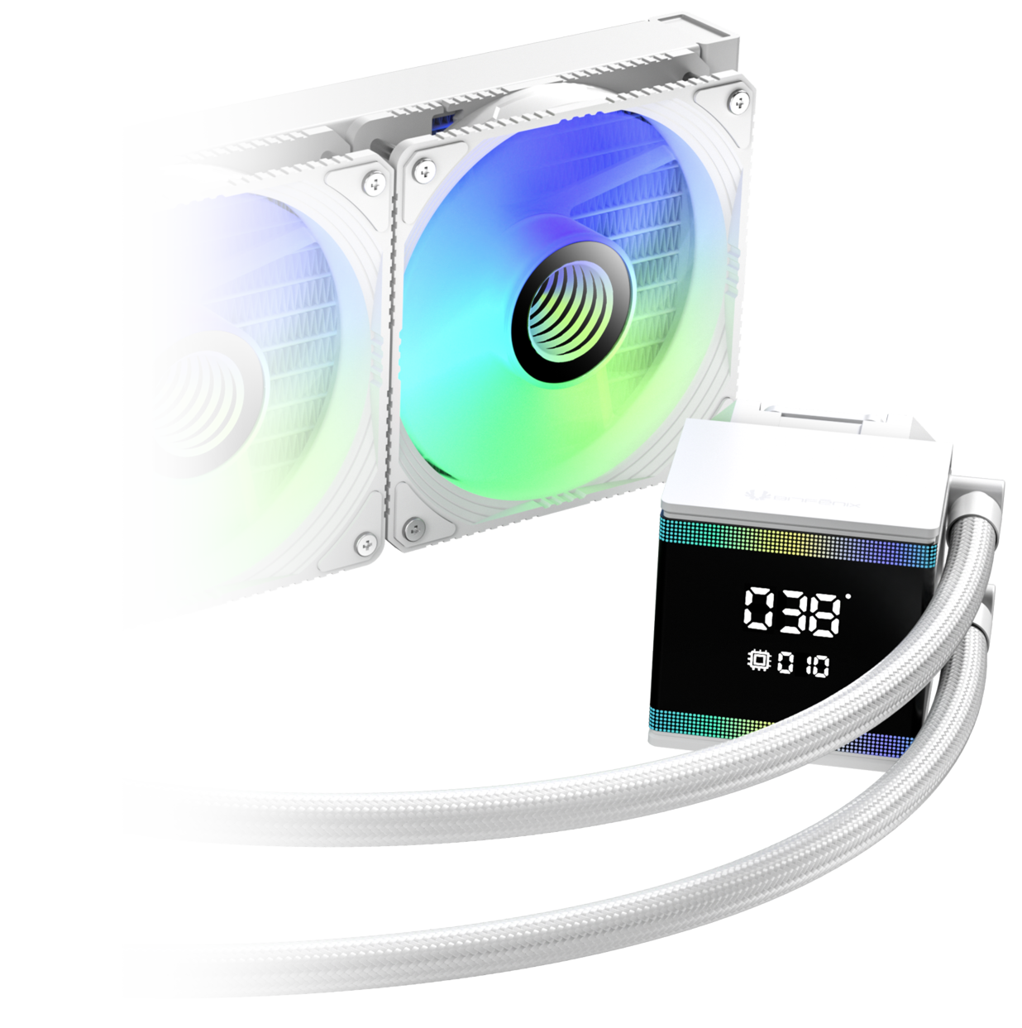
Third Generation Pump
In order to match the latest top-level CPUs, we have developed a brand new pump based on the popular pump architecture. It has the ultimate specifications of 3000 RPM
Socket compatibility | Intel: 1851 / 1700 / 1200 / 1150 / 1151 / 1155 AMD: AM5 / AM4
Pump speed (rpm) | 3000 ±10 rpm
Pump adjustable | 9V - 12V
Pump connector | 12V-4Pin PWM
Tube length (mm) | 400 mm
Noise level | ≤30dB(A)

Slide 7
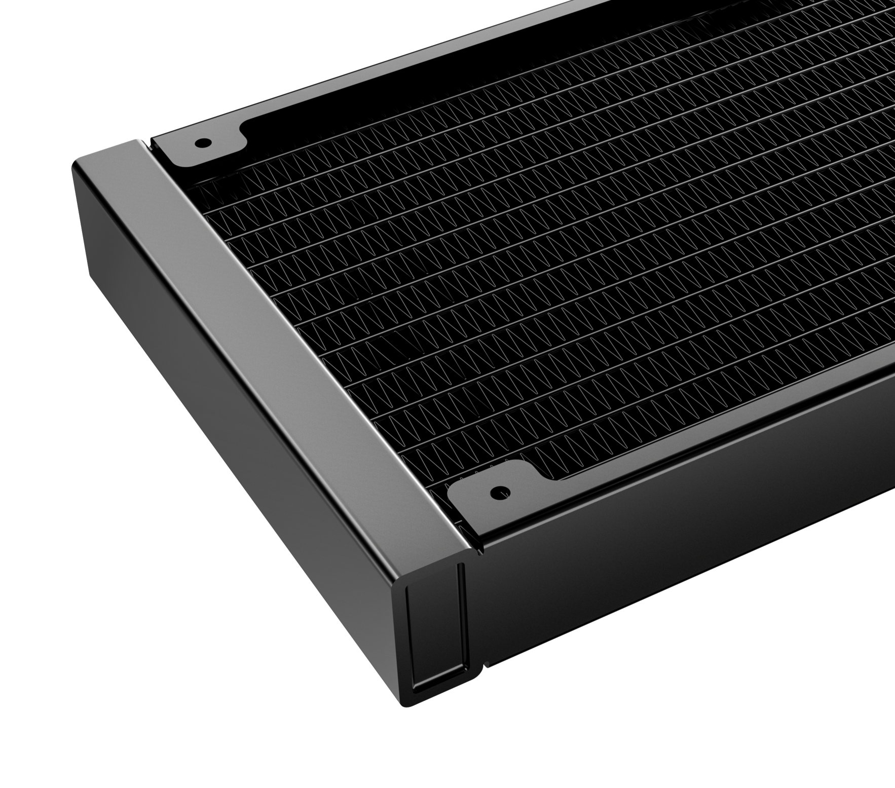
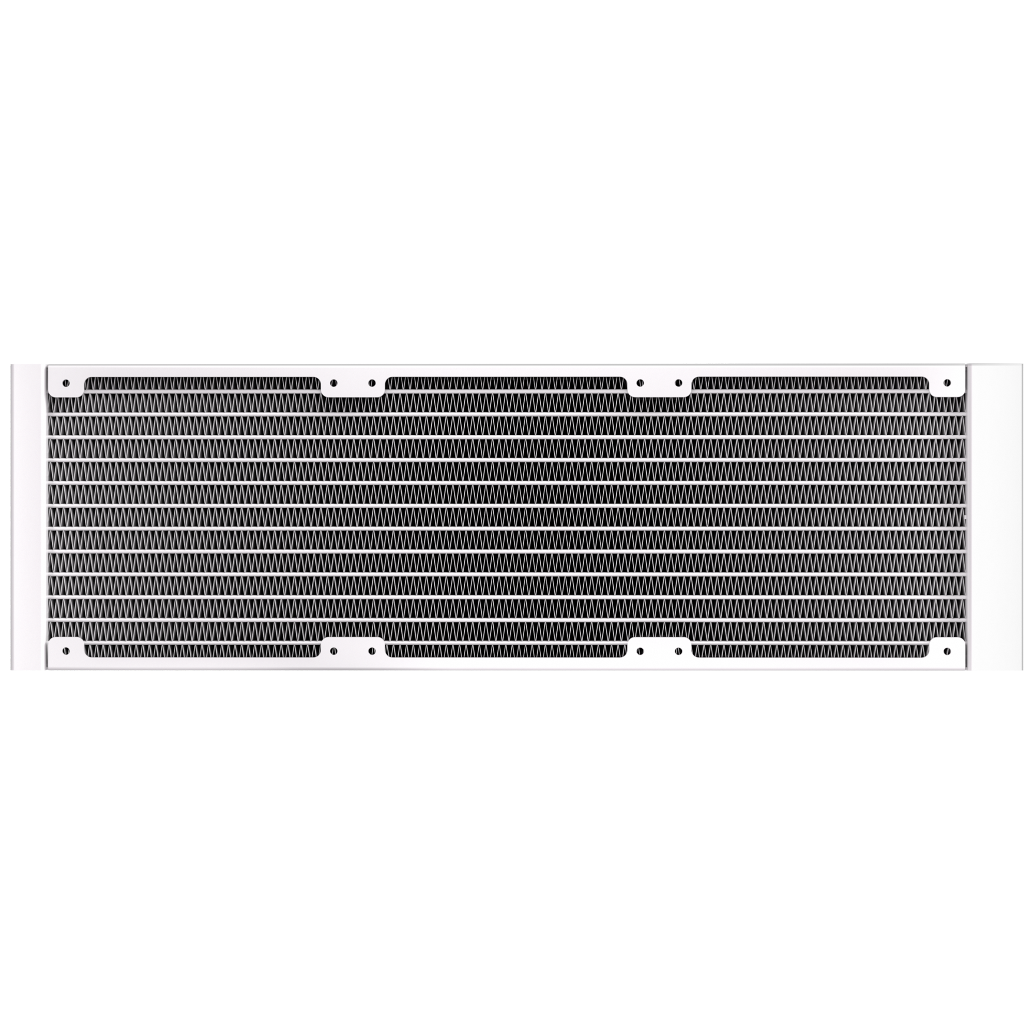
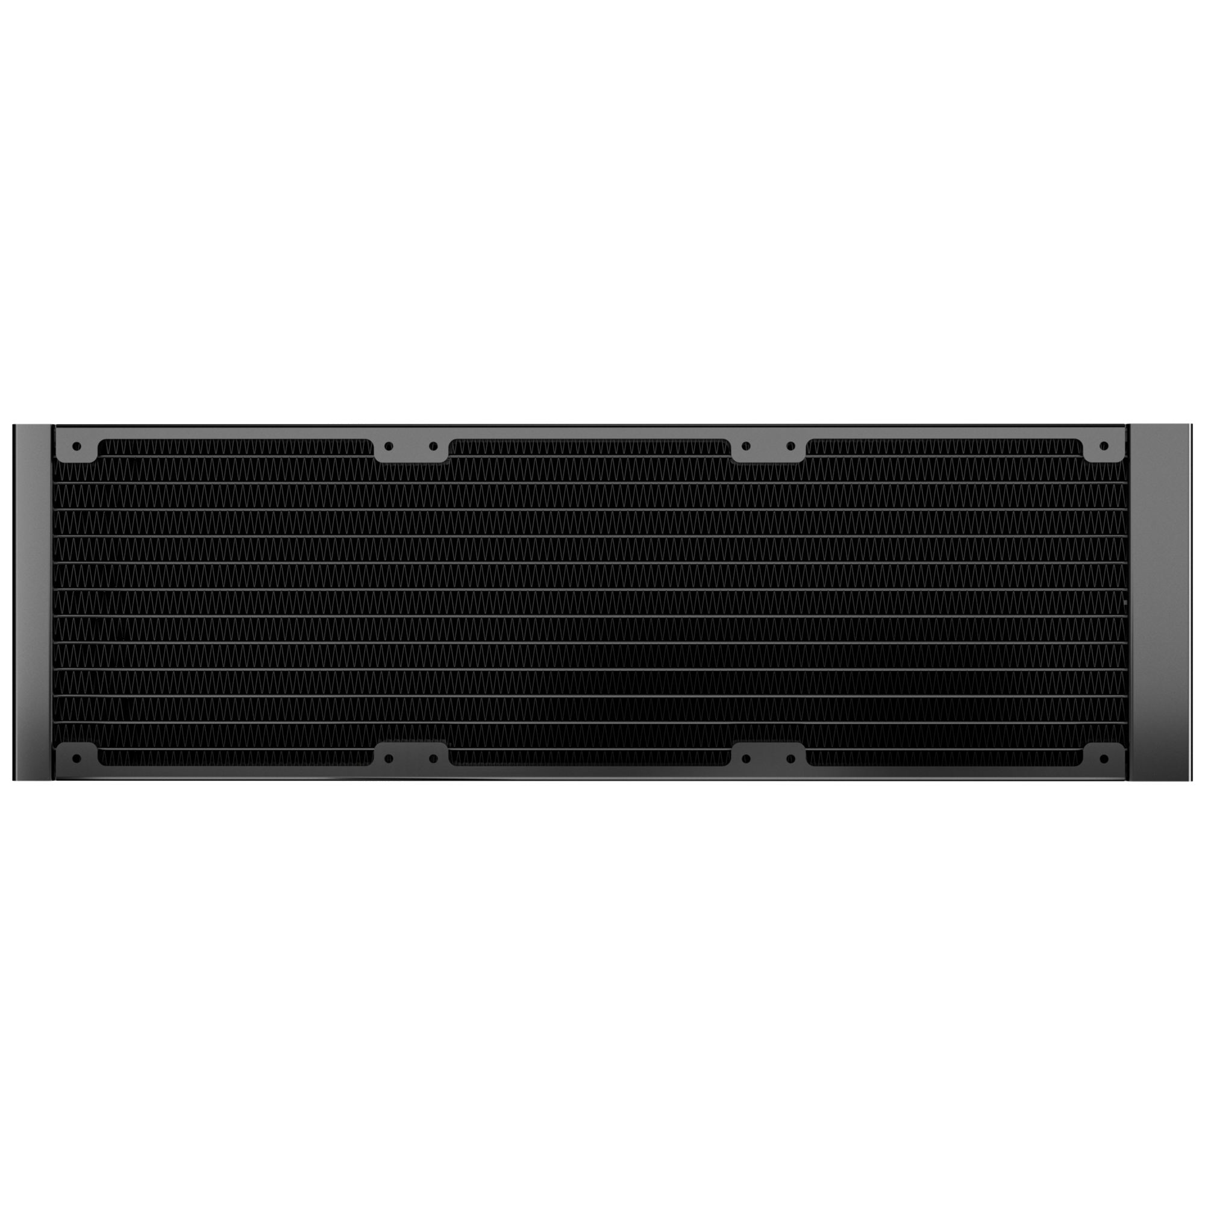
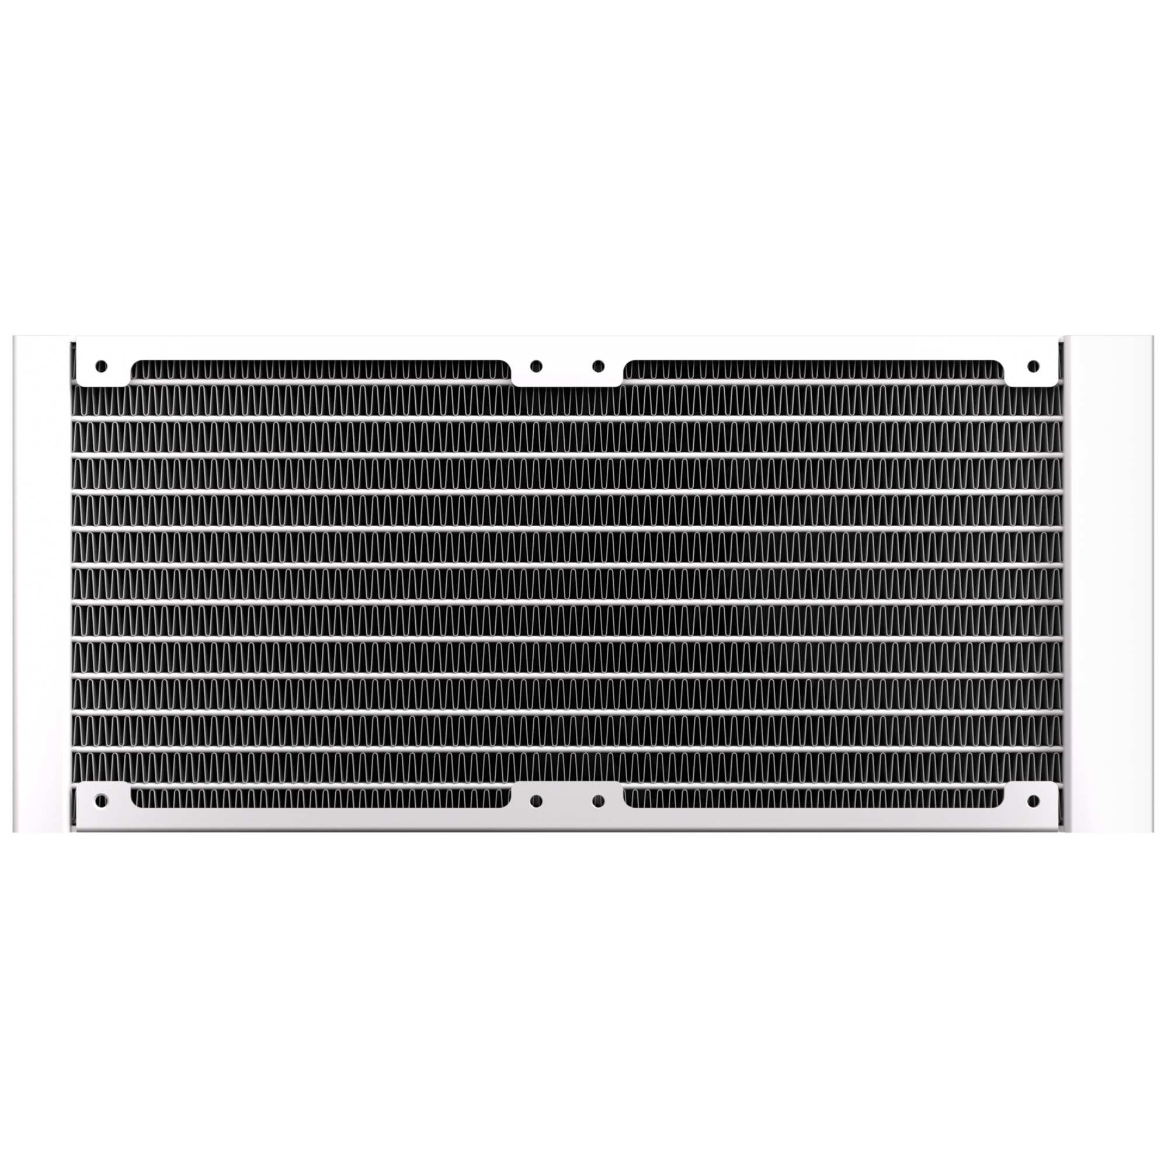
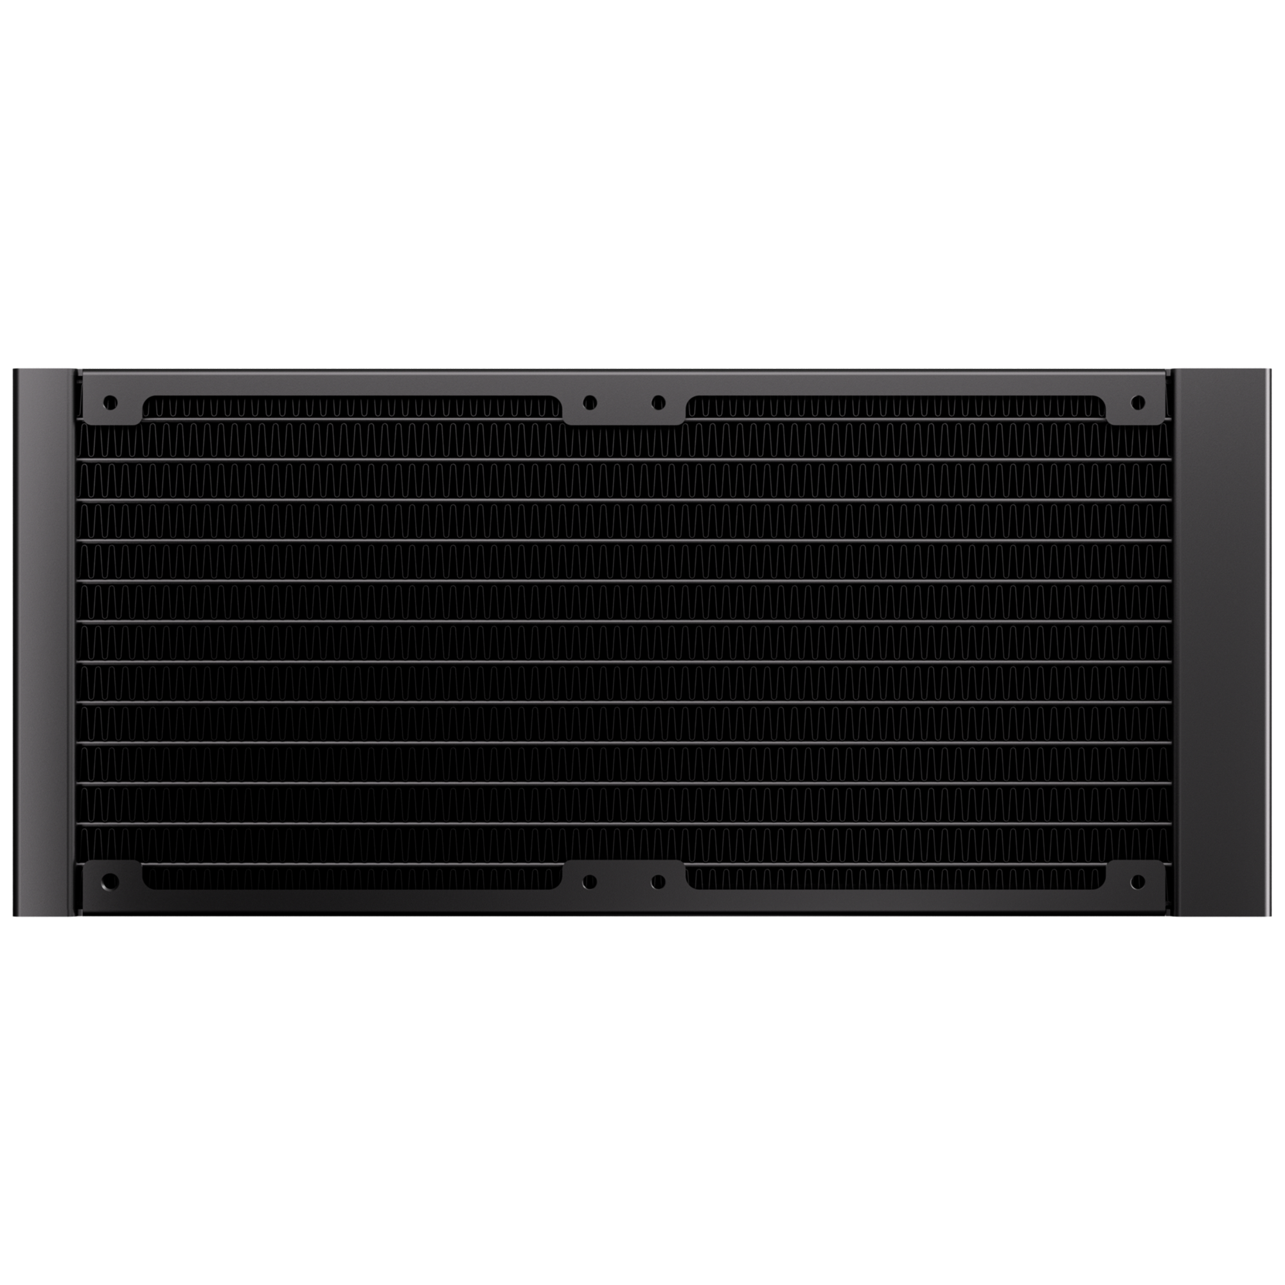
360mm
240mm
360 Radiator specifications
Dimensions (H x W x D), (mm) | 397 x 120 x 27
Radiator material / finish | aluminum / black or white spray painted
Base material | copper
240 Radiator specifications
Dimensions (H x W x D), (mm) | 277 x 120 x 27
Radiator material / finish | aluminum / black or white spray painted
Base material | copper

Slide 8
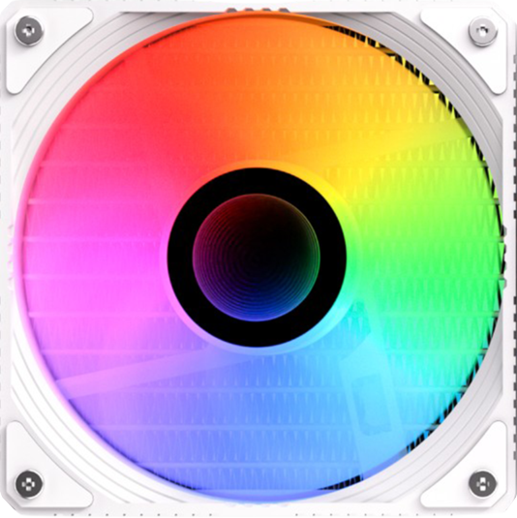

Fan SPEC
Fan model | ARGB 120mm PWM high-pressure Fan
Fan dimensions (mm) | 120 x 120 x 25
Speed @ 100% PWM (rpm) | 800-2000 ±10% RPM
Bearing technology | Hydraulic Bearing
Rated Voltage (V) | 12V
Start Voltage (V) | ≤5V(Power ON/OFF)
Power consumption (W) | 3W
Connector | 4-pin PWM
Max. air flow | 59.1CFM
Air Pressure | 1.73MM-H2O
Noise | ≤30 dB

Slide 9
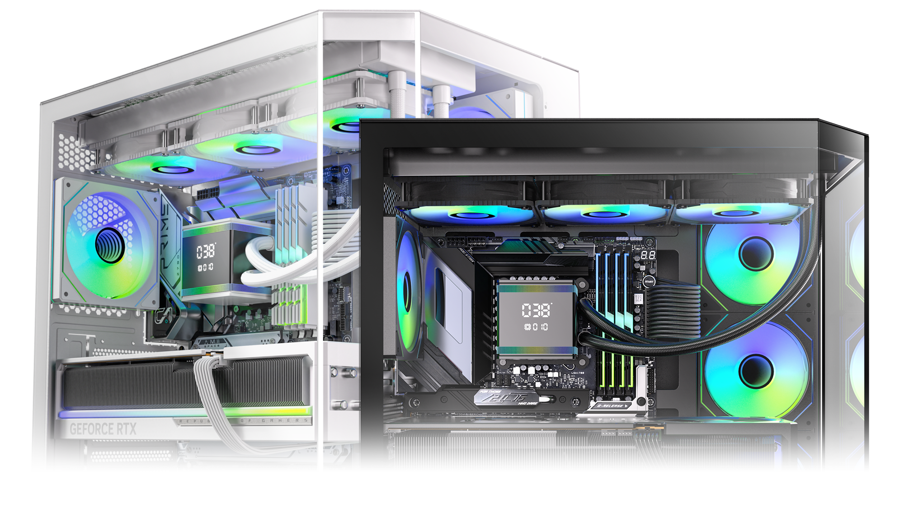
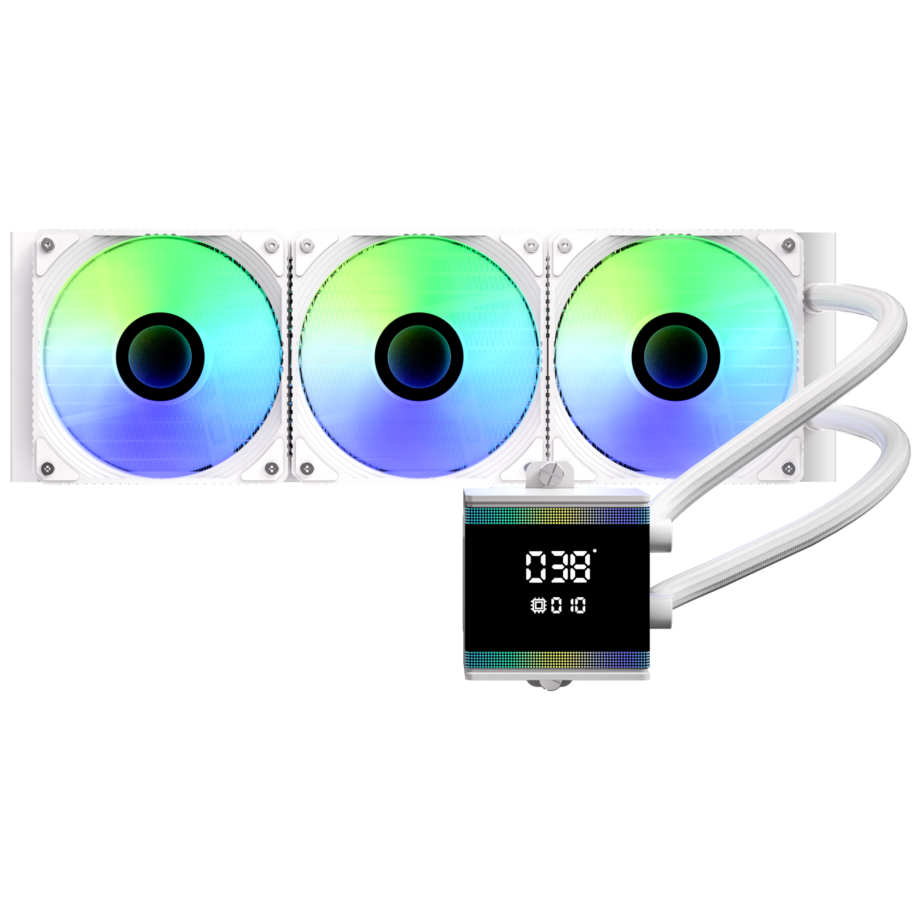
S7
S7 Black
Part Number | BFW-S7-360-KK27A-RP
EAN / UPC | 4716779449969 / 886027007440
All-In-One LIQUID COOLER
S7 White
Part Number | BFW-S7-360-WW27A-RP
EAN / UPC | 4716779449976 / 886027010297

