Slide 1
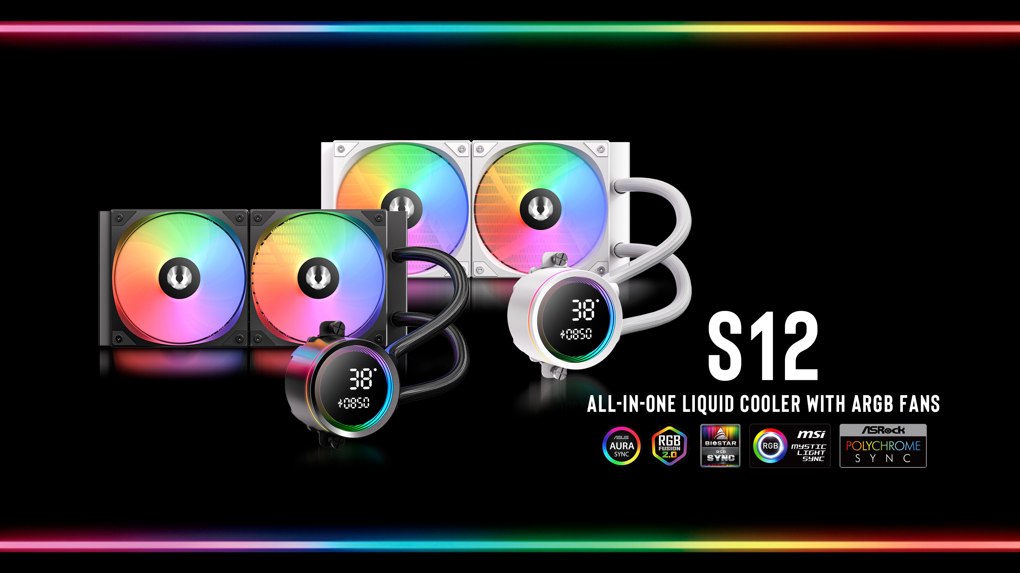

Slide 2
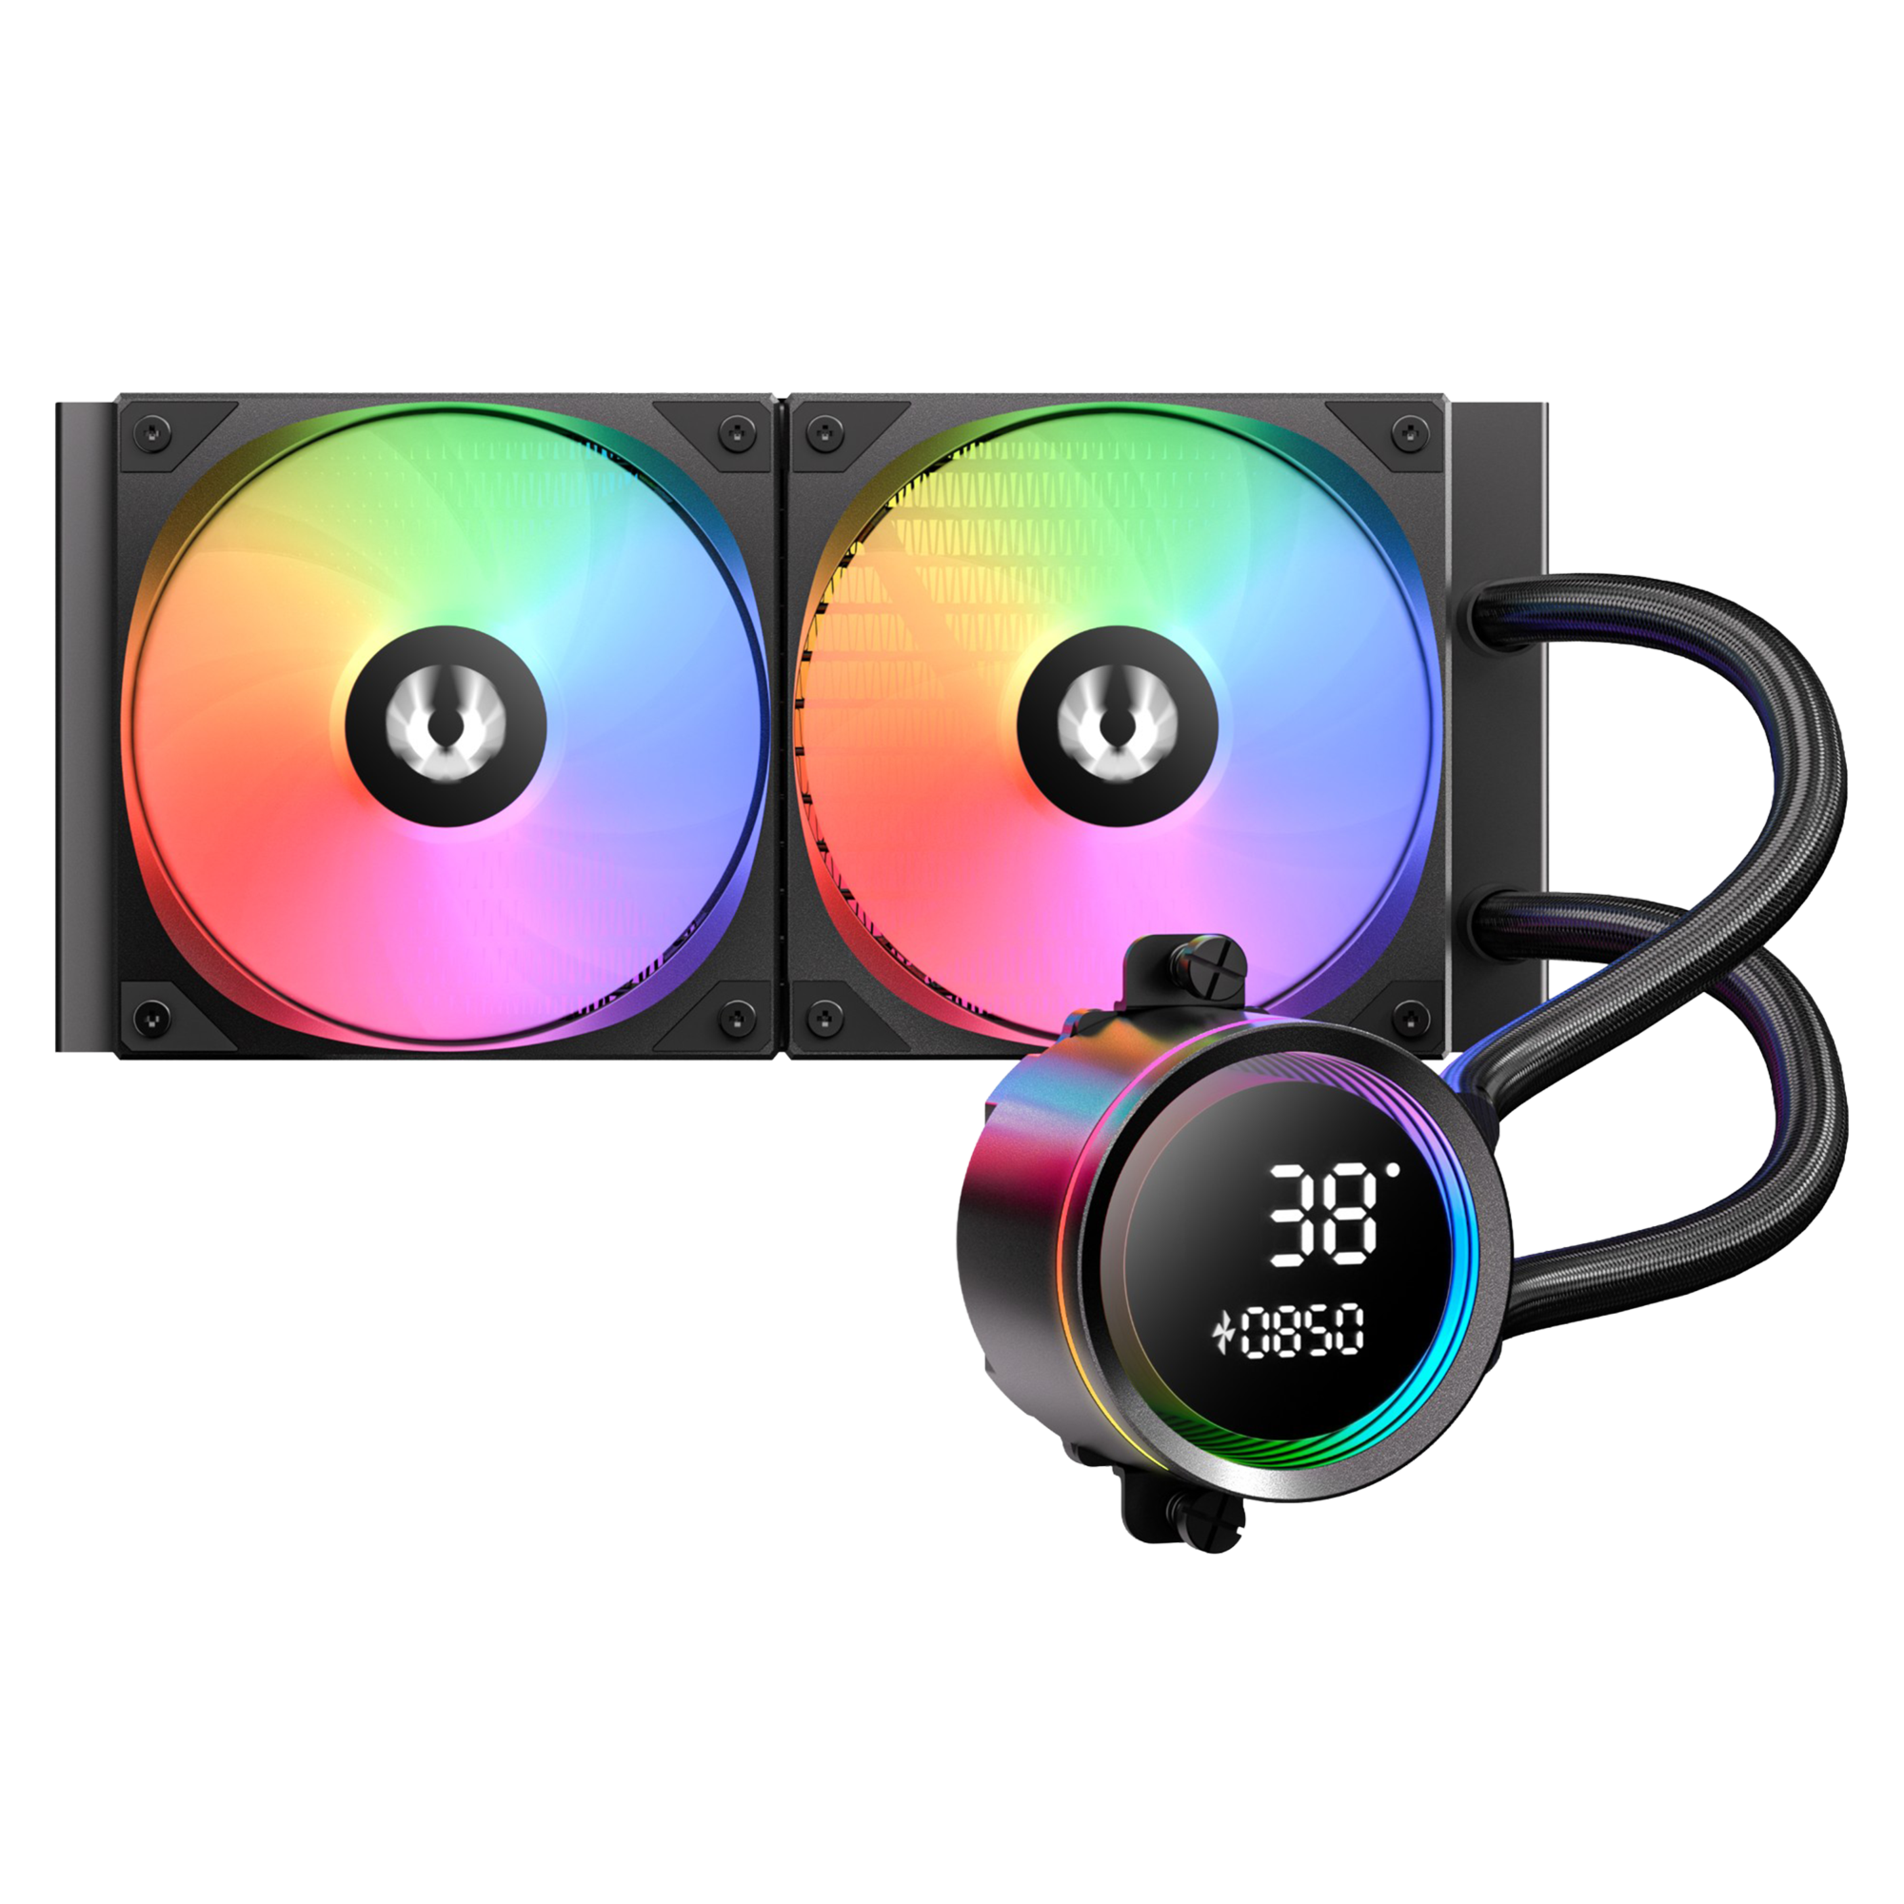
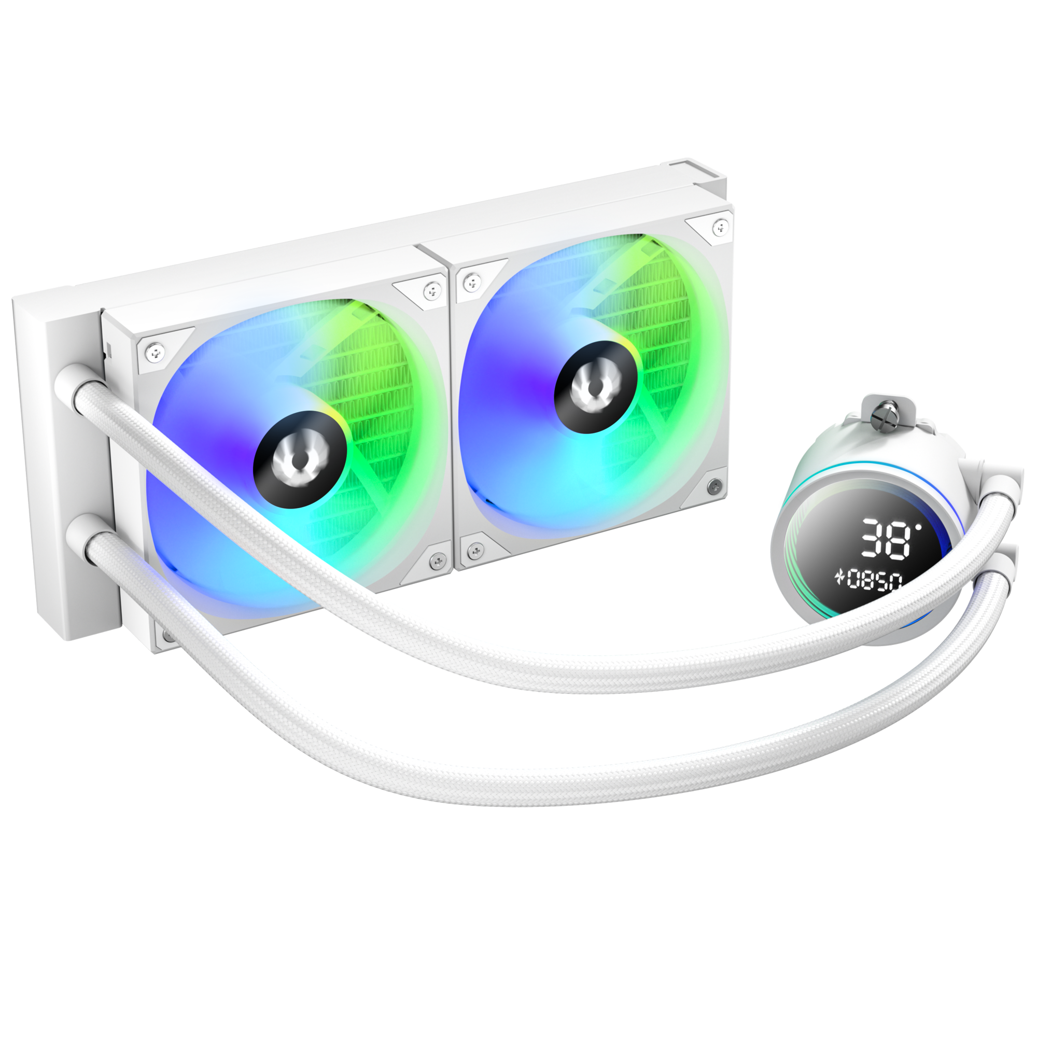

Bitfenix S12
Elevate your build with the BitFenix S12. This 4th Gen AIO cooler doesn't just boast superior pump efficiency—it features a custom fan designed to deliver a massive 82.8 CFM airflow and 2.6 mmH₂O pressure at a quiet 1600 RPM.
The S12's pump head merges a mesmerizing Infinity Mirror with a Segment LCD, putting vital temperature and RPM right in your line of sight. For gamers seeking the perfect balance of bold lighting and silent performance, the S12 Series stands unrivaled.
Support Motherboard-Brand Lighting Synchronization: Asus/Gigabyte/MSI/ASRock/Biostar...and other brands can support.

Slide 3
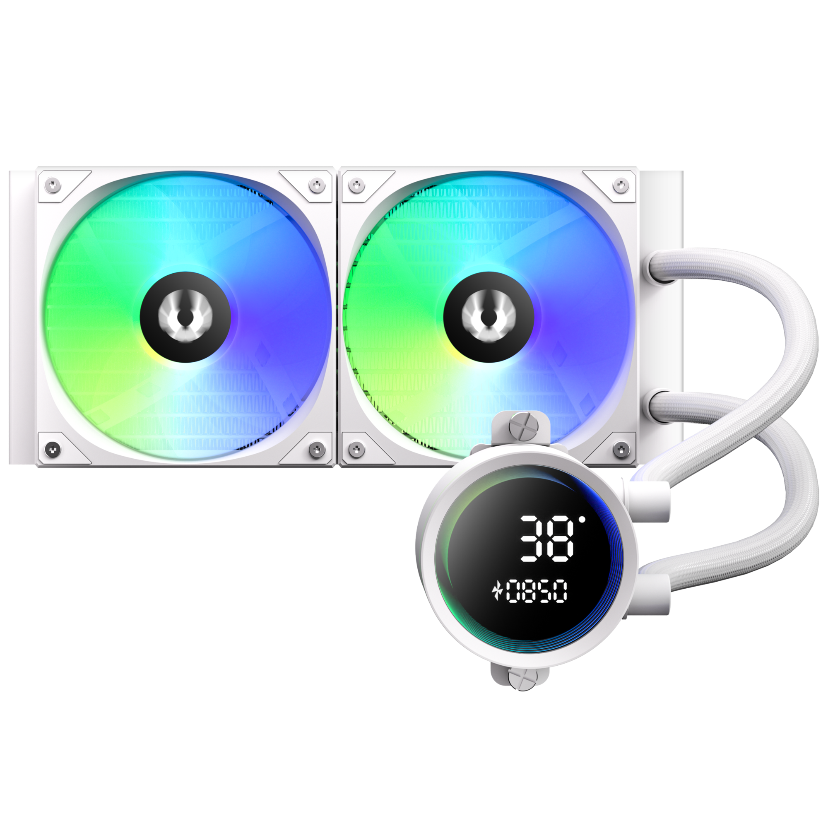
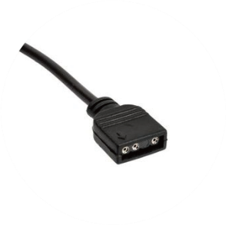
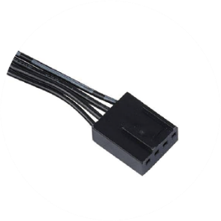
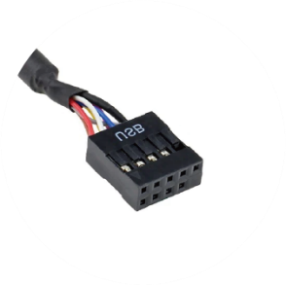
Introducing Water Block Connector Cables
ARGB Header
Connects to the motherboard's ARGB 3-pin socket
PUMP Header
Connects to the motherboard's pump/fan/extension cable Y-header
FAN Header
Monitor Header
Connected to the CPU FAN connector on the motherboard
Connects to the motherboard's USB 2.0 socket

Slide 4
CPU Temperature
Fan Speed
Segment LCD Screen Introduction

Slide 5
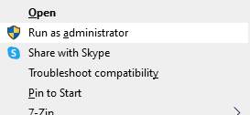

Bitfenix S12
Segment Display AIO Software
Welcome to the PC Monitor software installation.
Please follow these guidelines for a smooth setup:
Administrator Rights: The software must be installed using Administrator mode.
Clean Installation: If you have an older version installed, please uninstall it first and manually delete the original installation folder before proceeding.
Installation Path: We recommend using the default directory. Please ensure the installation path consists only of English characters.

Slide 6
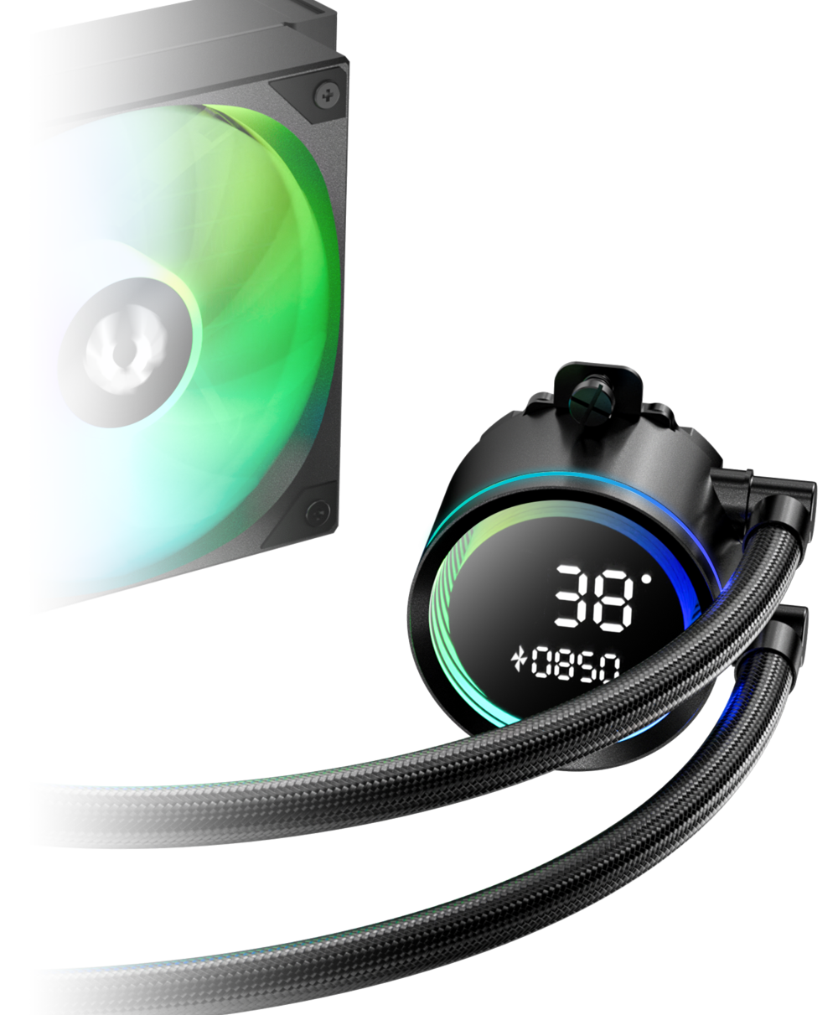
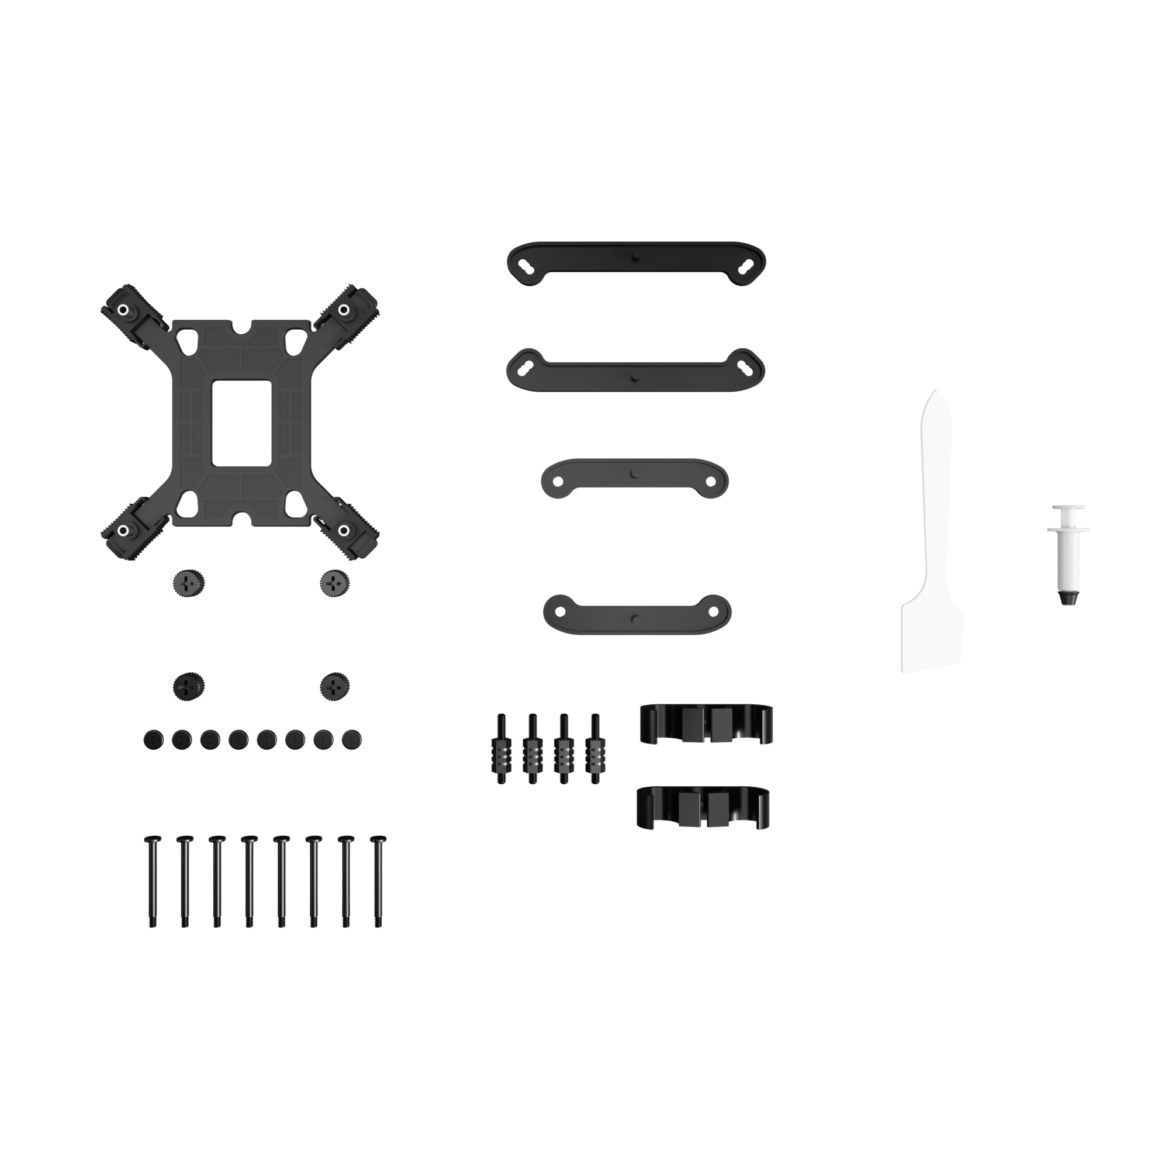
Third Generation Pump
In order to match the latest top-level CPUs, we have developed a brand new pump based on the popular pump architecture. It has the ultimate specifications of 3000 RPM
Socket compatibility | Intel: 1851 / 1700 / 1200 / 1150 / 1151 / 1155 AMD: AM5 / AM4
Pump speed (rpm) | 3000 ±10 rpm
Pump adjustable | 9V - 12V
Pump connector | 12V-4Pin PWM
Tube length (mm) | 400 mm
Noise level | ≤30dB(A)

Slide 7
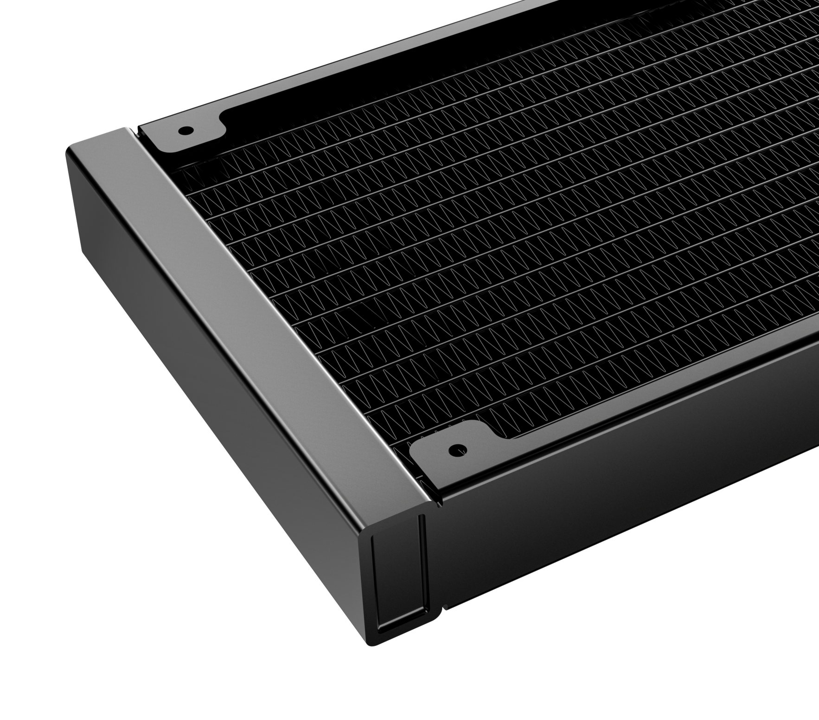
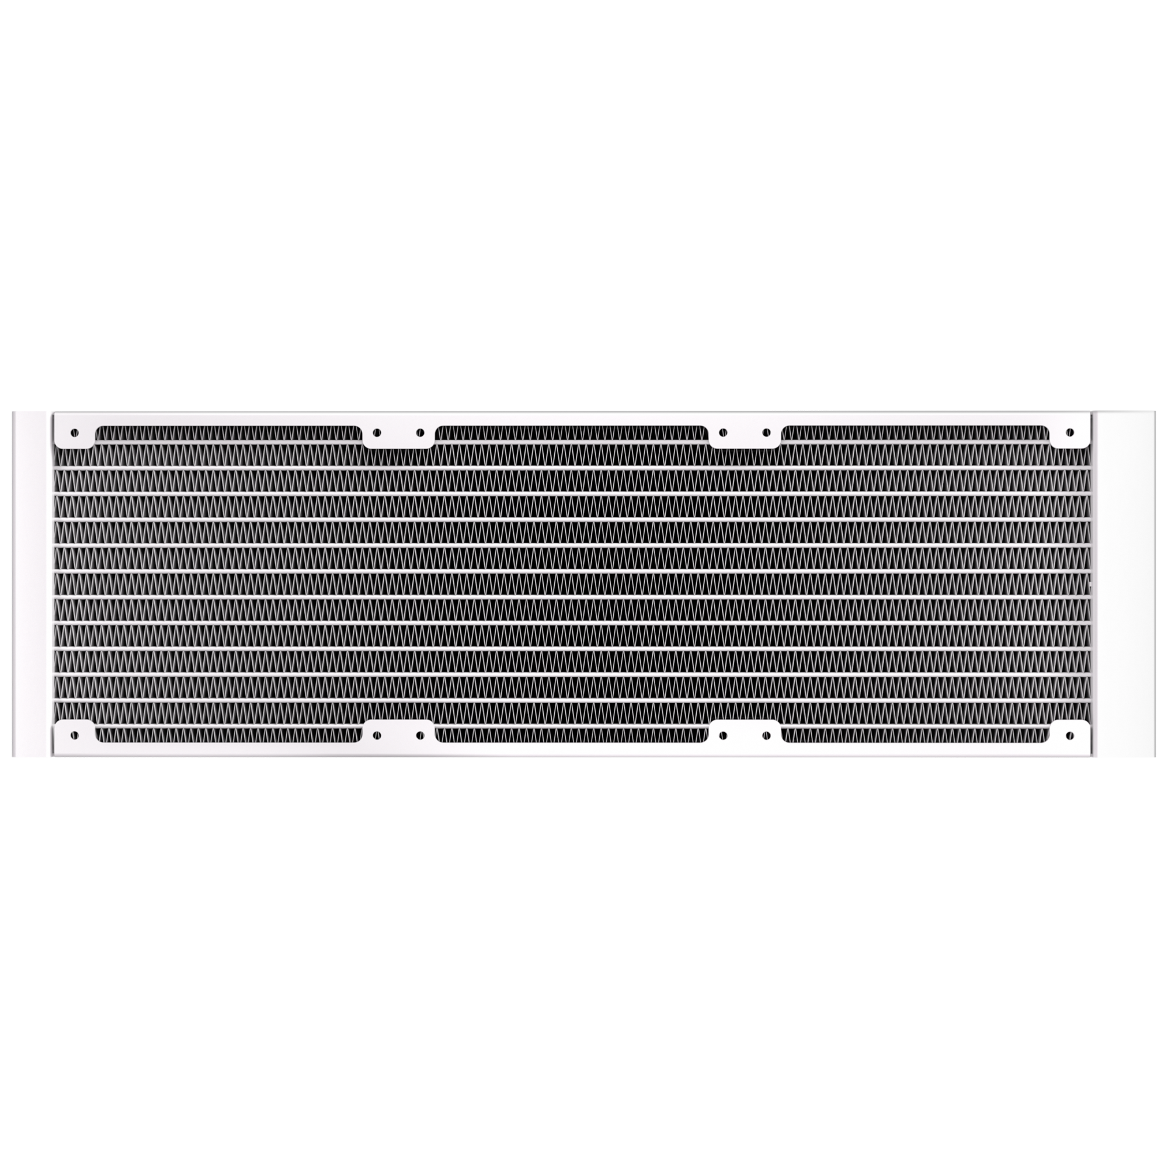
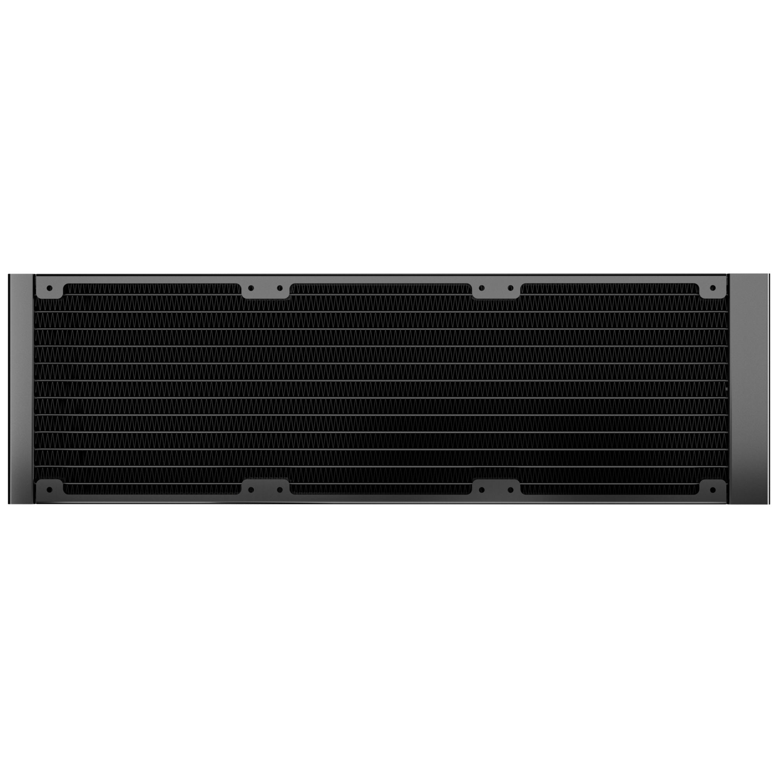
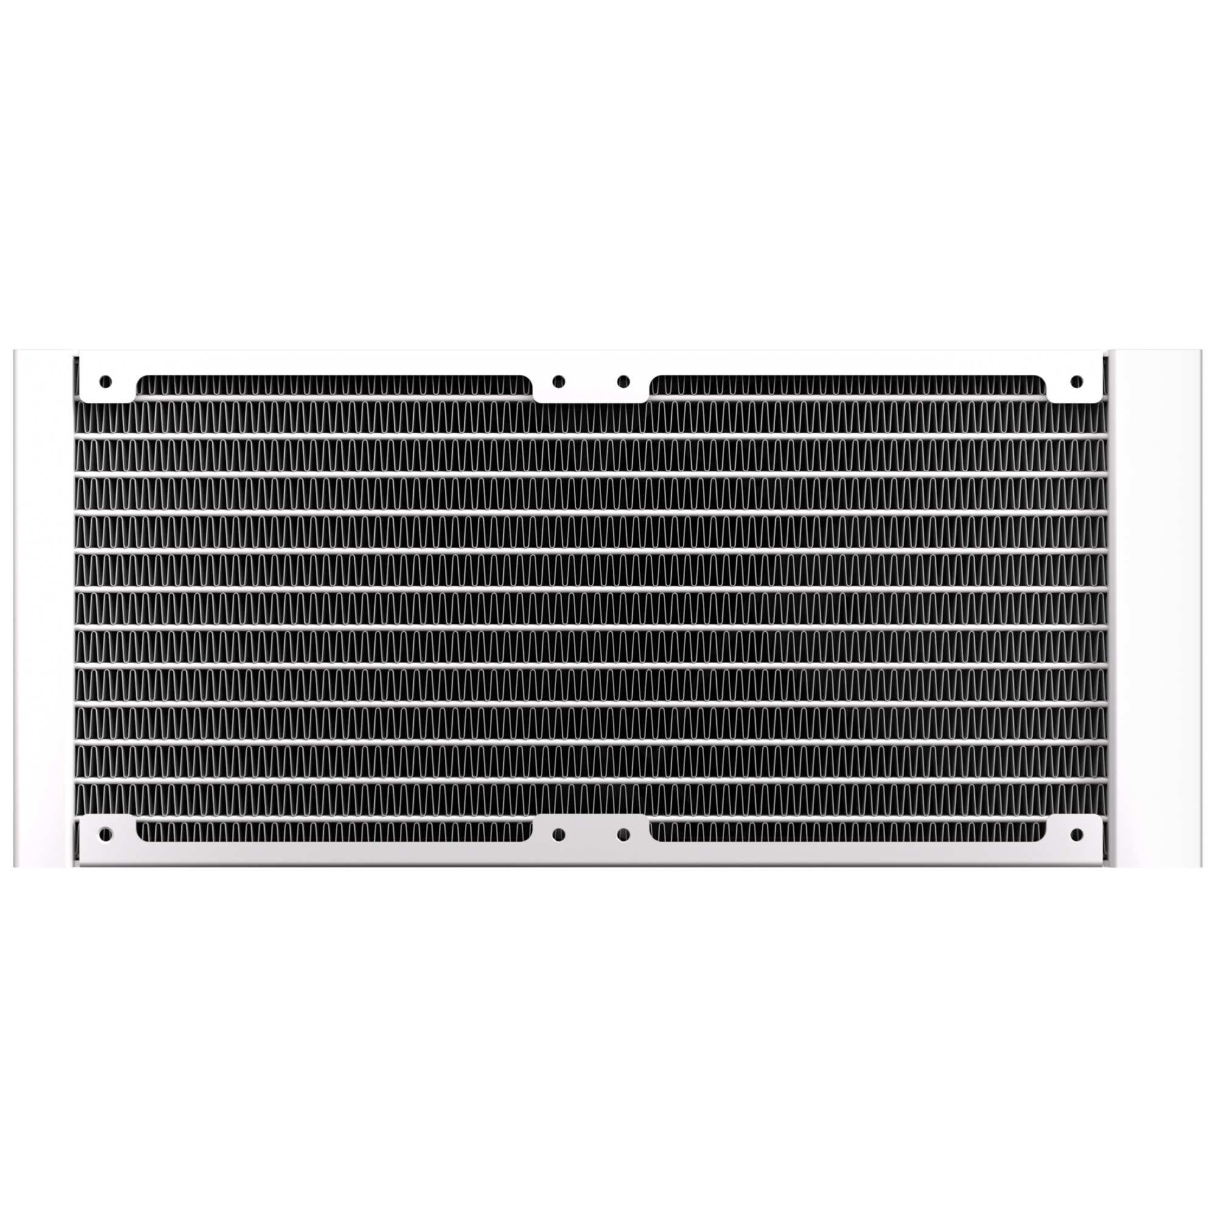
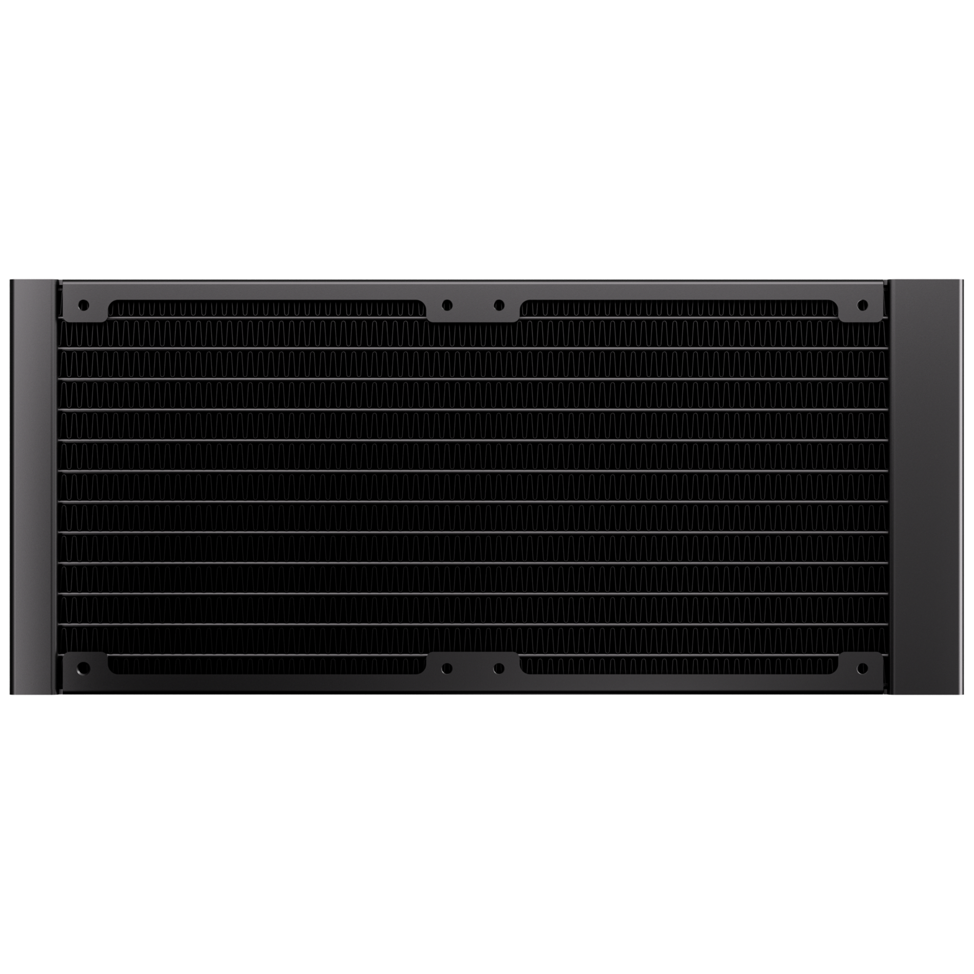
360mm
240mm
360 Radiator specifications
Dimensions (H x W x D), (mm) | 397 x 120 x 27
Radiator material / finish | aluminum / black or white spray painted
Base material | copper
240 Radiator specifications
Dimensions (H x W x D), (mm) | 277 x 120 x 27
Radiator material / finish | aluminum / black or white spray painted
Base material | copper

Slide 8


Fan SPEC
Fan model | ARGB 120mm PWM high-pressure Fan
Fan dimensions (mm) | 120 x 120 x 25
Speed @ 100% PWM (rpm) | 800-1600 ±10% RPM
Bearing technology | Hydraulic Bearing
Rated Voltage (V) | 12V
Start Voltage (V) | ≤5V(Power ON/OFF)
Power consumption (W) | 3W
Connector | 4-pin PWM
Max. air flow | 82.8CFM
Air Pressure | 2.6MM-H2O
Noise | ≤29 dB

Slide 9

S12
All-In-One LIQUID COOLER
S12 Black
Part Number | BFW-S12-240-KK27A-RP
EAN / UPC | 4716779449983 / 886027013021
S12 White
Part Number | BFW-S12-240-WW27A-RP
EAN / UPC | 4716779449990 / 886027007457

