Slide 1


Slide 2
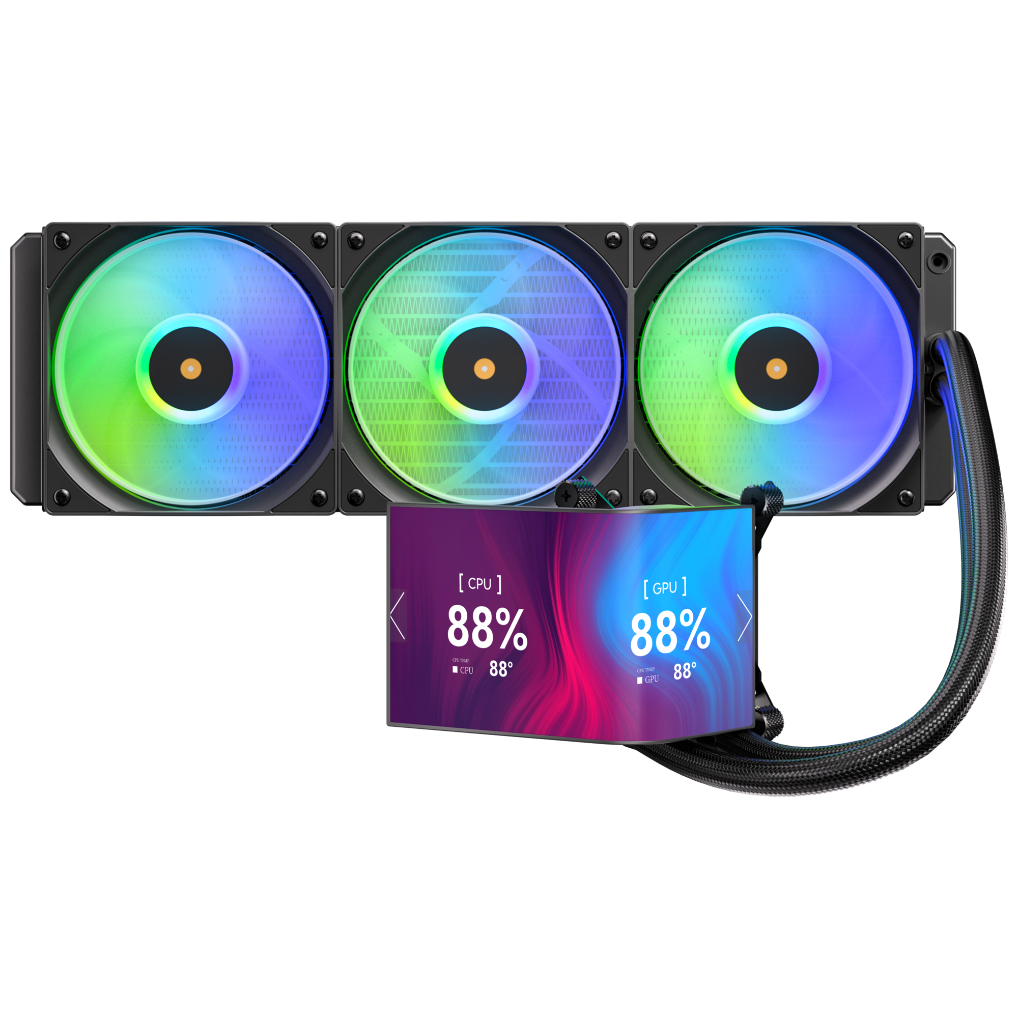

M7 – High-Performance AIO Liquid Cooler Equipped with a striking 6.8-inch curved screen
the M7 seamlessly combines outstanding cooling efficiency with expansive, dynamic visuals
Whether for an AI PC or a Gaming PC, the M7’s 2400 x 1080 curved screen includes customizable UI options tailored to fit any setup. In addition to its eye-catching design, it incorporates BitFenix's 4th-generation AIO pump, operating at 3000 RPM with a 1.5m head lift. Together with flagship fans featuring 2.2 mmH₂O static pressure, the system keeps any high-end CPU running cool under intense workloads.
Support Motherboard-Brand Lighting Synchronization: Asus/Gigabyte/MSI/ASRock/Biostar...and other brands can support.

Slide 3
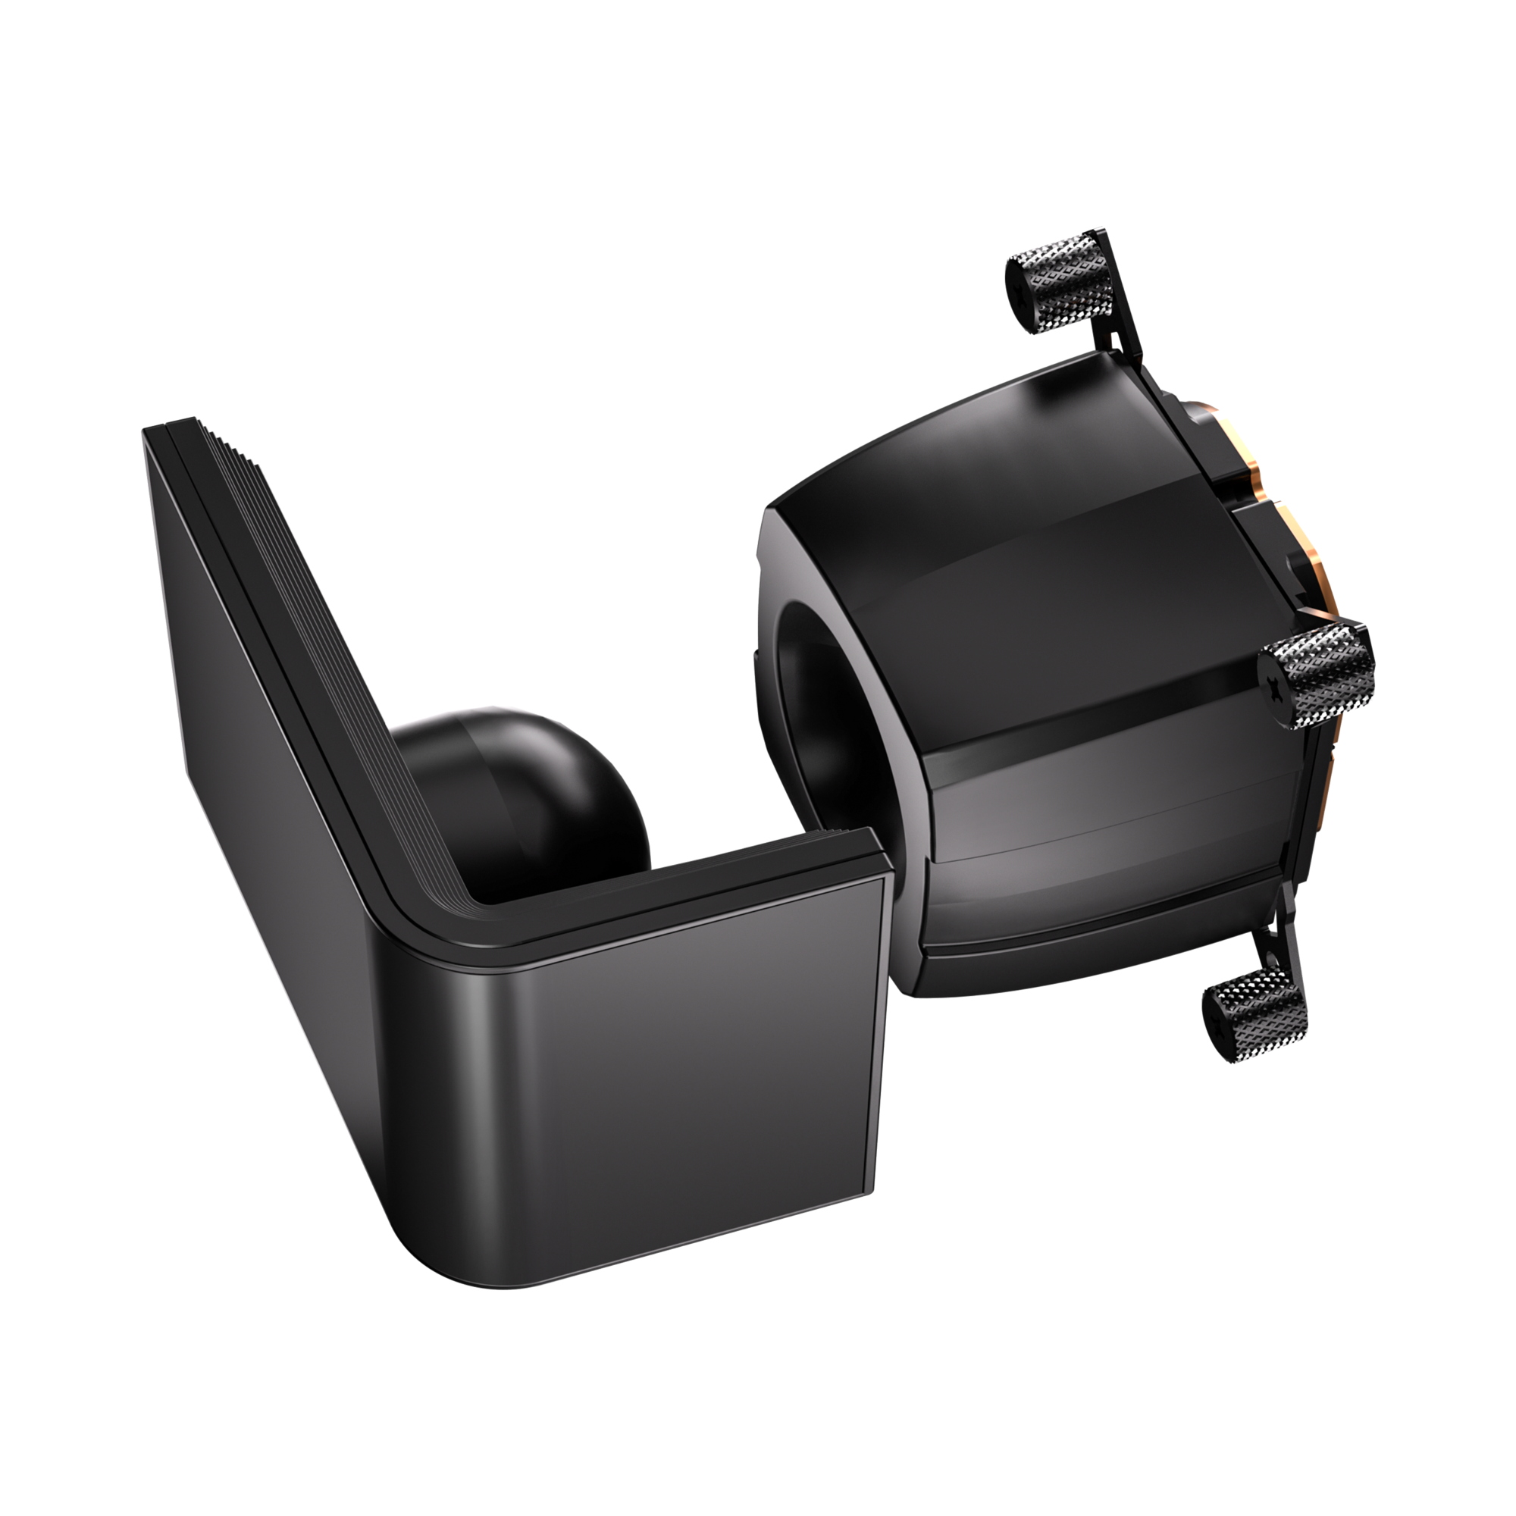
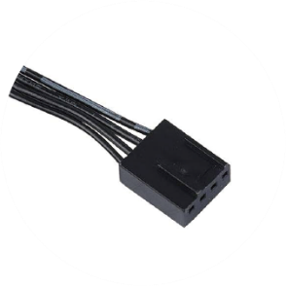
Introducing Water Block Connector Cables
PUMP Header
Connects to the motherboard's pump/fan/extension cable Y-header
FAN Header
Connected to the CPU FAN connector on the motherboard

Slide 4
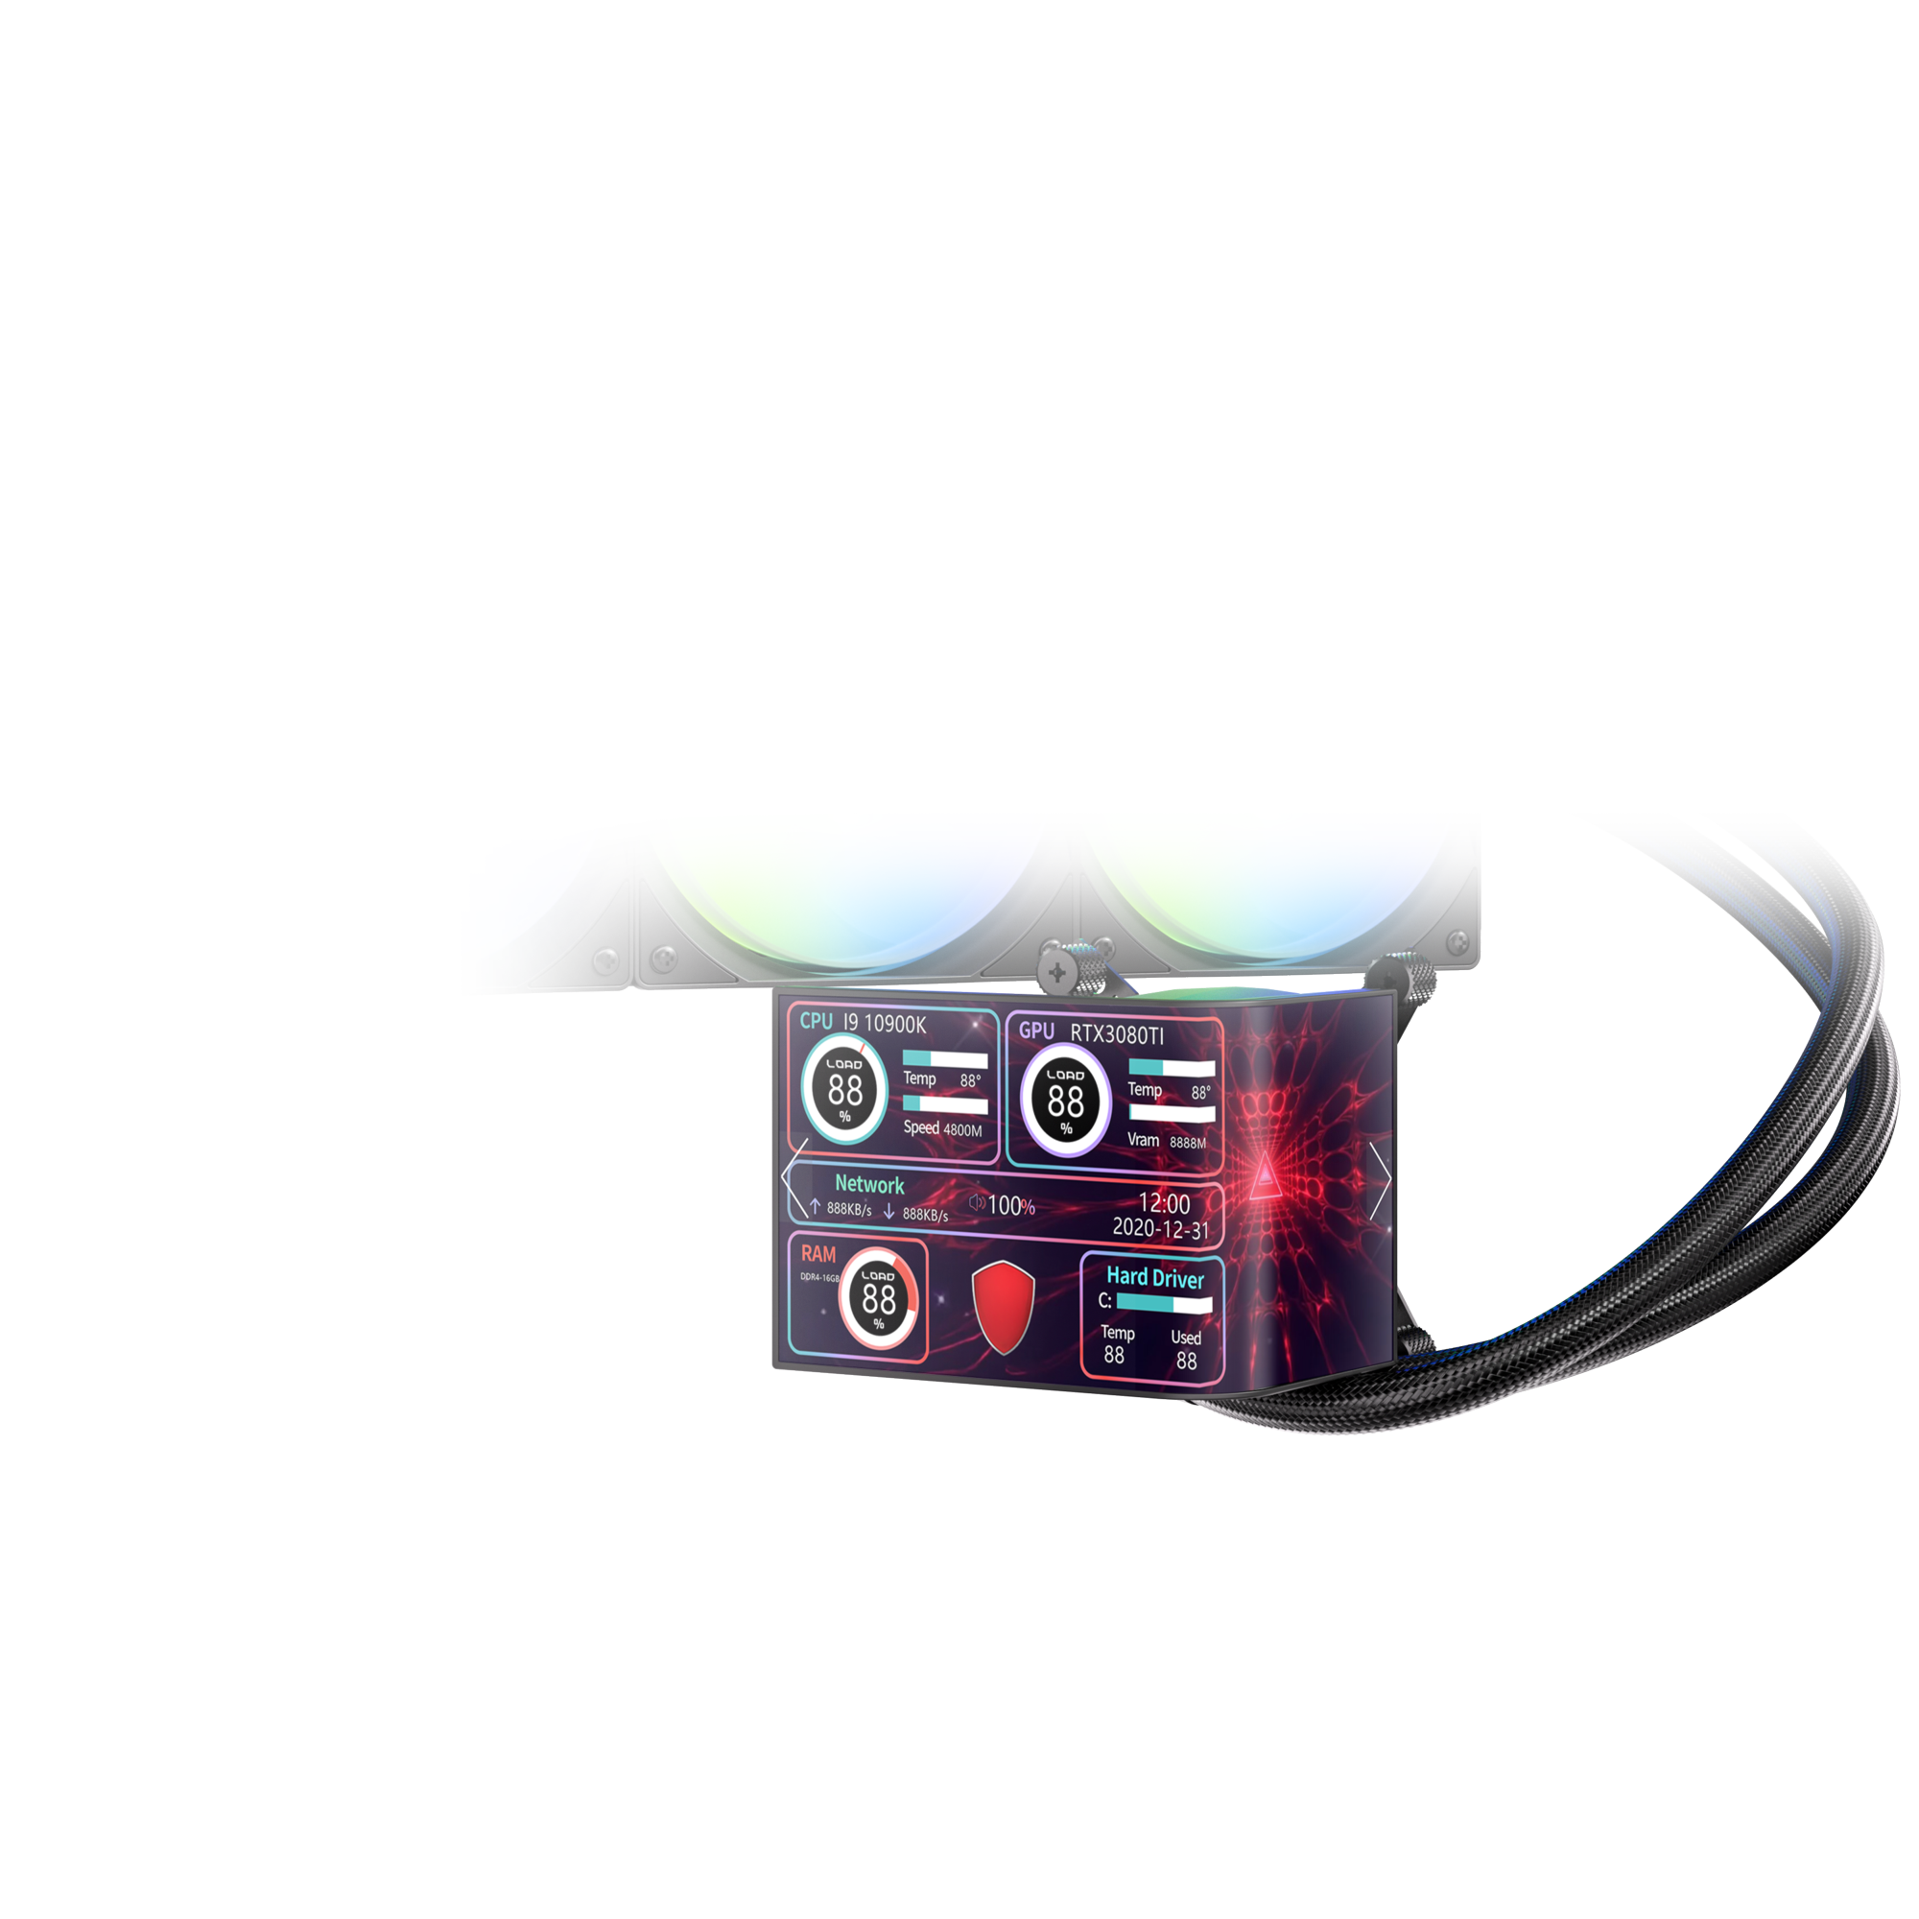
Item | Specification
Substrate Thickness | 0.15(TPF)+0.041(panel)+0.088( BP) mm
Panel Outline Dimension | 165.04X71.452X0.279
Active Screen Size | 6.67 Inch
Active Area | 154.56 x 69.552 mm
Resolution | 1080RGBx2400 pixel
Pixel Size | 64.4*64.4 um
Pixel Configuration | Windmill
Viewing Direction | All
Pixel Driving Element | LTPS
Suggested driver IC(LCD) | RM692E5/NT37701A
Display Mode | OLED
Technology Type | TPOT
Surface Treatment(Up Polarizer) | HC

Slide 5
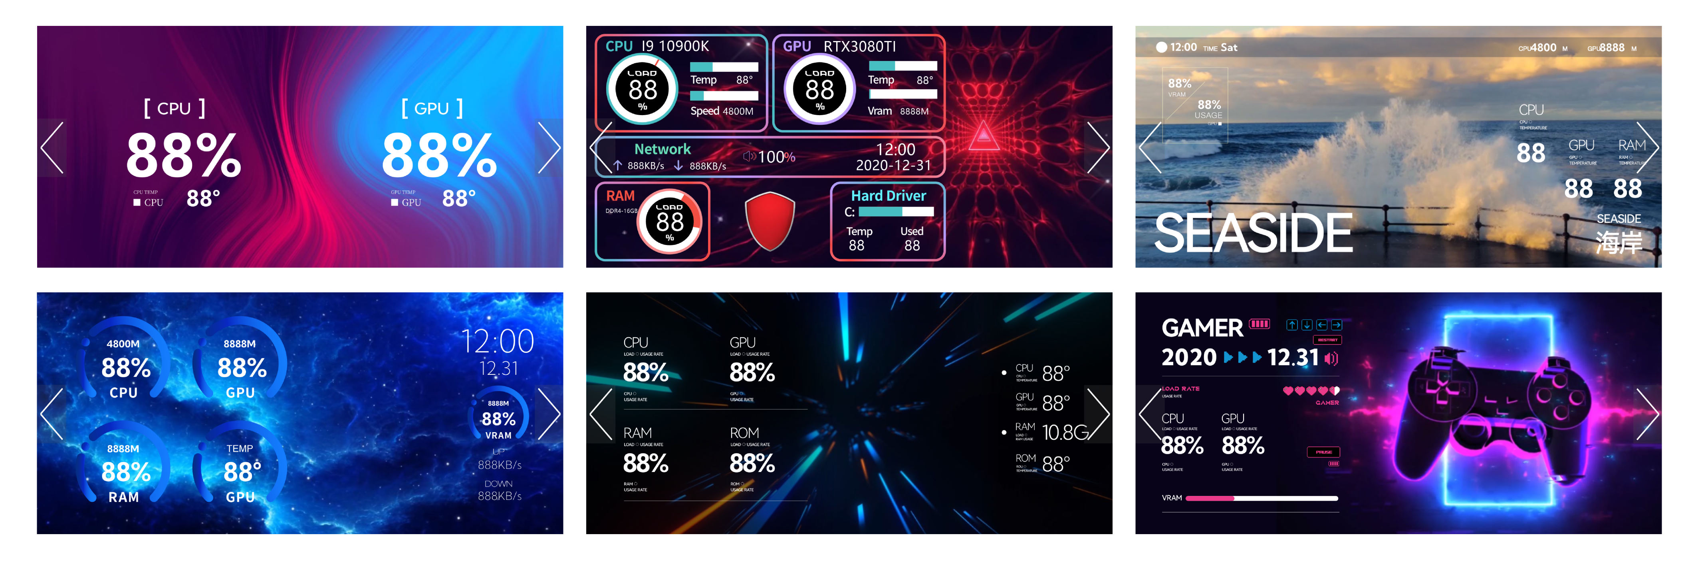
Players can choose from a variety of interfaces, install the software to access more options.

Slide 6
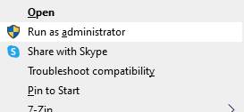

Bitfenix M7
Display AIO Software
Welcome to the PC Monitor software installation.
Please follow these guidelines for a smooth setup:
Administrator Rights: The software must be installed using Administrator mode.
Clean Installation: If you have an older version installed, please uninstall it first and manually delete the original installation folder before proceeding.
Installation Path: We recommend using the default directory. Please ensure the installation path consists only of English characters.

Slide 7
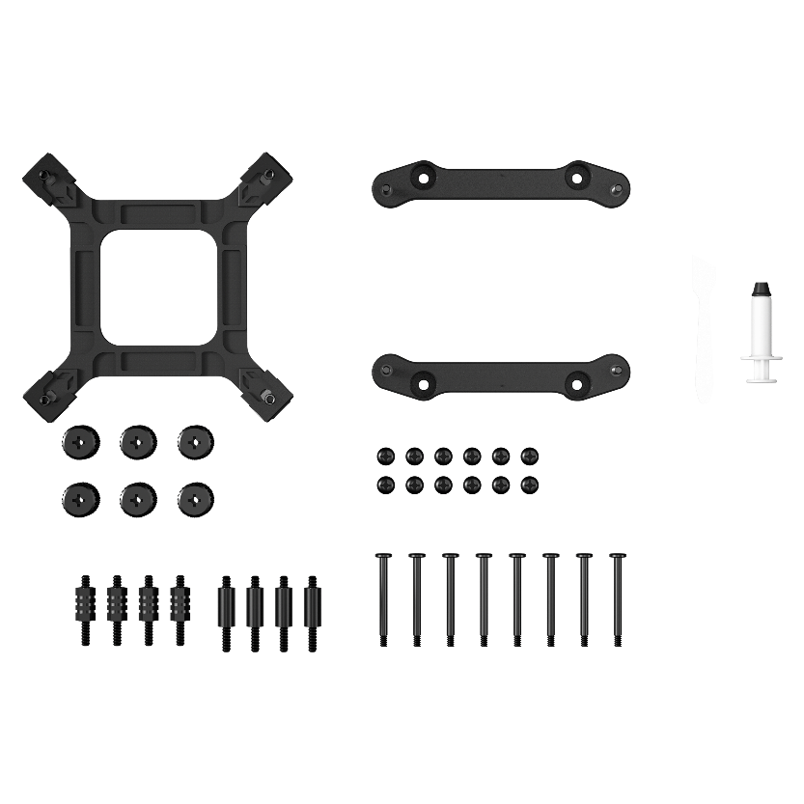
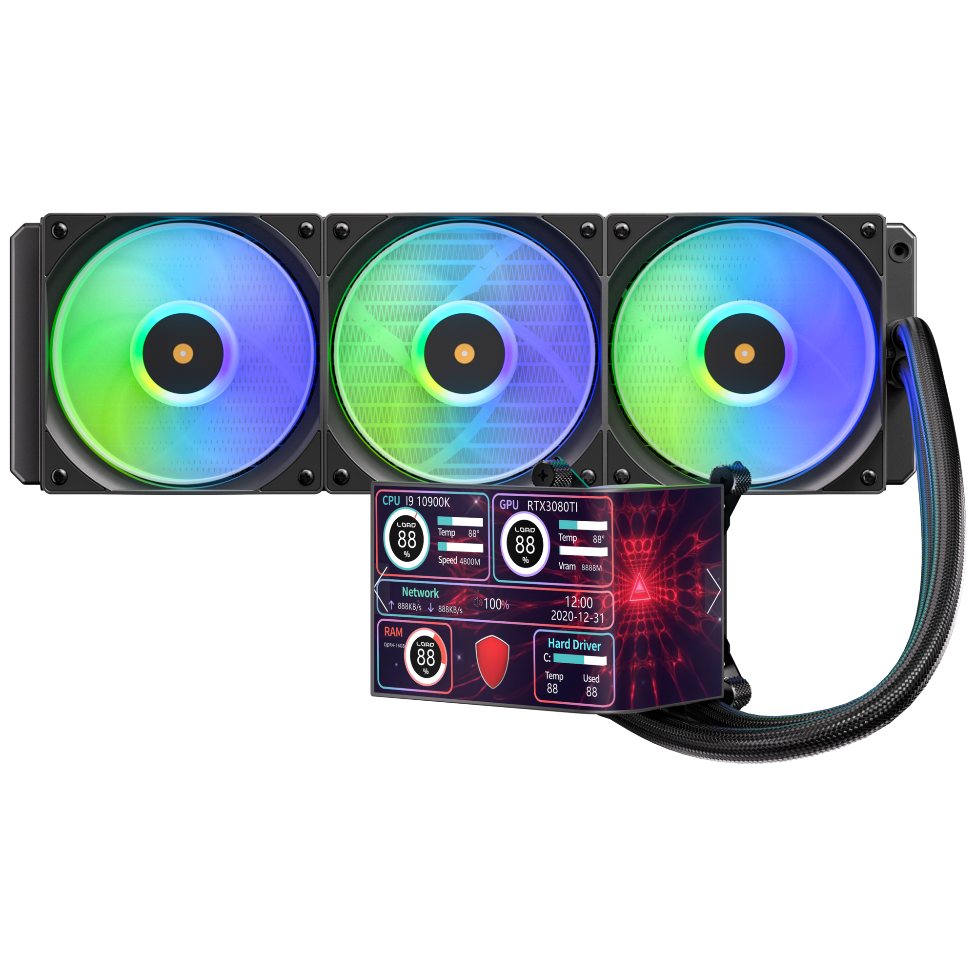
Third Generation Pump
In order to match the latest top-level CPUs, we have developed a brand new pump based on the popular pump architecture. It has the ultimate specifications of 2500 RPM
Socket compatibility | Intel: 1851 / 1700 / 1200 / 1150 / 1151 / 1155 AMD: AM5 / AM4
Pump speed (rpm) | 2500 ±10 rpm
Pump adjustable | 4.5V - 12V
Pump connector | 12V-4Pin PWM
Tube length (mm) | 450 mm
Noise level | ≤30dB(A)

Slide 8
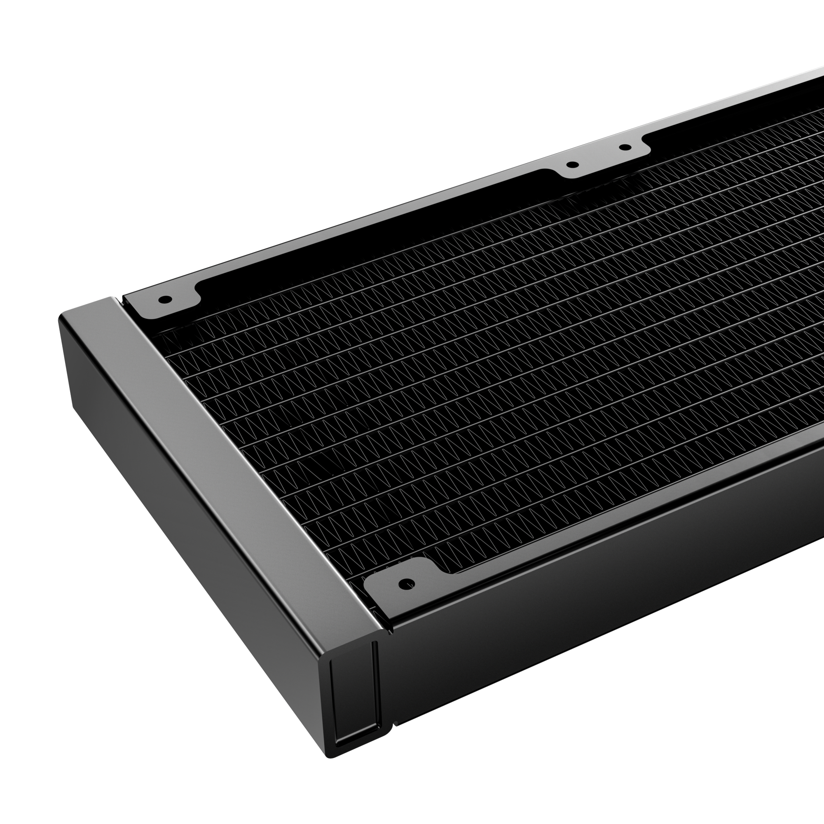
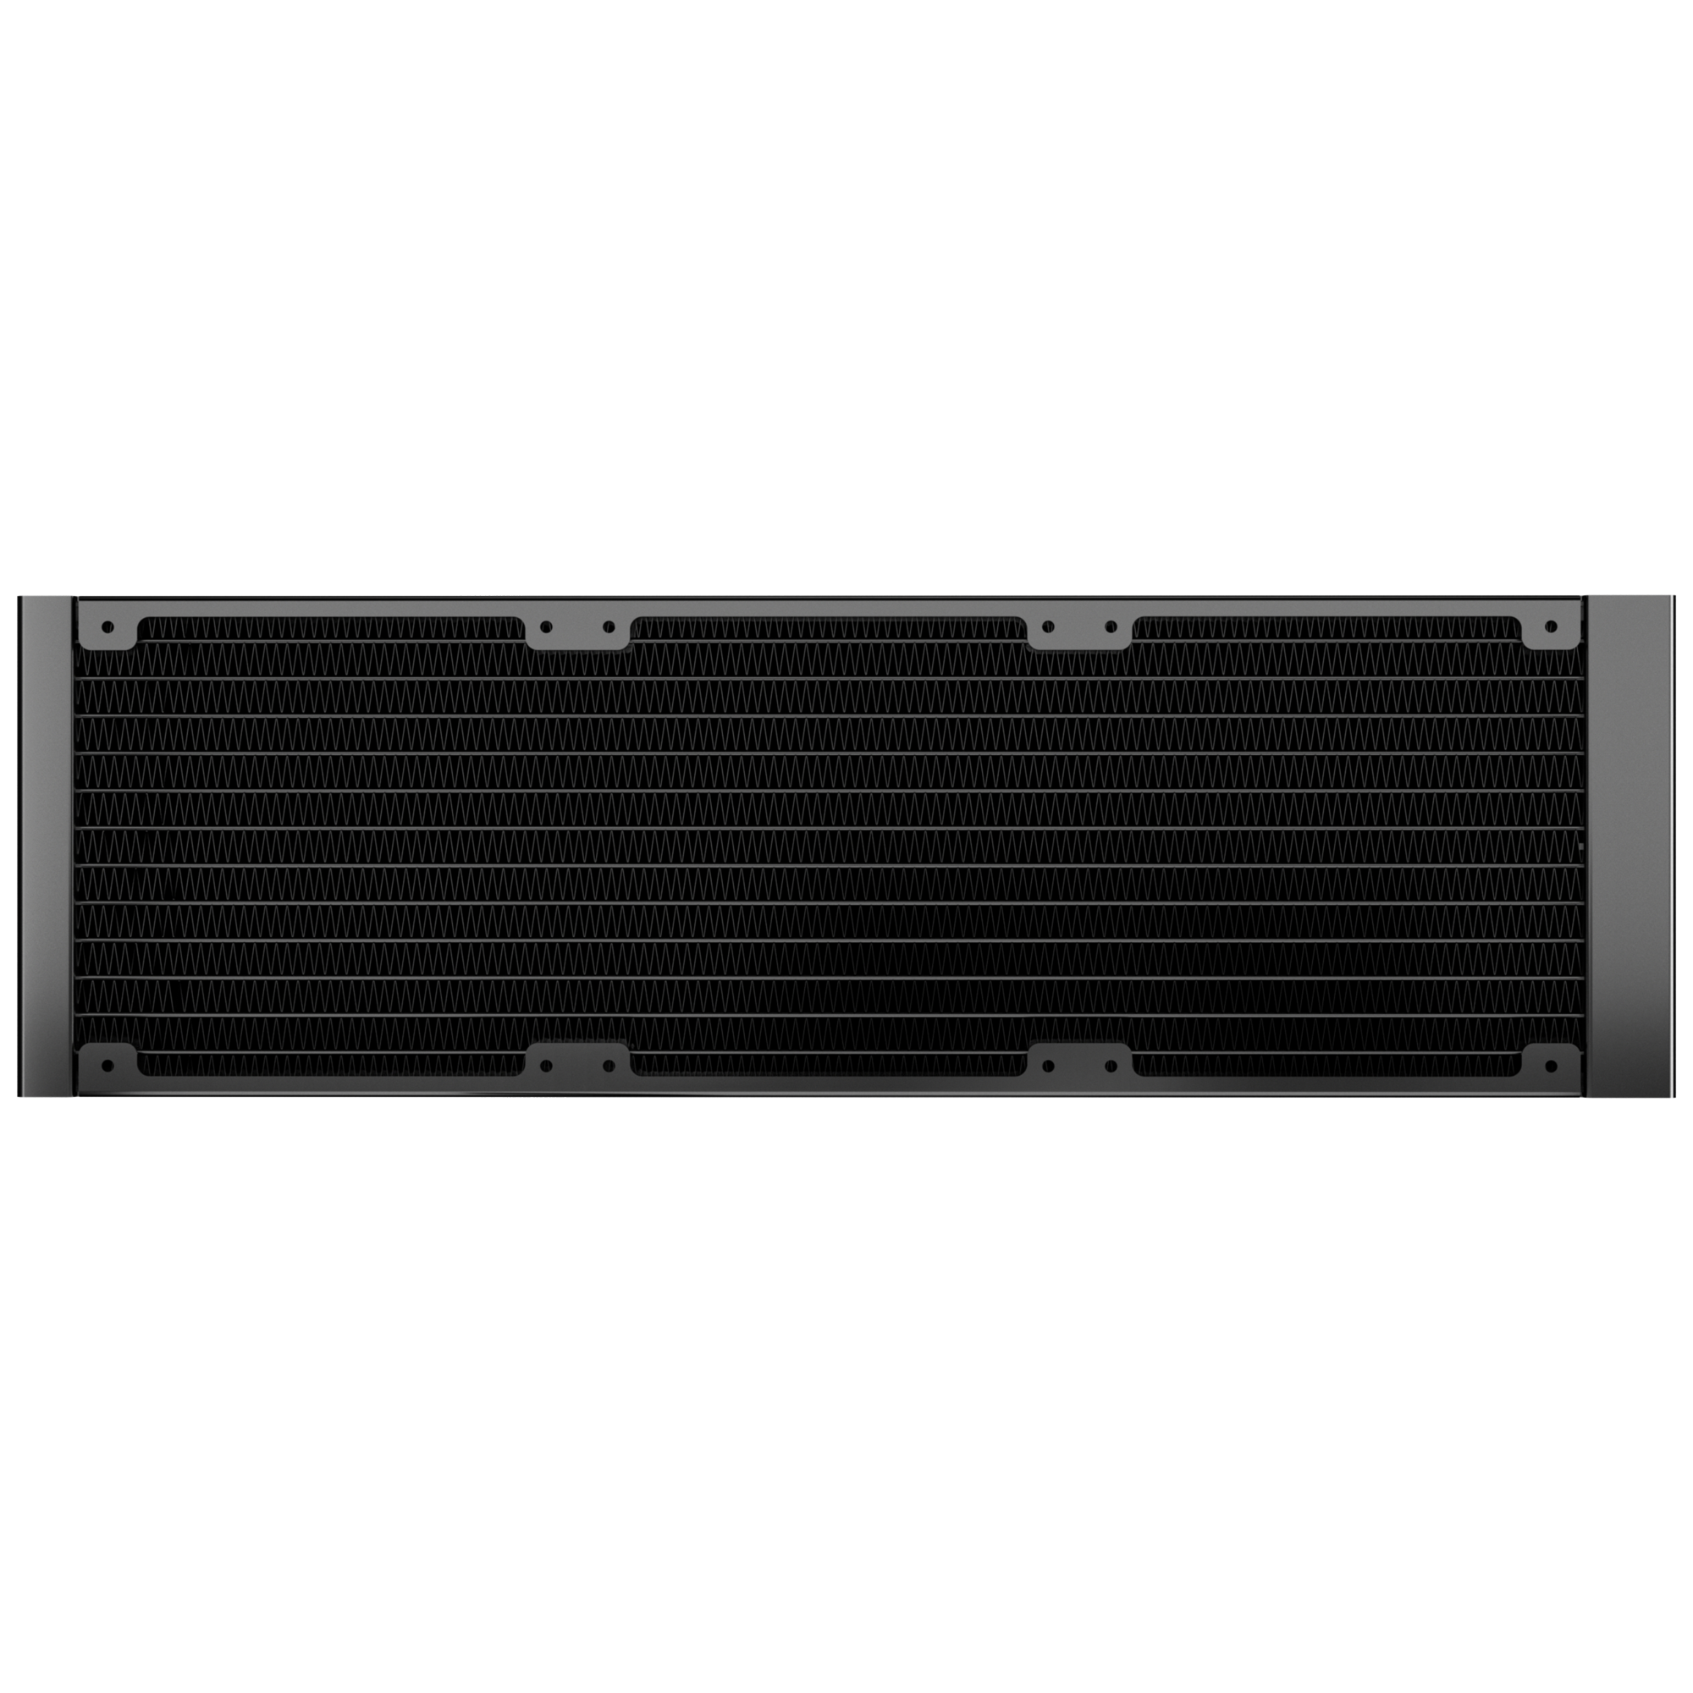
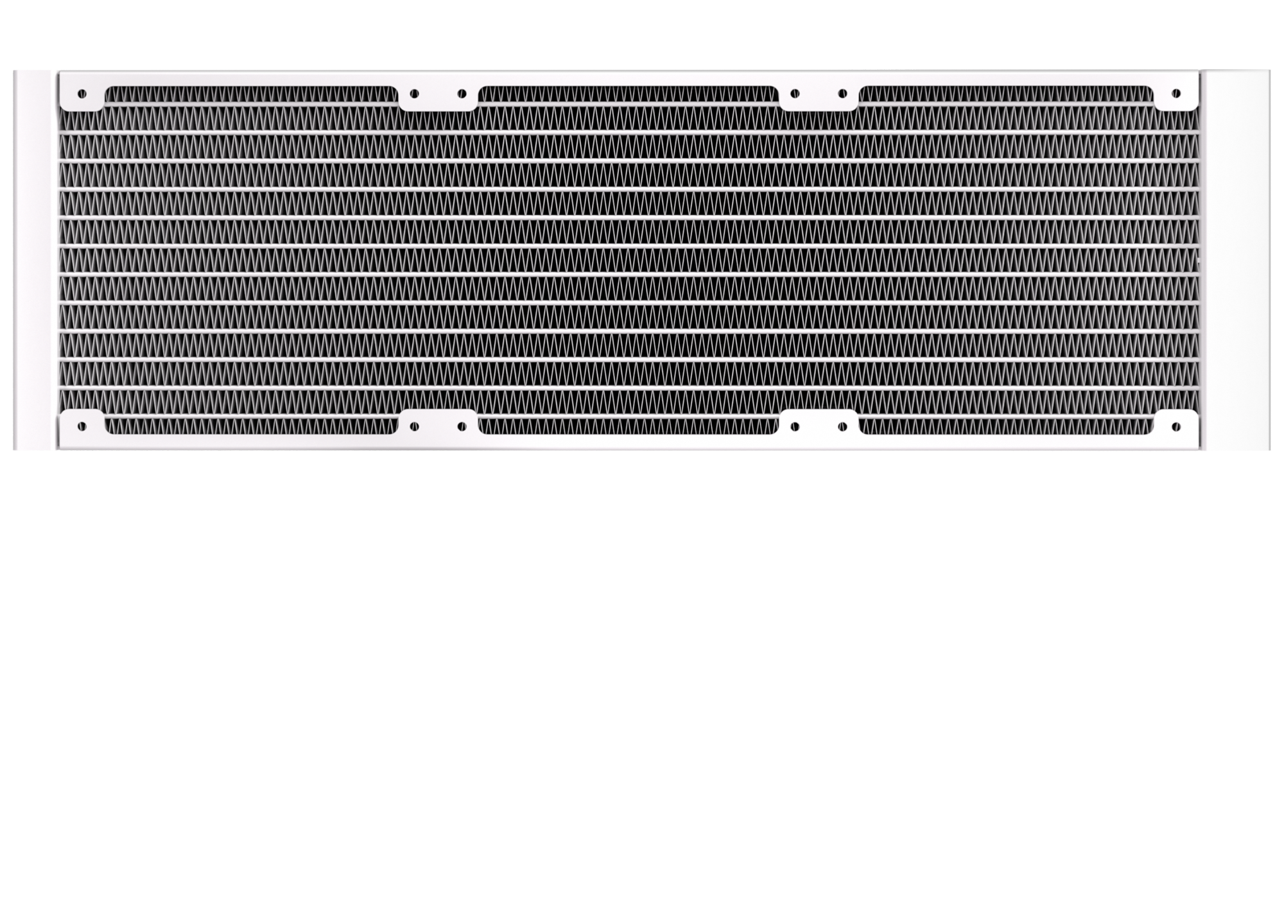
360mm
360 Radiator specifications
Dimensions (H x W x D), (mm) | 397 x 120 x 27
Radiator material / finish | aluminum / black or white spray painted
Base material | copper

Slide 9
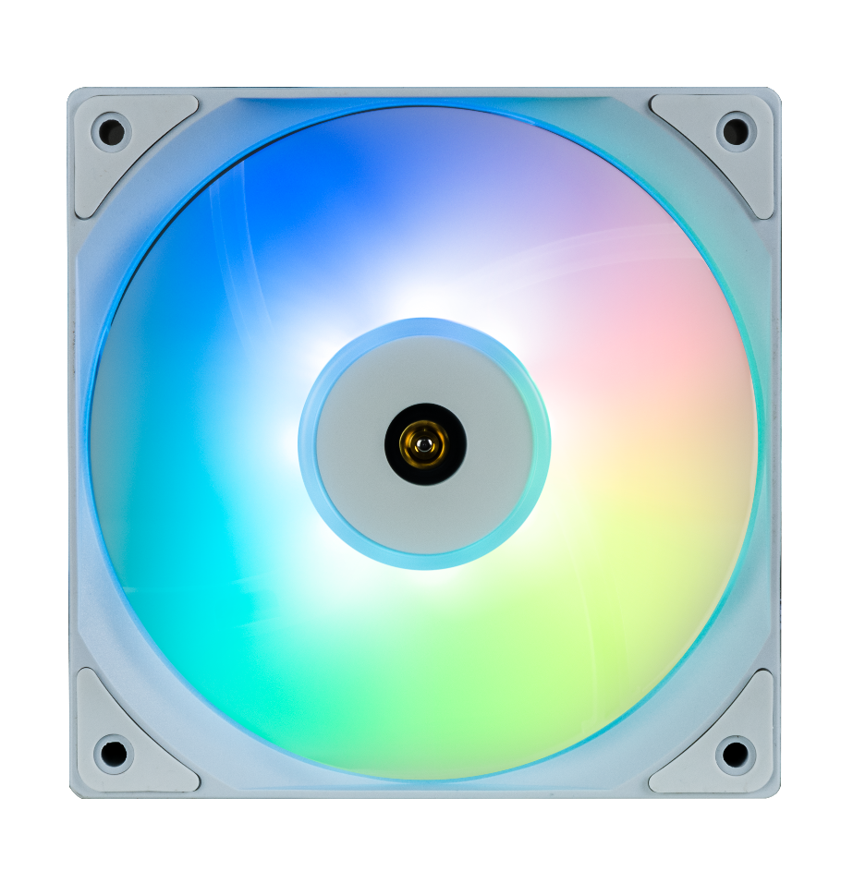
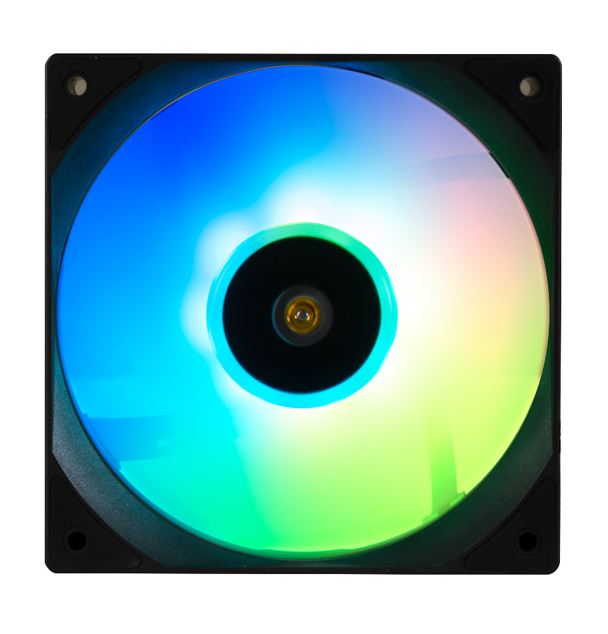
Fan SPEC
Fan model | ARGB 120mm PWM high-pressure Fan
Fan dimensions (mm) | 120 x 120 x 25
Speed @ 100% PWM (rpm) | 400-2200 ±10% RPM
Bearing technology | Hydraulic Bearing
Rated Voltage (V) | 12V
Start Voltage (V) | ≤5V(Power ON/OFF)
Rated current (A) | 0.2A / LED:0.30A
Power consumption (W) | 2.28W
Connector | 4-pin PWM
Max. air flow | 68CFM
Air Pressure | 2.2MM-H2O
Noise | ≤27 dB
Extension Cble length | 400+200 mm

Slide 10
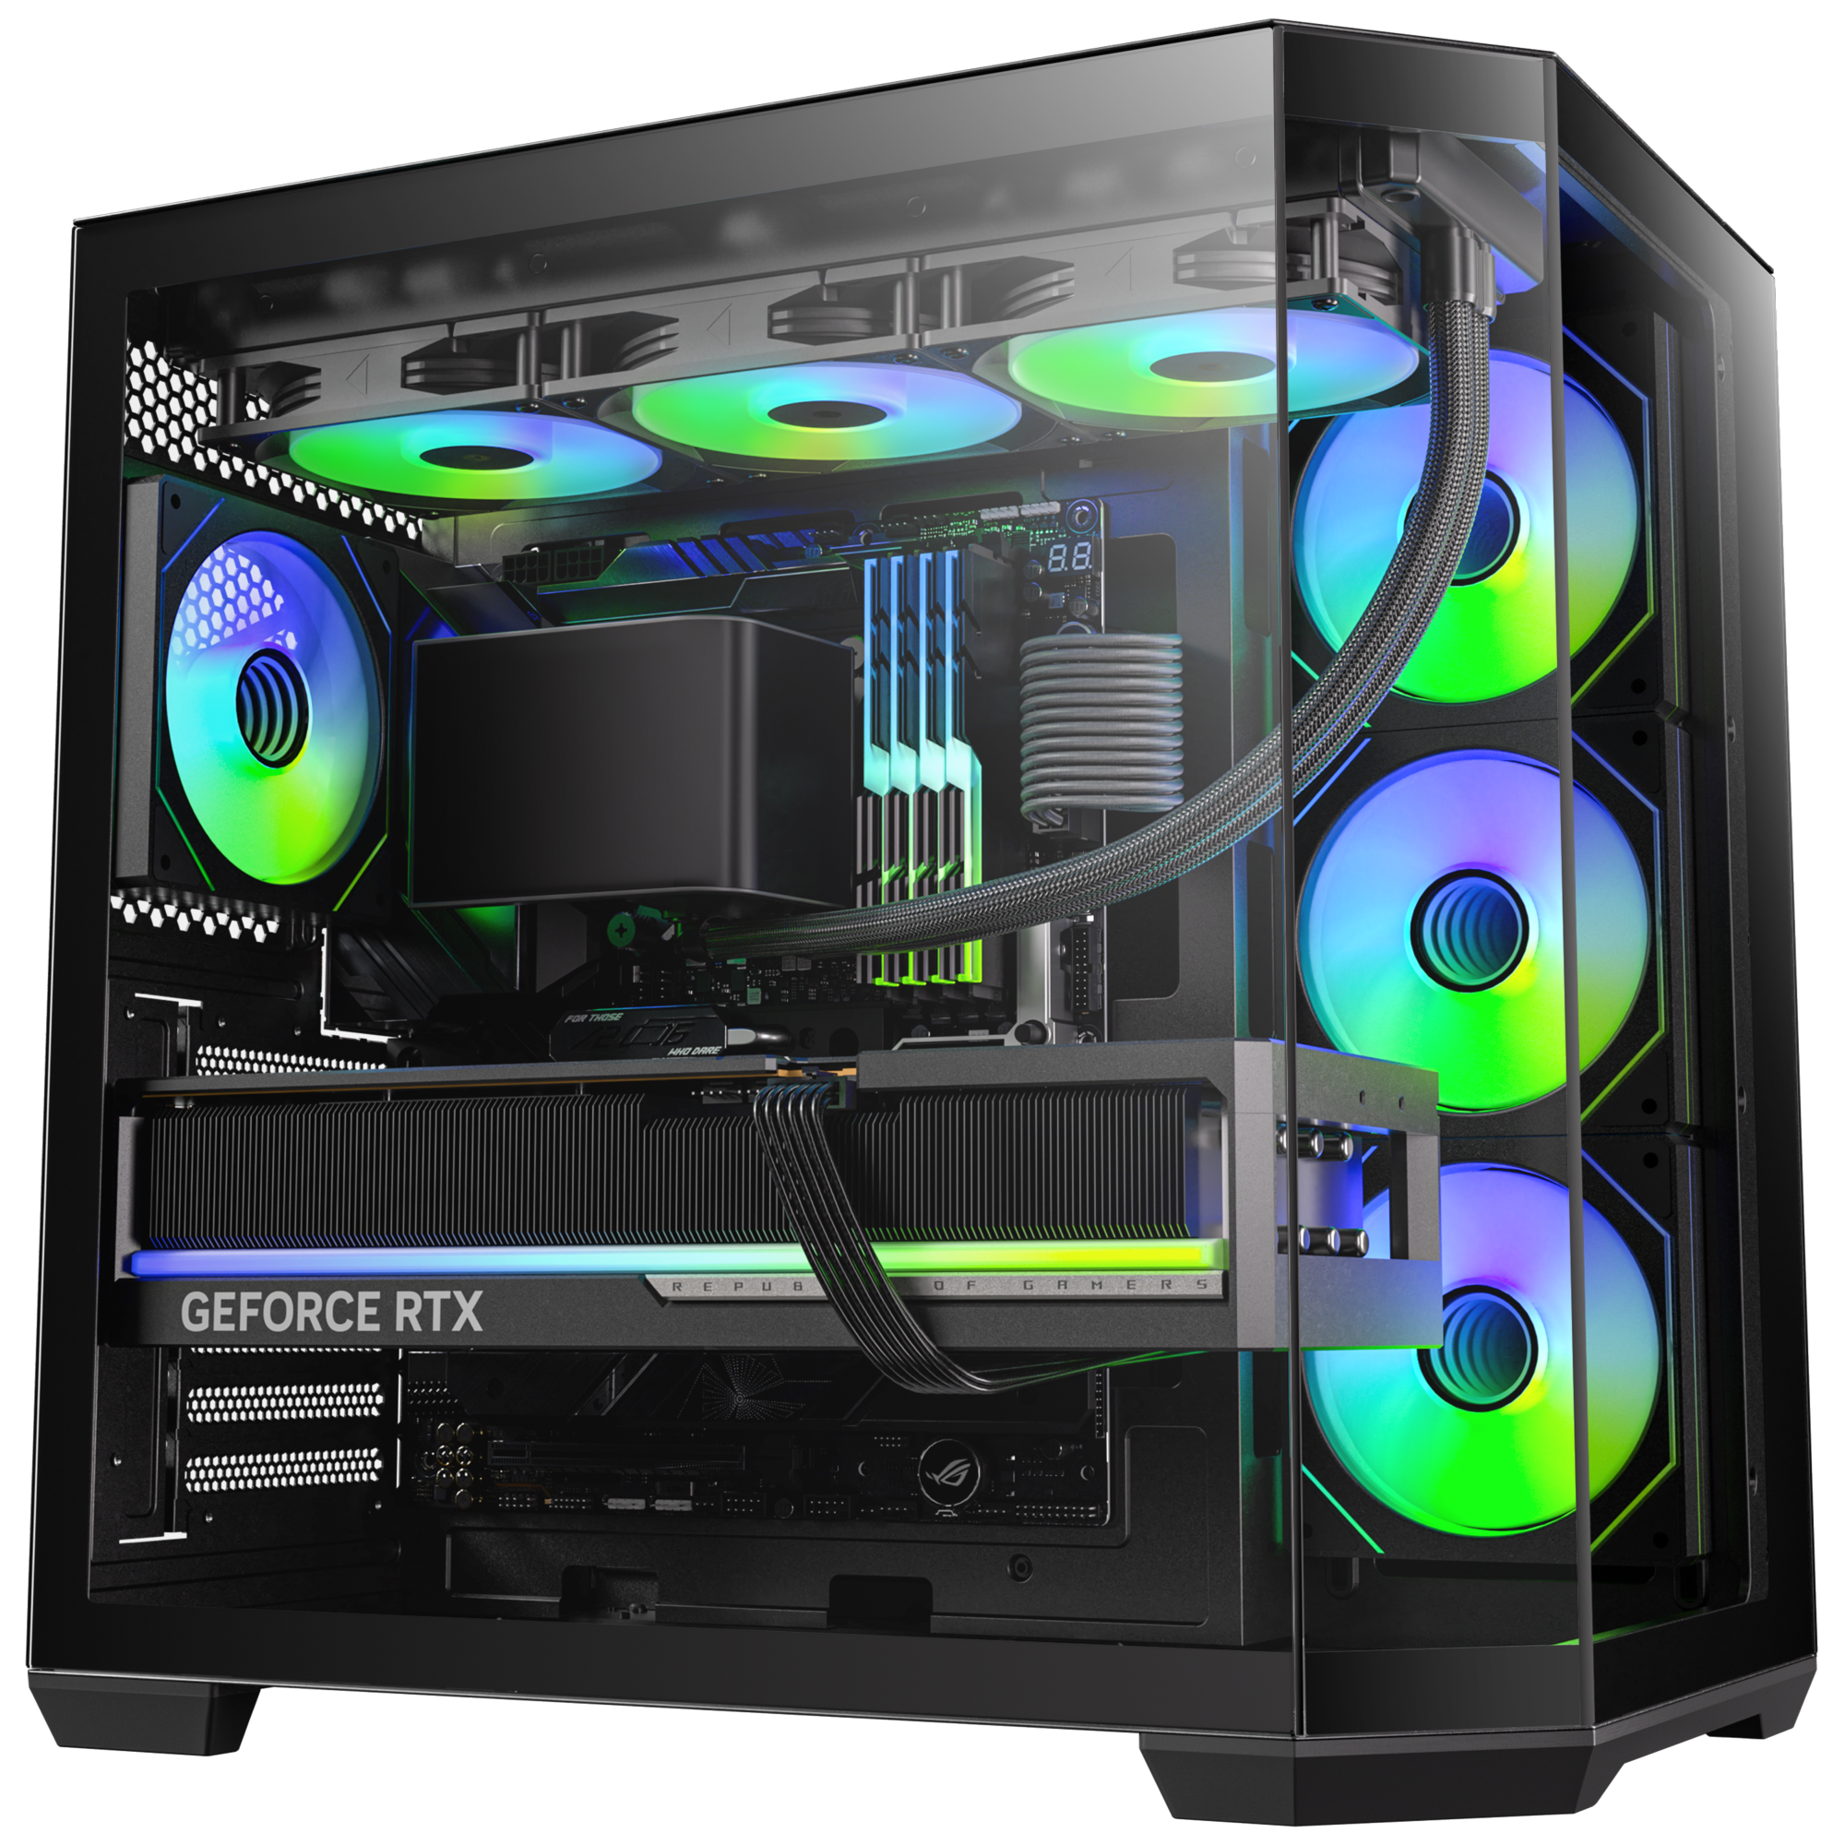
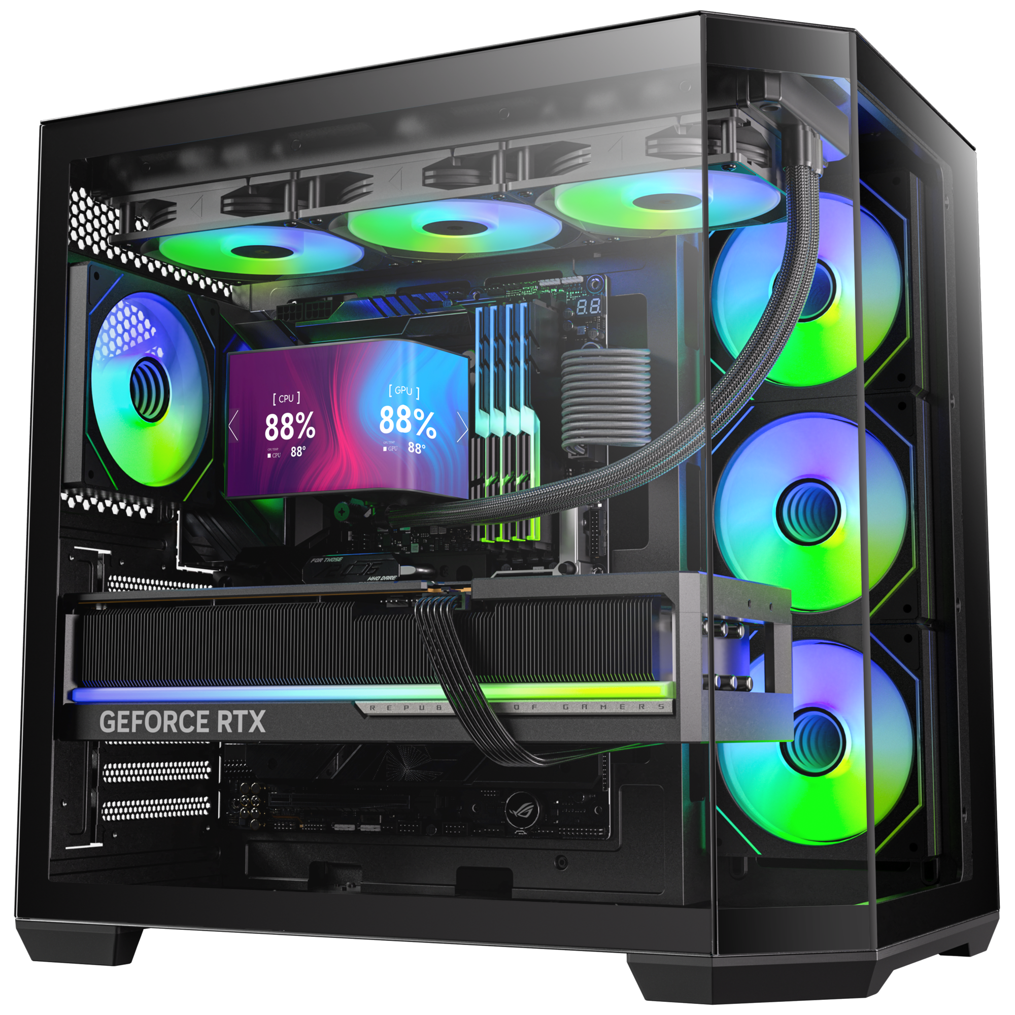
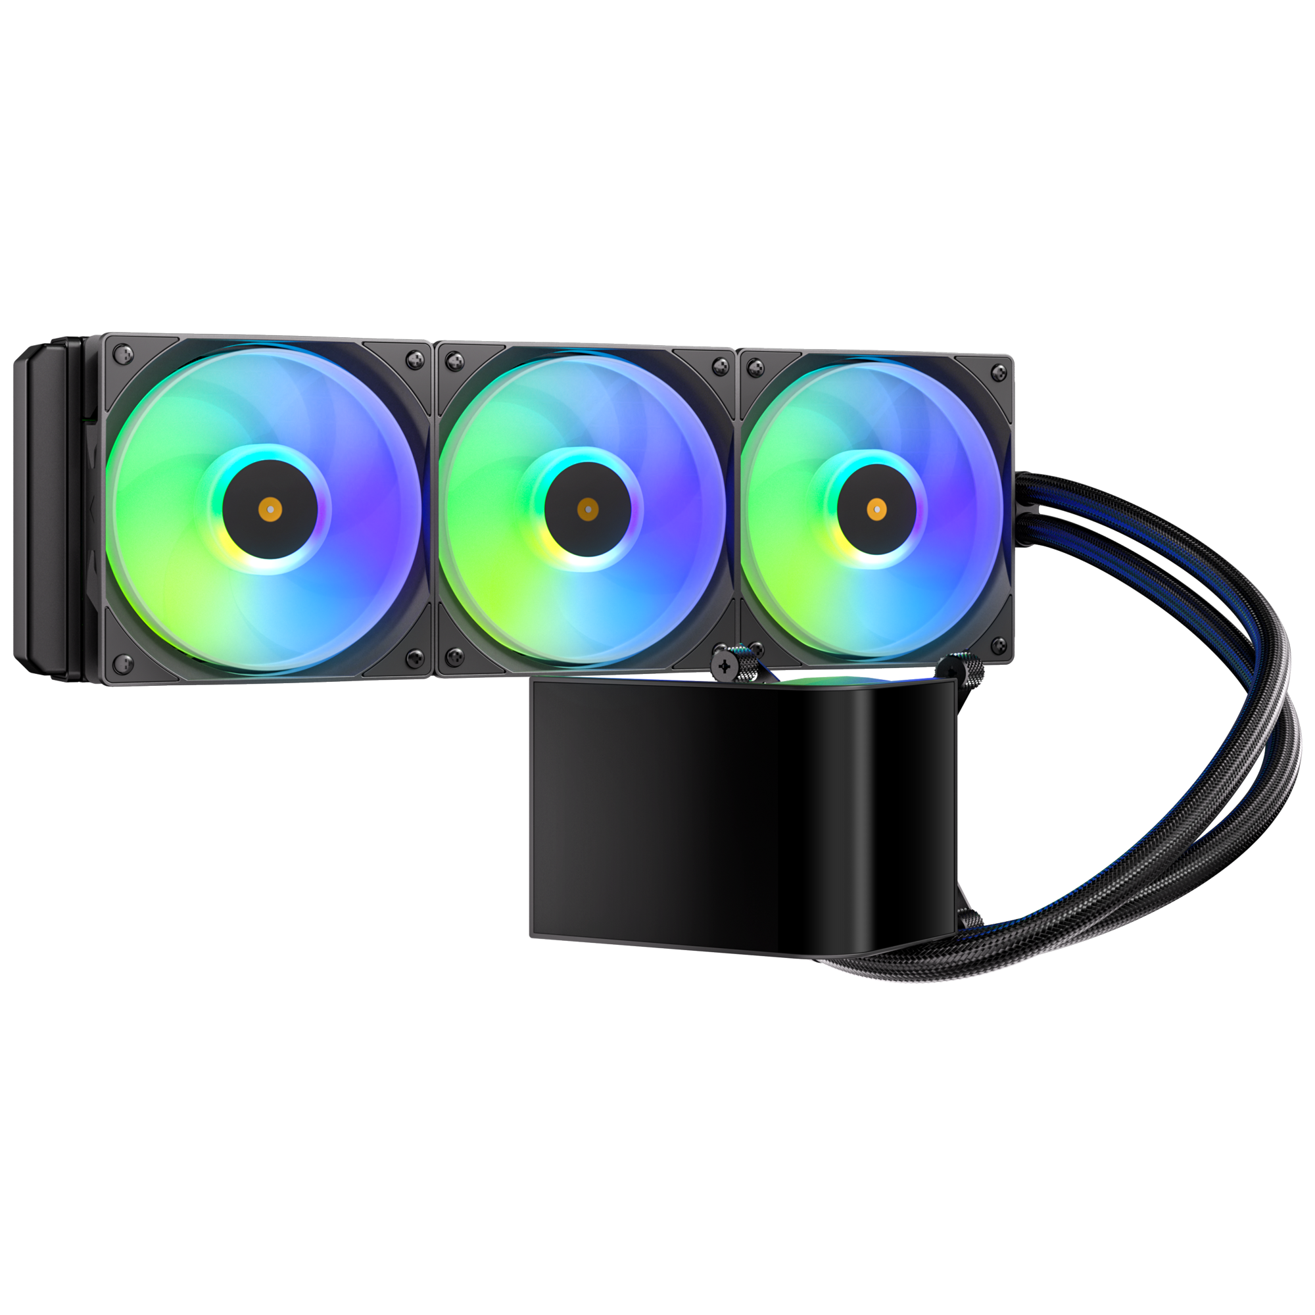
M7
All-In-One
LIQUID COOLER
M7 360 - Black
Part Number | BFW-M7-360-KK27A-RP
EAN / UPC | 4712883213458 / 886027010358

