Slide 1


Slide 2
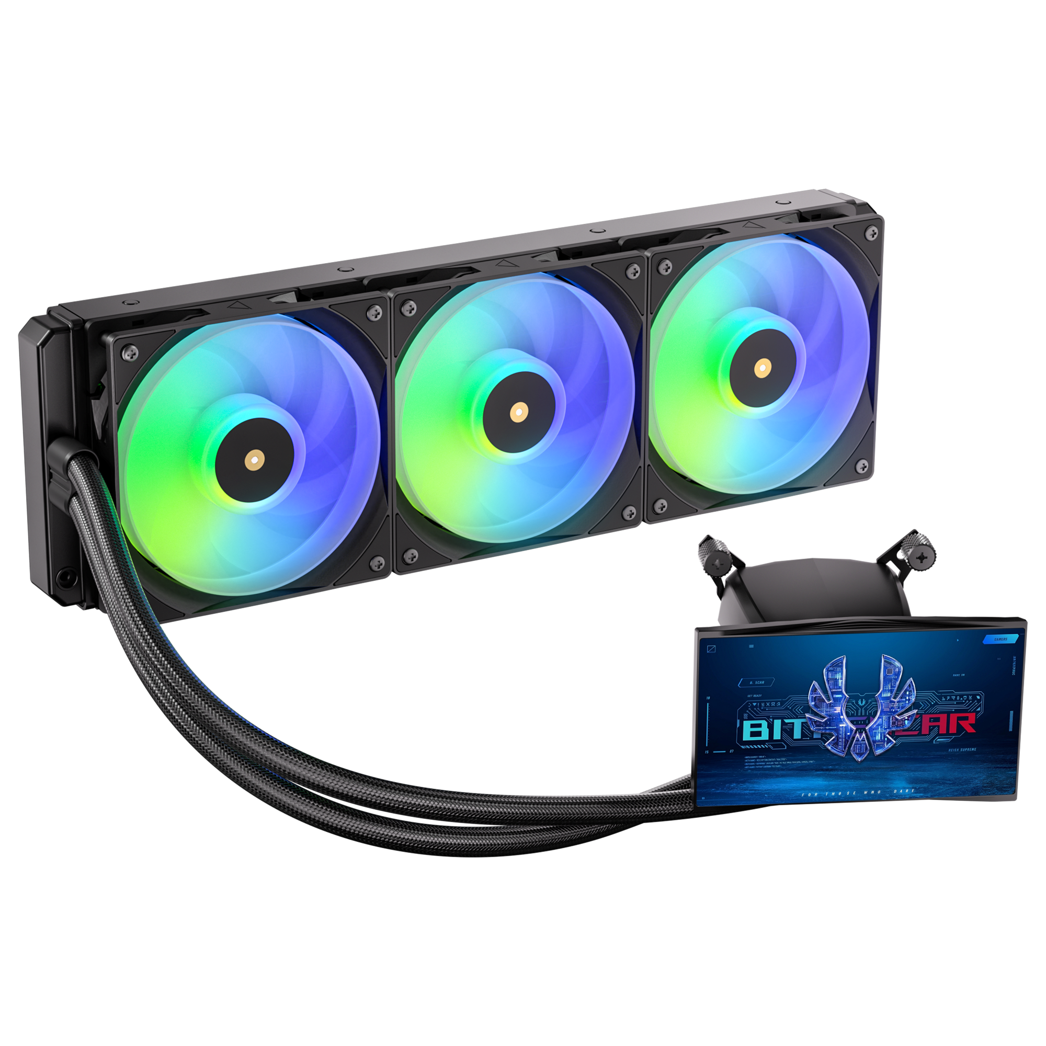

M5 – High-Performance Liquid Cooler with Auxiliary Display Pair high-efficiency cooling with endless personalizatio
The M5 combines a reliable Gen 4 pump and high-static-pressure fans for exceptional thermal management. Highlighting the system is a 5-inch display that operates natively through Windows without proprietary software, granting users full creative control over their visual setup.
Support Motherboard-Brand Lighting Synchronization: Asus/Gigabyte/MSI/ASRock/Biostar...and other brands can support.

Slide 3
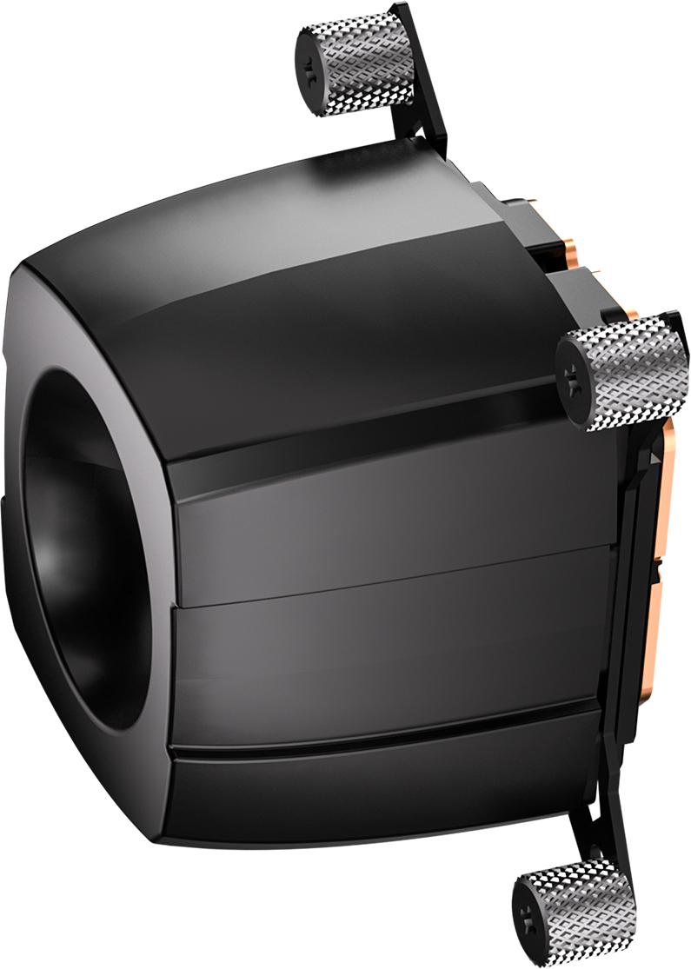
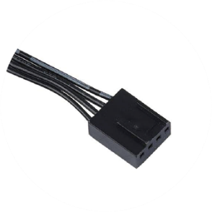
Introducing Water Block Connector Cables
PUMP Header
Connects to the motherboard's pump/fan/extension cable Y-header
FAN Header
Connected to the CPU FAN connector on the motherboard

Slide 4
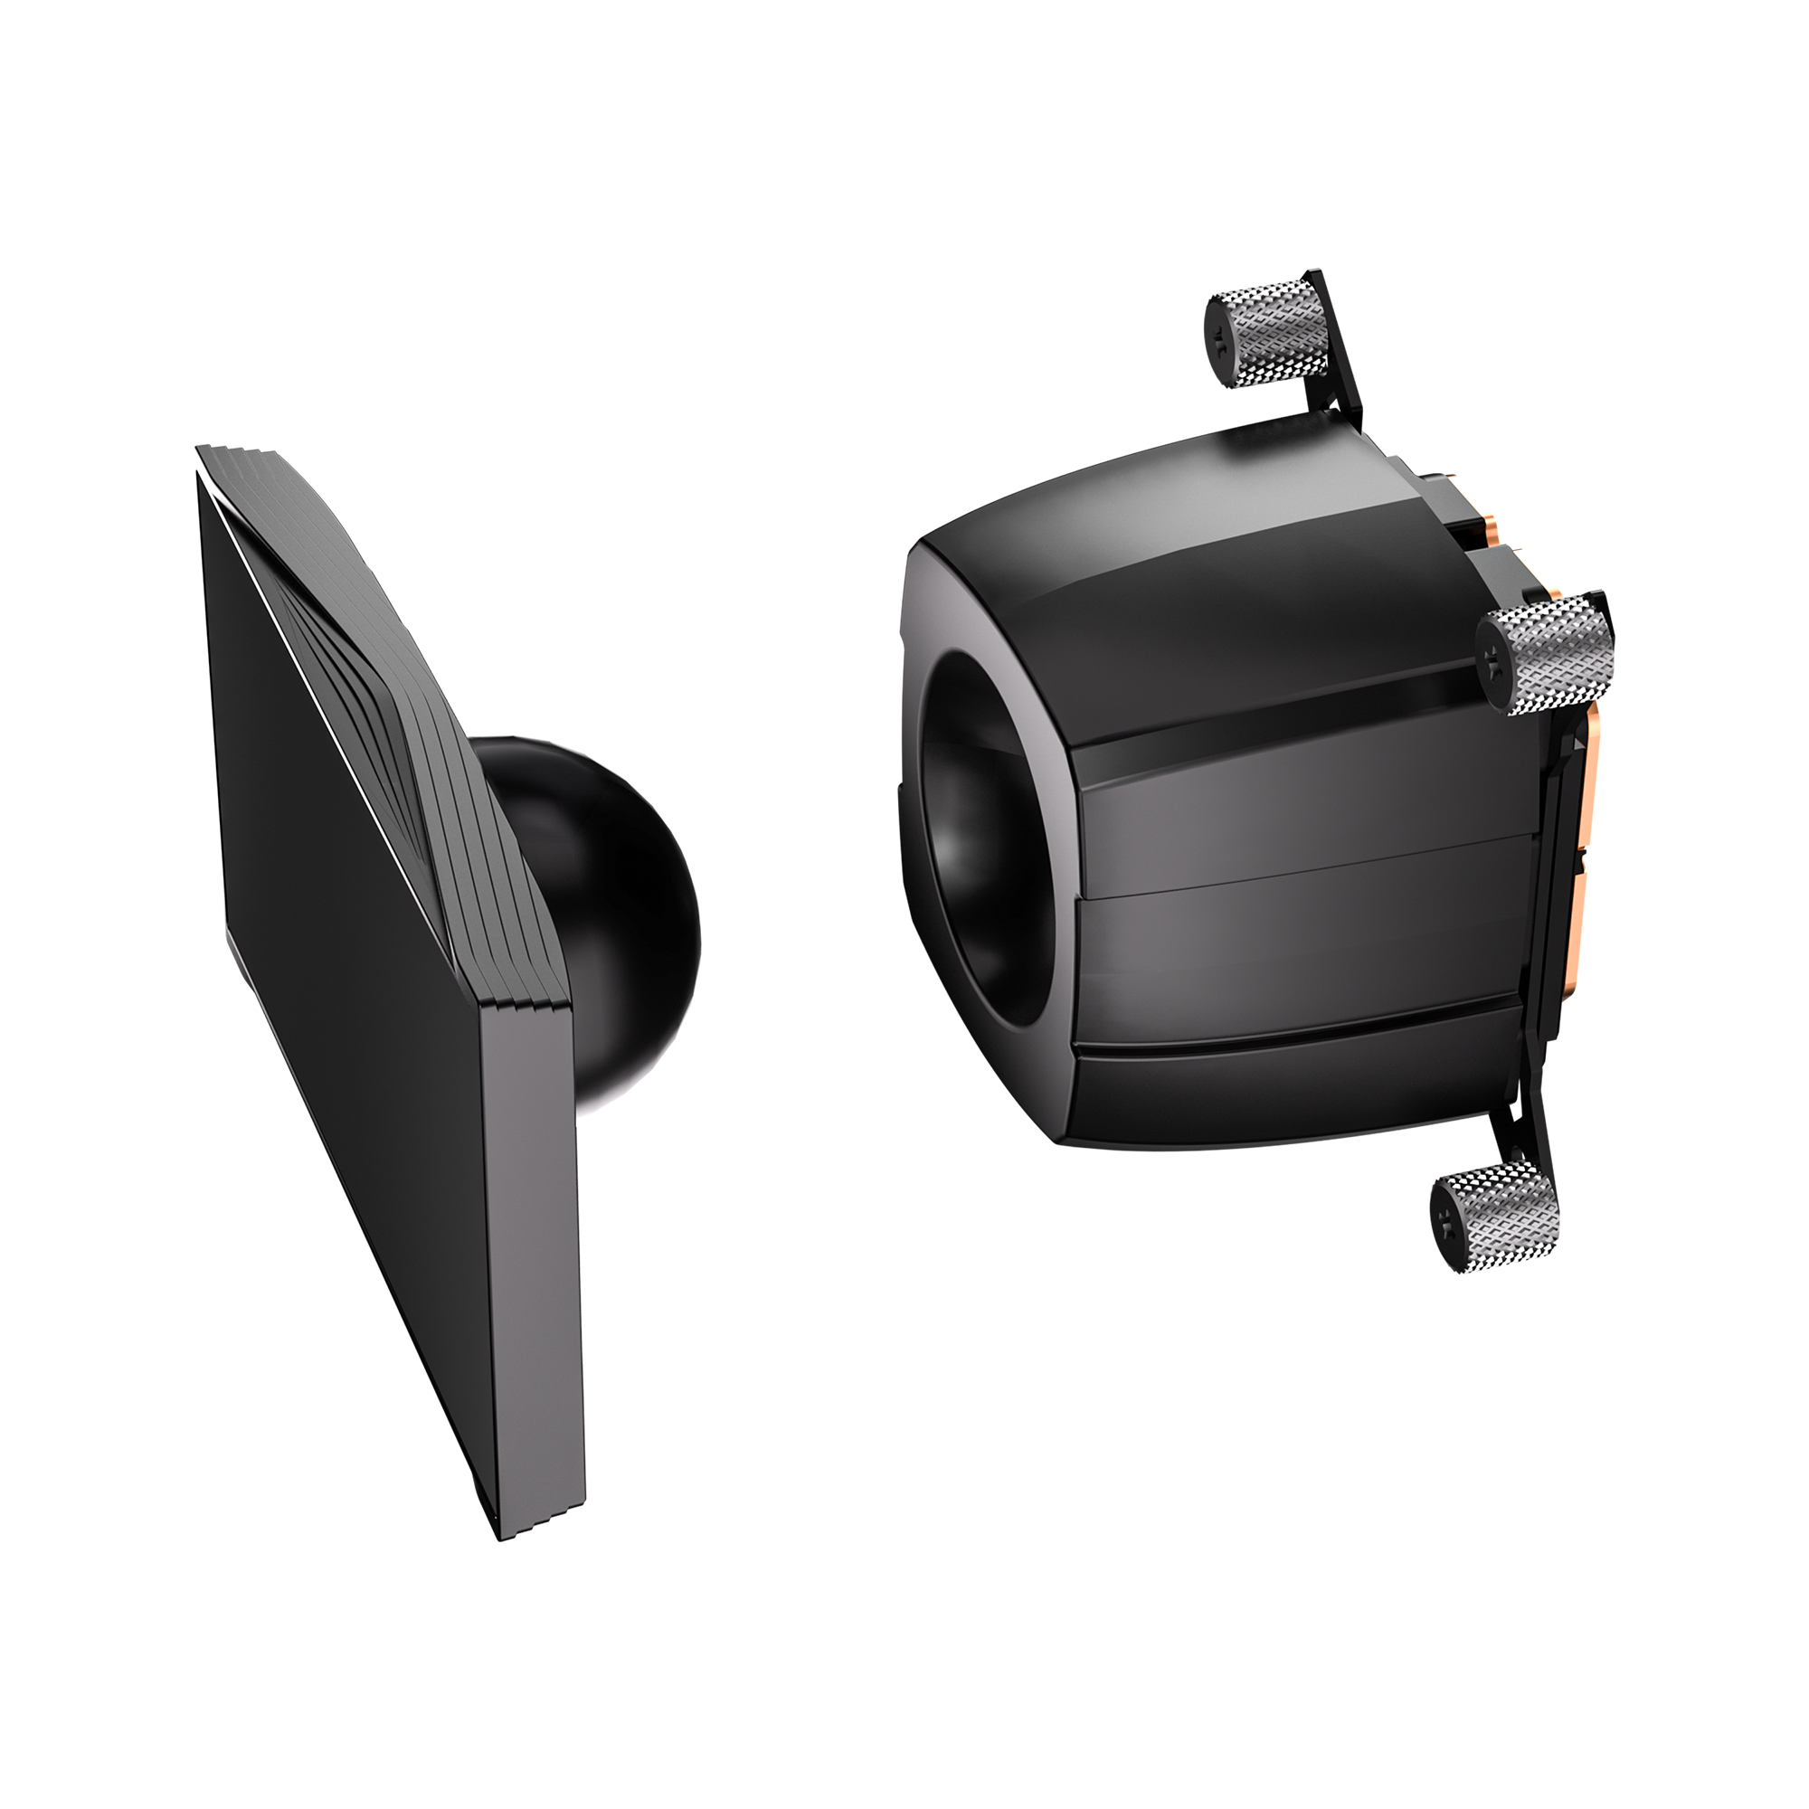
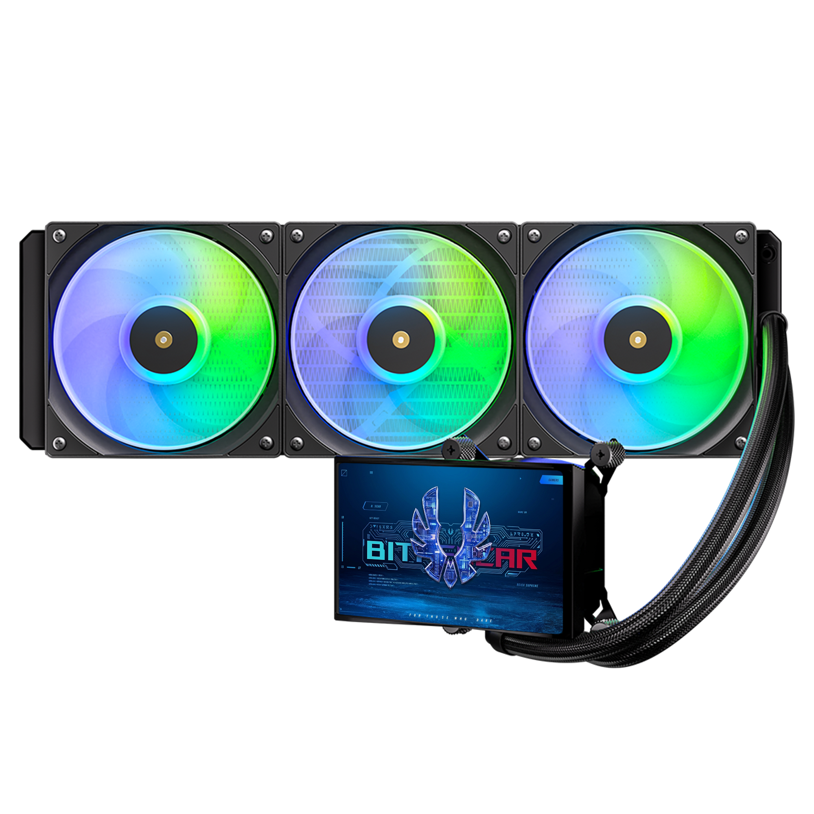
CHARACTERISTICS
Feature | Spec
Size | 5 inch
Resolution | 1280*720
Interface | MIPI
Connect type | Connector
Color Depth | 16.7M
Technology type | a-Si
Pixel pitch (mm) | -
Pixel Configuration | R.G.B. Vertical Stripe
Display Mode | Normally Black
LCD Driver IC | FL7703
Viewing Direction | All
Gray Scale Inversion Direction | -
MECHANICAL
Feature | Spec
LCM (W x H x T) (mm) | 64.70*118.80*1.51
TP Active Area(mm) | 62.10*110.40
With /Without TSP | Without TSP
Weight (g) | TBD
LED Numbers | 10 LED

Slide 5
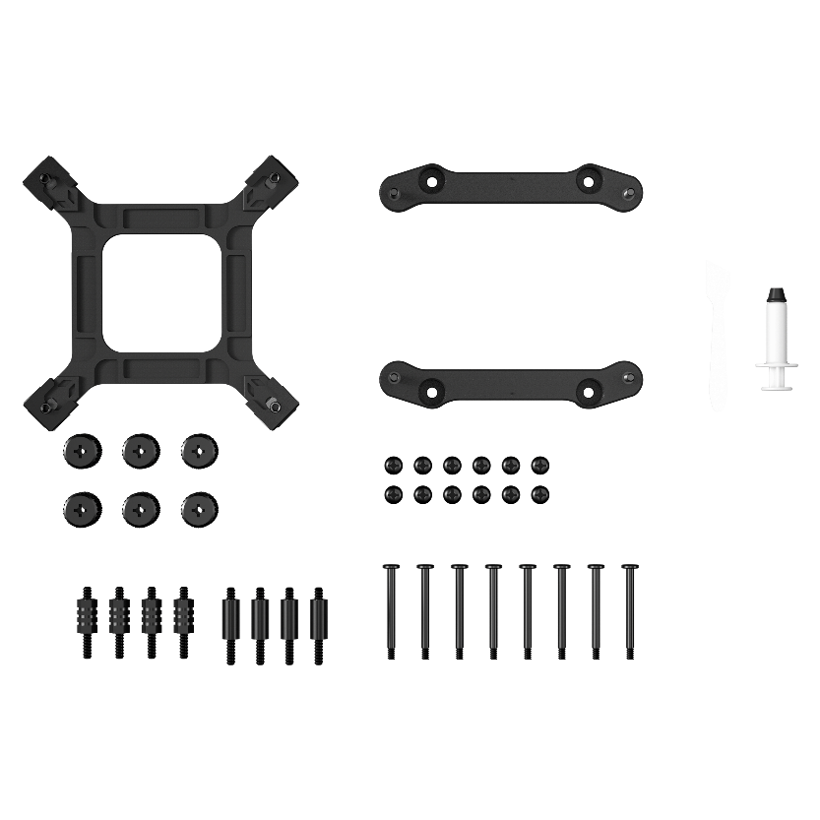
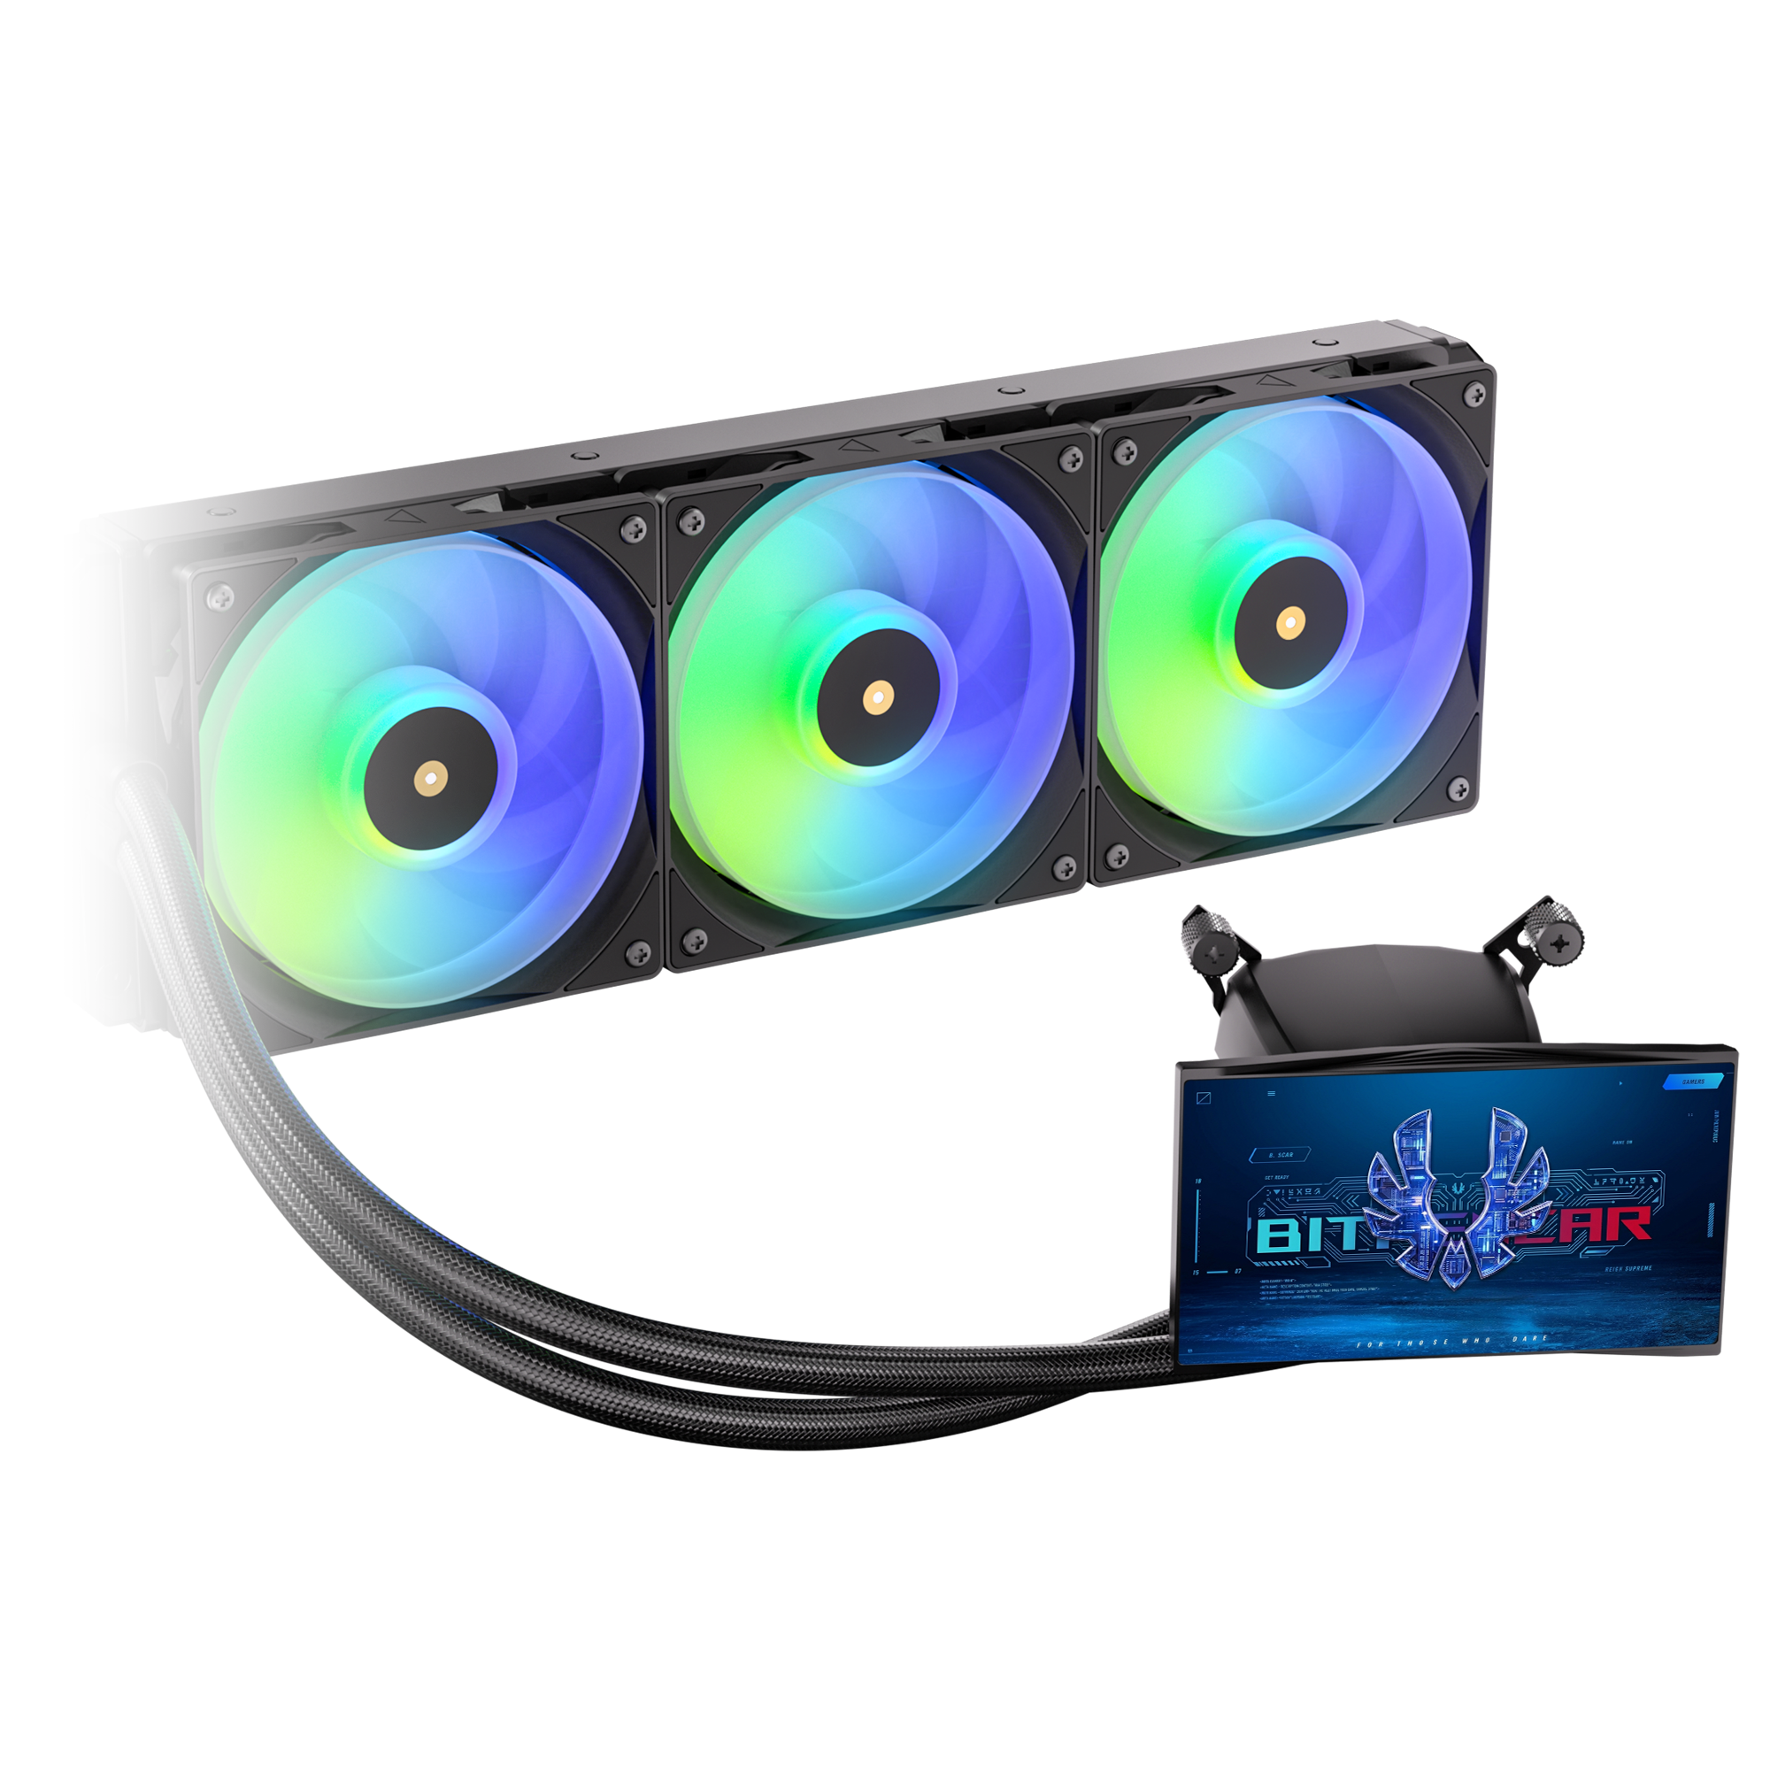
Third Generation Pump
In order to match the latest top-level CPUs, we have developed a brand new pump based on the popular pump architecture. It has the ultimate specifications of 2500 RPM
Socket compatibility | Intel: 1851 / 1700 / 1200 / 1150 / 1151 / 1155 AMD: AM5 / AM4
Pump speed (rpm) | 2500 ±10 rpm
Pump adjustable | 4.5V - 12V
Pump connector | 12V-4Pin PWM
Tube length (mm) | 450 mm
Noise level | ≤30dB(A)

Slide 6
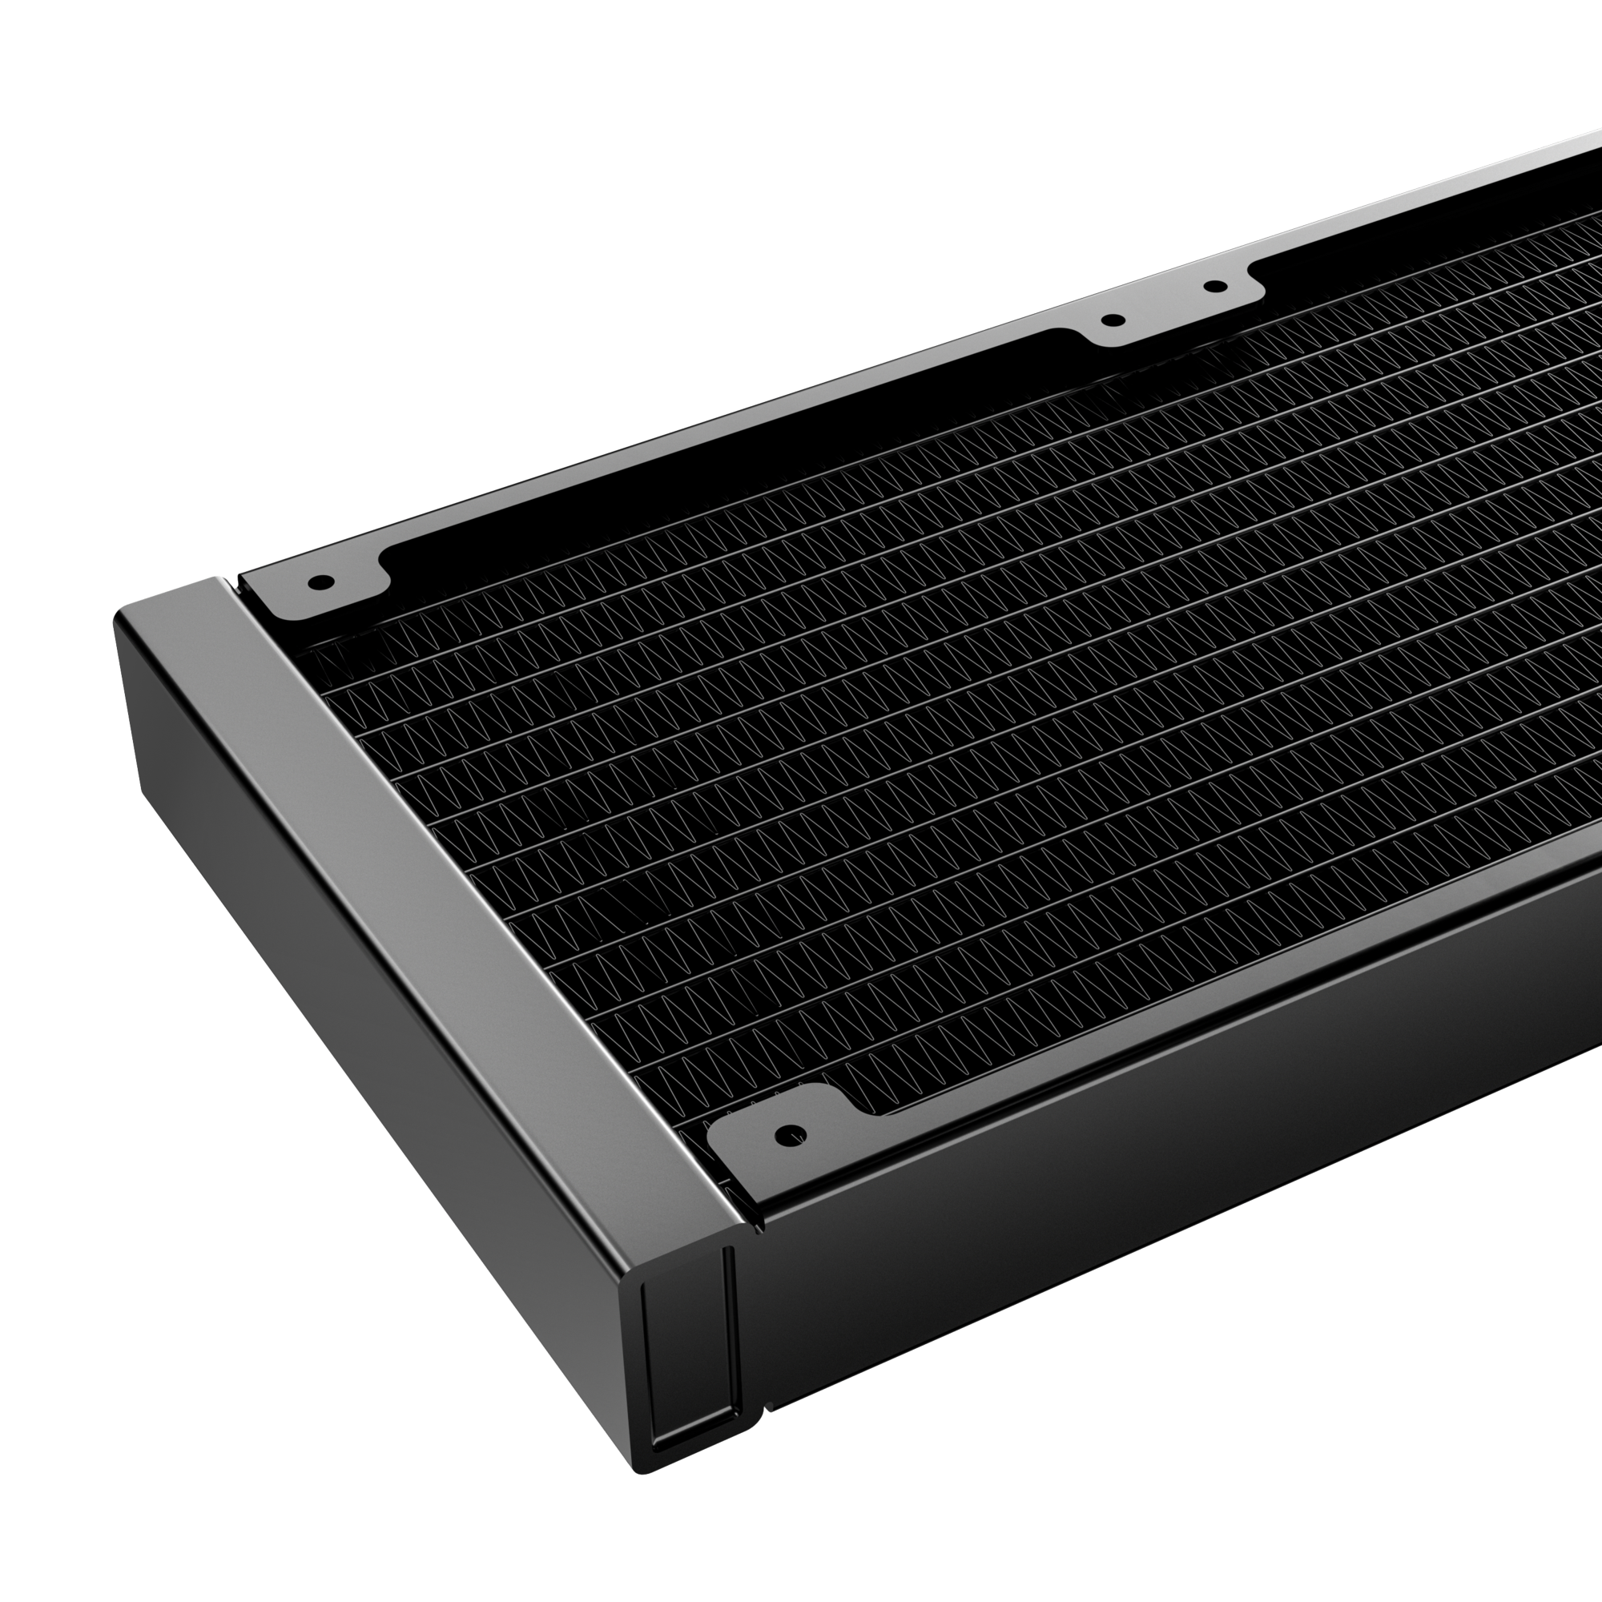
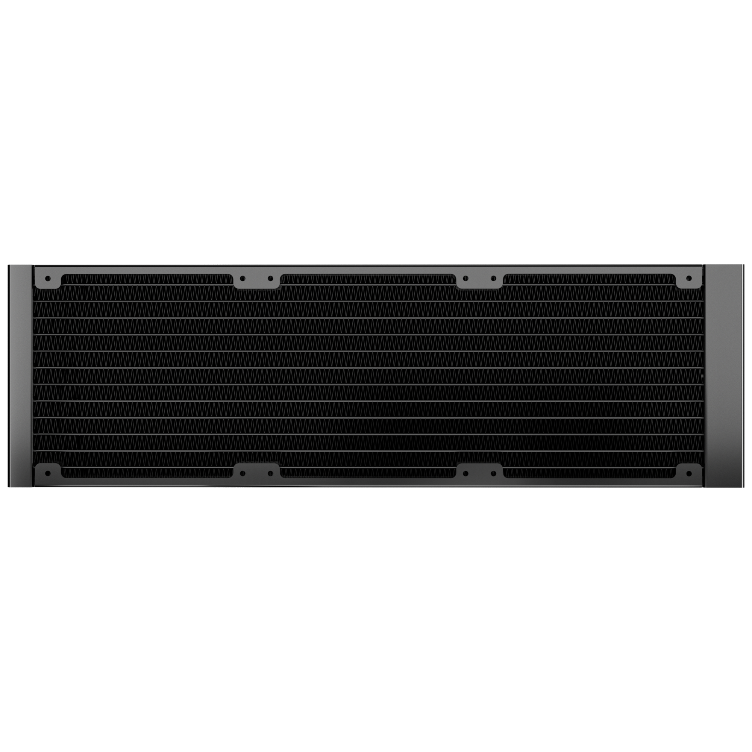
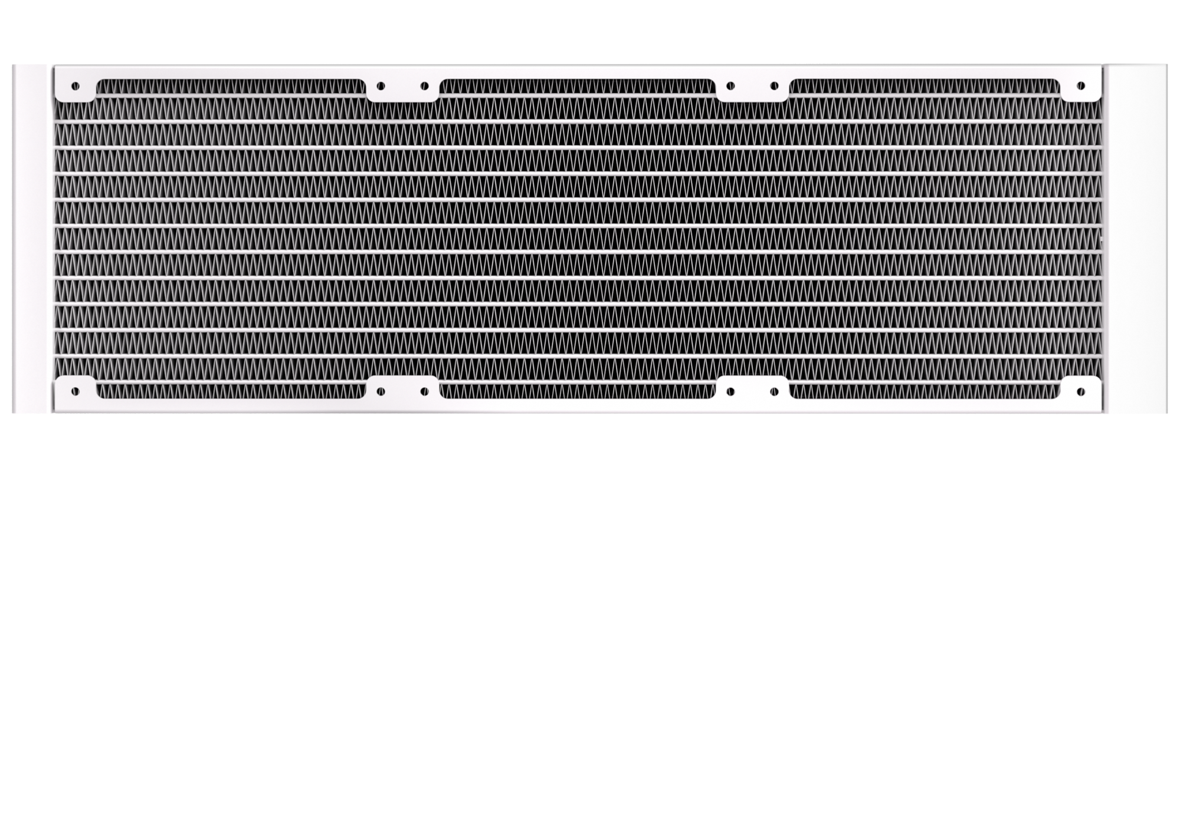
360mm
360 Radiator specifications
Dimensions (H x W x D), (mm) | 397 x 120 x 27
Radiator material / finish | aluminum / black or white spray painted
Base material | copper

Slide 7
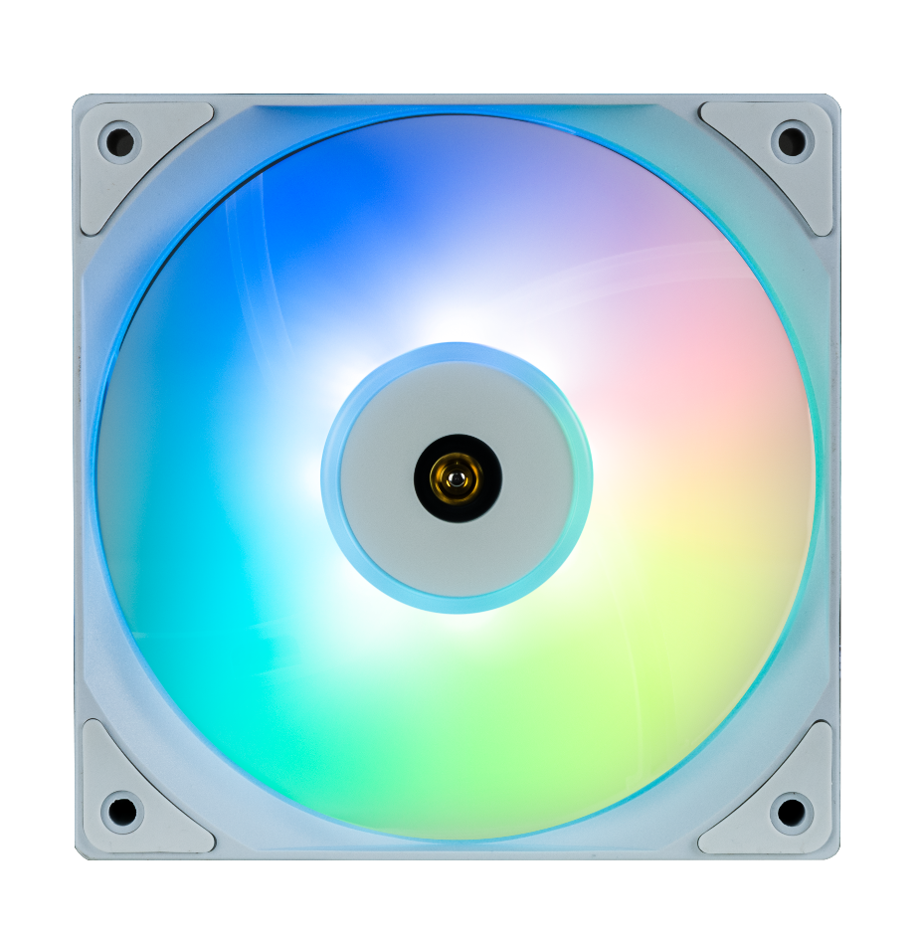

Fan SPEC
Fan model | ARGB 120mm PWM high-pressure Fan
Fan dimensions (mm) | 120 x 120 x 25
Speed @ 100% PWM (rpm) | 400-2200 ±10% RPM
Bearing technology | Hydraulic Bearing
Rated Voltage (V) | 12V
Start Voltage (V) | ≤5V(Power ON/OFF)
Rated current (A) | 0.2A / LED:0.30A
Power consumption (W) | 2.28W
Connector | 4-pin PWM
Max. air flow | 68CFM
Air Pressure | 2.2MM-H2O
Noise | ≤27 dB
Extension Cble length | 400+200 mm

Slide 8
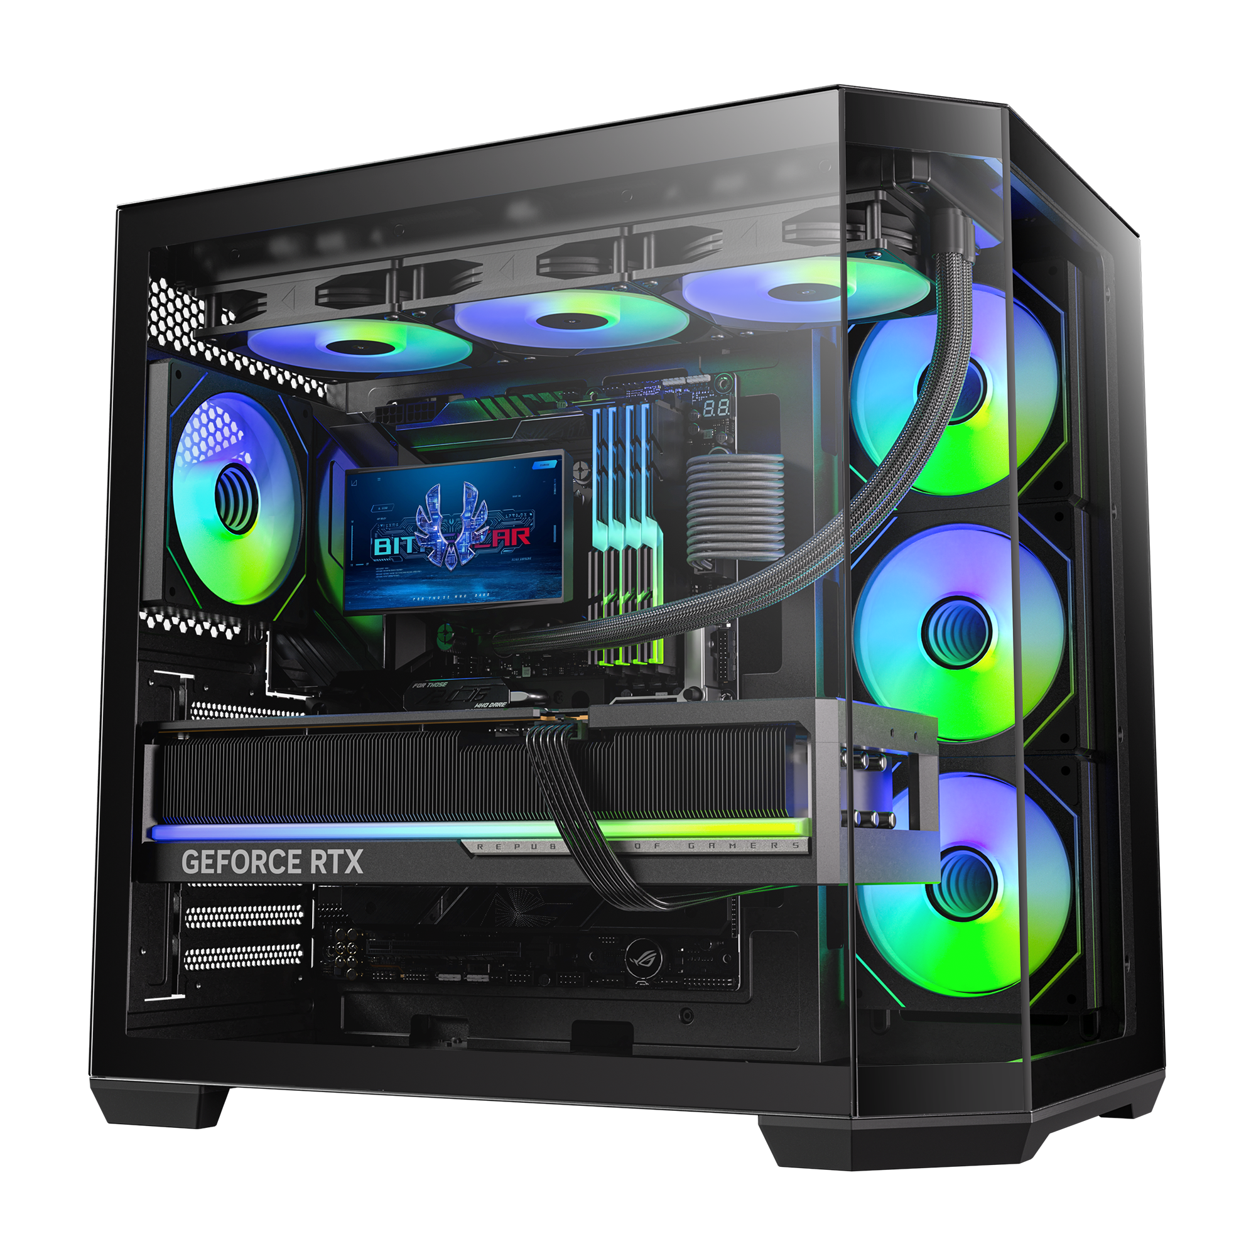
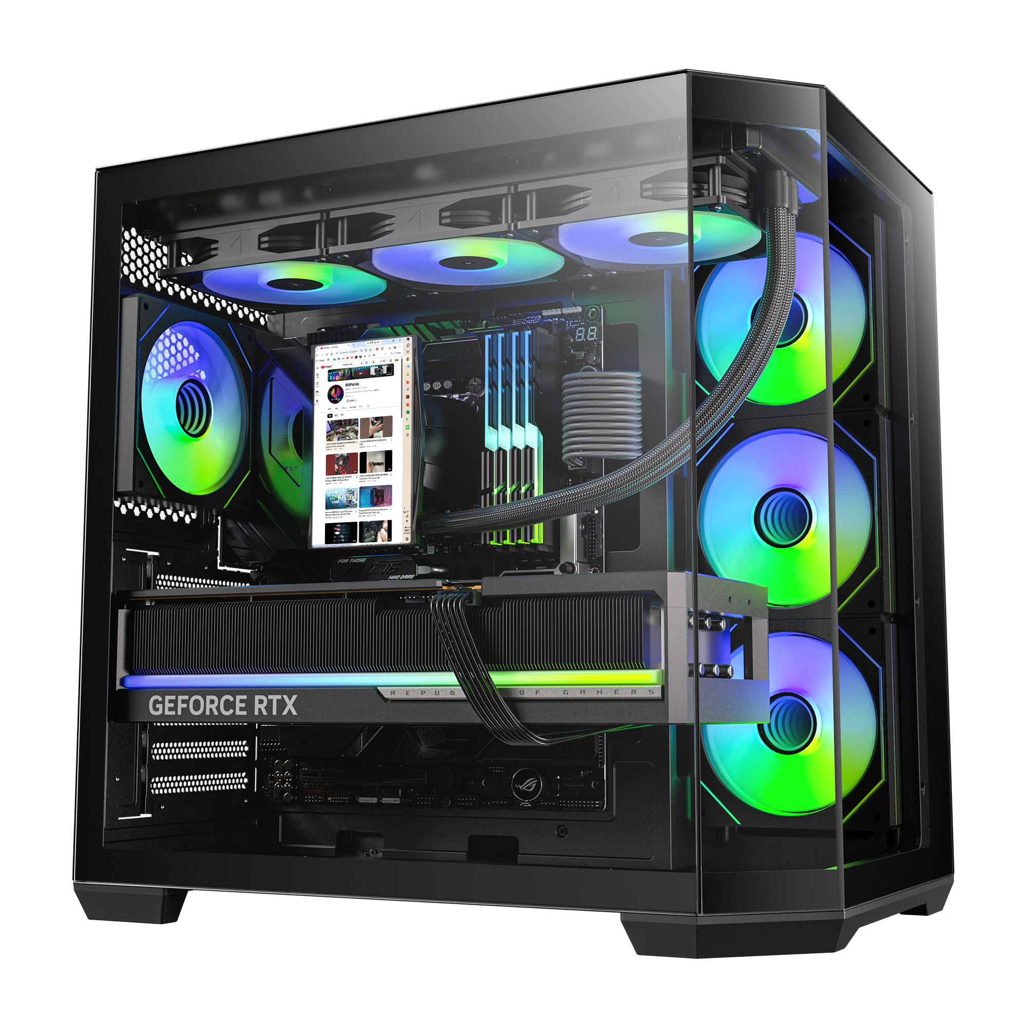
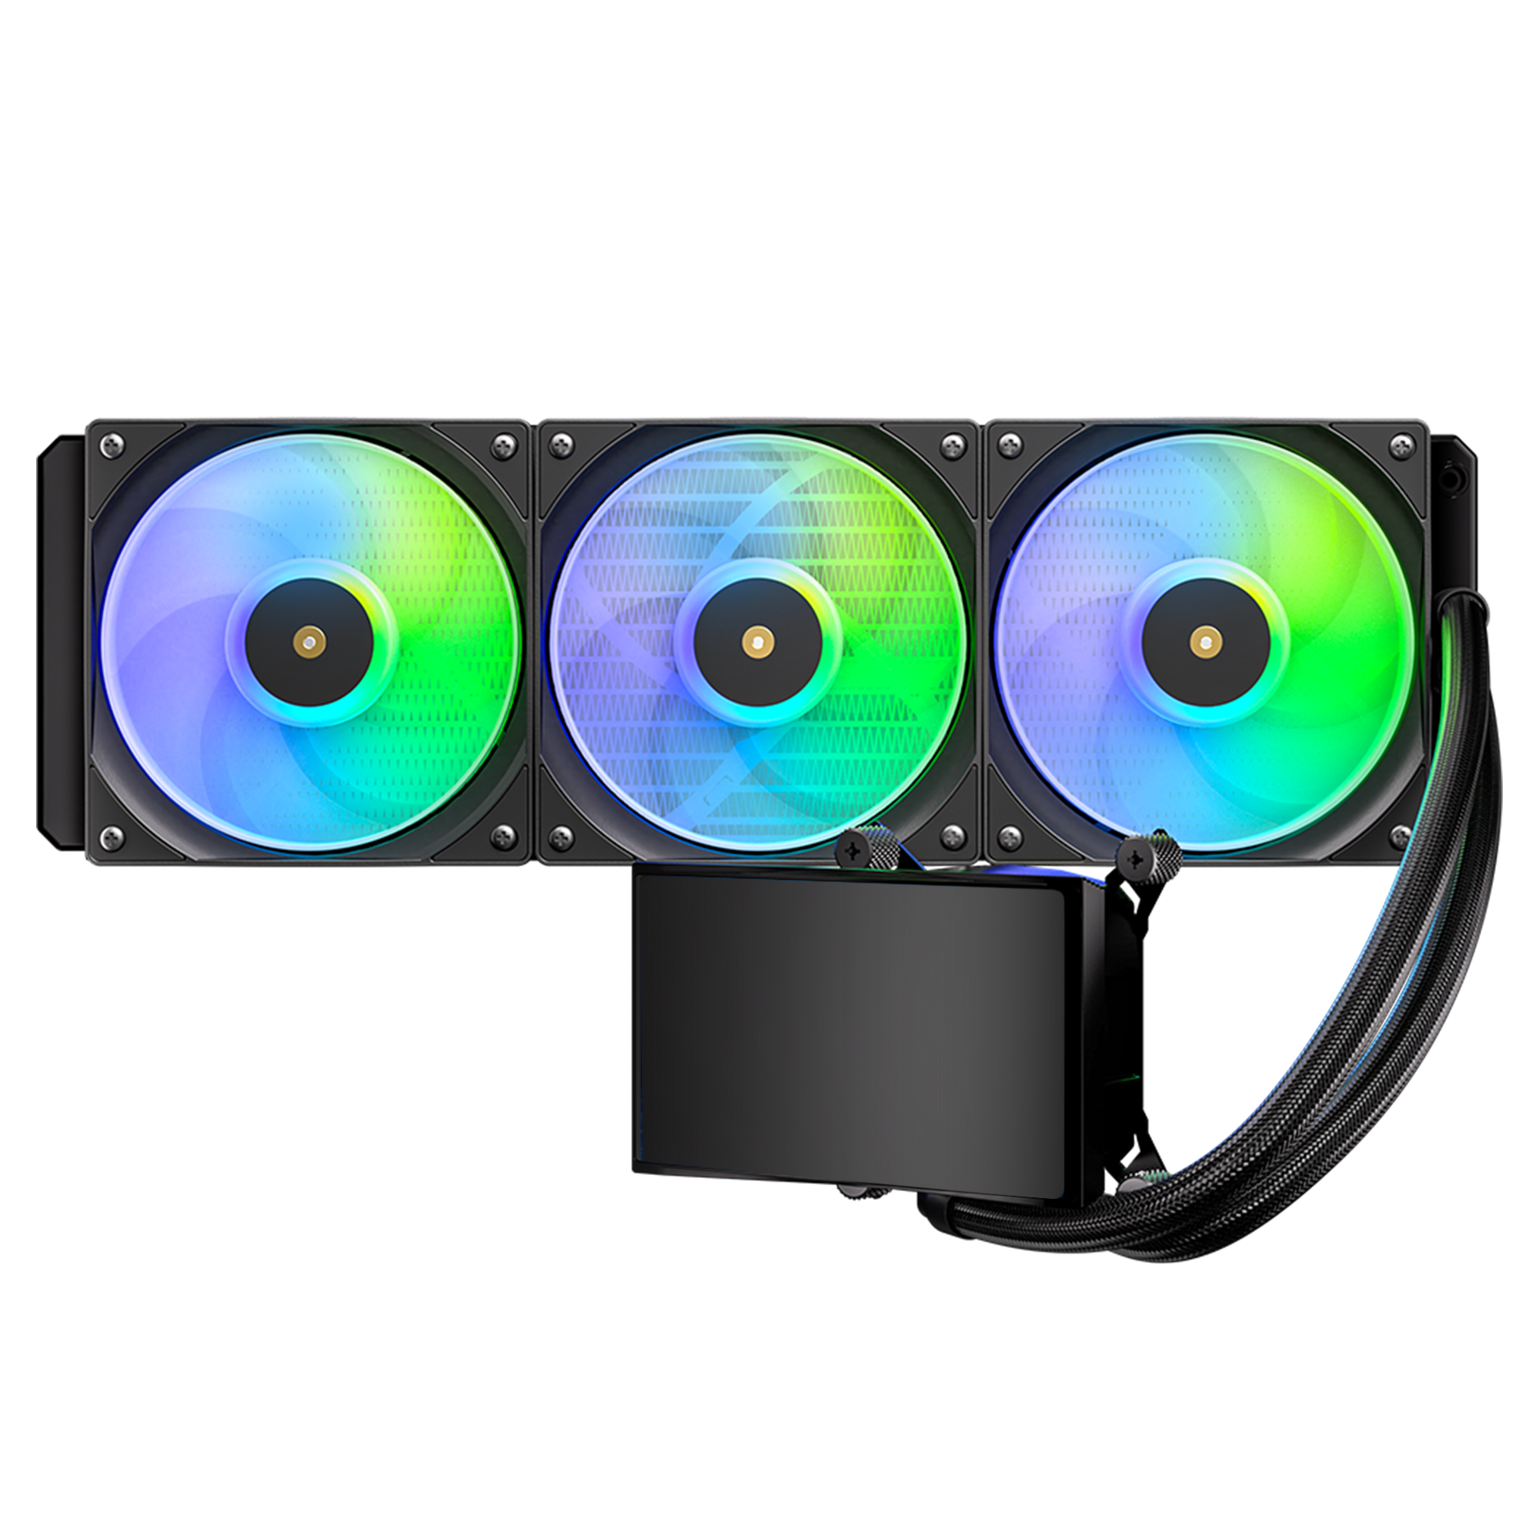
M5
All-In-One
LIQUID COOLER
M5 360 - Black
Part Number | BFW-M5-360-KK27A-RP
EAN / UPC | 4712883213441 / 886027013083

