Slide 1
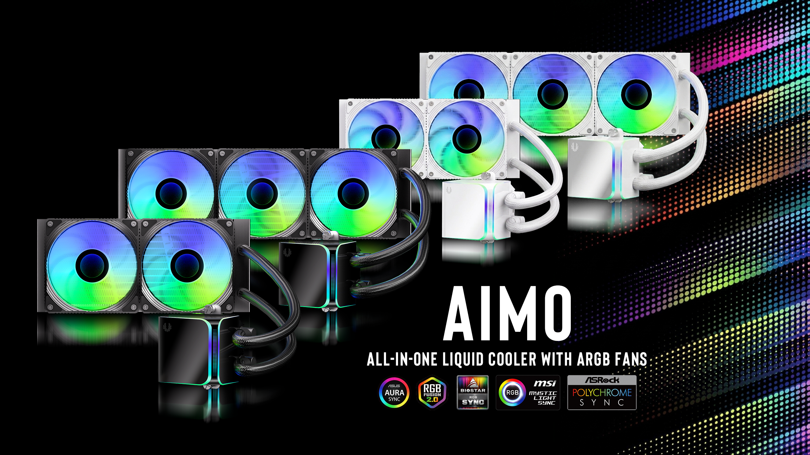

Slide 2
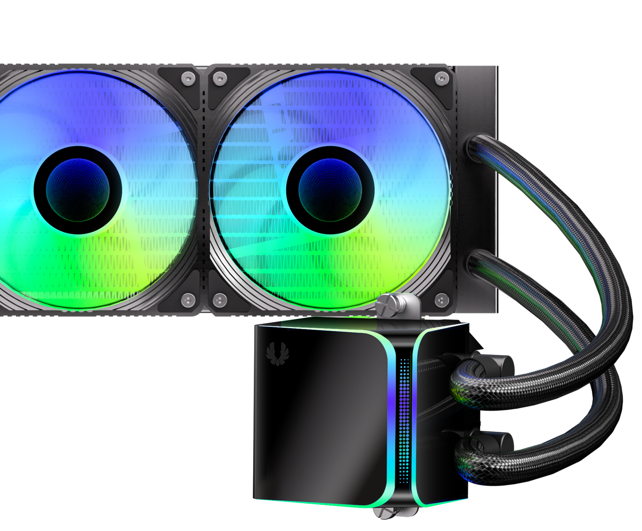
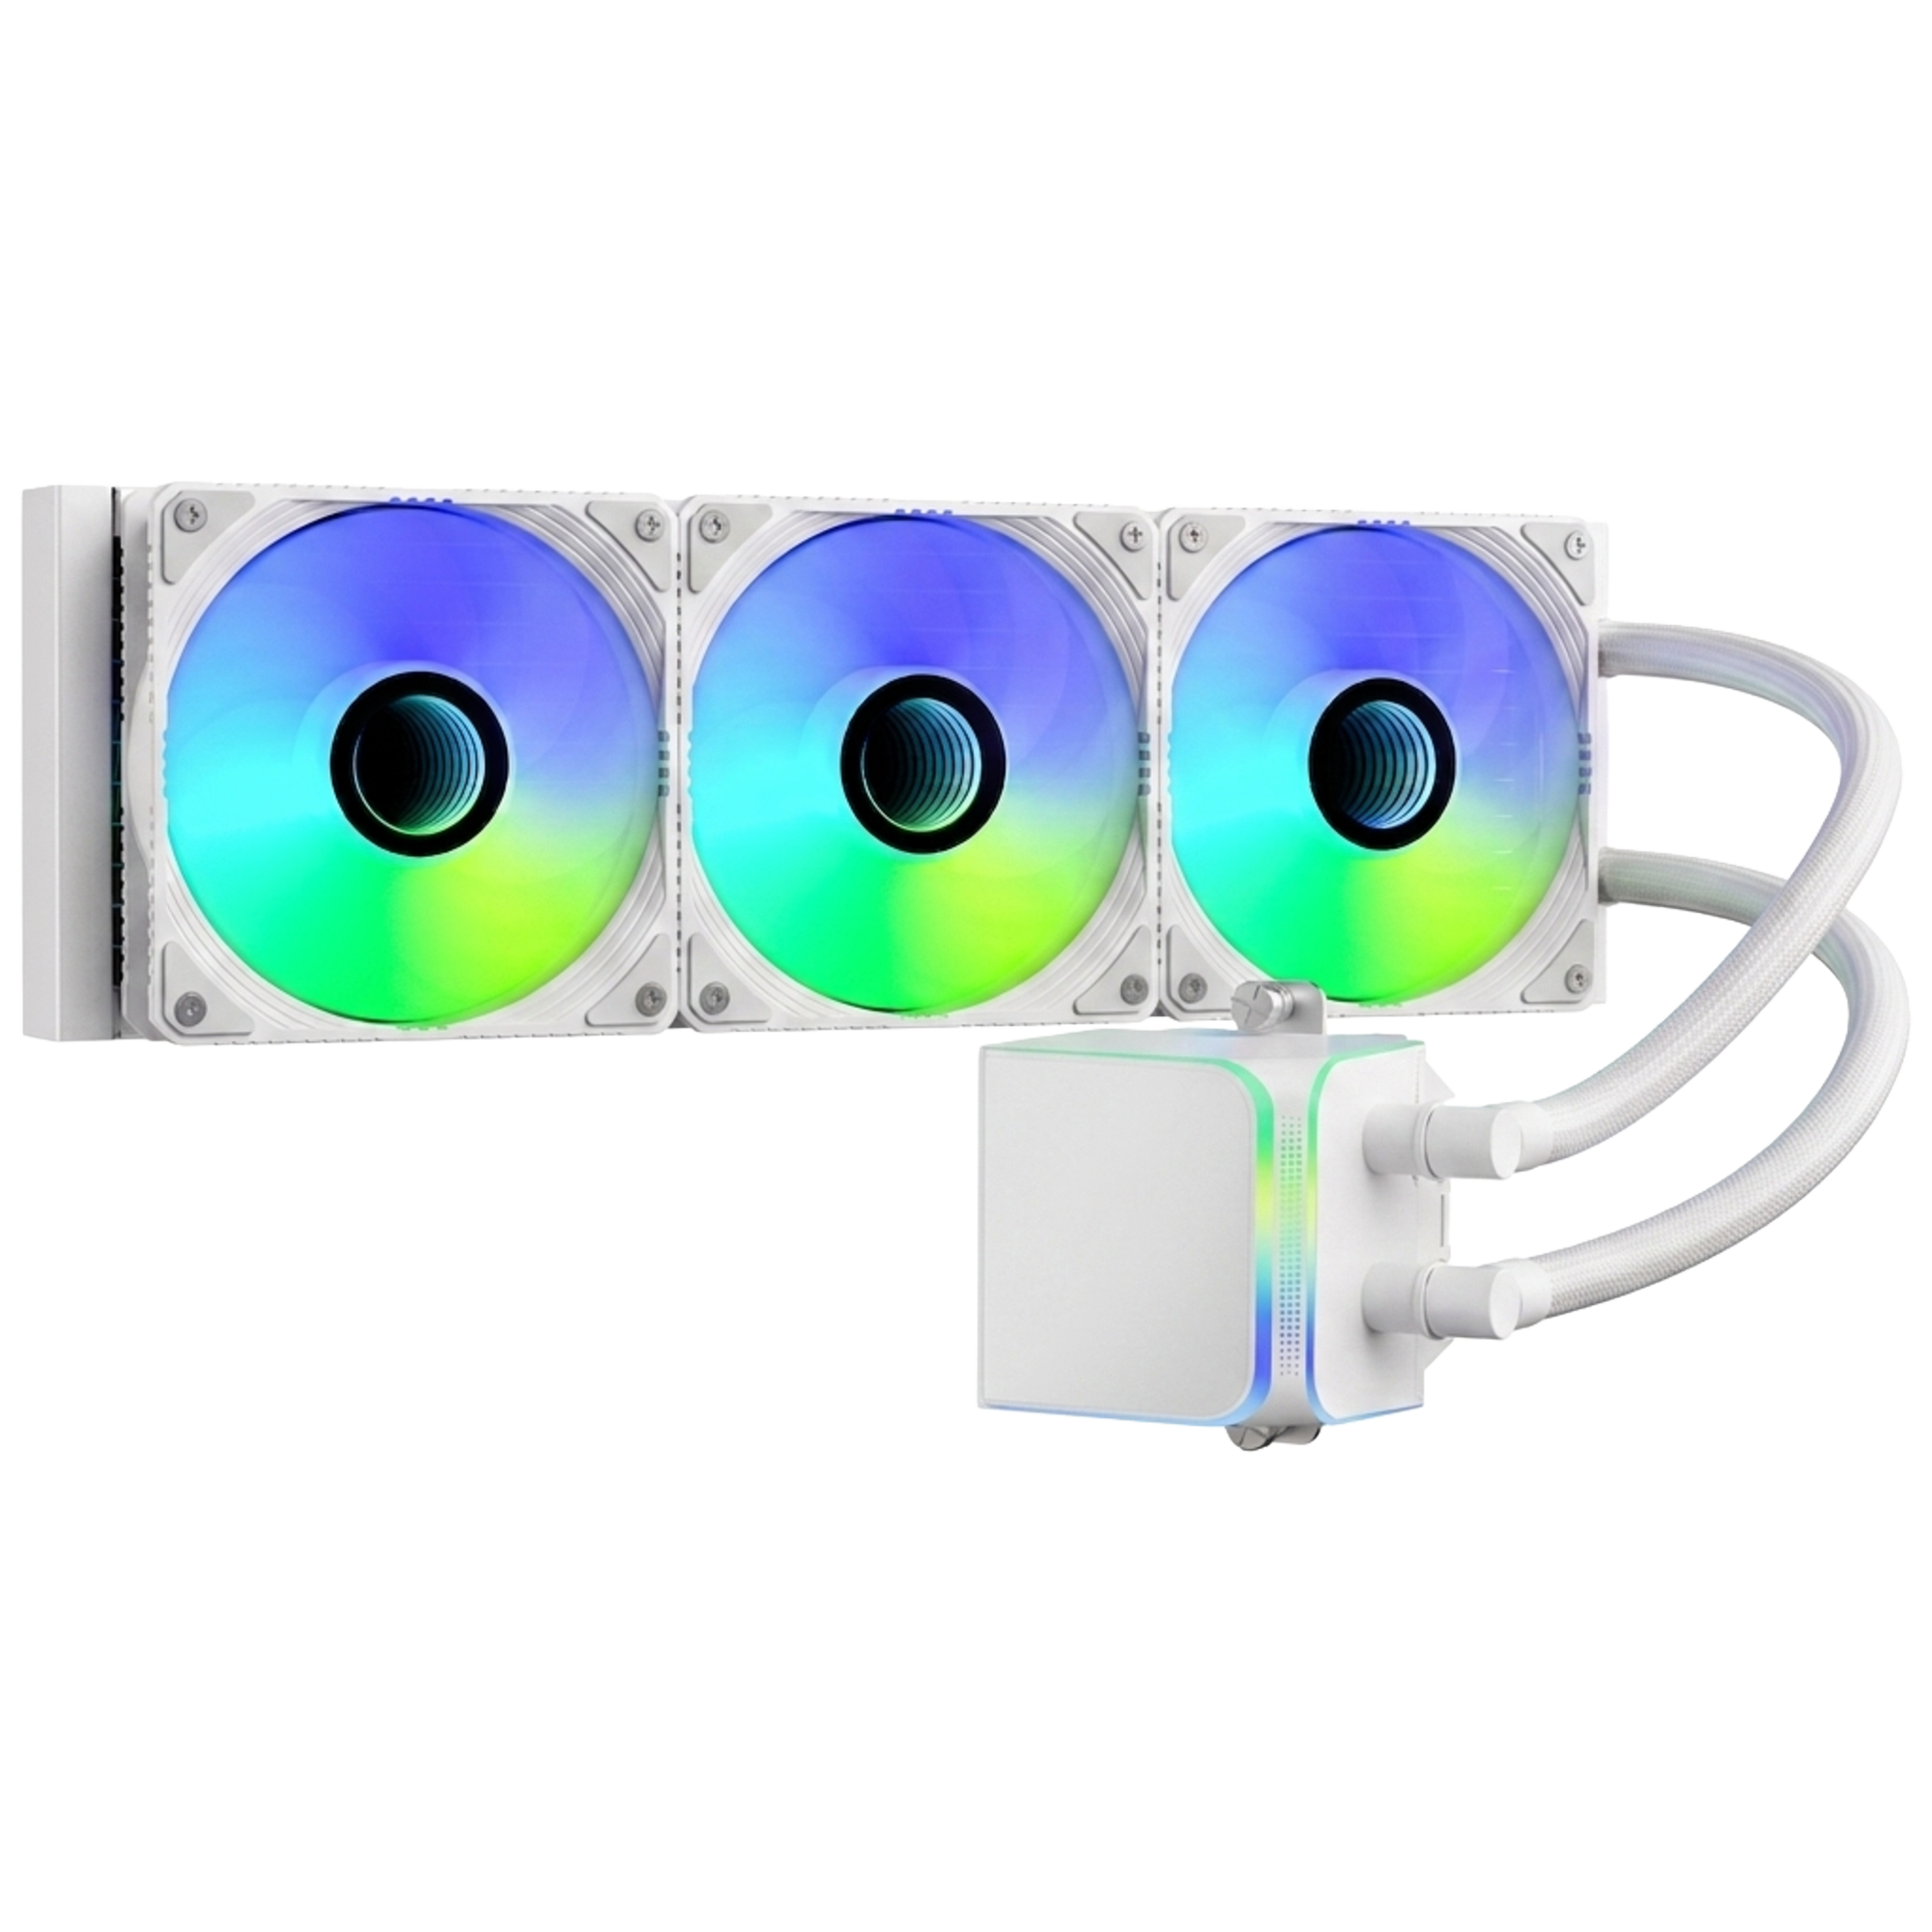

Meet the BitFenix AIMO: Where Performance Meets Style
Powered by BitFenix’s 4th-gen liquid cooling technology, the AIMO features a vibrant ARGB water block and high-performance fans. High-end cooling, premium aesthetics, accessible price.
Support Motherboard-Brand Lighting Synchronization: Asus/Gigabyte/MSI/ASRock/Biostar...and other brands can support.

Slide 3
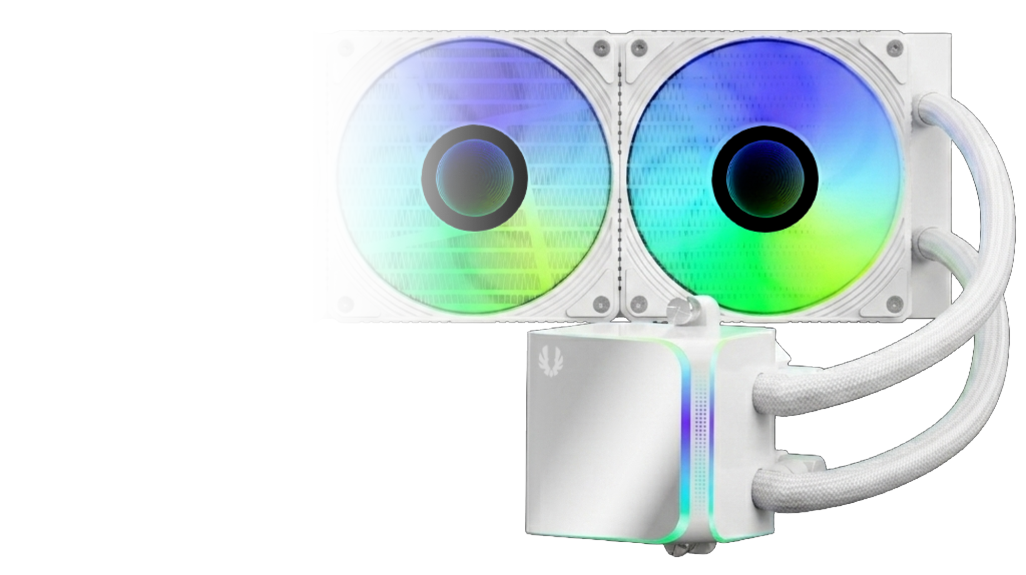
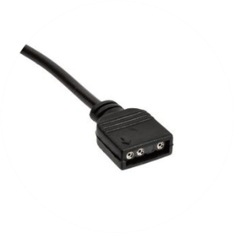
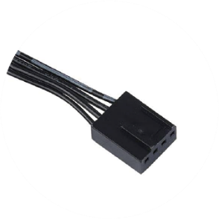
Introducing Water Block Connector Cables
ARGB Header
Connects to the motherboard's ARGB 3-pin socket
PUMP Header
Connects to the motherboard's pump/fan/extension cable Y-header
FAN Header
Connected to the CPU FAN connector on the motherboard

Slide 4
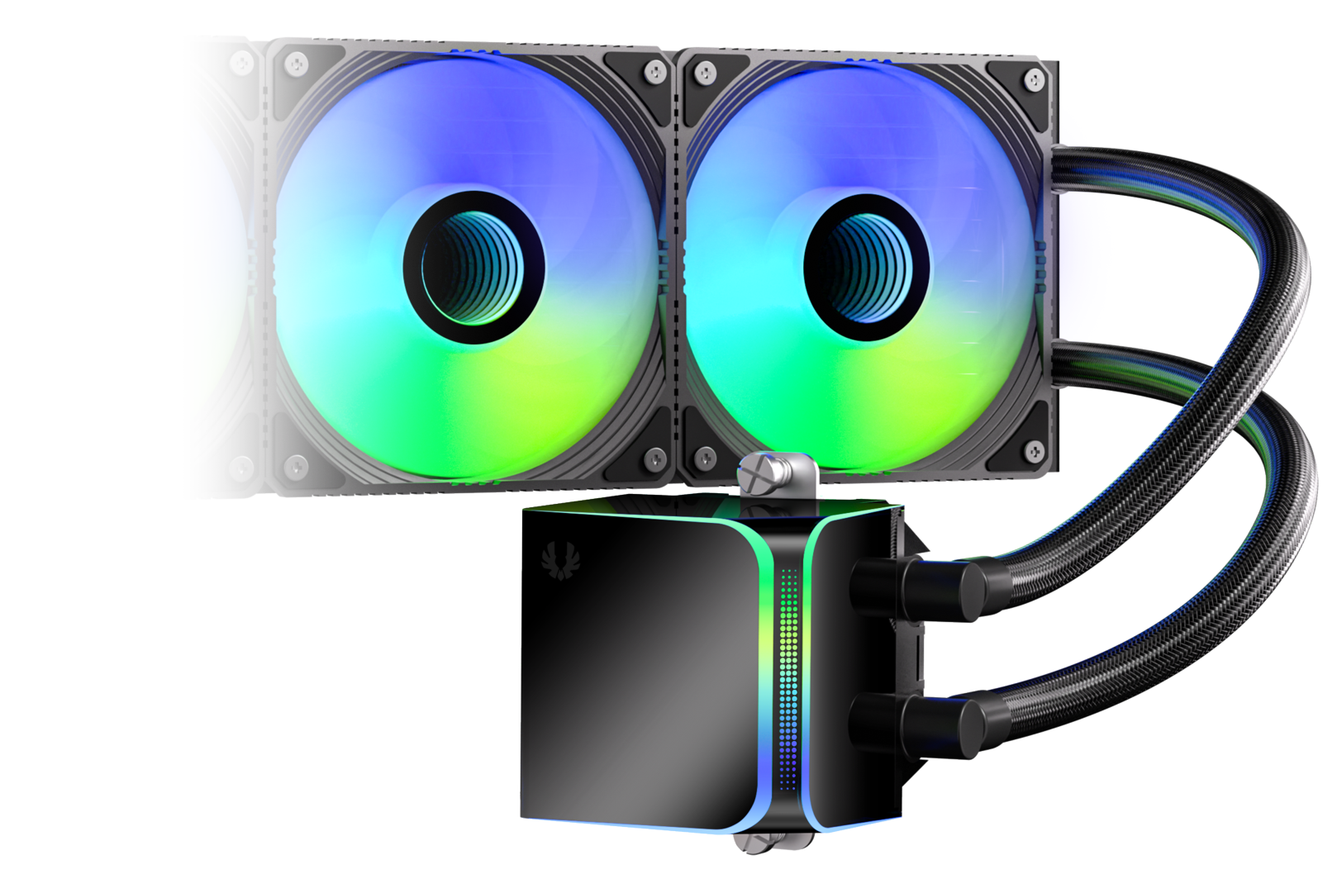
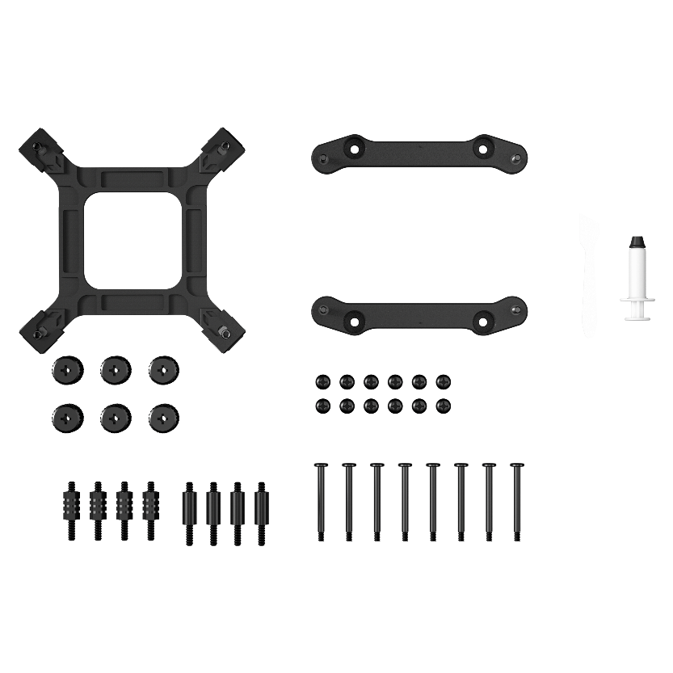
Socket compatibility | Intel: 1851 / 1700 / 1200 / 1150 / 1151 / 1155 AMD: AM5 / AM4
Pump speed (rpm) | 3000 ±10 rpm
Pump adjustable | 9V - 12V
Pump connector | 12V-4Pin PWM
Tube length (mm) | 400 mm
Noise level | ≤30dB(A)
Third Generation Pump
In order to match the latest top-level CPUs, we have developed a brand new pump based on the popular pump architecture. It has the ultimate specifications of 3000 RPM

Slide 5
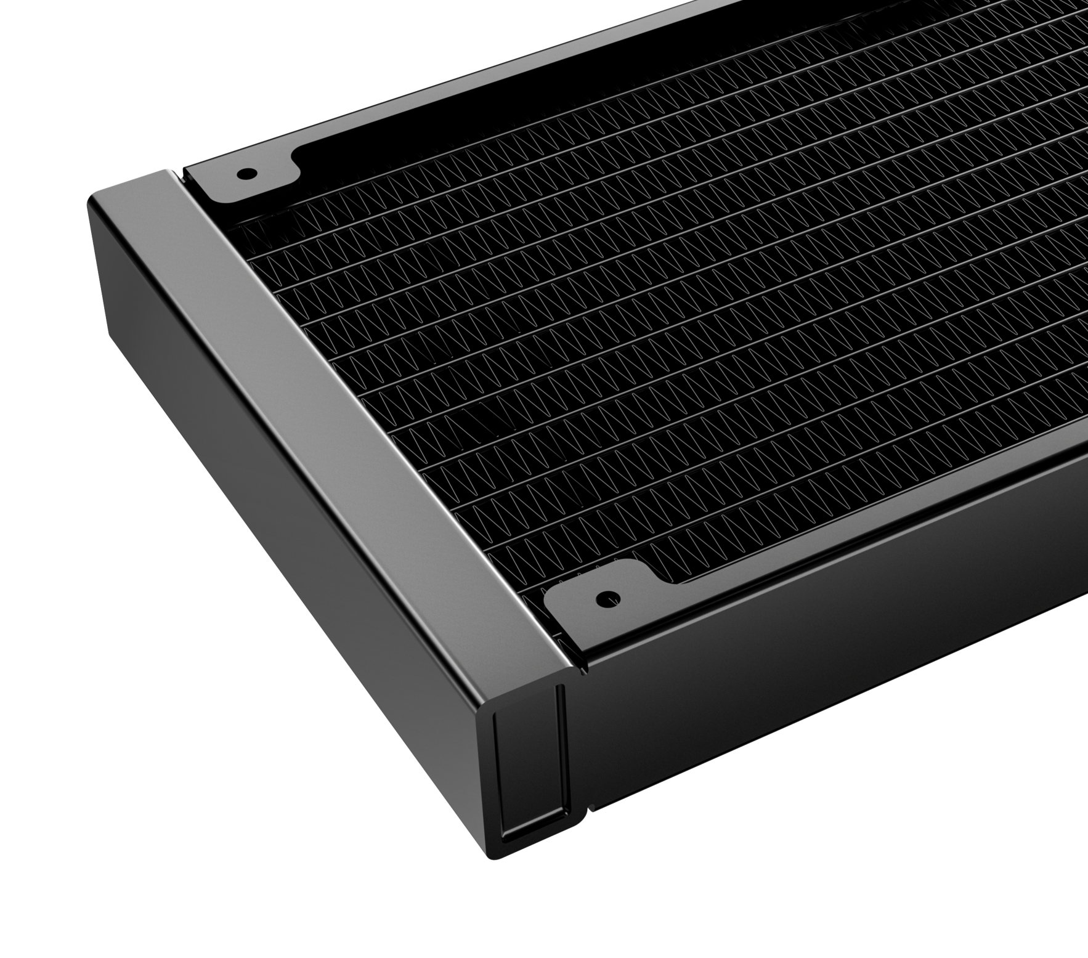
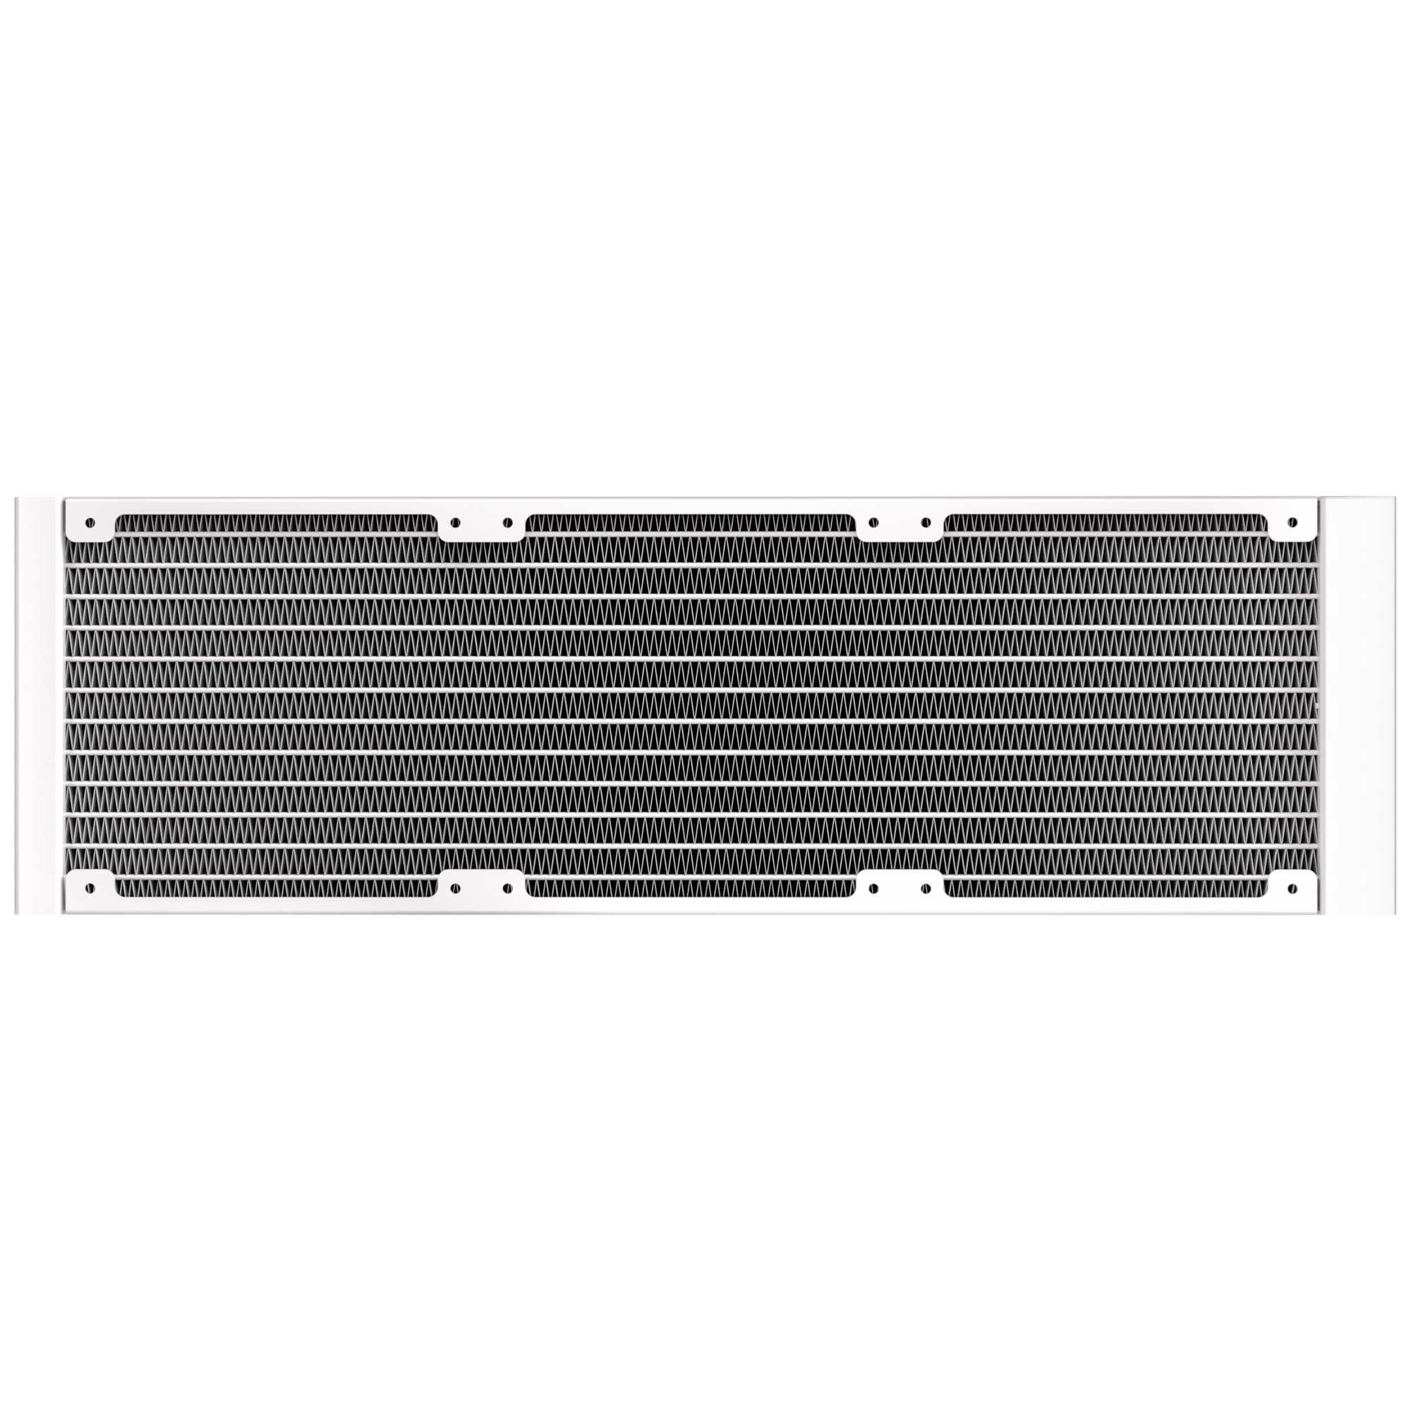
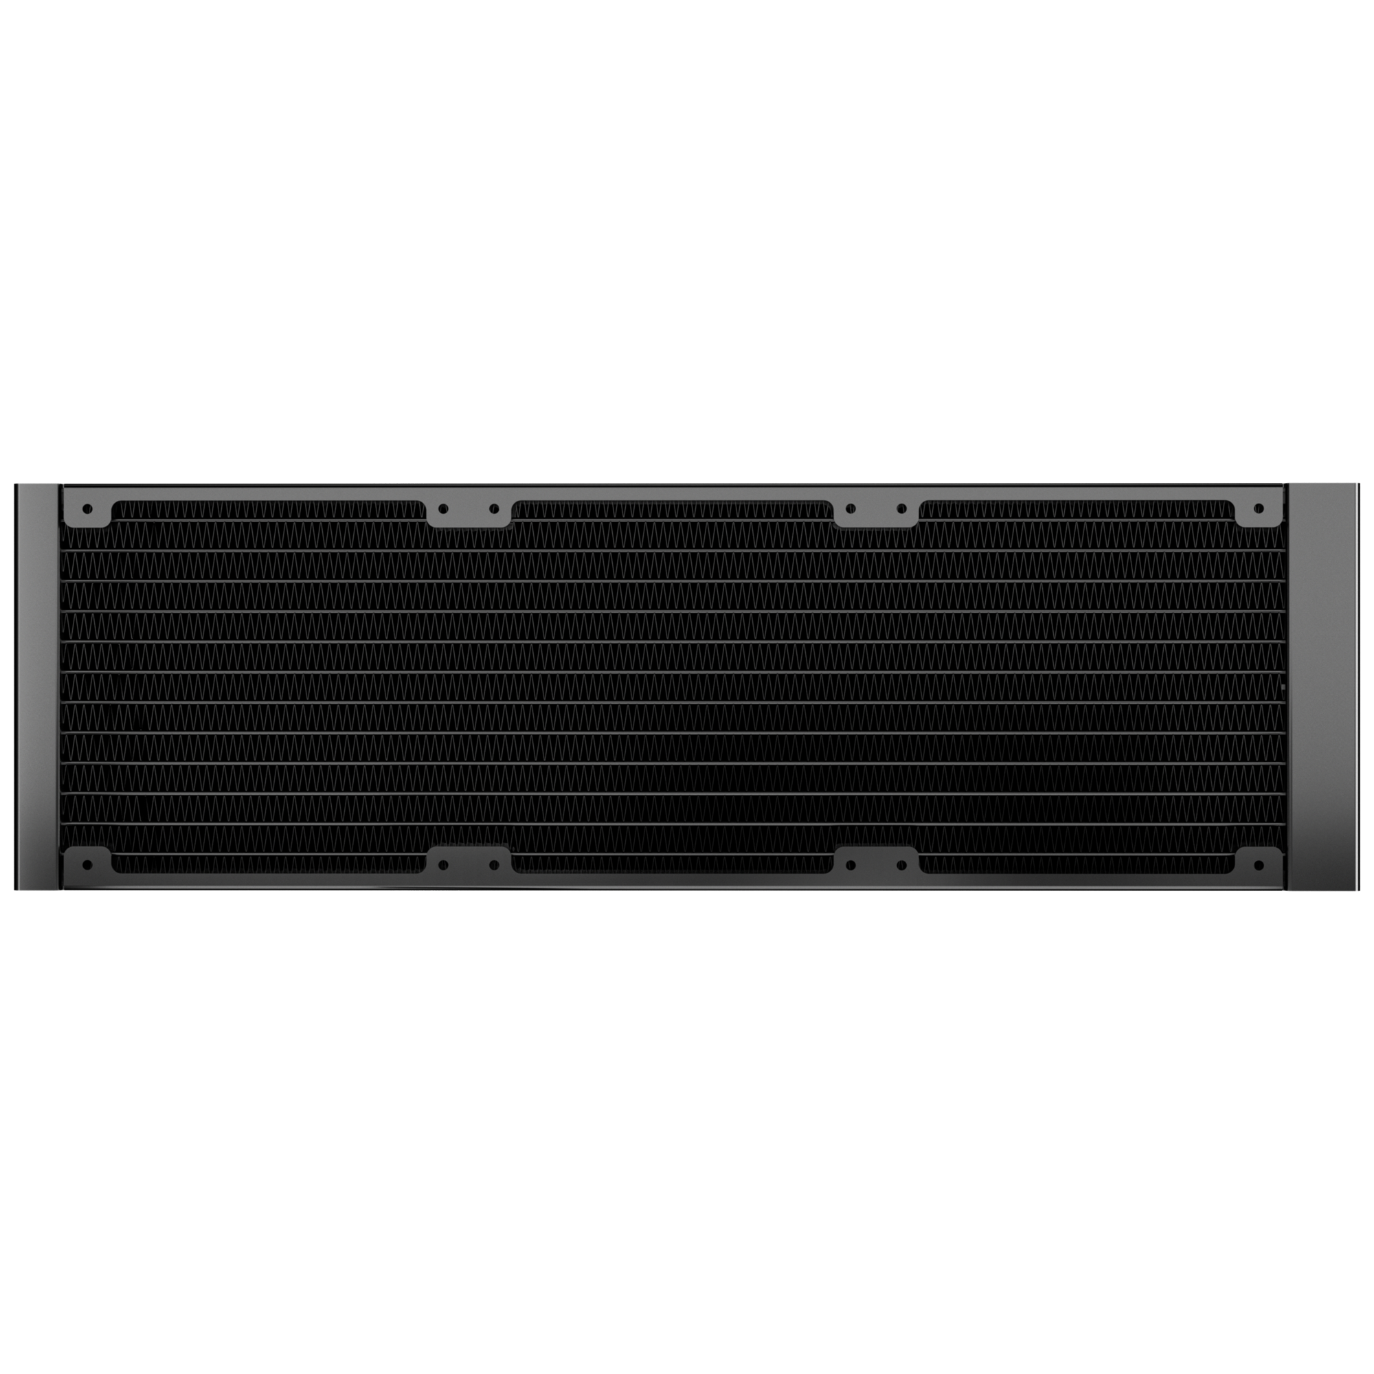
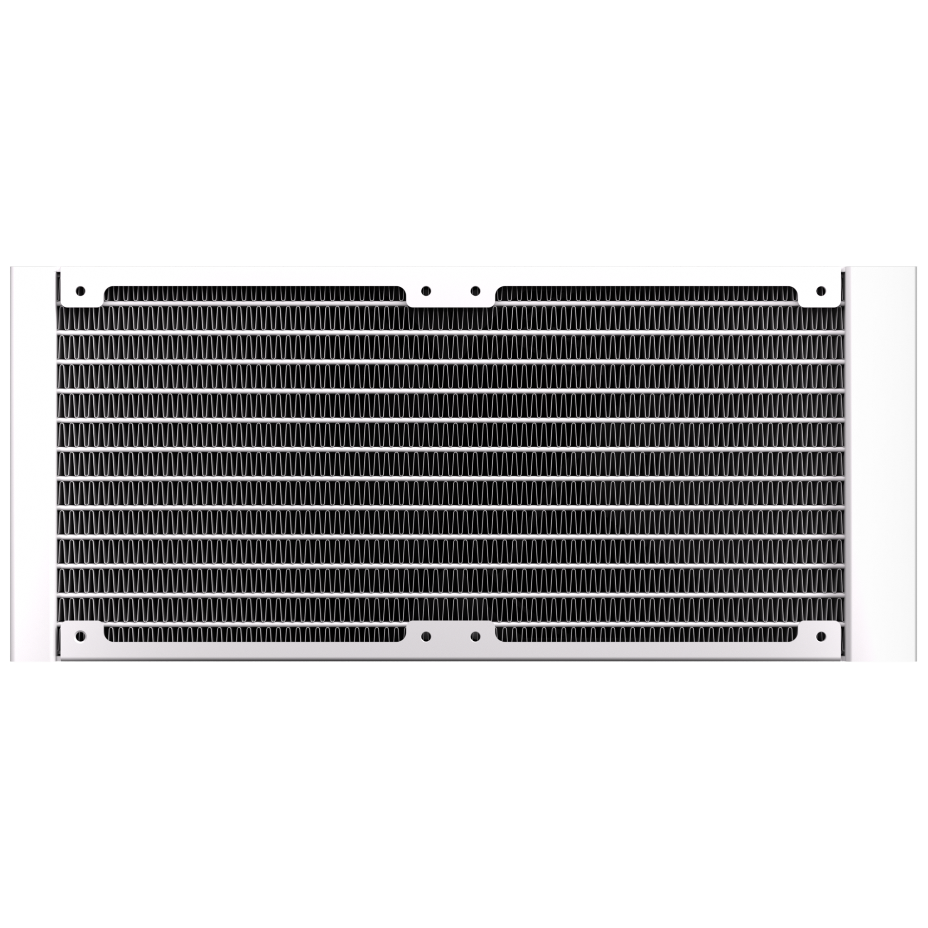
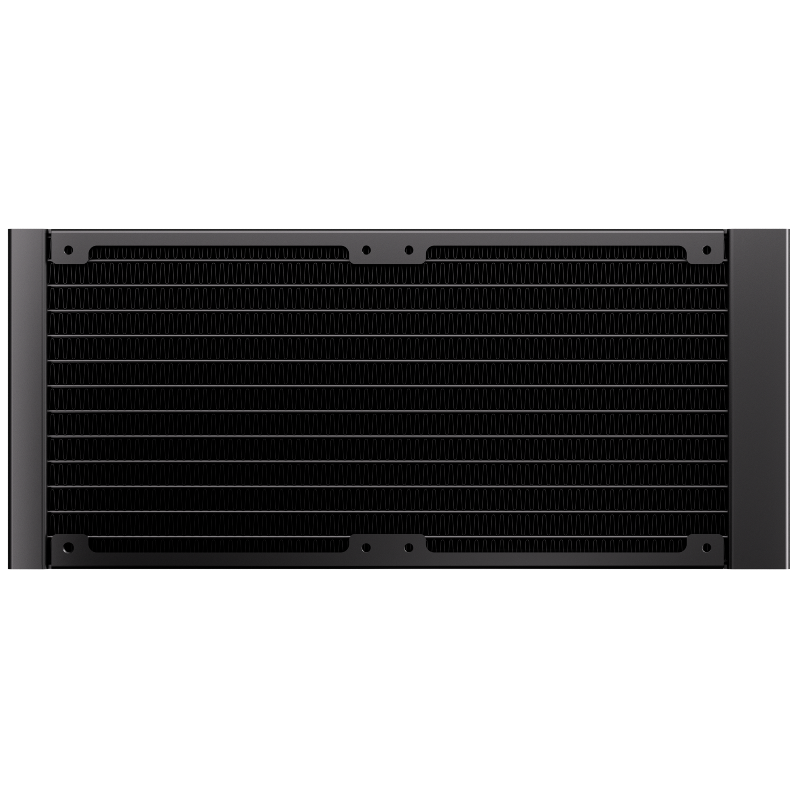
360mm
240mm
360 Radiator specifications
Dimensions (H x W x D), (mm) | 397 x 120 x 27
Radiator material / finish | aluminum / black or white spray painted
Base material | copper
240 Radiator specifications
Dimensions (H x W x D), (mm) | 277 x 120 x 27
Radiator material / finish | aluminum / black or white spray painted
Base material | copper

Slide 6
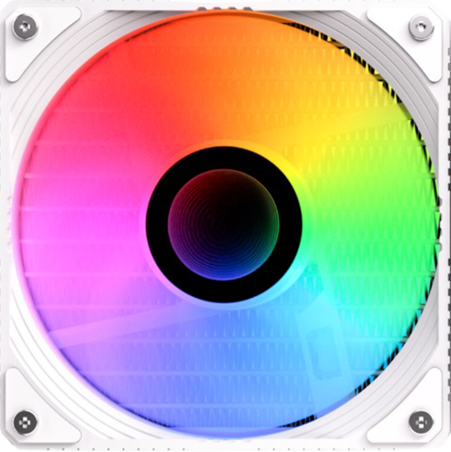

Fan SPEC
Fan model | ARGB 120mm PWM high-pressure Fan
Fan dimensions (mm) | 120 x 120 x 25
Speed @ 100% PWM (rpm) | 800-2000 ±10% RPM
Bearing technology | Hydraulic Bearing
Rated Voltage (V) | 12V
Start Voltage (V) | ≤5V(Power ON/OFF)
Power consumption (W) | 3W
Connector | 4-pin PWM
Max. air flow | 59.1CFM
Air Pressure | 1.73MM-H2O
Noise | ≤30 dB

Slide 7
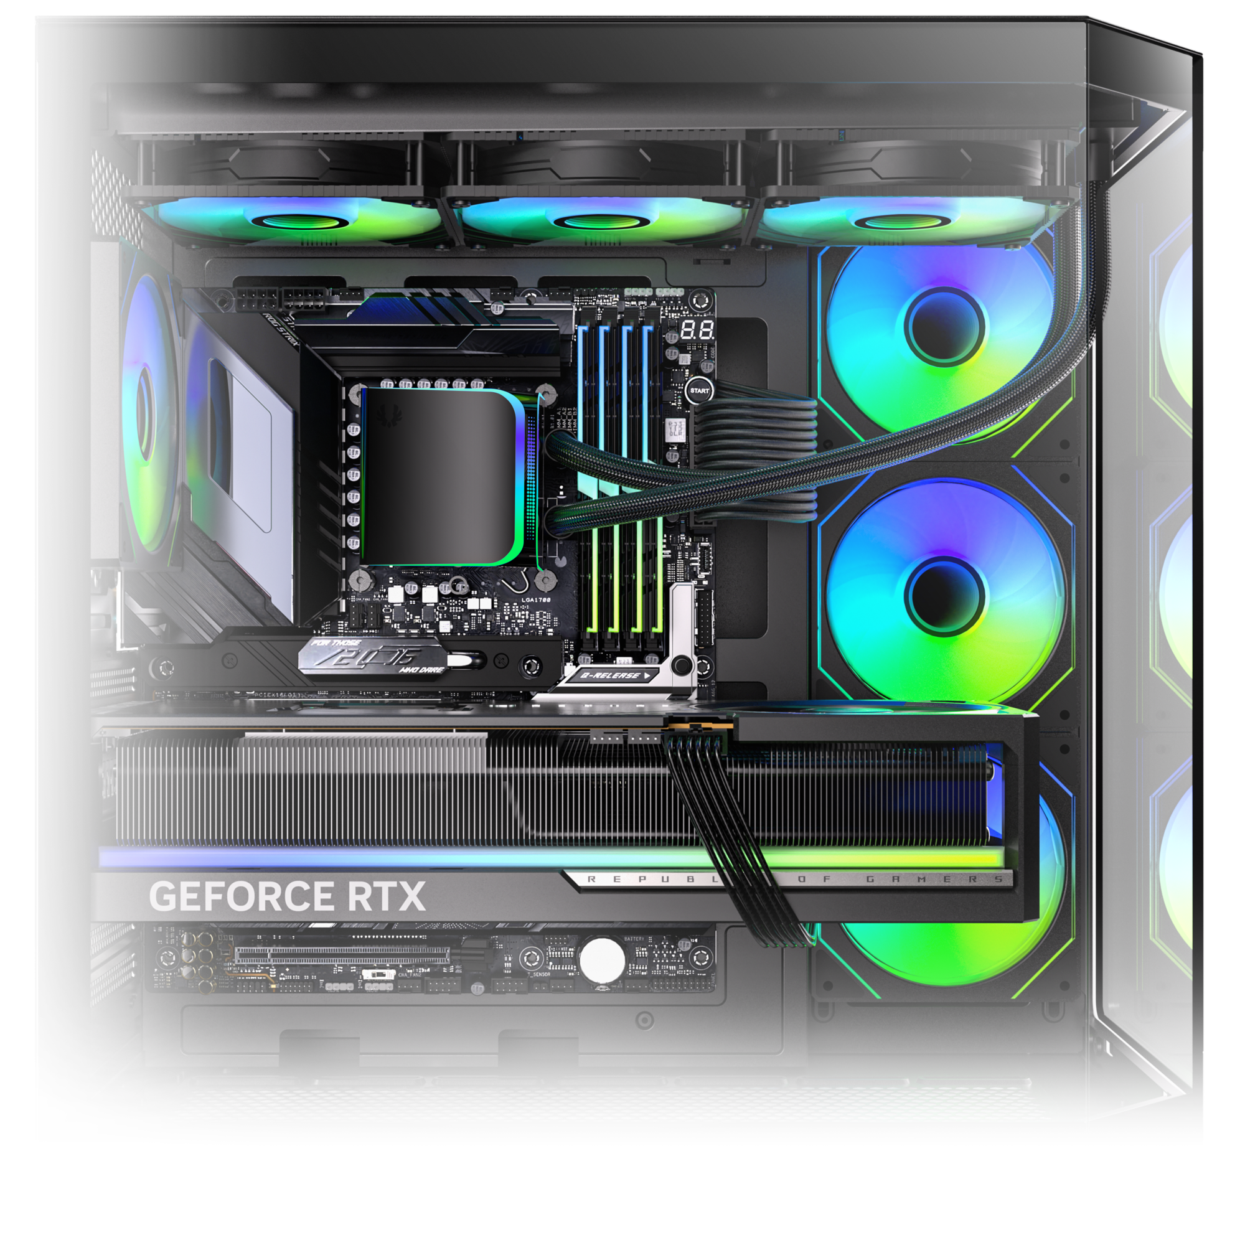
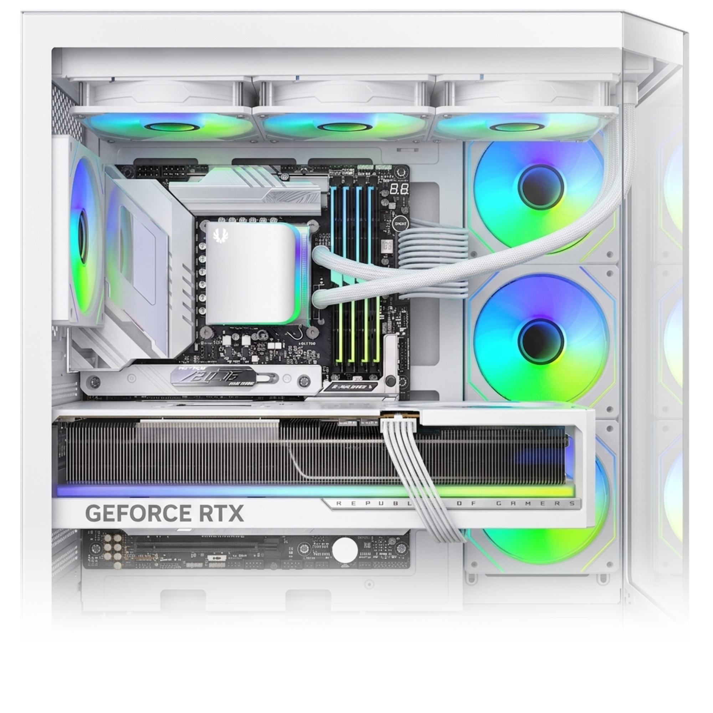
AIMO
All-In-One
LIQUID COOLER
AIMO 360 - Black
Part Number | BFW-AMO-360-KK27A-RP
EAN / UPC | 4712883213410 / 886027013090
AIMO 360 - White
Part Number | BFW-AMO-360-WW27A-RP
EAN / UPC | 4716779444766 / 886027007525
AIMO 240 - Black
Part Number | BFW-AMO-240-KK27A-RP
EAN / UPC | 4712883213427 / 886027010365

