Slide 1
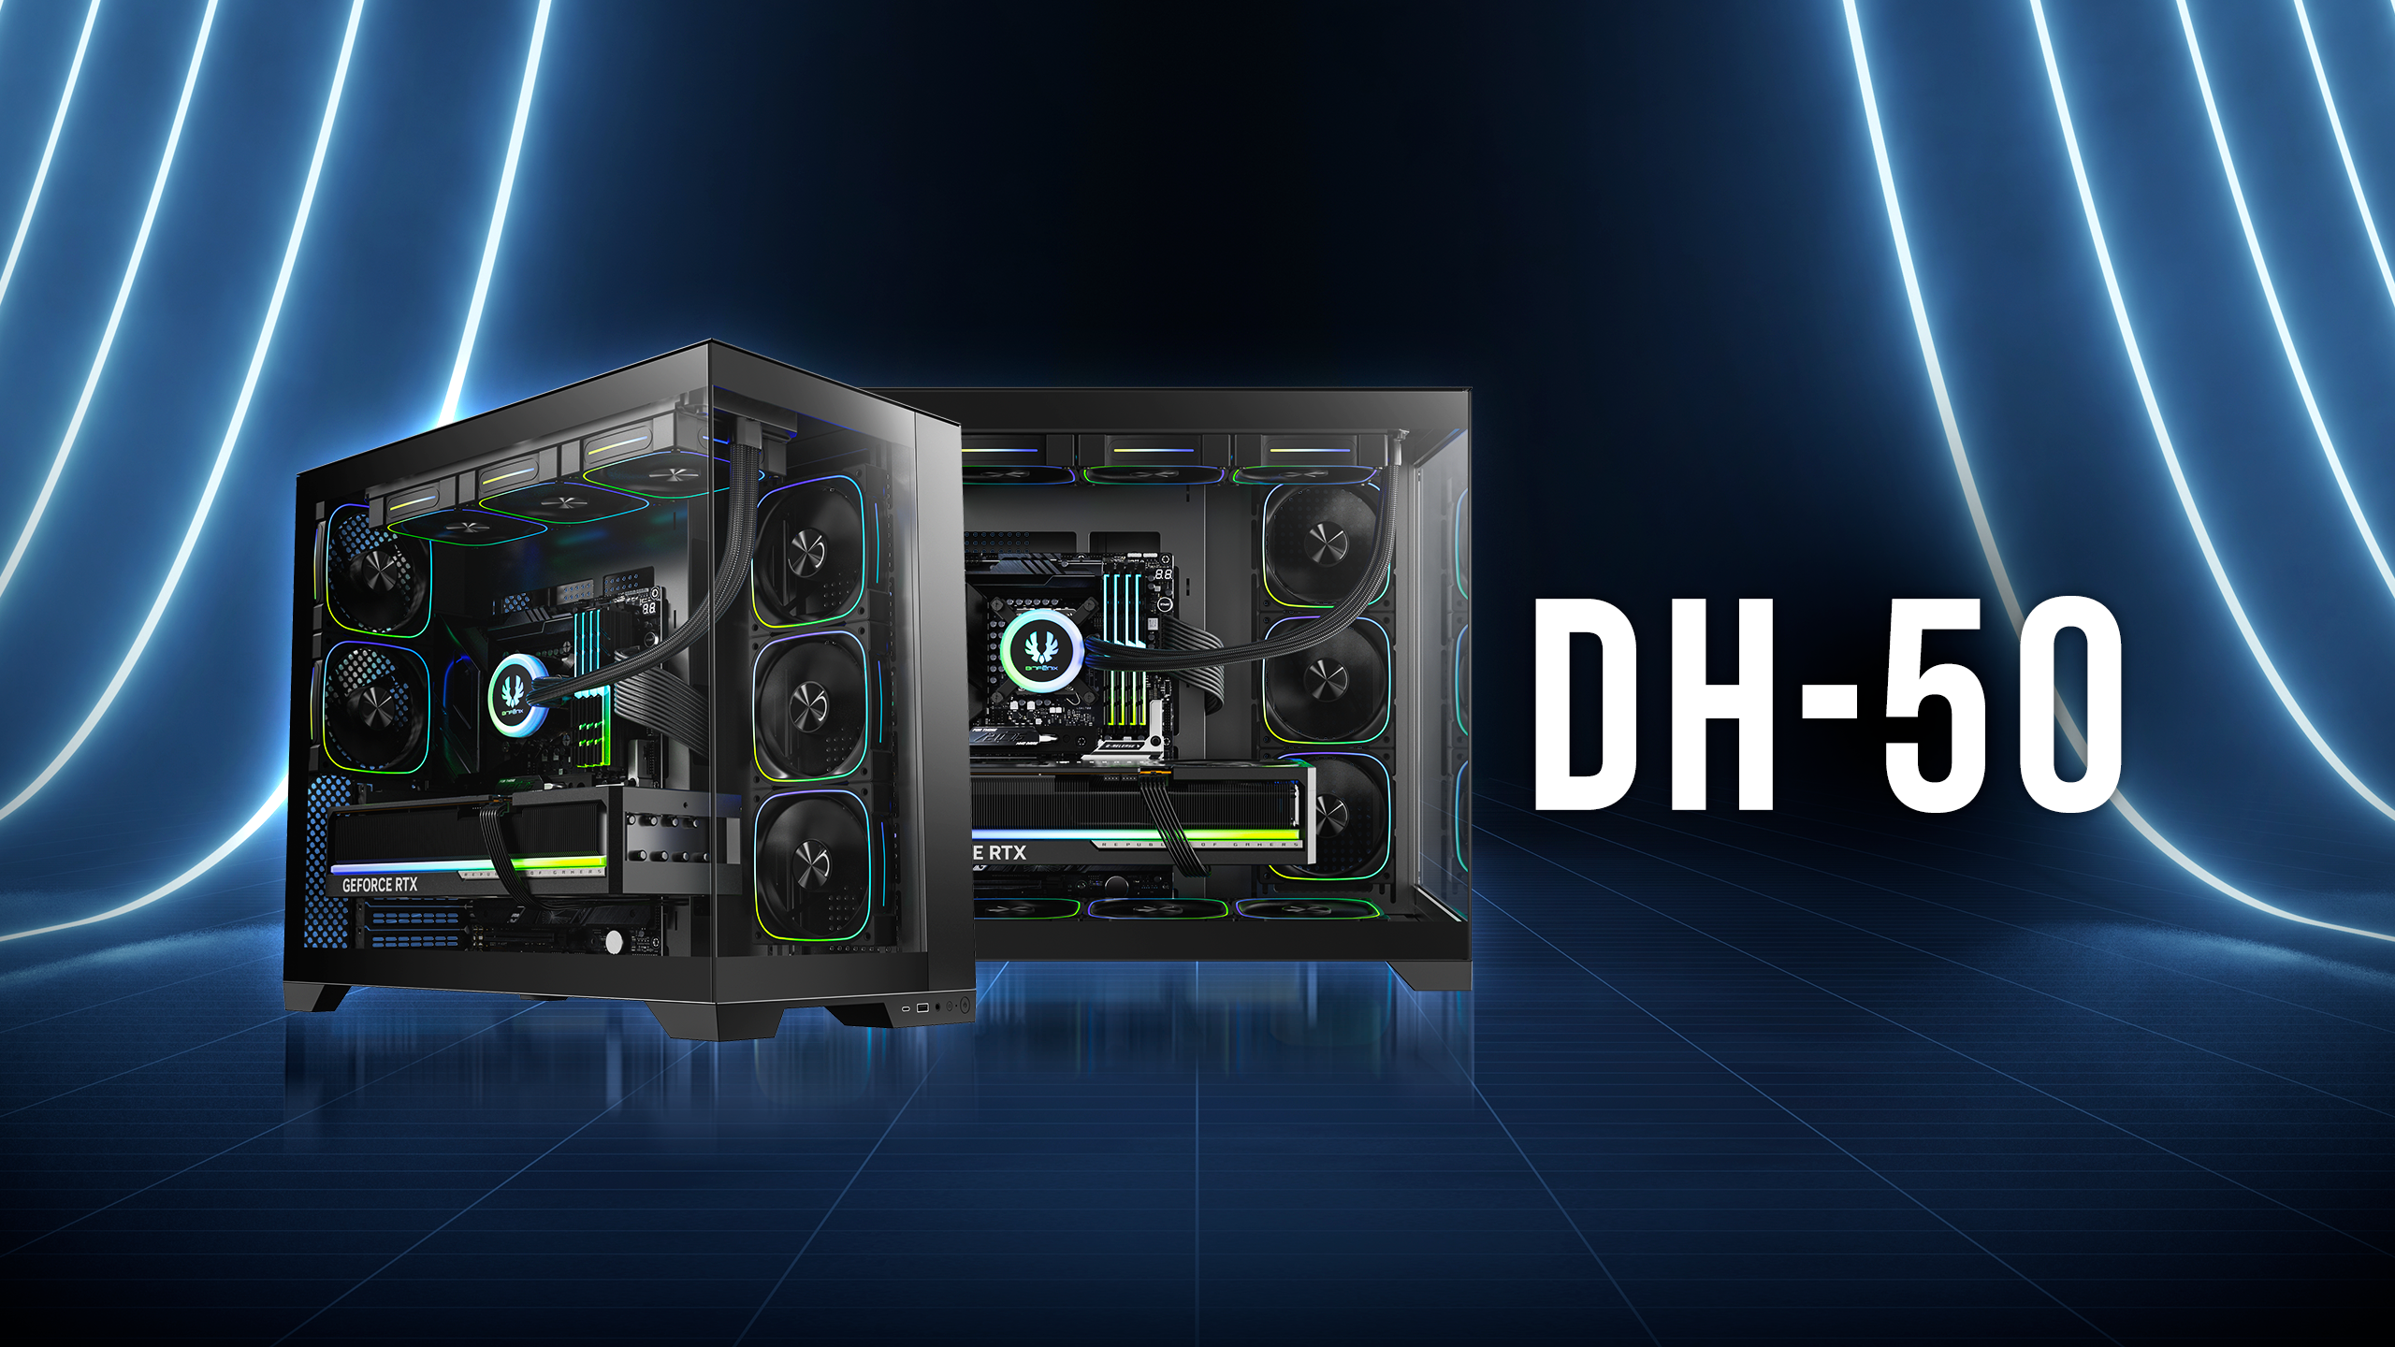

Slide 2
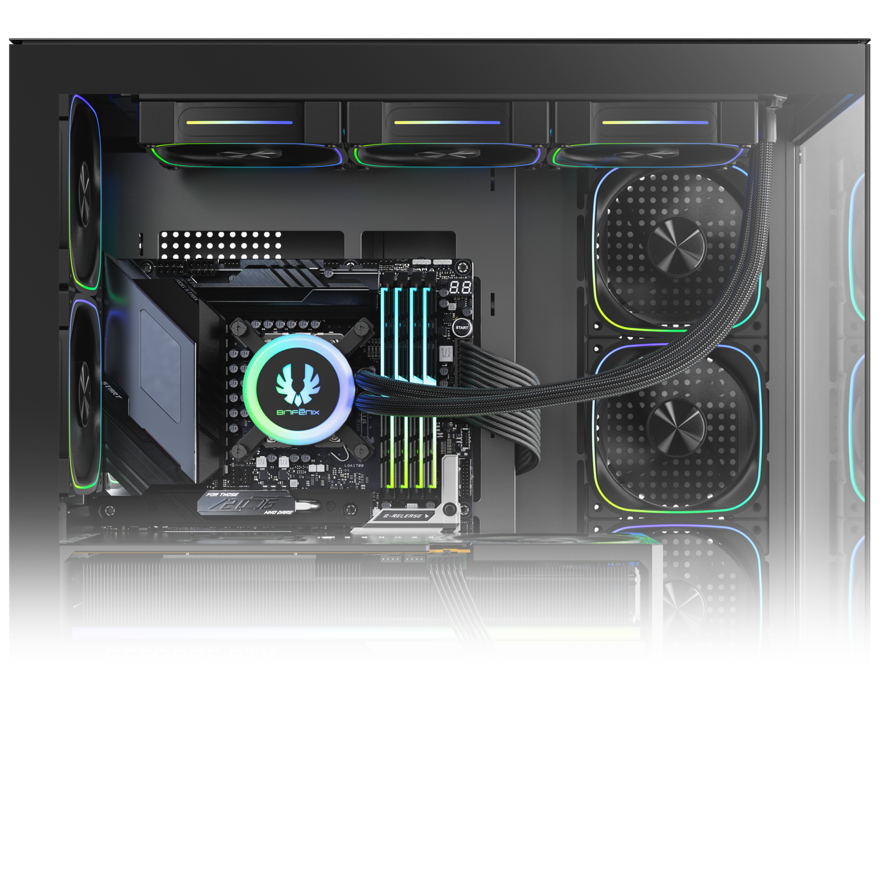
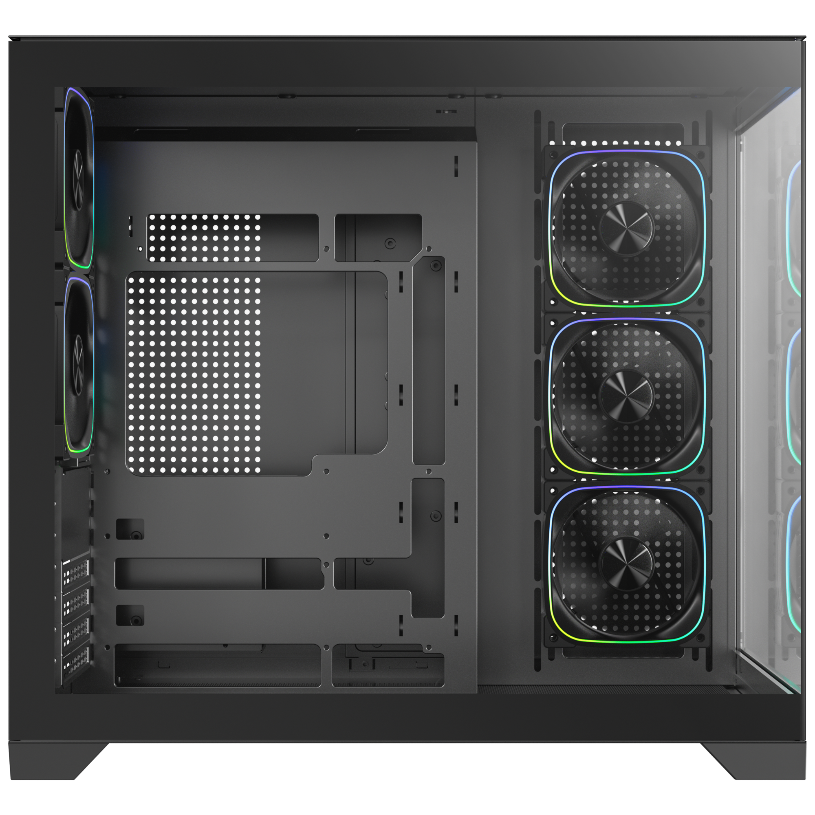
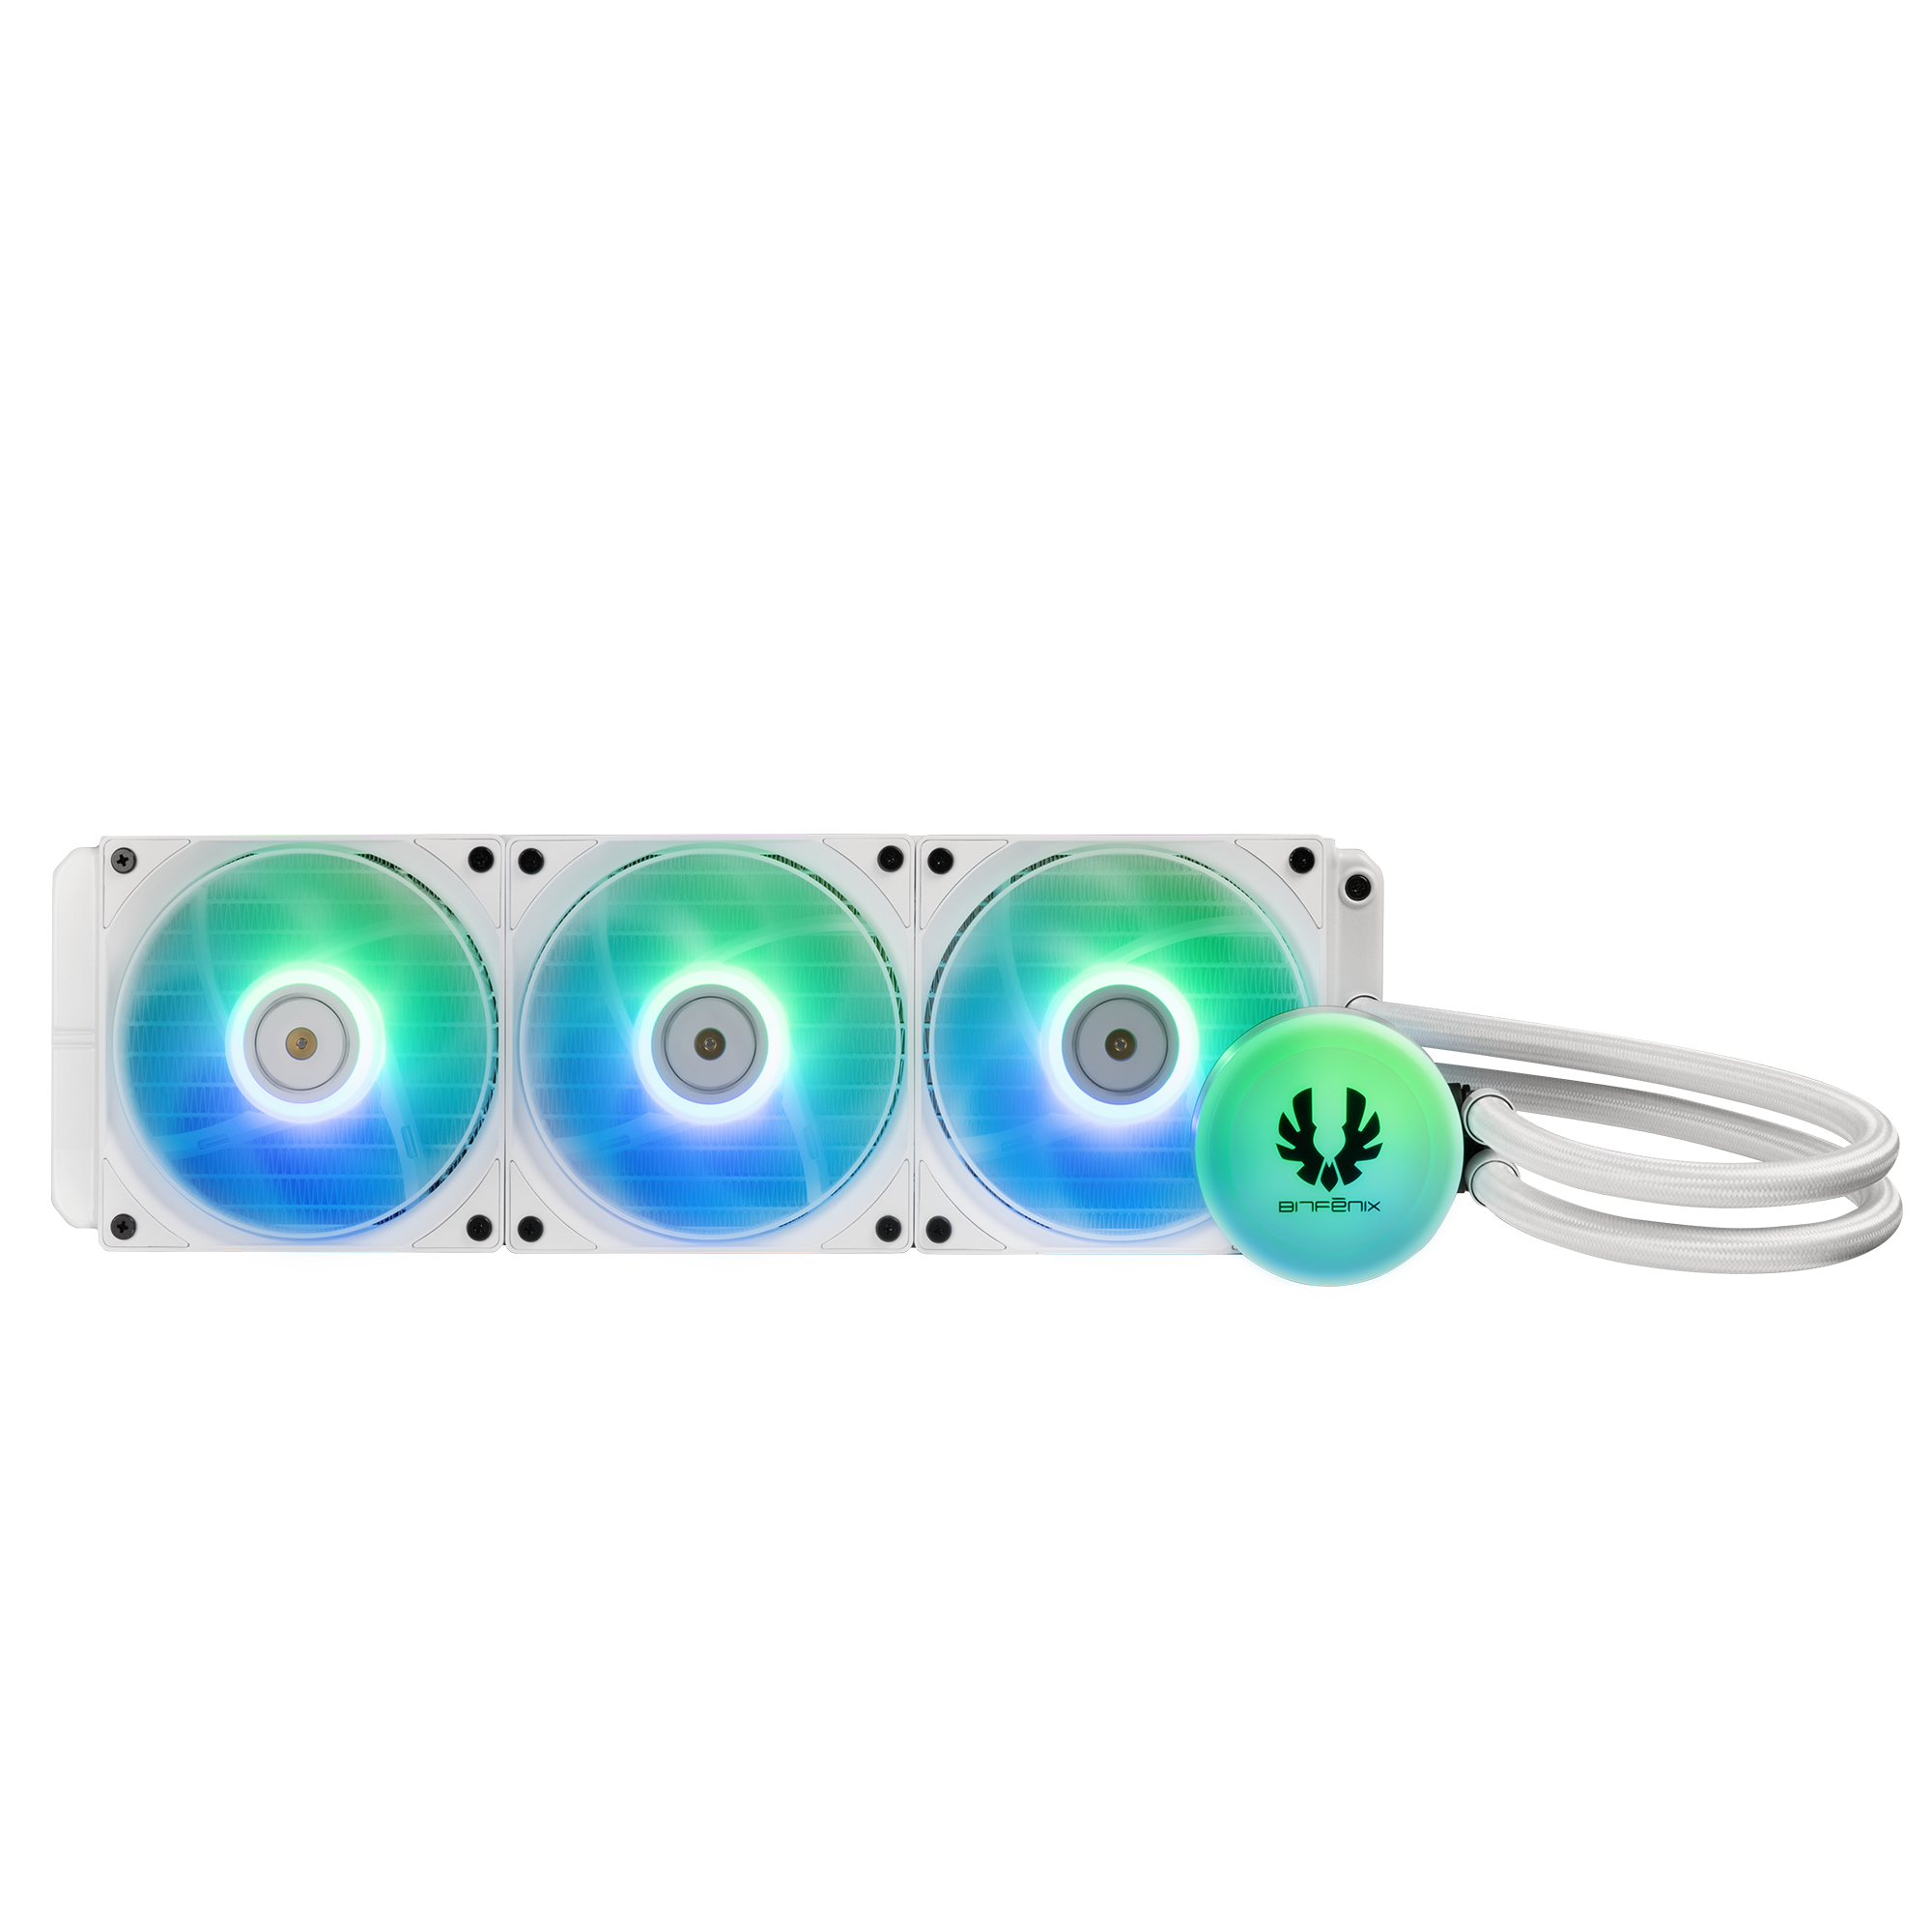
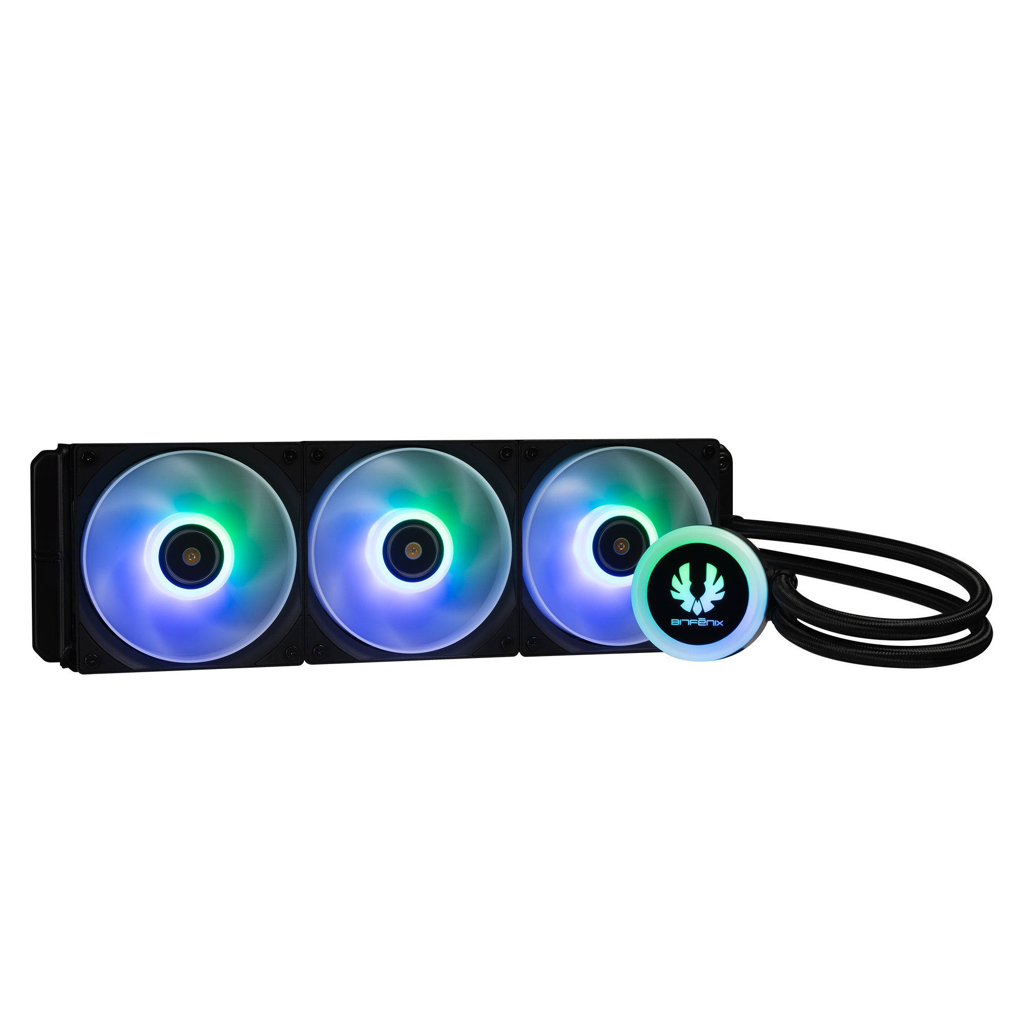
420mm AIO Support : Top/ Bottom 360mm AIO Support : Top/ Bottom/ MB Tray
140mm
MB
120mm
140mm
120mm
120mm
140mm
120mm

Slide 3
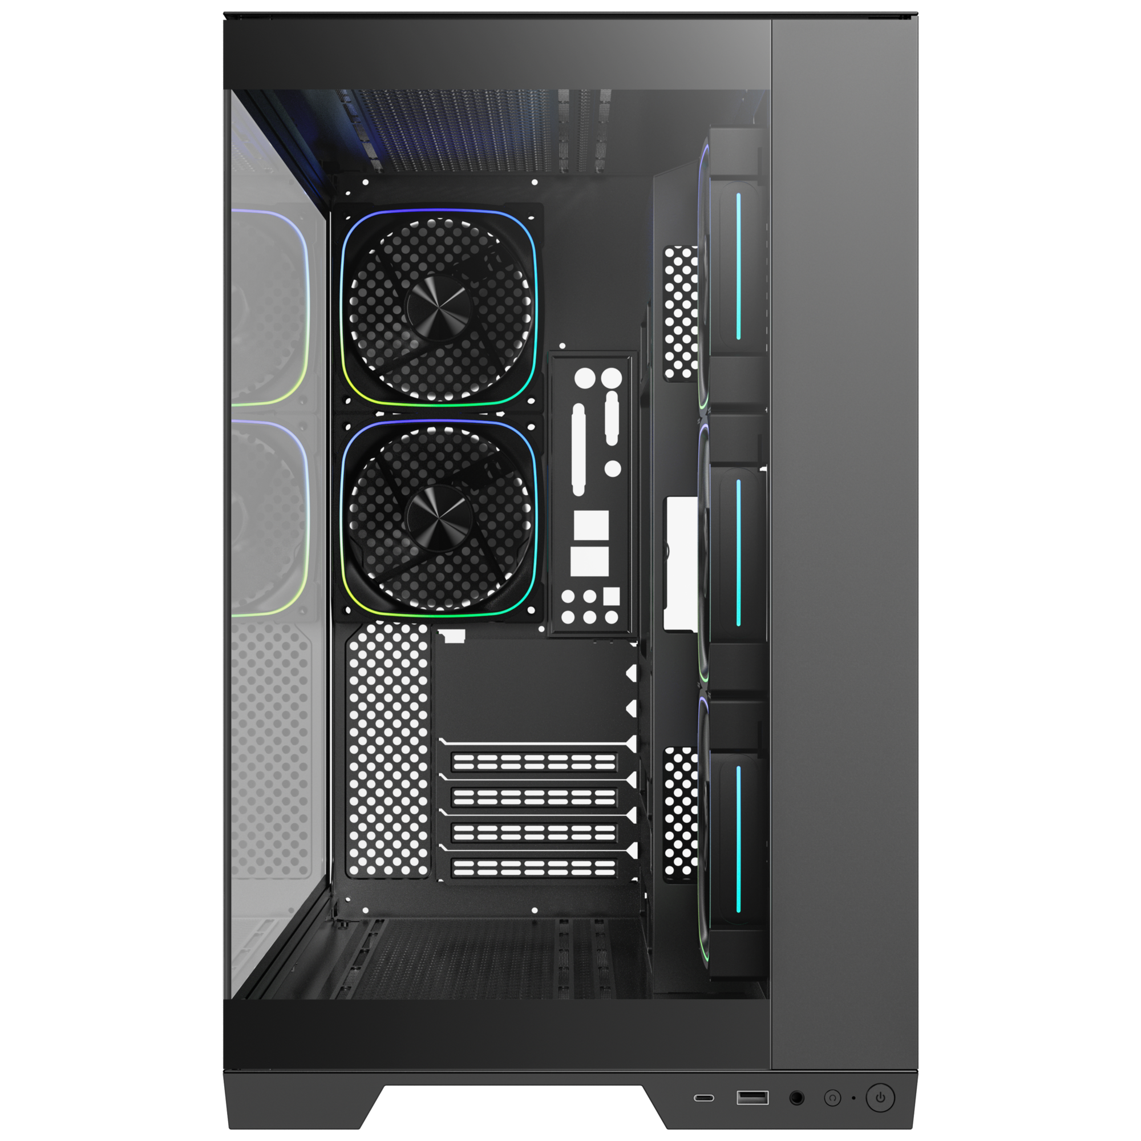
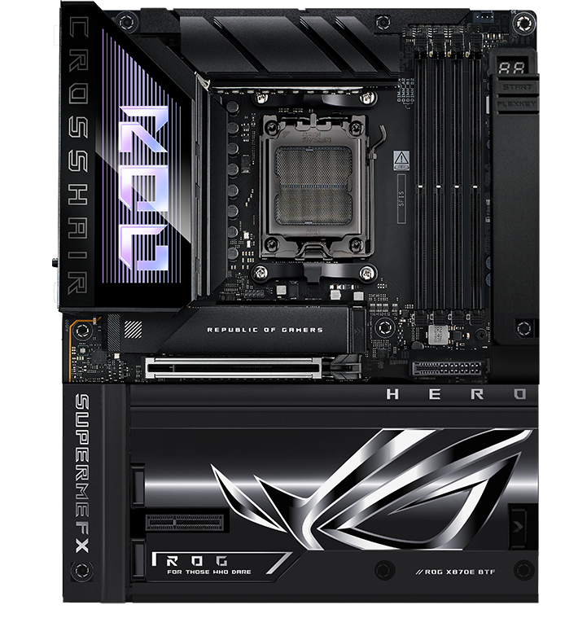
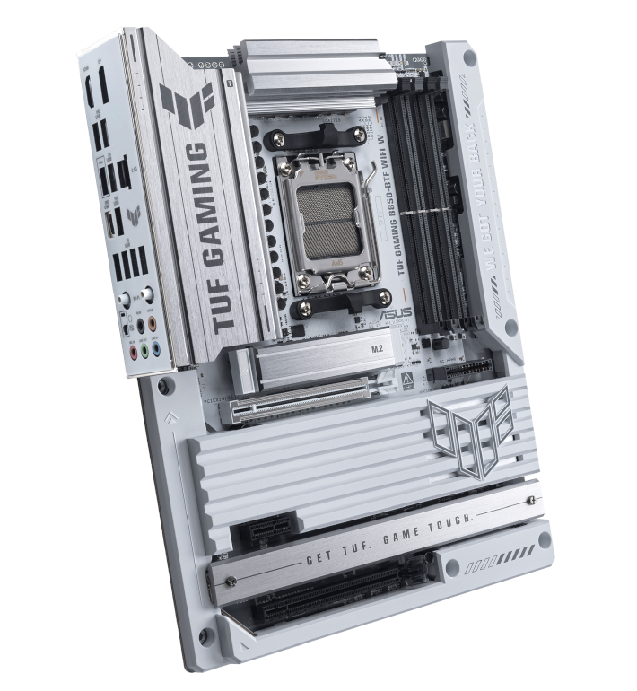
Supports BTF Back-Connect Motherboard
285mm
490mm
Maximun CPU
Cooler Height
Back-Connect Motherboard
Motherboard
Support
170
mm
ITX/ M-ATX
ATX
EATX
458mm
Cable Management Space 100 mm
Maximun Graphics Card
Support
440
mm

Slide 4

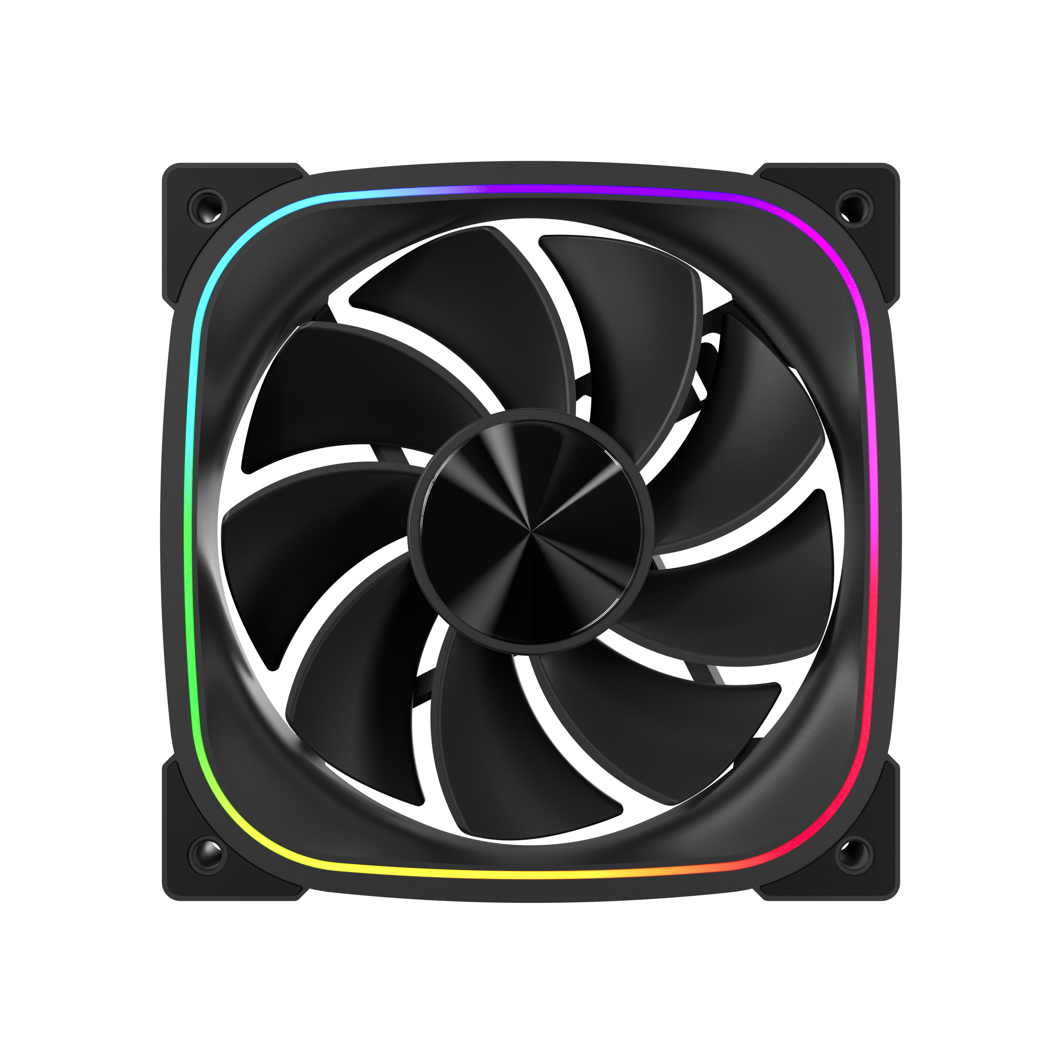
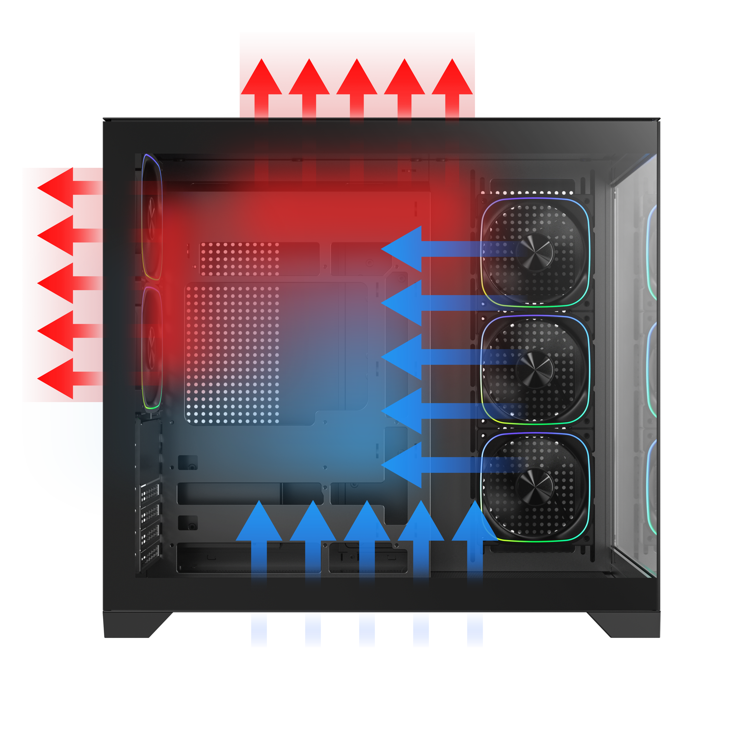
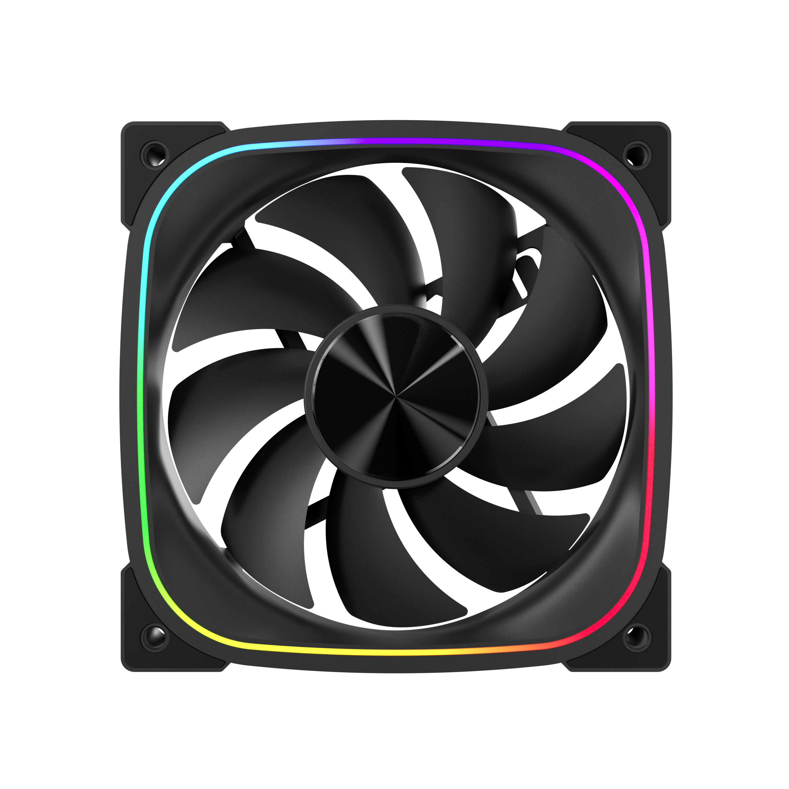
High-Performance Reverse ARGB Fan
DUAL CHAMBER
HIGH
3X
AIRFLOW PERFORMANCE
1X
High-Performance ARGB Fan

Slide 5
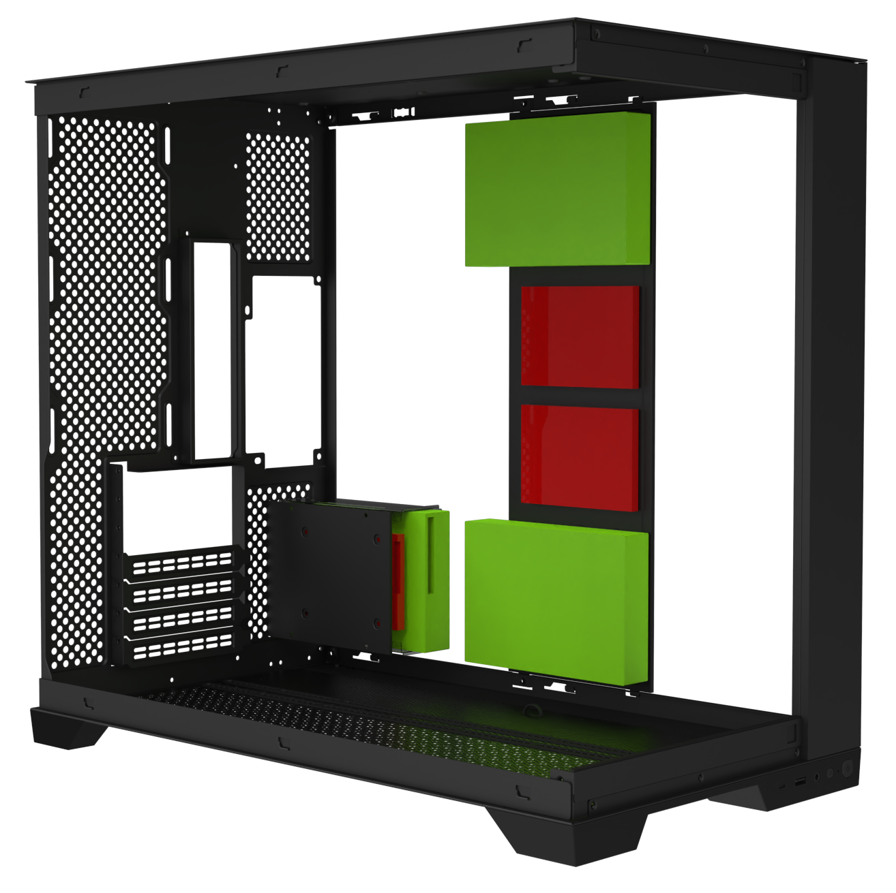
PSU
ATX & Standard /
up to 200mm
SSD
HDD
3 X 3.5’’ Drive & 3+2 X 2.5’’Drive

Slide 6
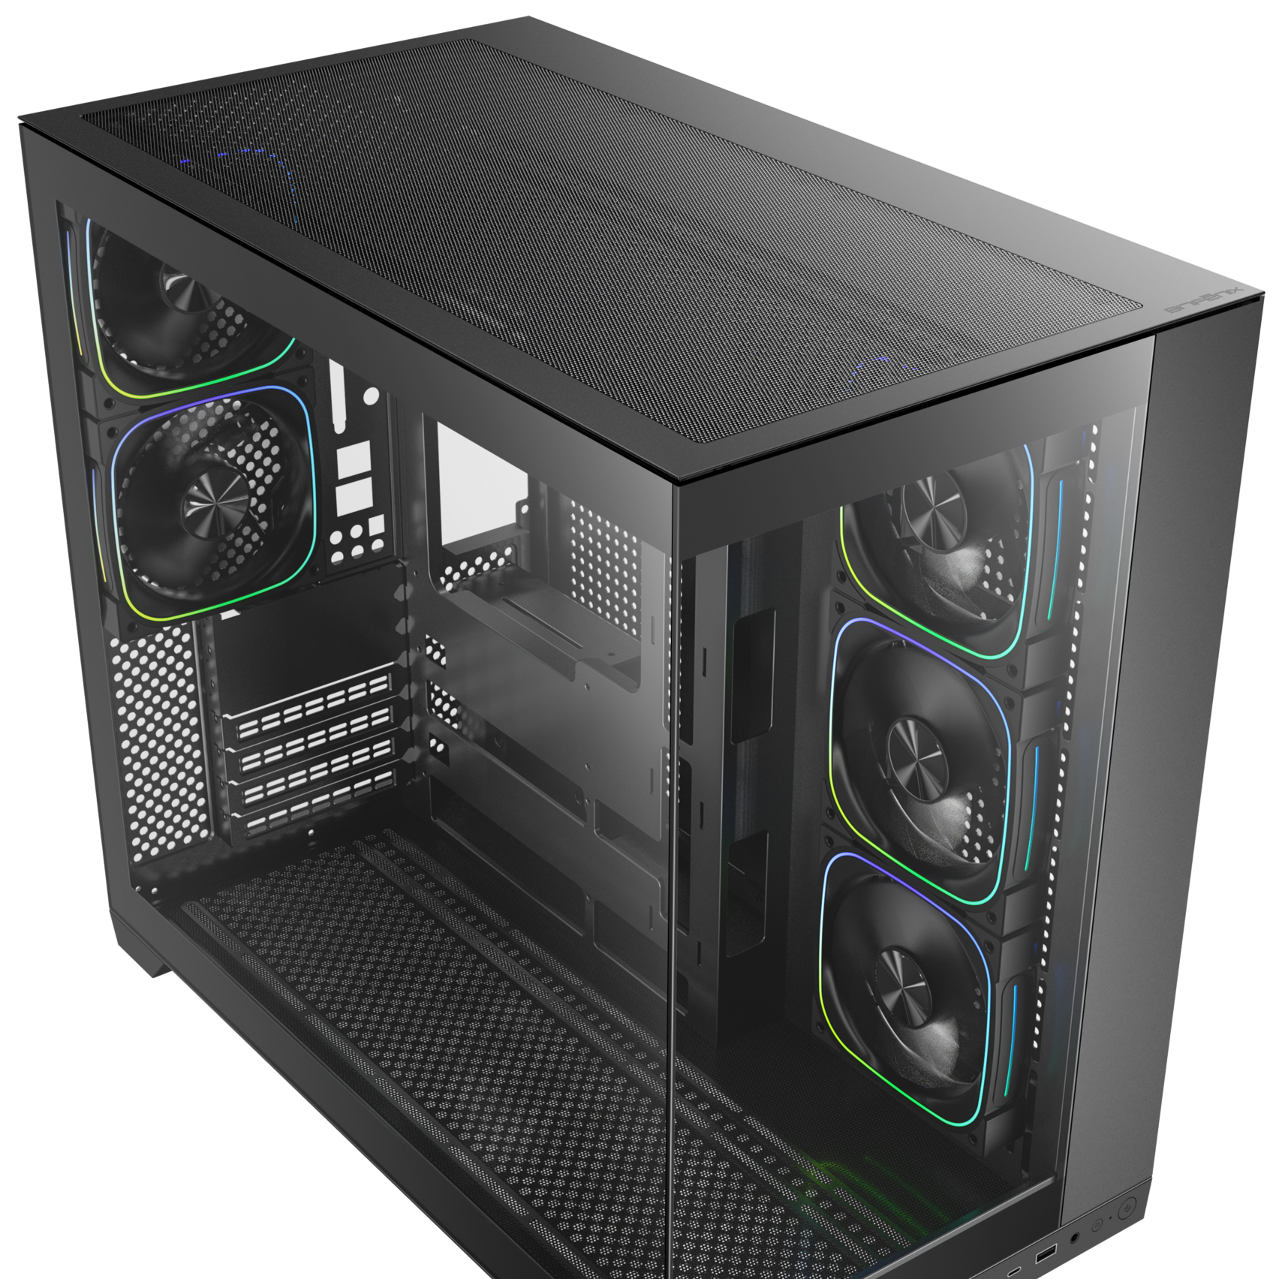
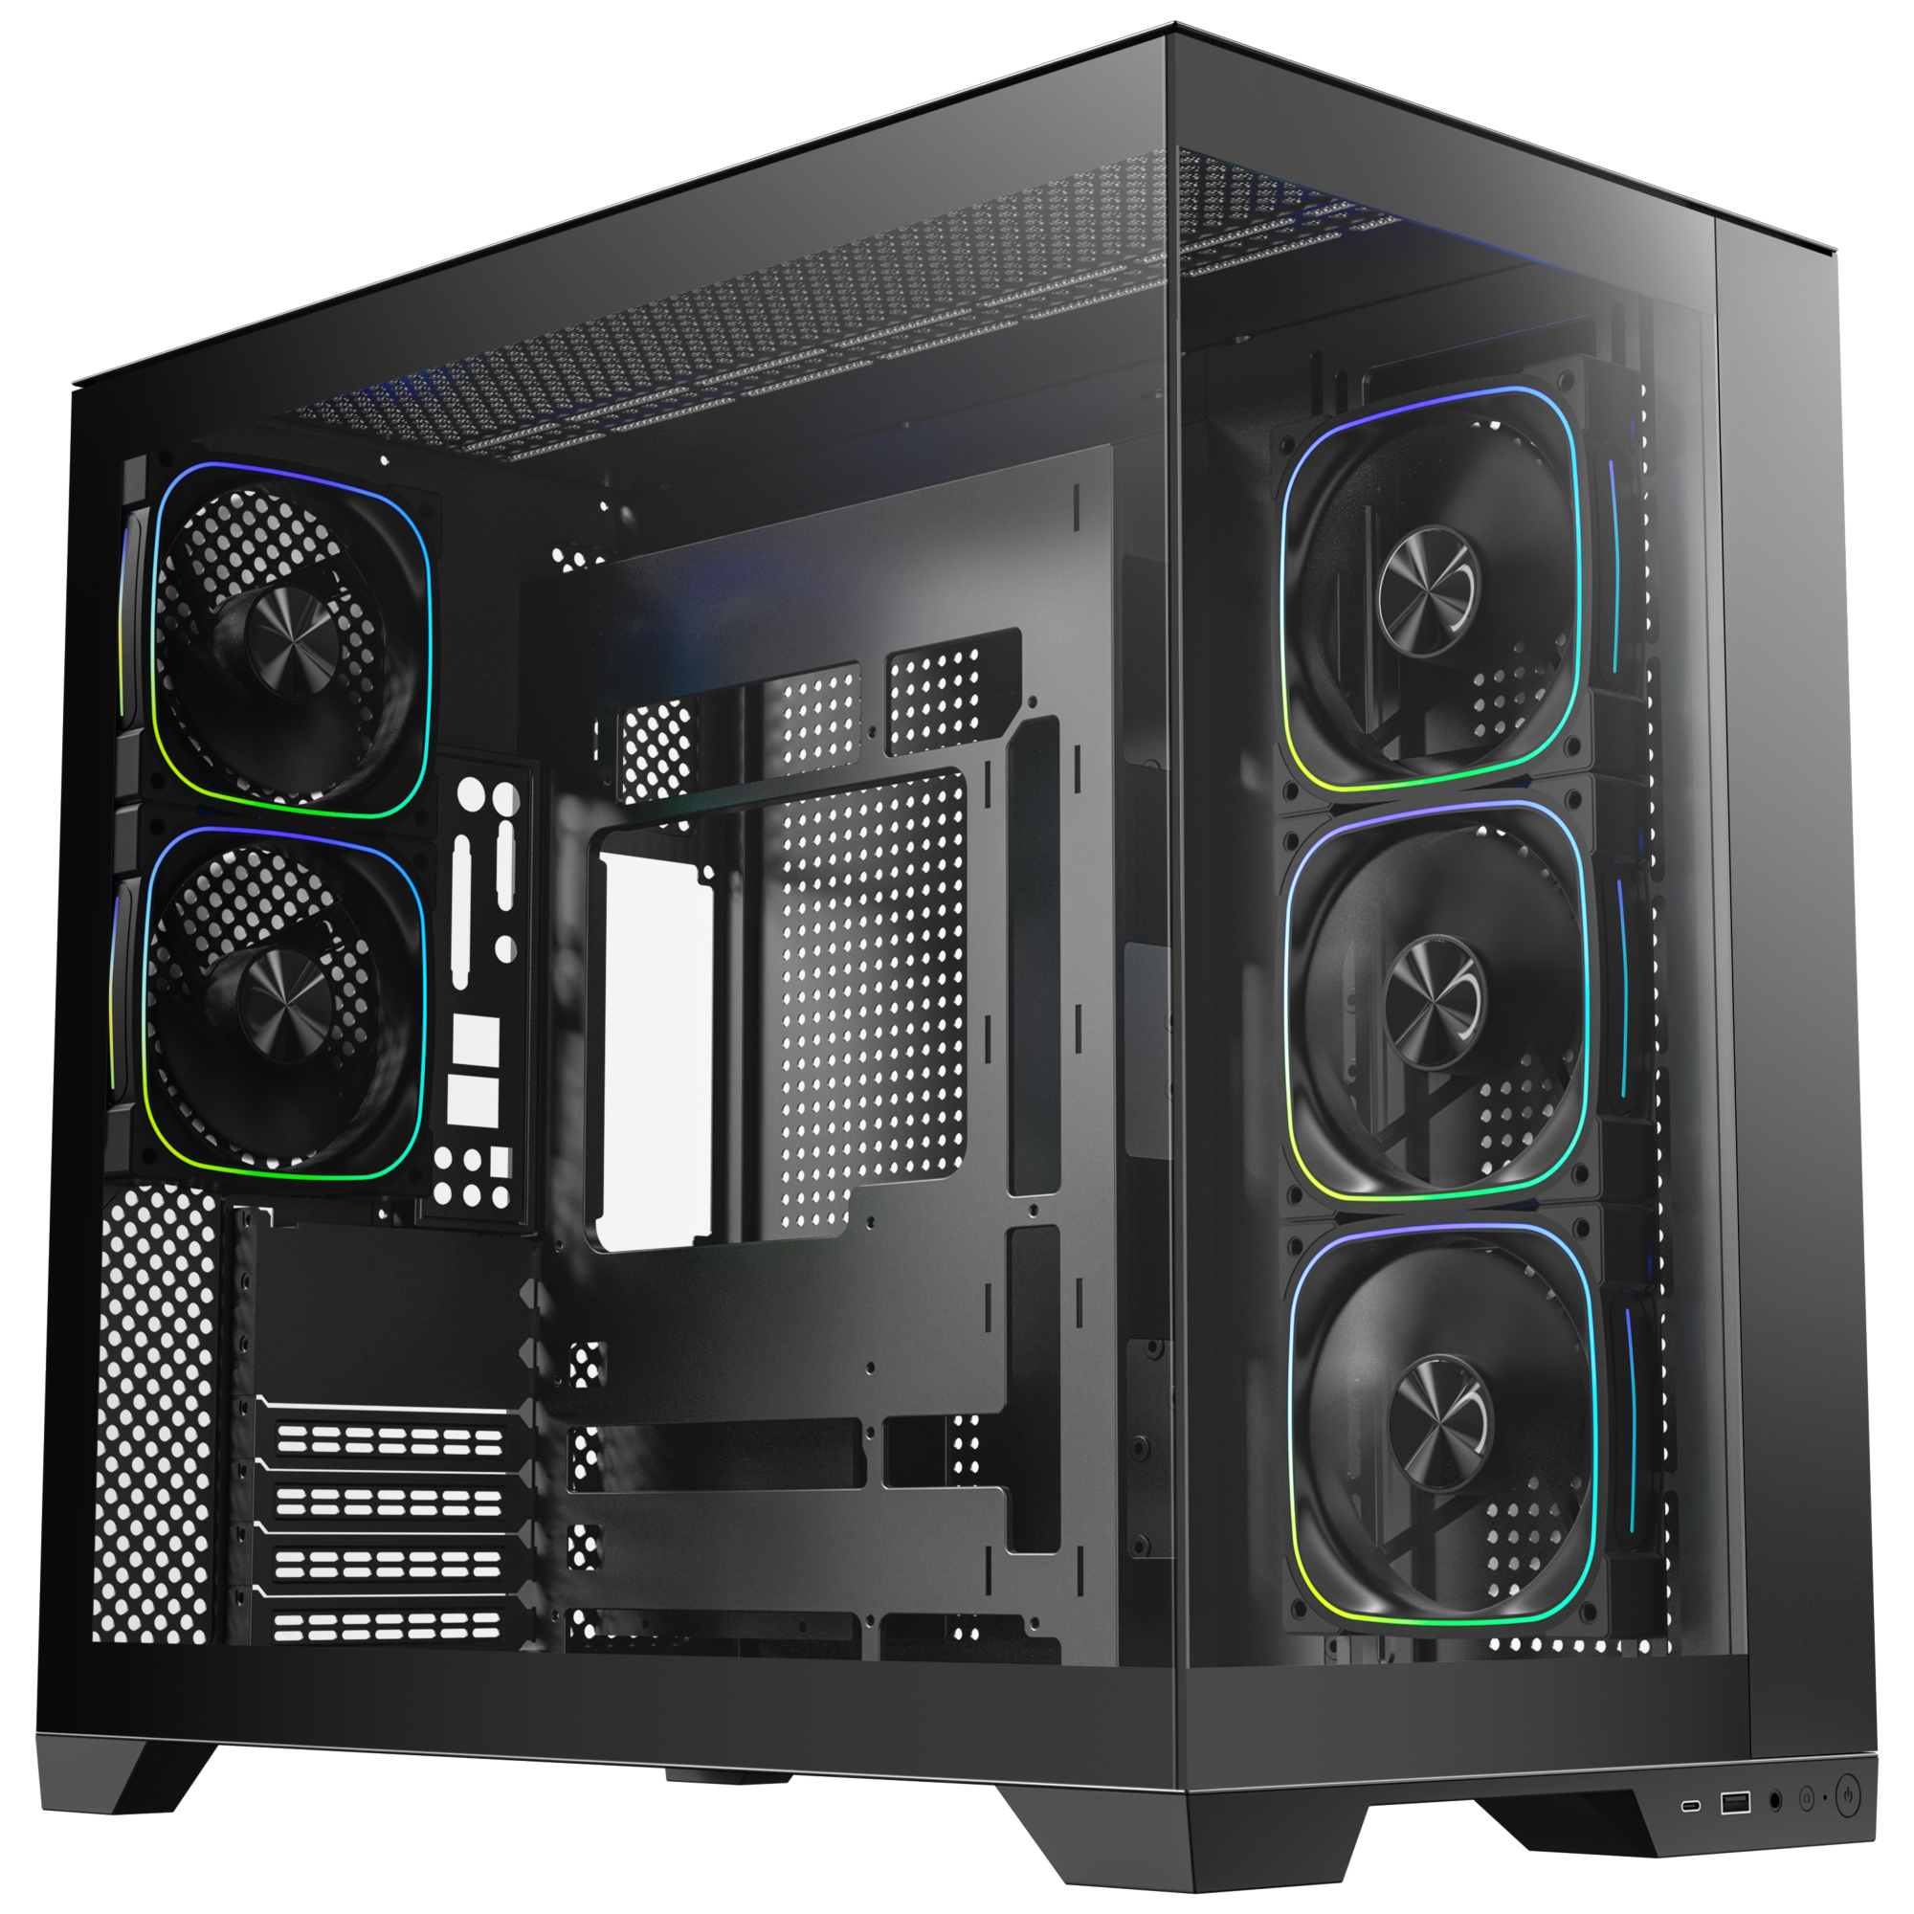
Top
Bottom
Easy Clean With Removable Dust Filters

Slide 7
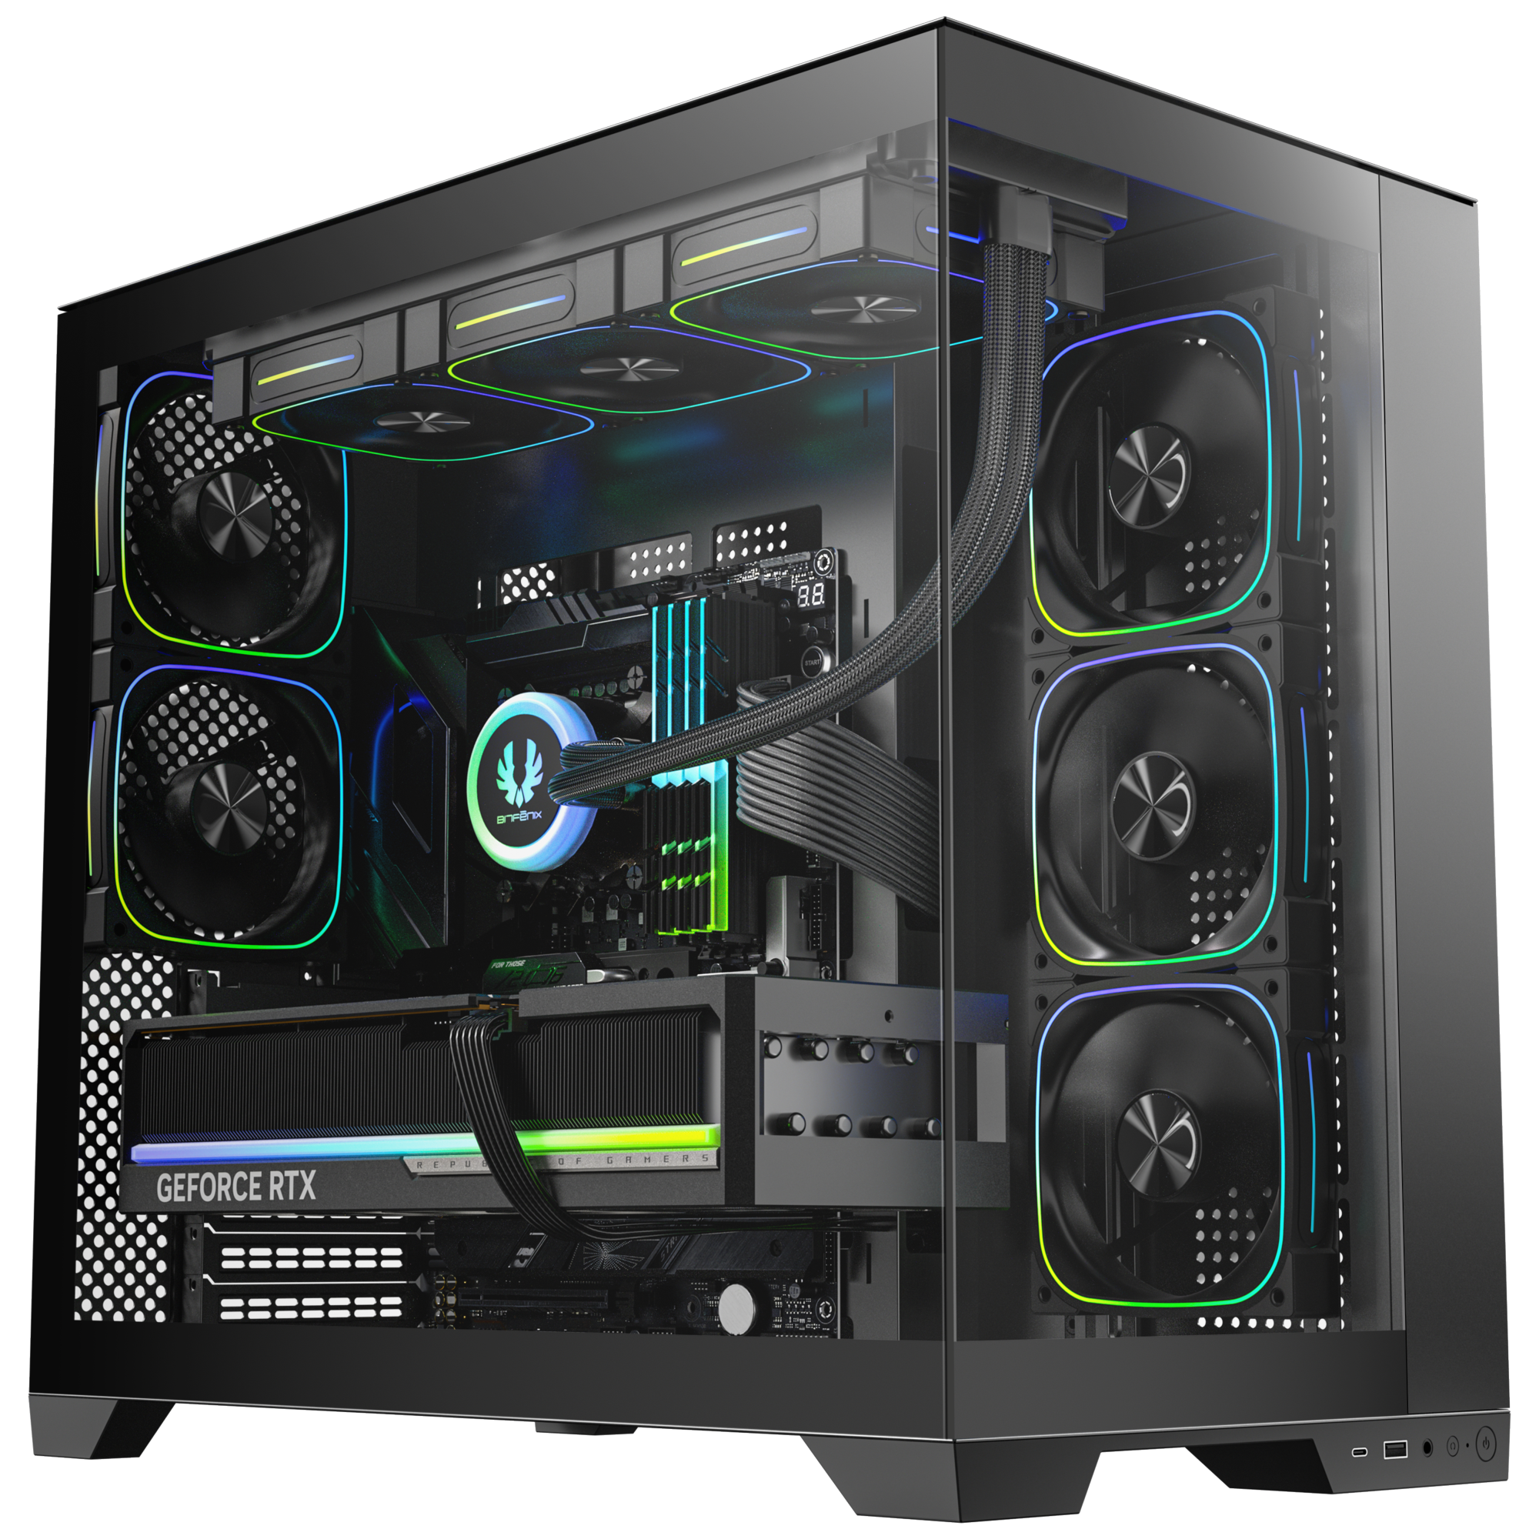
Tool-free Removal
Reset Button
Power Button
1X TypeC
1X USB 3.0

Slide 8
Best |  | Black
Part no. |  | BFC-DH85KKGKK-5F
EAN |  | 4716779449150
UPC |  | 886027007532
Net weight (NW) Gross weight (GW) |  | N.W: Kgs / G.W: Kgs
Materials |  | Steel, Mesh, Plastic, Tempered Glass
Chassis Dimensions (W x H x D) |  | 285 mm x 490 mm x 458 mm
Motherboard Supports |  | Mini-ITX, MicroATX, ATX, EATX
Air Cooler Height Support |  | 170mm
VGA Length Support |  | 440mm
Cable Management Support |  | up to 100mm
2.5" / 3.5" Drive Bay |  | 3+2 / 3
Fan mounts | MB | 3 x 120mm or 3 x 140mm
 | Top | 3 x 120mm or 3 x 140mm
 | Rear | 2 x 120mm
 | Bottom | 3 x 120mm or 3 x 140mm
Radiator Support | MB | 1 x 360mm/ 1 x 280mm/ 1 x 240mm (Thickness up to 27mm)
 | Top | 1 x 420mm/ 1 x 360mm/ 1 x 280mm/ 1 x 240mm (Thickness up to 27mm)
 | Rear | 1 x 120mm
 | Bottom | 1 x 420mm/ 1 x 360mm/ 1 x 280mm/ 1 x 240mm (Thickness up to 27mm)
PCI-E Slots |  | 7 Slots
I/O Ports |  | 1 x TypeC/ 1 x USB3.0/ Audio I/O
Power Supply |  | ATX & Standard / up to 200mm
DH-50
DH-50

