Slide 2
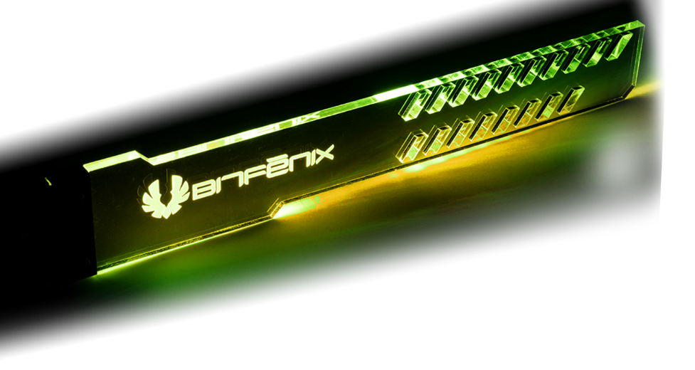
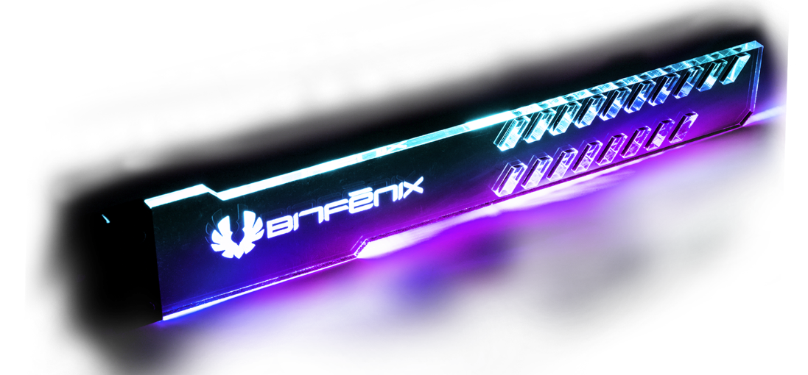
See-through crystal clear acrylics by laser carving, shining with magnificent addressable RGB illumination, Alchemy 3.0 ARGB GPU Bracket provides strong strength to support all sizes
of graphics cards up to 7.5 Kg and height of 80-120 mm

Slide 3
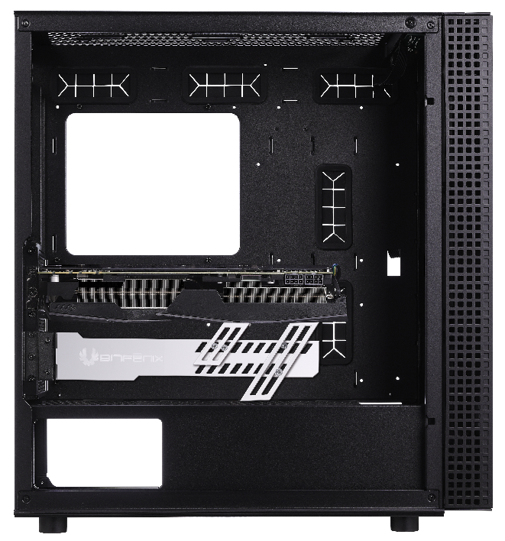
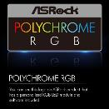
The 18 mounting holes enables the flexibilities to fit all sizes of graphics cards.
3 sizes of extension holders included, 45mm, 80mm and 120mm, for you to customize the best strength you would like to have to hold your graphics card.
Note: Please make sure there are at least 3 PCI slots free under the graphics card to be able to install the GPU bracket

Slide 4
MAXIMUM GRAPCHIC CARD WEIGHT SUPPORT | 7.5 kg
Cable Length | 700mm
RGB Pin Header | 5V 3-pin
Dimensions | 280X45X10.2mm (11 x 9.6x 0.4 inch)
Main Holder
Short Extension Holder(45mm)
Midium Extension Holder(80mm)
Long Extension Holder(120mm)

Slide 5
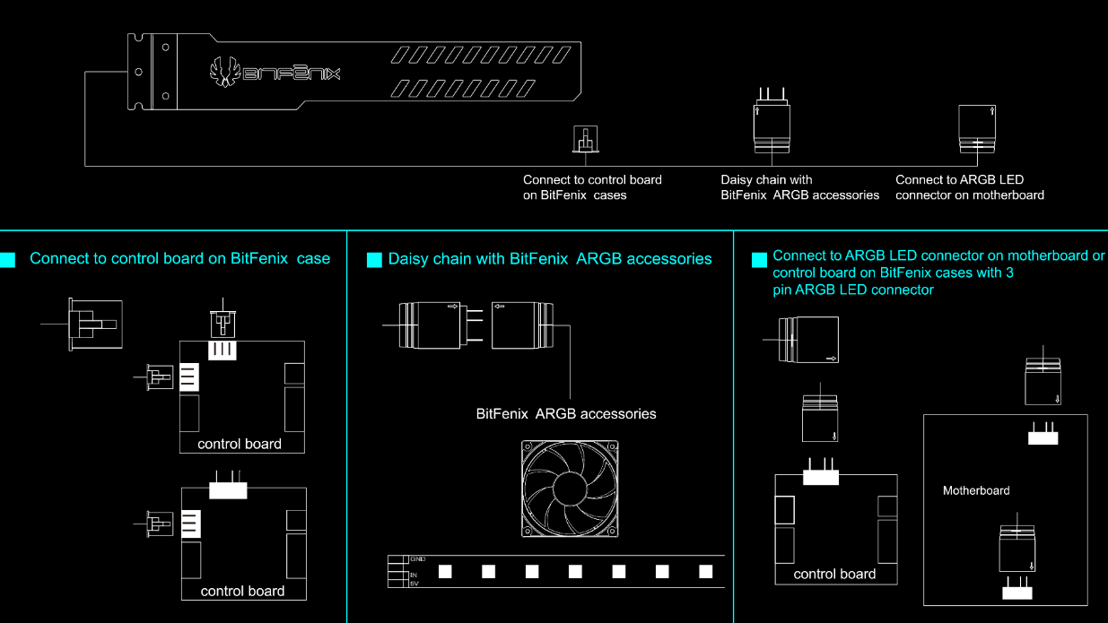
Daisy chained and synchronized with all Alchemy 3.0 ARGB LED strips and Spectre ARGB fans

Slide 6
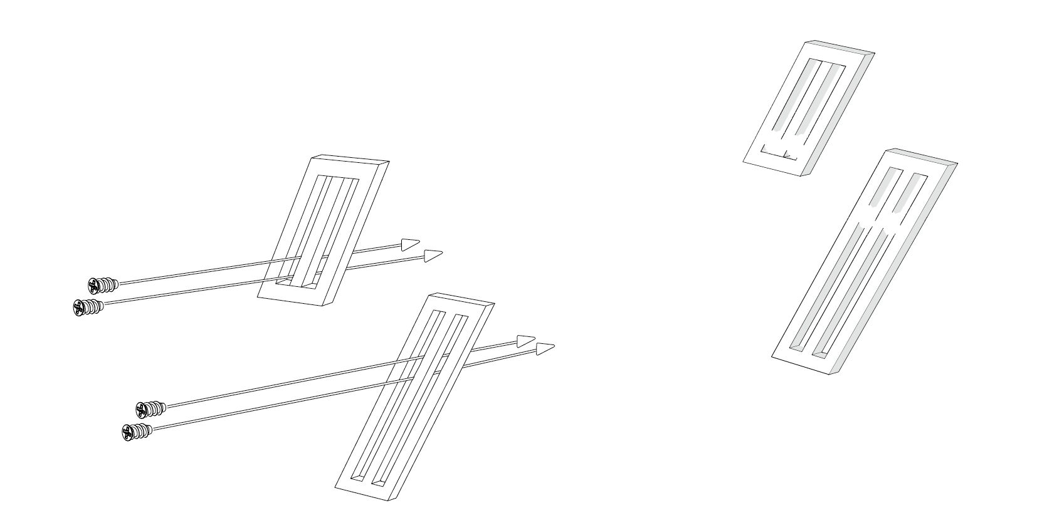
How to install the Extension Holder From Front

Slide 7
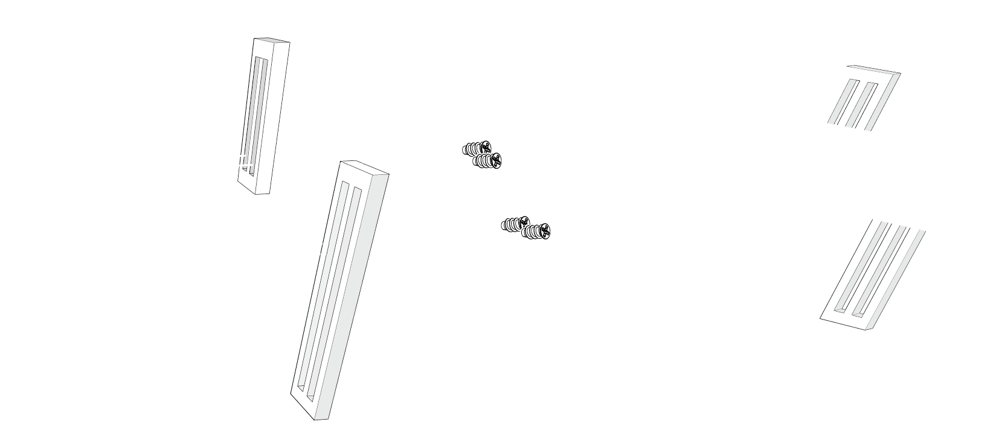
How to install the Extension Holder From Rear

Slide 8
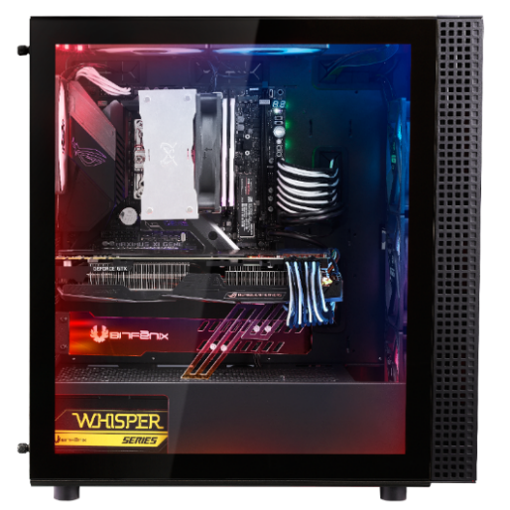
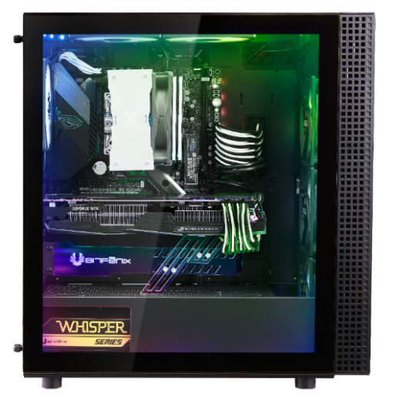
Alchemy 3.0 Addressable RGB GPU Bracket
Name | Part Number | EAN | UPC
Alchemy 3.0 Addressable RGB GPU Bracket | BFA-GPUBKT-ADDG1-RP | 4712883217265 | 886027158869

