Slide 1

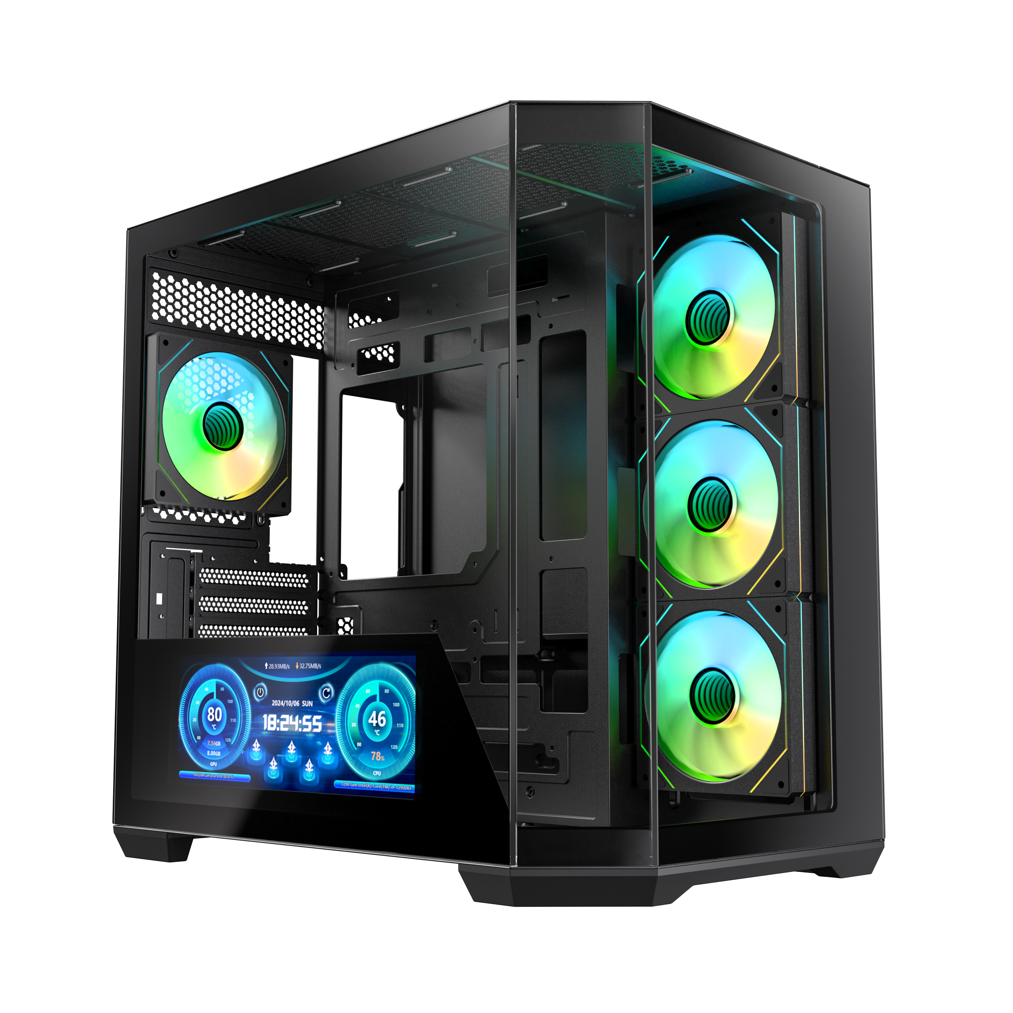
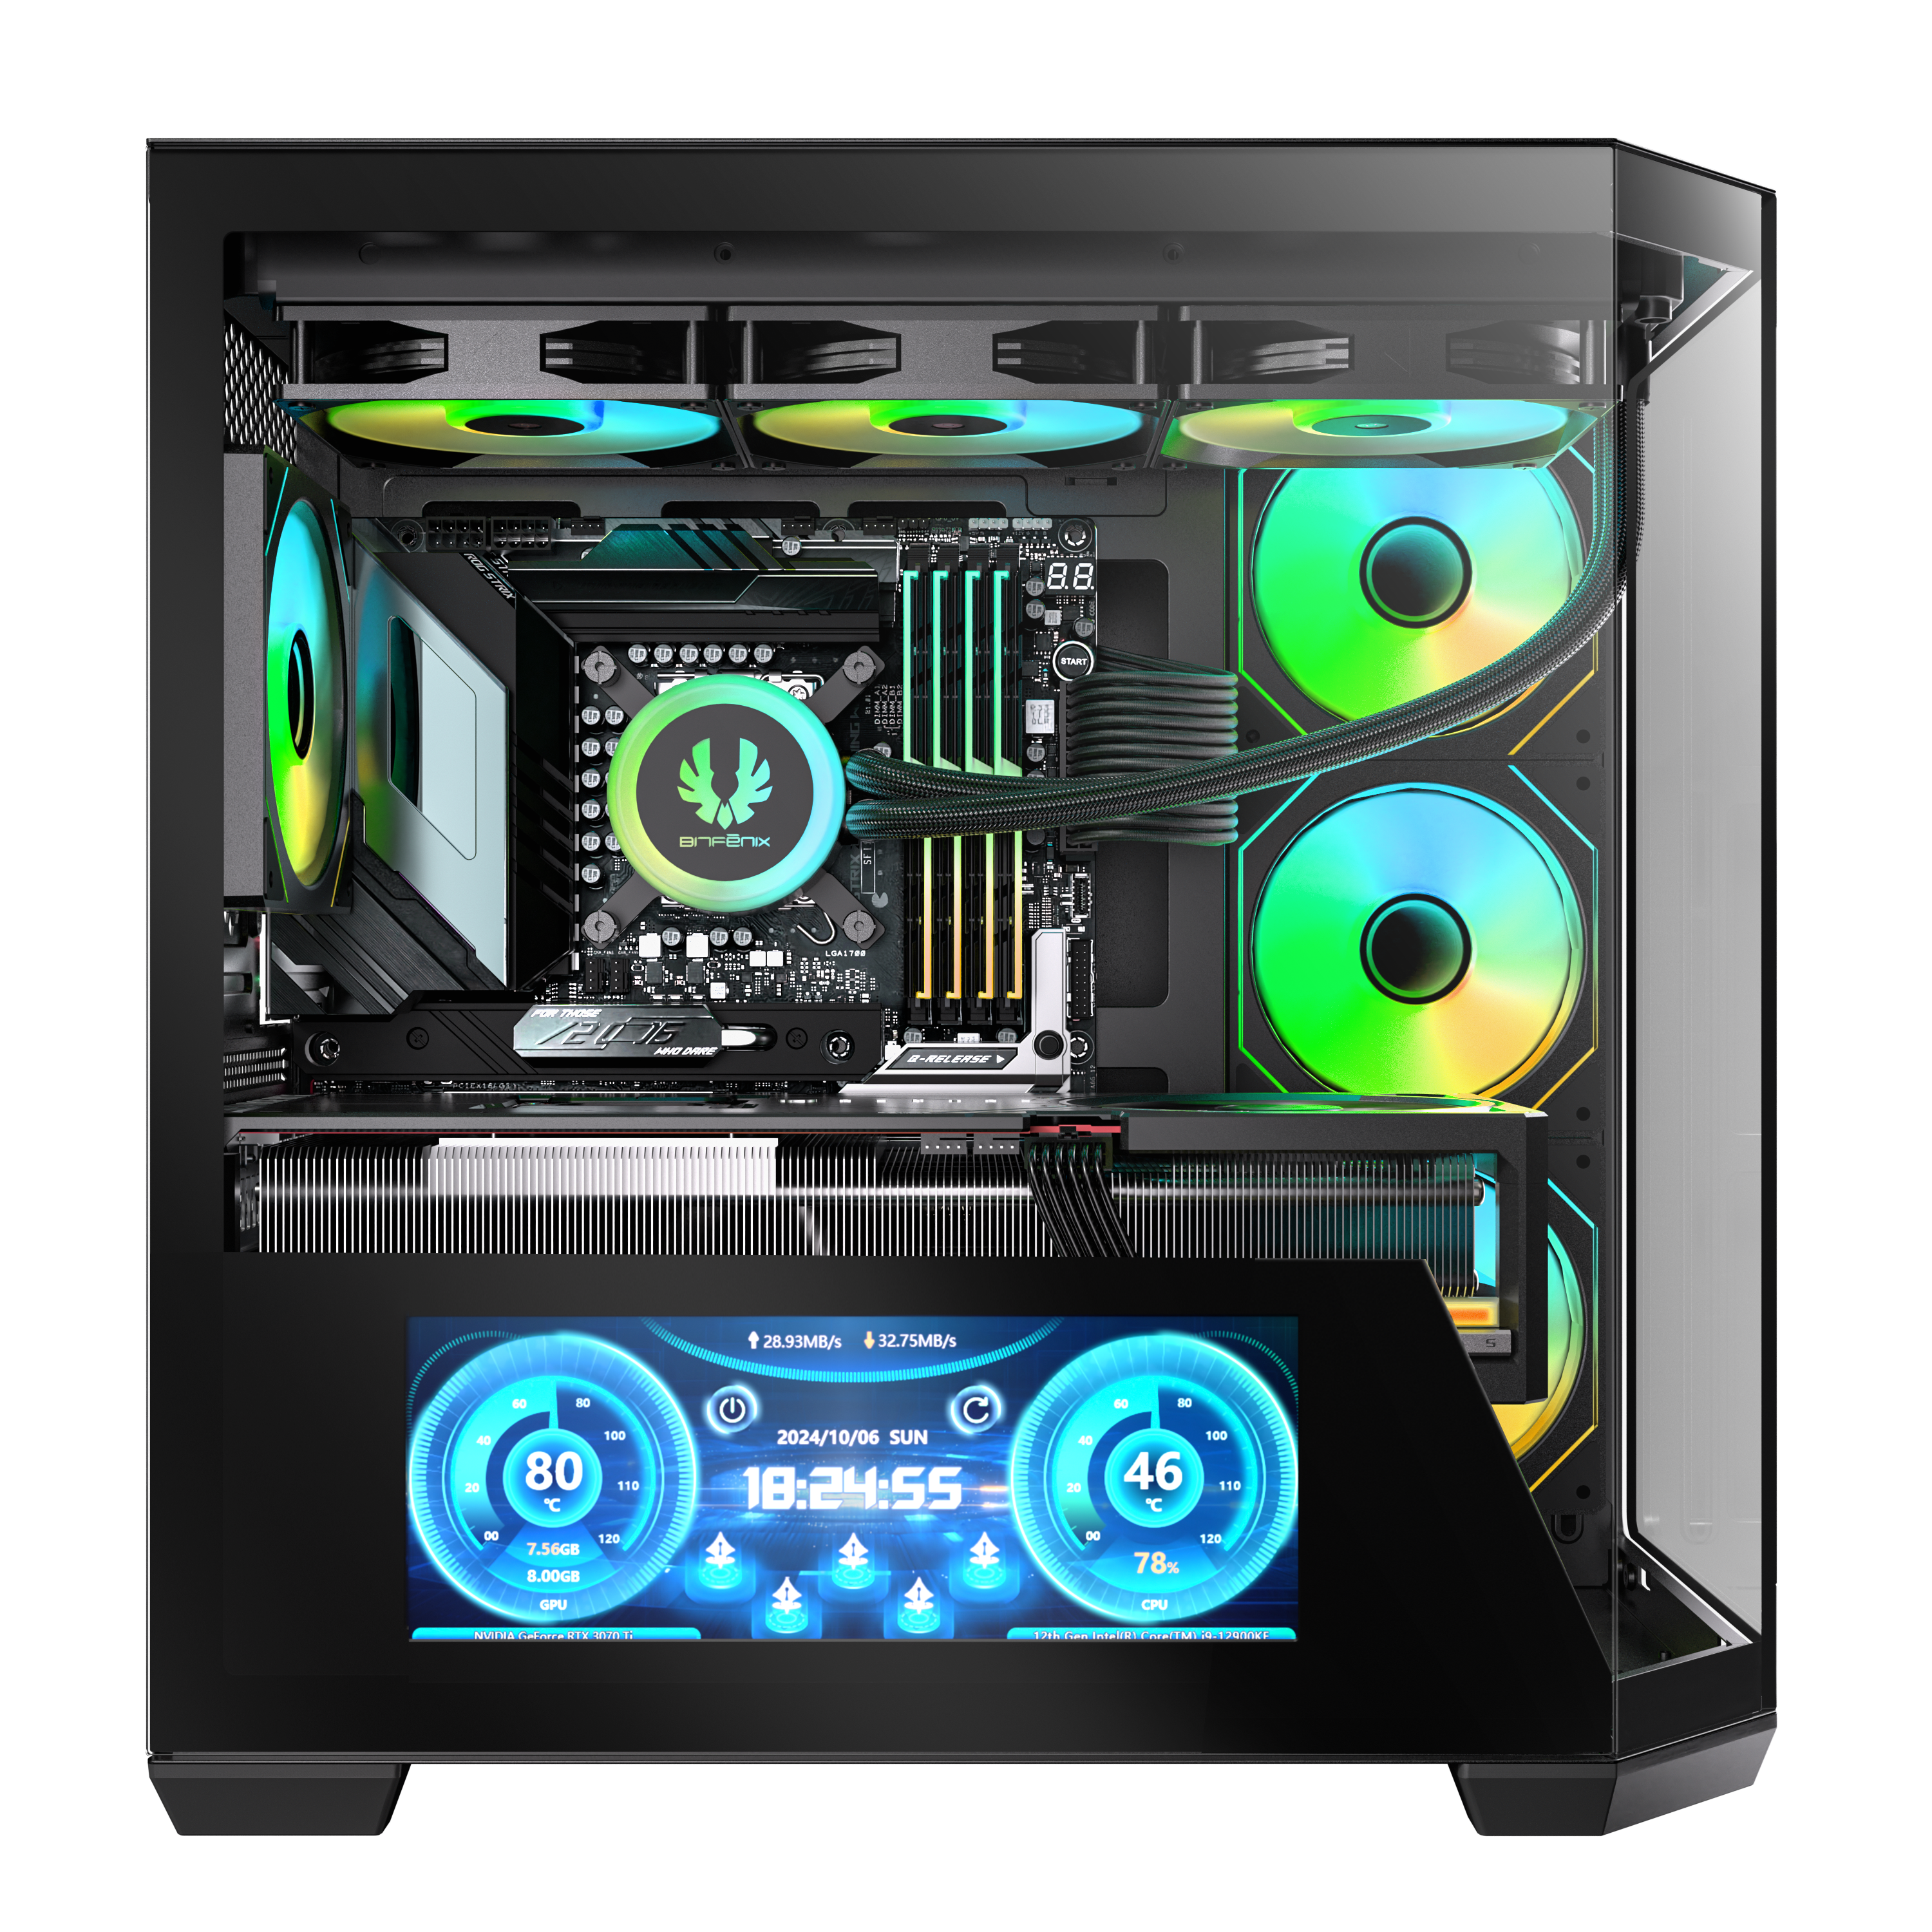
T1O
DIGITAL ES
10.24 INCH

Slide 2

540 X 1440 Pixels 10.24-inch IPS Live Performace Display
243mm
91mm

Slide 3
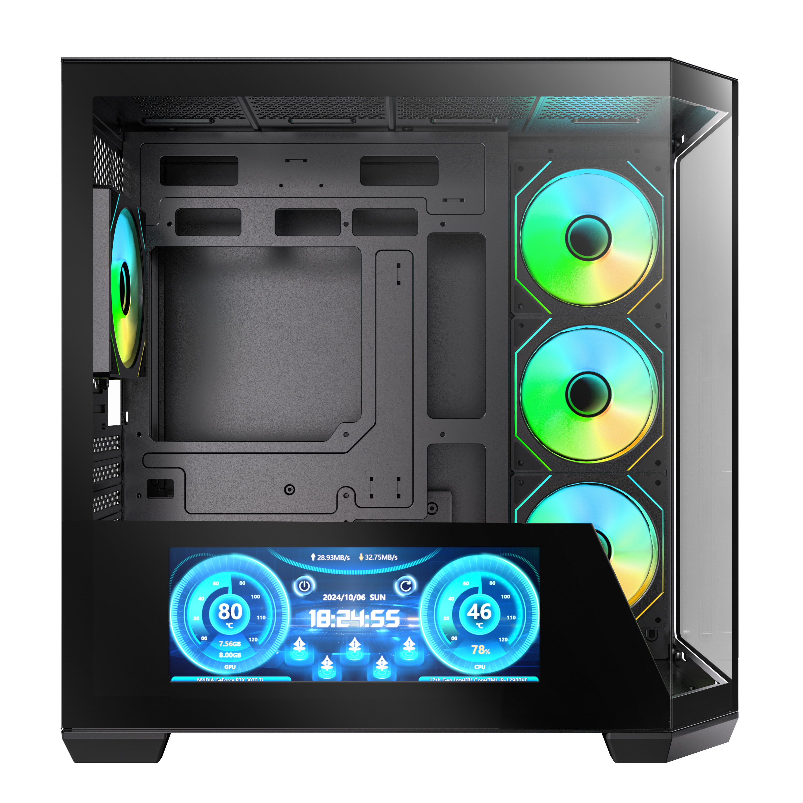
360 mm AIO Support At Top
MB

Slide 4
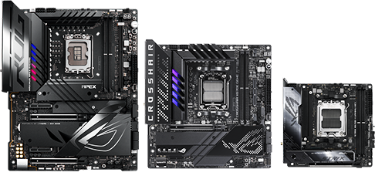
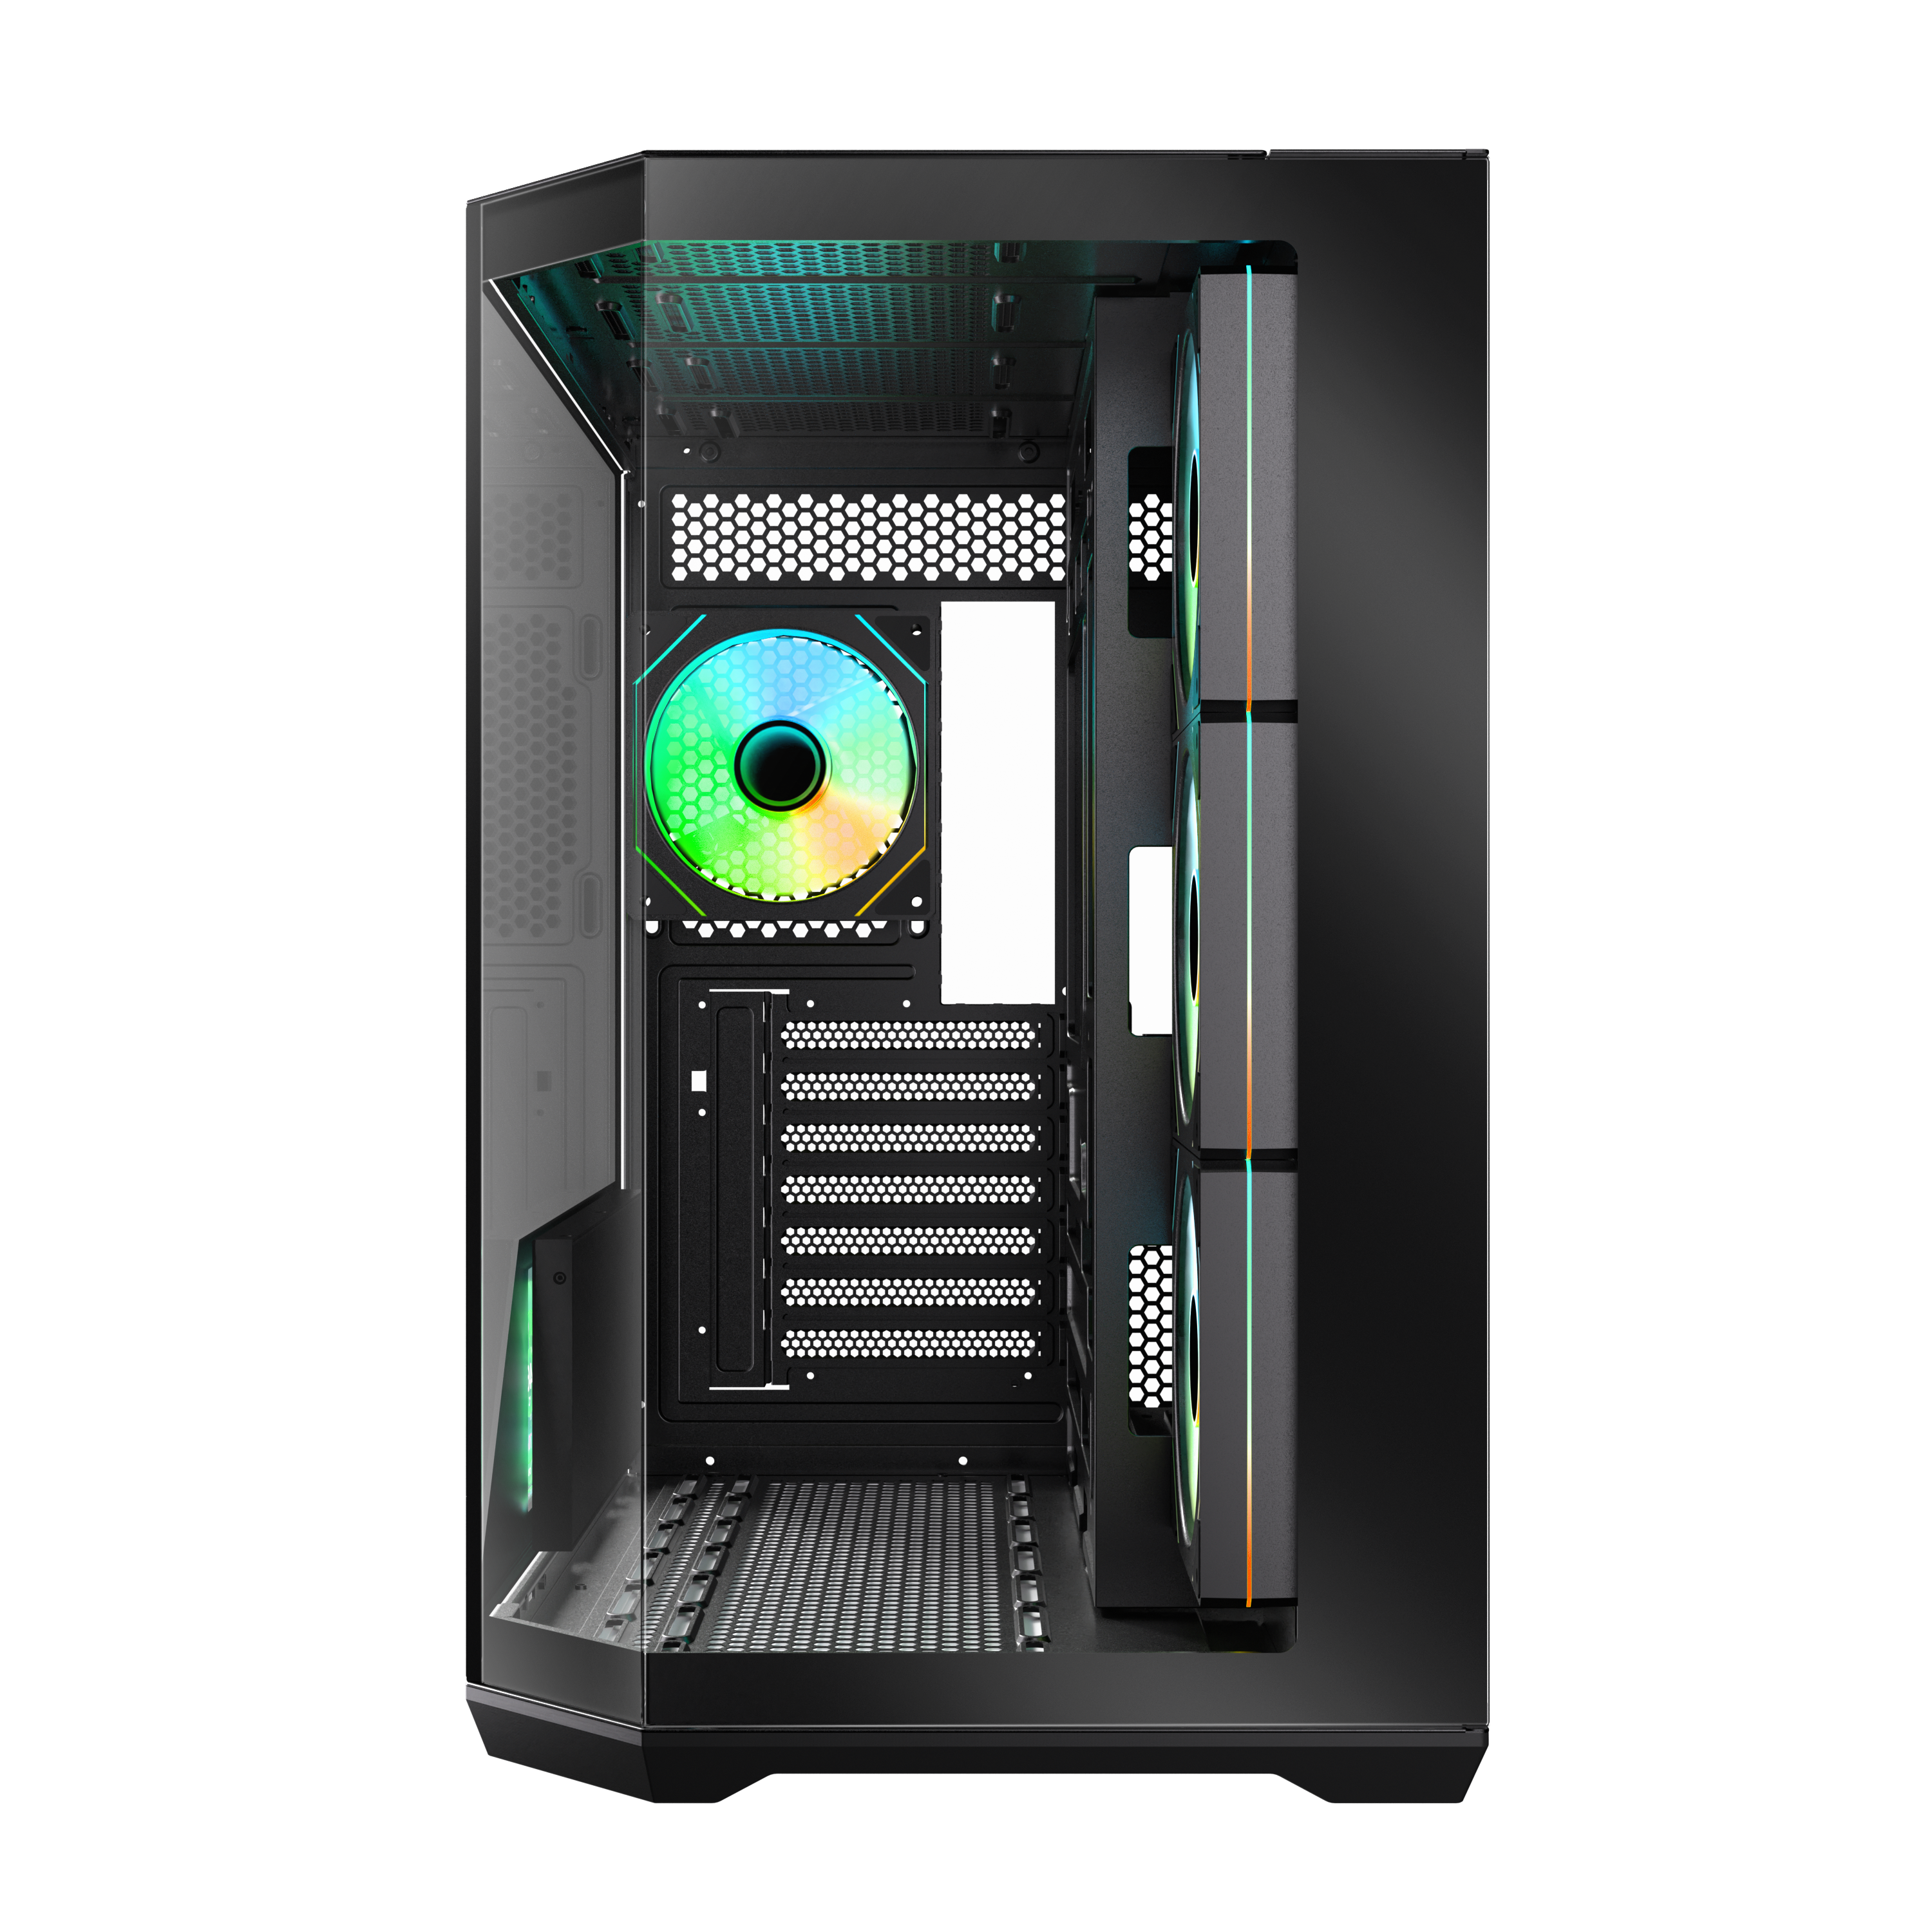
Motherboard
277mm(10.9 Inch)
443mm(17.4 Inch)
VGA Length Support
Motherboard
Support
Maximun CPU
Cooler Height
420mm
155mm
(6.1 Inch)
Mini-ITX
Micro
ATX
(16.5inch)
426mm(16.7 Inch)
Cable Management Space 90mm(3.5 Inch)
Maximun Graphics Card Support
Cable Management
420mm(16.5 Inch)
Up To
90mm(3.5inch)

Slide 5
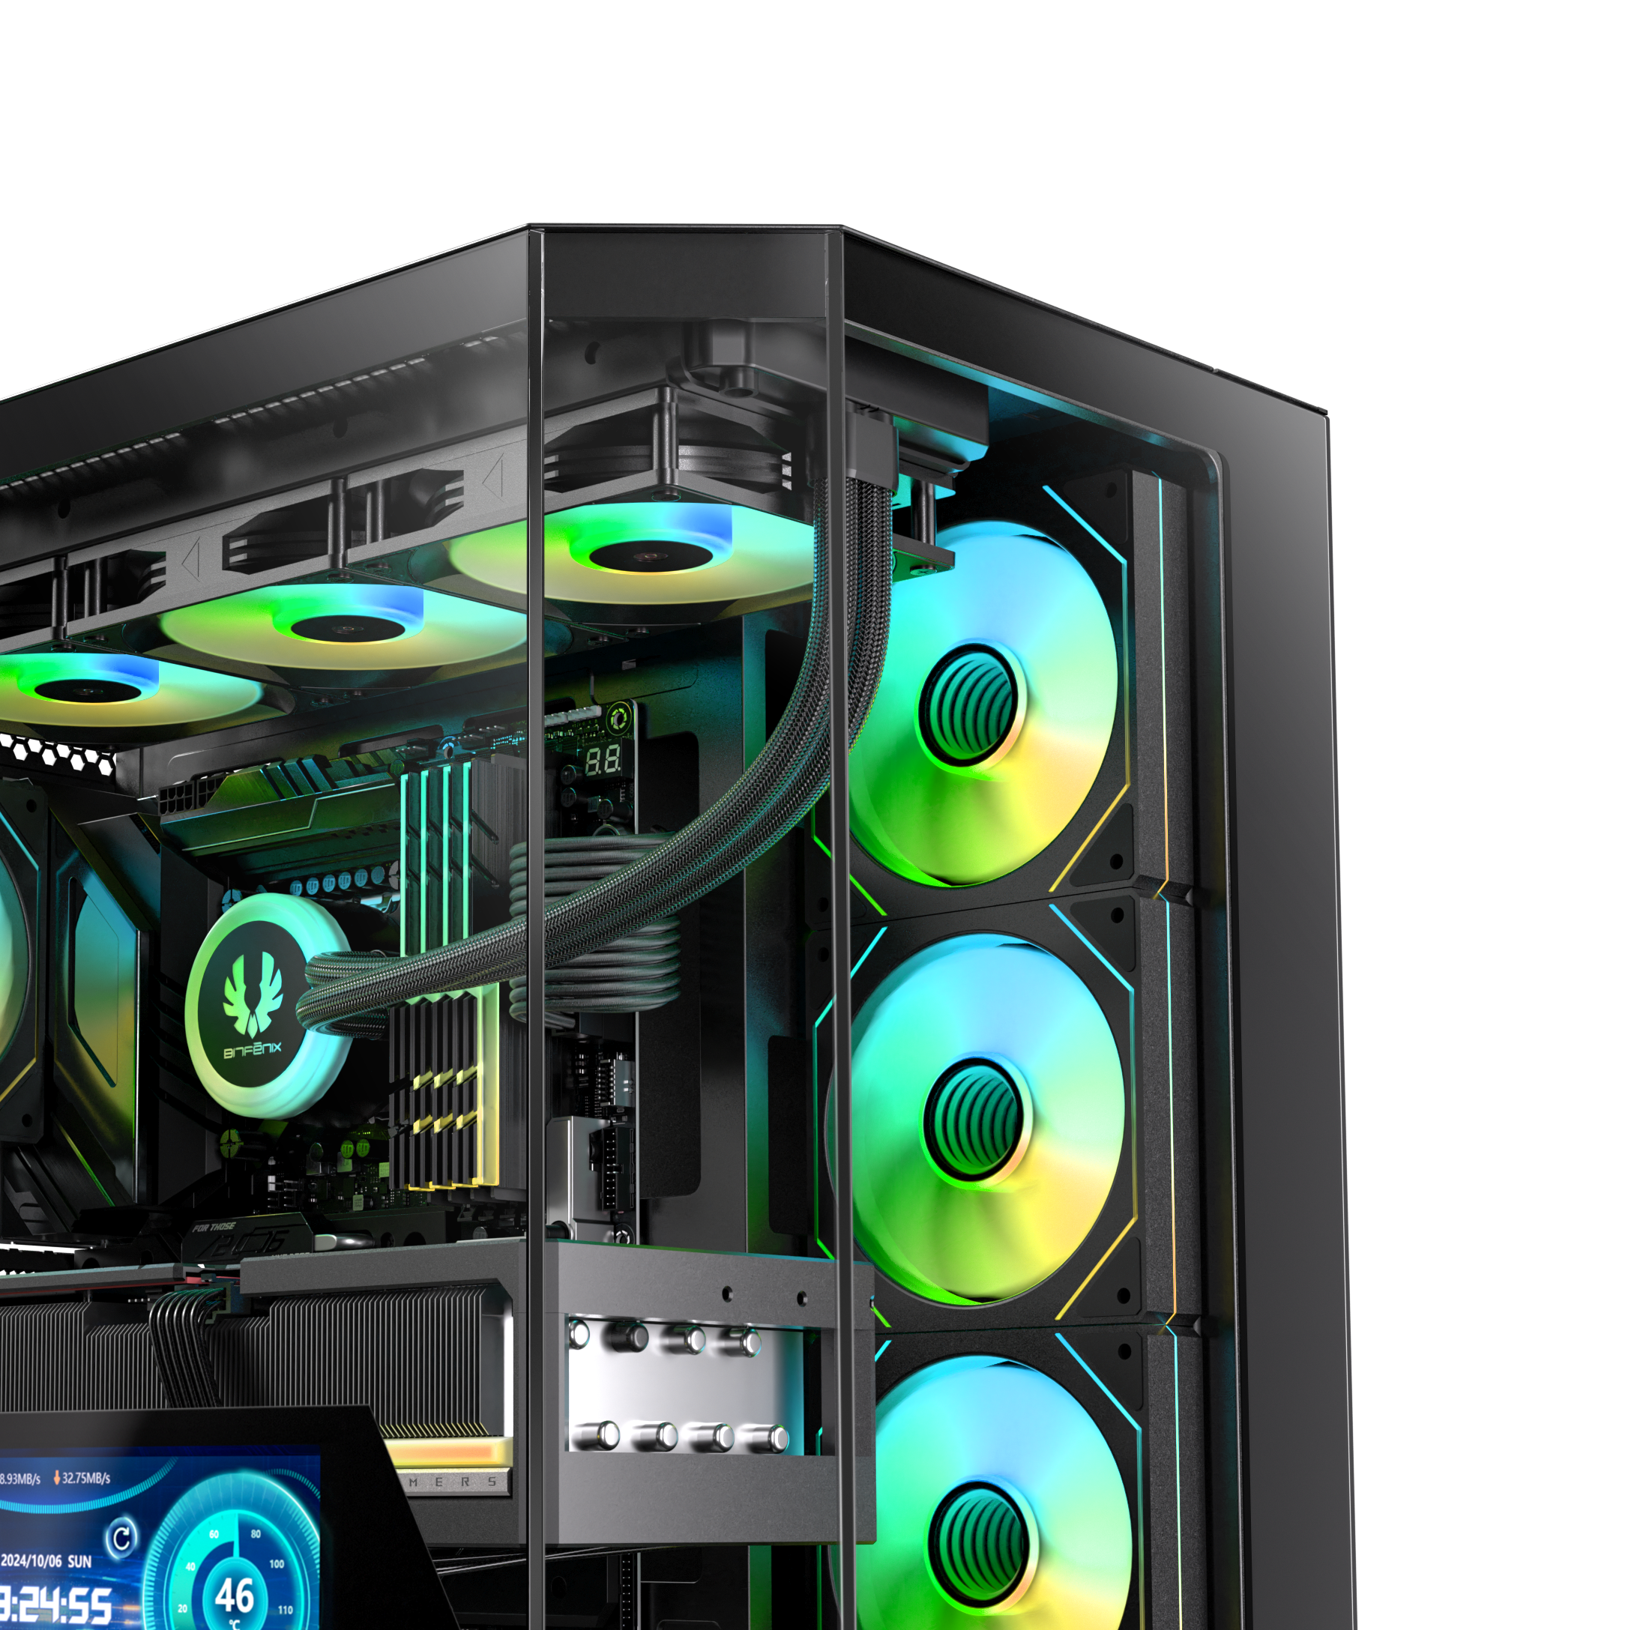
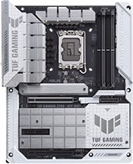
Trendy Design With Reverse Connect ATX Motherboard Compatibility
TUF GAMING
Z790-BTF WIFI

Slide 6
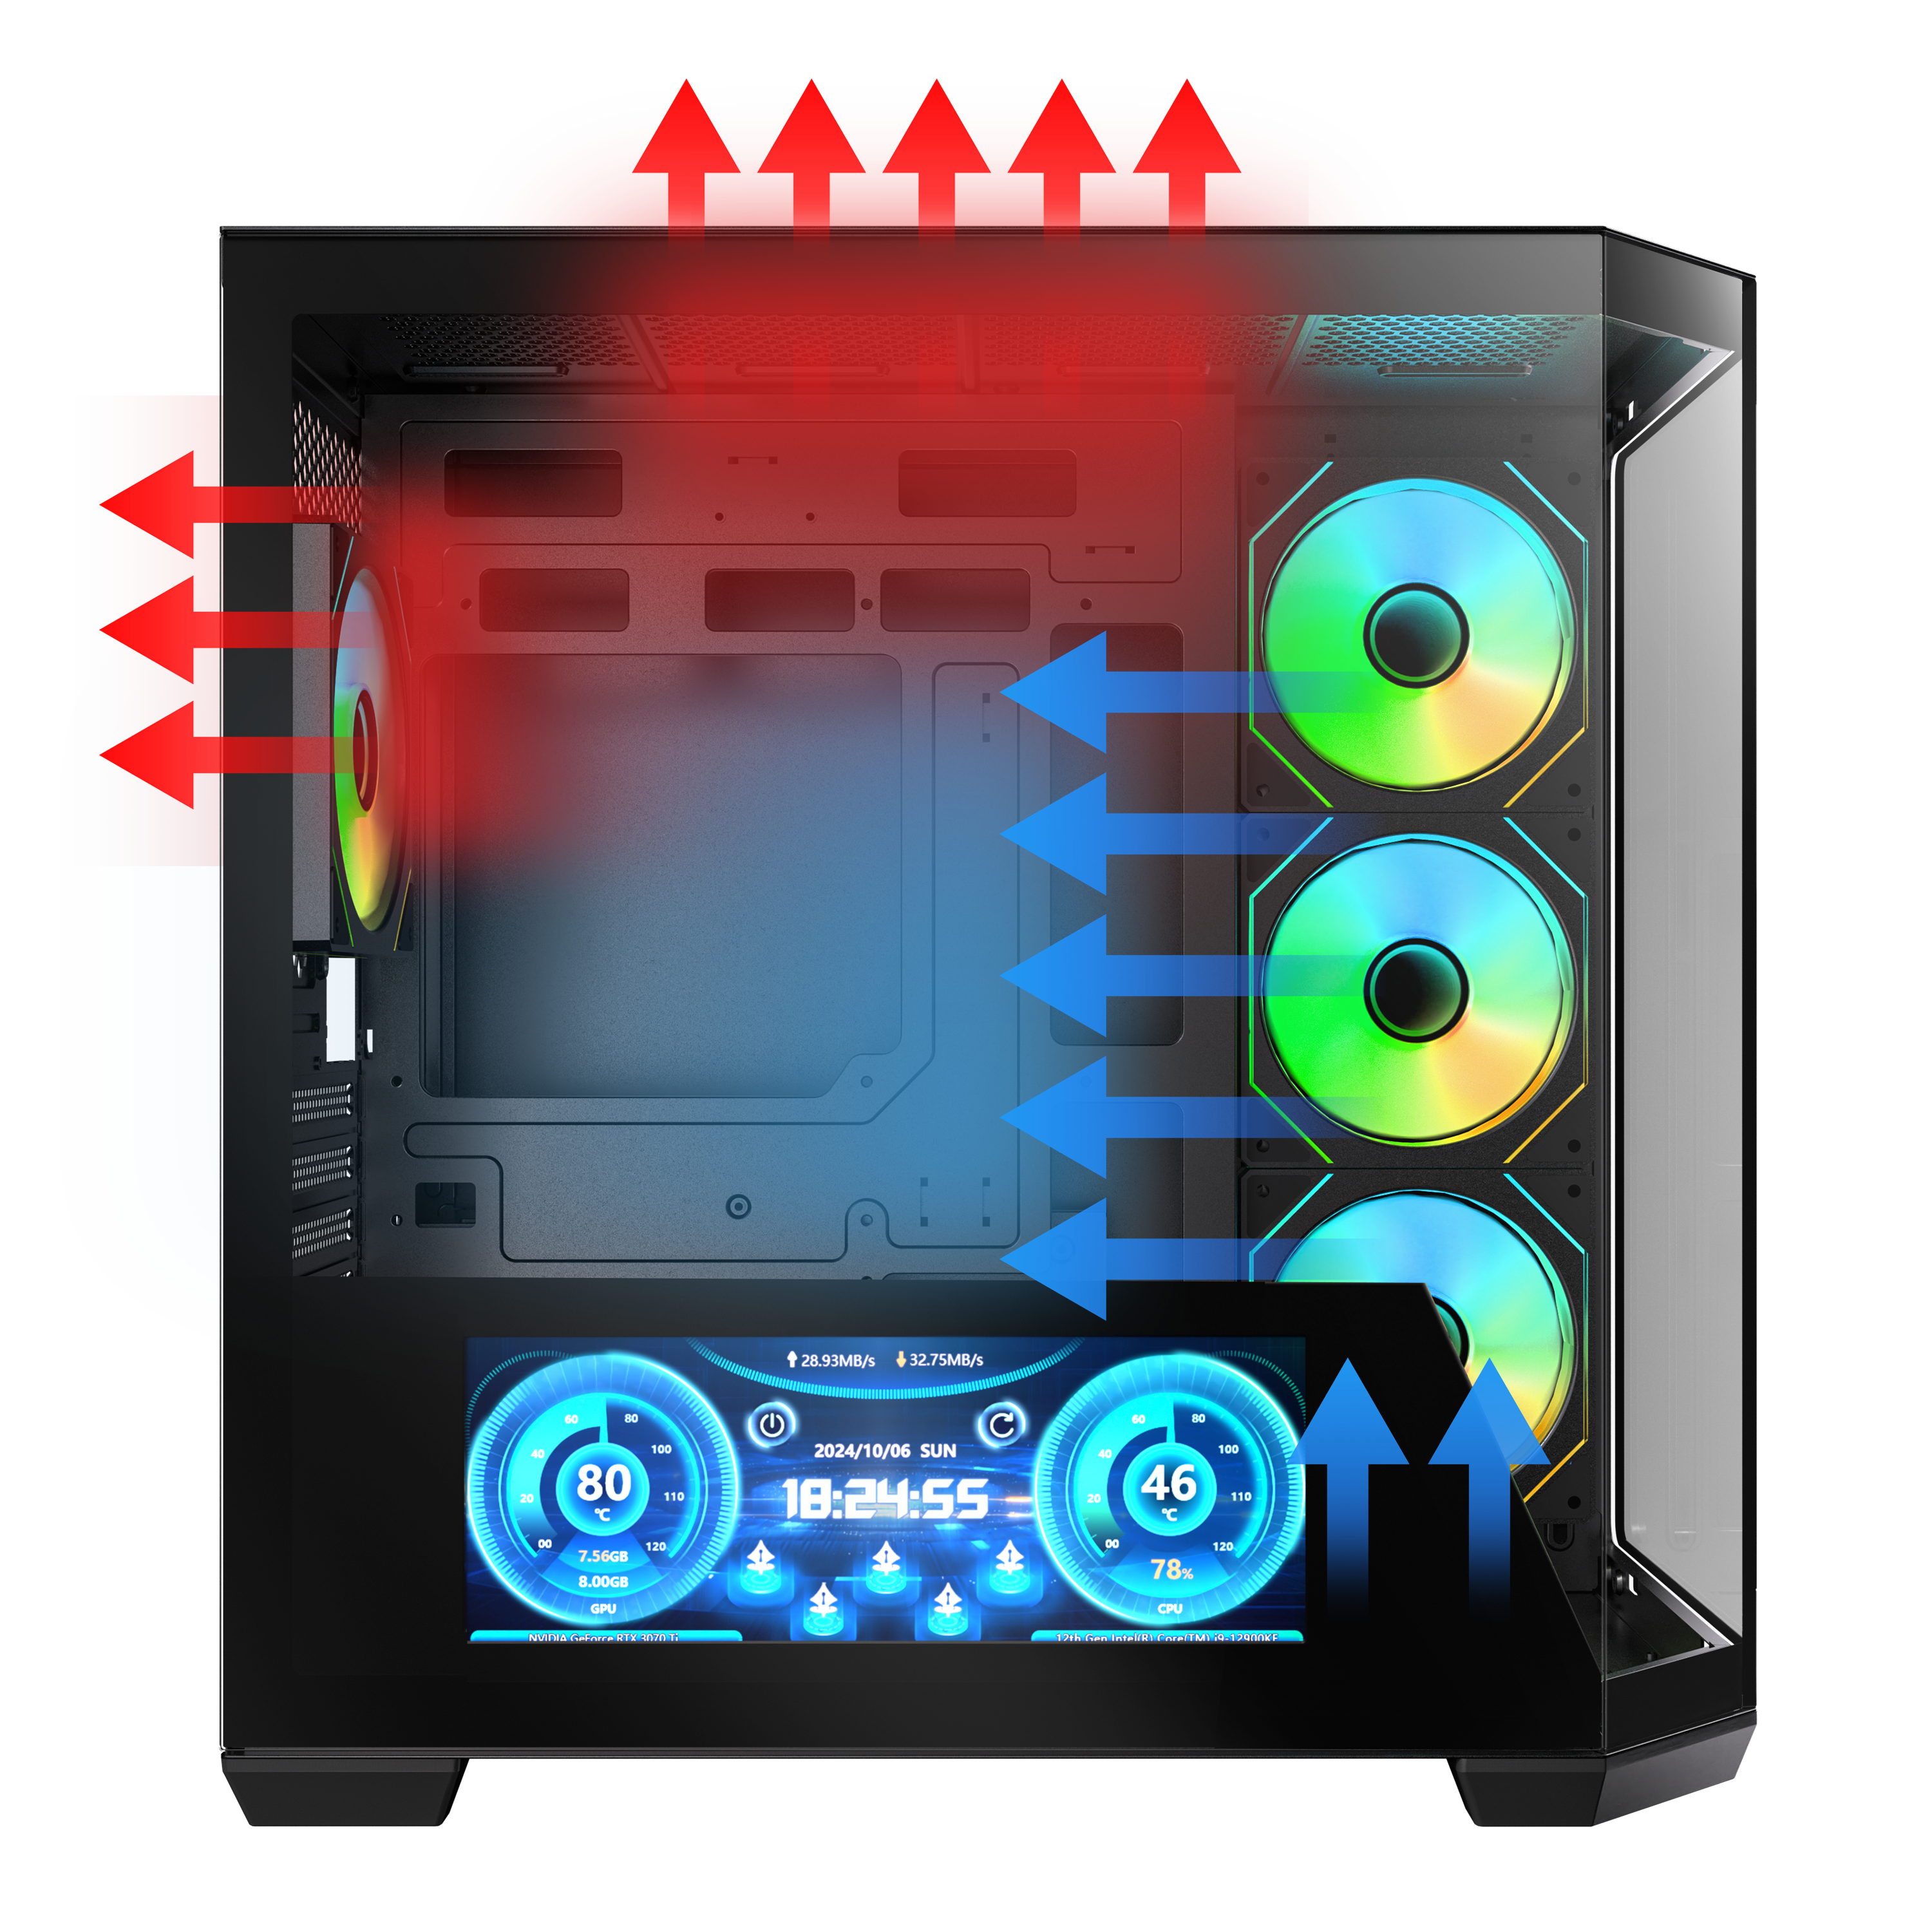

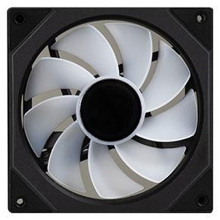
Reverse Infinity Mirrors ARGB fans
3X
DUAL CHAMBER
HIGH
AIRFLOW PERFORMANCE

Slide 7
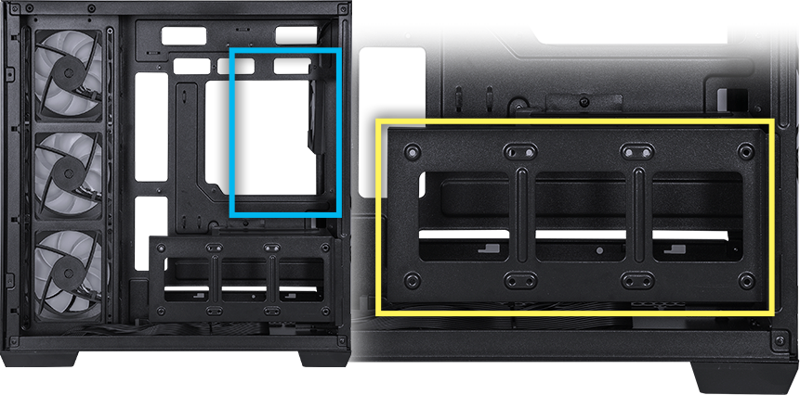
Power Supply
ATX & Standard /
up to 200mm(7.8 Inch)
2X 3.5” Drive or 3X 2.5” Drive

Slide 8
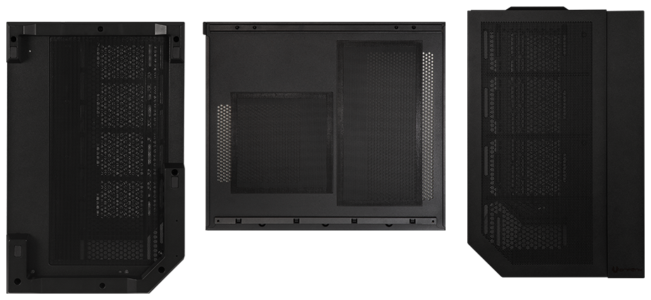
Bottom
Top
Side Panel
Easy Clean With Removable Dust Filters

Slide 9
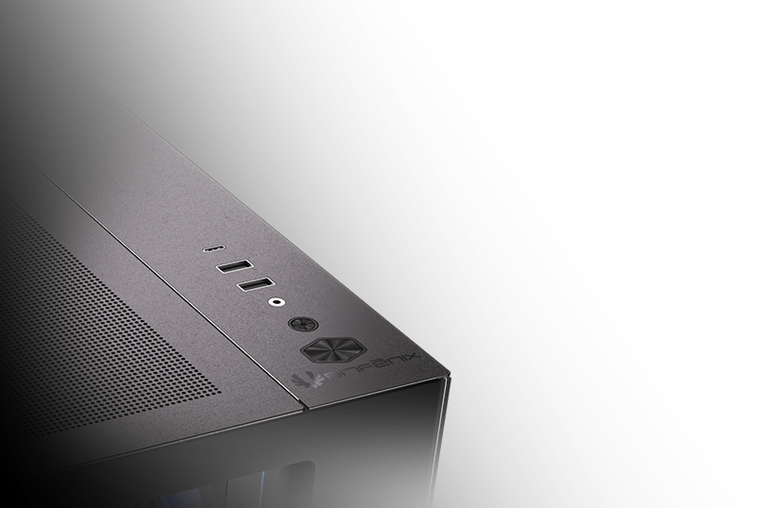

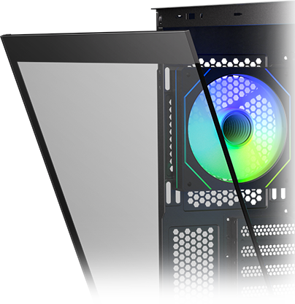
Snap-on Panel For Easy
and Tool-free Removal
1X Type-C & 1X USB 3.0
1X
Type-C
Power Button
1X USB 3.0
1X USB 2.0
Reset Button
( Caution!!! Please hold the glass panel with two hands)

Slide 10
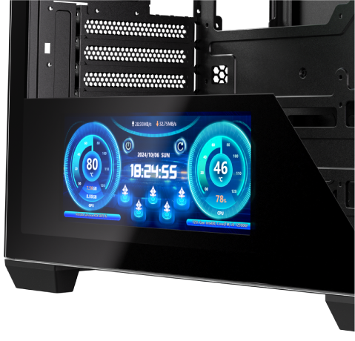
Display screen visible size
243mm x 91mm
T10 Digital ES 10.24 |  | Black | White
Part no. |  | BFC-KT10ES10-4A | BFC-WT10ES10-4A
EAN
UPC
Net weight (NW) Gross weight (GW) |  | N.W:6.9Kgs / G.W:7.9Kgs | N.W:6.9Kgs / G.W:7.9Kgs
Materials |  | Steel, Mesh, Plastic, Tempered Glass
Chassis Dimensions (W x H x D) |  | 277 mm x 426 mm x 443
Motherboard Supports |  | Mini-ITX, MicroATX, ATX
Air Cooler Height Support |  | 155mm
VGA Length Support |  | 420mm
Cable Management Support |  | up to 90mm
3.5" Drive Bay |  | 2
2.5" Drive Bay |  | 3
Fan mounts | MB | 3 x 120mm or 2 x 140mm
 | Top | 3 x 120mm or 2 x 140mm
 | Rear | 3 x 120mm or 3 x 140mm
 | Bottom | 3 x 120mm or 3 x 140mm
Radiator Support | MB | 1 x 360mm/ 1 x 280mm/ 1 x 240mm (Thickness up to 27mm)
 | Top | 1 x 360mm/ 1 x 280mm/ 1 x 240mm (Thickness up to 27mm)
 | Bottom/ Rear | 1 x 280mm/ 1 x 240mm (Thickness up to 27mm) /1 x 120mm
PCI-E Slots |  | 7 Slots
I/O Ports |  | 1 x Type-C/ 1 x USB 3.0/ 1 x USB 2.0/ Audio I/O
Power Supply |  | ATX & Standard / up to 200mm
Product (frame) size
264mm x 110mm x 15mm
Display resolution
540 x 1440 Pixels
Display interface Type-C,
USB Type-C adapter
cable, cable length 1000mm.
Adhesive backing on the front.

