Slide 1
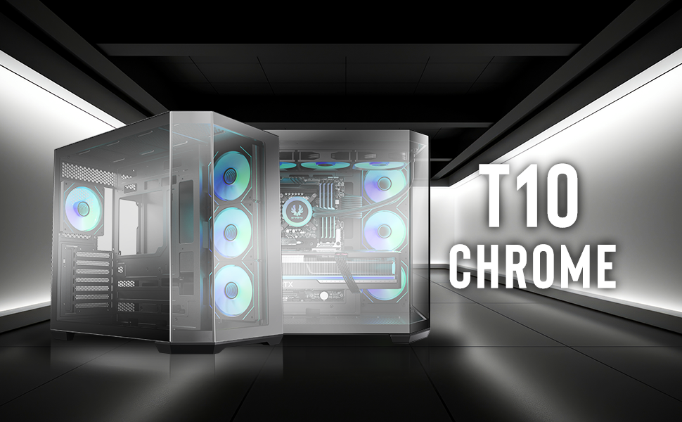

Slide 2
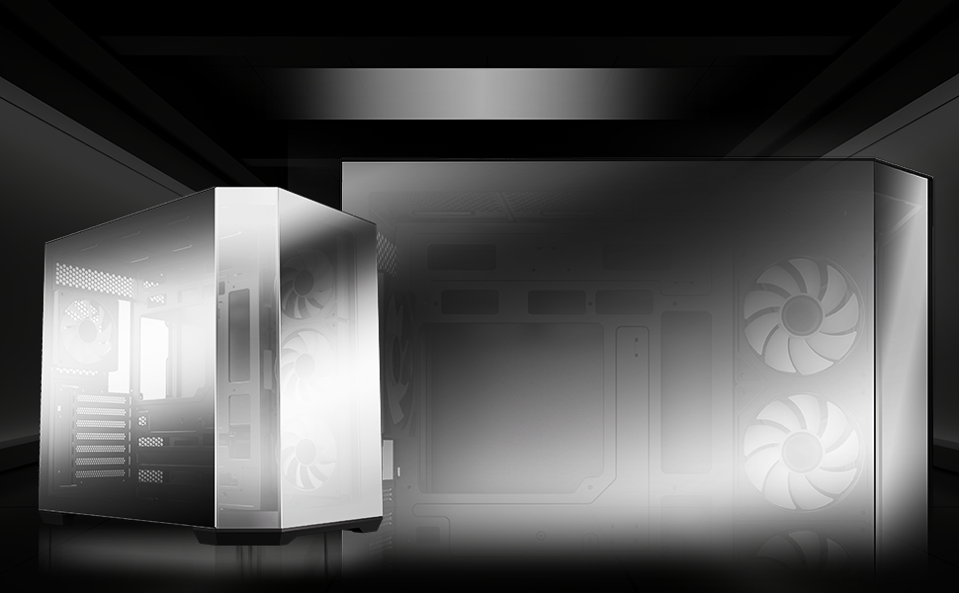
MIRROR TEMPERED GLASS PANEL

Slide 3
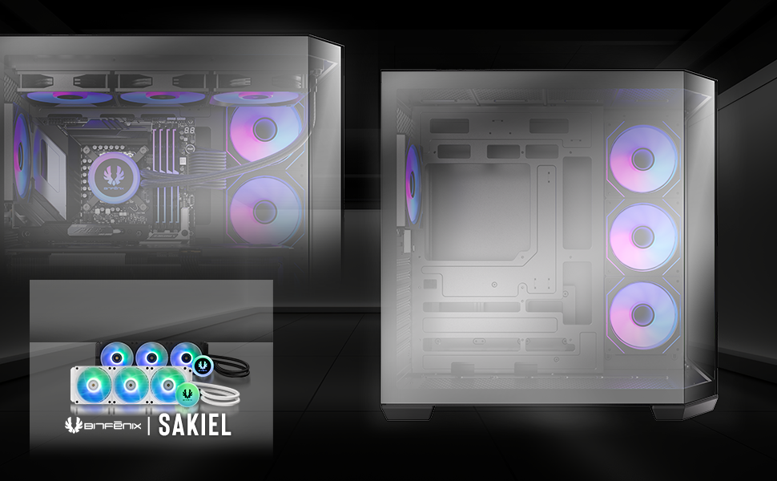





360mm
AIO SUPPORT AT TOP

Slide 4
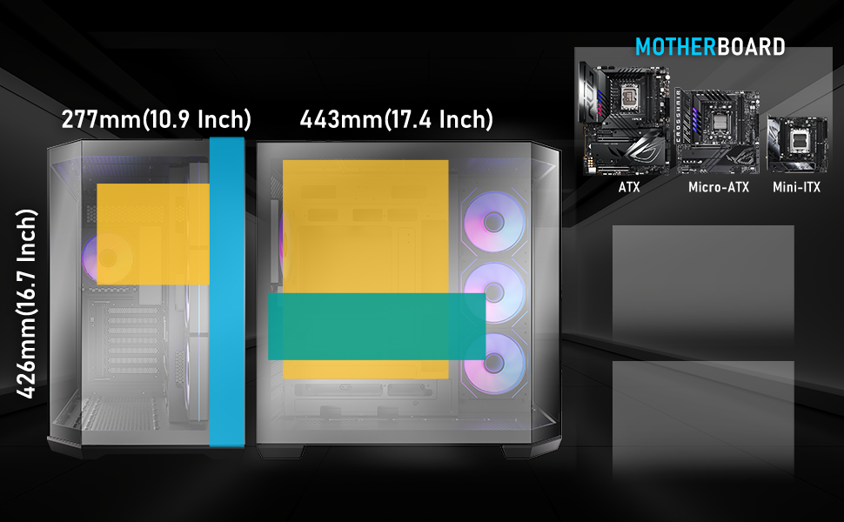
Motherboard
Support
Maximun CPU
Cooler Height
Mini-ITX
MicroATX
ATX
VGA LENGTH
SUPPORT
155mm
(6.1 Inch)
420mm
(16.5 Inch)
Maximun Graphics Card
Support
420mm(16.5 Inch)
CABLE
MANAGEMENT
UP TO
90mm(16.5 Inch)

Slide 5
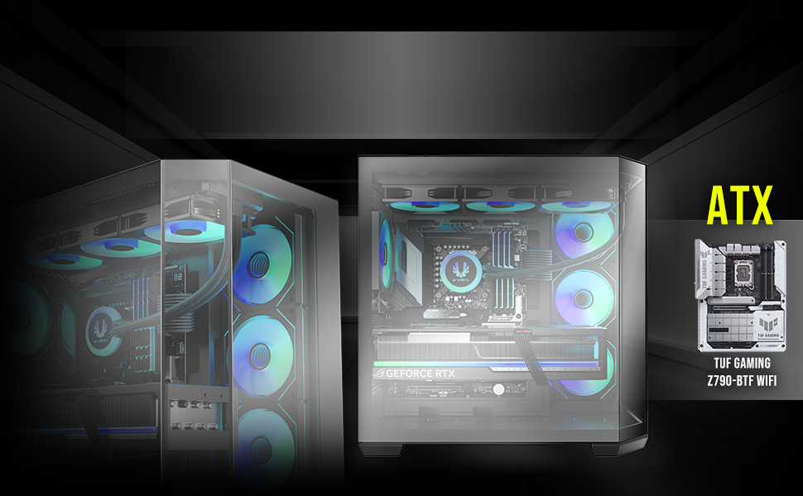
TRENDY DESIGN WITH
REVERSE CONNECT ATX
MOTHERBOARD COMPATIBILITY

Slide 6
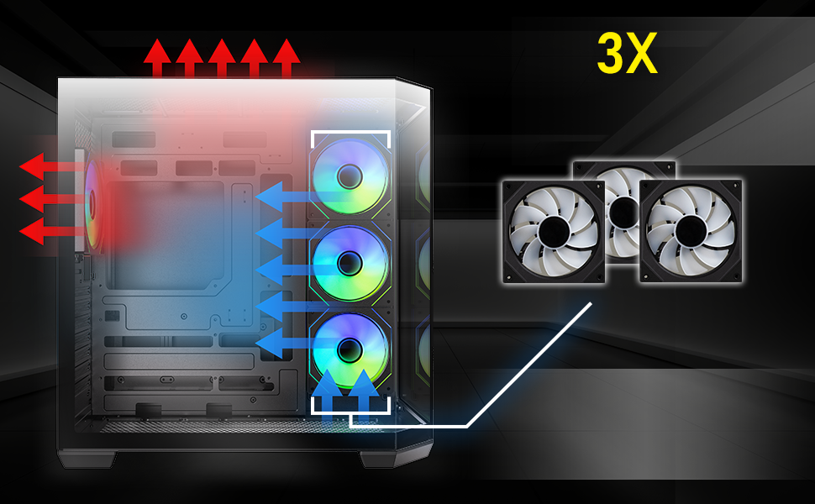
Reverse Infinity
Mirrors ARGB Fans
DUAL CHAMBER
HIGH
AIRFLOW PERFORMANCE

Slide 7
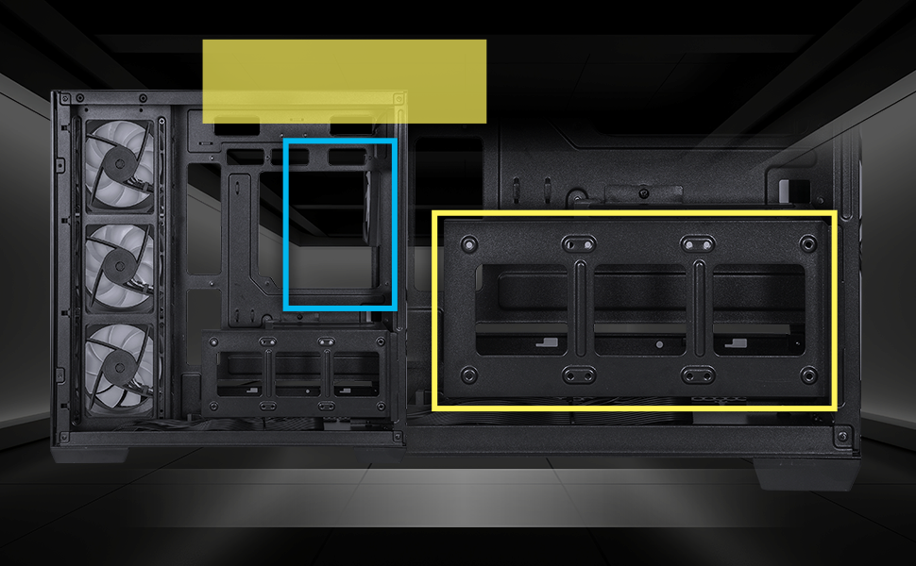
Power Supply
ATX & Standard
Up To 200mm(7.8 Inch)
2X 3.5” Drive or 3X 2.5” Drive

Slide 8
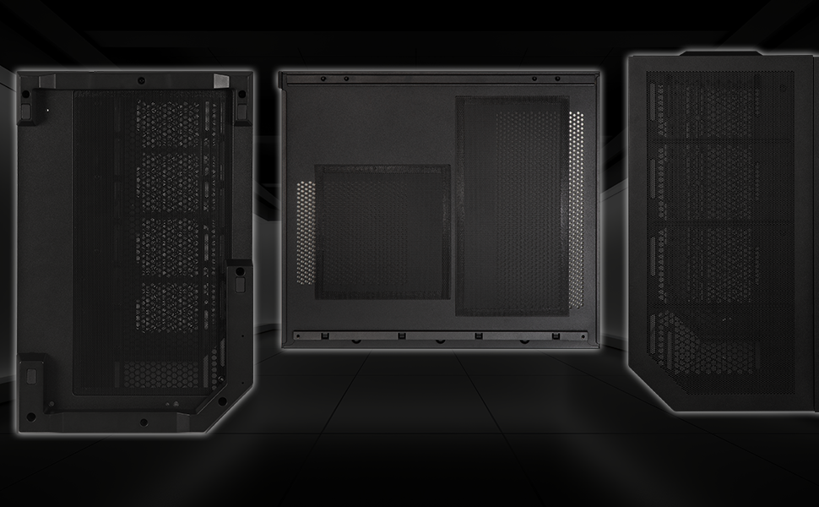
BOTTOM
SIDE PANEL
TOP
EASY CLEAN WITH
REMOVABLE DUST FILTERS

Slide 9
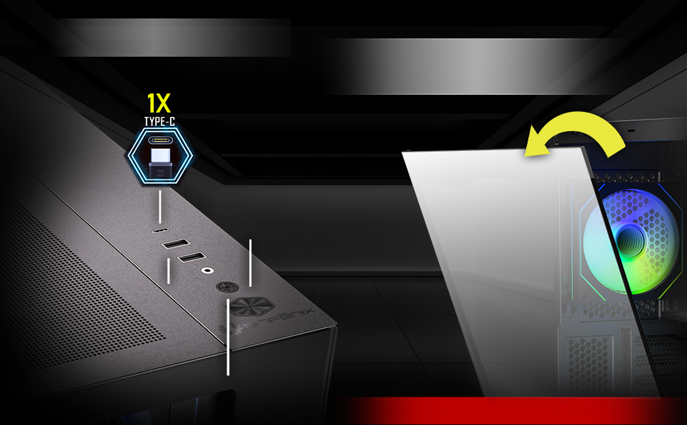
I/O
SNAP- ON PANEL FOR EASY
AND TOOL-FREE REMOVAL
Power Button
1X USB3.0
1X USB2.0
Reset Button
(Caution!!! Please hold the glass panel with two hands)

Slide 10
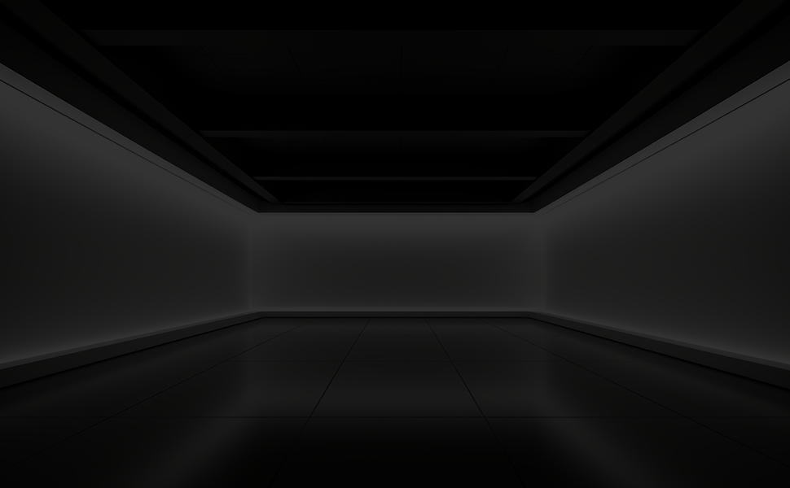
 |  | T10 Chrome
Part no. |  | BFC-MIT10-B85-KKGSK-4A
EAN / UPC |  | 4712883210754 / 886027162057
(NW)/ (GW) |  | N.W:6.9Kgs / G.W:7.9Kgs
Materials |  | Steel, Mesh, Plastic, Tempered Glass
Dimensions (W x H x D) |  | 277 mm x 426 mm x 443 mm
Carton Size (W x H x D) |  | 344 mm x 515 mm x 492 mm
Motherboard Supports |  | Mini-ITX, MicroATX, ATX
Air Cooler Height Support |  | 155mm
VGA Length Support |  | 420mm
Cable Management Support |  | up to 90mm
3.5" Drive Bay |  | 2
2.5" Drive Bay |  | 3
Fan mounts | MB | 120mm x 3 or 140mm x 2
 | Top | 120mm x 3 or 140mm x 2
 | Bottom | 120mm x 3 or 140mm x 2
 | Rear | 120mm x 1
Radiator Support | MB | 360mm/ 280mm/ 240mm (Thickness up to 27mm)
 | Top/ Bottom | 360mm/ 280mm/ 240mm (Thickness up to 27mm)
 | Rear | 120mm x 1
PCI-E Slots |  | 7 Slots
I/O Ports |  | USB 3.1/Type C x 1, USB 3.0 x 1, USB 2.0 x 1, Audio I/O
Power Supply |  | ATX & Standard / up to 200mm

