Slide 2
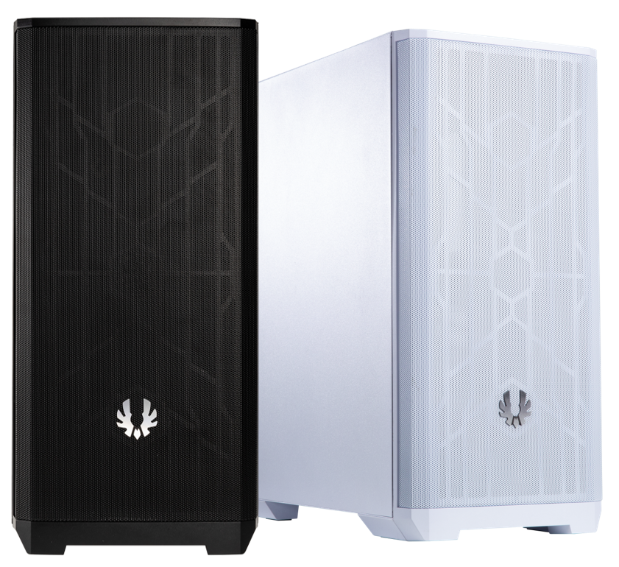
Nova Mesh SE, Special Edition of Nova Mesh, inheriting the core values of Nova Mesh
NOVA MESH SE presents not only BitFenix’s long standing aesthetics theme of simple elegance, but also the dedication towards offering a well-rounded PC chassis. The core of the NOVA MESH SE TG is its clean mesh design with 1 x 120mm fans pre-installed. It is well balanced between a perfectly organized interior structure and a sleek exterior design complemented with metal side panel. Its design boasts of multiple features that enhance the ease of installation and use such as the user friendly installation and removable high-density mesh dust filter and dual chamber design.

Slide 3
Sleek Design With Mesh
Front -Your Color, Your Style
BitFenix NOVA MESH SE is an all-rounder offering great airflow coupled with modern elegant design which makes it an ideal choice for most user scenarios.
This SE version comes with color options for your styles, Black body with Black mesh and 1 black fans , White body with White mesh and 1 white fans .

Slide 4
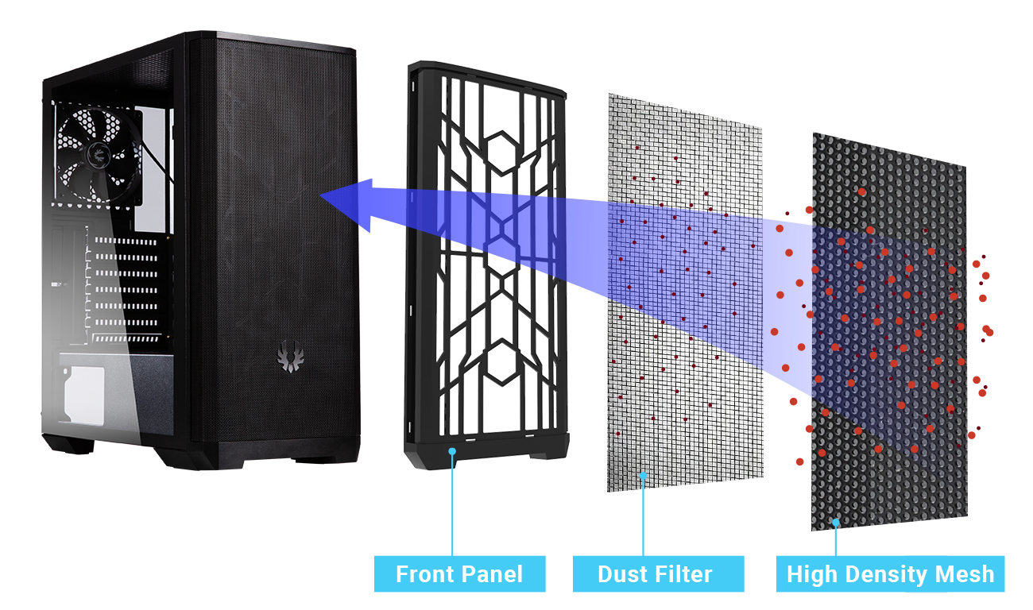
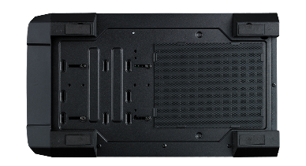
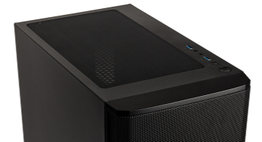
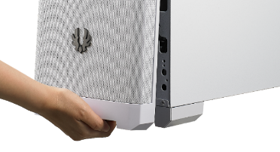
High Density Mesh With Dual Protection As Air Purifier Easy Clean With Removable Dust Filters
Nova Mesh SE is designed to offer reliable performance for years to come. By filtering out dust particle which reduces system lifespan, systems built with Nova Mesh SE can boast of dust free operation. The improved air intake mesh on the front comes with an embedded nylon filter that prevents dust from entering the system while the filter at the bottom keeps PSU free from dust. The top exhaust is also equipped with a nylon filter to ensure versatility. All these filters can be easily removed for a faster cleaning job.
PSU Dust Filter
Magnets Dust Filter
Easy Clean With Removable Dust Filters

Slide 5
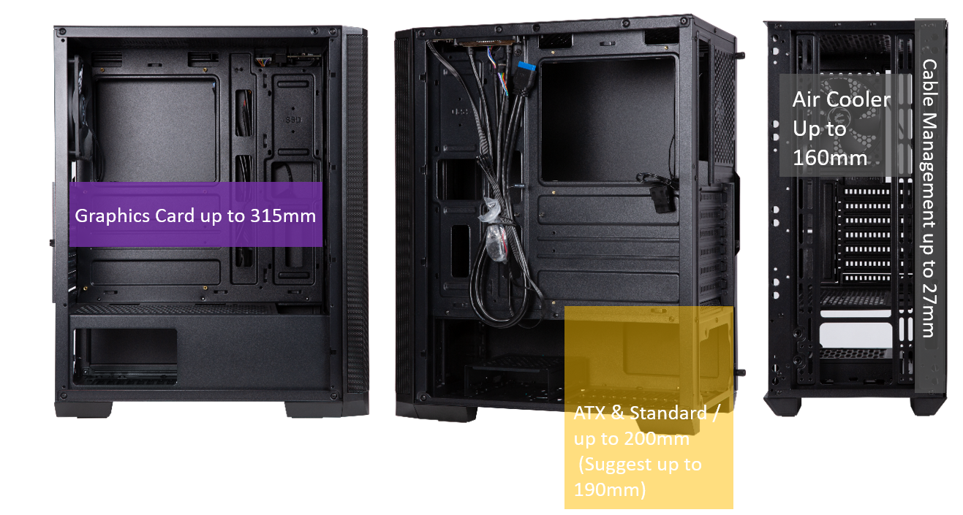
Clean Interior With 27mm
Cable Management Space
The NOVA MESH SE comes with PSU shroud that hides the PSU with the support to mount ATX size PSUs of up to 200mm (190mm PSUs recommended), meaning that a clean and elegant system can be built within. The 27mm cable management with multiple cable tie spots space behind motherboard tray makes it an easy job to manage the cables clean. With the drive-trays out of the way, the NOVA MESH SE provides plenty of space for graphics cards with a length up to 315mm.

Slide 6
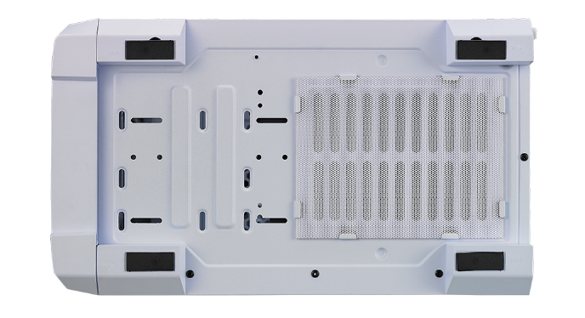
Modular Hard Drive Cage
The modular HDD cage in the BitFenix Nova Mesh SE Can accommodate up to 2 HDDs beneath it( 1 HDD+ 1 SSD), while 2 more SSDs can be mounted at the back of the motherboard tray. This HDD cage can also be shifted closer to the PSU to give extra space for thicker radiators in liquid cooled builds or it can be easily removed if the space is required to mount a water pump.

Slide 7
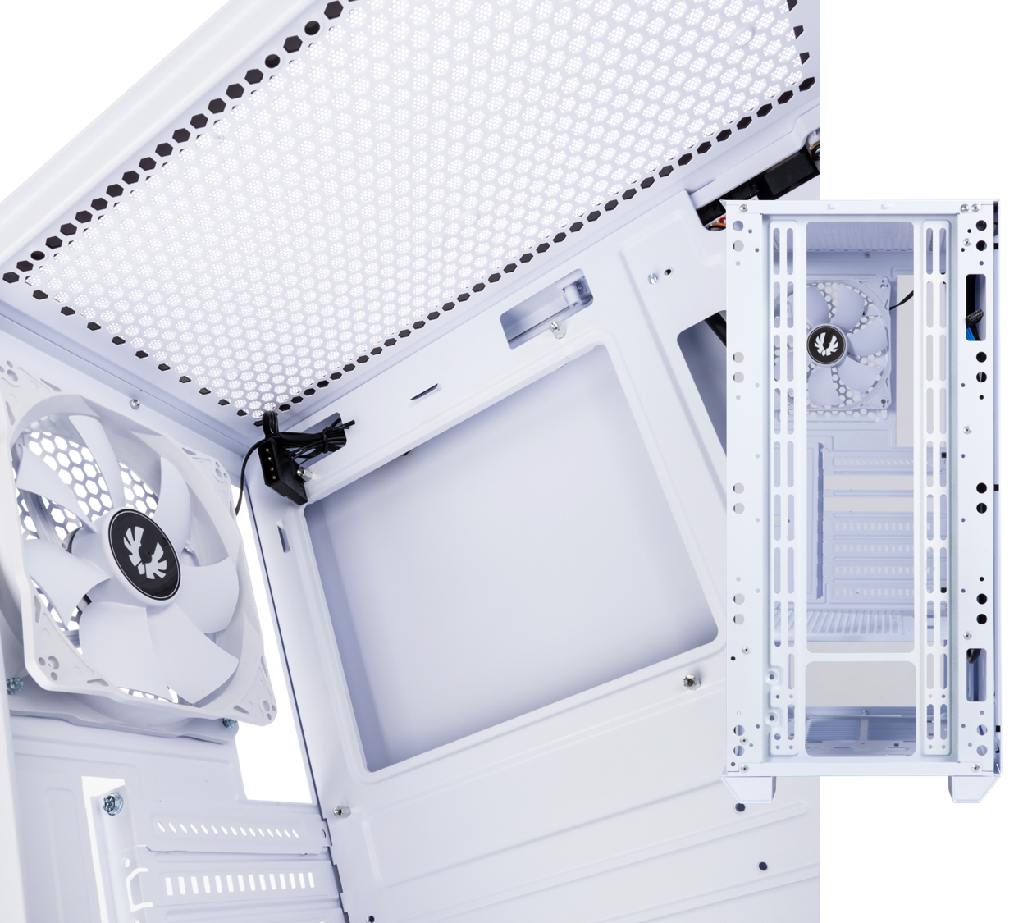
Spectre SE
Dimension | 120 x 120 x 25mm
Rated voltage | DC 12V
Start Voltage | ≦ 6V
Speed | 1000 ± 200 RPM
Max Air Flow | 41.6 CFM
Noise | 23.6 dB-A
Silent & Enhanced Airflow
Each Nova Mesh SE will include 1 Spectre SE fans. BitFenix Spectre SE fans are designed to cool silently, so you can keep you mind focused on the task at hand.
Spectre SE Fans feature fan blades, which create a torrent of air without creating excess noise. This means that your system stays cool in the heat of battle without disturbing your computing environment.

Slide 8
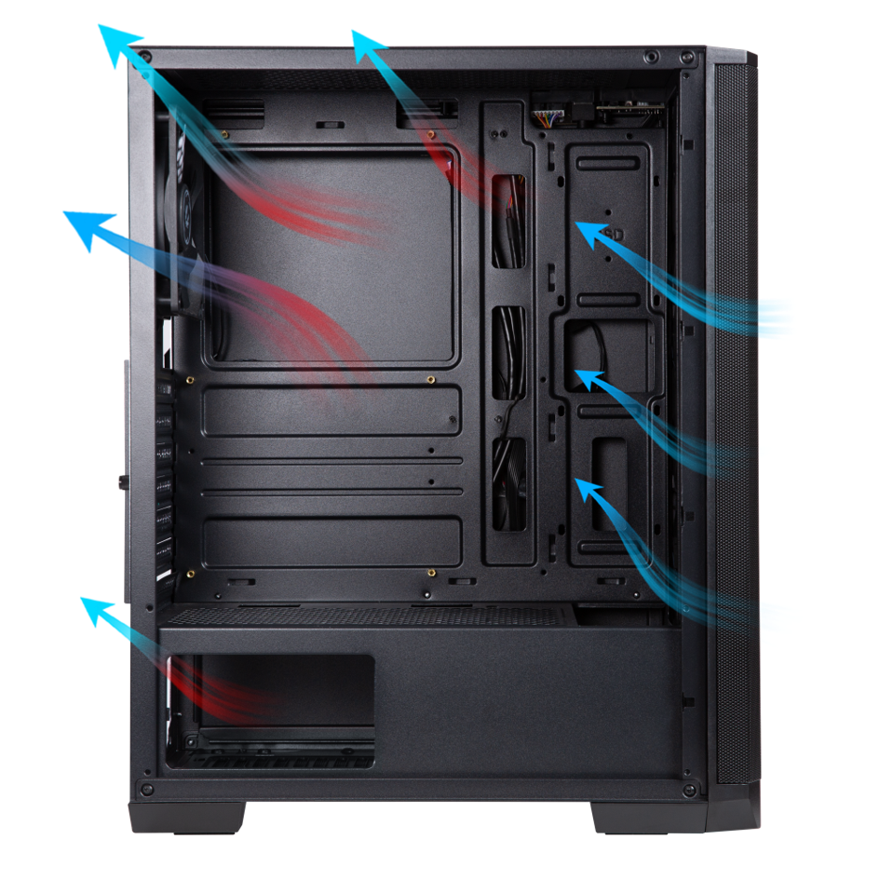
Thermal Capability
Optimized airflow is essential for good performance and extended lifetime of components. The BitFenix Nova Mesh SE offers the best airflow with support up to 360mm Radiator* in the front or 3x 120mm fans*. Coupled with the top 240mm exhaust and the rear 120mm exhaust, it maintains a good balance of air intake and exhaust. Both these air vents comes with easily removable dust filters including the PSU air intake.

Slide 9
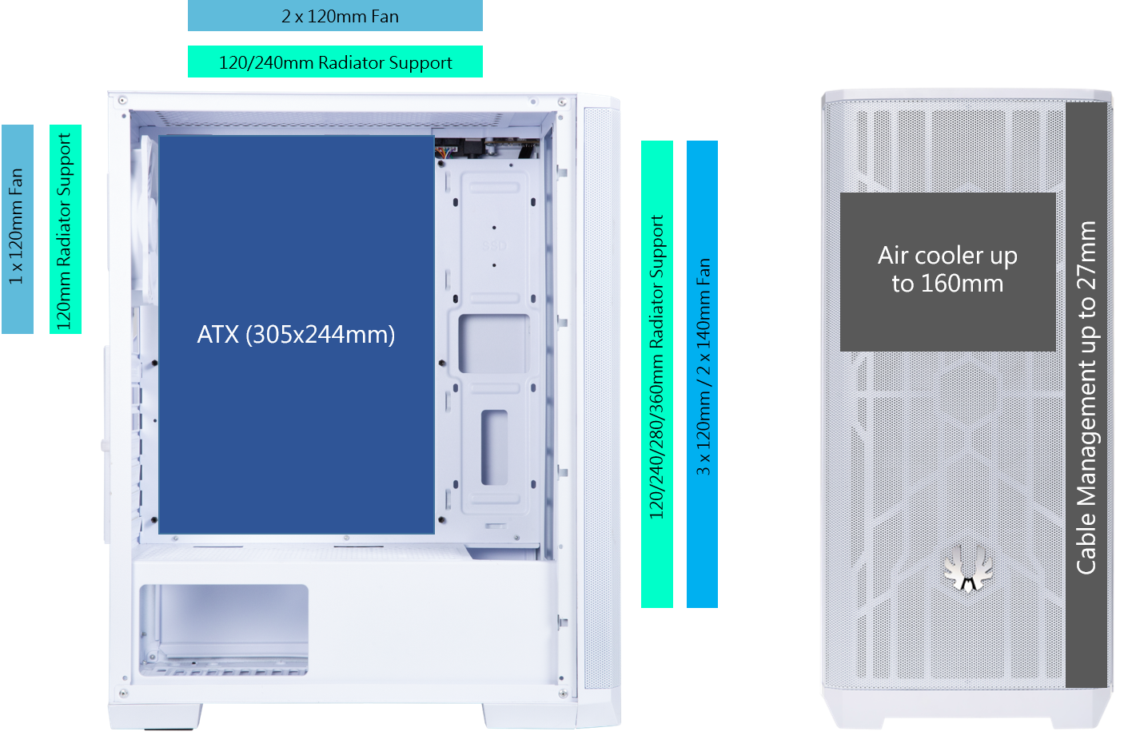

Slide 10
 |  | NOVA MESH SE - WHITE | NOVA MESH SE - BLACK
Part no. |  | BFC-NSE-300-WWXKW-RP | BFC-NSE-300-KKXSK-RP
EAN |  | 4712883217586 | 4712883217593
UPC |  | 886027157886 | 886027157893
Net weight (NW) Gross weight (GW) |  | 3.8 / 4.6 | 3.8 / 4.6
Dimensions (Packing) |  | 496*273*438 | 496*273*438
Materials |  | Steel, Mesh, Plastic
Chassis Dimensions (W x H x D) |  | 210mm x 450mm x 380mm
Motherboard Supports |  | Mini-ITX, MicroATX, ATX
ATX Motherboard Supports |  | 305mm x244mm
Air Cooler Height Support |  | 160mm
VGA Length Support |  | 315mm
Cable Management Support |  | up to 27mm
3.5" Drive Bay |  | 2
2.5" Drive Bay |  | 2+1
Fan mounts | Front | 3 x 120mm or 2 x 140mm
 | Top | 2 x 120mm
 | Rear | 1 x 120mm
Included Cooling Fan | Rear | 1 x 120mm White Fan
Radiator Support | Front | 360mm x 1/280mm x 1/ 240mm x 1/ 140mm x 1/ 120mm x 1 (Thickness up to 27mm)
 | Top | 240mm x 1/ 120mm x 1 (Thickness up to 27mm/ width up to 125mm,with height of the memory up to 32 mm)
 | Rear | 120mm x 1
PCI-E Slots |  | 7 Slots
I/O Ports |  | 2 x USB 3.0, Audio I/O
Power Supply |  | ATX & Standard / up to 200mm (Suggest up to 190mm)
High density Mesh design
Dust filter at Front / Top / Bottom(PSU)
1 x 120mm Spectre SE fans included
Support VGA Length up to 315mm
Dual USB 3.0 ports at TOP
Modular HDD CAGE

