Slide 1


Slide 2
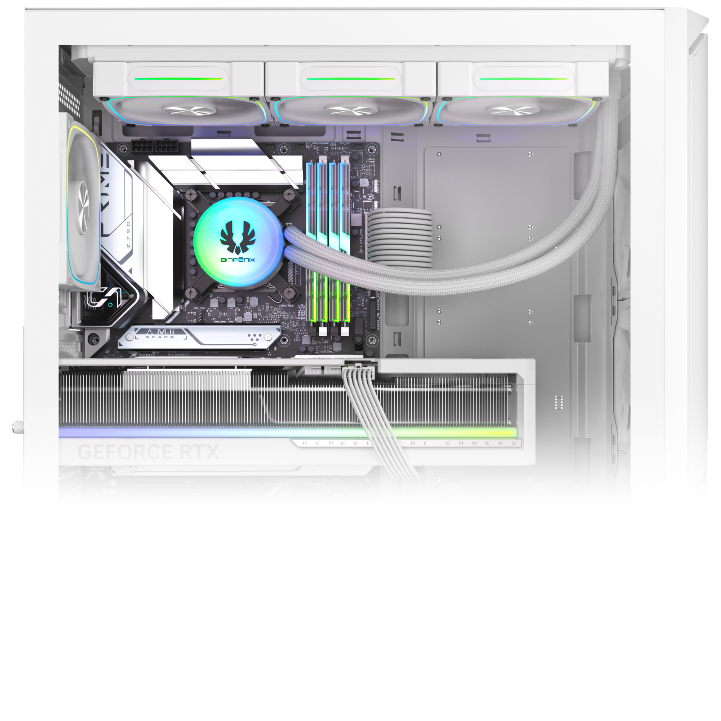
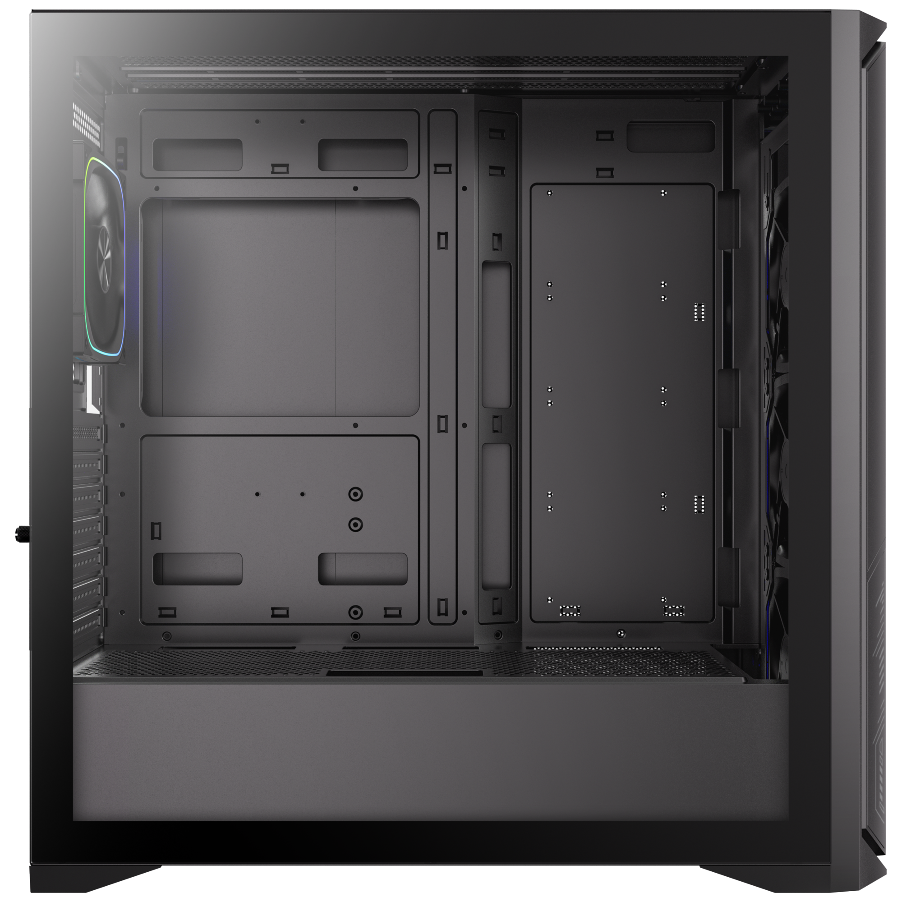
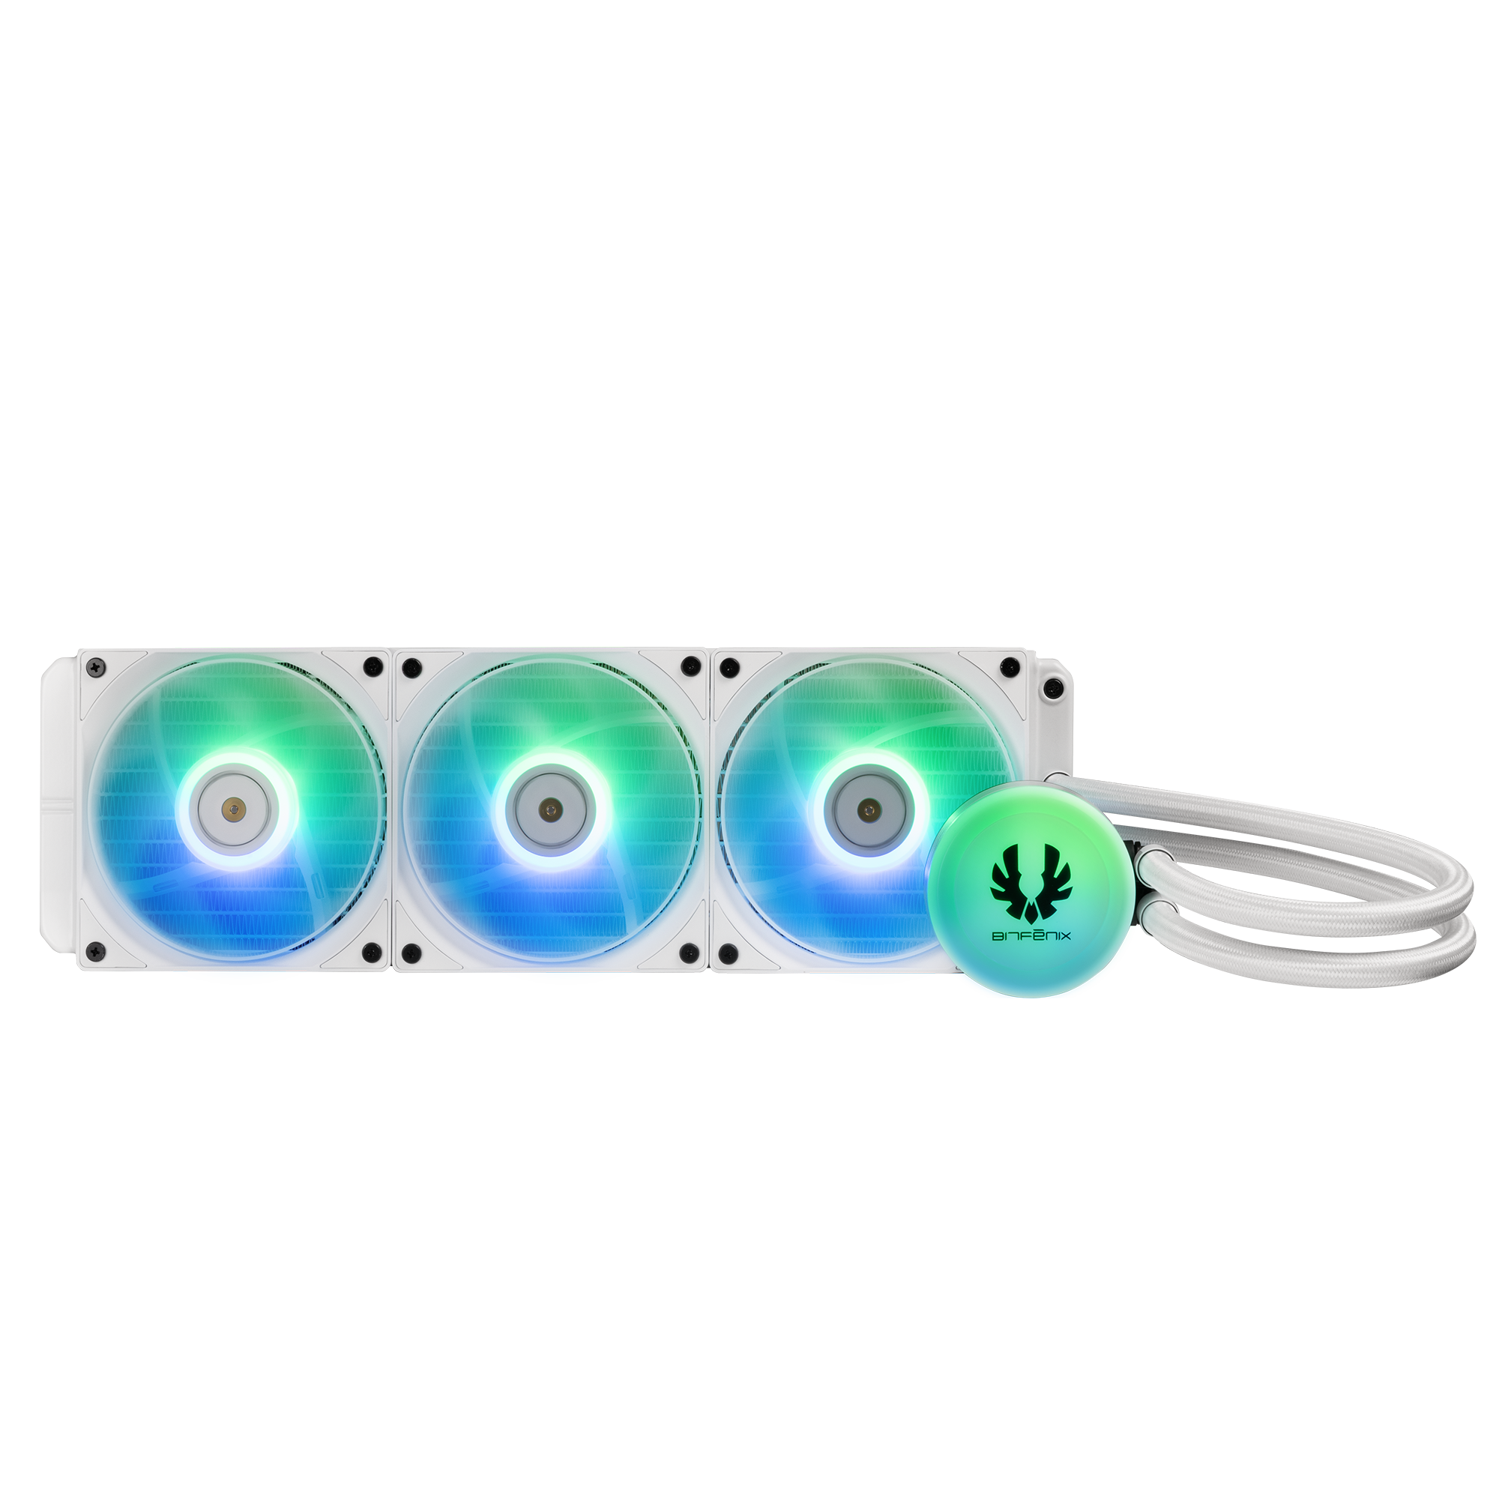
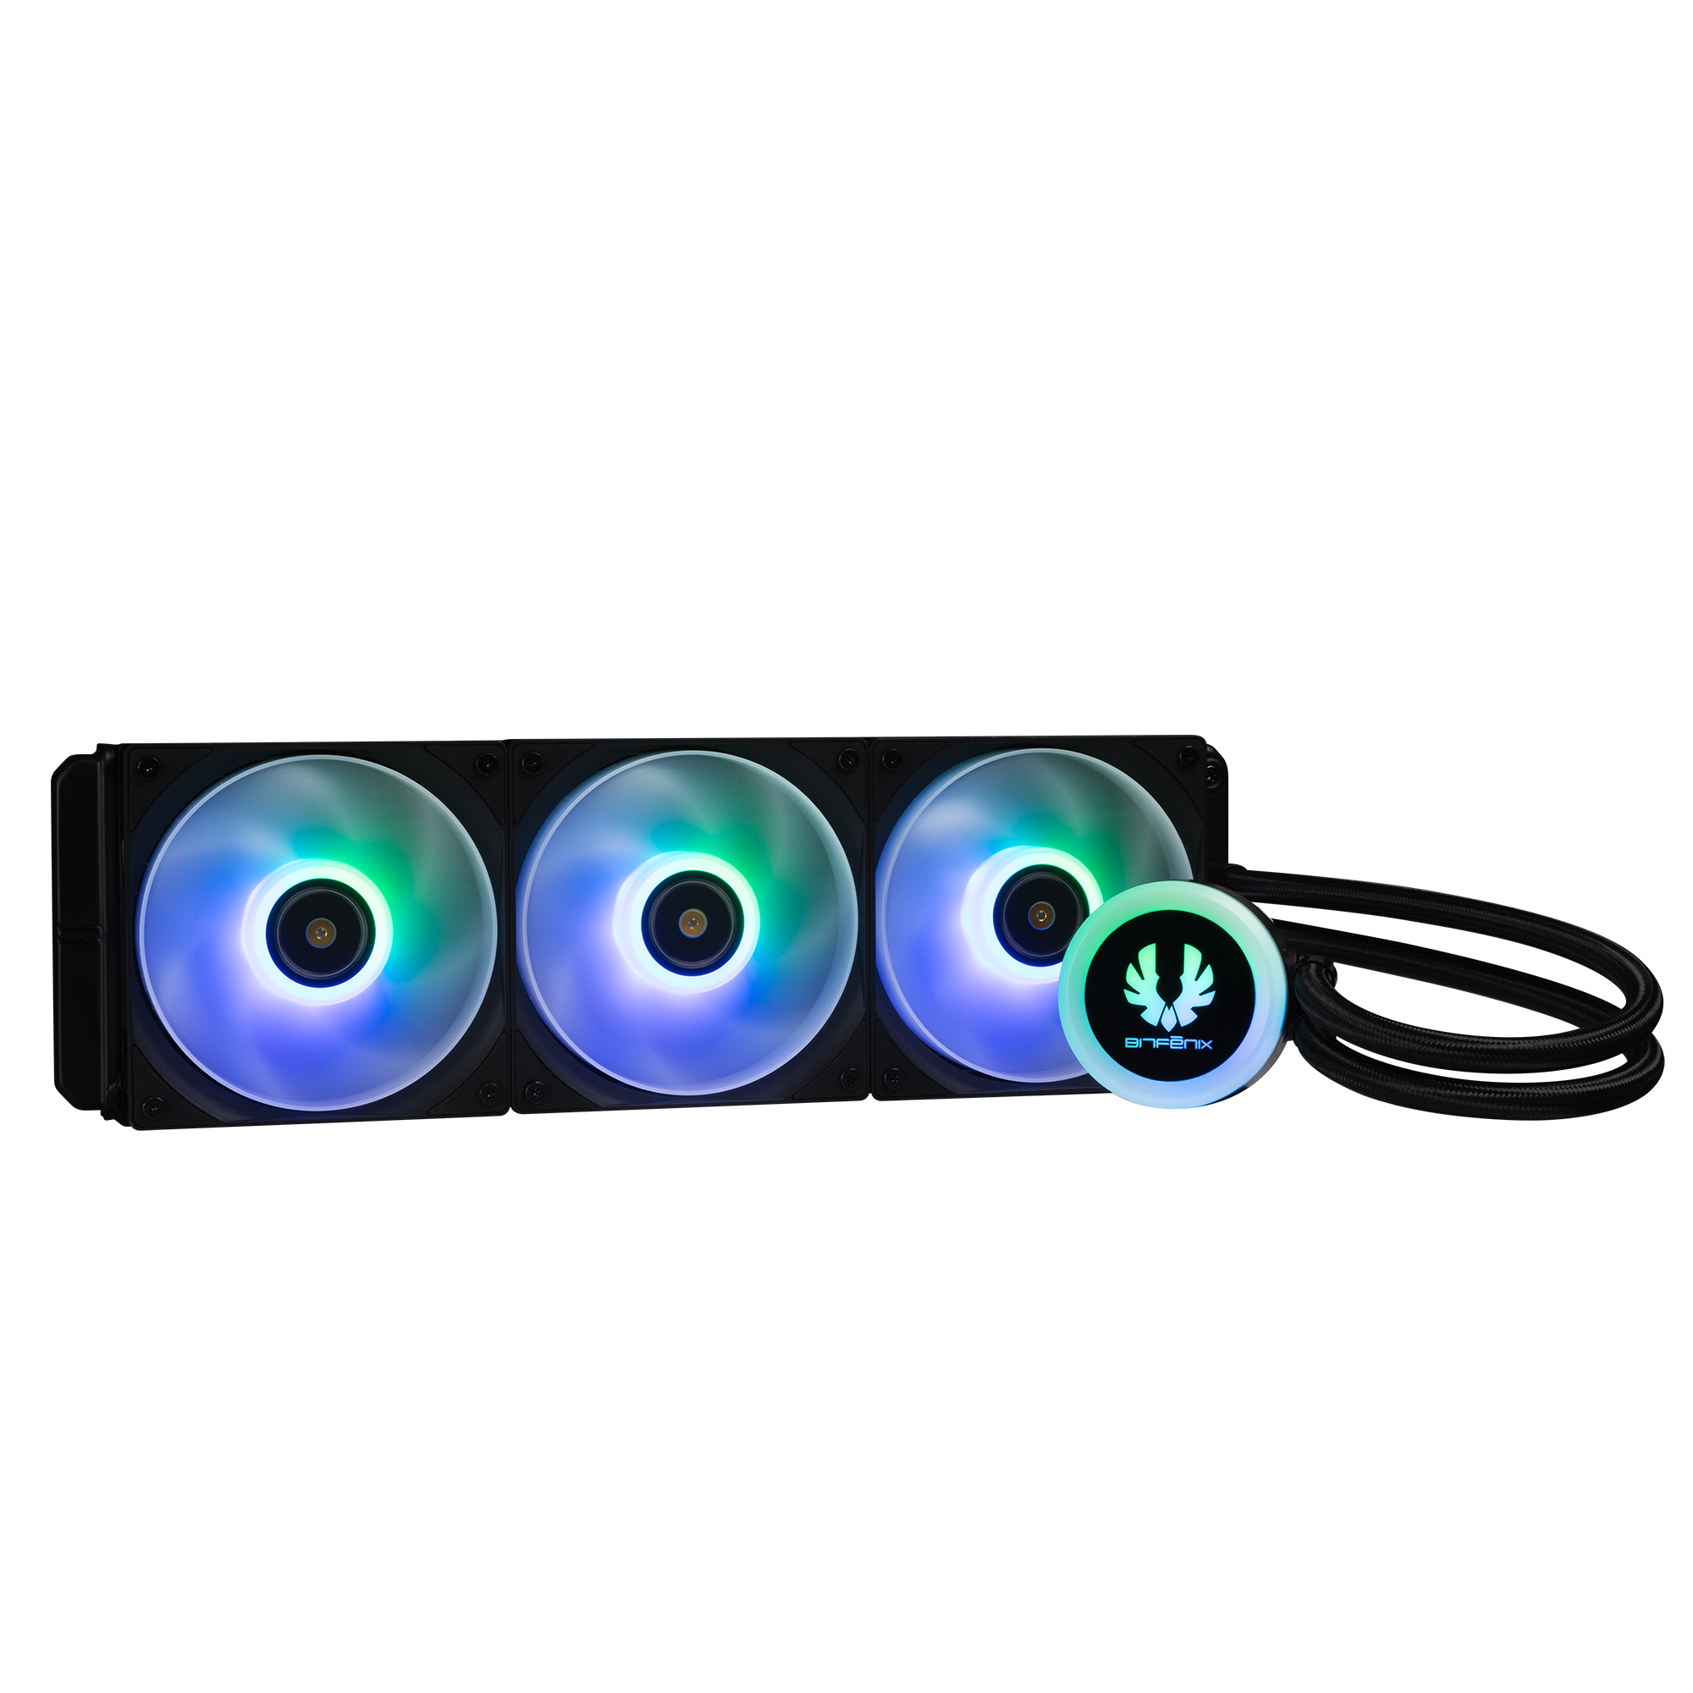
360mm AIO Support
140mm
120mm
140mm
120mm
120mm

Slide 3
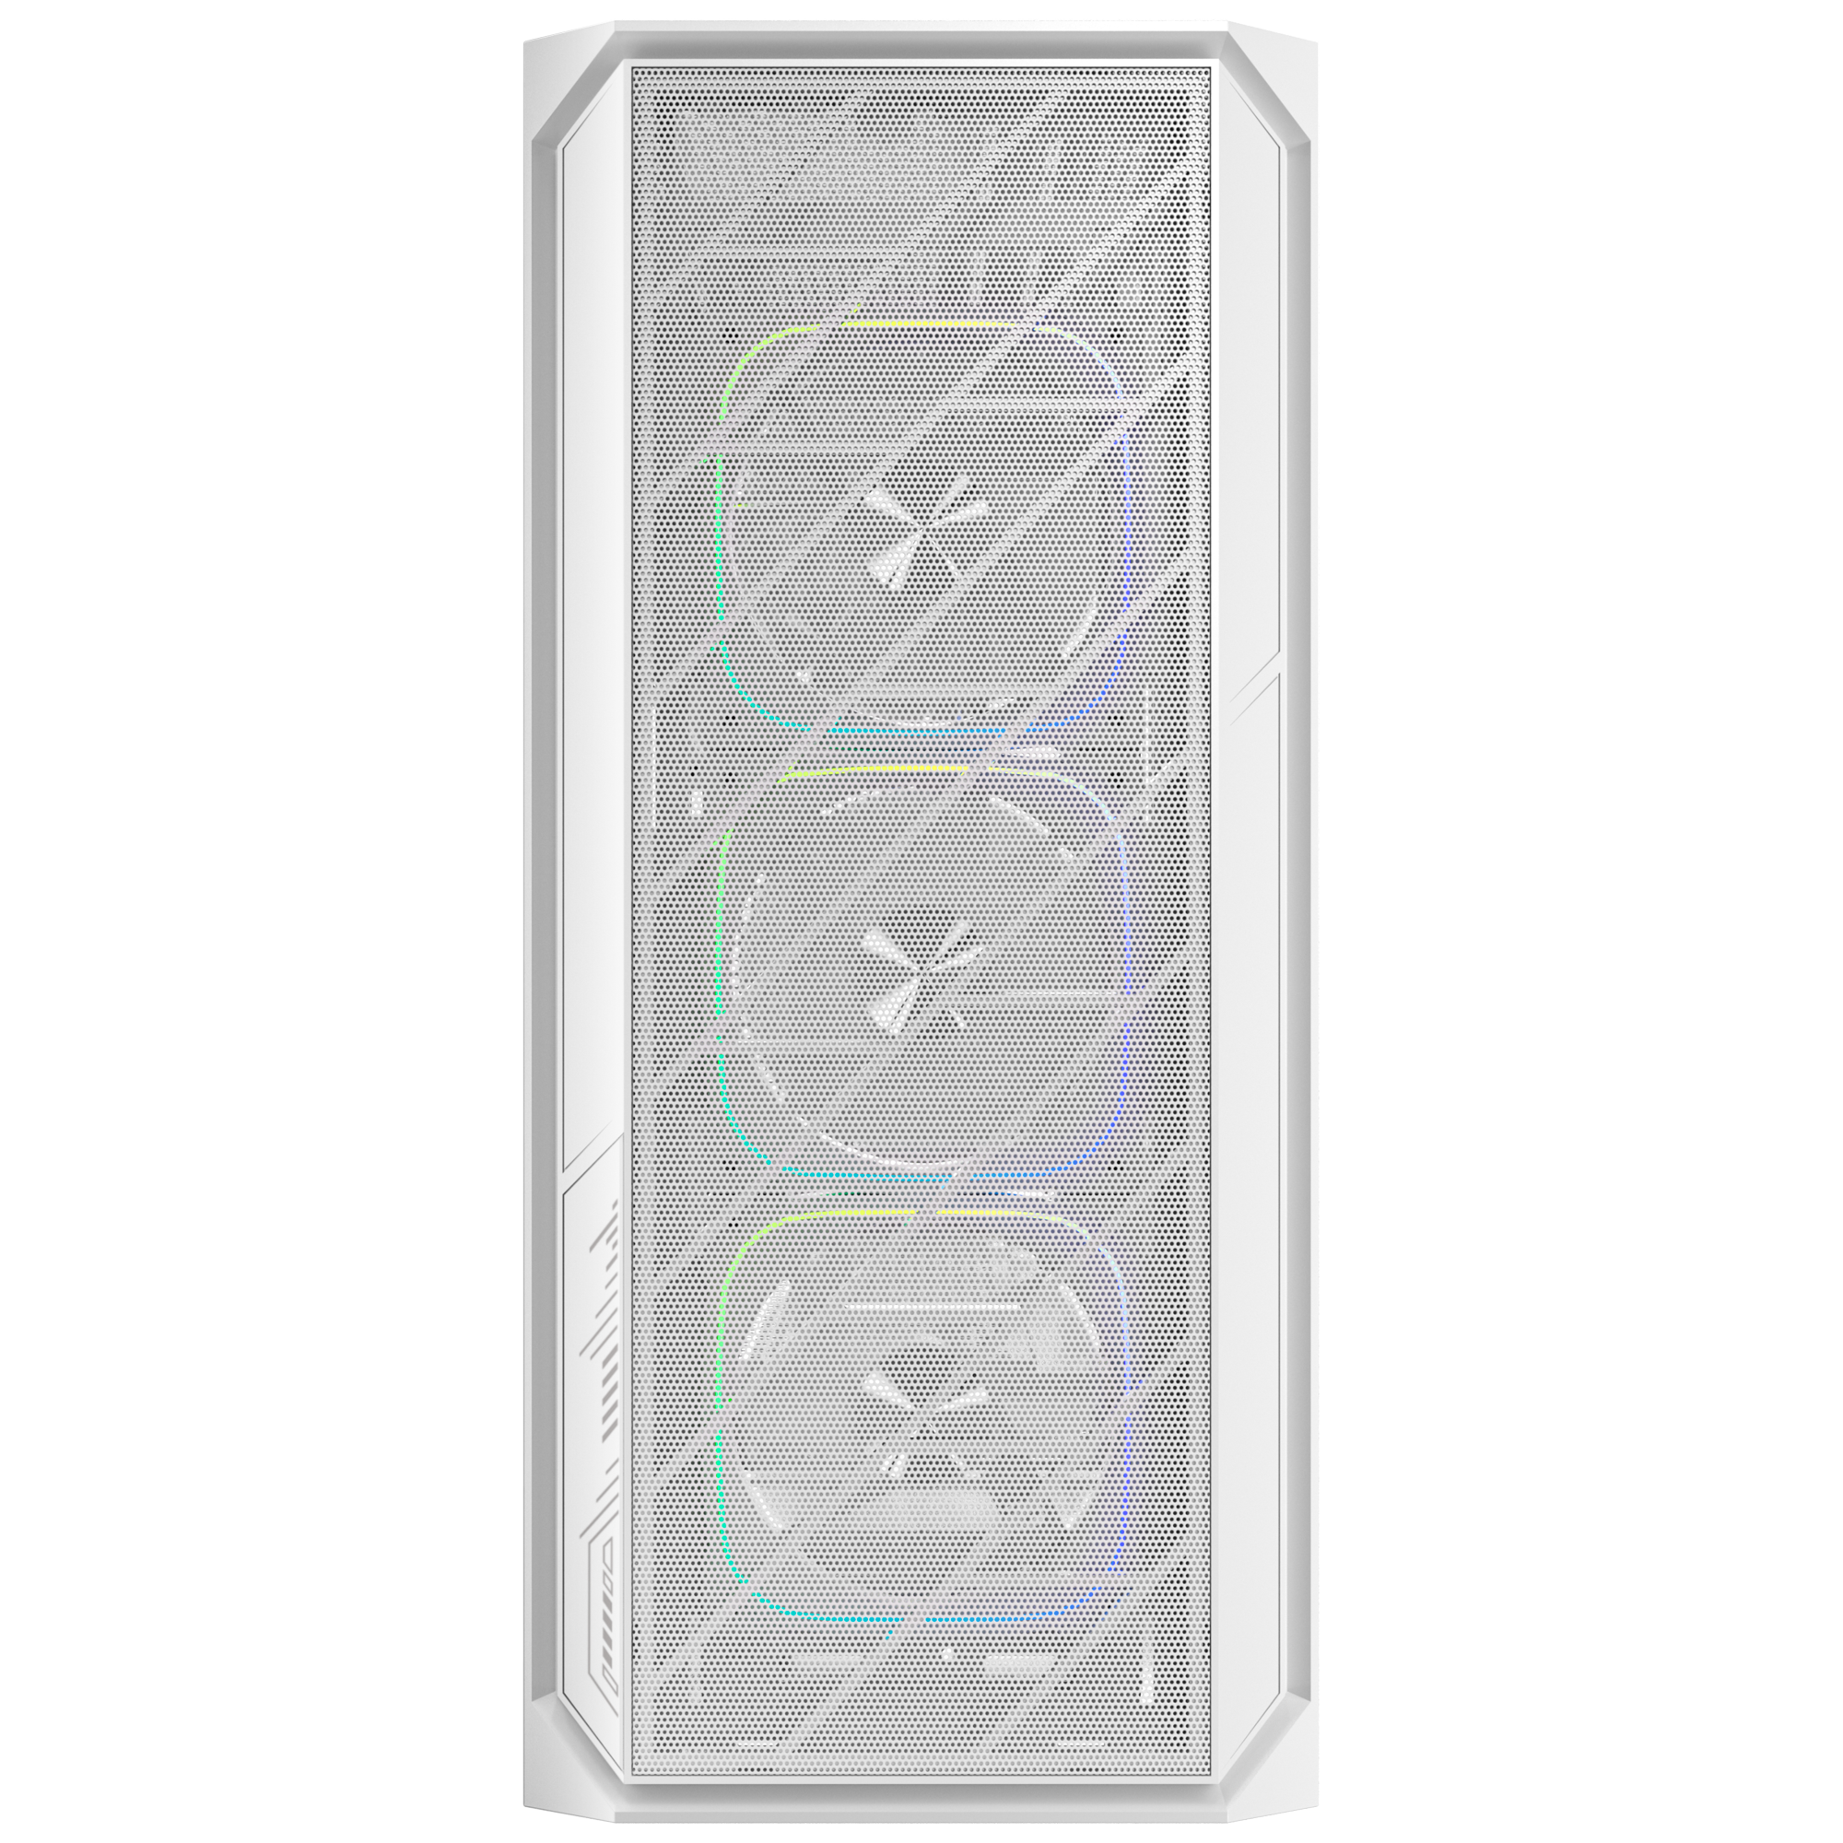
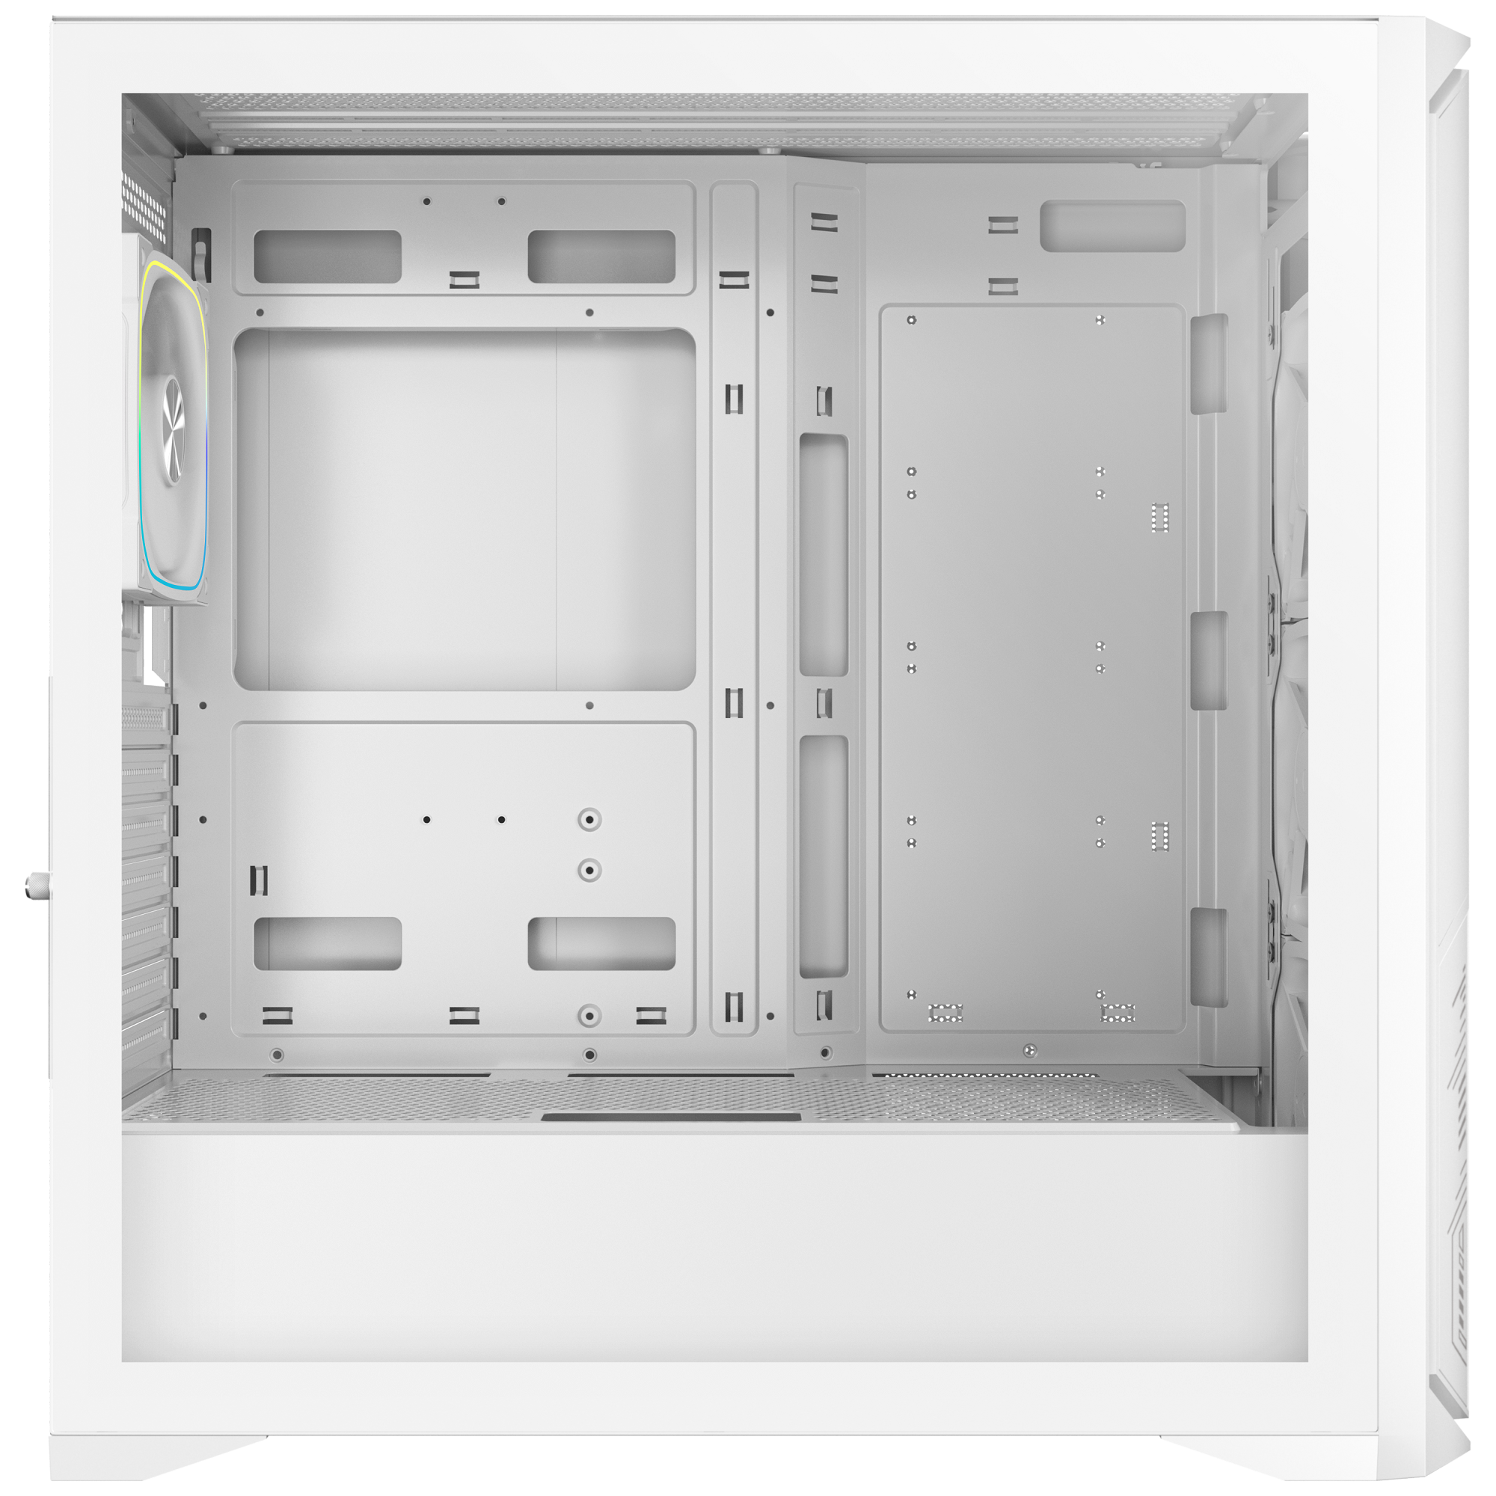
Dimension
220mm
440mm
Maximun CPU
Cooler Height
Motherboard
Support
165
mm
ITX
M-ATX
ATX
Cable Management Space 30mm
470mm
Maximun Graphics Card
Support
435
mm

Slide 4
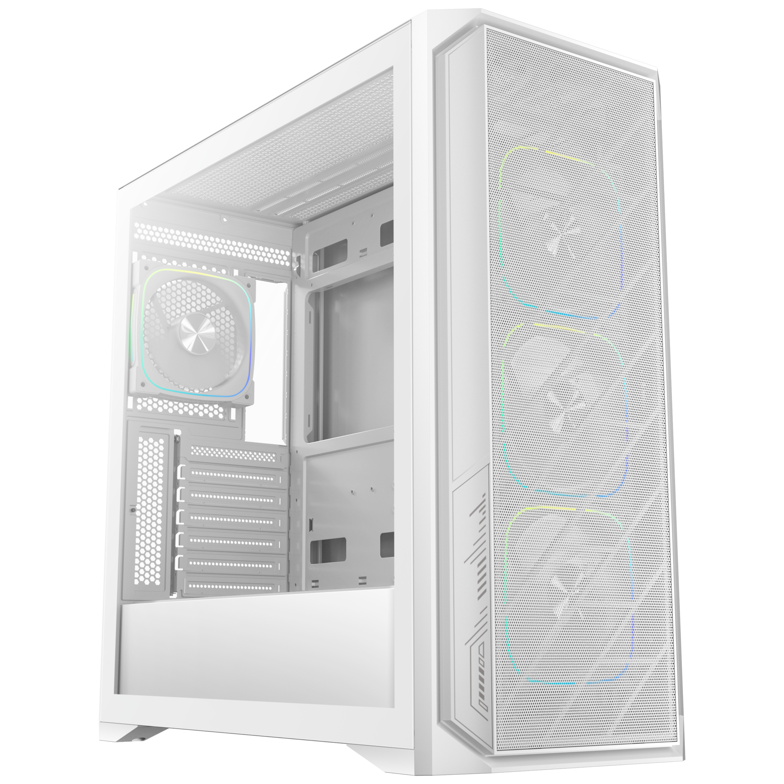
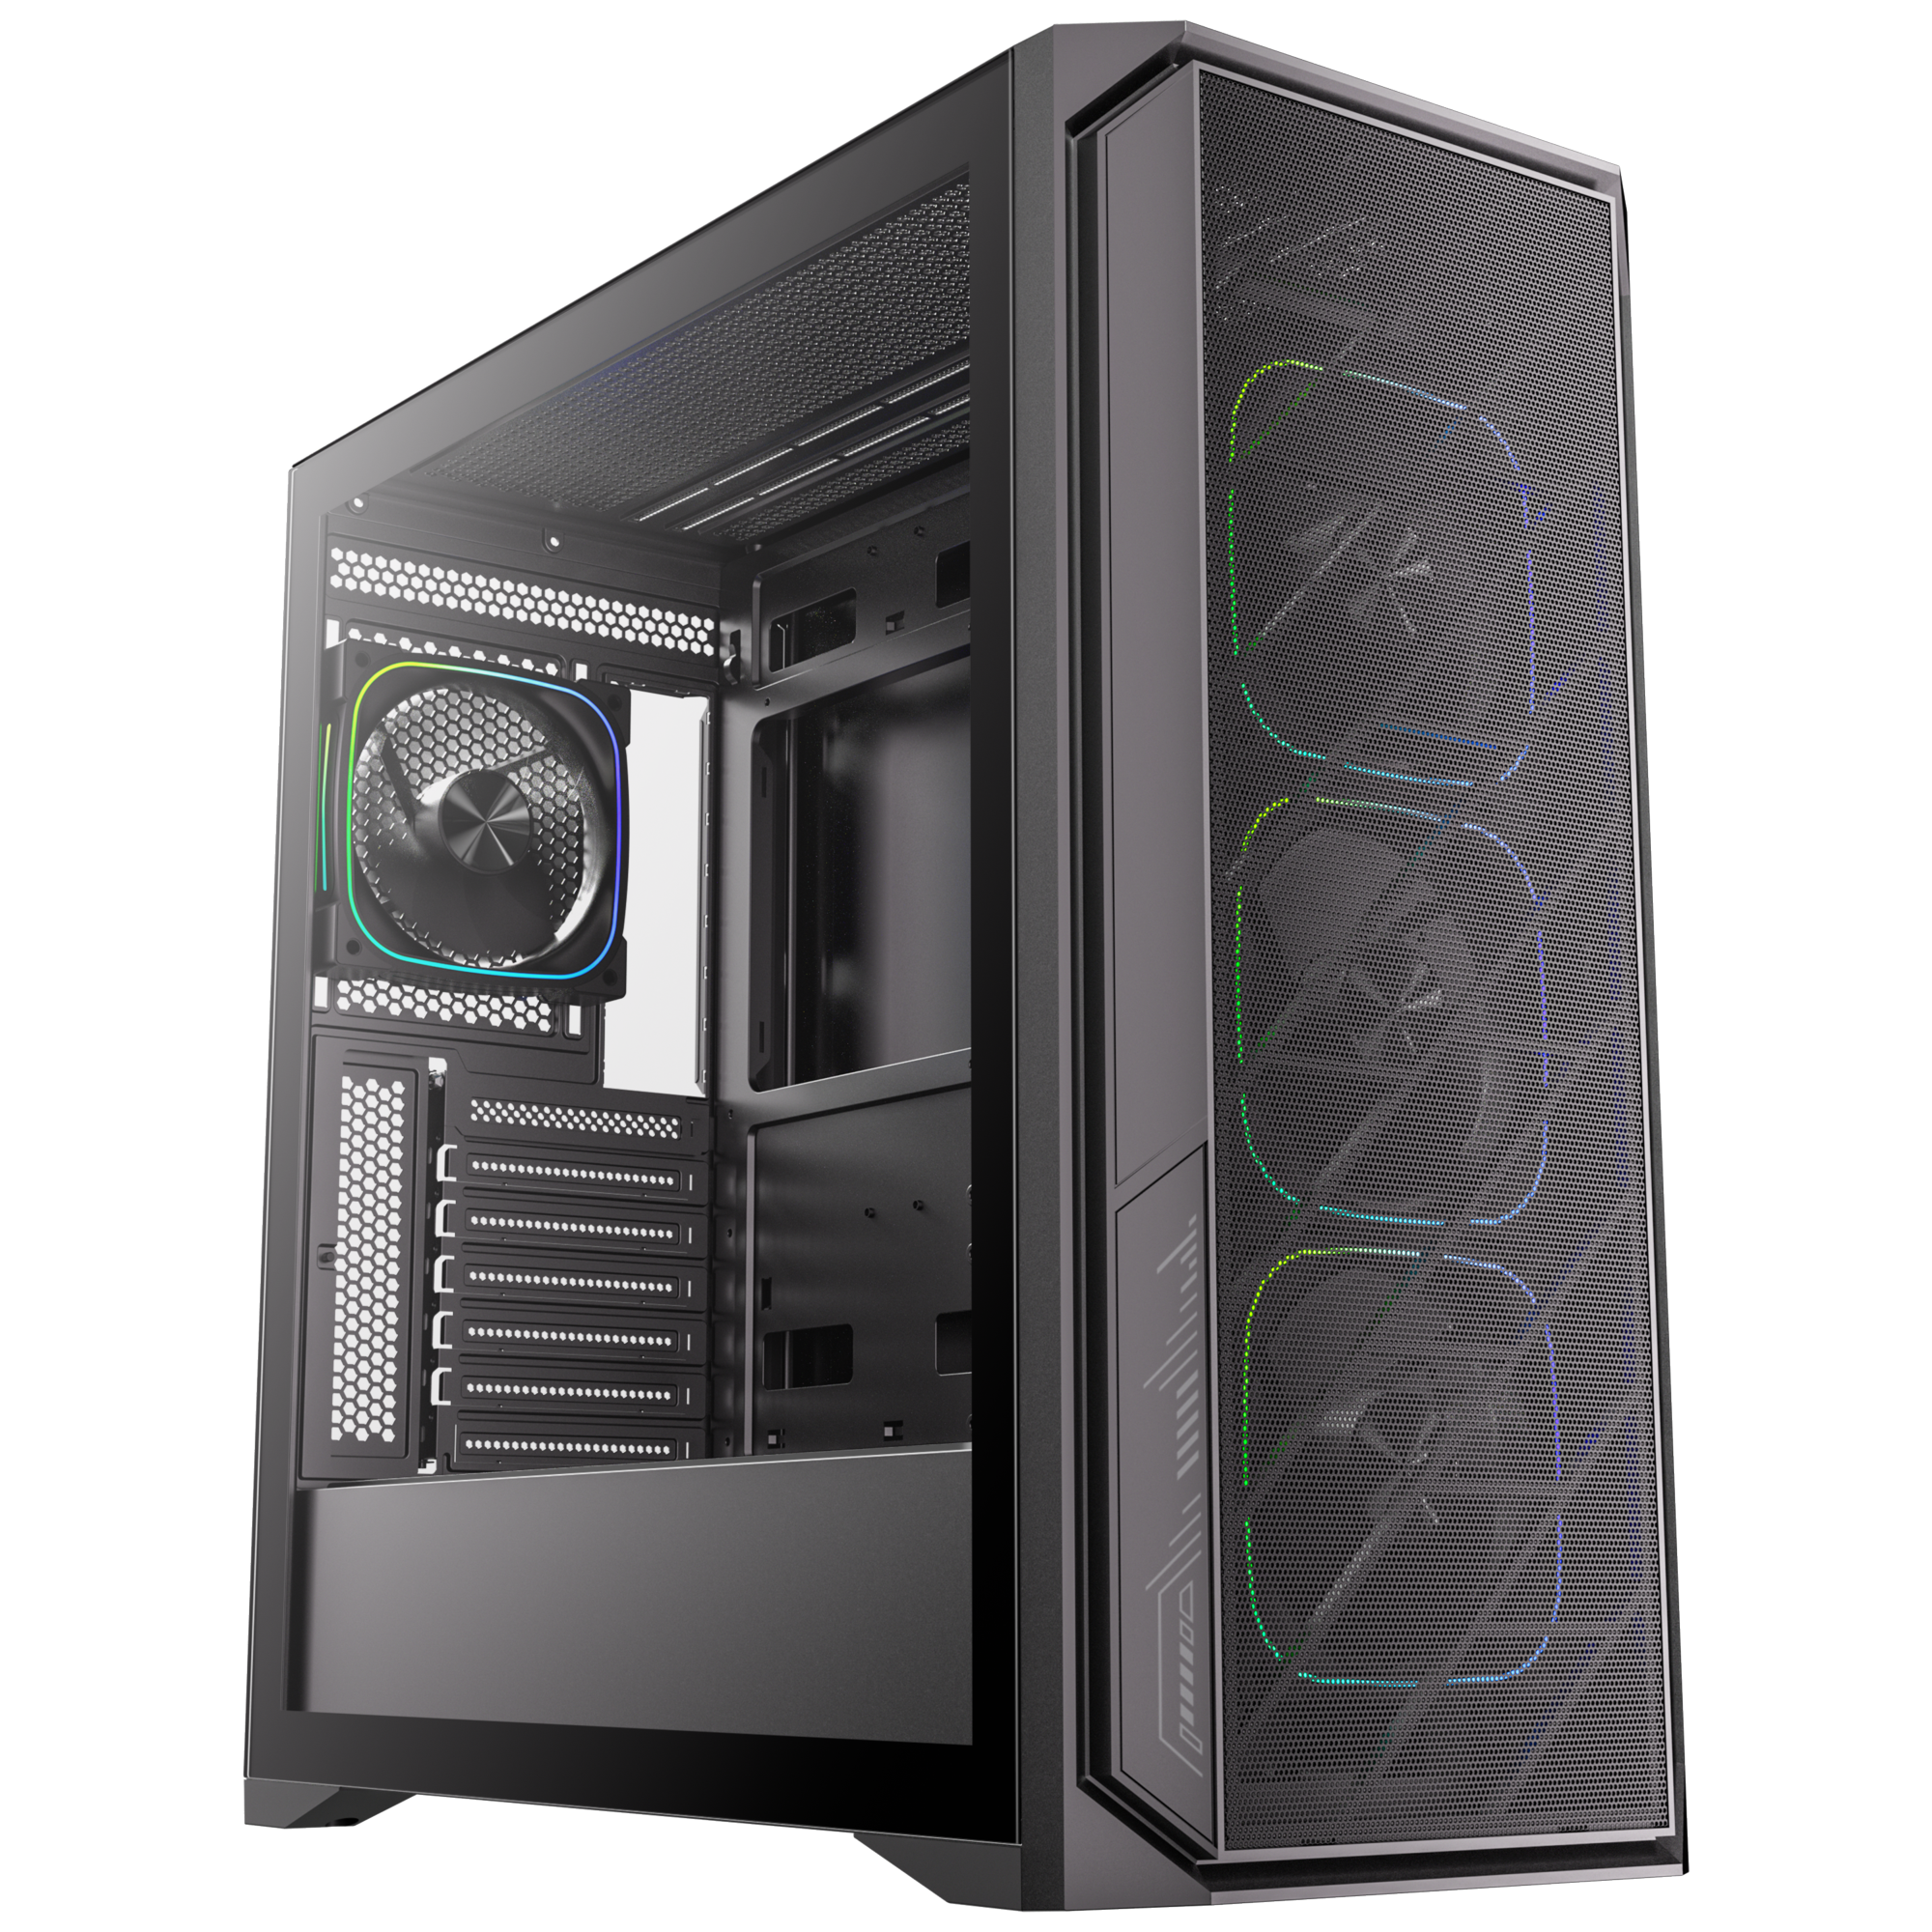
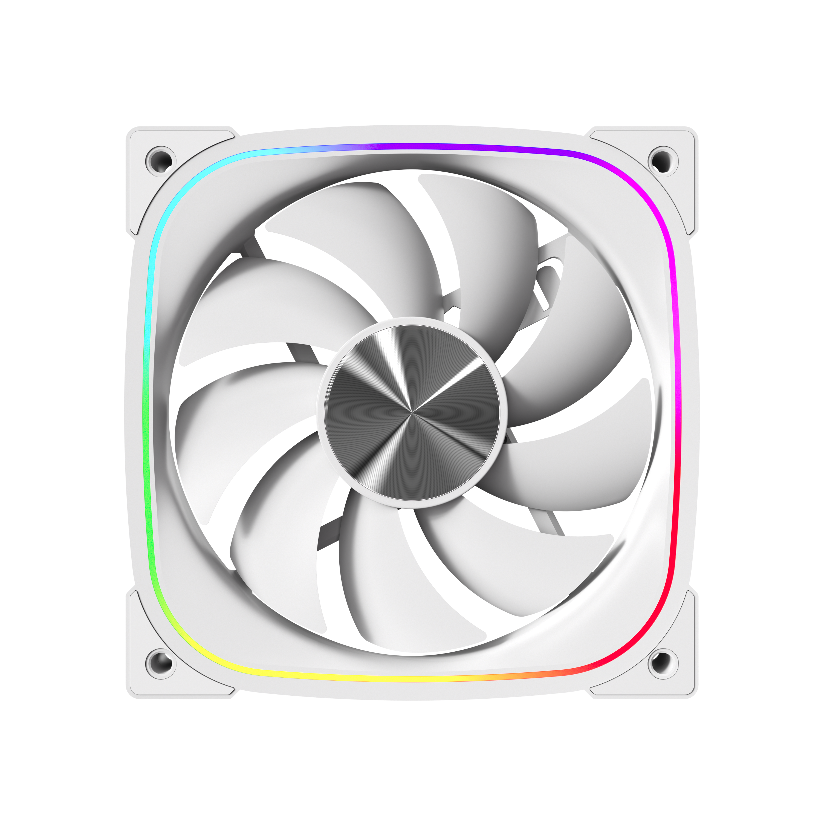

4X
High-Performance ARGB Fan

Slide 5
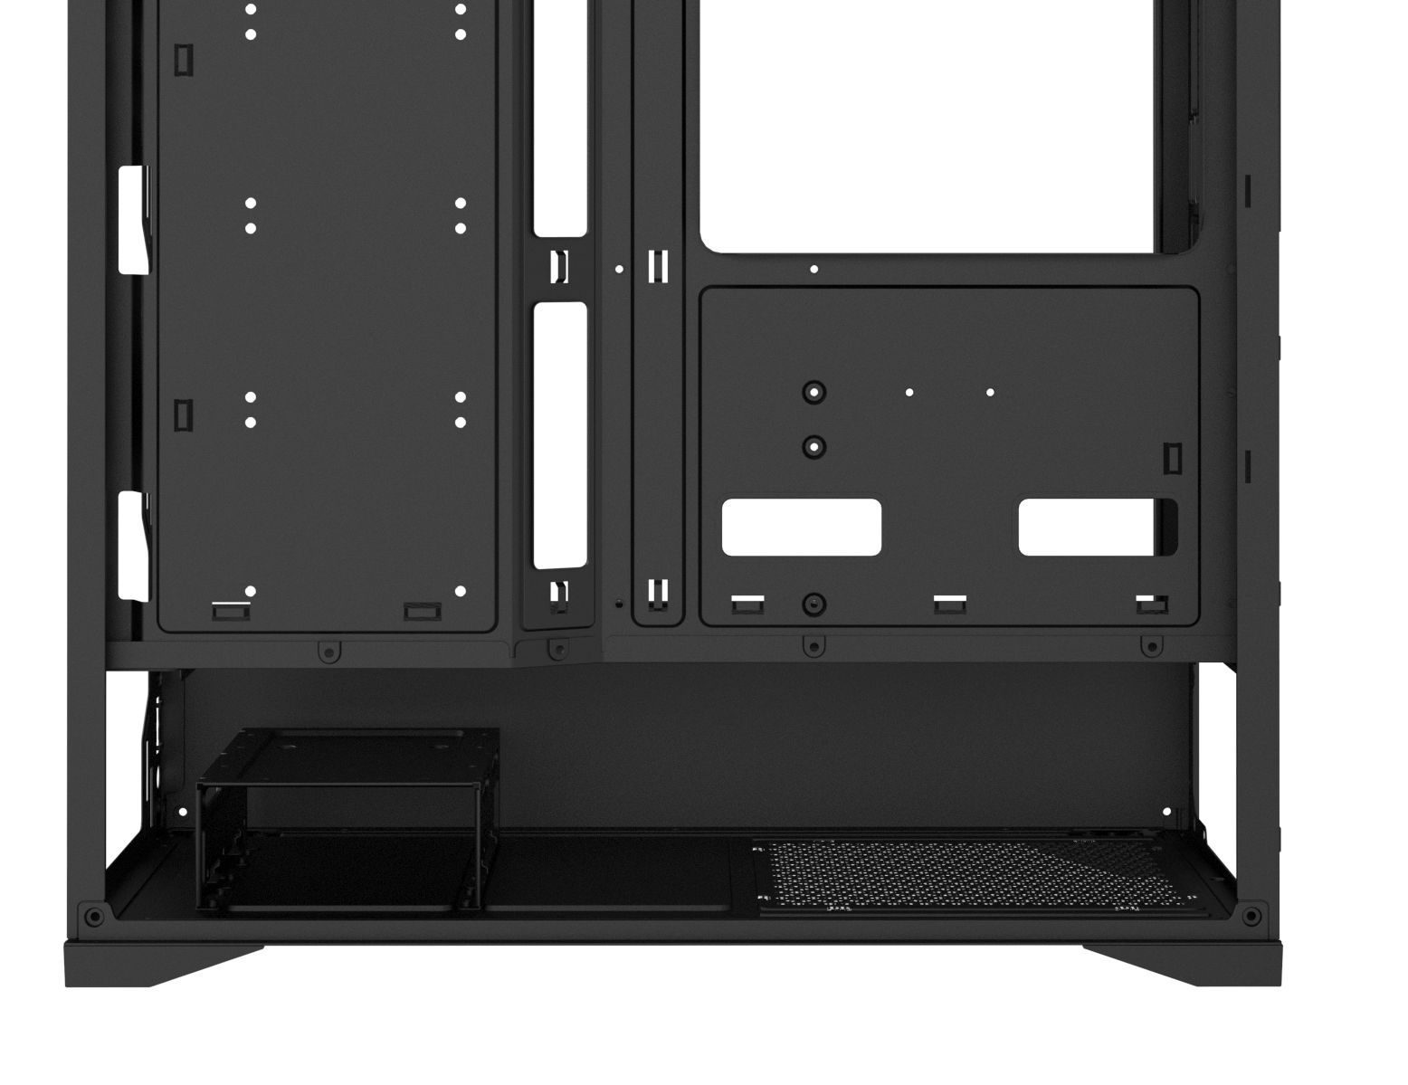
1X SSD + 1XHDD
or
2X HDD
PSU
4X SSD
ATX & Standard /
up to 260mm
1+4 X 2.5’’ Drive & 2 X 3.5’’Drive

Slide 6
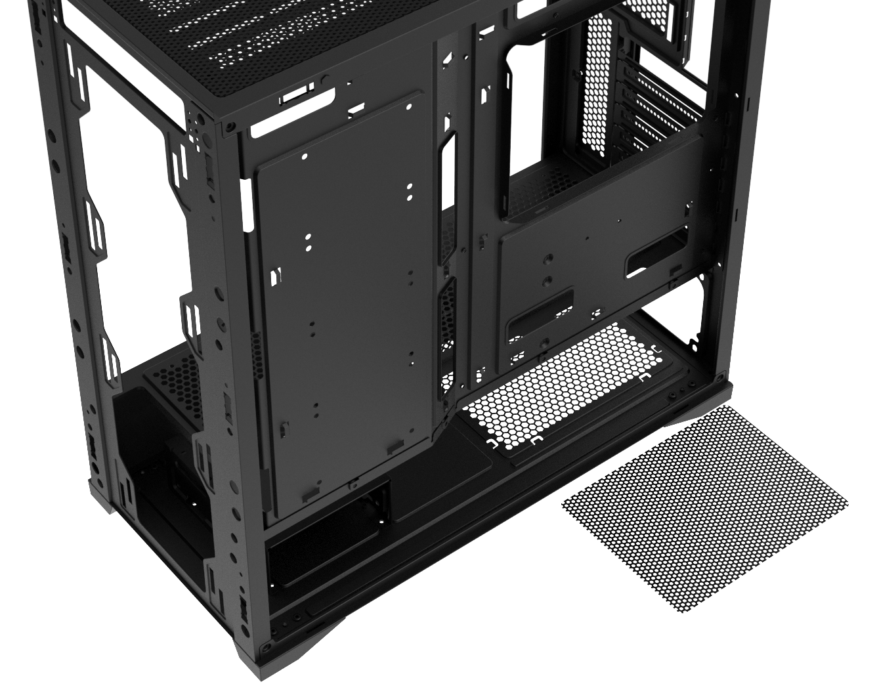
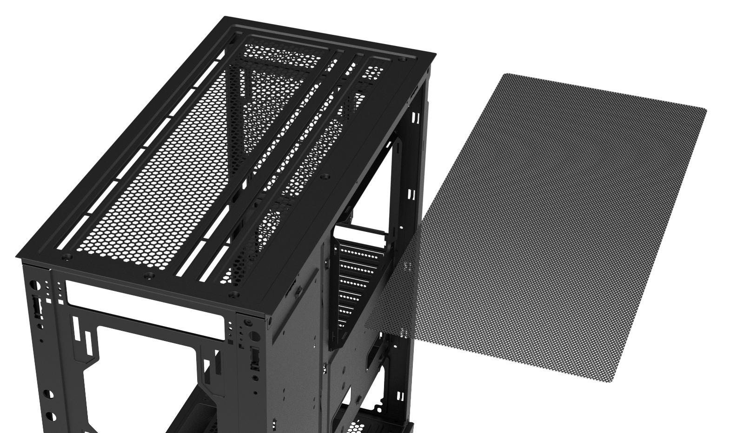
Top
Bottom
Easy Clean With Removable Dust Filters

Slide 7
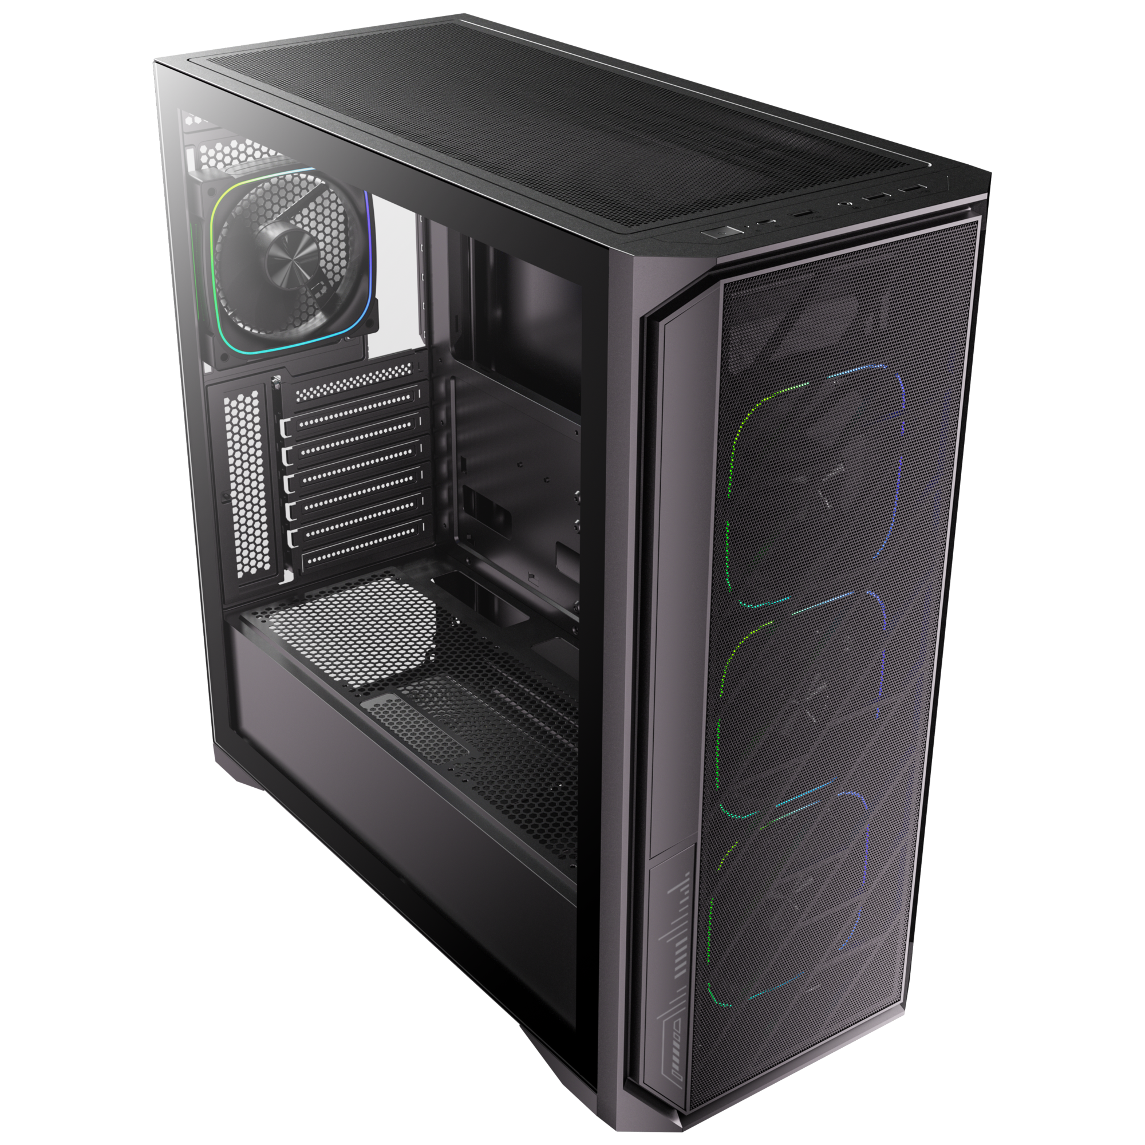
1X USB 3.0 / 2X USB
Power Button
Reset Button

Slide 8
NI522 4F |  | Black | White
Part no. |  | BFC-NI52B75KKGKK-4F | BFC-NI52B75WWGWW-4F
EAN |  | 4716779449808 | 4716779449815
UPC |  | 886027007556 | 886027010402
Net weight (NW) Gross weight (GW) |  | N.W: 6.1Kgs / G.W: 7.1Kgs | N.W: 6.1Kgs / G.W: 7.1Kgs
Materials |  | Steel, Mesh, Plastic, Tempered Glass
Chassis Dimensions (W x H x D) |  | 220 mm x 470 mm x 440 mm
Motherboard Supports |  | Mini-ITX, MicroATX, ATX
Air Cooler Height Support |  | 165mm
VGA Length Support |  | 435mm
Cable Management Support |  | up to 30mm
2.5" / 3.5" Drive Bay |  | 1+4 / 2
Fan mounts | Front | 3 x 120mm, 3 x 140mm
 | Top | 3 x 120mm, 2 x 140mm
 | Rear | 1 x 120mm
Radiator Support | Front | 1 x 360mm/ 1 x 280mm/ 1 x 240mm (Thickness up to 27mm)
 | Top | 1 x 360mm/ 1 x 280mm/ 1 x 240mm (Thickness up to 27mm)
 | Rear | 1 x 120mm
PCI-E Slots |  | 7 Slots
I/O Ports |  | 1 x USB 3.0/ 2 x USB/ Audio I/O
Power Supply |  | ATX & Standard / up to 260mm
NI522
NI522

