Slide 1
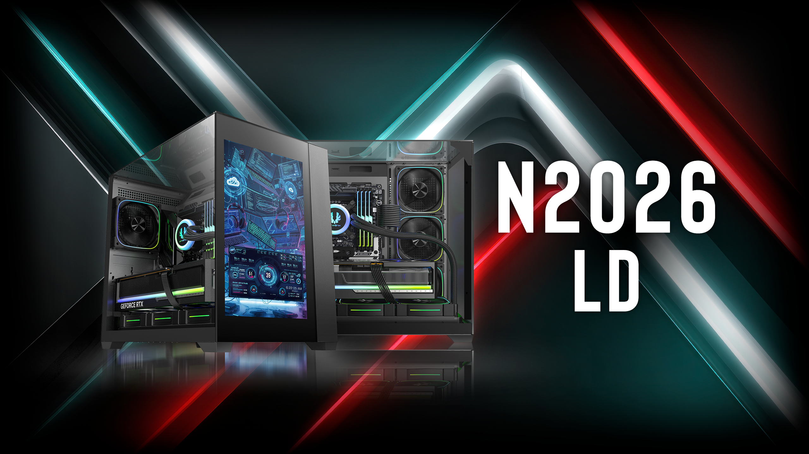

Slide 2
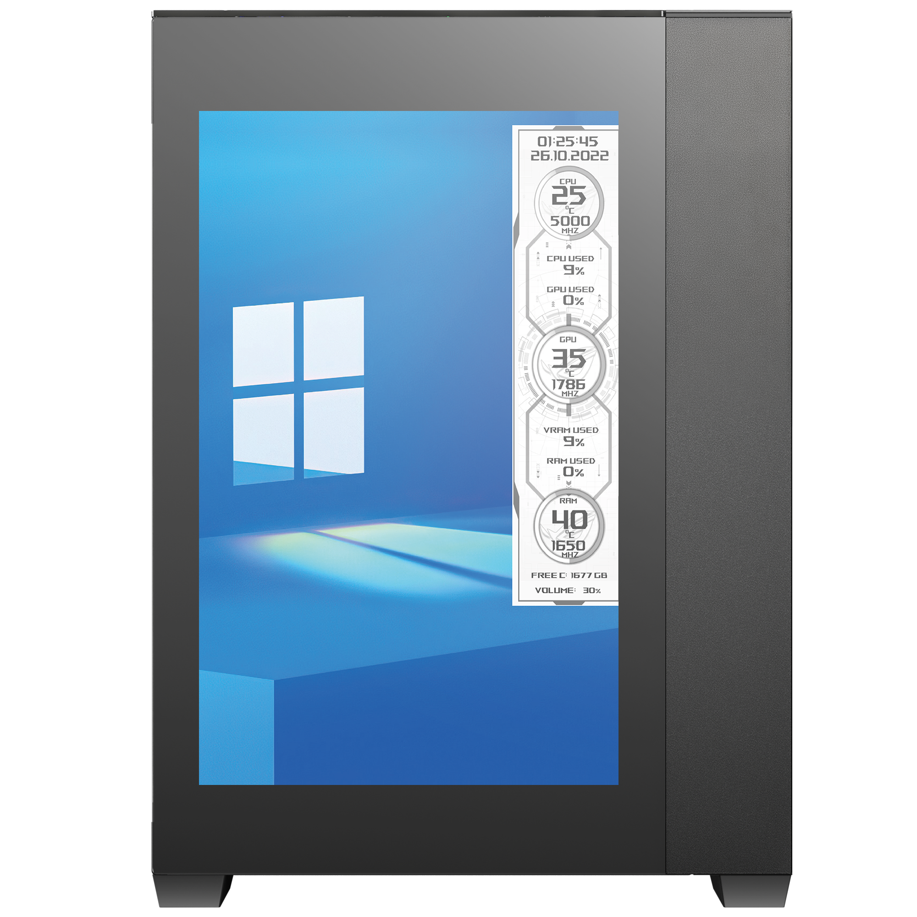
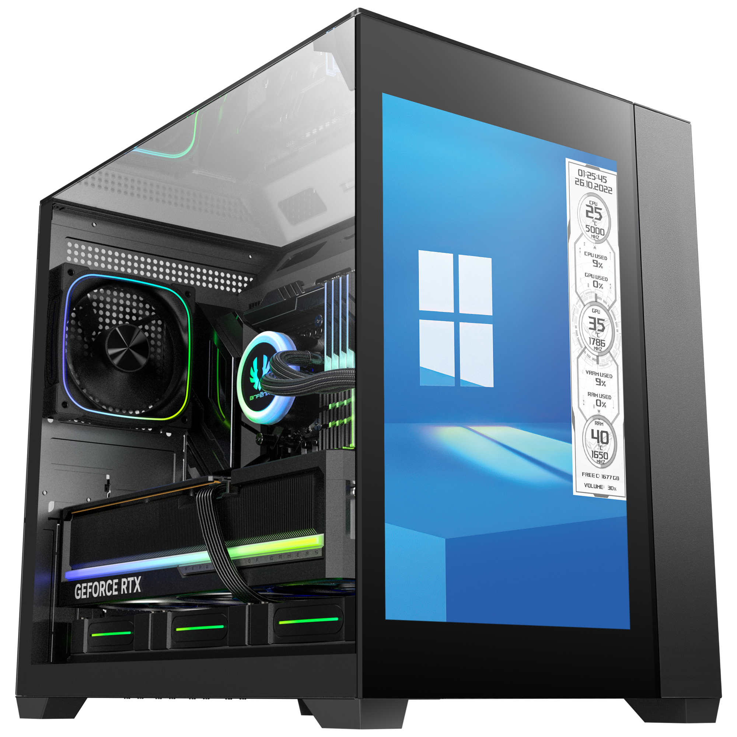
1920 X 1200 Pixels
14-inch IPS Live Performace Display
188mm
301mm

Slide 3
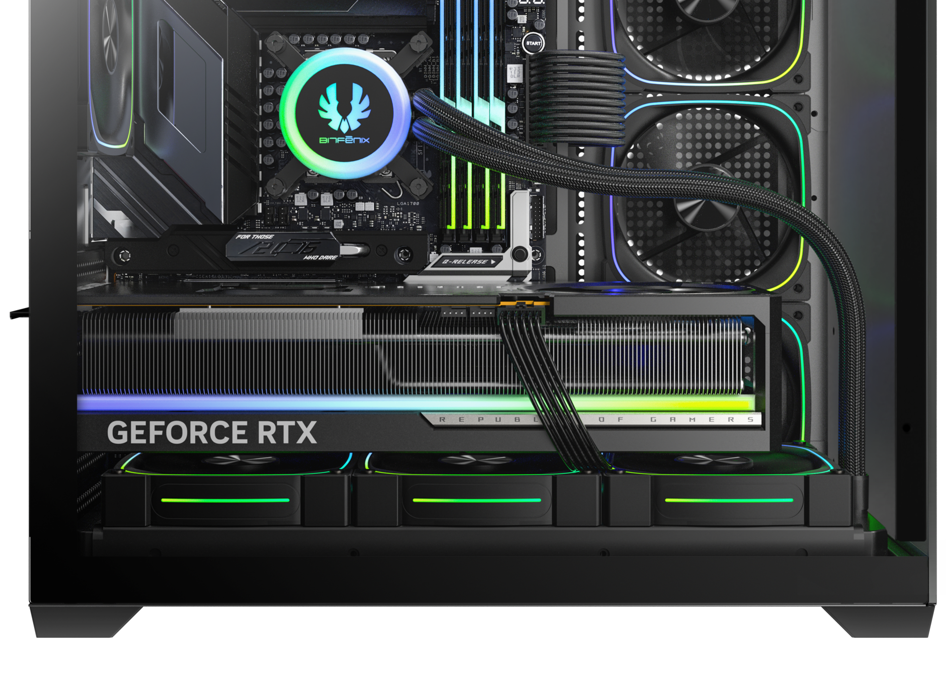
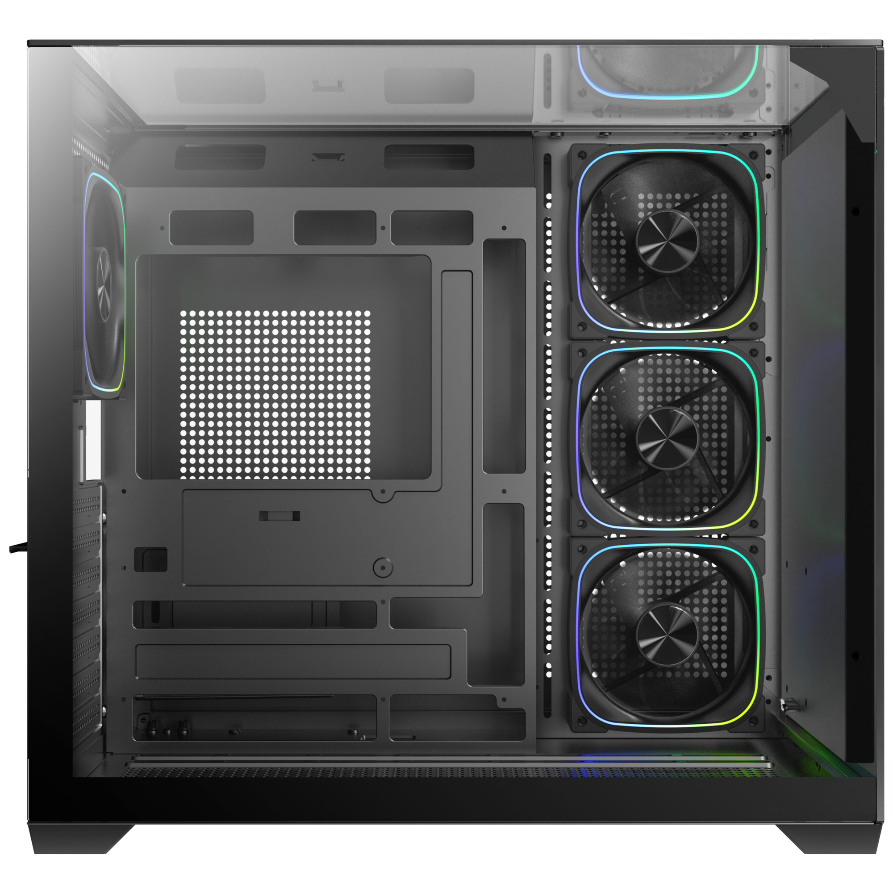
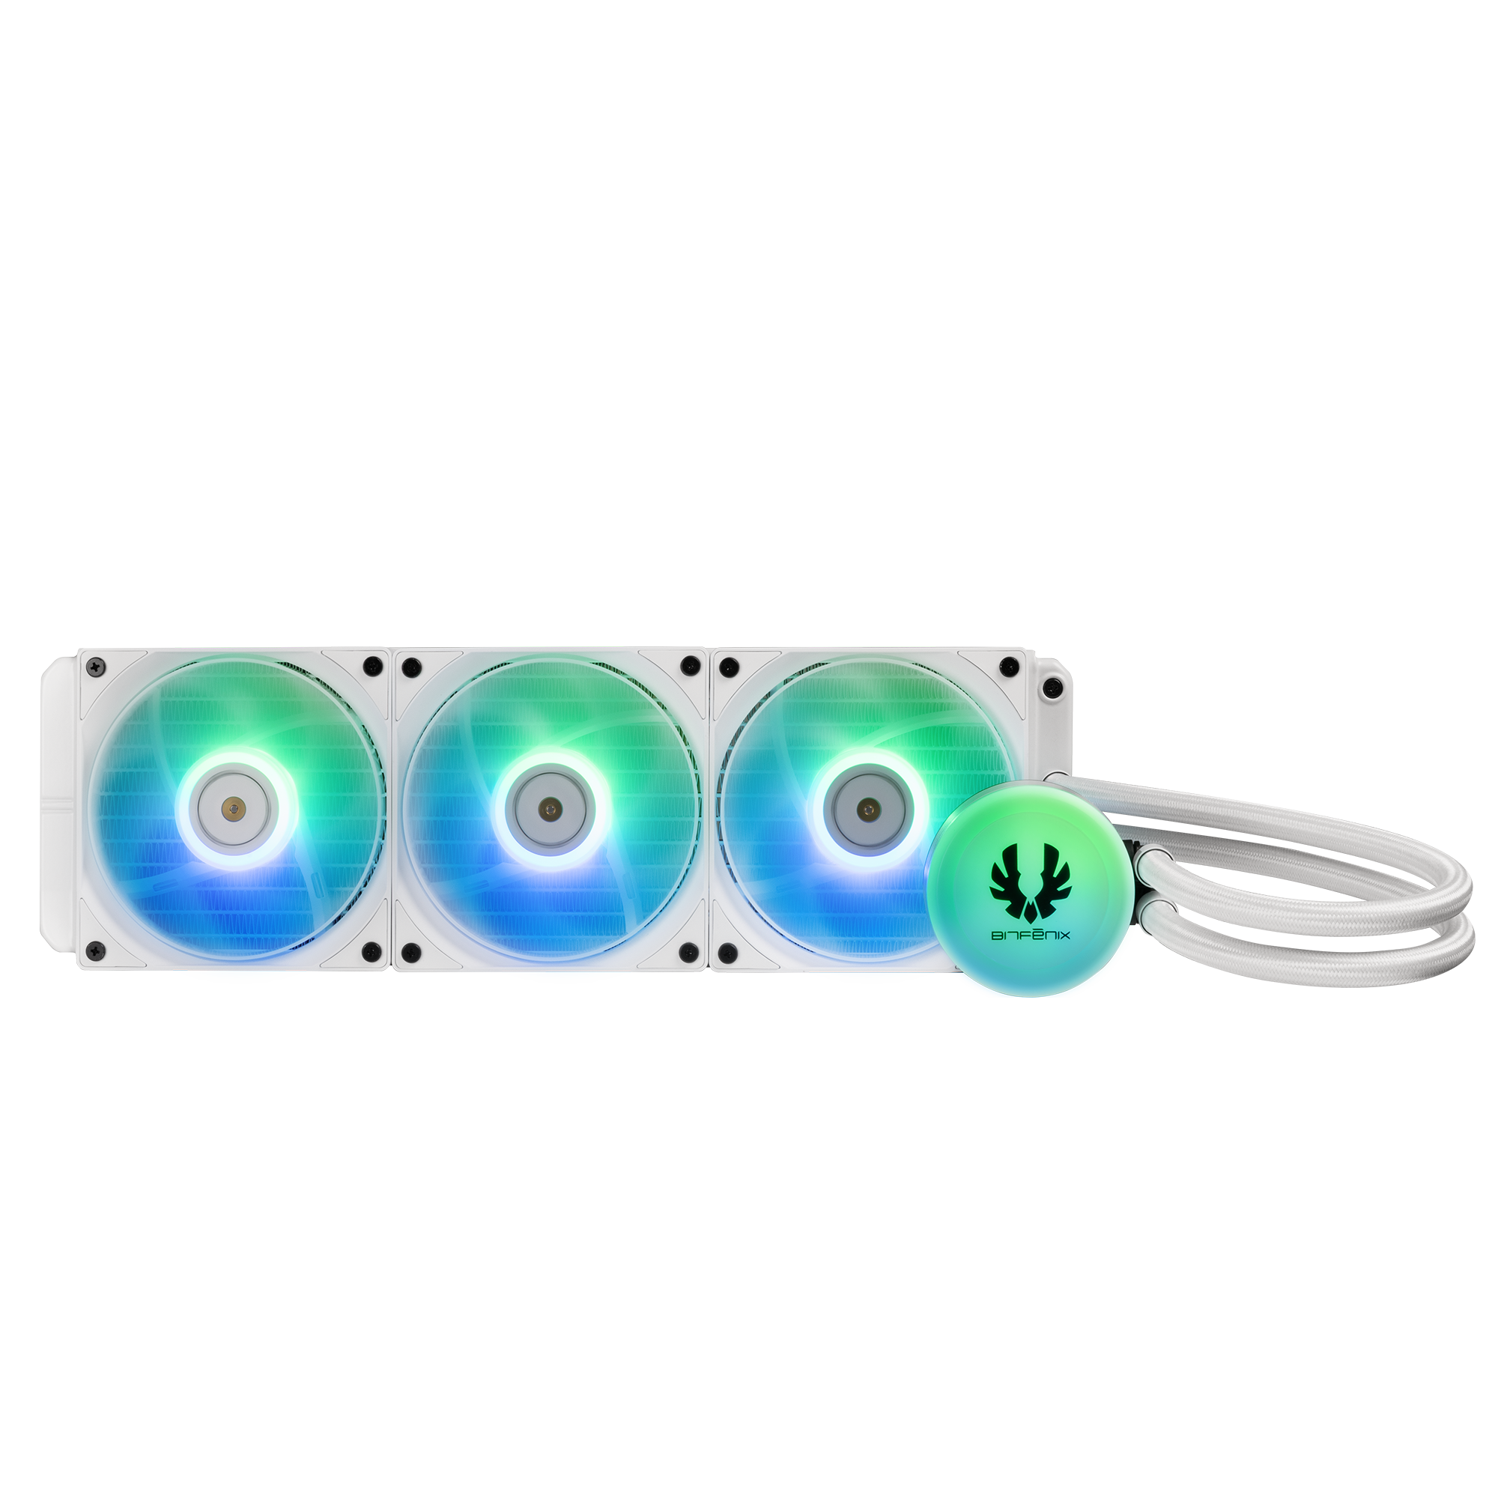
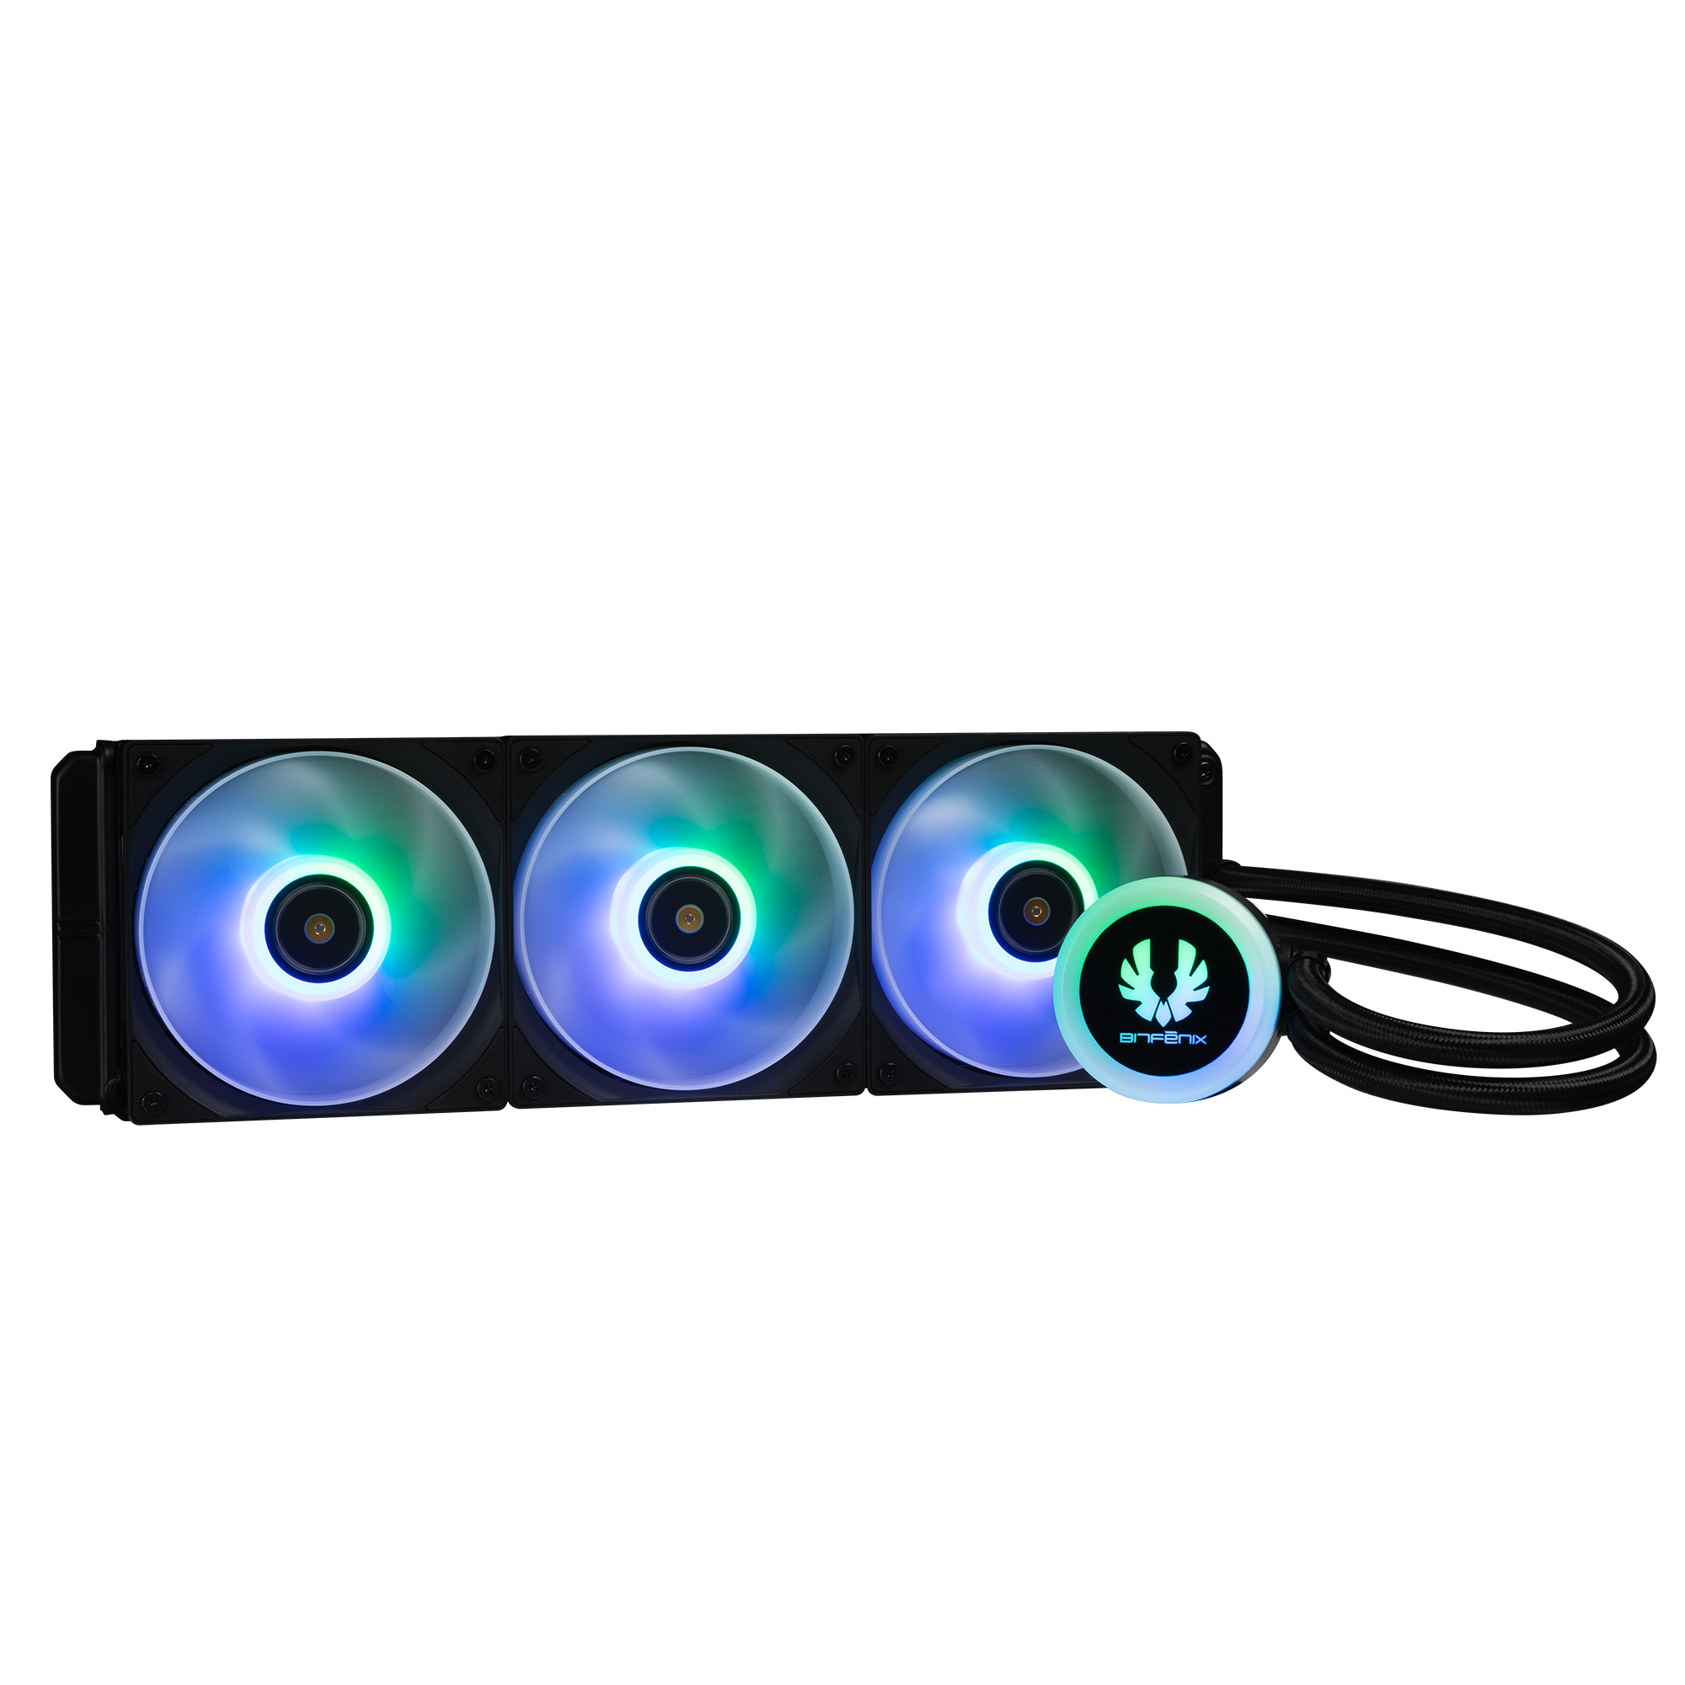
360mm AIO Support
At Bottom
MB
120mm
120mm
120mm

Slide 4
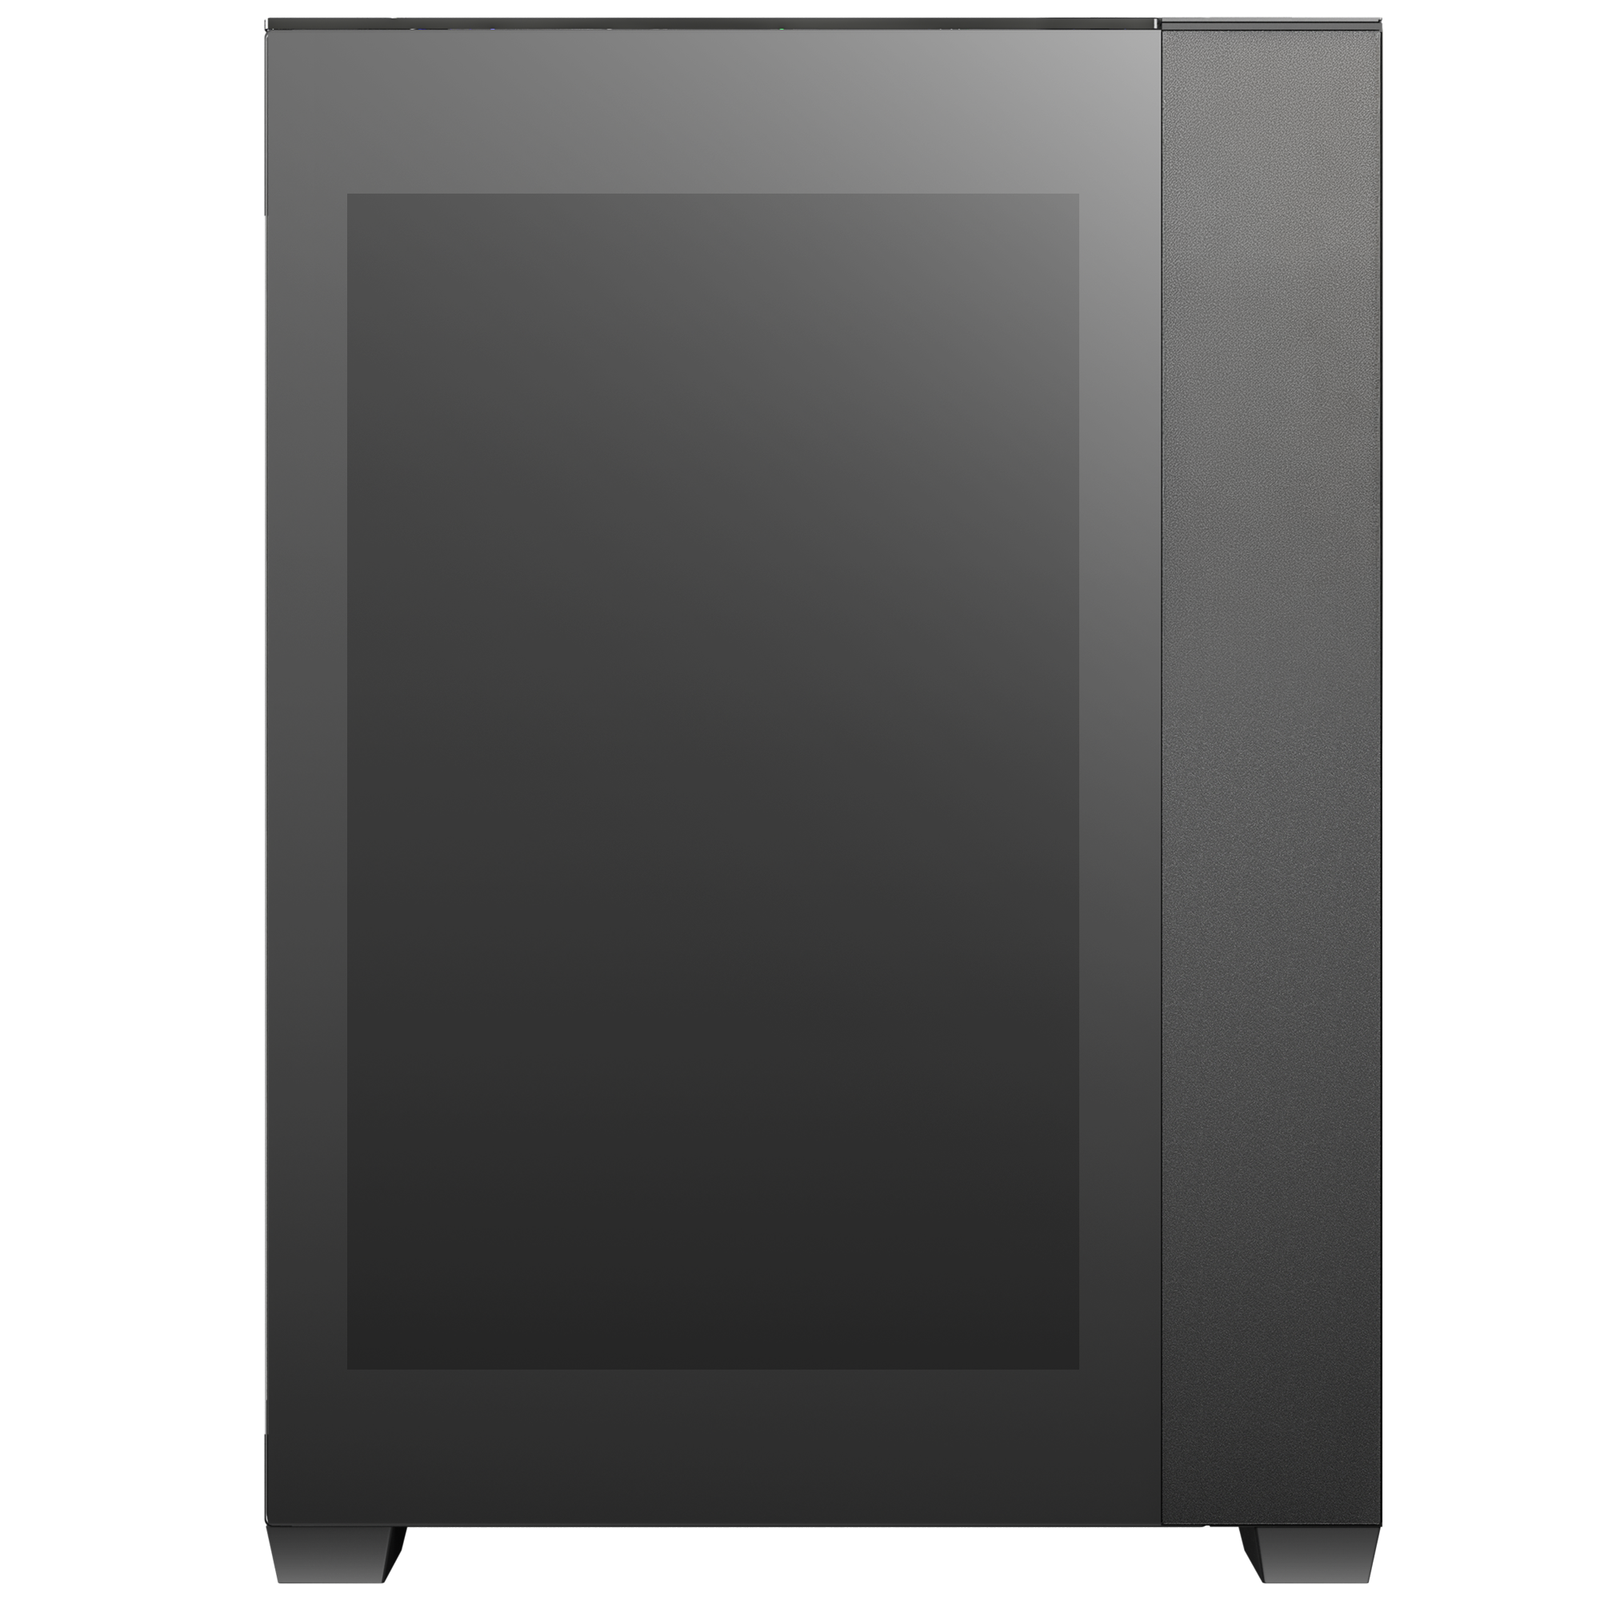
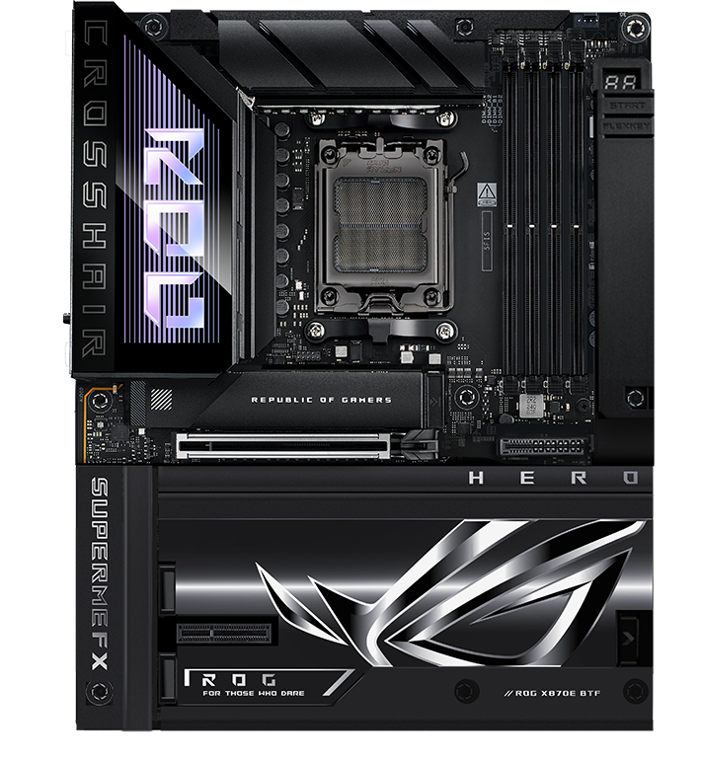
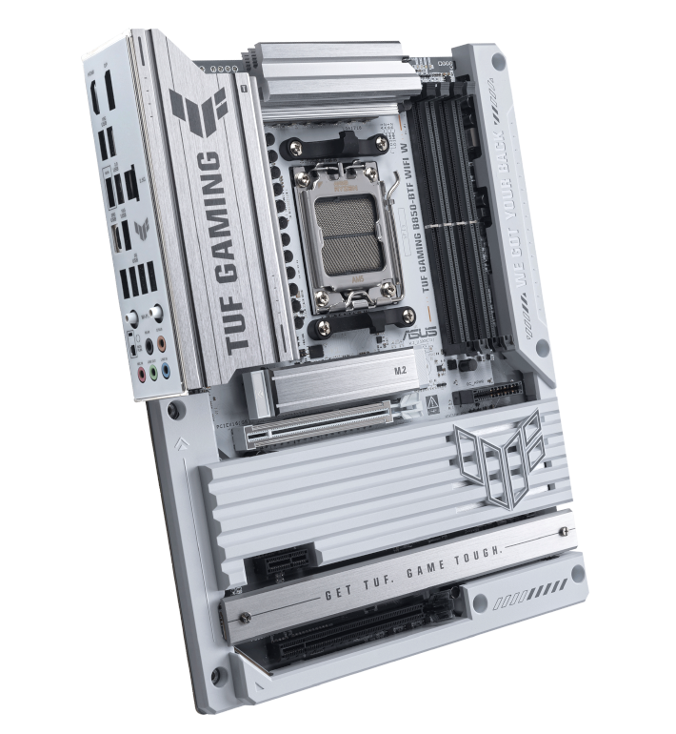
Supports BTF Back-Connect Motherboard
285mm
420mm
Maximun CPU
Cooler Height
Back-Connect Motherboard
Motherboard
Support
165
mm
ITX
M-ATX
ATX
400mm
Cable Management Space 90.9 mm
Maximun Graphics Card
Support
400
mm

Slide 5
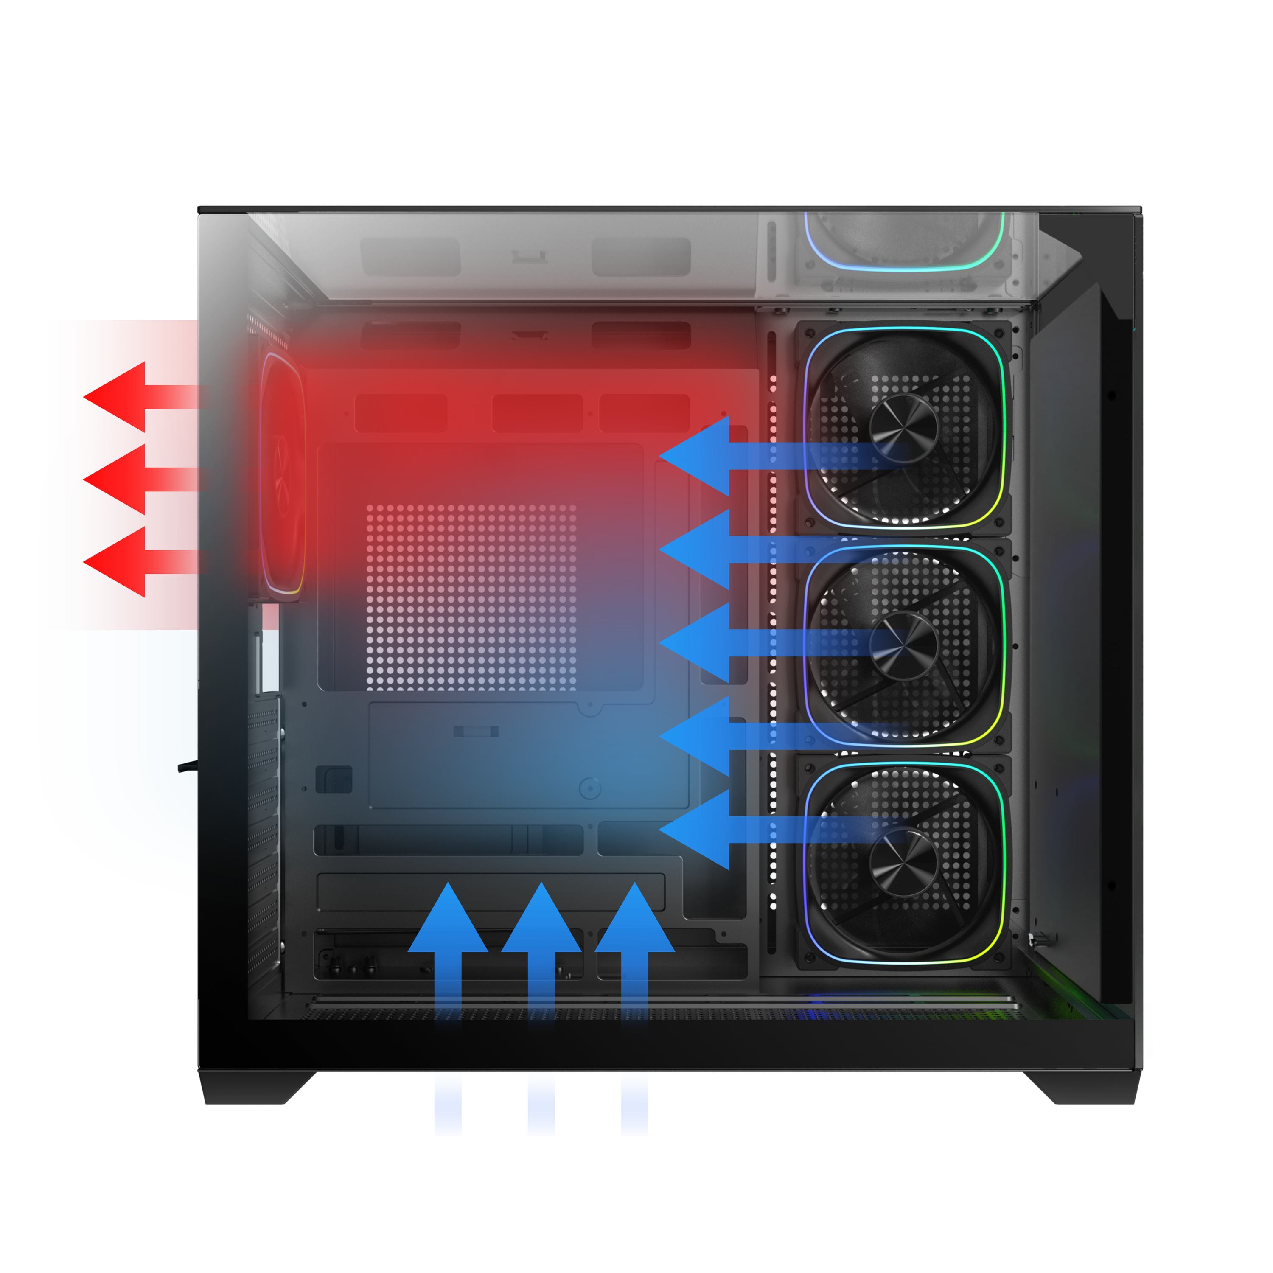

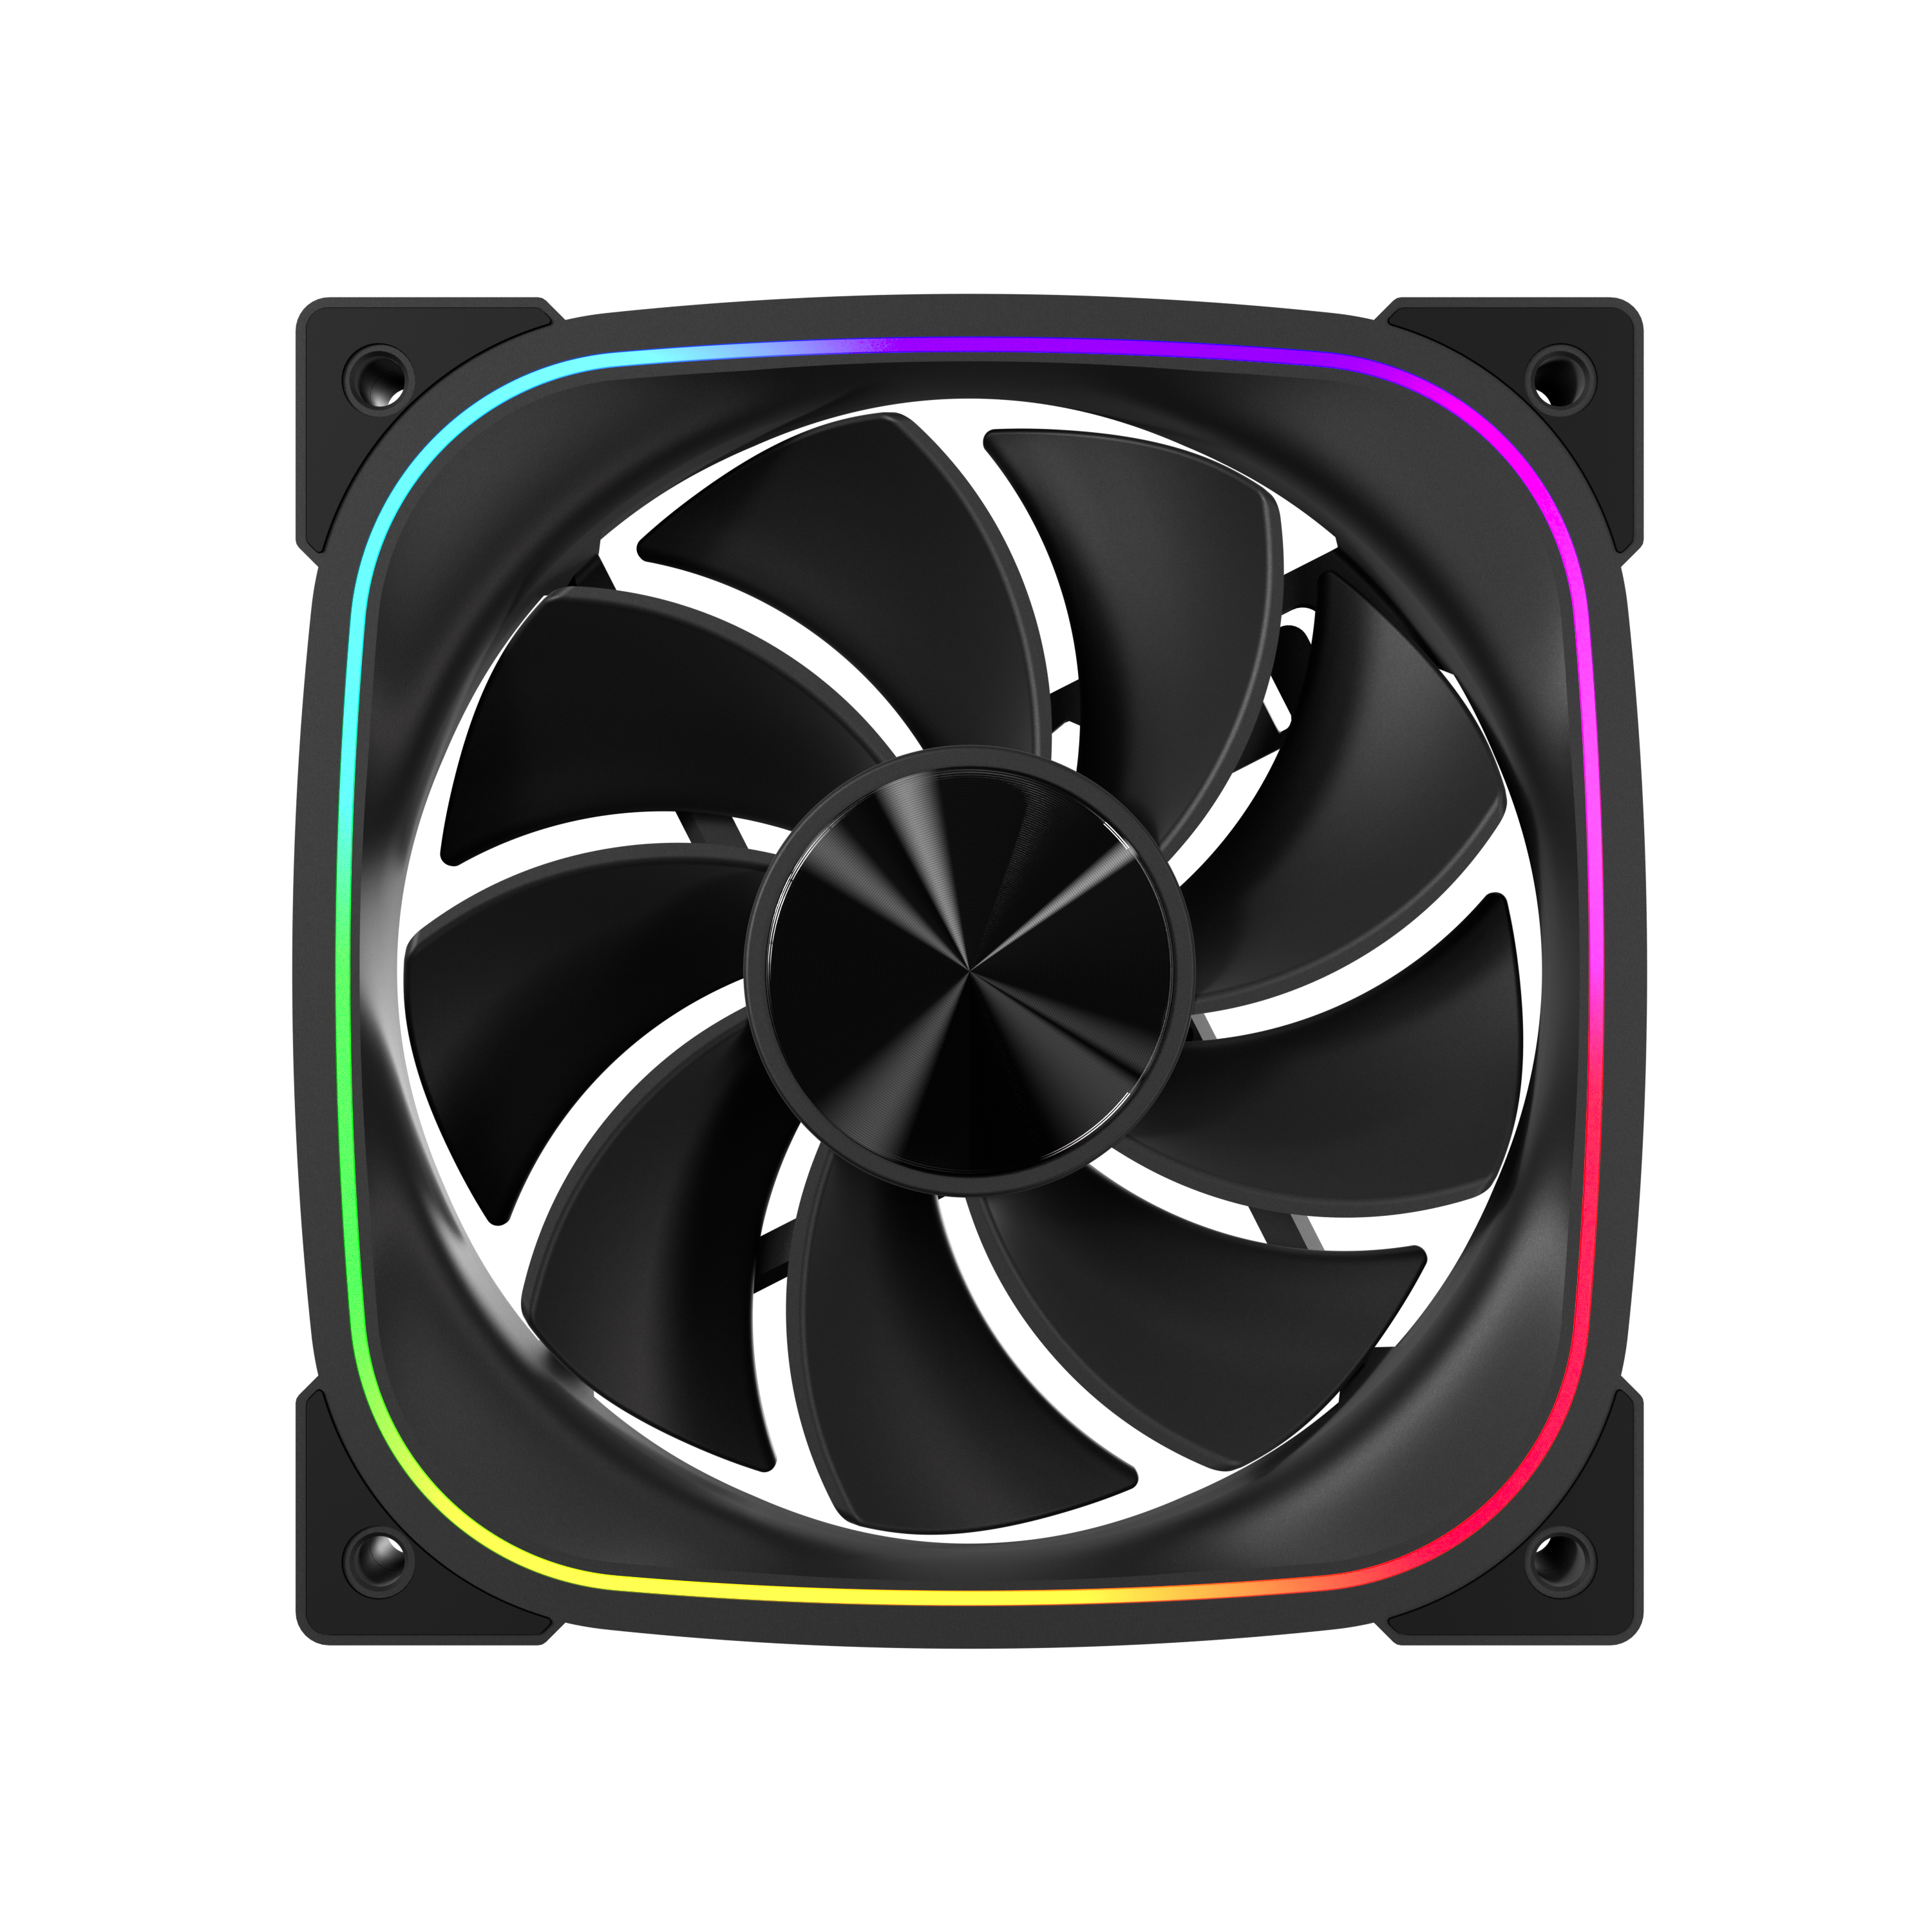
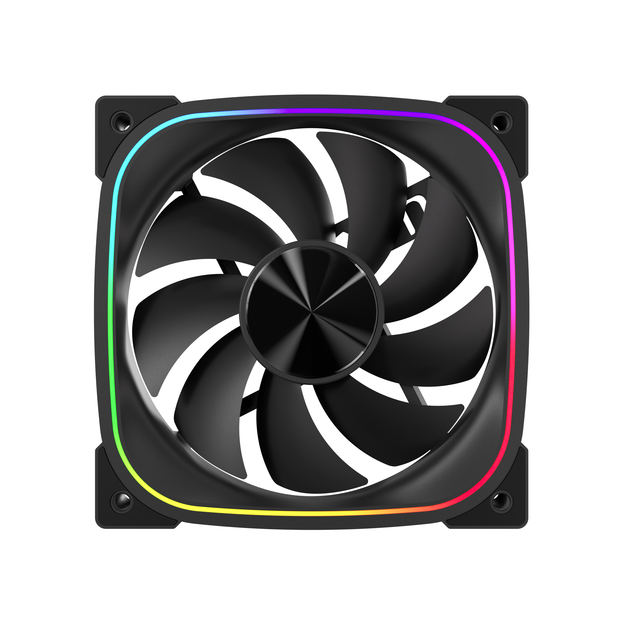
High-Performance
Reverse ARGB Fan
3X
DUAL CHAMBER
1X
HIGH
AIRFLOW PERFORMANCE
High-Performance ARGB Fan

Slide 6
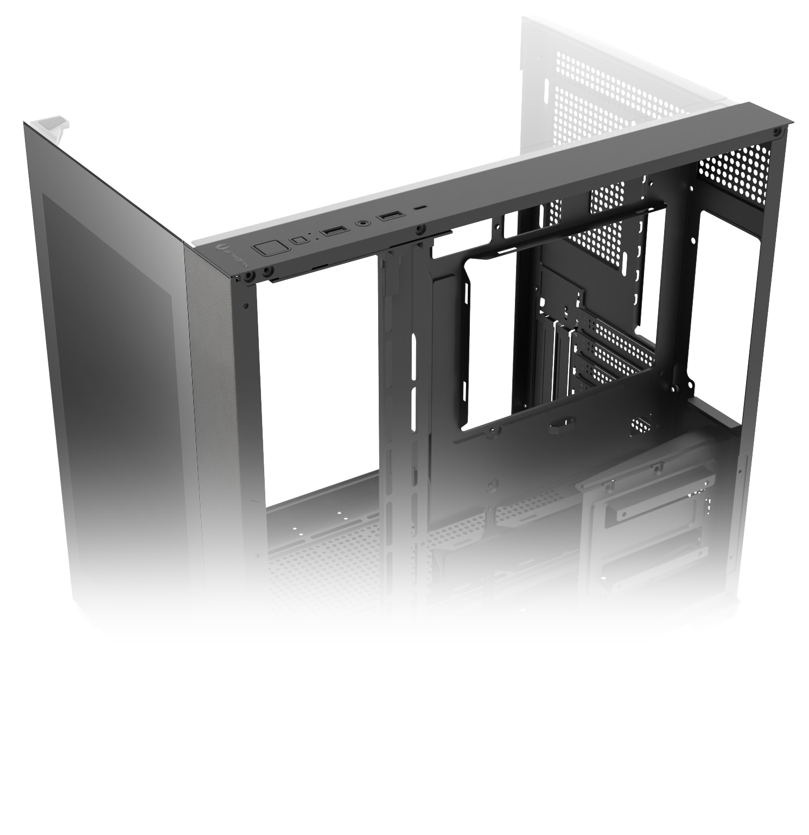
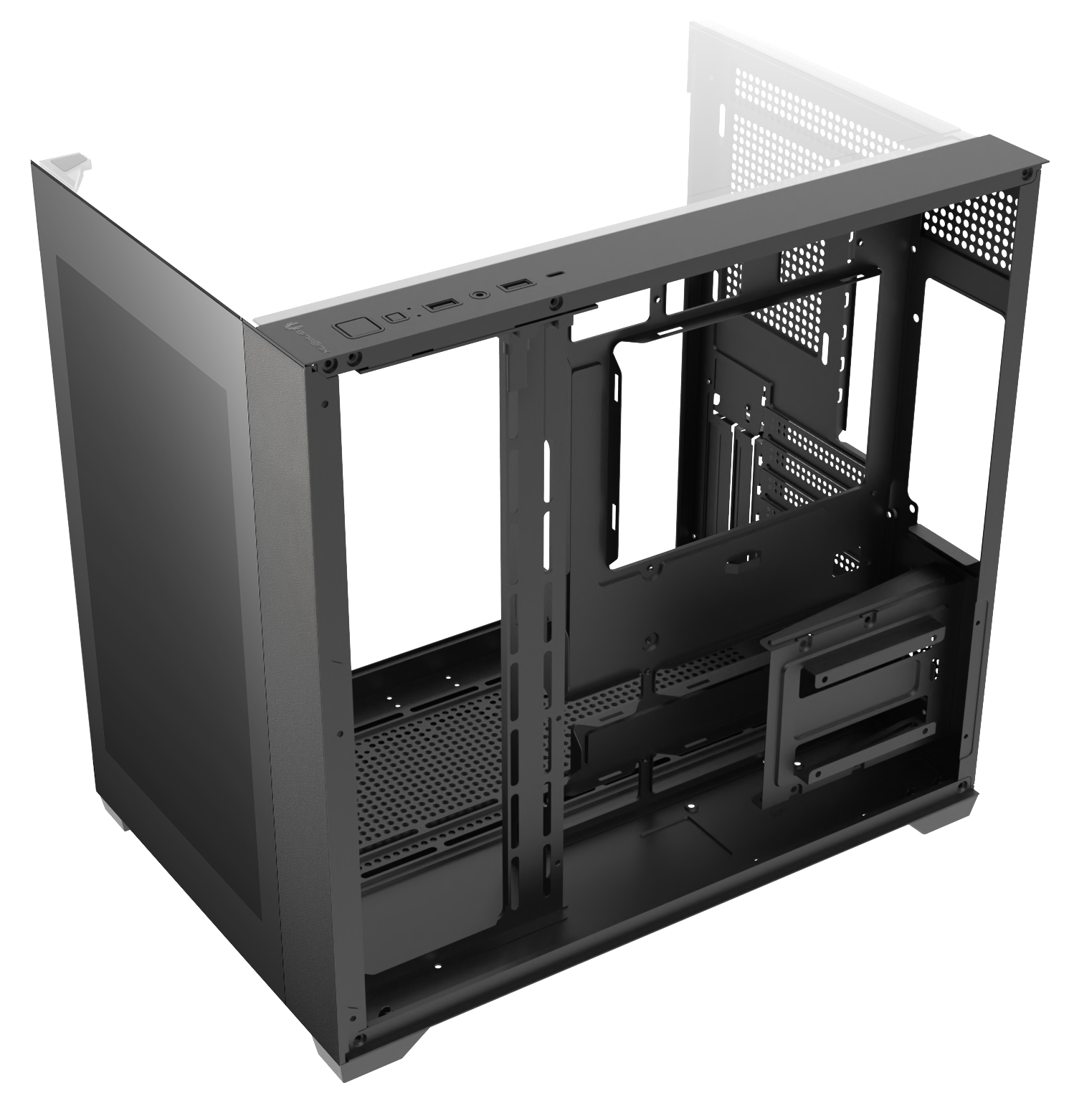
1X SSD & 1X HDD
PSU
ATX & Standard /
up to 190mm
1X SSD
1 X 3.5’’ Drive & 2 X 2.5’’Drive

Slide 7
Easy Clean With Removable Dust Filter
Dust Filter (Bottom)

Slide 8
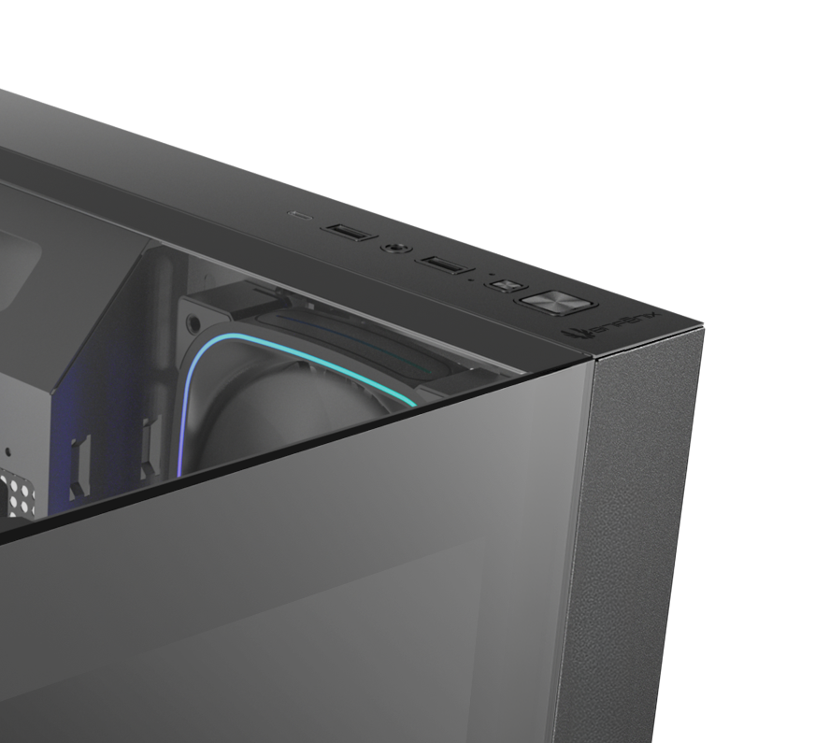
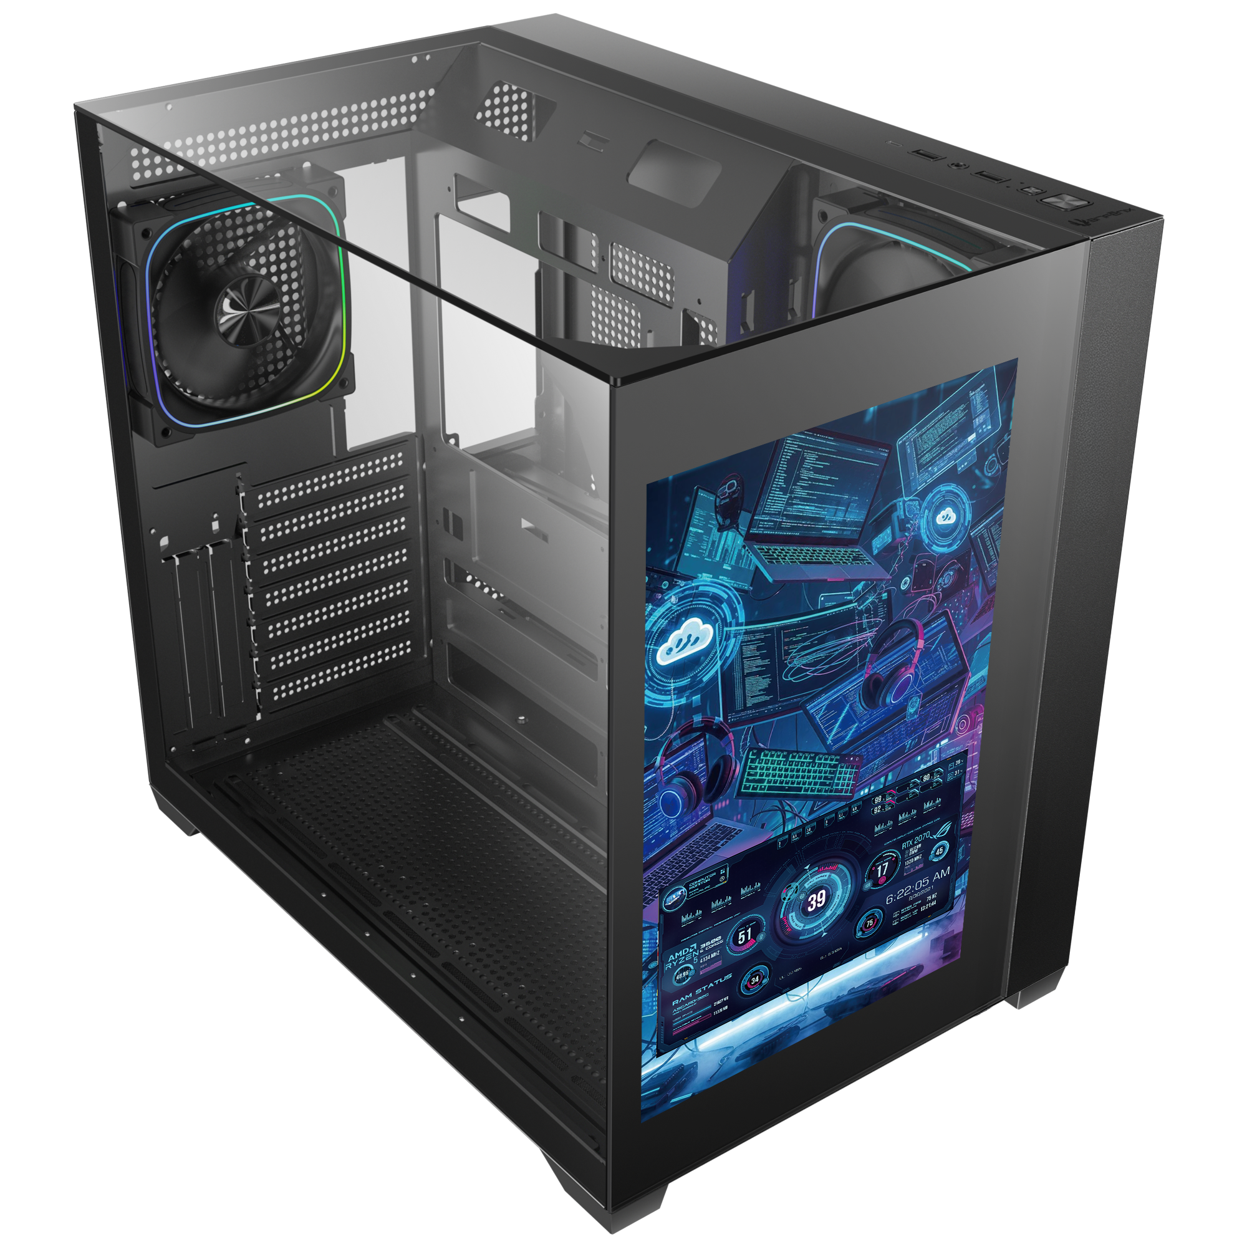
1X TypeC
Tool-free Removal
Reset
Button
Power Button
2X USB
1X USB 3.0

Slide 9
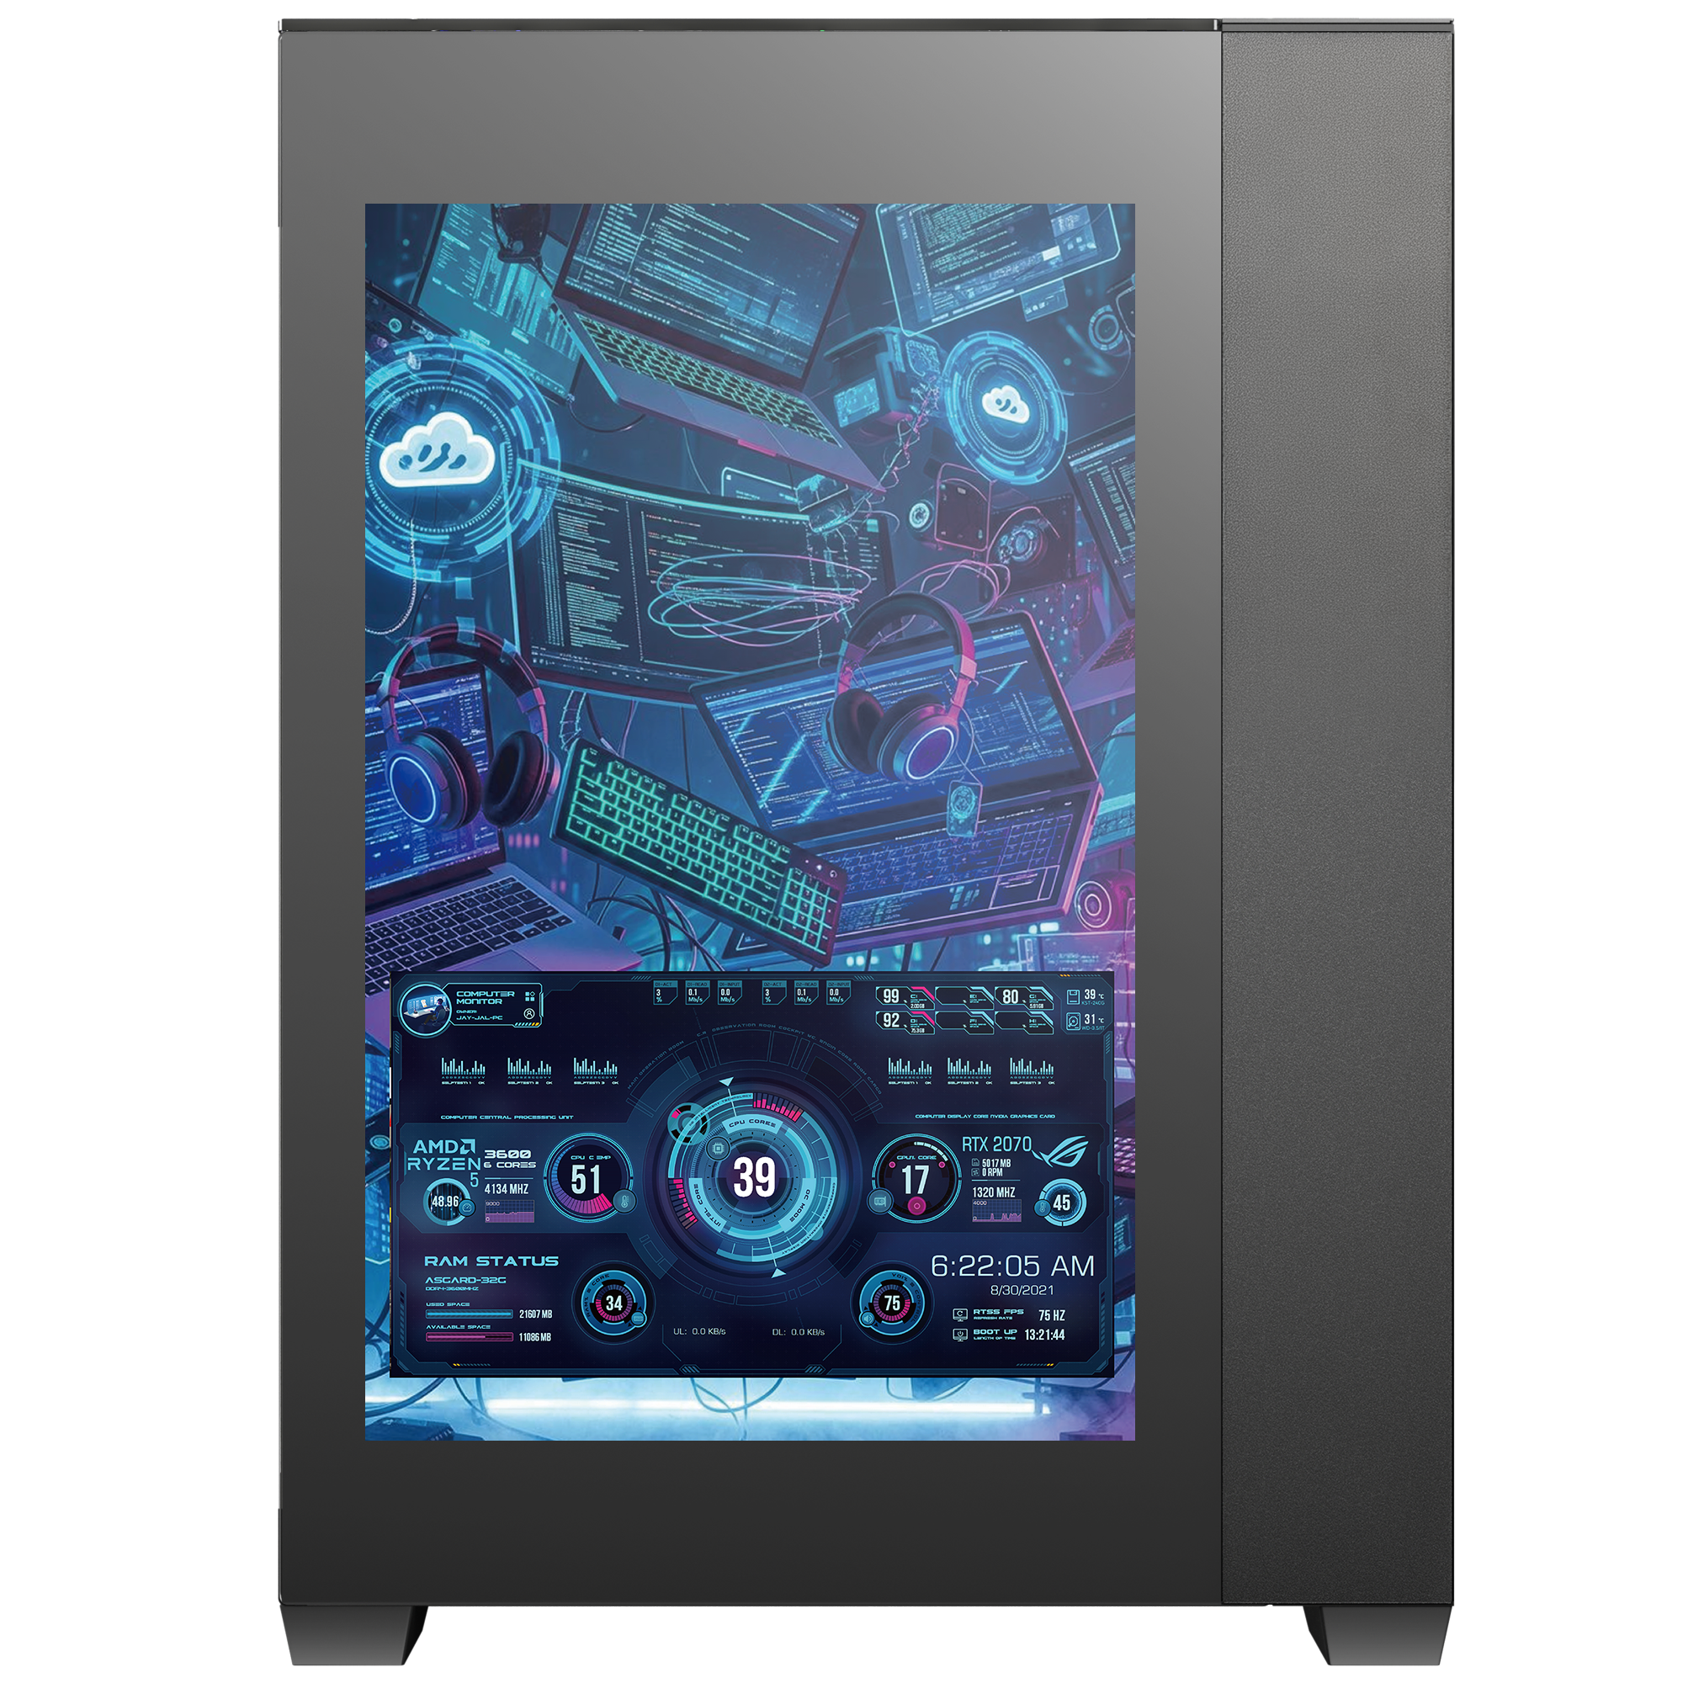
N2026 LD Black
Part no. |  | BFC-NLD850KKGKK-4A
EAN |  | 4712883213403
UPC |  | 886027010372
Net weight (NW) Gross weight (GW) |  | N.W: Kgs / G.W: Kgs
Materials |  | Steel, Mesh, Plastic, Tempered Glass
Chassis Dimensions (W x H x D) |  | 420 mm x 285 mm x 400 mm
Motherboard Supports |  | Mini-ITX, MicroATX, ATX
Air Cooler Height Support |  | 165mm
VGA Length Support |  | 400mm
Cable Management Support |  | up to 90.9mm
2.5" / 3.5" Drive Bay |  | 2 / 1
Fan mounts | Rear | 1 x 120mm
 | M/B | 3 x 120mm
 | Bottom | 3 x 120mm
Radiator Support | Rear | 1 x 120mm
 | M/B | 1 x 240mm
 | Bottom | 1 x 360mm/ 1 x 280mm/ 1 x 240mm (Thickness up to 27mm)
PCI-E Slots |  | 7 Slots
I/O Ports |  | 1 x TypeC/ 1 x USB 3.0/ 1 x USB/ Audio I/O
Power Supply |  | ATX & Standard / up to 190mm
14-inch Monitor
Display screen visible size
301mm x 188mm
N2026 LD
Product (frame) size
311mm x 201mm x 11mm
Display resolution
1920 x 1200 Pixels
Interfaces
HDMI, USB-TYPE-C adapter cable, cable length 1000mm

