Slide 1
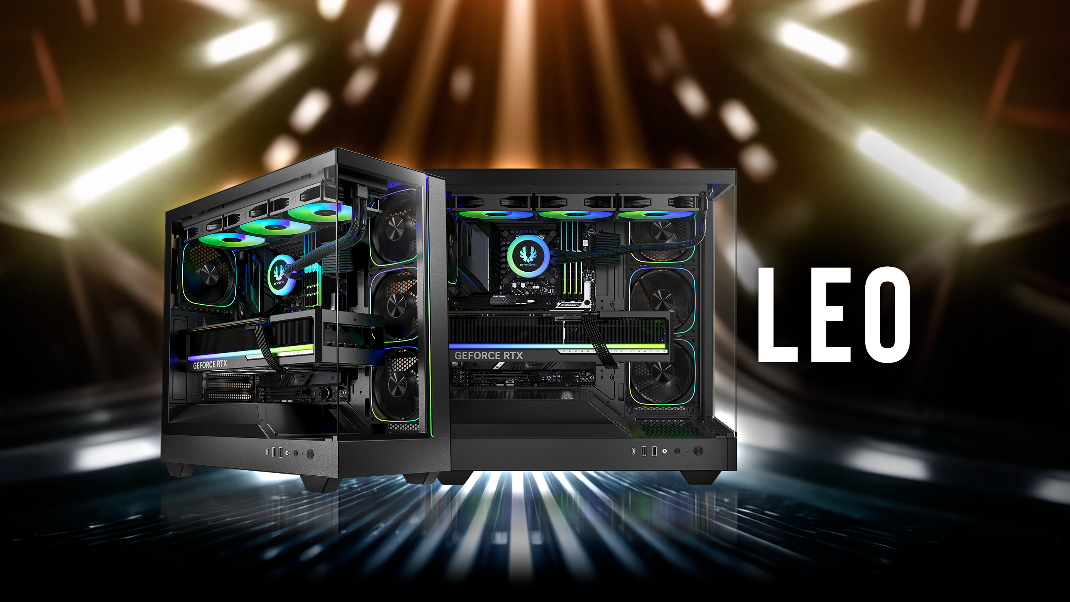

Slide 2
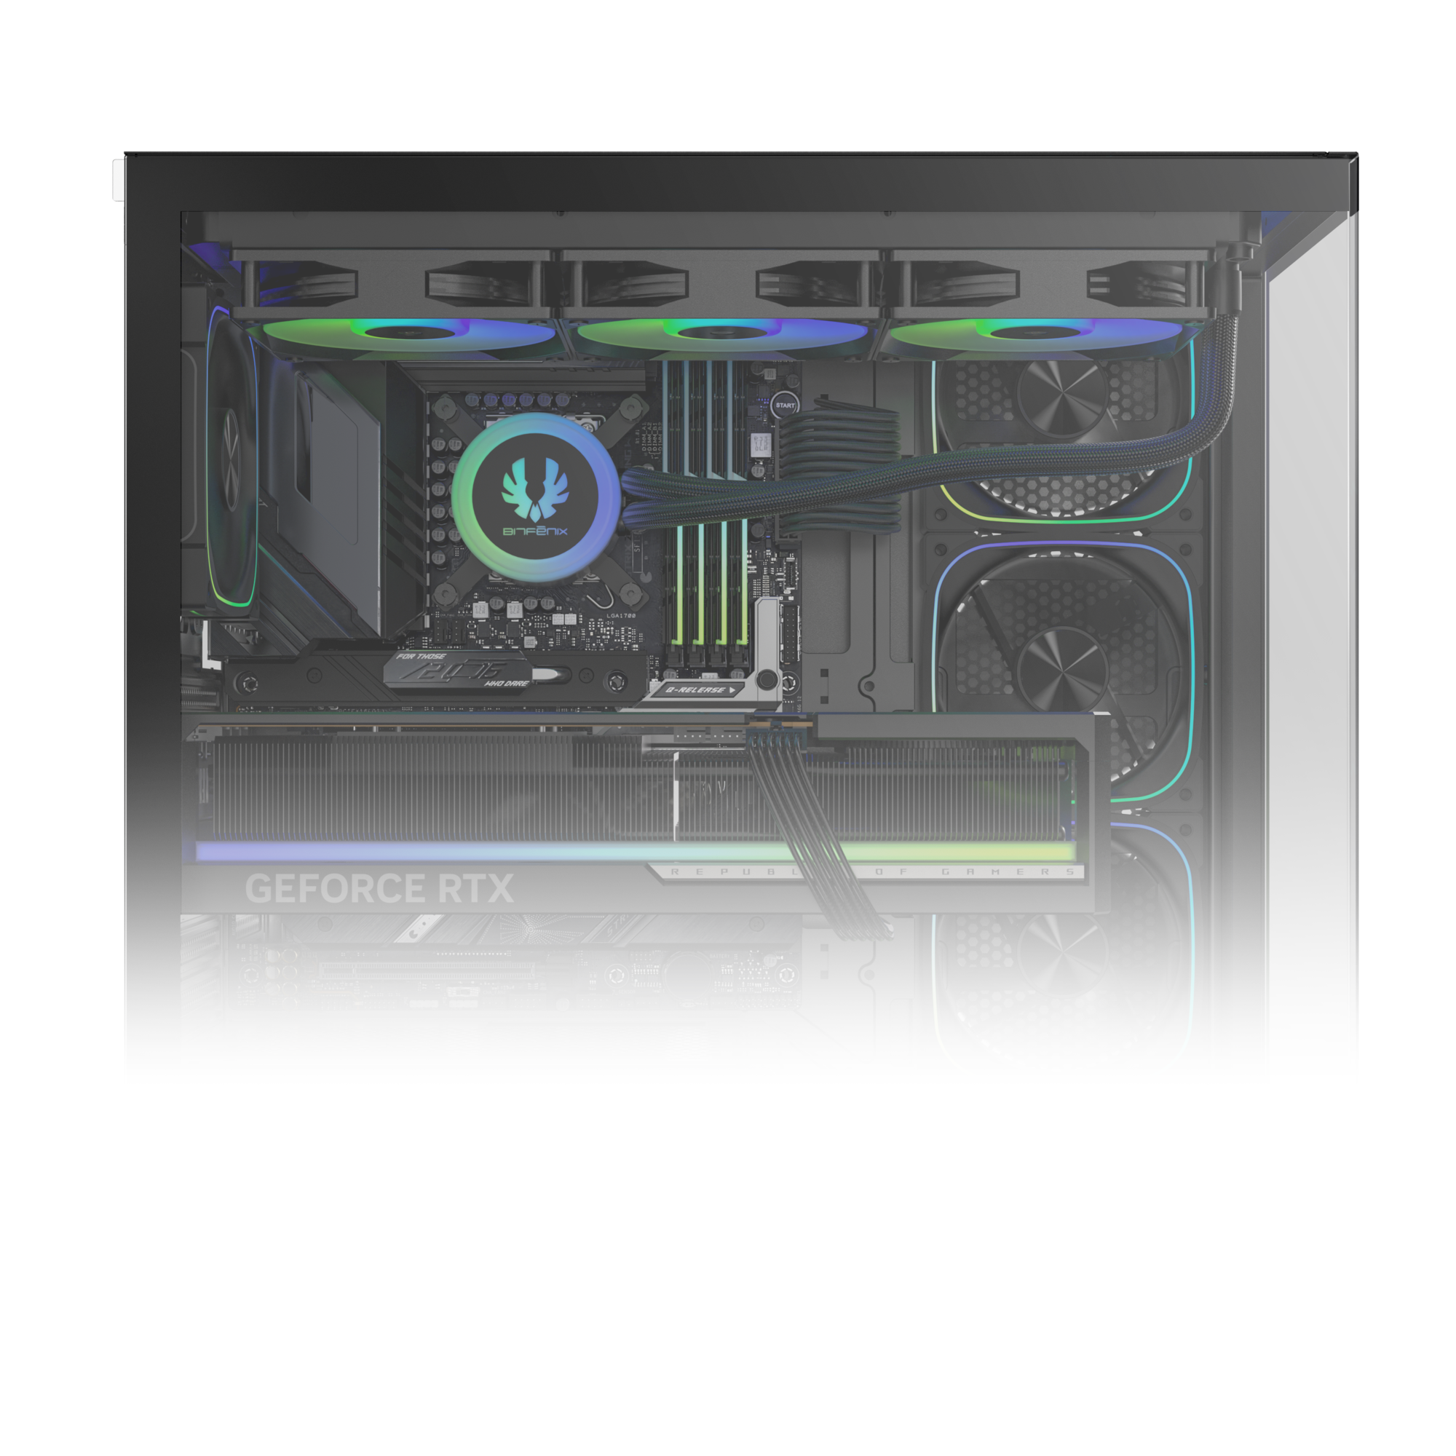
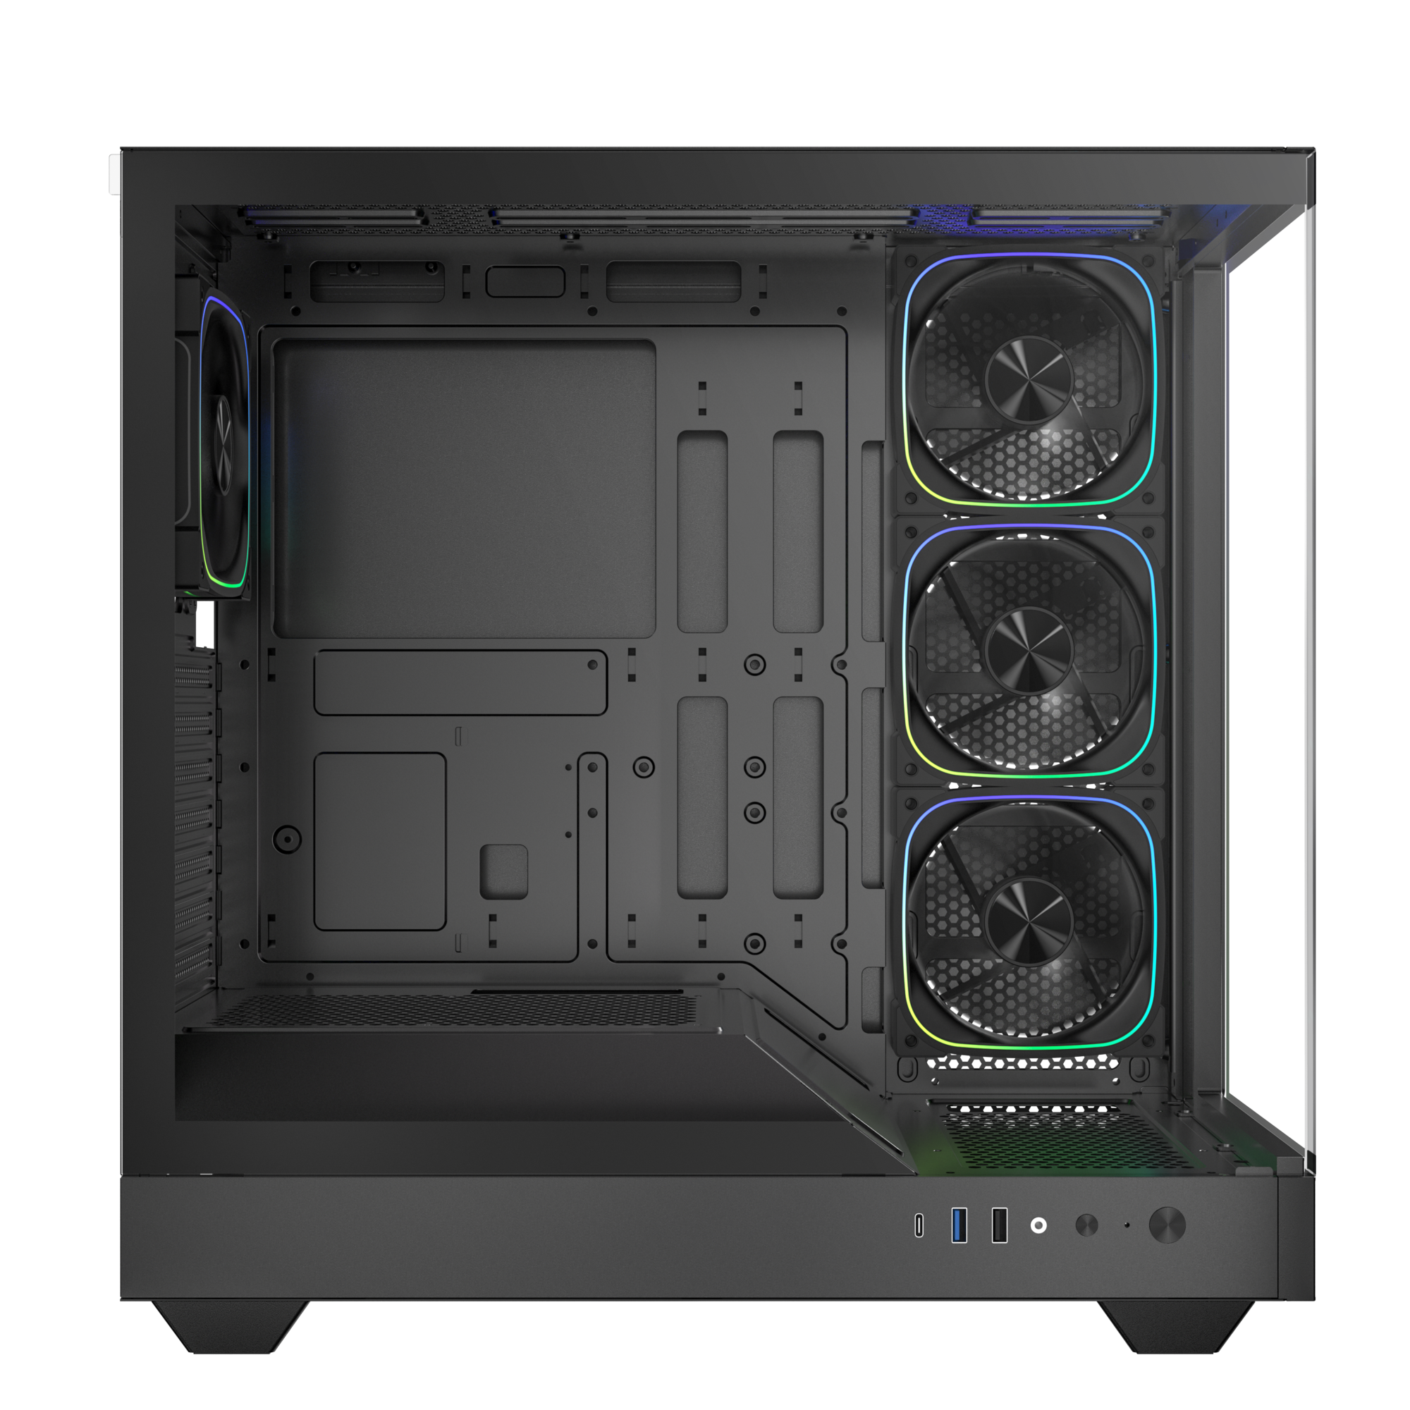
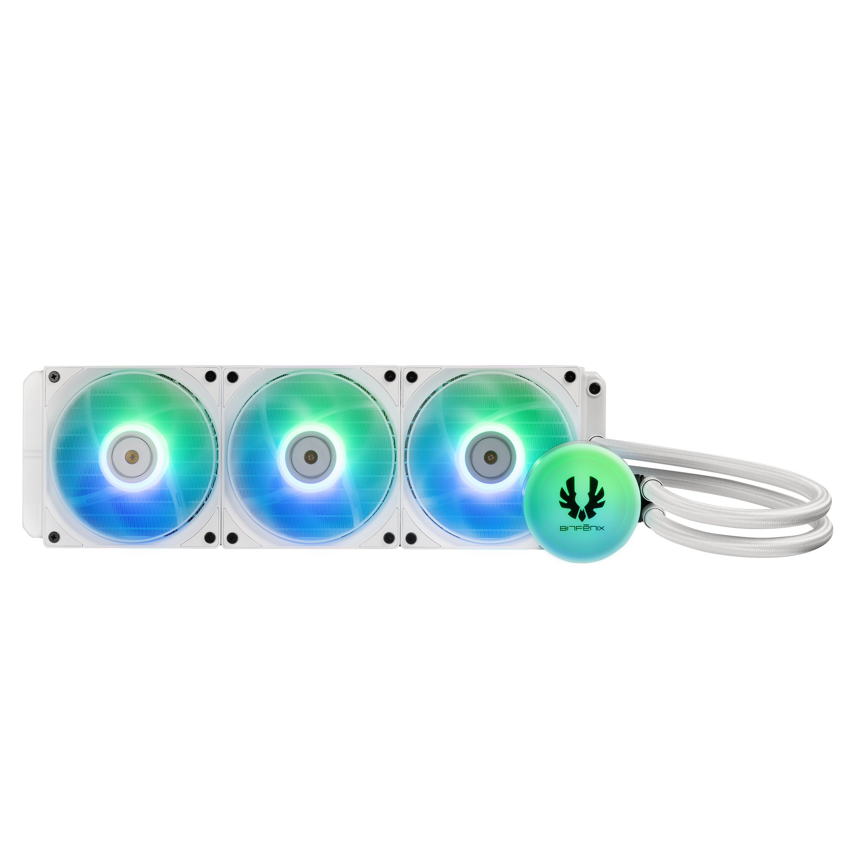
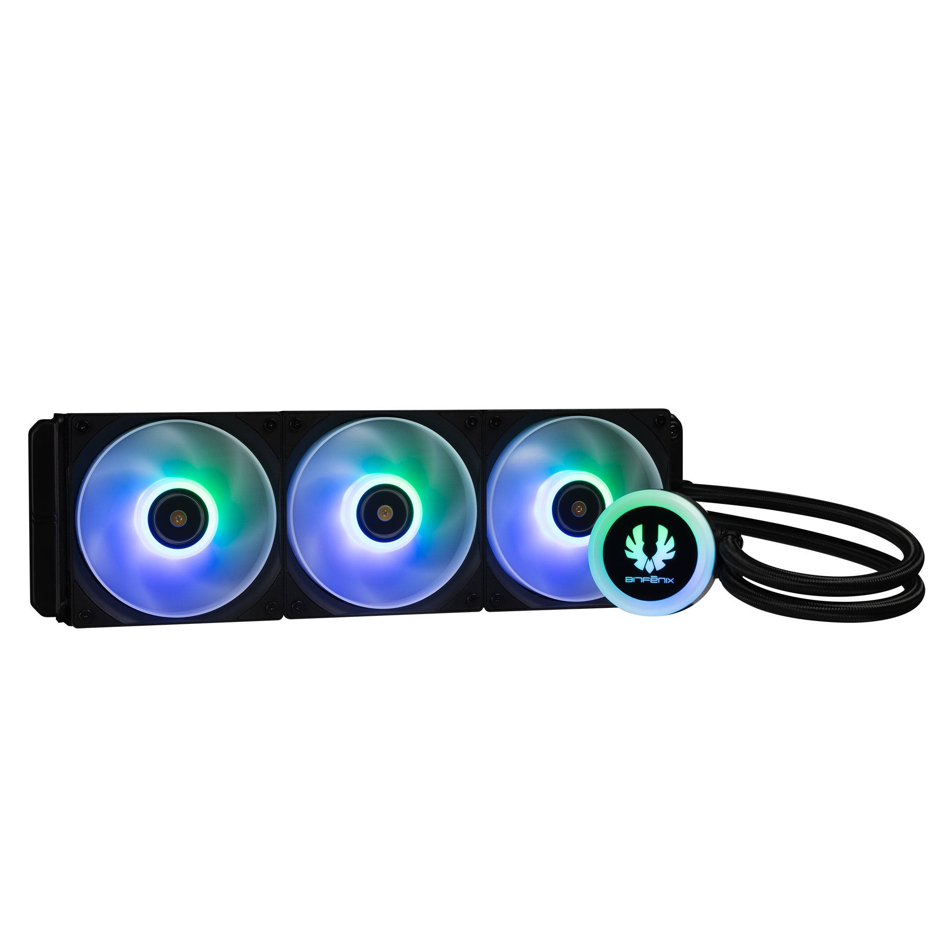
360mm AIO Top-mount support
140mm
MB
120mm
120mm
120mm

Slide 3
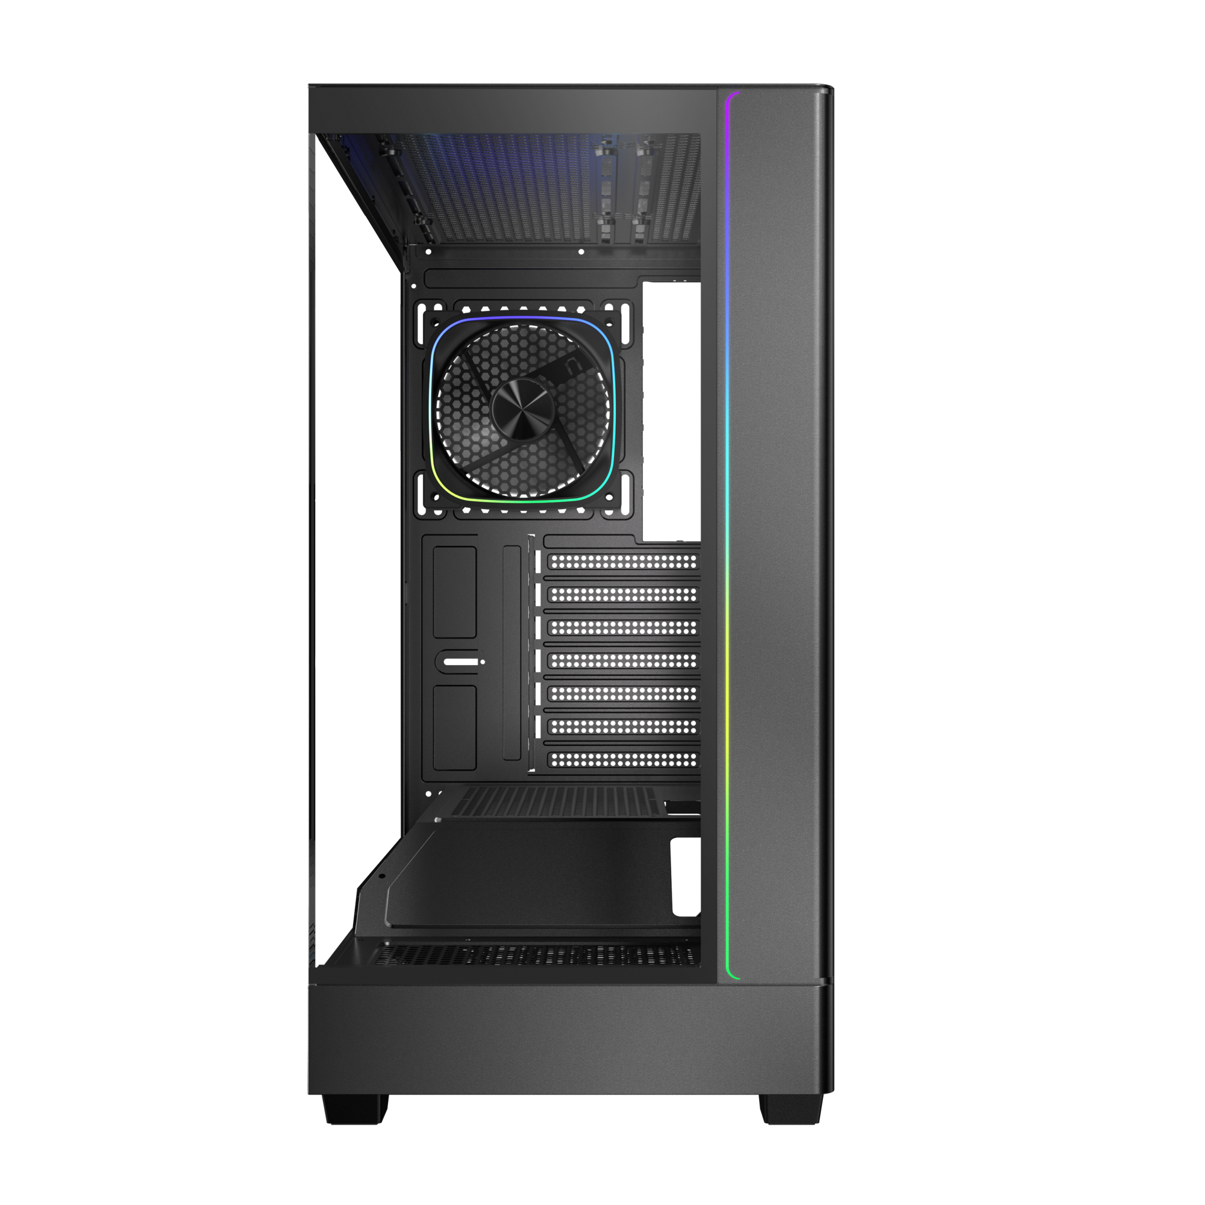
Dimension
225mm
430mm
Maximun CPU
Cooler Height
Motherboard
Support
165
mm
ITX
M-ATX
ATX
430mm
Cable Management Space 35mm
Maximun Graphics Card
Support
410
mm

Slide 4
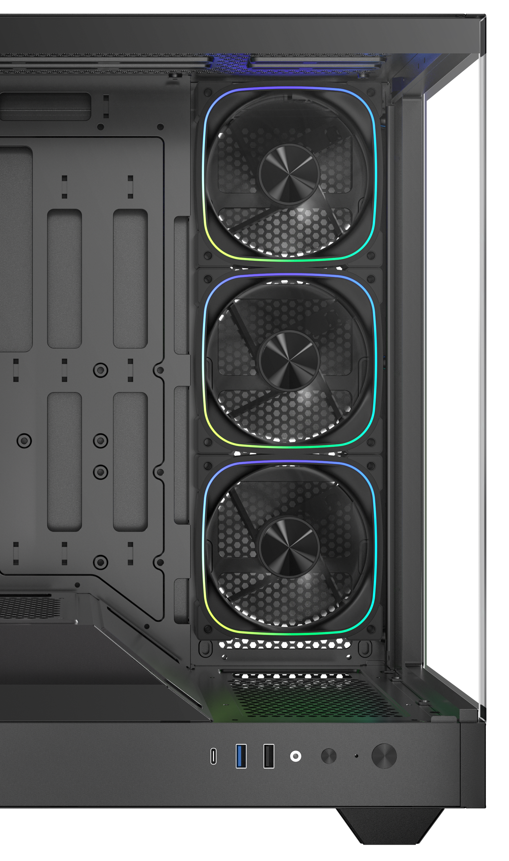

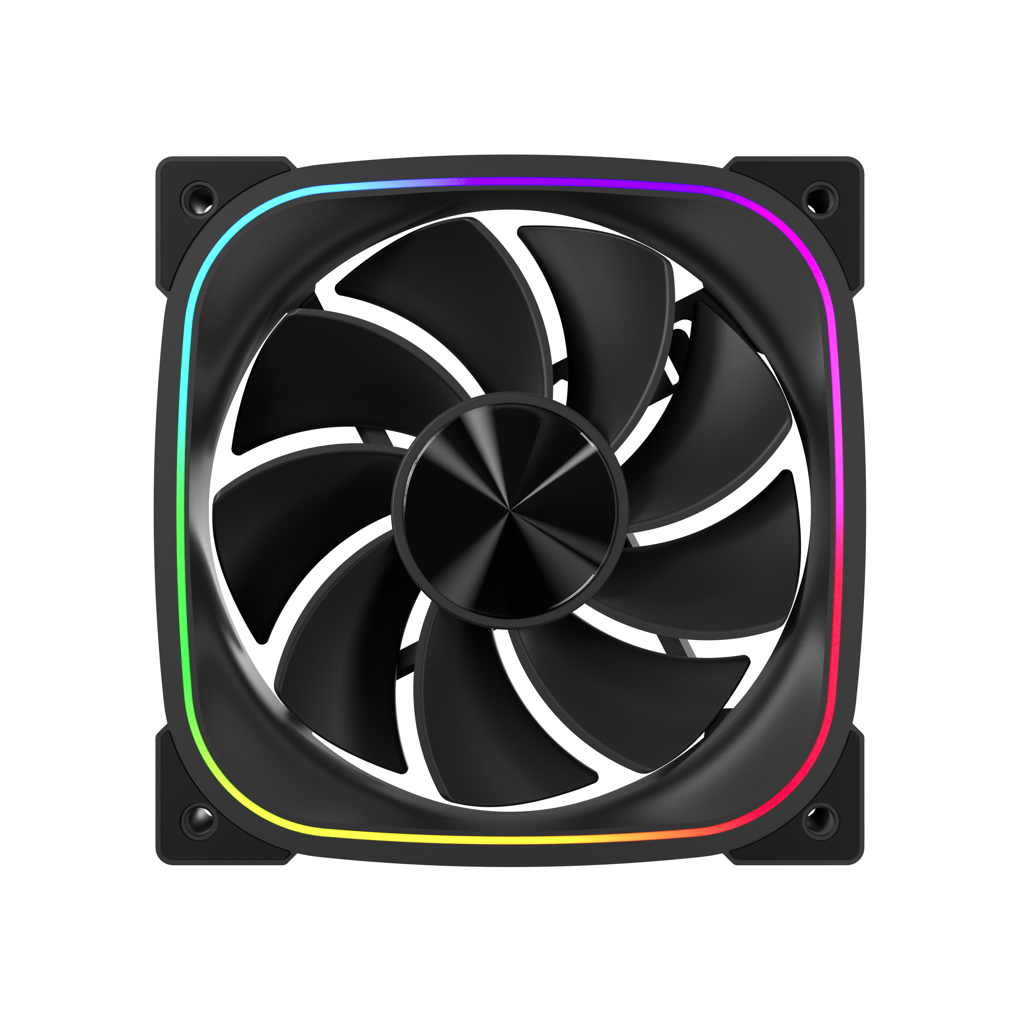
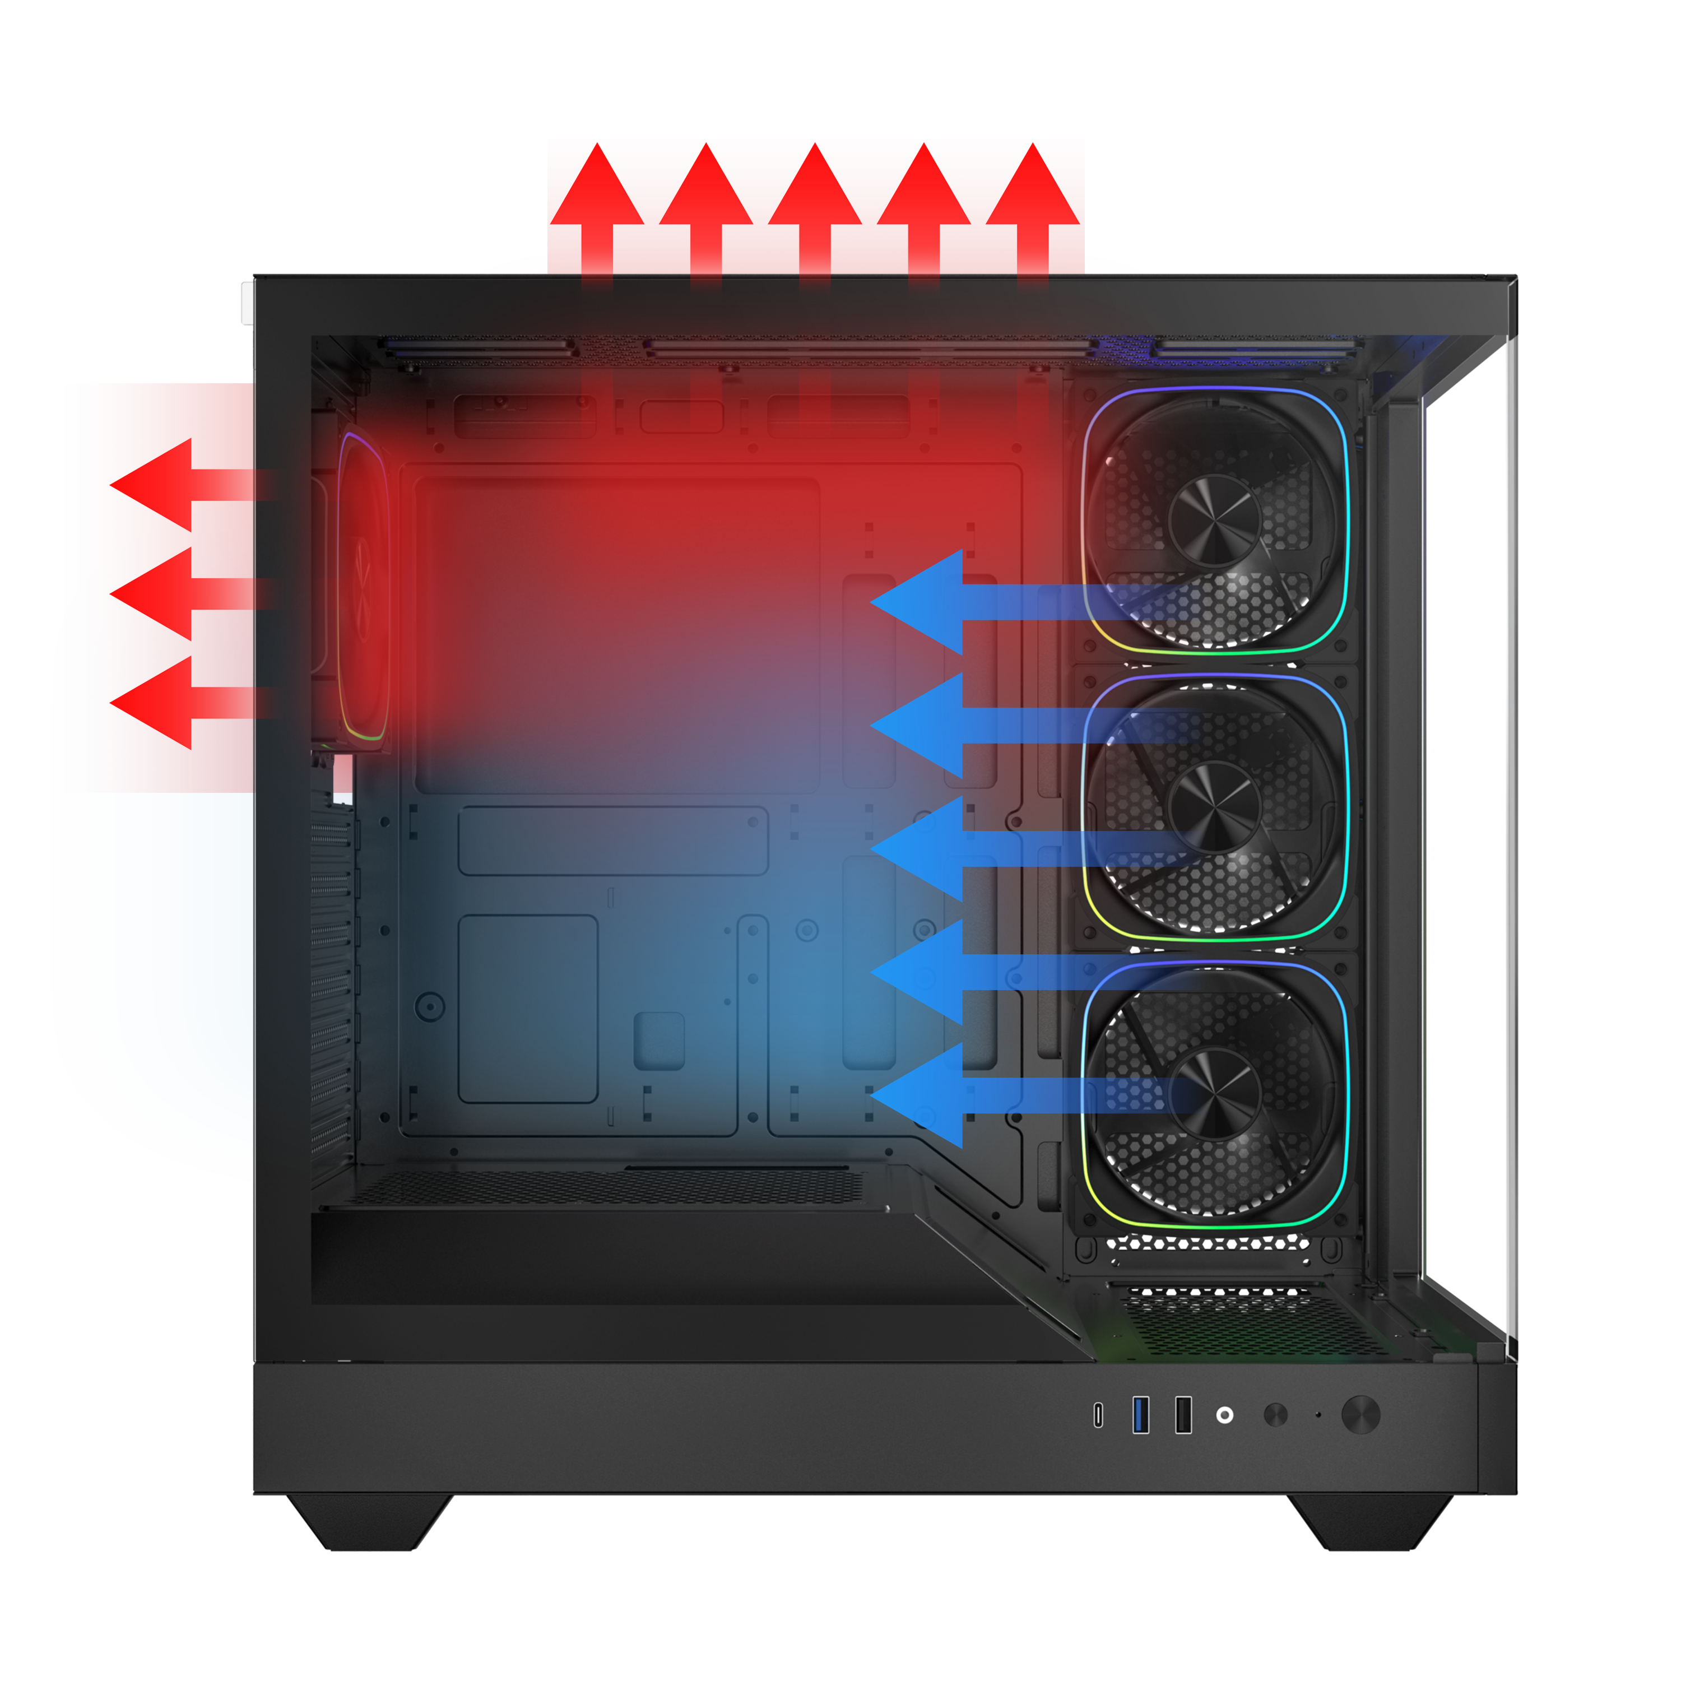

High-Performance Reverse ARGB Fan
DUAL CHAMBER
HIGH
3X
AIRFLOW PERFORMANCE
1X
High-Performance ARGB Fan

Slide 5
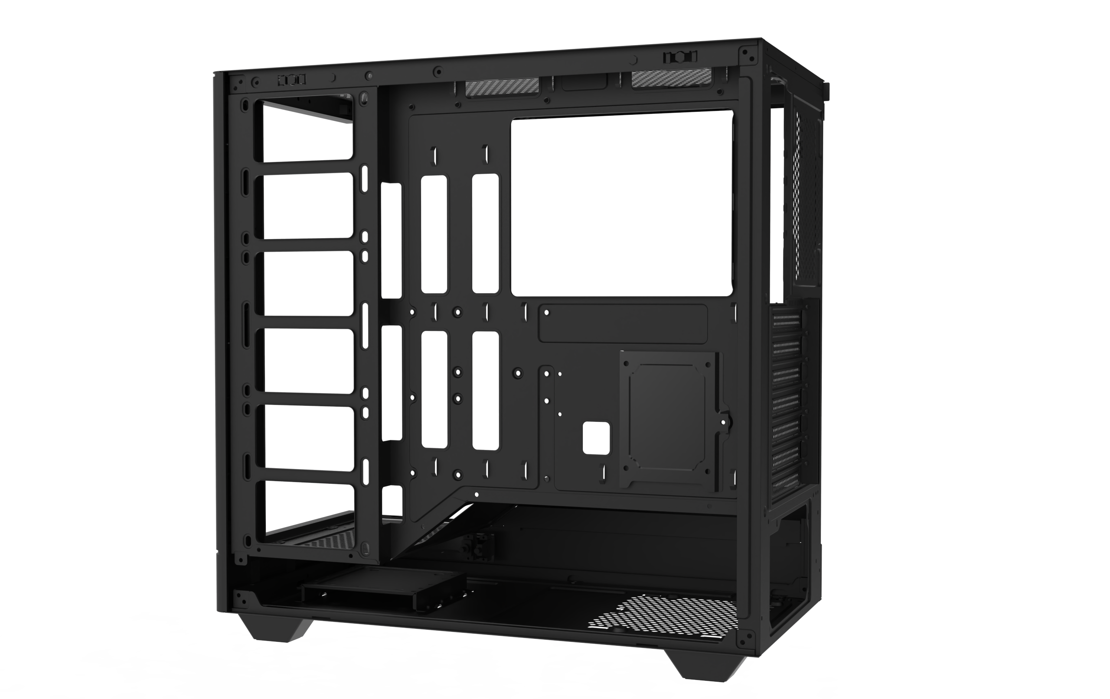
PSU
1X SSD
ATX & Standard /
up to 200mm
1X SSD & 1X HDD
1 X 3.5’’ Drive & 2 X 2.5’’Drive

Slide 6
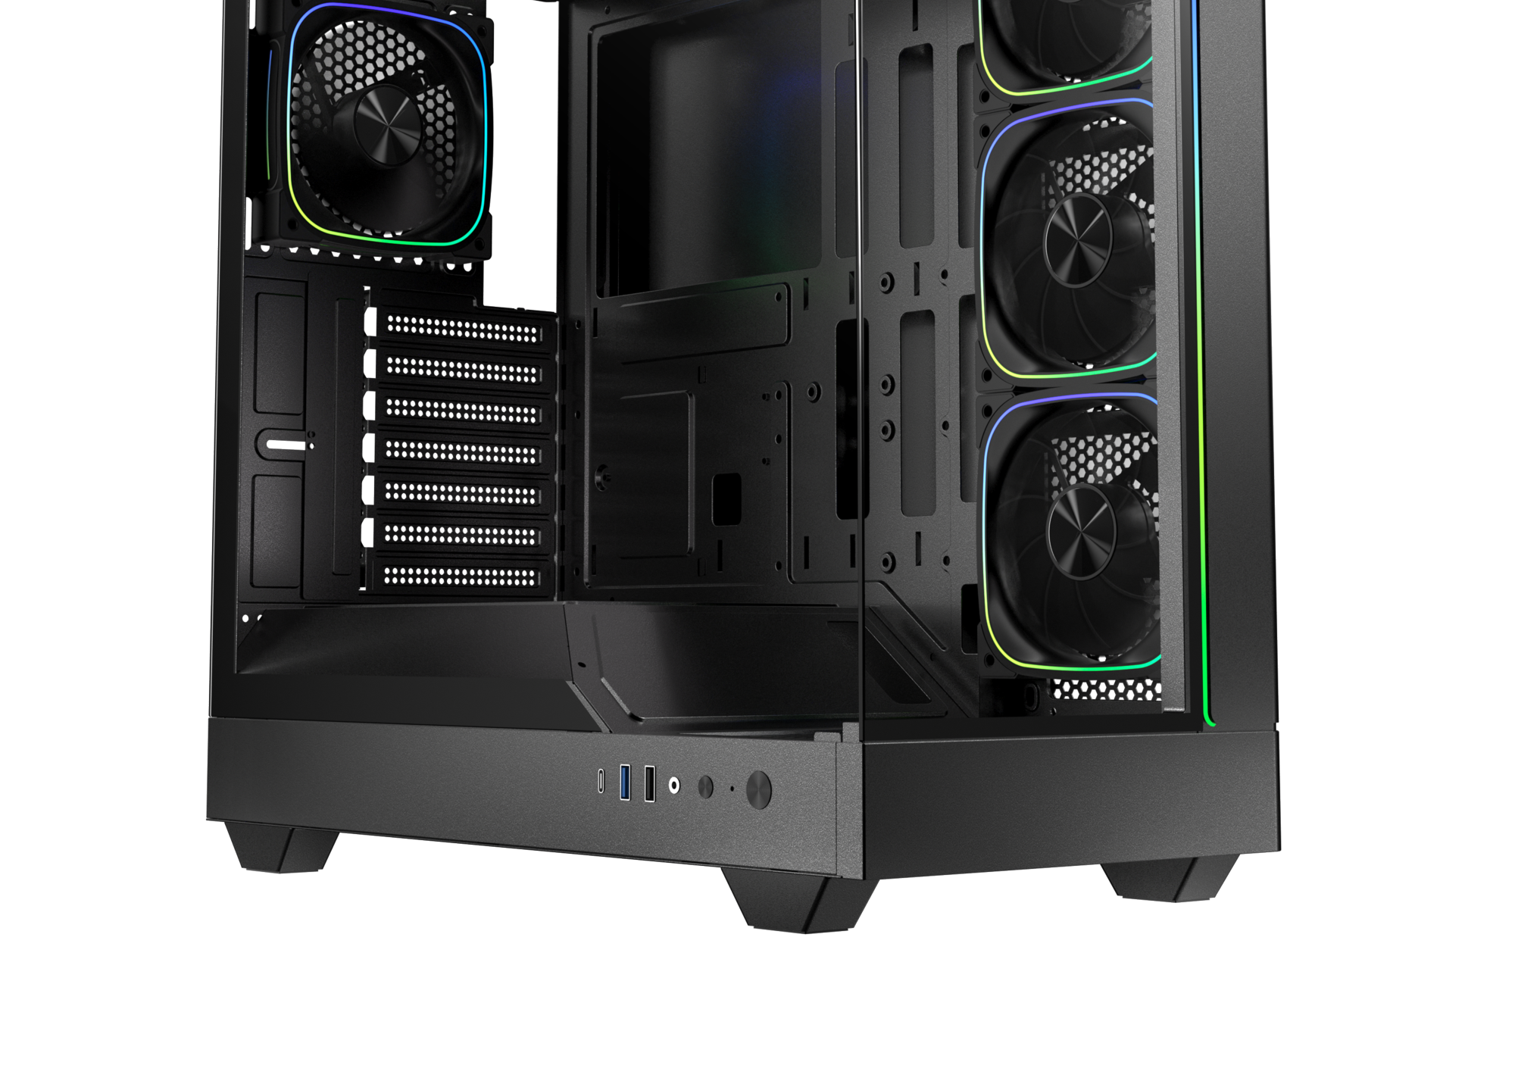
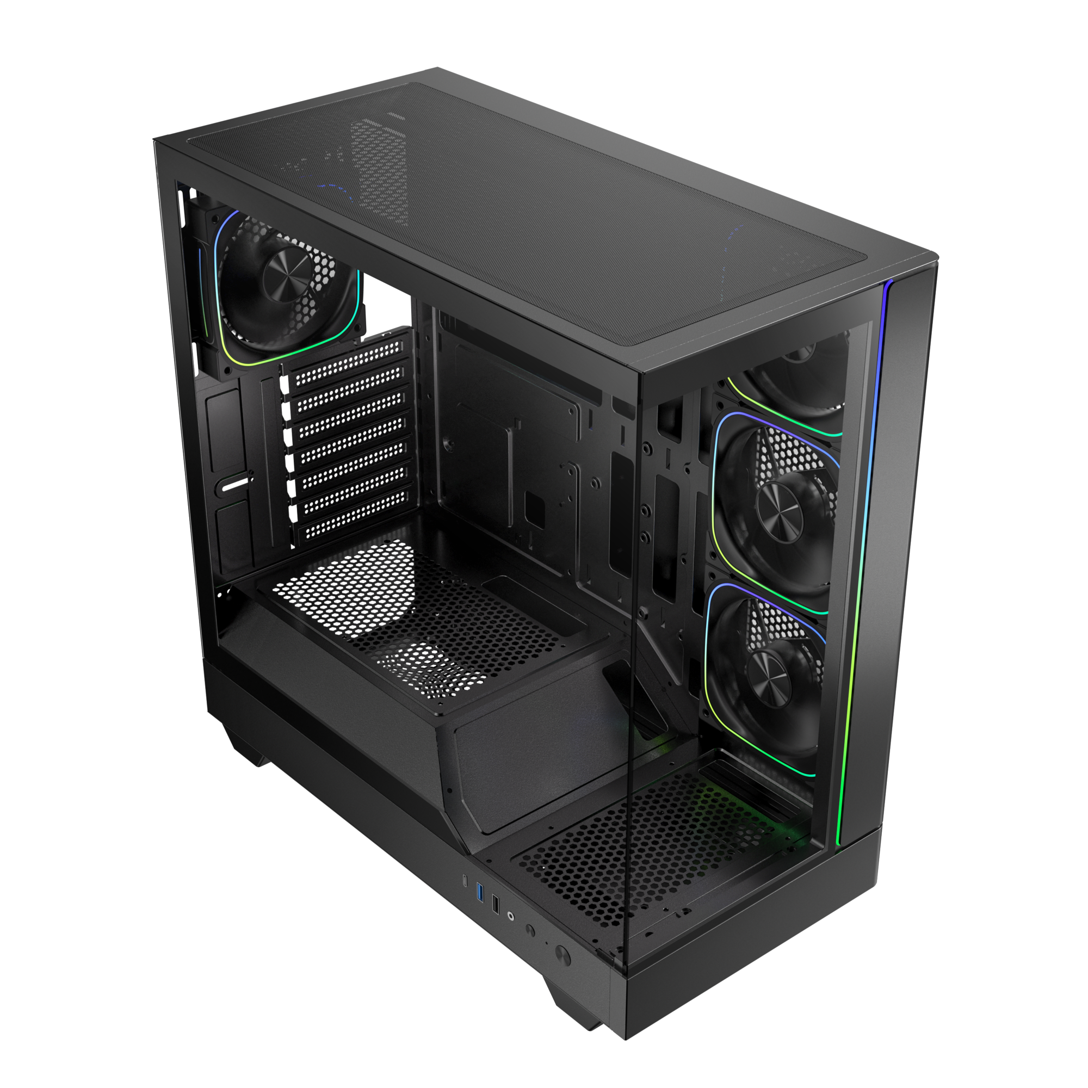
Top
Bottom
Easy Clean With Removable Dust Filters

Slide 7
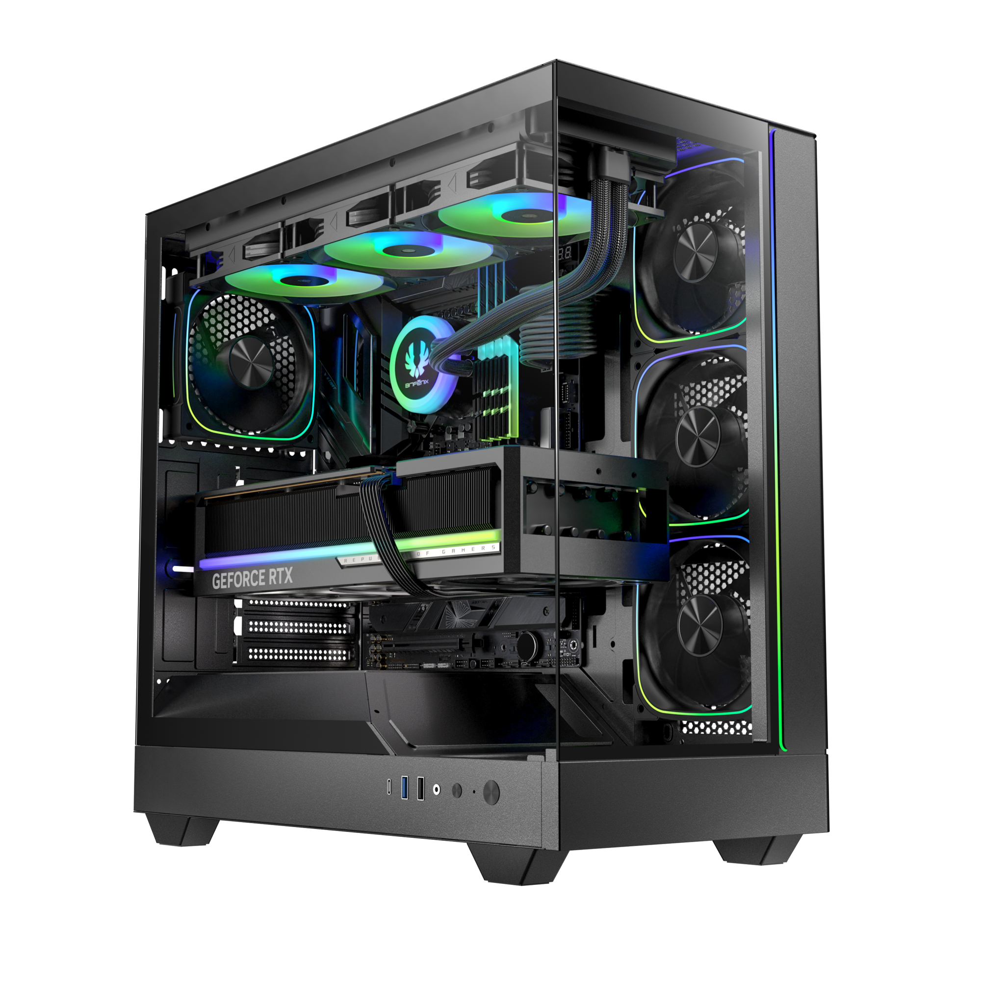
Tool-free Removal
Reset Button
Power Button
1X TypeC
1X USB 3.0 / 1X USB

Slide 8
LEO
Best |  | Black
Part no. |  | BFC-LEO85KKGKK-4A
EAN |  | 4716779449075
UPC |  | 886027010259
Net weight (NW) Gross weight (GW) |  | N.W: Kgs / G.W: Kgs
Materials |  | Steel, Mesh, Plastic, Tempered Glass
Chassis Dimensions (W x H x D) |  | 225 mm x 430 mm x 430 mm
Motherboard Supports |  | Mini-ITX, MicroATX, ATX
Air Cooler Height Support |  | 165mm
VGA Length Support |  | 410mm
Cable Management Support |  | up to 35mm
2.5" / 3.5" Drive Bay |  | 2 / 1
Fan mounts | MB | 3 x 120mm or 2 x 140mm
 | Top | 3 x 120mm or 2 x 140mm
 | Rear | 1 x 120mm
Radiator Support | MB | 1 x 360mm/ 1 x 280mm/ 1 x 240mm (Thickness up to 27mm)
 | Top | 1 x 360mm/ 1 x 280mm/ 1 x 240mm (Thickness up to 27mm)
 | Rear | 1 x 120mm
PCI-E Slots |  | 7 Slots
I/O Ports |  | 1 x TypeC/ 1 x USB3.0/ 1 x USB1.0/ Audio I/O
Power Supply |  | ATX & Standard / up to 200mm
LEO

