Slide 1

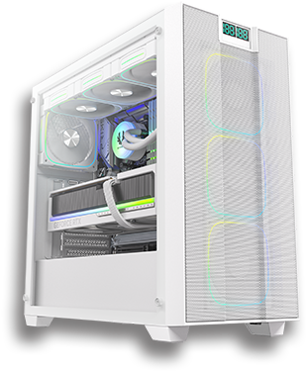
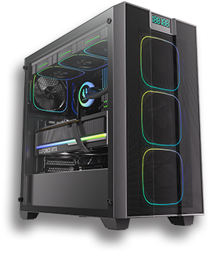


Slide 2

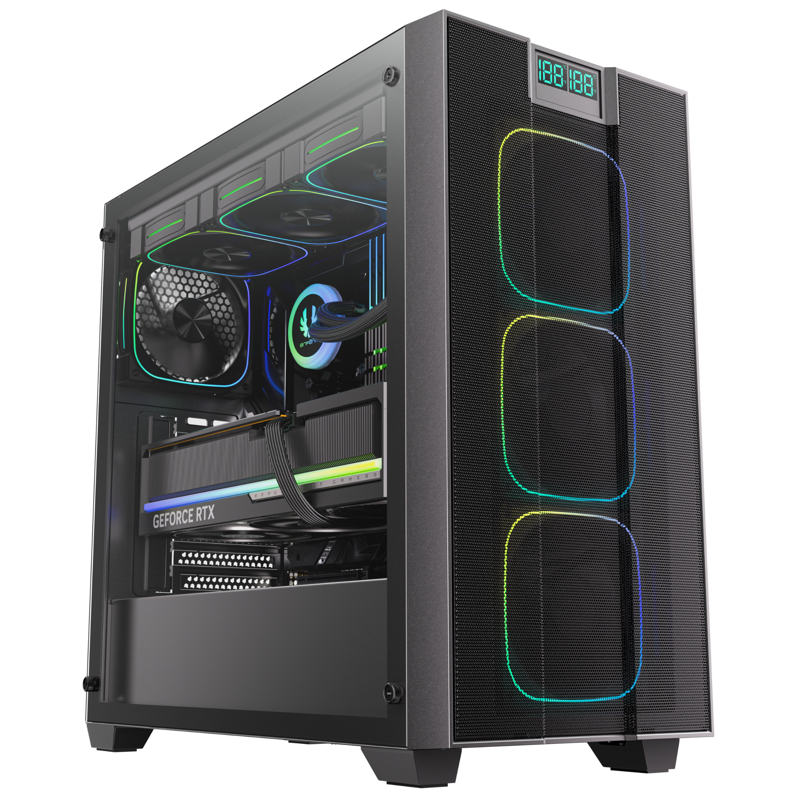
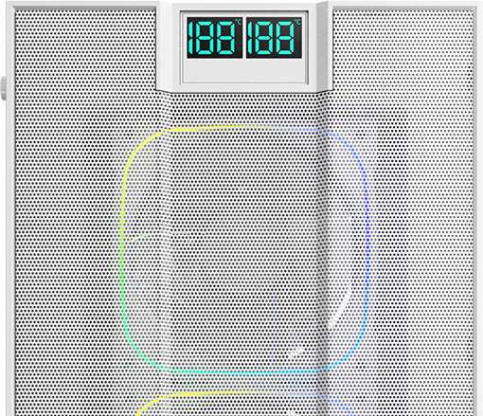
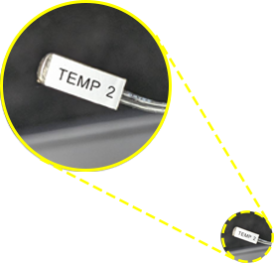
COMPUTER TEMPERATURE MONITOR - 2 SETS INCLUDED
Note: Do not place the sensor directly on the motherboard, graphics card, memory, or other related components to avoid damage.

Slide 3
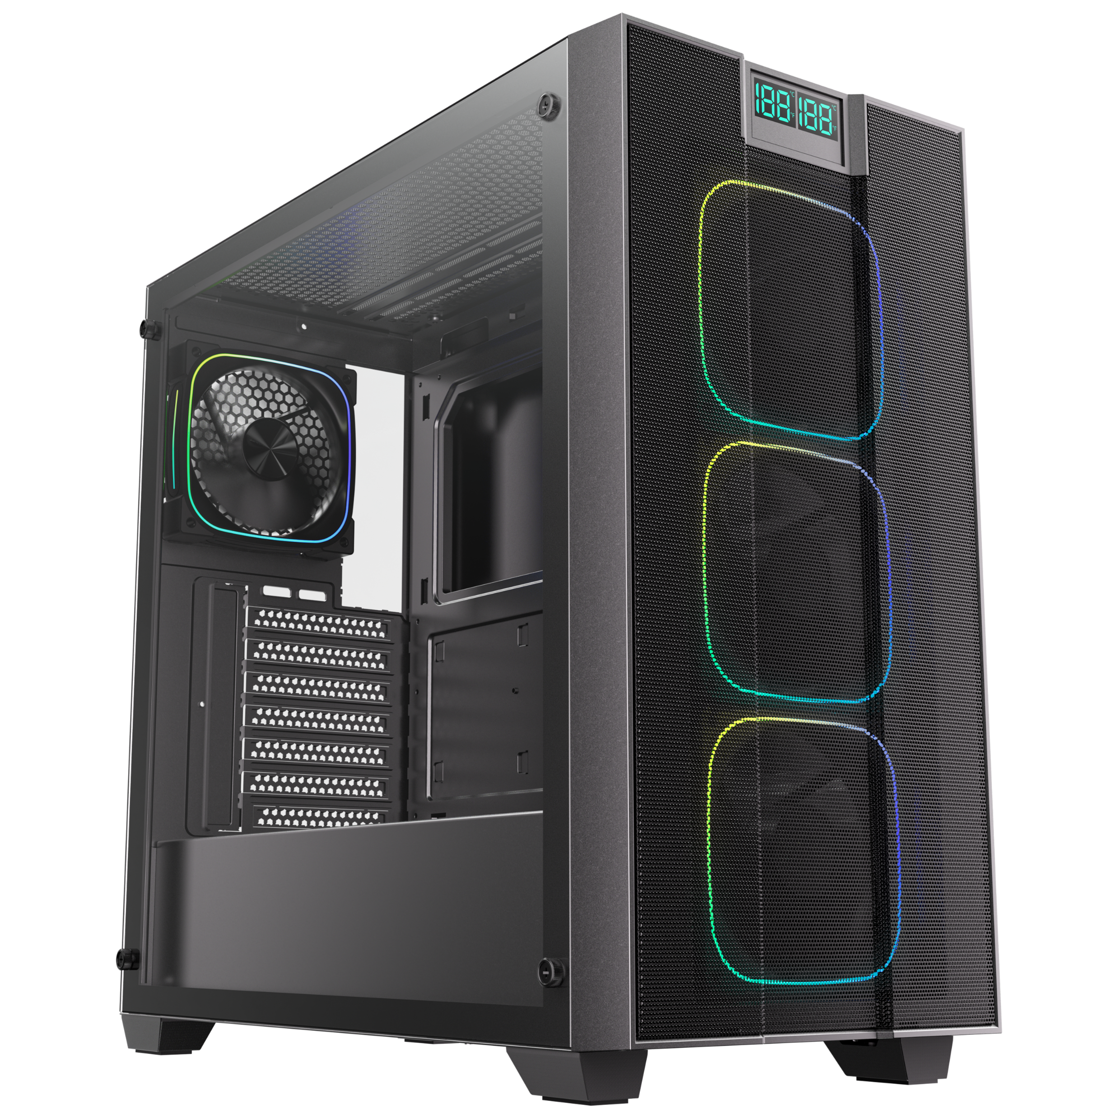
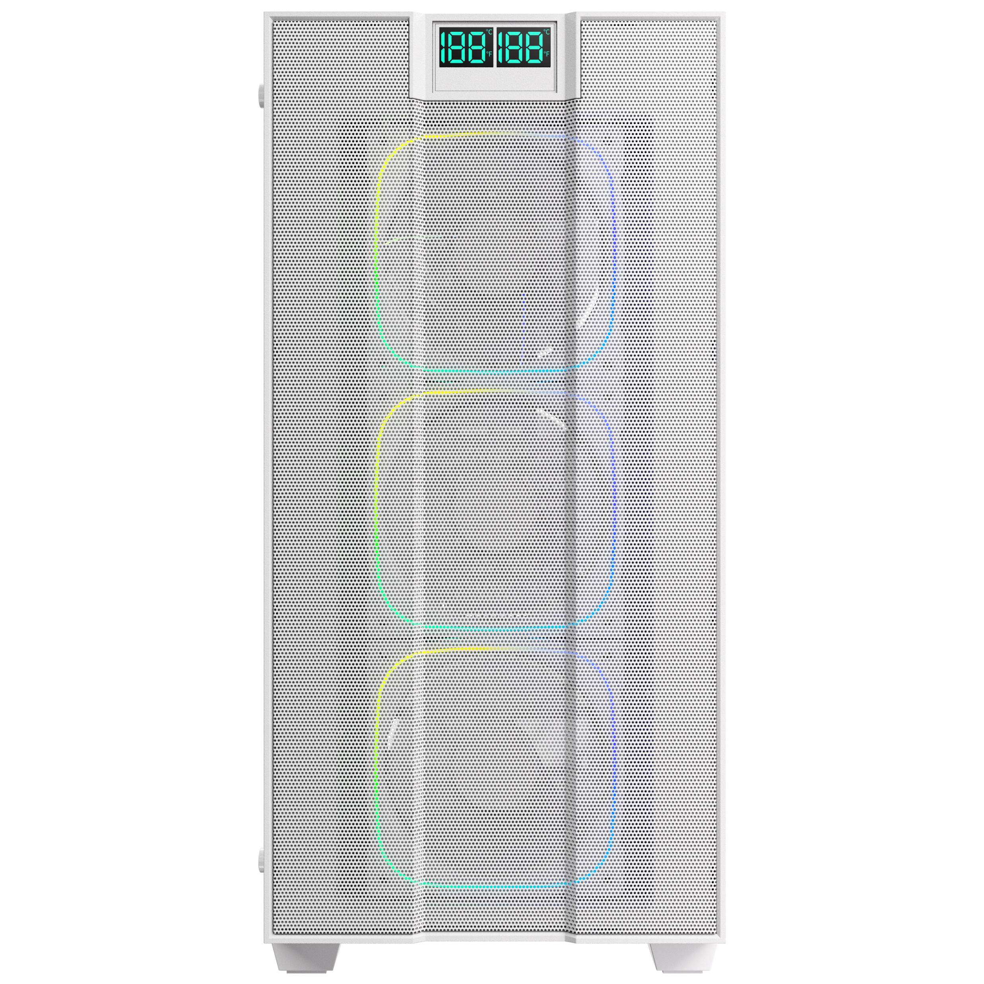
218mm(8.5 Inch)
465mm(18.3 Inch)
453mm(17.8 Inch)

Slide 4
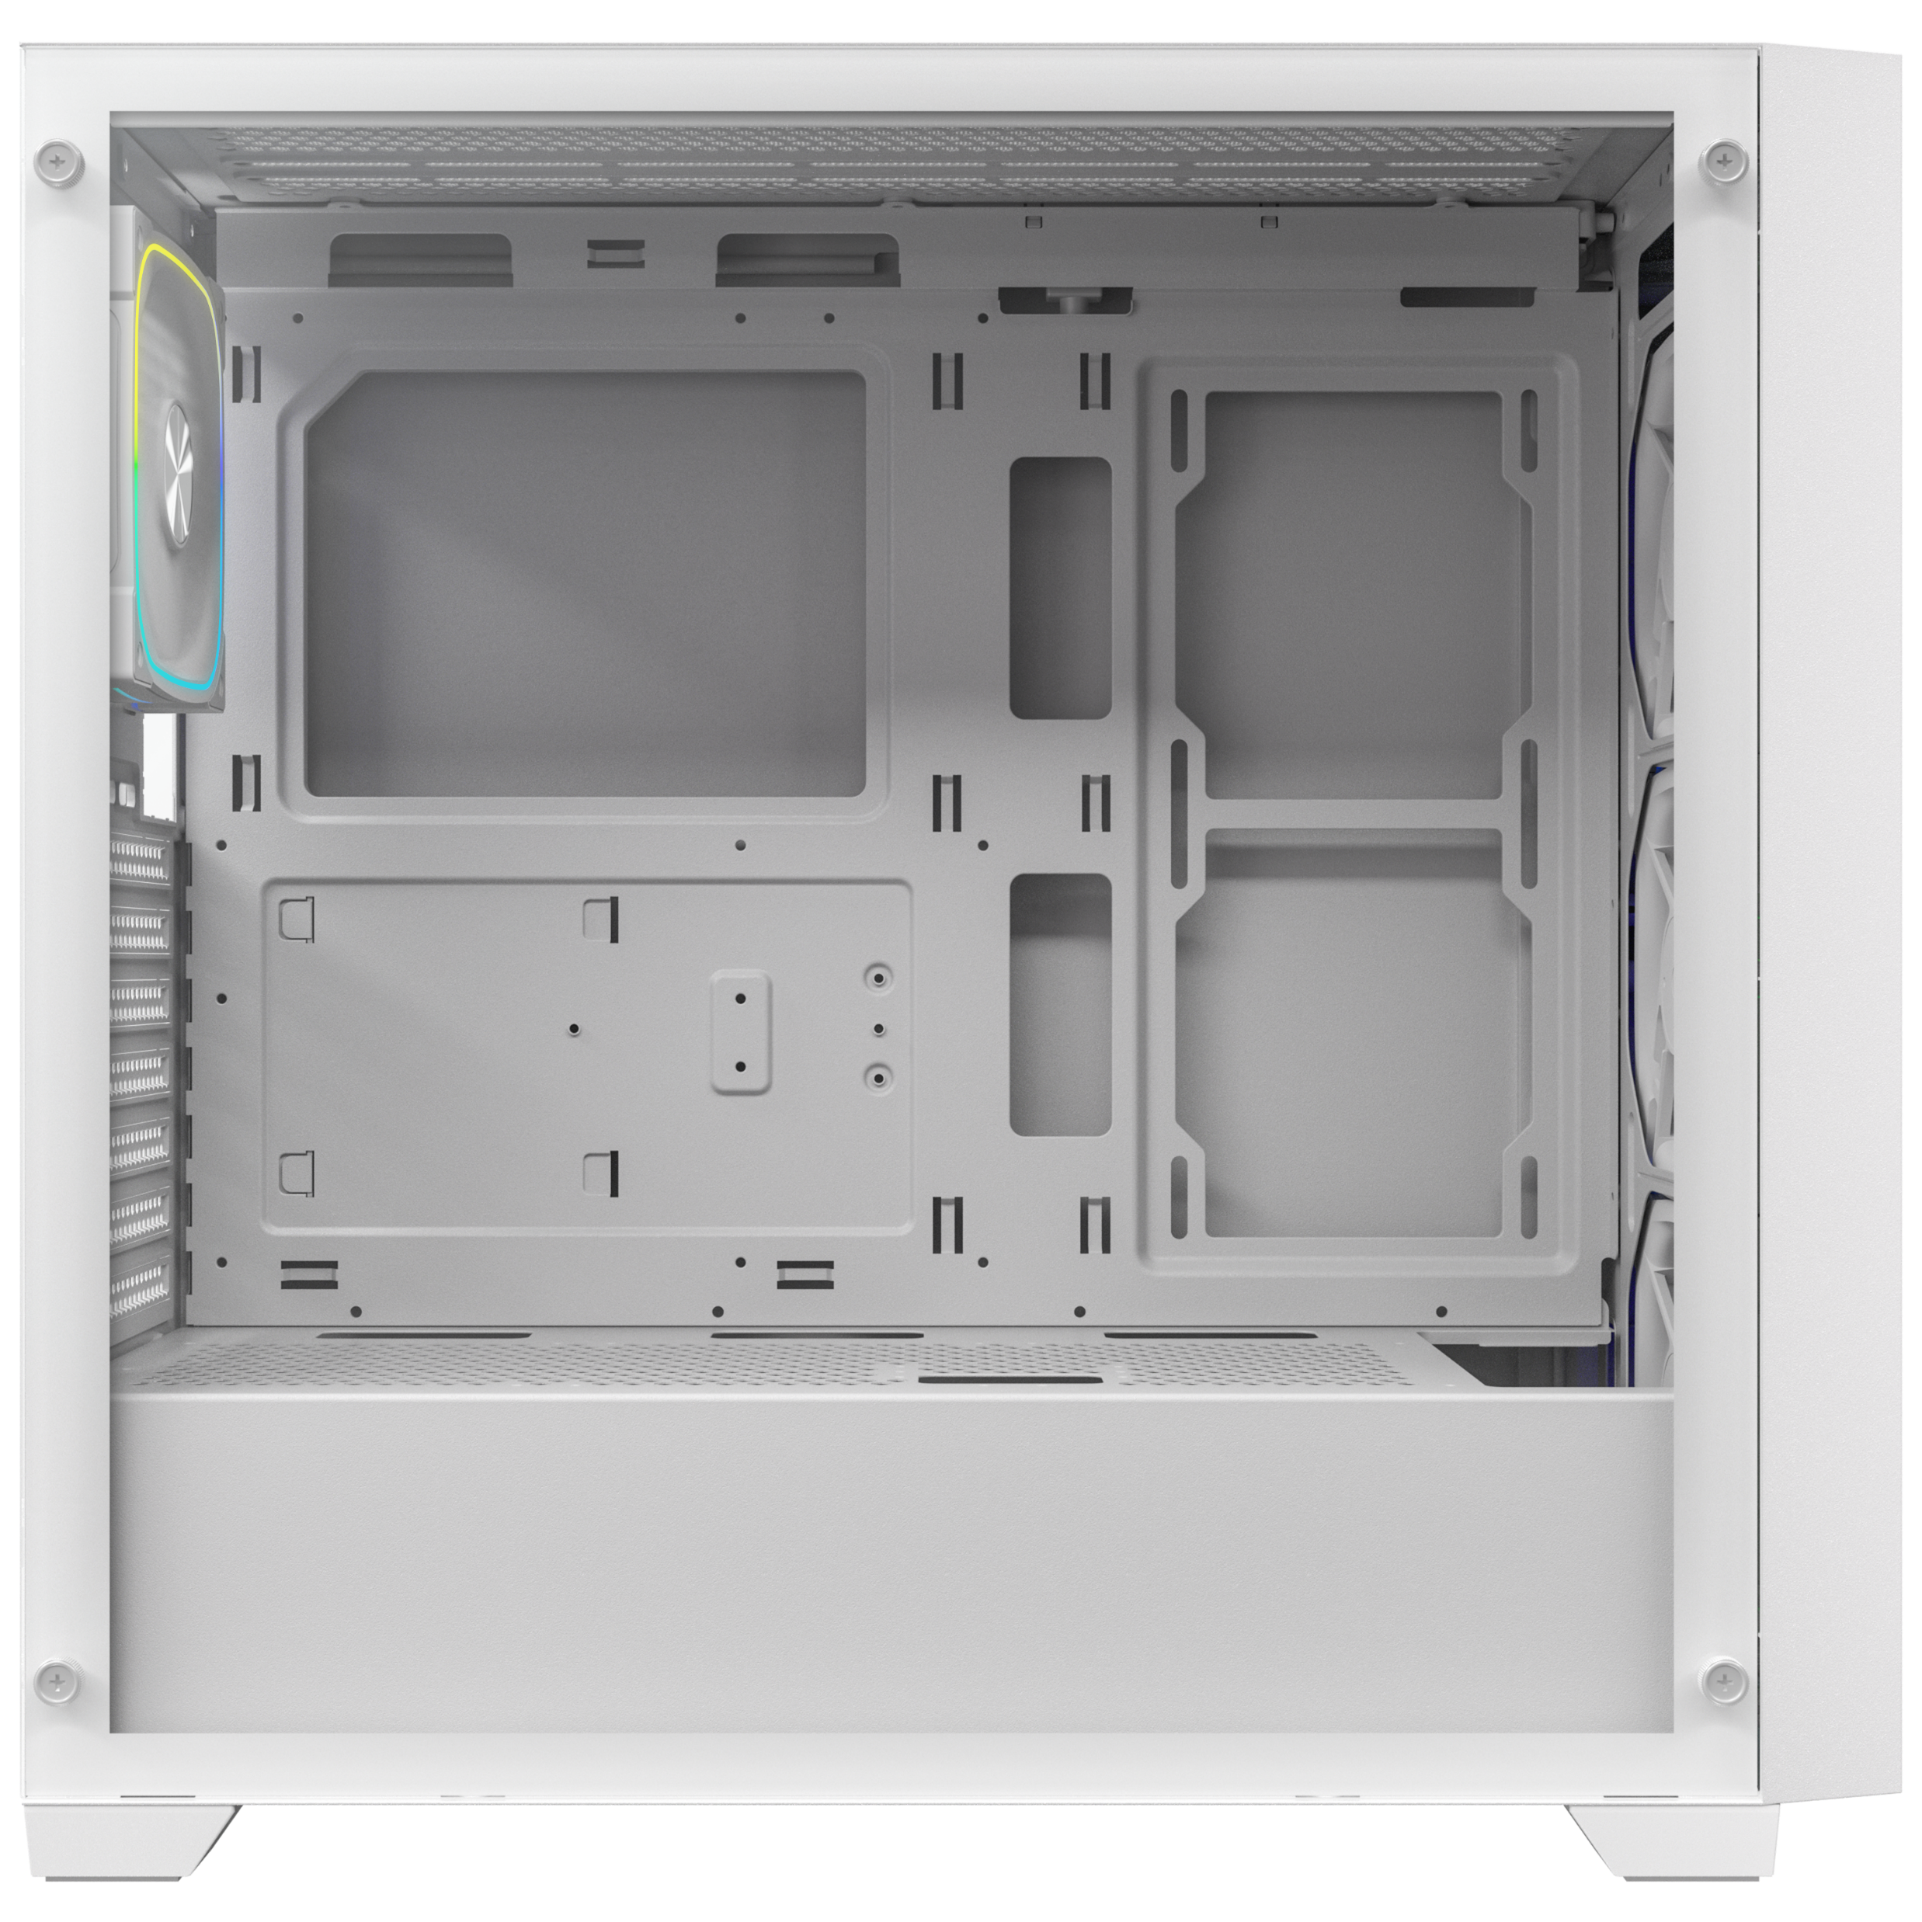
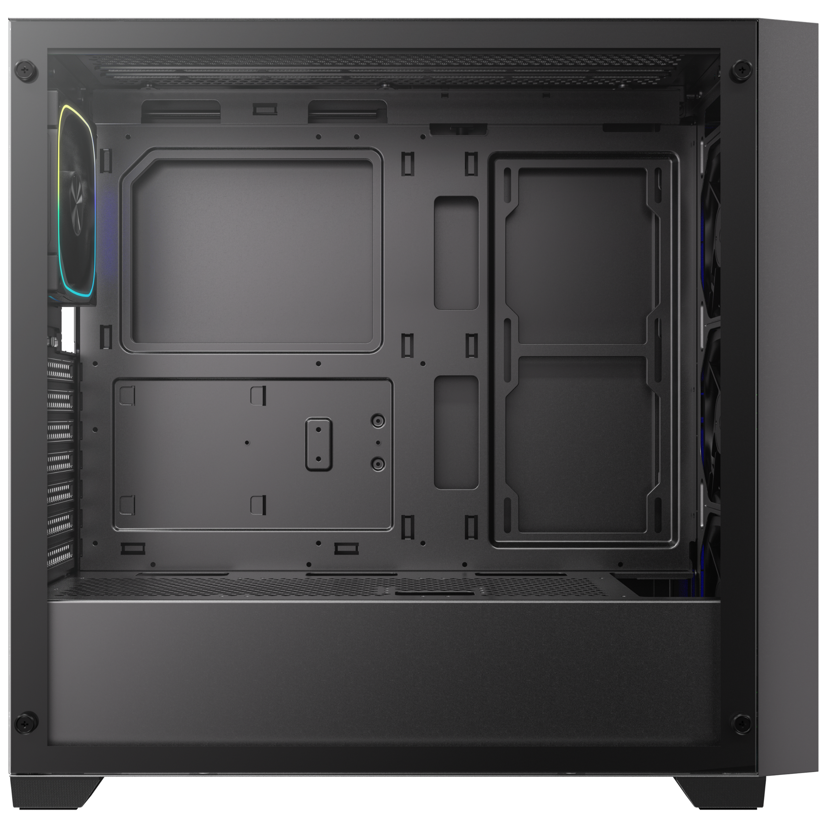
120mm
120mm
140mm
140mm
Radiator 360mm/280mm/240mm
120mm
140mm
MB
120mm x2
Radiator
140mm/120mm
Radiator 360mm/280mm/240mm
PSU Cover
120mm x3

Slide 5
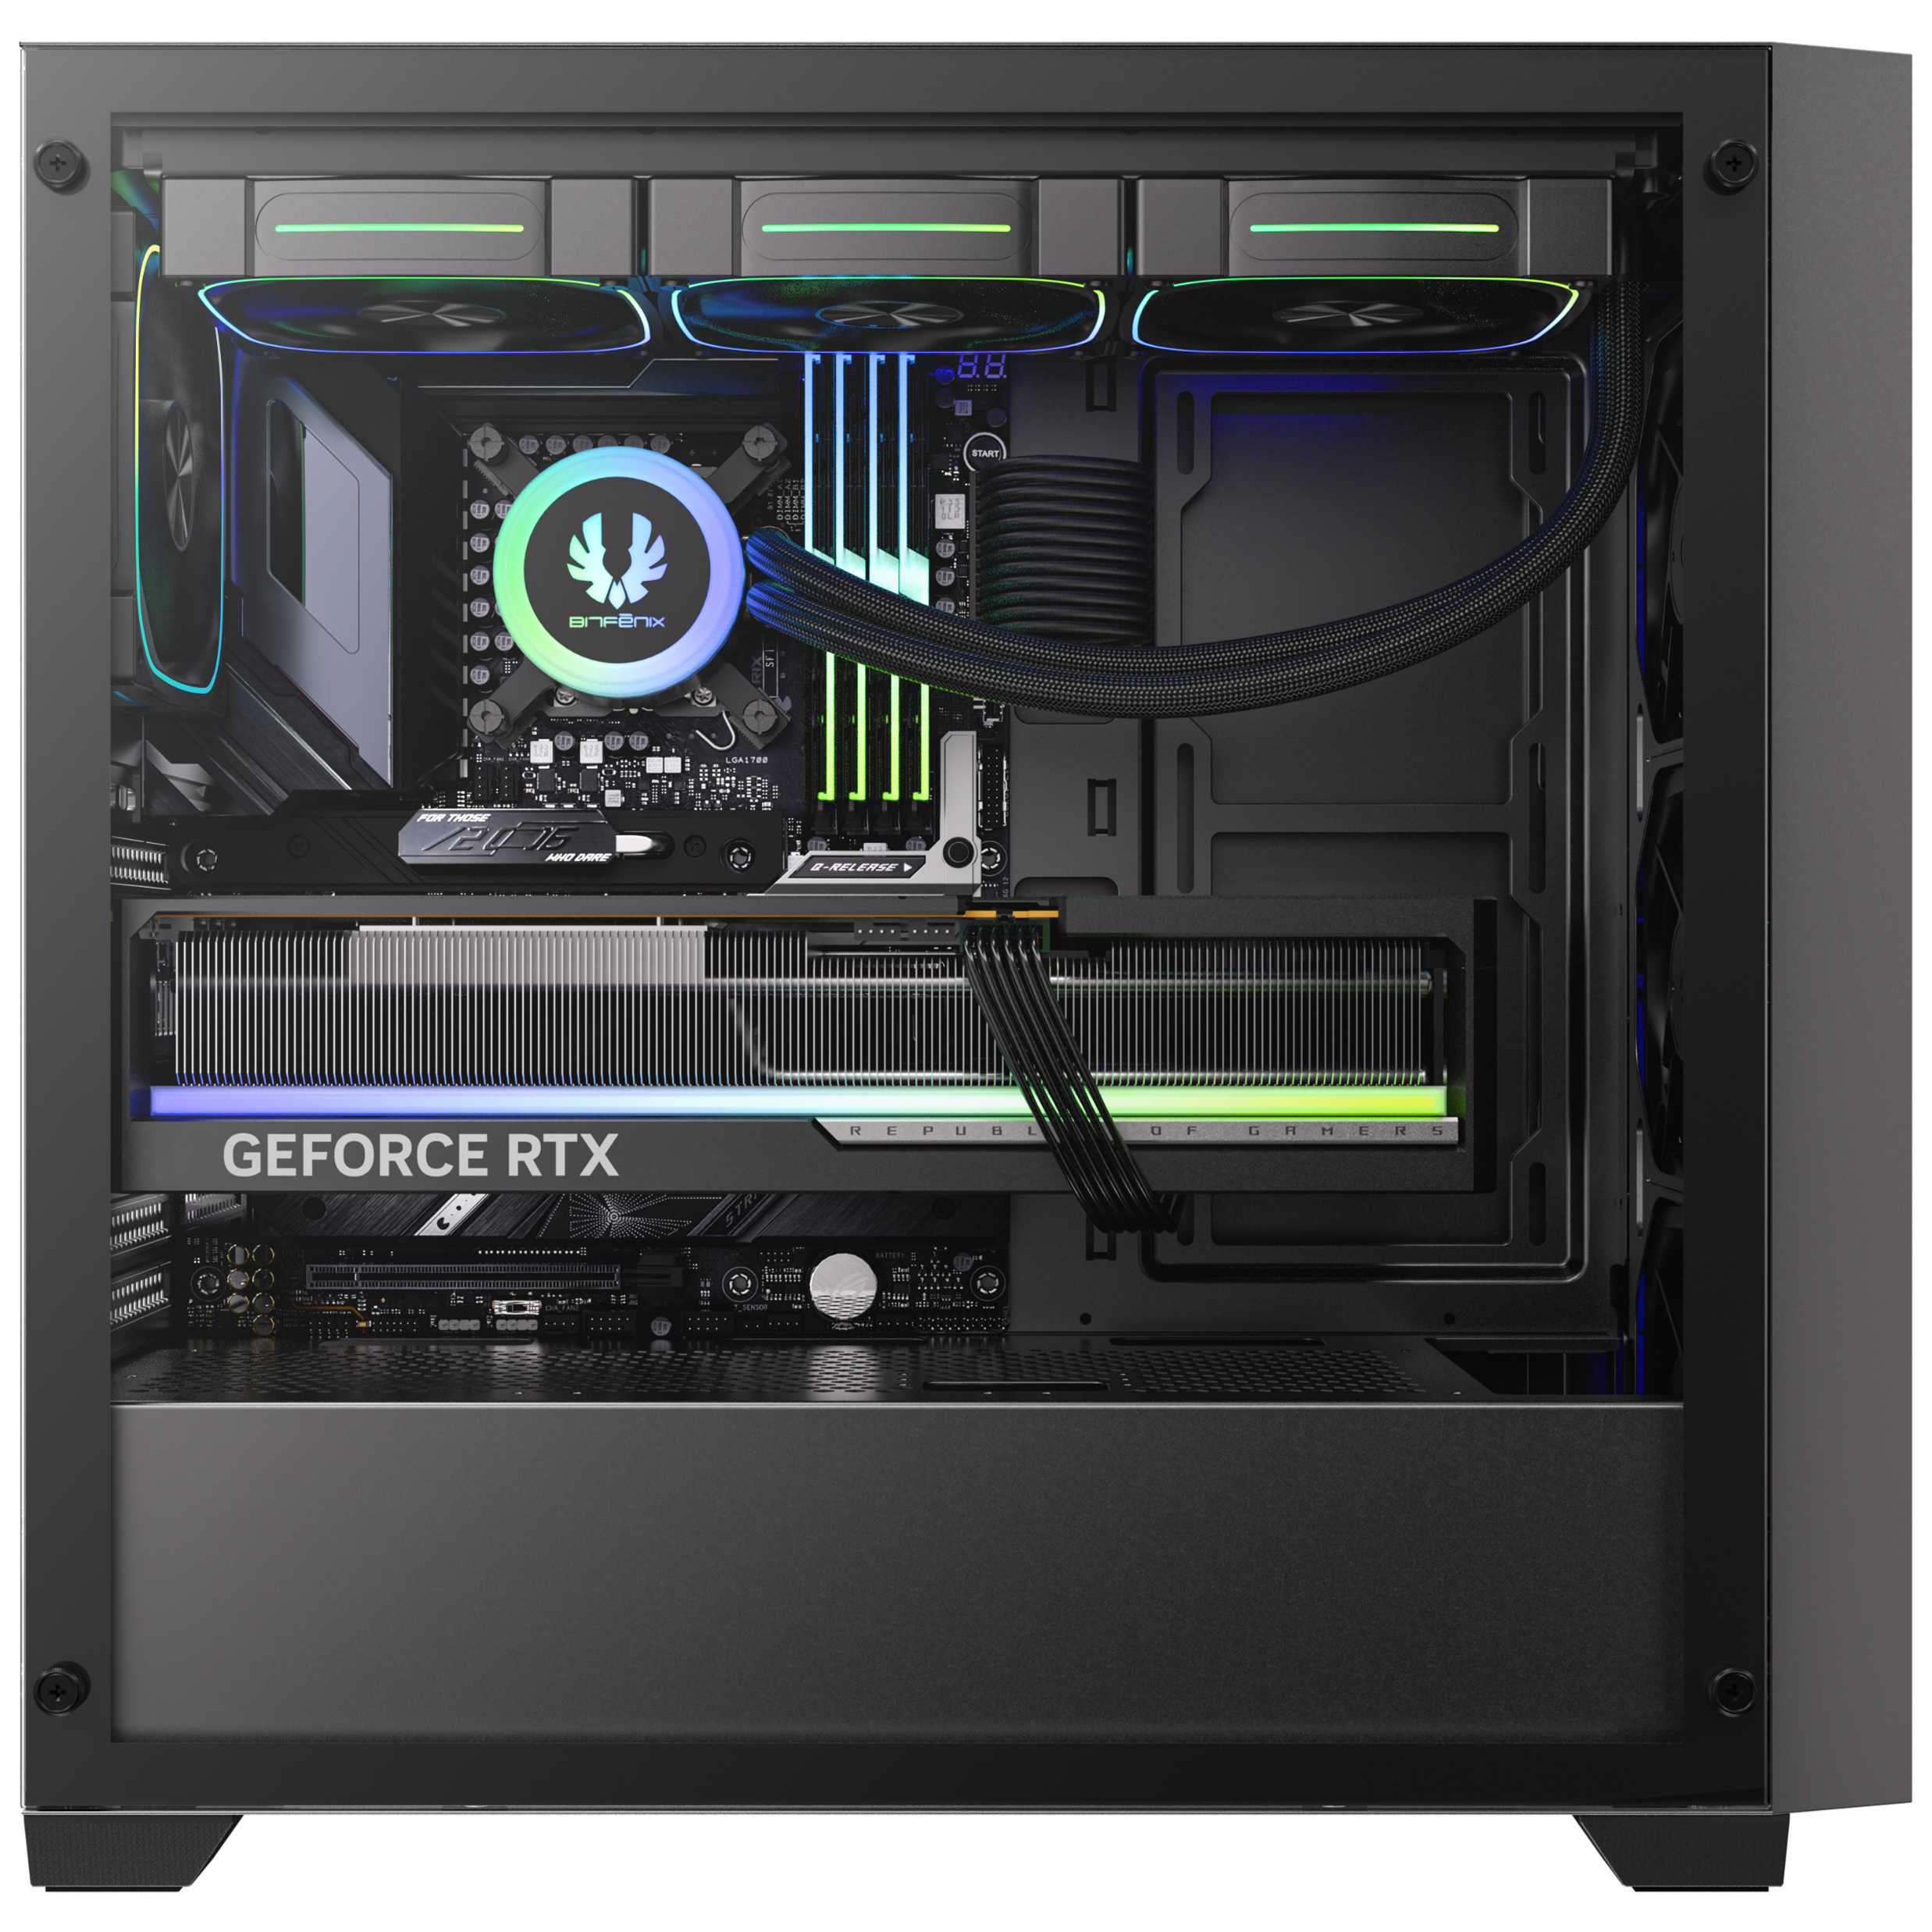
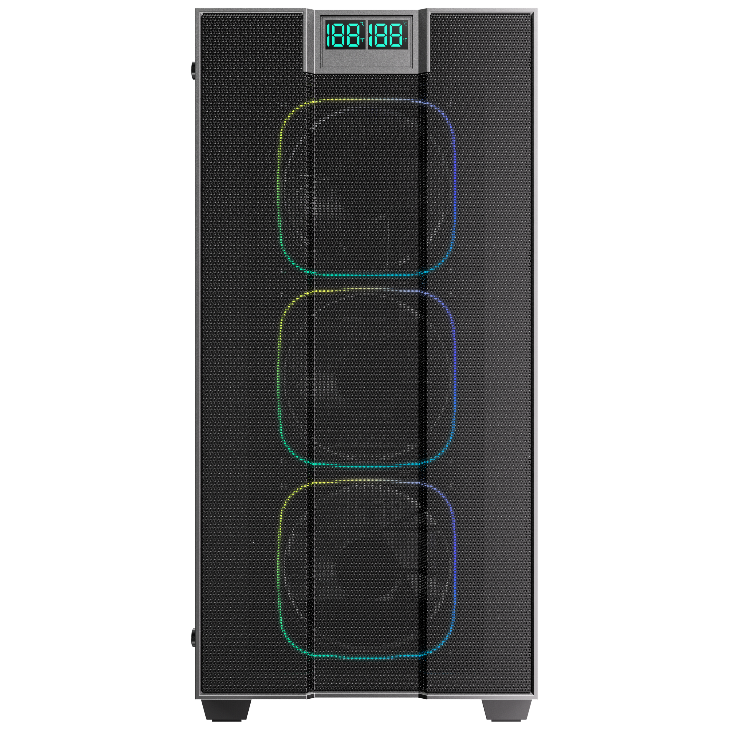
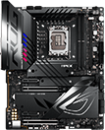
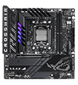



MOTHERBOARD
Maximum CPU
Cooler Height
165mm
(6.49inch)
ATX
Micro-ATX
Mini-ITX
VGA LENGTH
SUPPORT
410mm
(16inch)
CABLE
MAMAGEMENT
360mm
AIO Support At Top
UP TO
30mm(1.8inch)

Slide 6
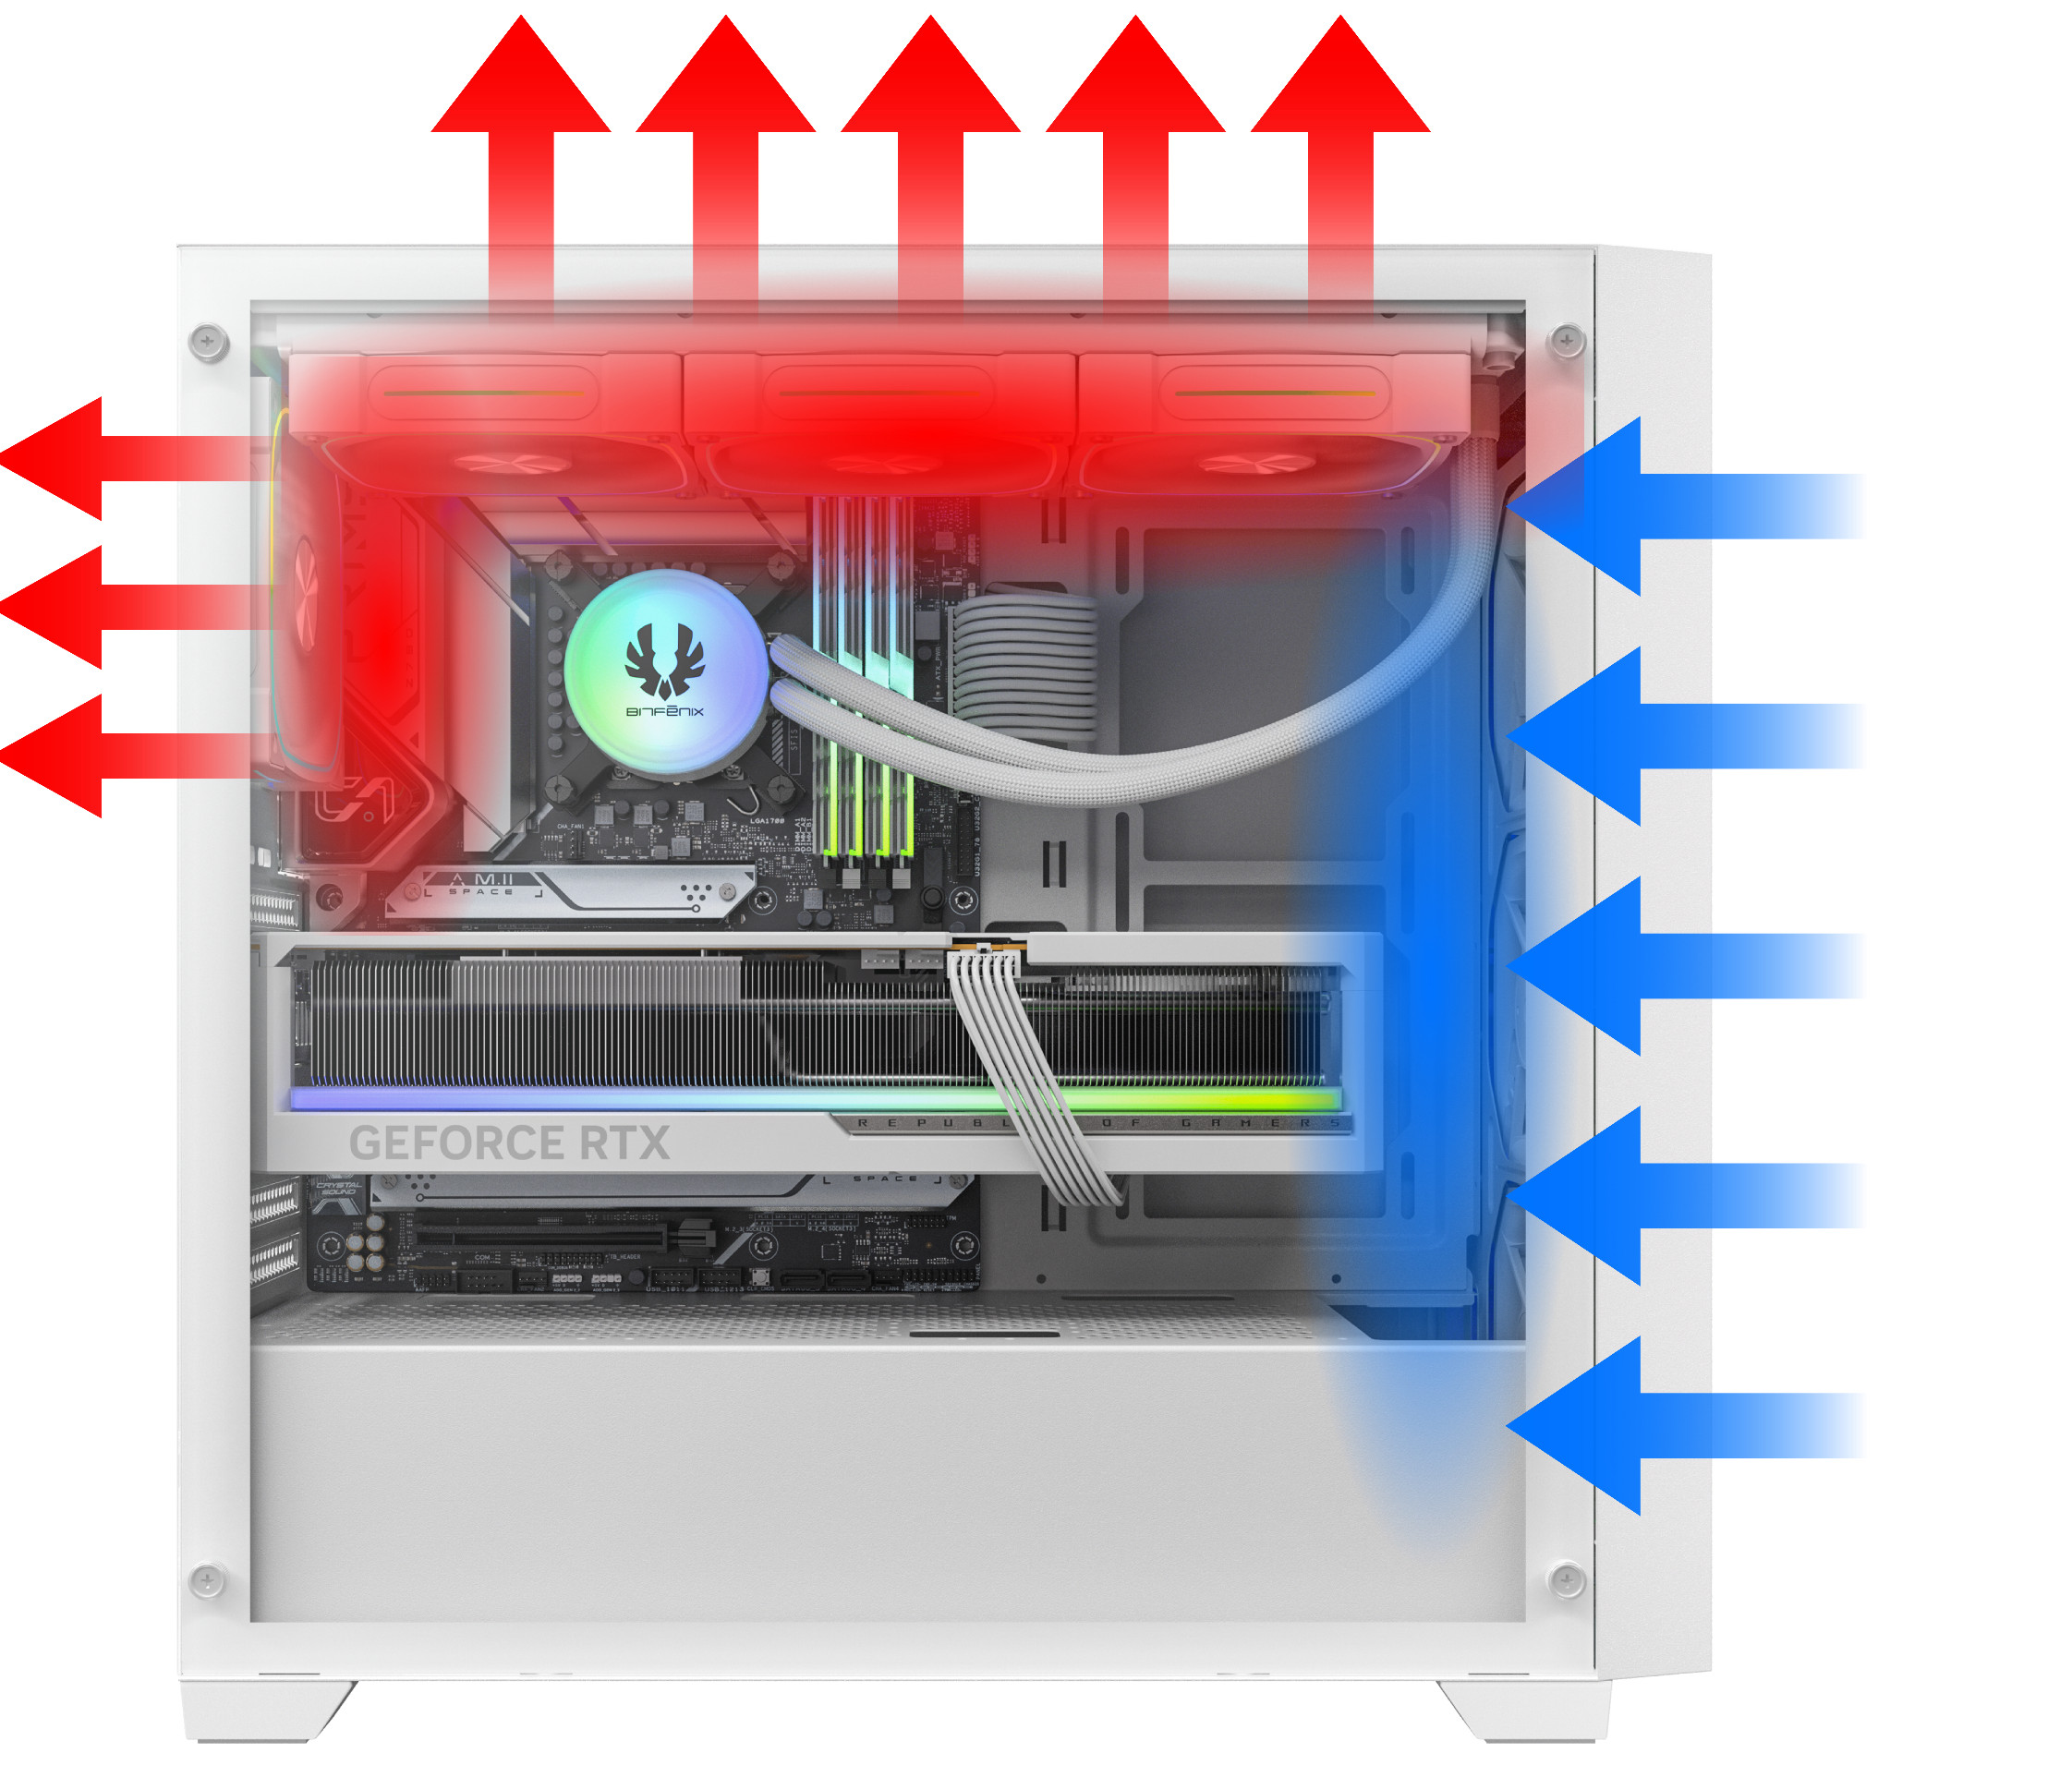
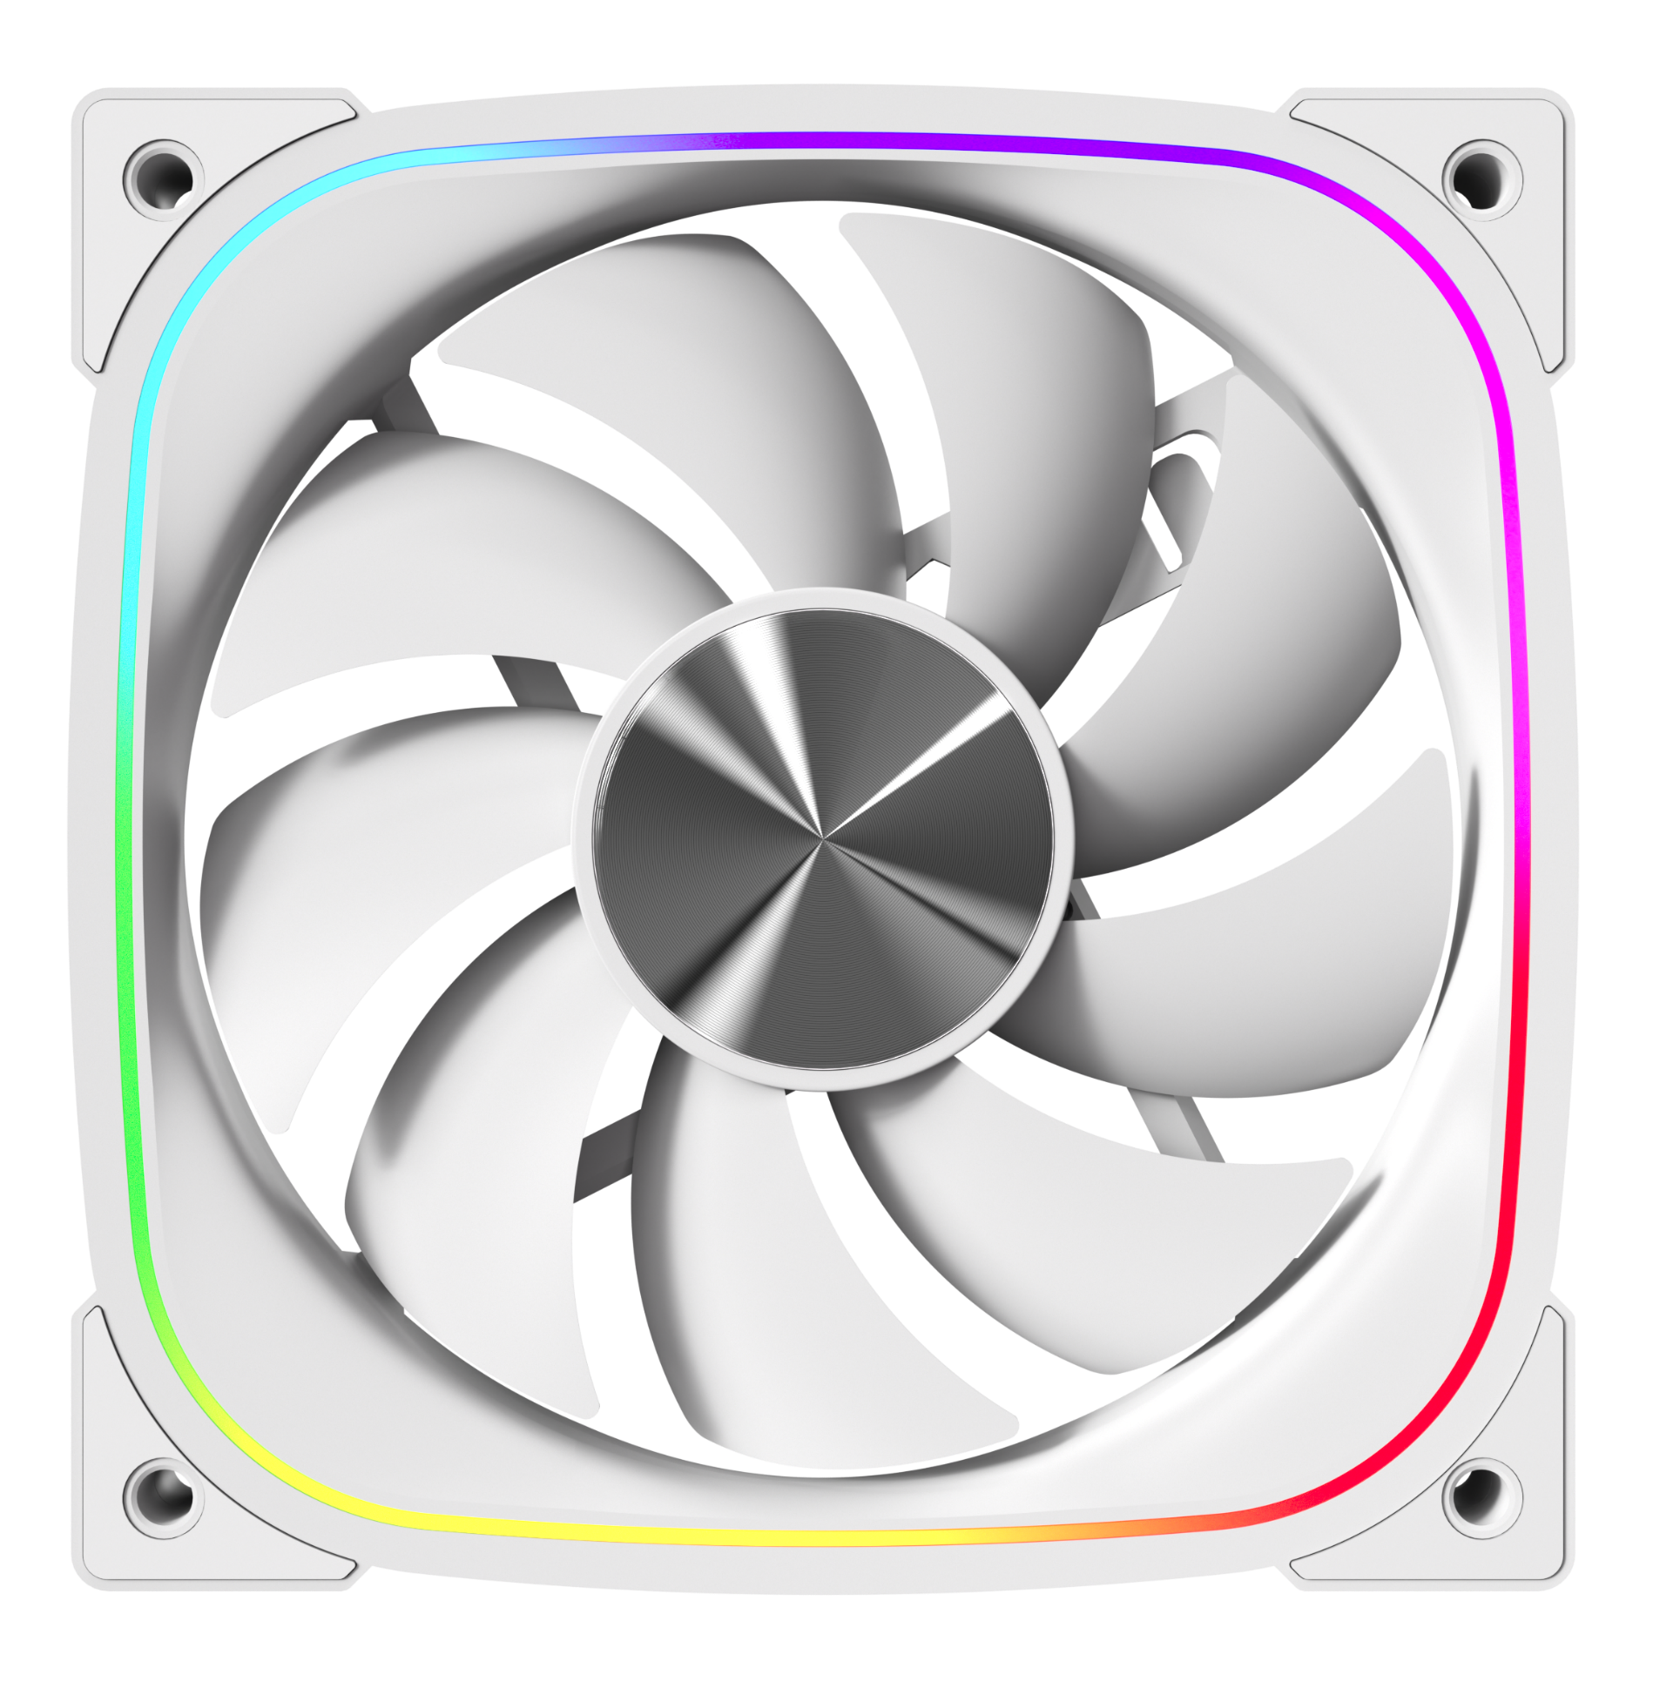
4X
PRE-INSTALLED
ARGB FANS
HIGH-DENSITY MESH FRONT
HIGH
AIRFLOW PERFORMANCE

Slide 7
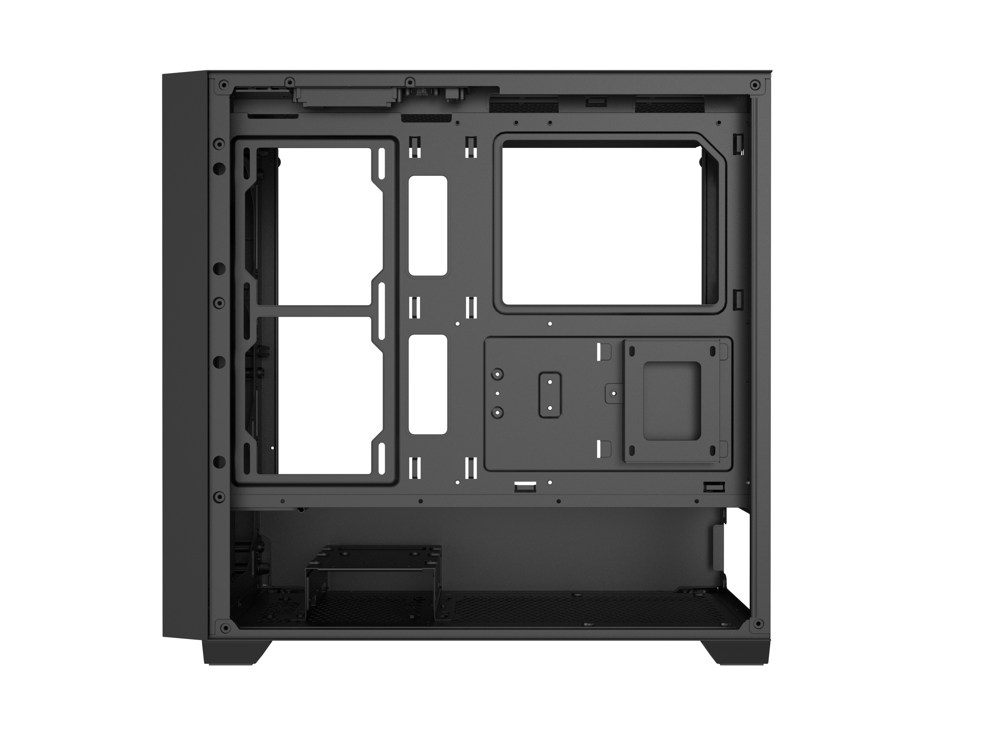
2.5" Drive X1
POWER SUPPLY
ATX & Standard /
up to 220mm(8.7 Inch)
3.5" Drive X2 or
2.5" Drive X1 + 3.5" Drive X1

Slide 8
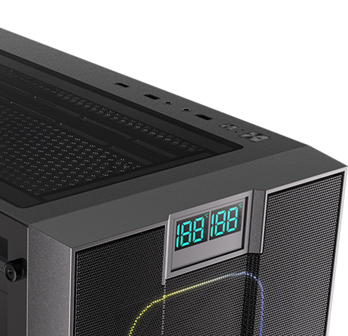
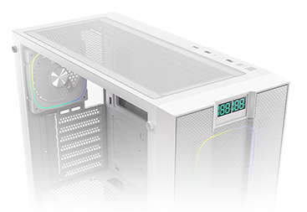

EASY CLEAN WITH
REMOVABLE DUST FILTERS
USB 3.0
USB 2.0
TOP
USB 2.0
Power Button
LED/Reset
Button
BOTTOM

Slide 9
IT 200 |  | Black | White
Part no. |  | BFC-IT2-700-KKGXK-4A | BFC-IT2-700-WWGXW-4A
Materials |  | Steel, Mesh, Plastic, Tempered Glass
Chassis Dimensions (W x H x D) |  | 465 x 218 x 453mm
Motherboard Supports |  | Mini-ITX, Micro-ATX, ATX
Air Cooler Height Support |  | 165mm
VGA Length Support |  | 410mm
Cable Management Support |  | up to 30mm
3.5" Drive Bay |  | 2
2.5" Drive Bay |  | 1+1
Fan | Front | 3 x 120mm
 | MB | 2 x 120mm
 | Top | 2 x 140mm / 3 x 120mm
 | Rear | 1 x 120mm
 | PSU Cover | 3 x 120mm
Radiator | Front | 1 x 360mm/ 1 x 280mm/ 1 x 240mm (Thickness up to 27mm)
 | Top | 1 x 360mm/ 1 x 280mm/ 1 x 240mm (Thickness up to 27mm)
 | Rear | 1 x 140mm / 1 x 120mm (Thickness up to 27mm)
PCI-E Slots |  | 7 Slots
I/O Ports |  | 1 x USB 3.0/ 2 x USB 2.0/ Audio I/O
Power Supply |  | ATX & Standard / up to 220mm

