Slide 1
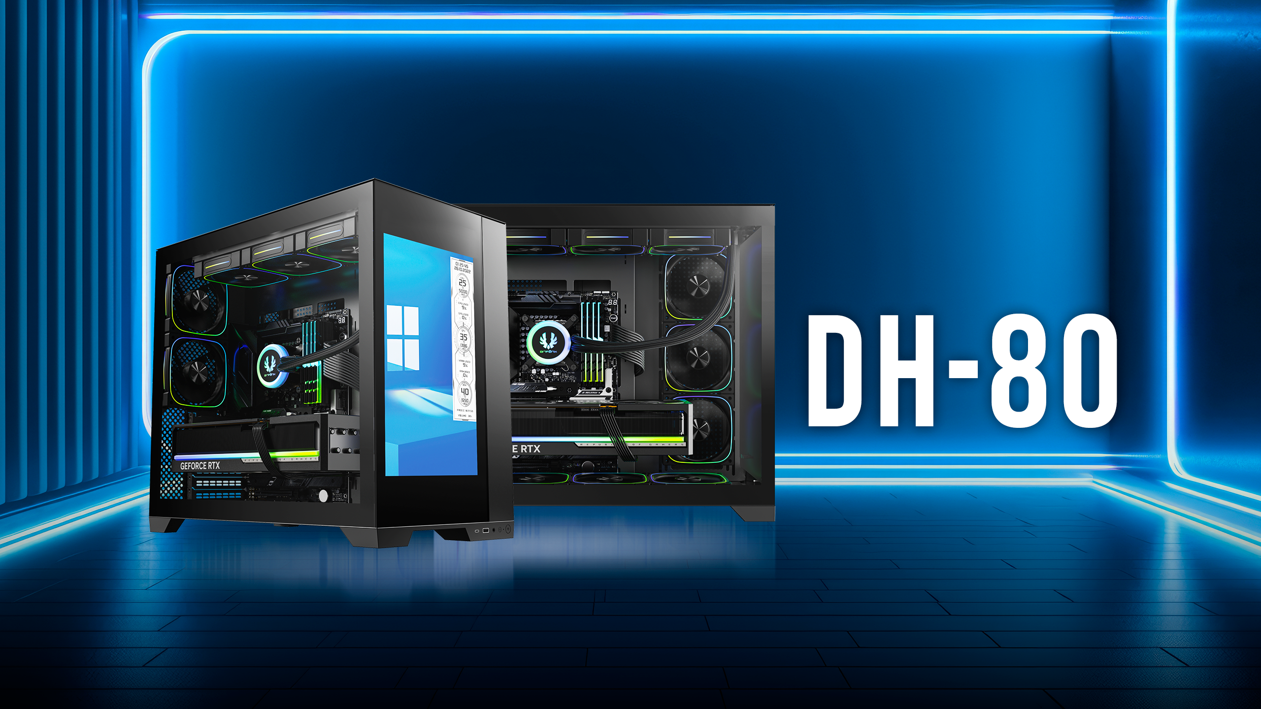

Slide 2
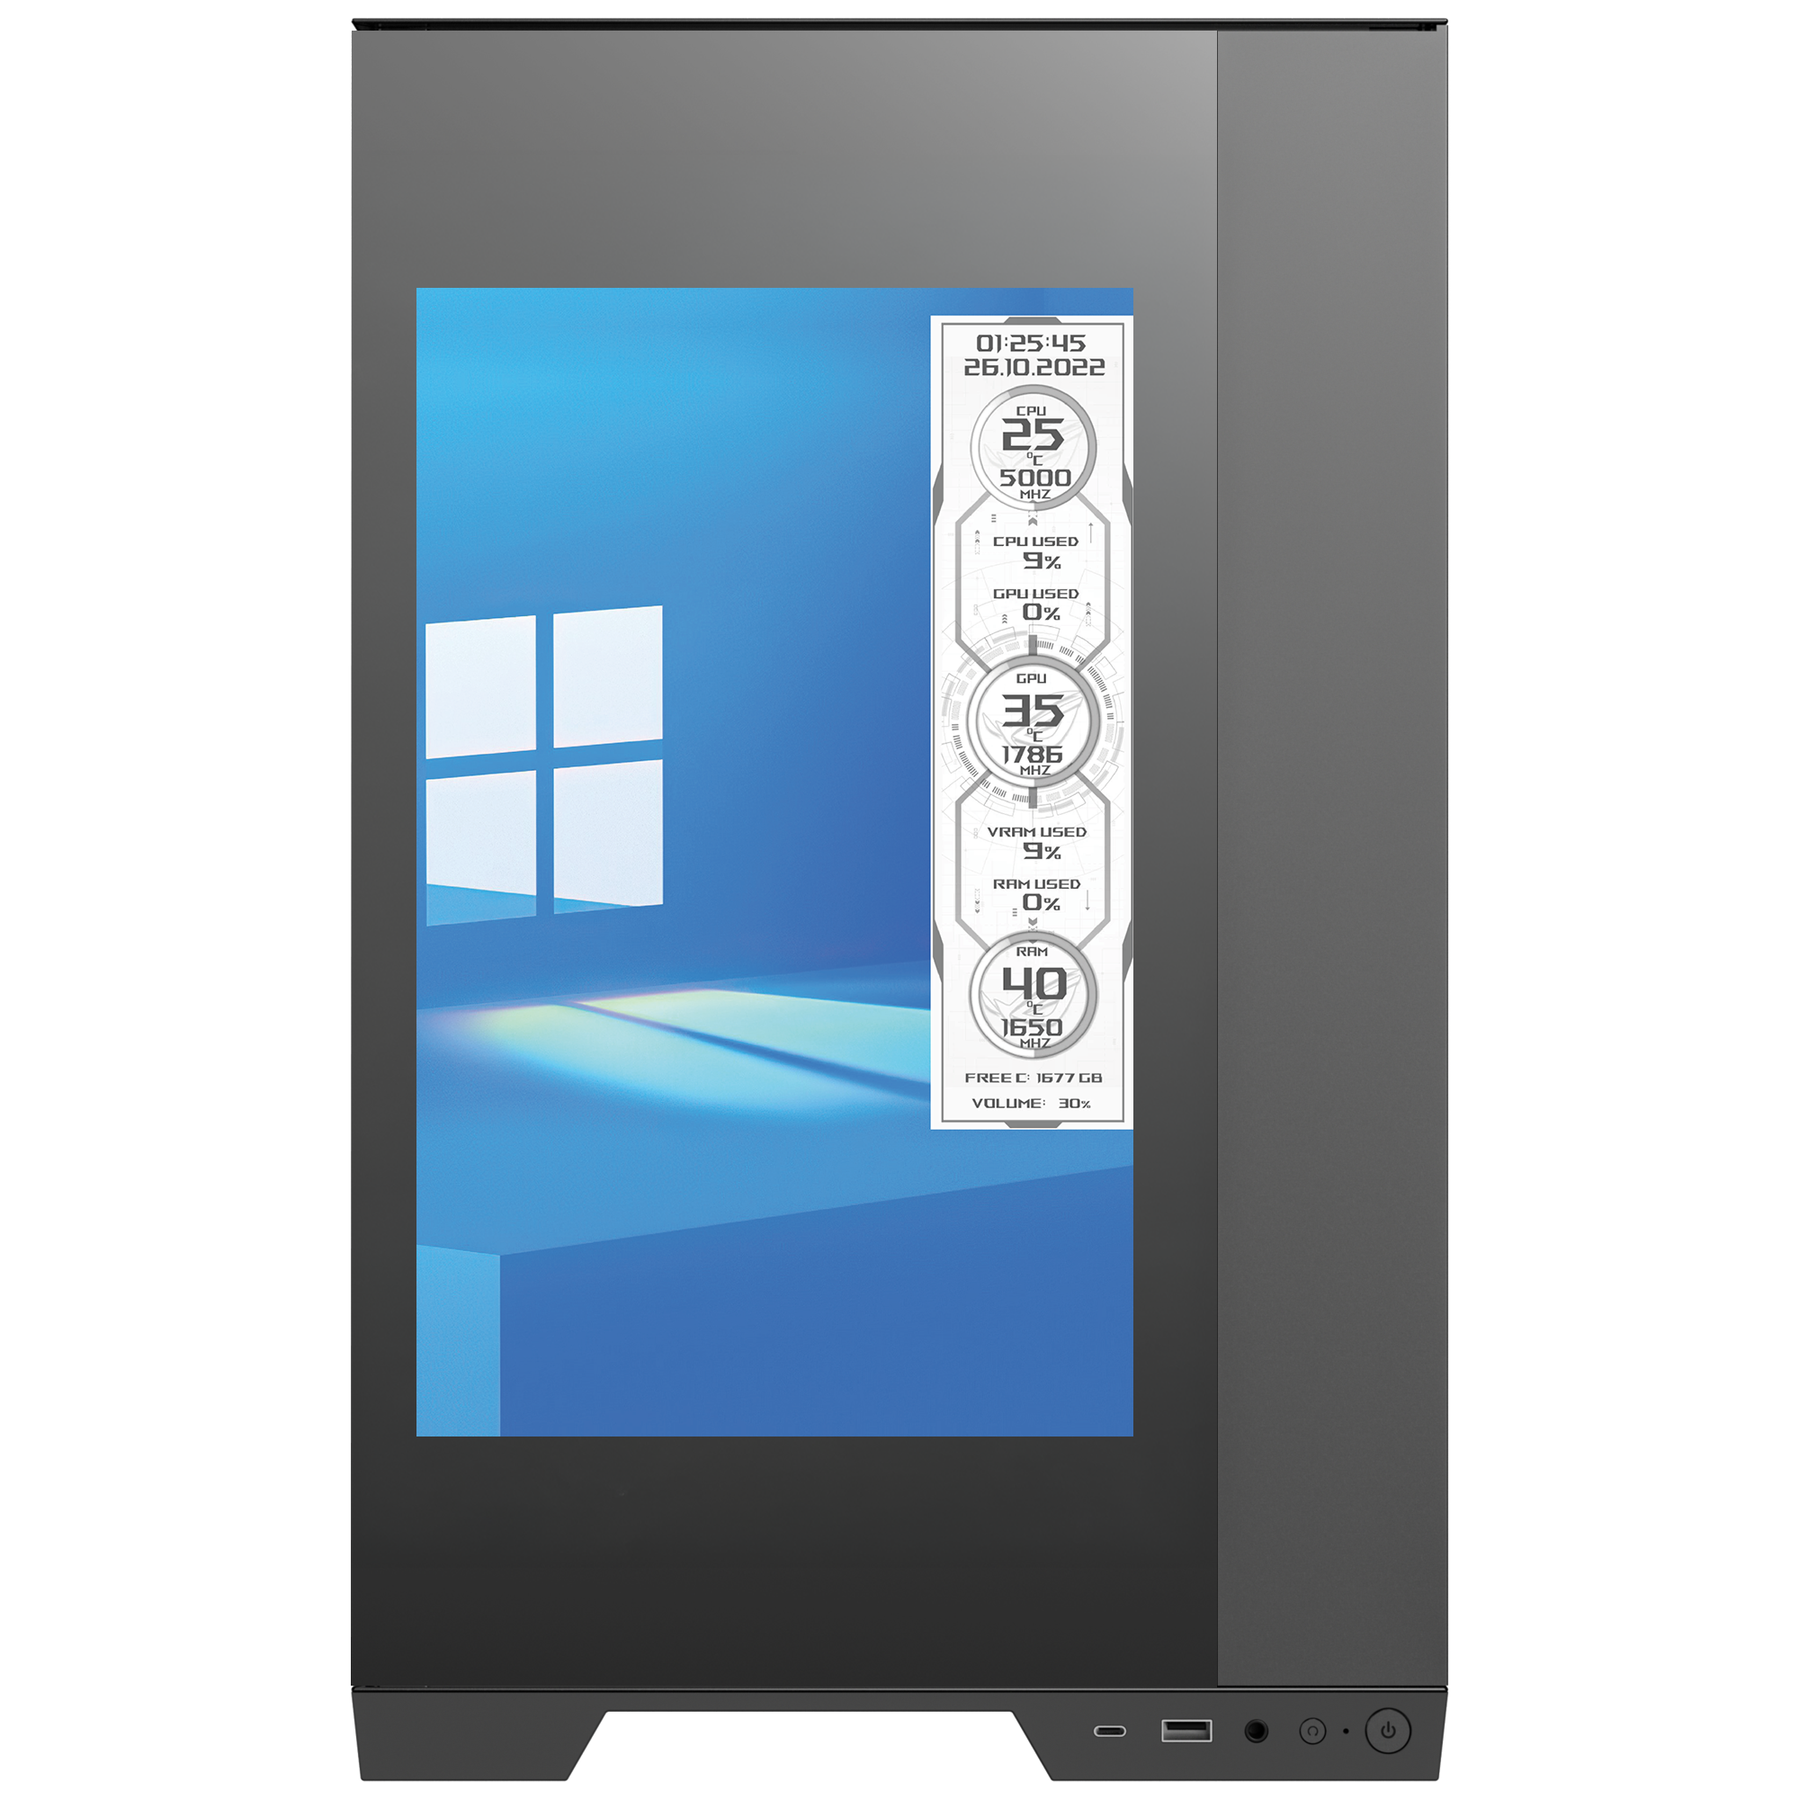
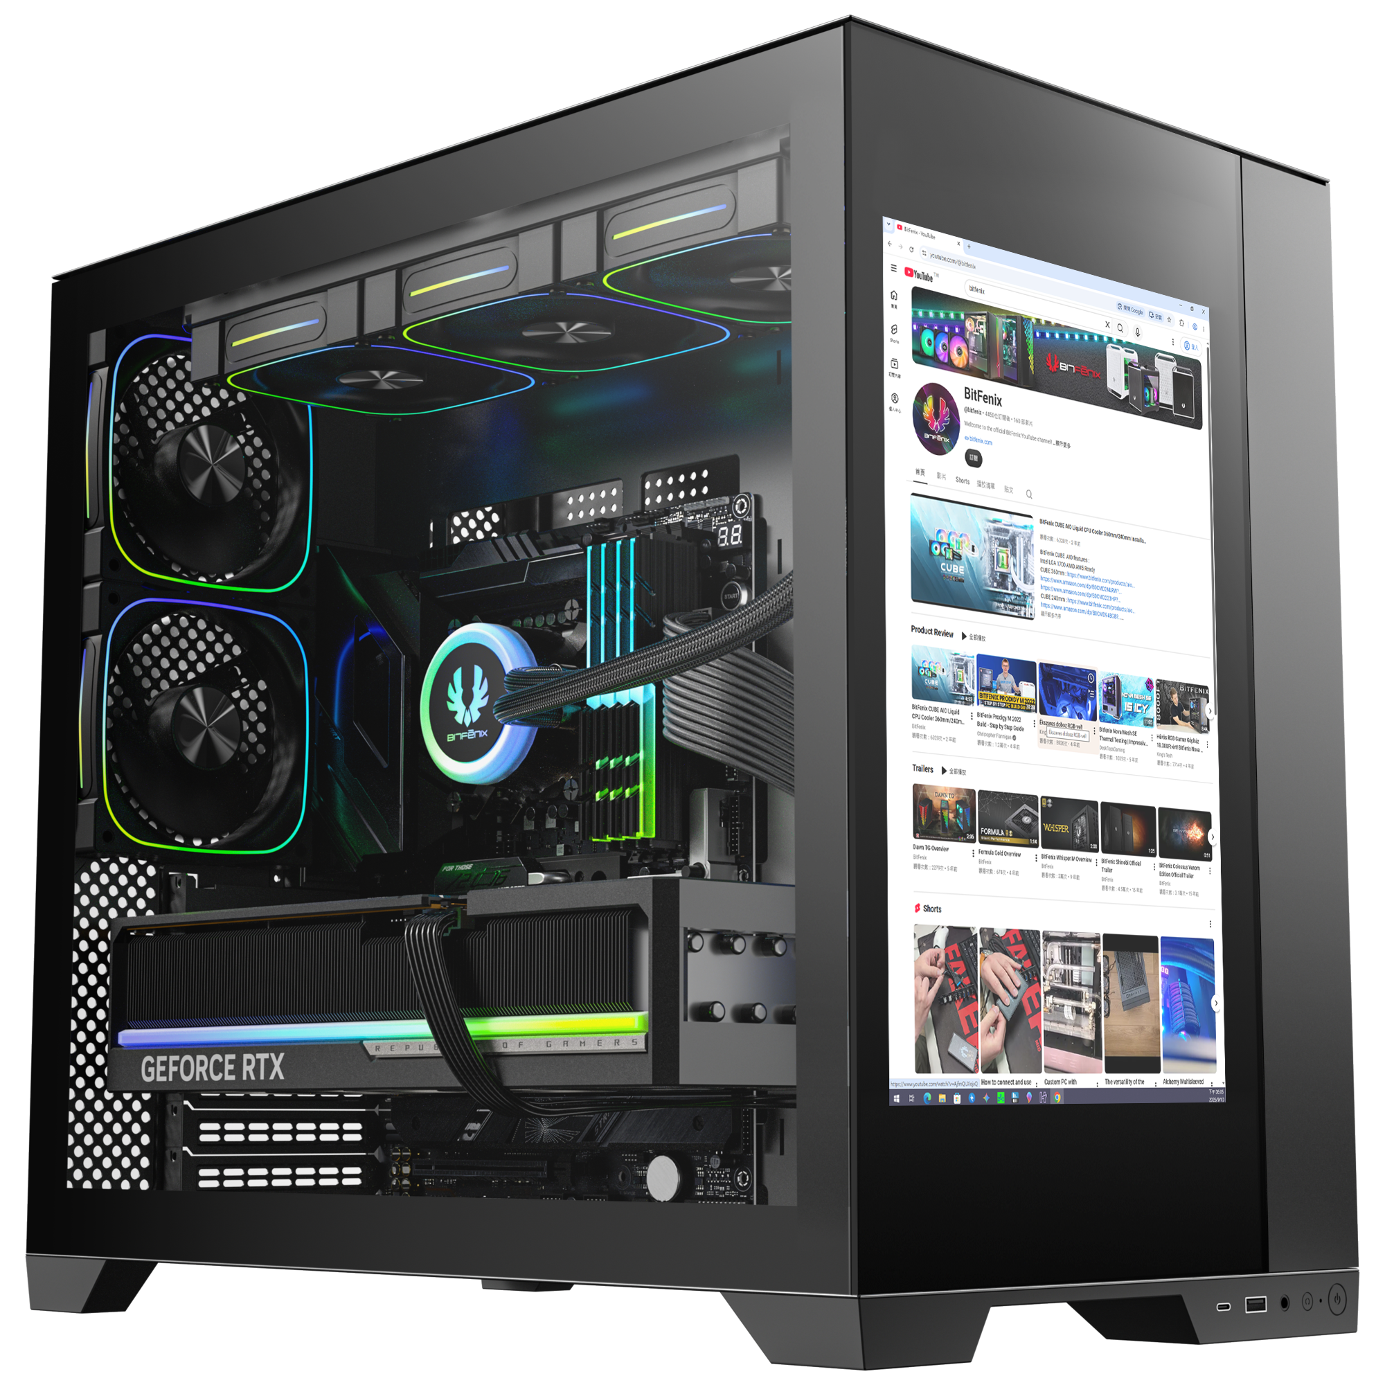
1920 X 1200 Pixels
14-inch IPS Live Performace Display
188mm
301mm

Slide 3
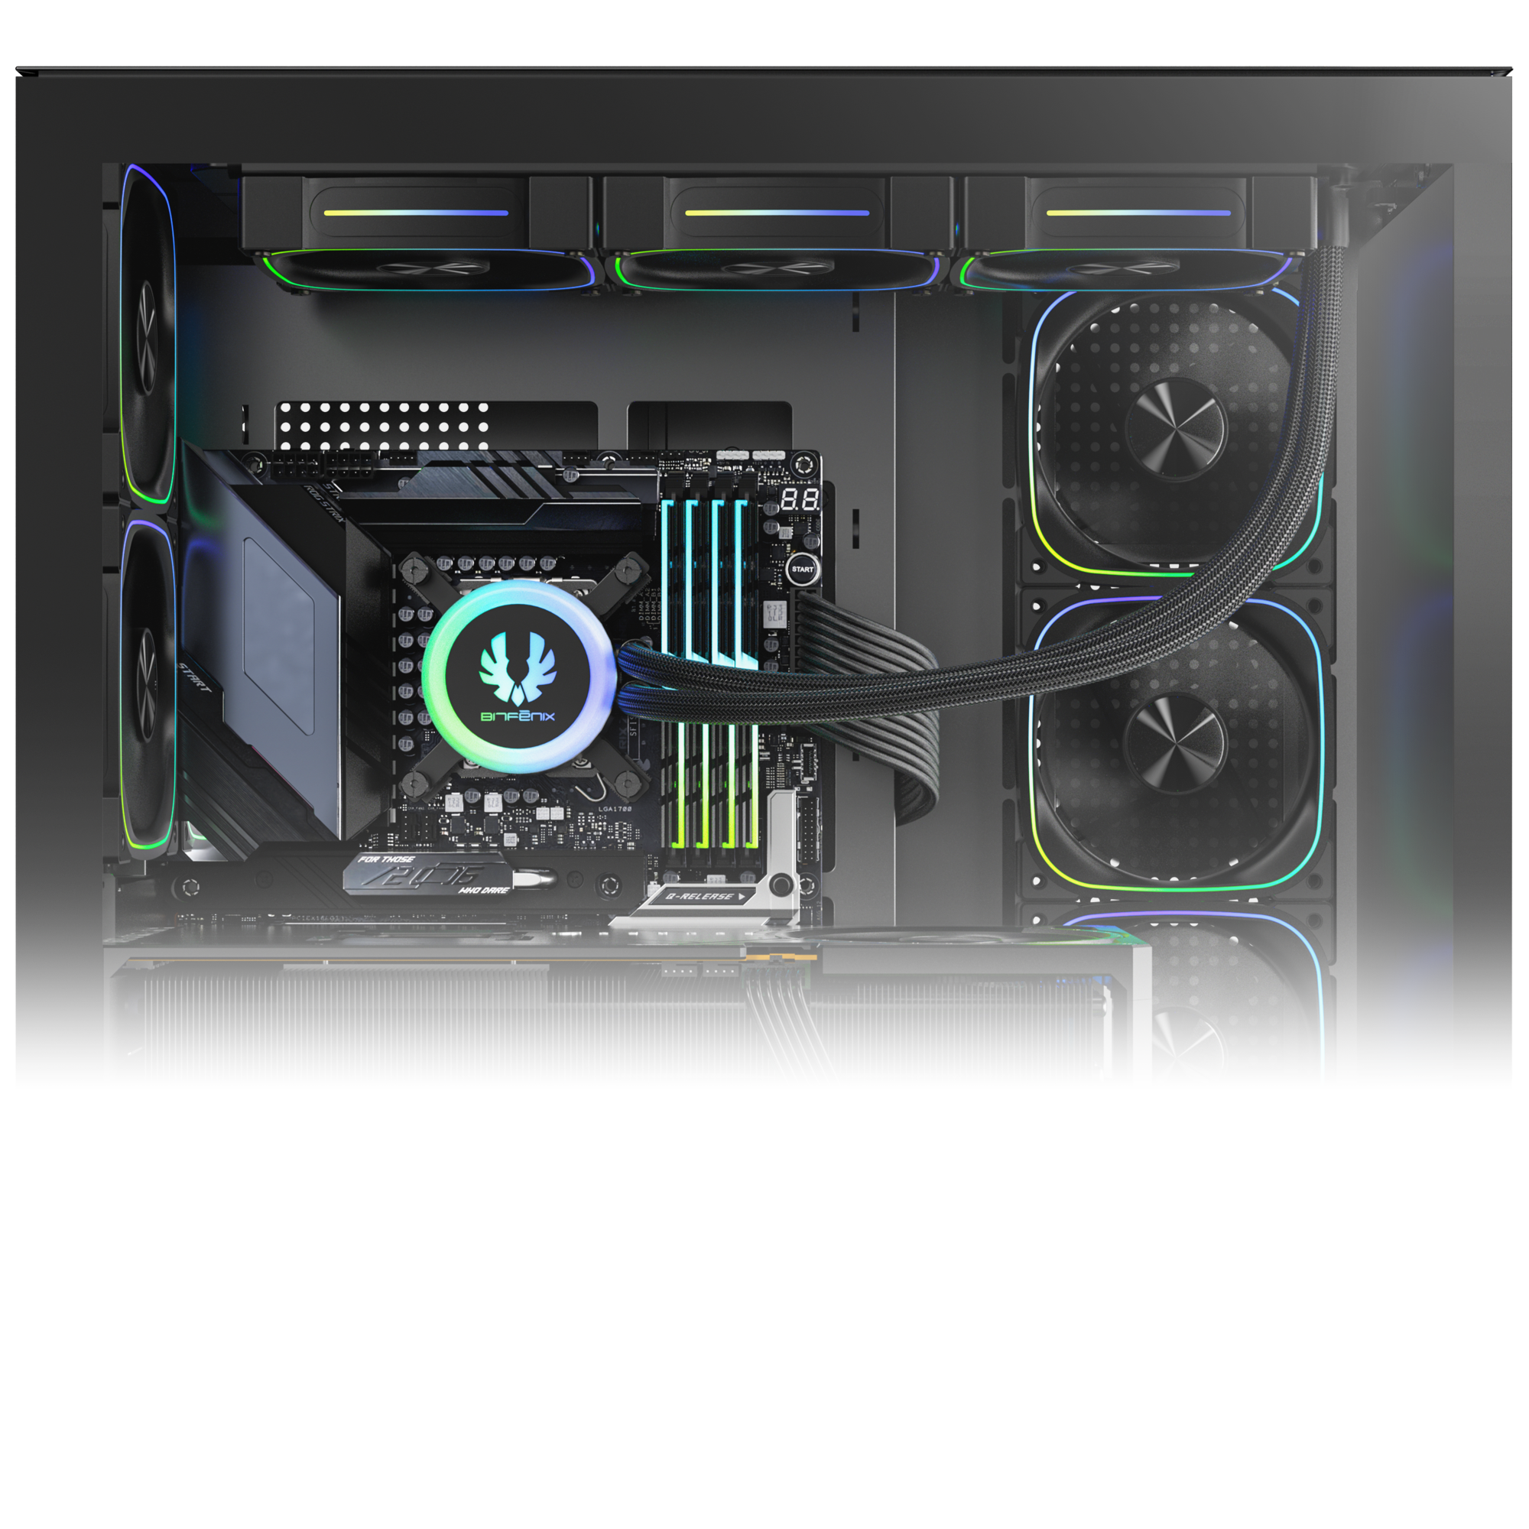
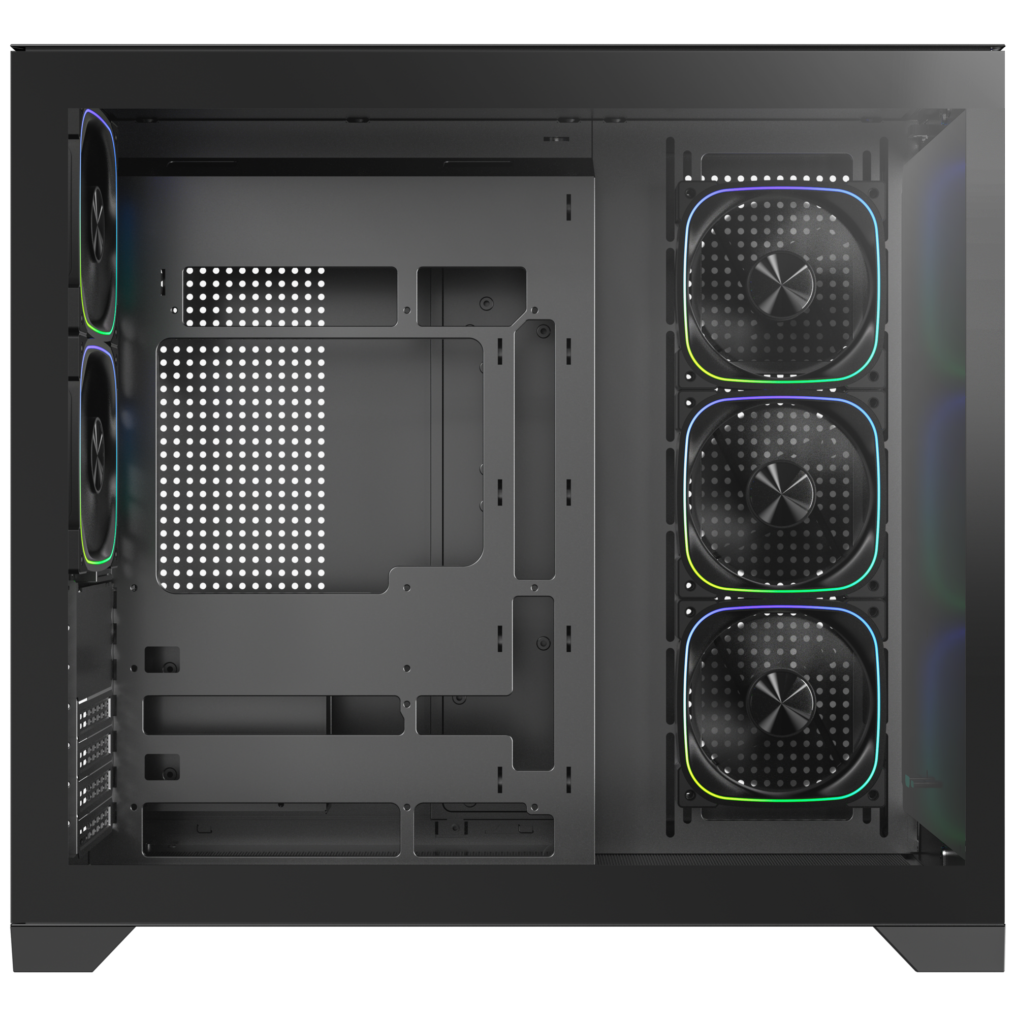
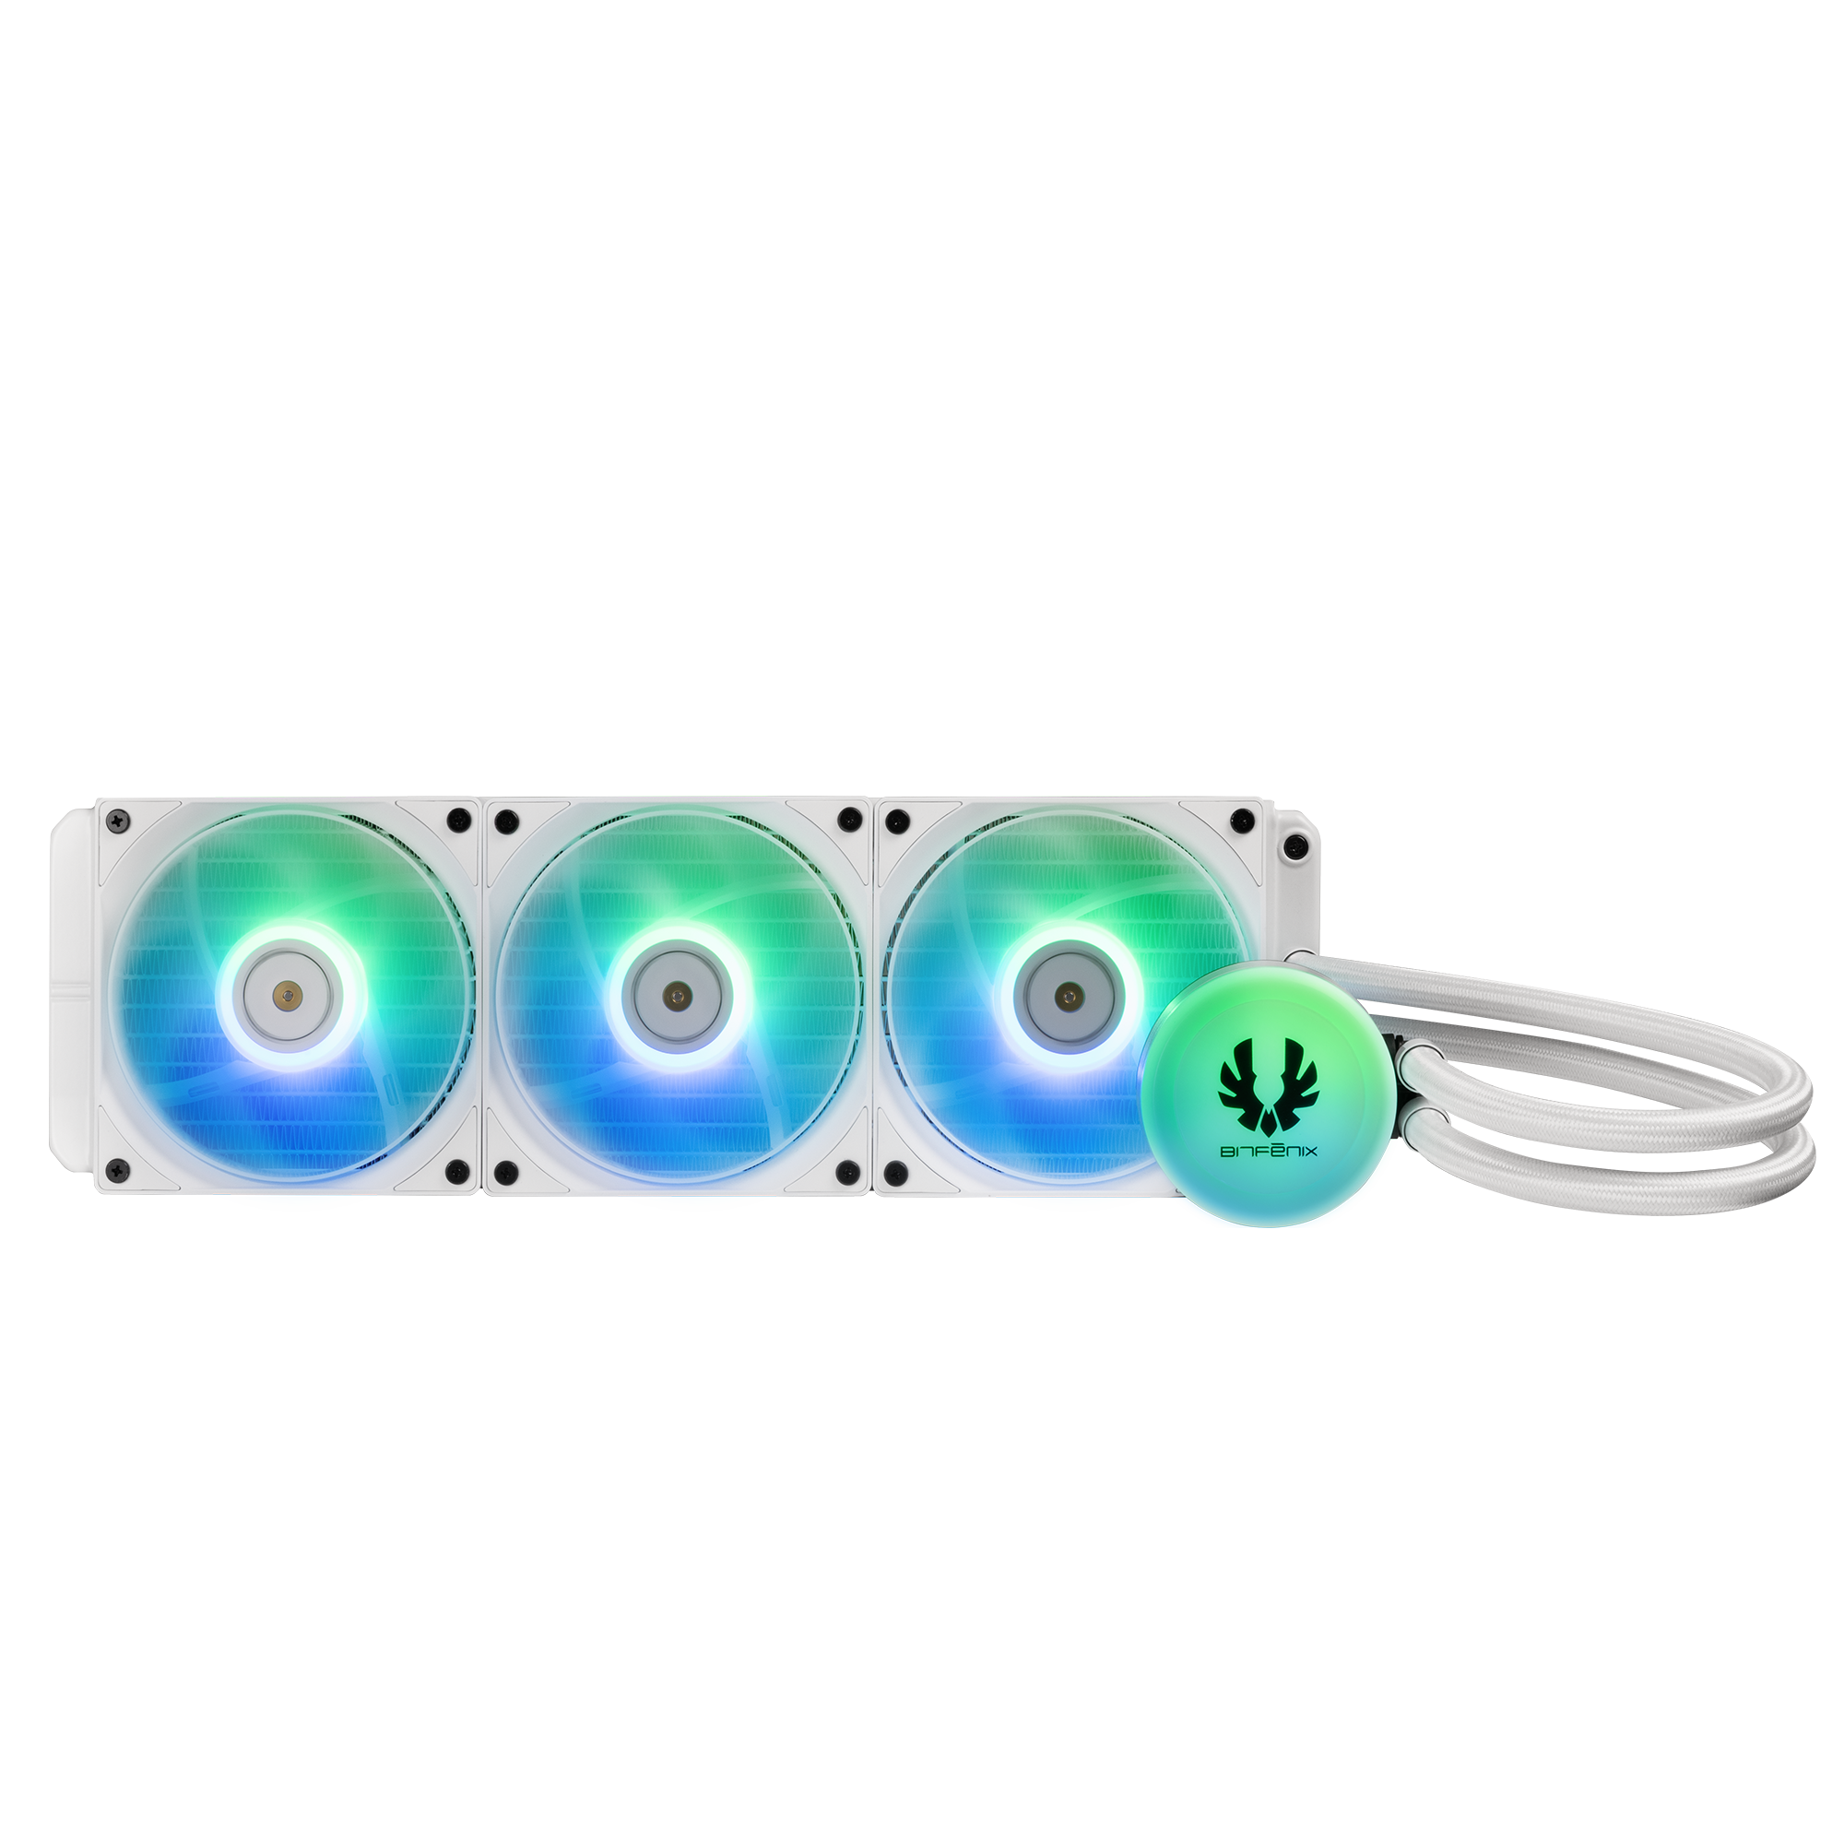
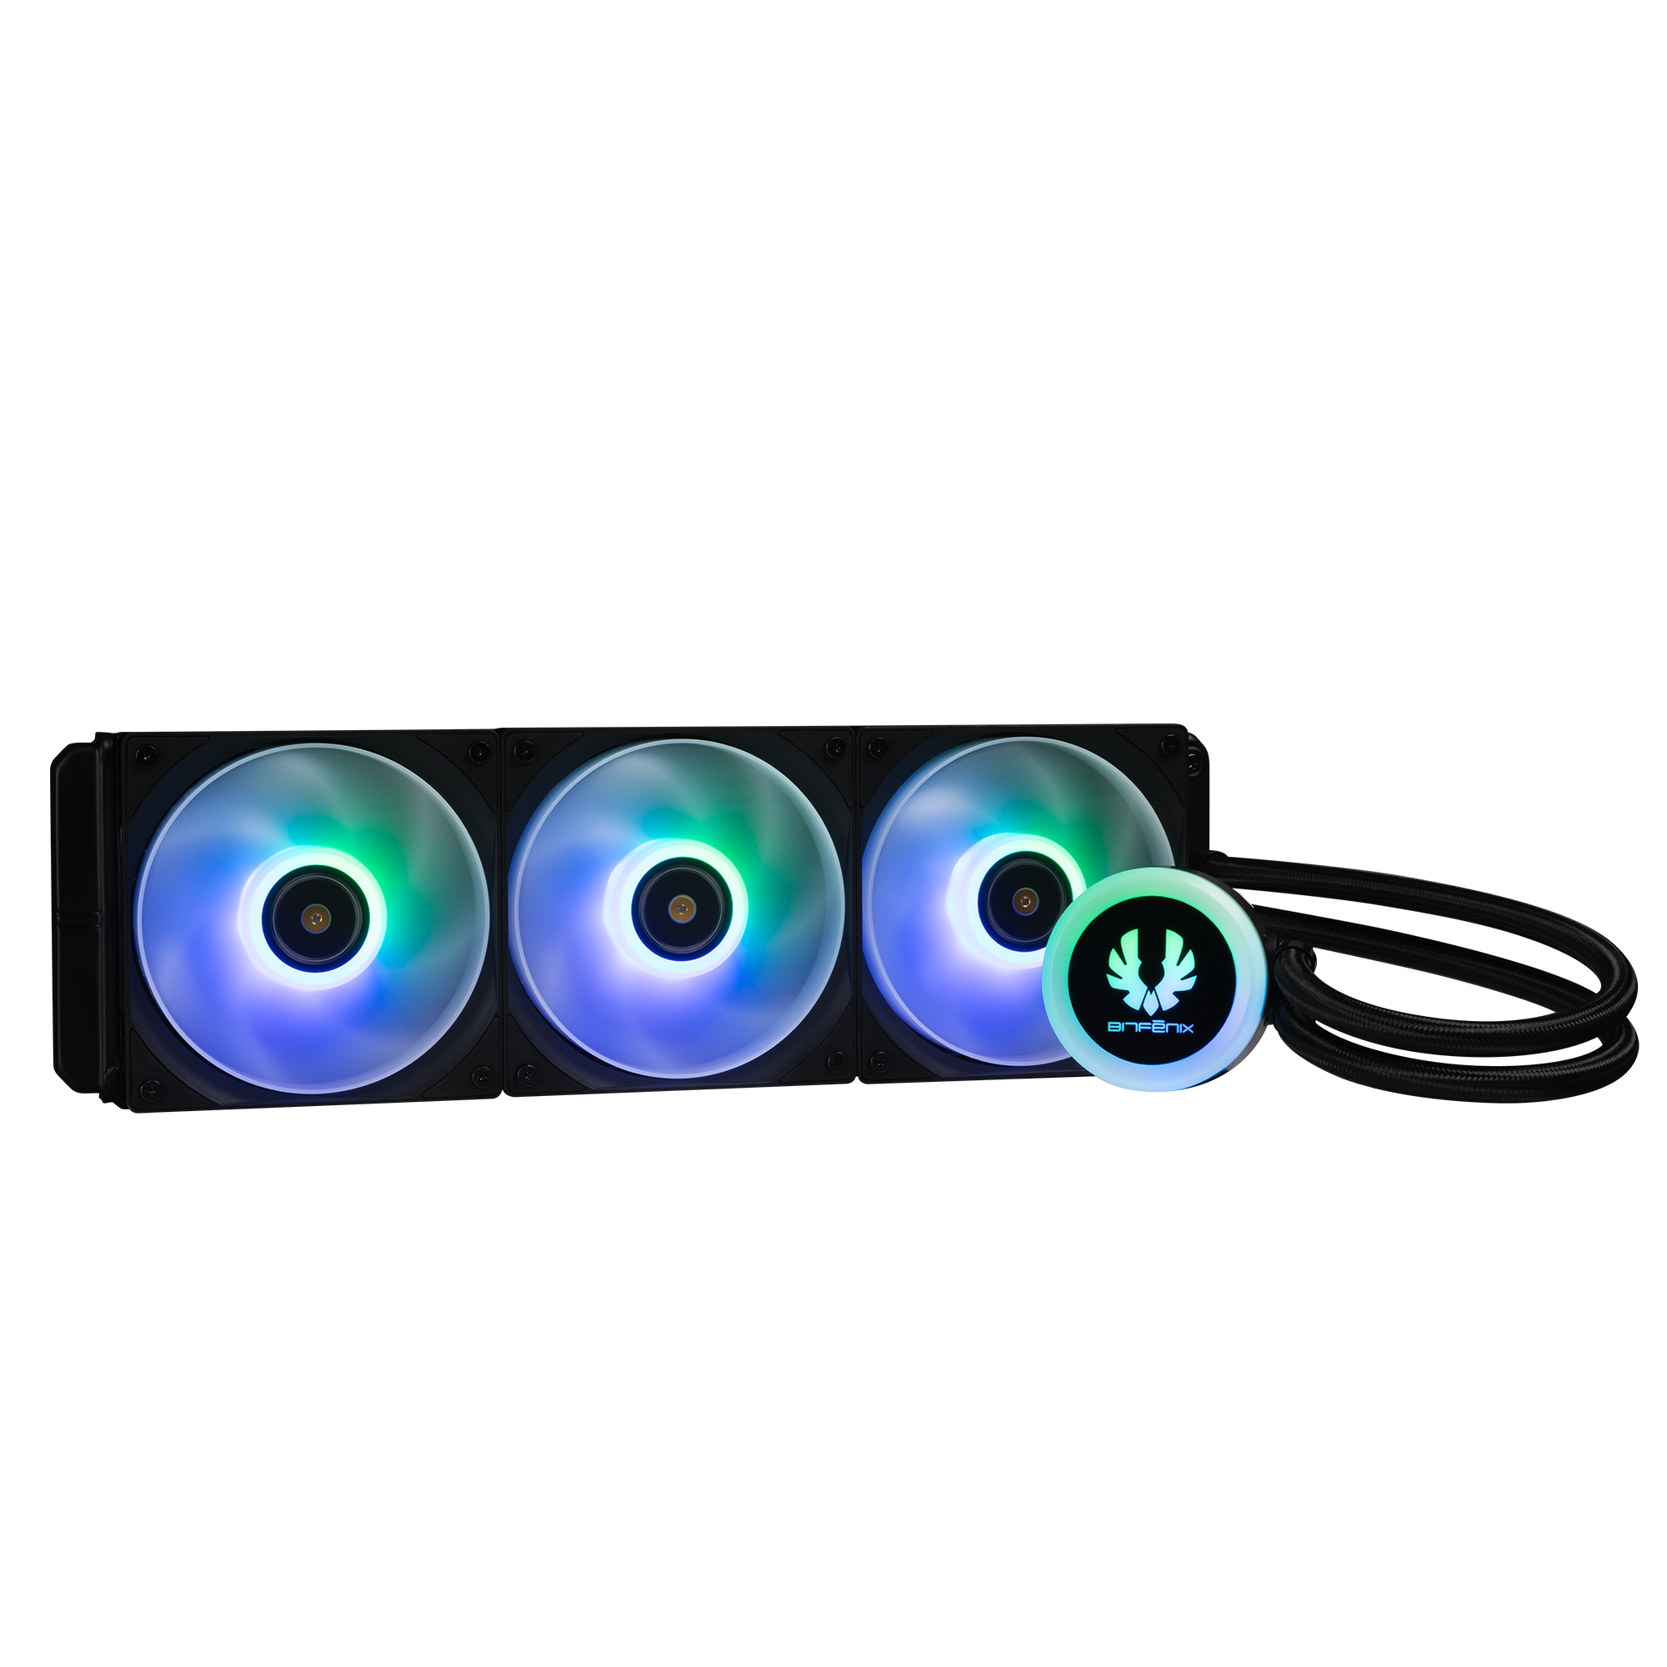
420mm AIO Support : Top/ Bottom
360mm AIO Support : Top/ Bottom/ MB Tray
140mm
MB
120mm
140mm
120mm
120mm
140mm
120mm

Slide 4
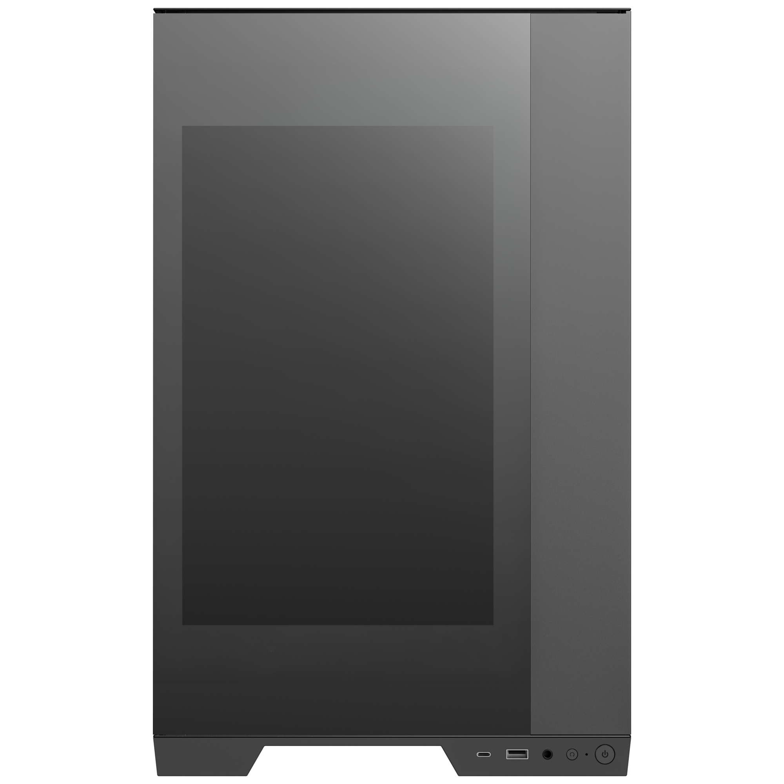
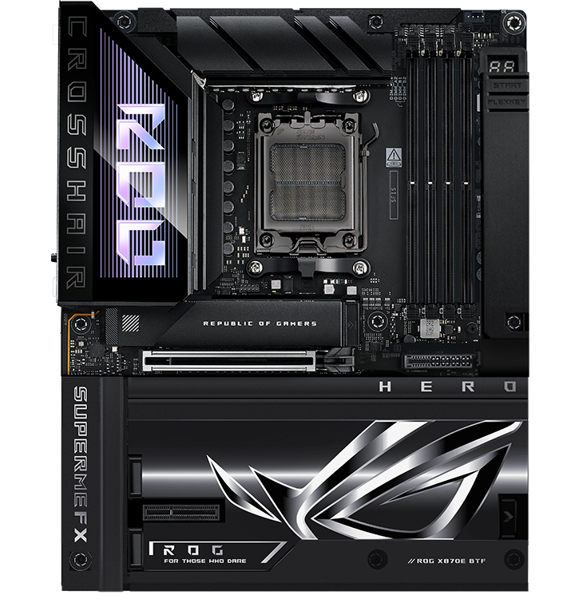
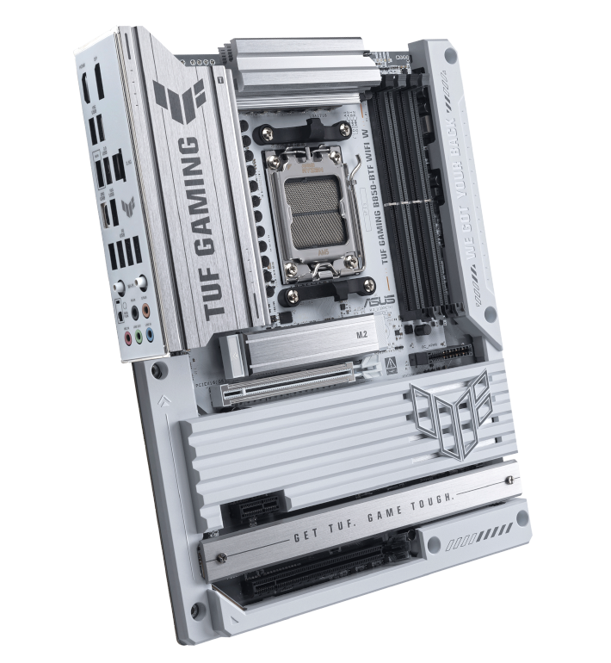
Supports BTF Back-Connect Motherboard
285mm
490mm
Maximun CPU
Cooler Height
Back-Connect Motherboard
Motherboard
Support
170
mm
ITX/ M-ATX
ATX
EATX
458mm
Cable Management Space 100 mm
Maximun Graphics Card
Support
440
mm

Slide 5

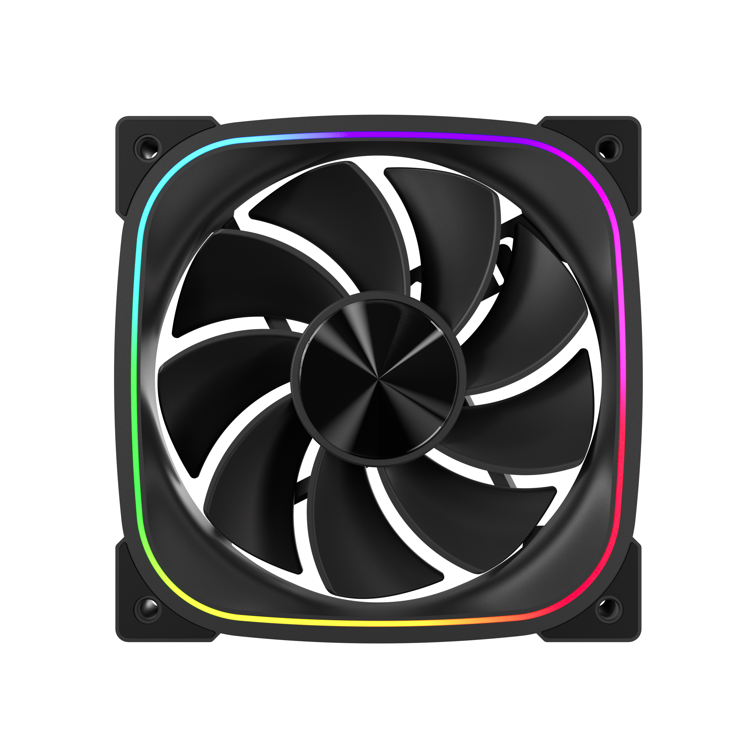
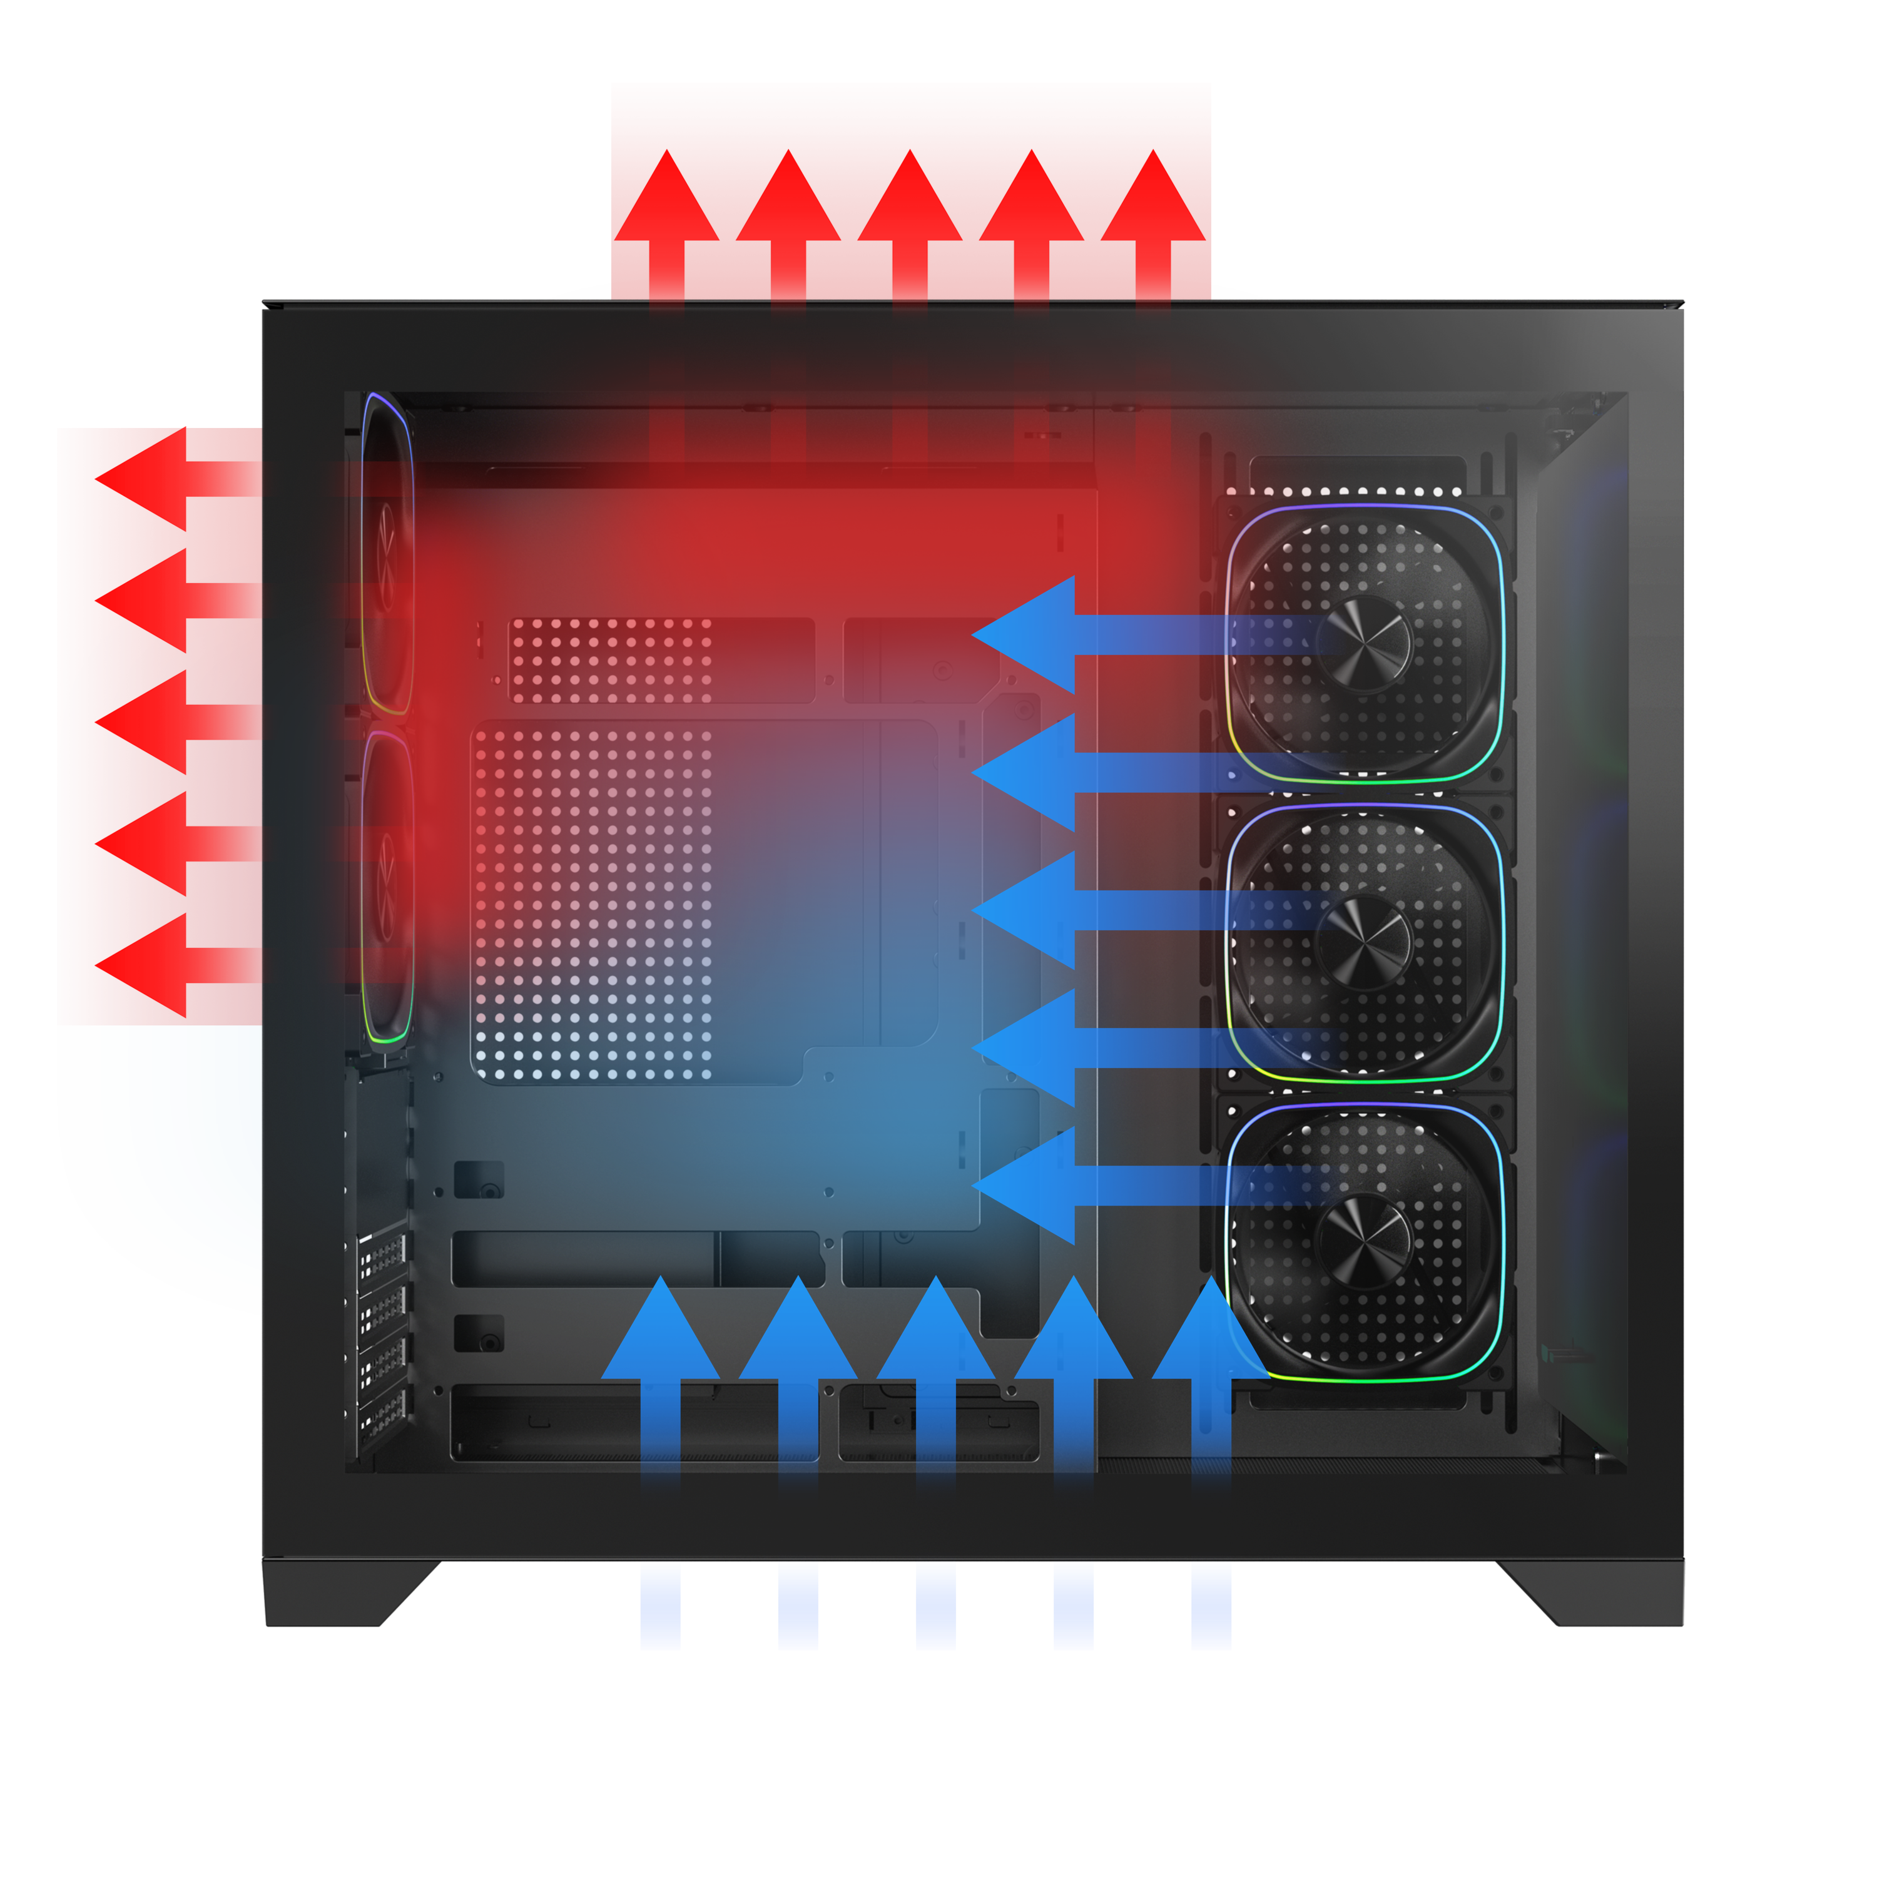
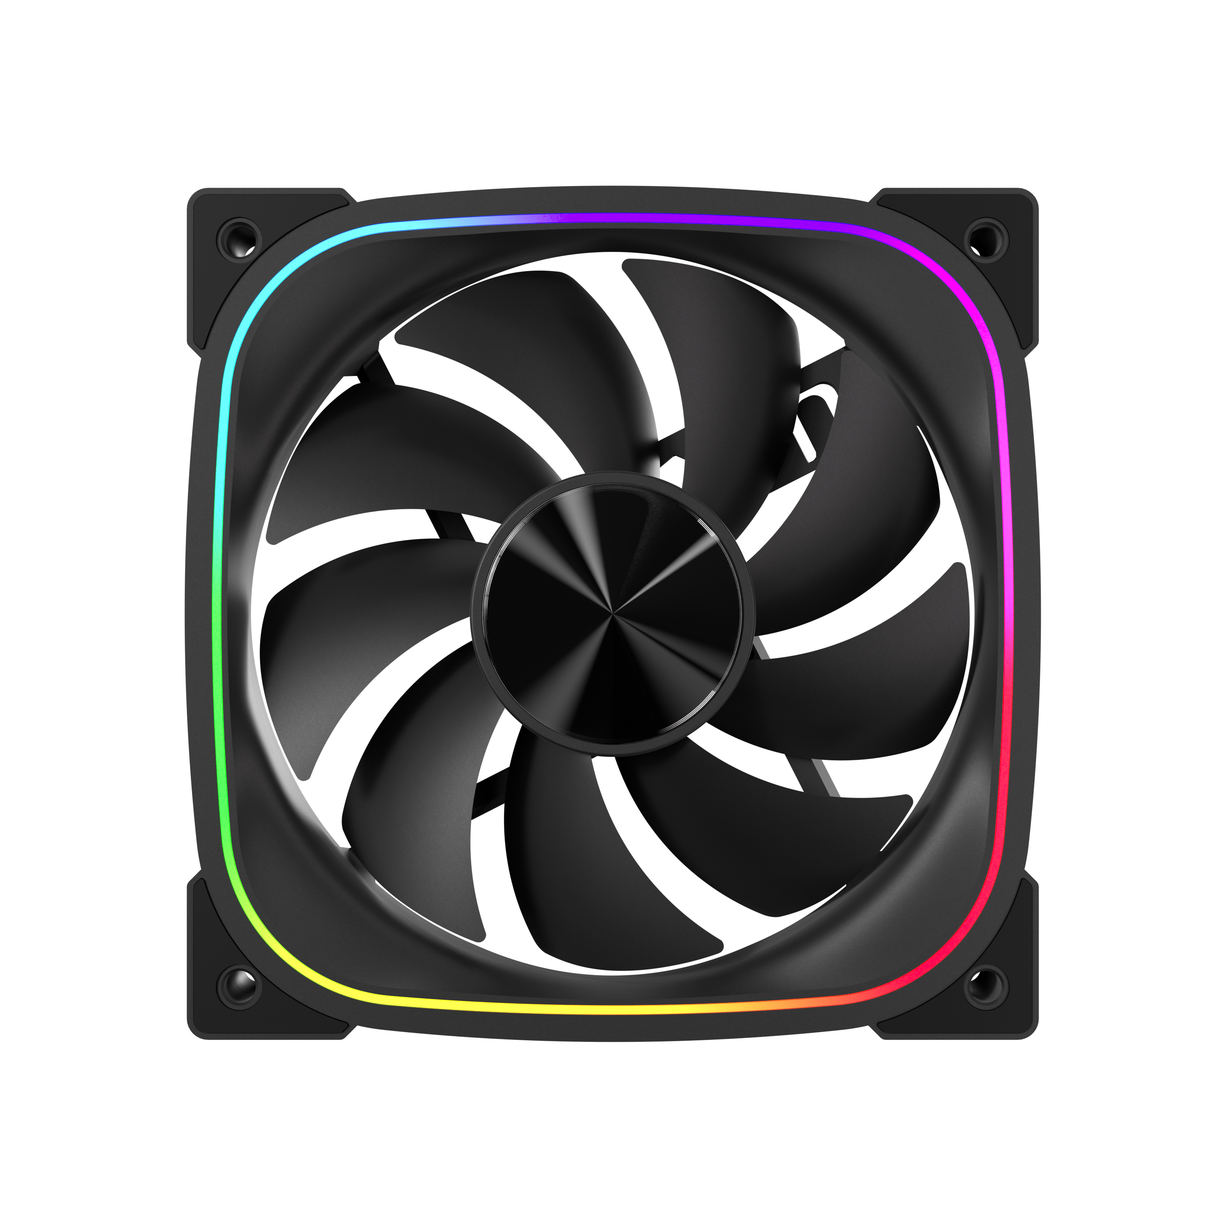
High-Performance
Reverse ARGB Fan
DUAL CHAMBER
HIGH
3X
AIRFLOW PERFORMANCE
2X
High-Performance ARGB Fan

Slide 6
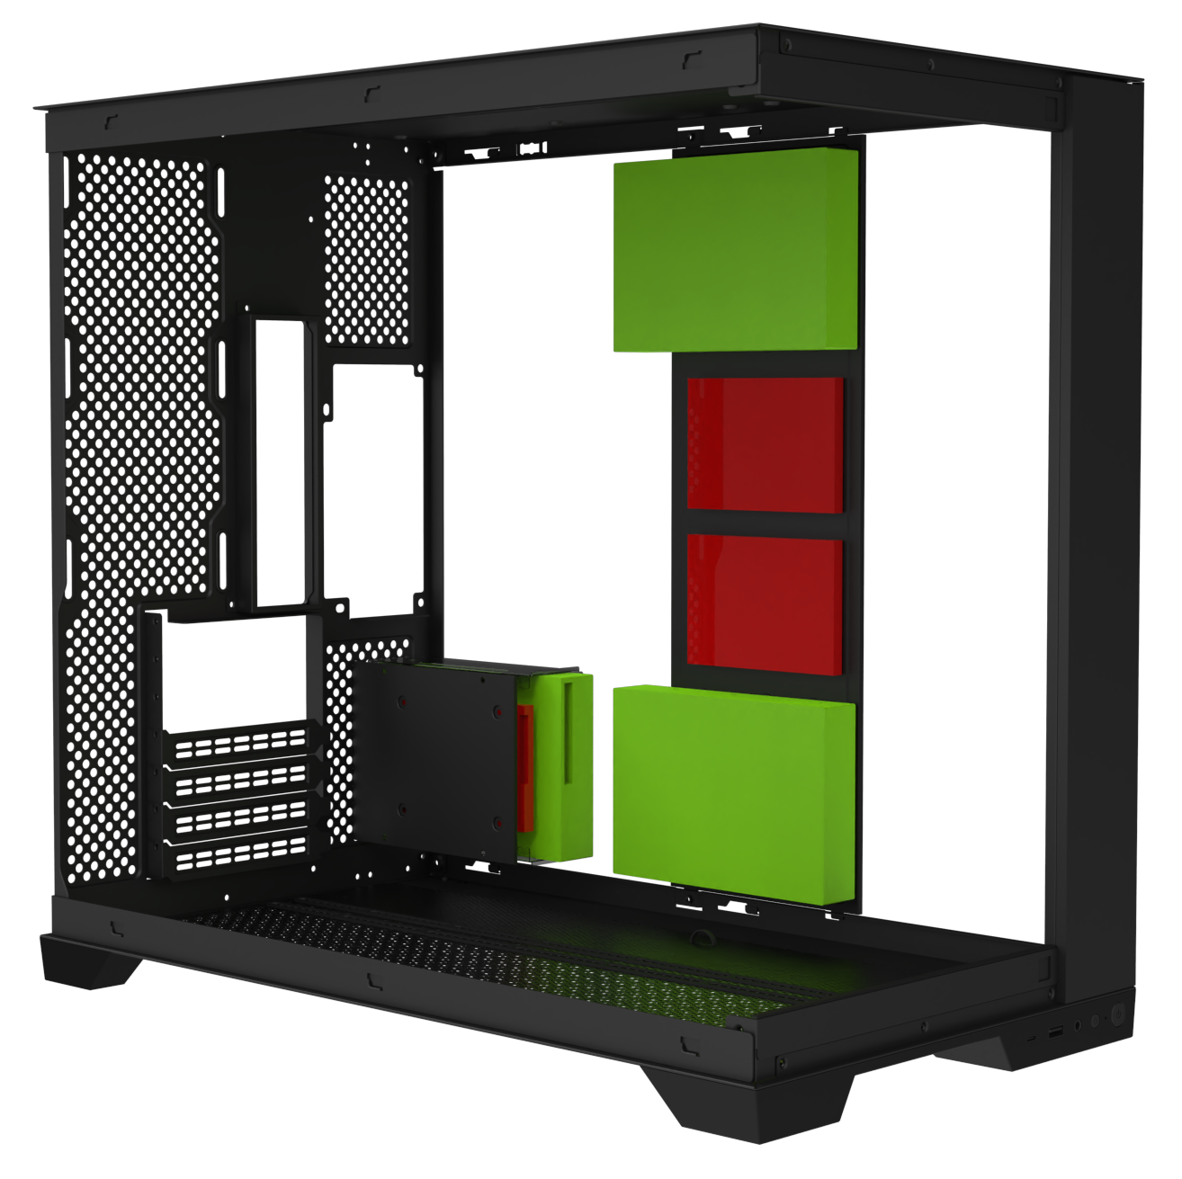
PSU
ATX & Standard /
up to 200mm
SSD
HDD
3 X 3.5’’ Drive & 3+2 X 2.5’’Drive

Slide 7
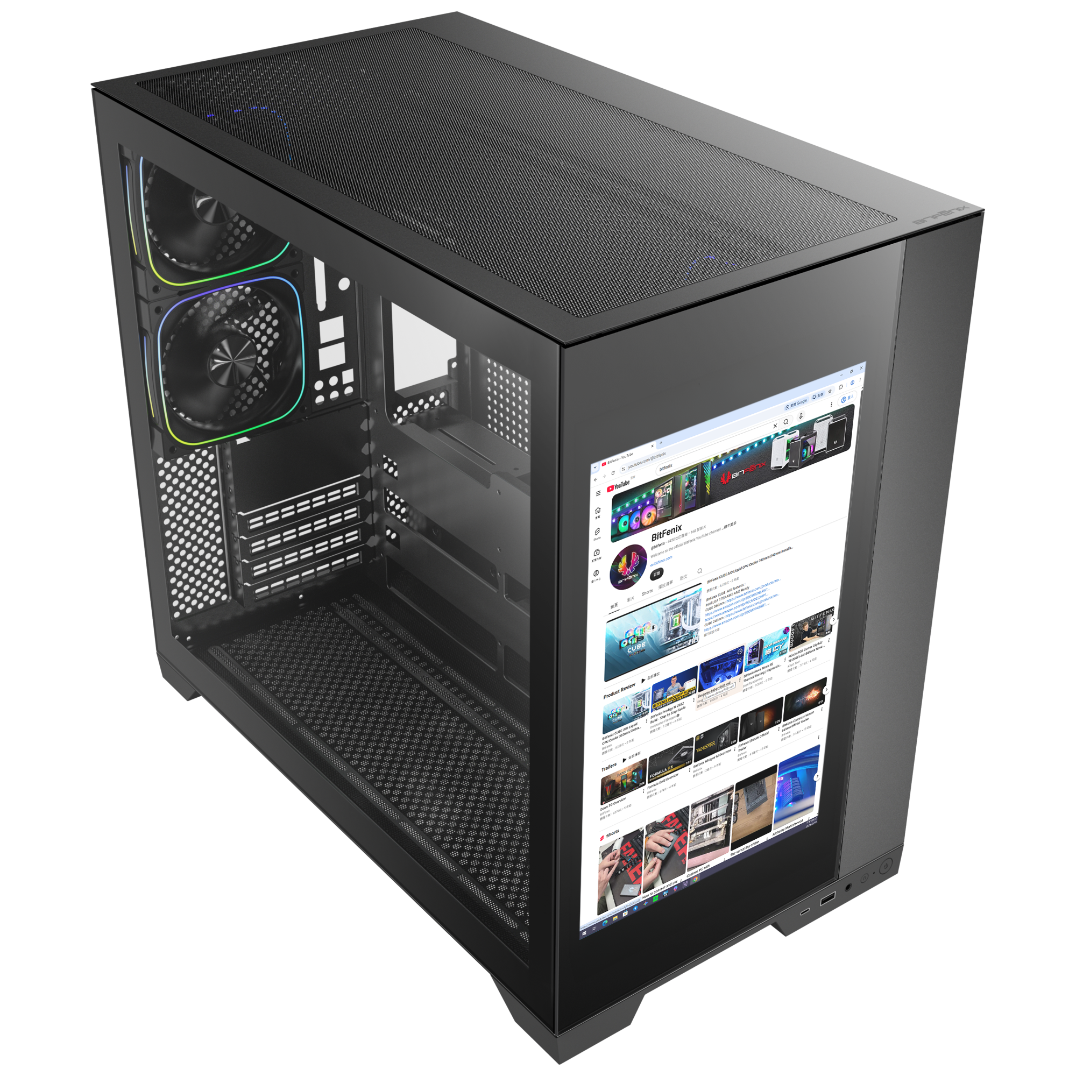
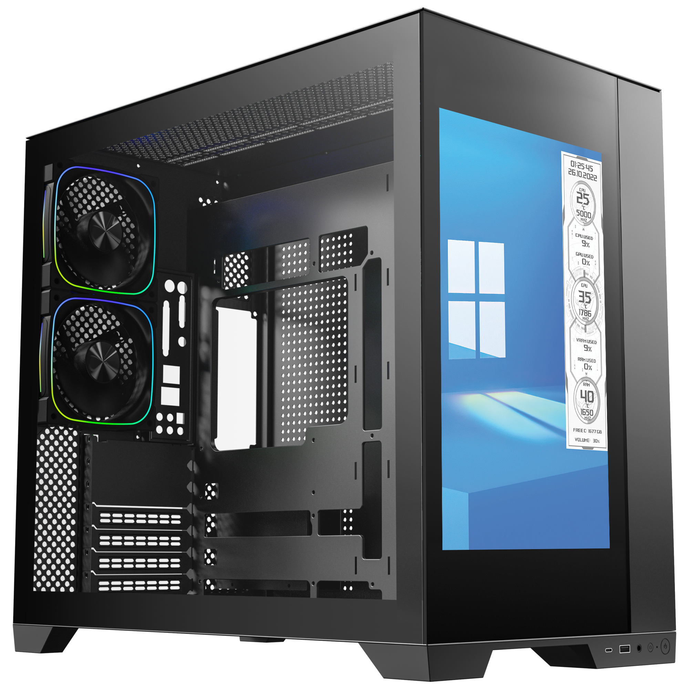
Top
Bottom
Easy Clean With Removable Dust Filters

Slide 8
Tool-free Removal
Reset Button
Power Button
1X TypeC
1X USB 3.0

Slide 9
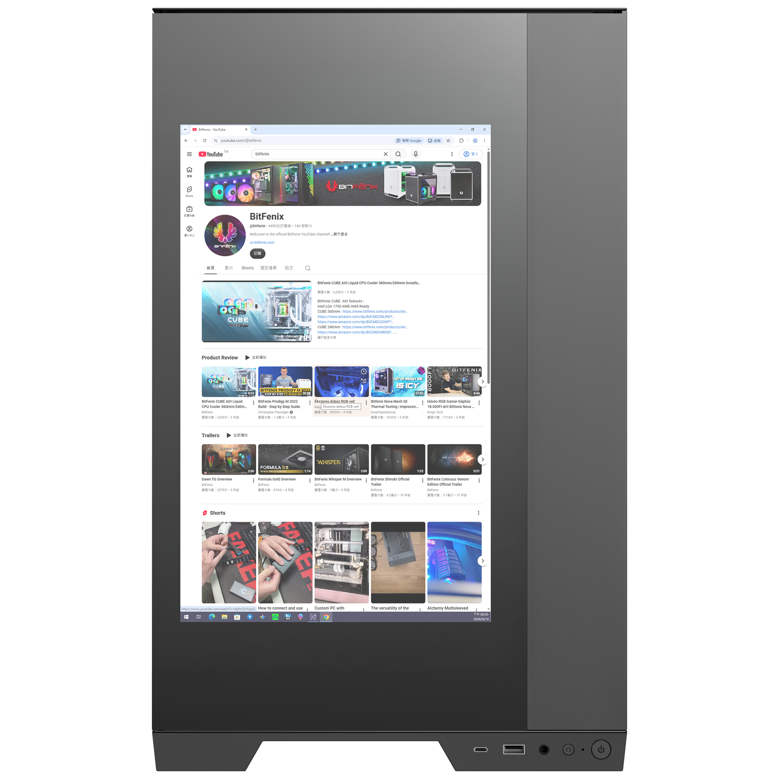
Best |  | Black
Part no. |  | BFC-DLD850KKGKK-5A
EAN |  | 4712883213472
UPC |  | 886027007617
Net weight (NW) Gross weight (GW) |  | N.W: Kgs / G.W: Kgs
Materials |  | Steel, Mesh, Plastic, Tempered Glass
Chassis Dimensions (W x H x D) |  | 285 mm x 490 mm x 458 mm
Motherboard Supports |  | Mini-ITX, MicroATX, ATX
Air Cooler Height Support |  | 170mm
VGA Length Support |  | 430mm
Cable Management Support |  | up to 100mm
2.5" / 3.5" Drive Bay |  | 3+2 / 3
Fan mounts | MB | 3 x 120mm or 3 x 140mm
 | Top | 3 x 120mm or 3 x 140mm
 | Rear | 2 x 120mm
 | Bottom | 3 x 120mm or 3 x 140mm
Radiator Support | MB | 1 x 360mm/ 1 x 280mm/ 1 x 240mm (Thickness up to 27mm)
 | Top | 1 x 420mm/ 1 x 360mm/ 1 x 280mm/ 1 x 240mm (Thickness up to 27mm)
 | Rear | 1 x 120mm
 | Bottom | 1 x 420mm/ 1 x 360mm/ 1 x 280mm/ 1 x 240mm (Thickness up to 27mm)
PCI-E Slots |  | 7 Slots
I/O Ports |  | 1 x TypeC/ 1 x USB3.0/ Audio I/O
Power Supply |  | ATX & Standard / up to 200mm
14-inch Monitor
Display screen visible size
301mm x 188mm
Product (frame) size
311mm x 201mm x 11mm
DH-80
Display resolution
1920 x 1200 Pixels
Interfaces
HDMI, USB-TYPE-C adapter cable, cable length 1000mm

