Slide 1

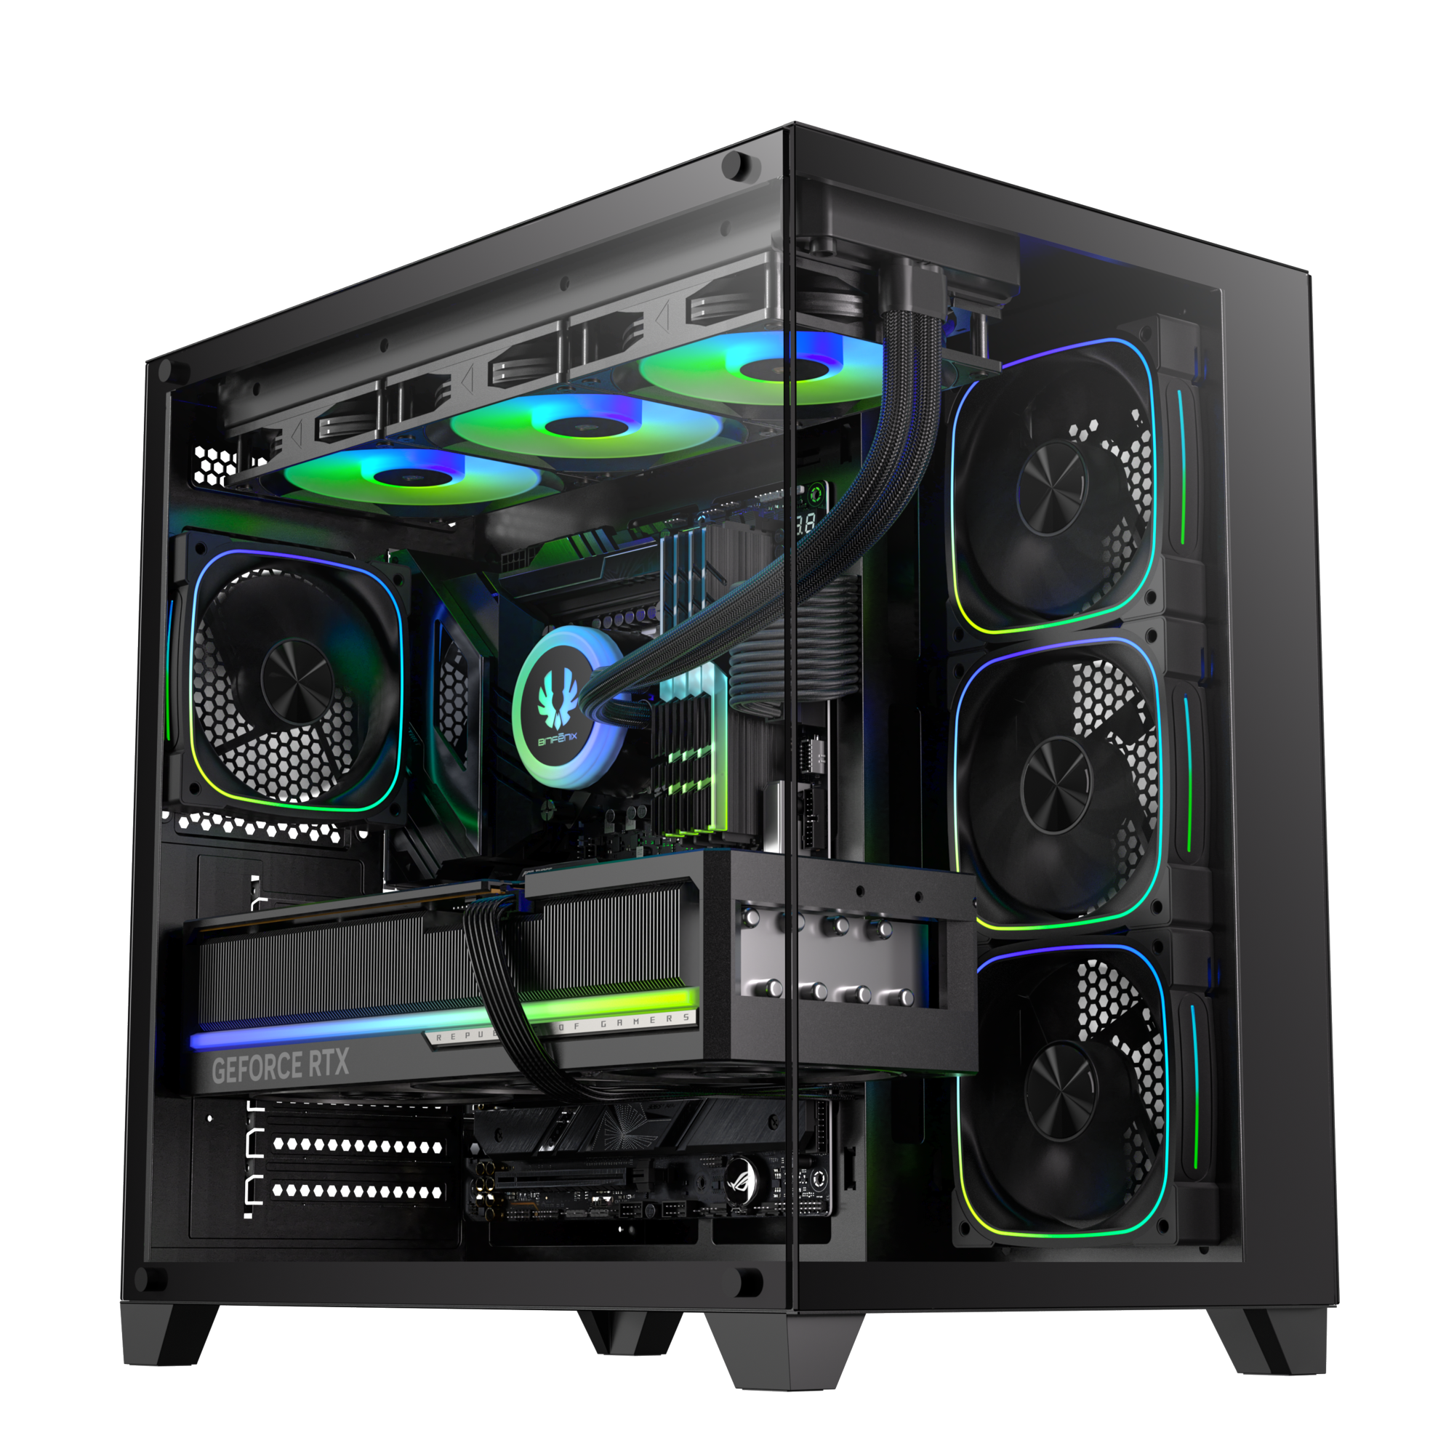
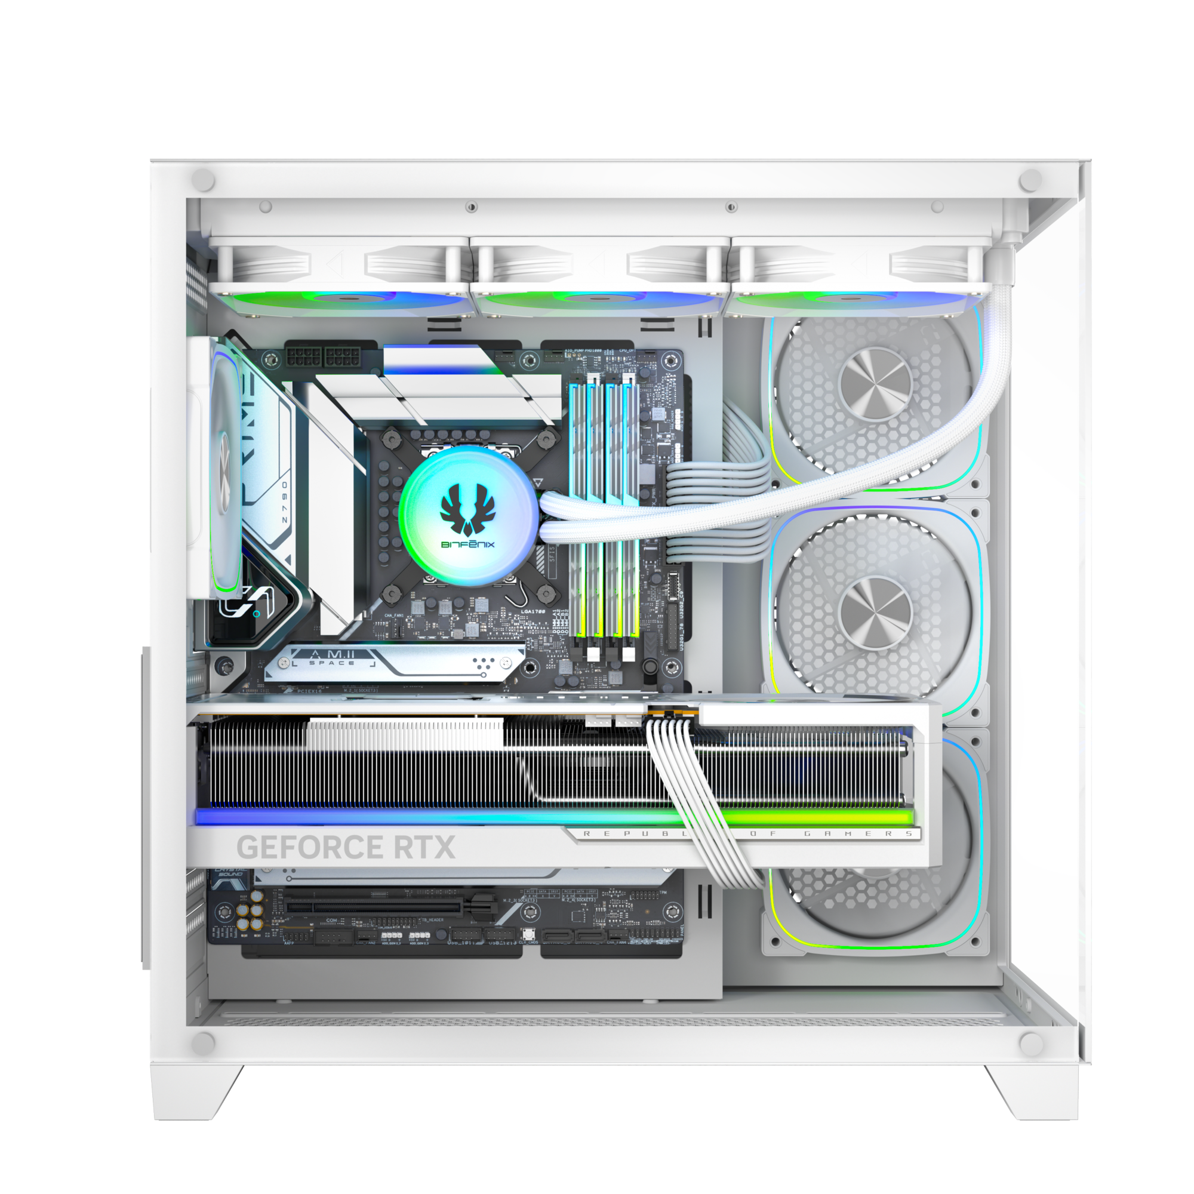
COL II

Slide 2
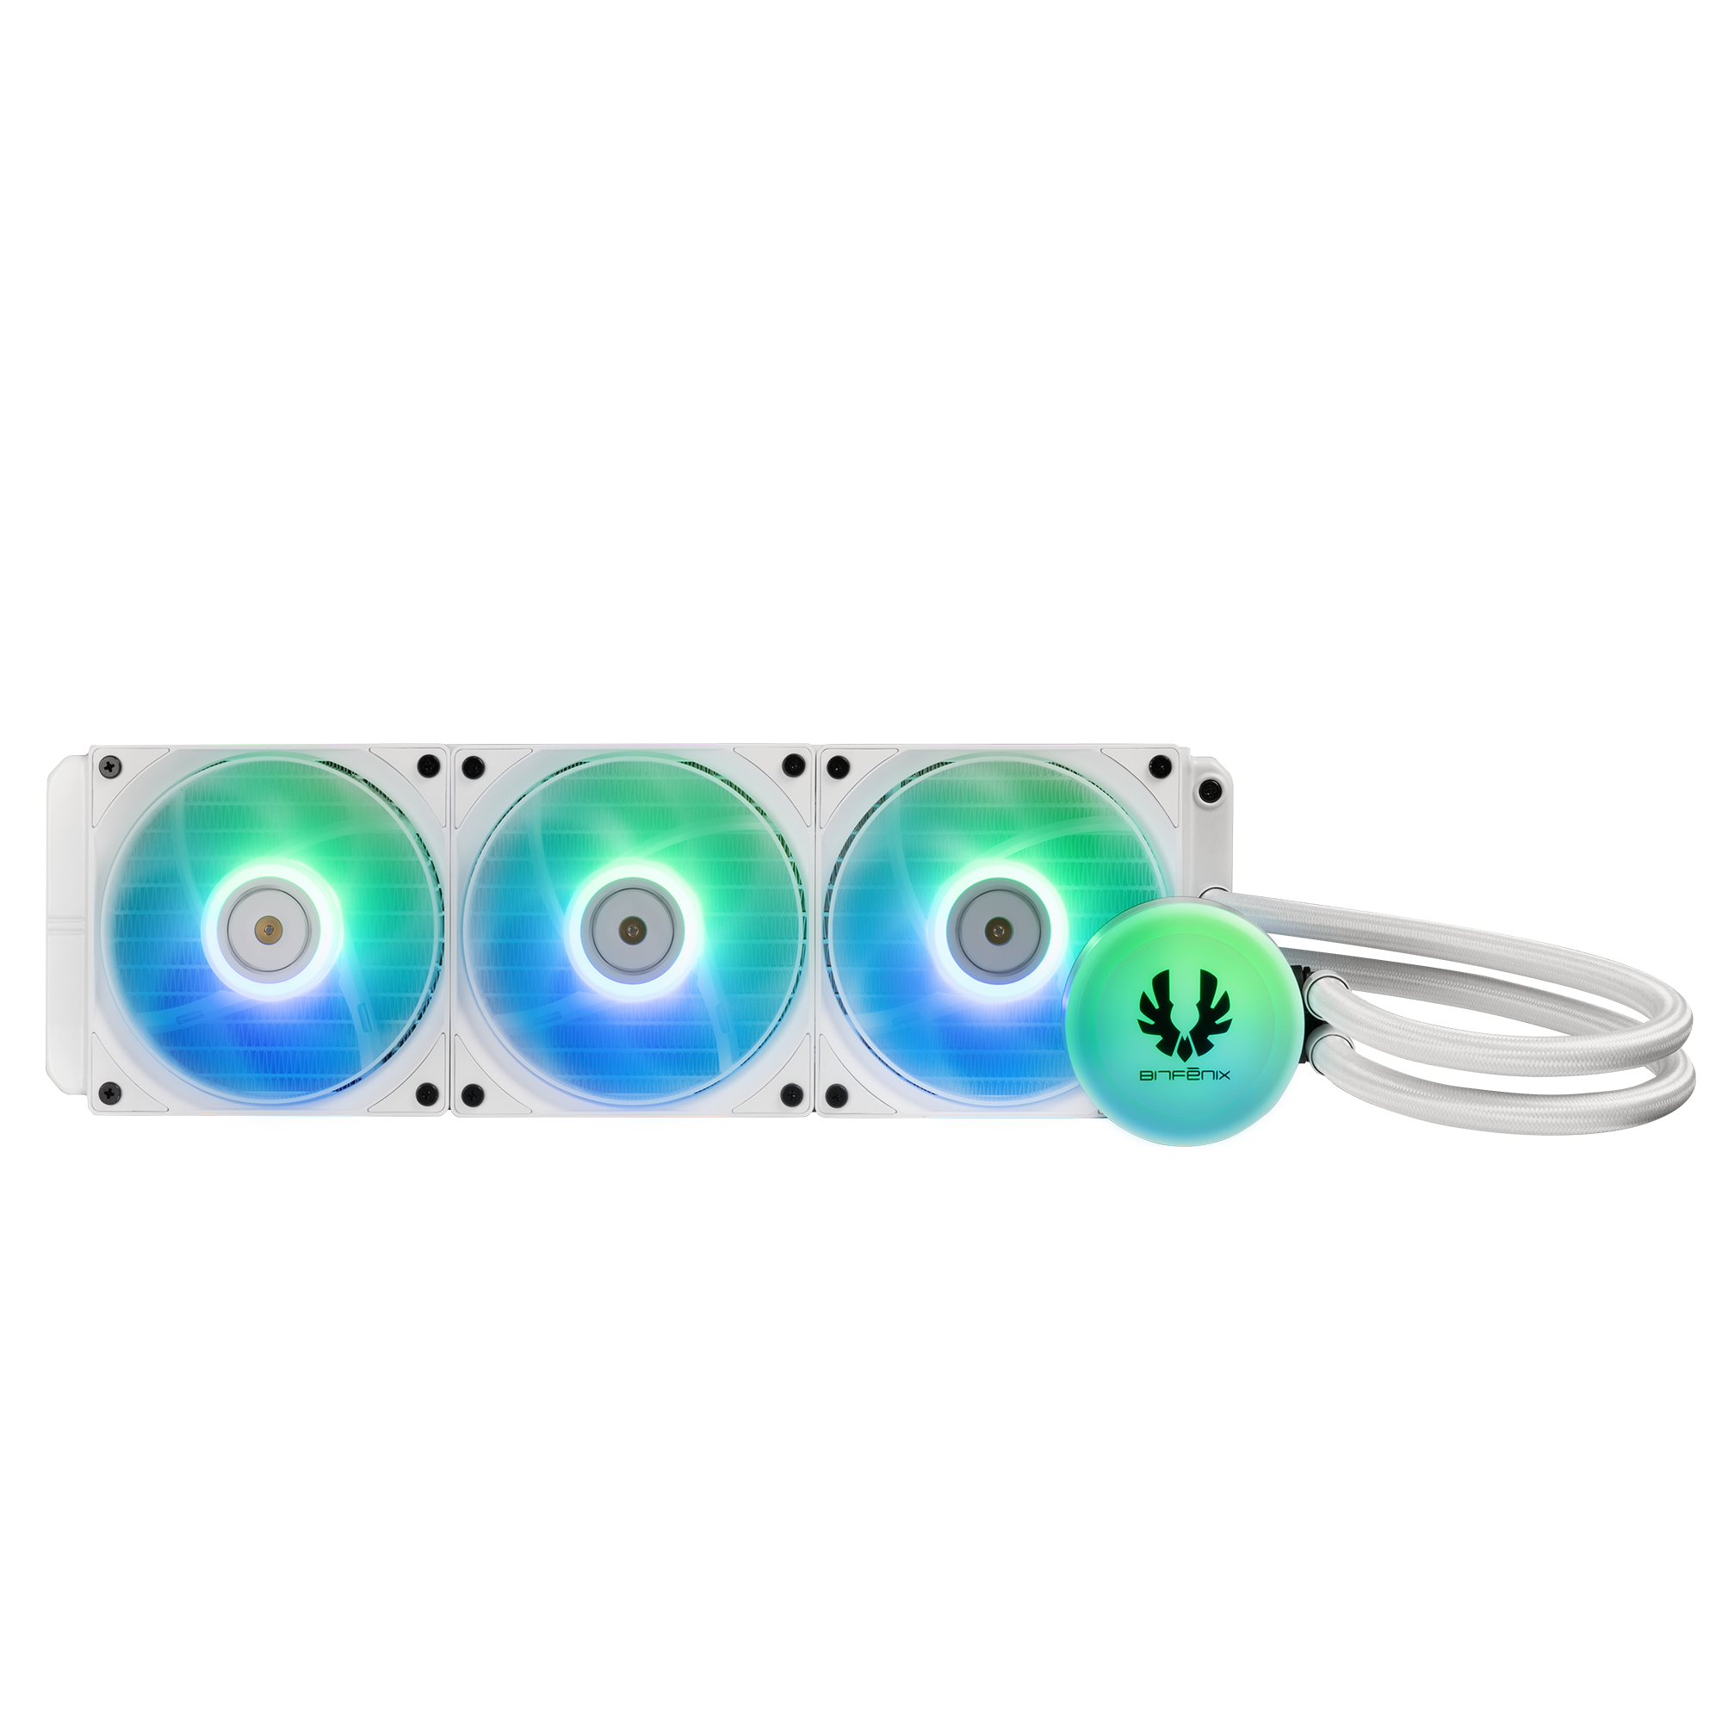
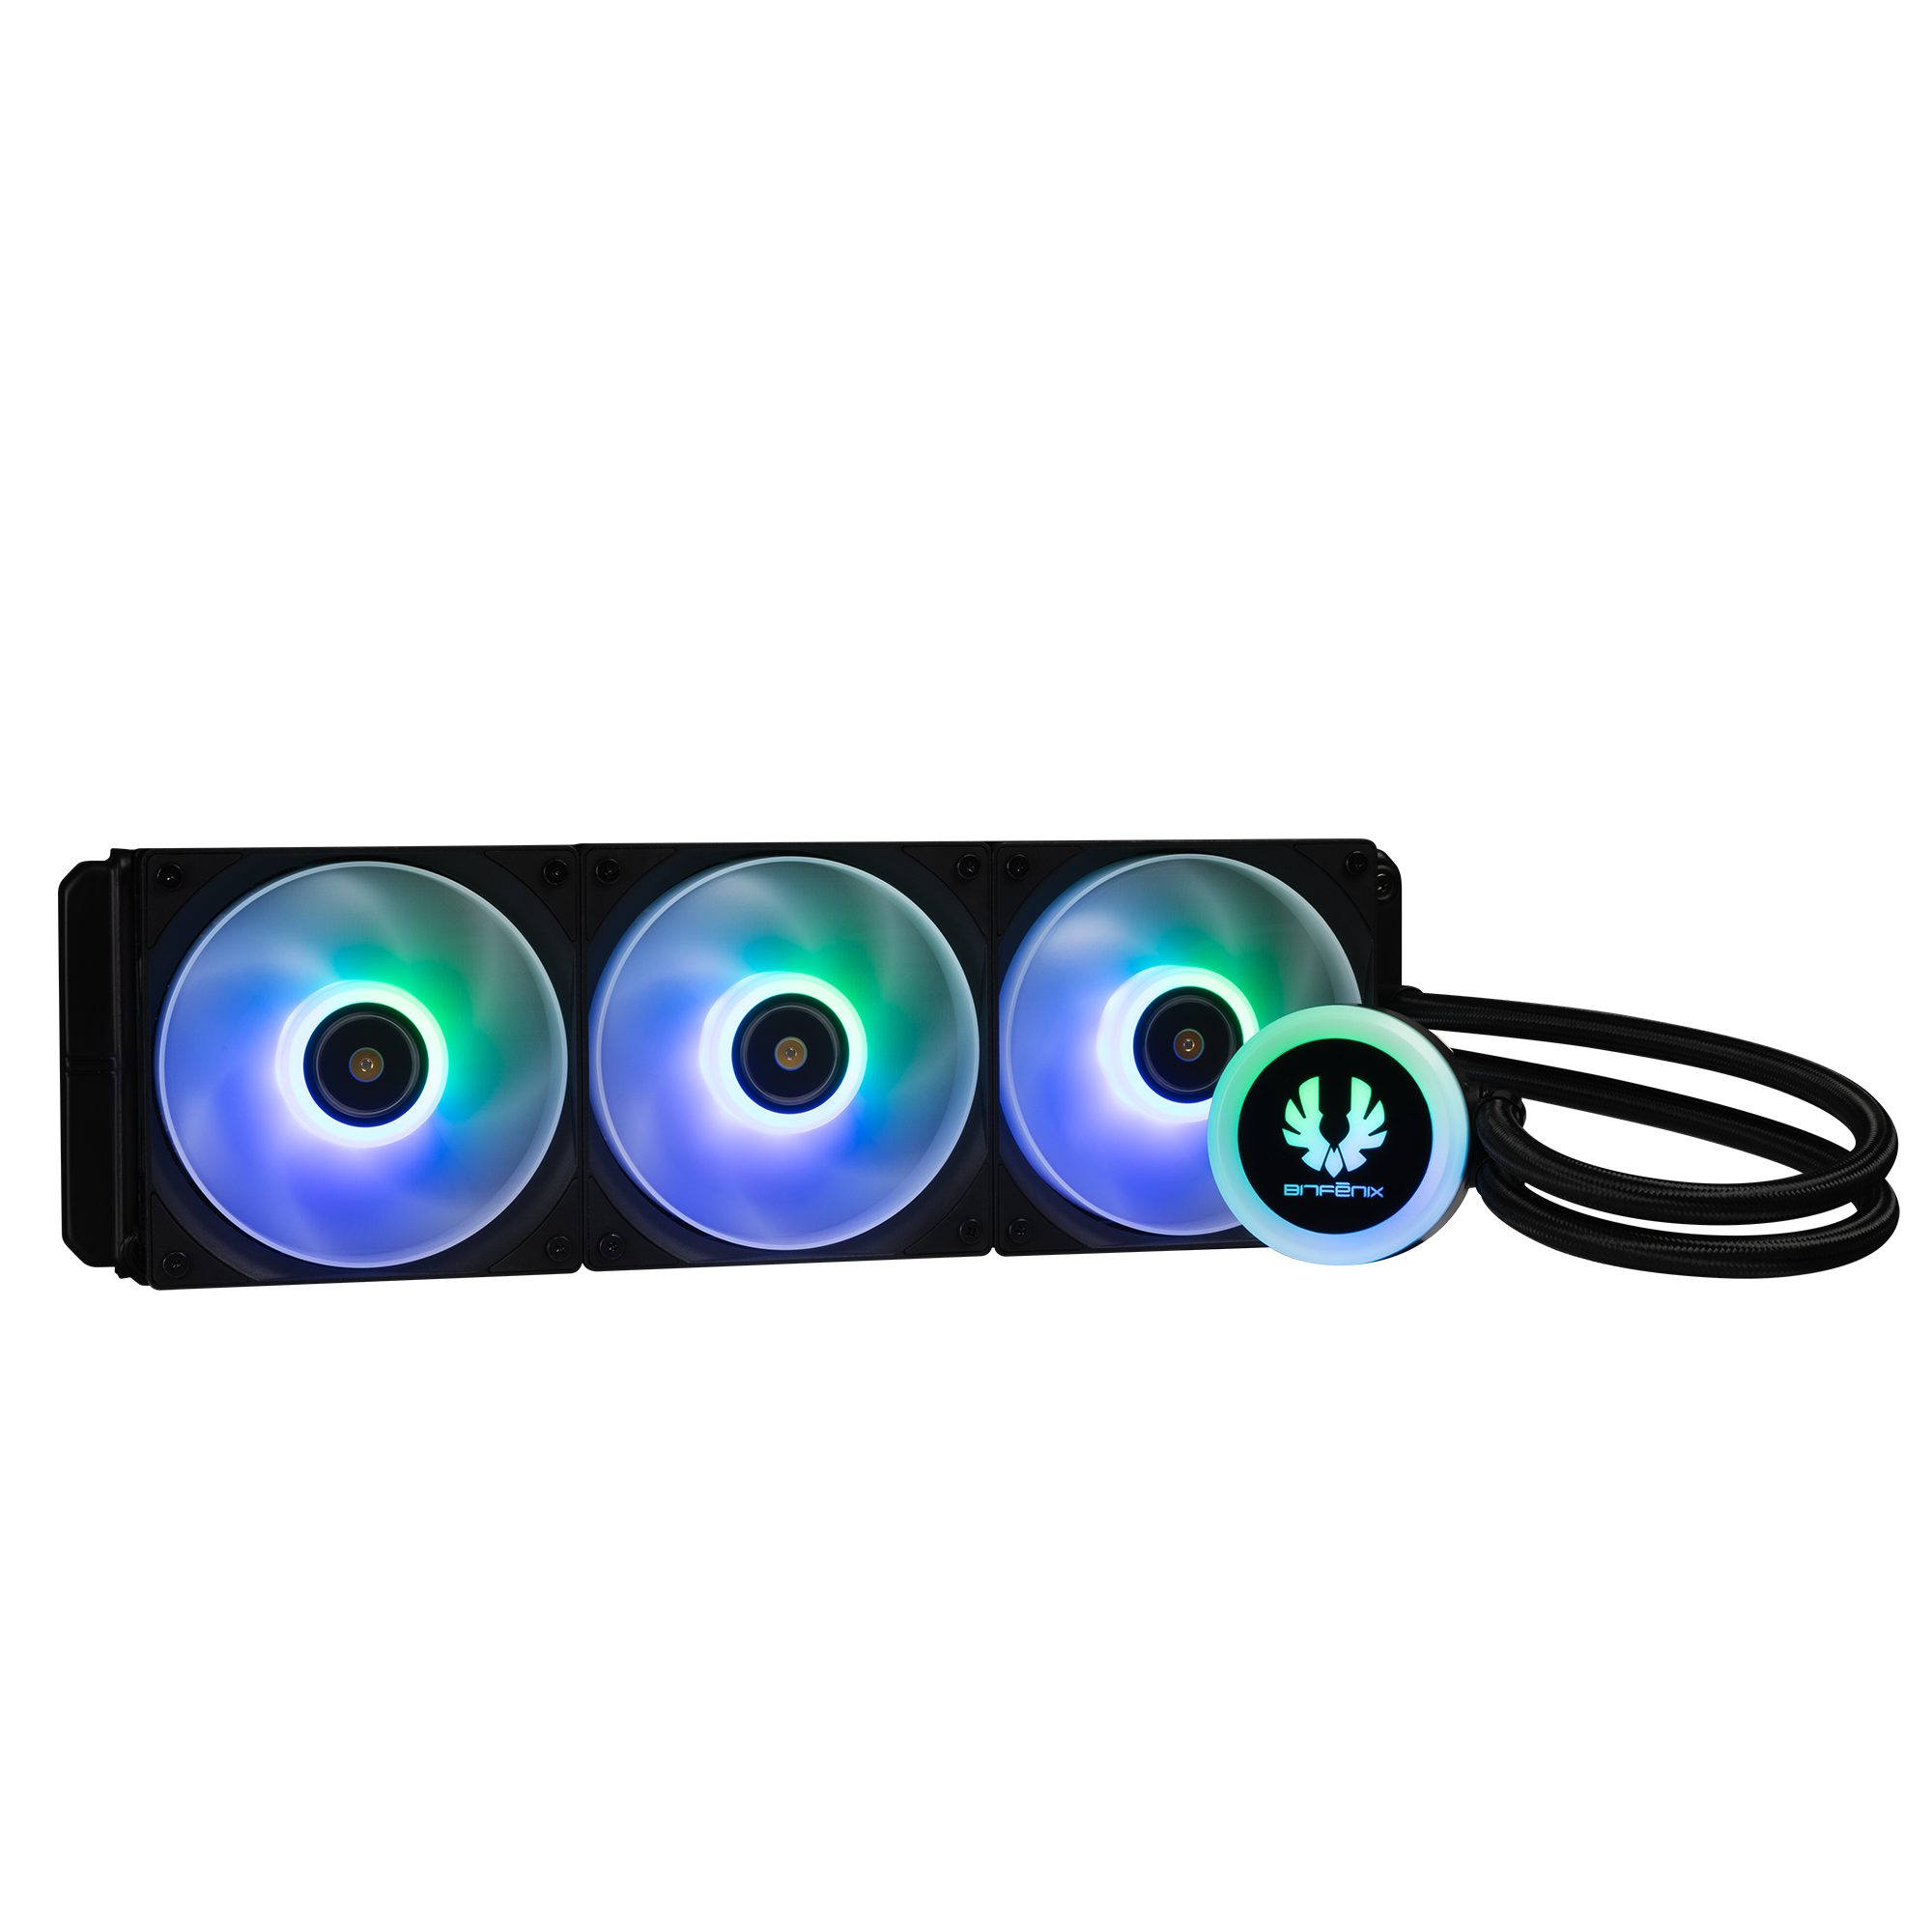
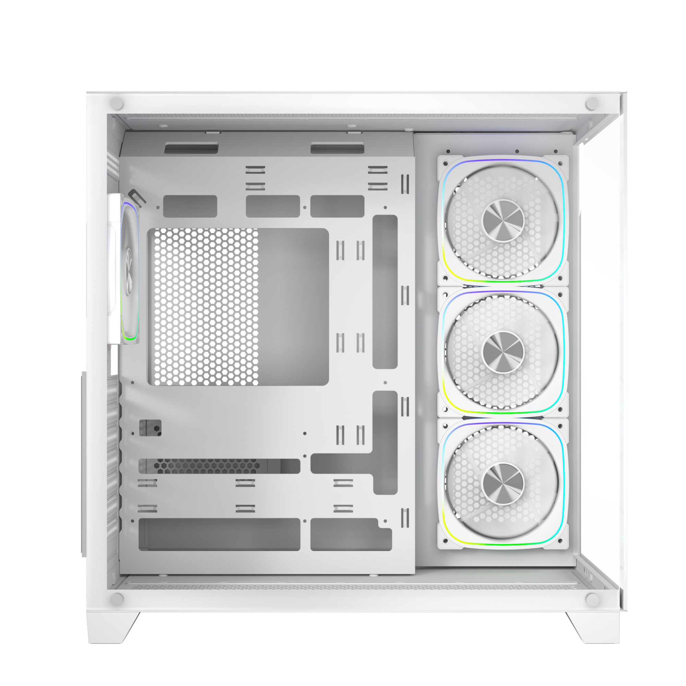
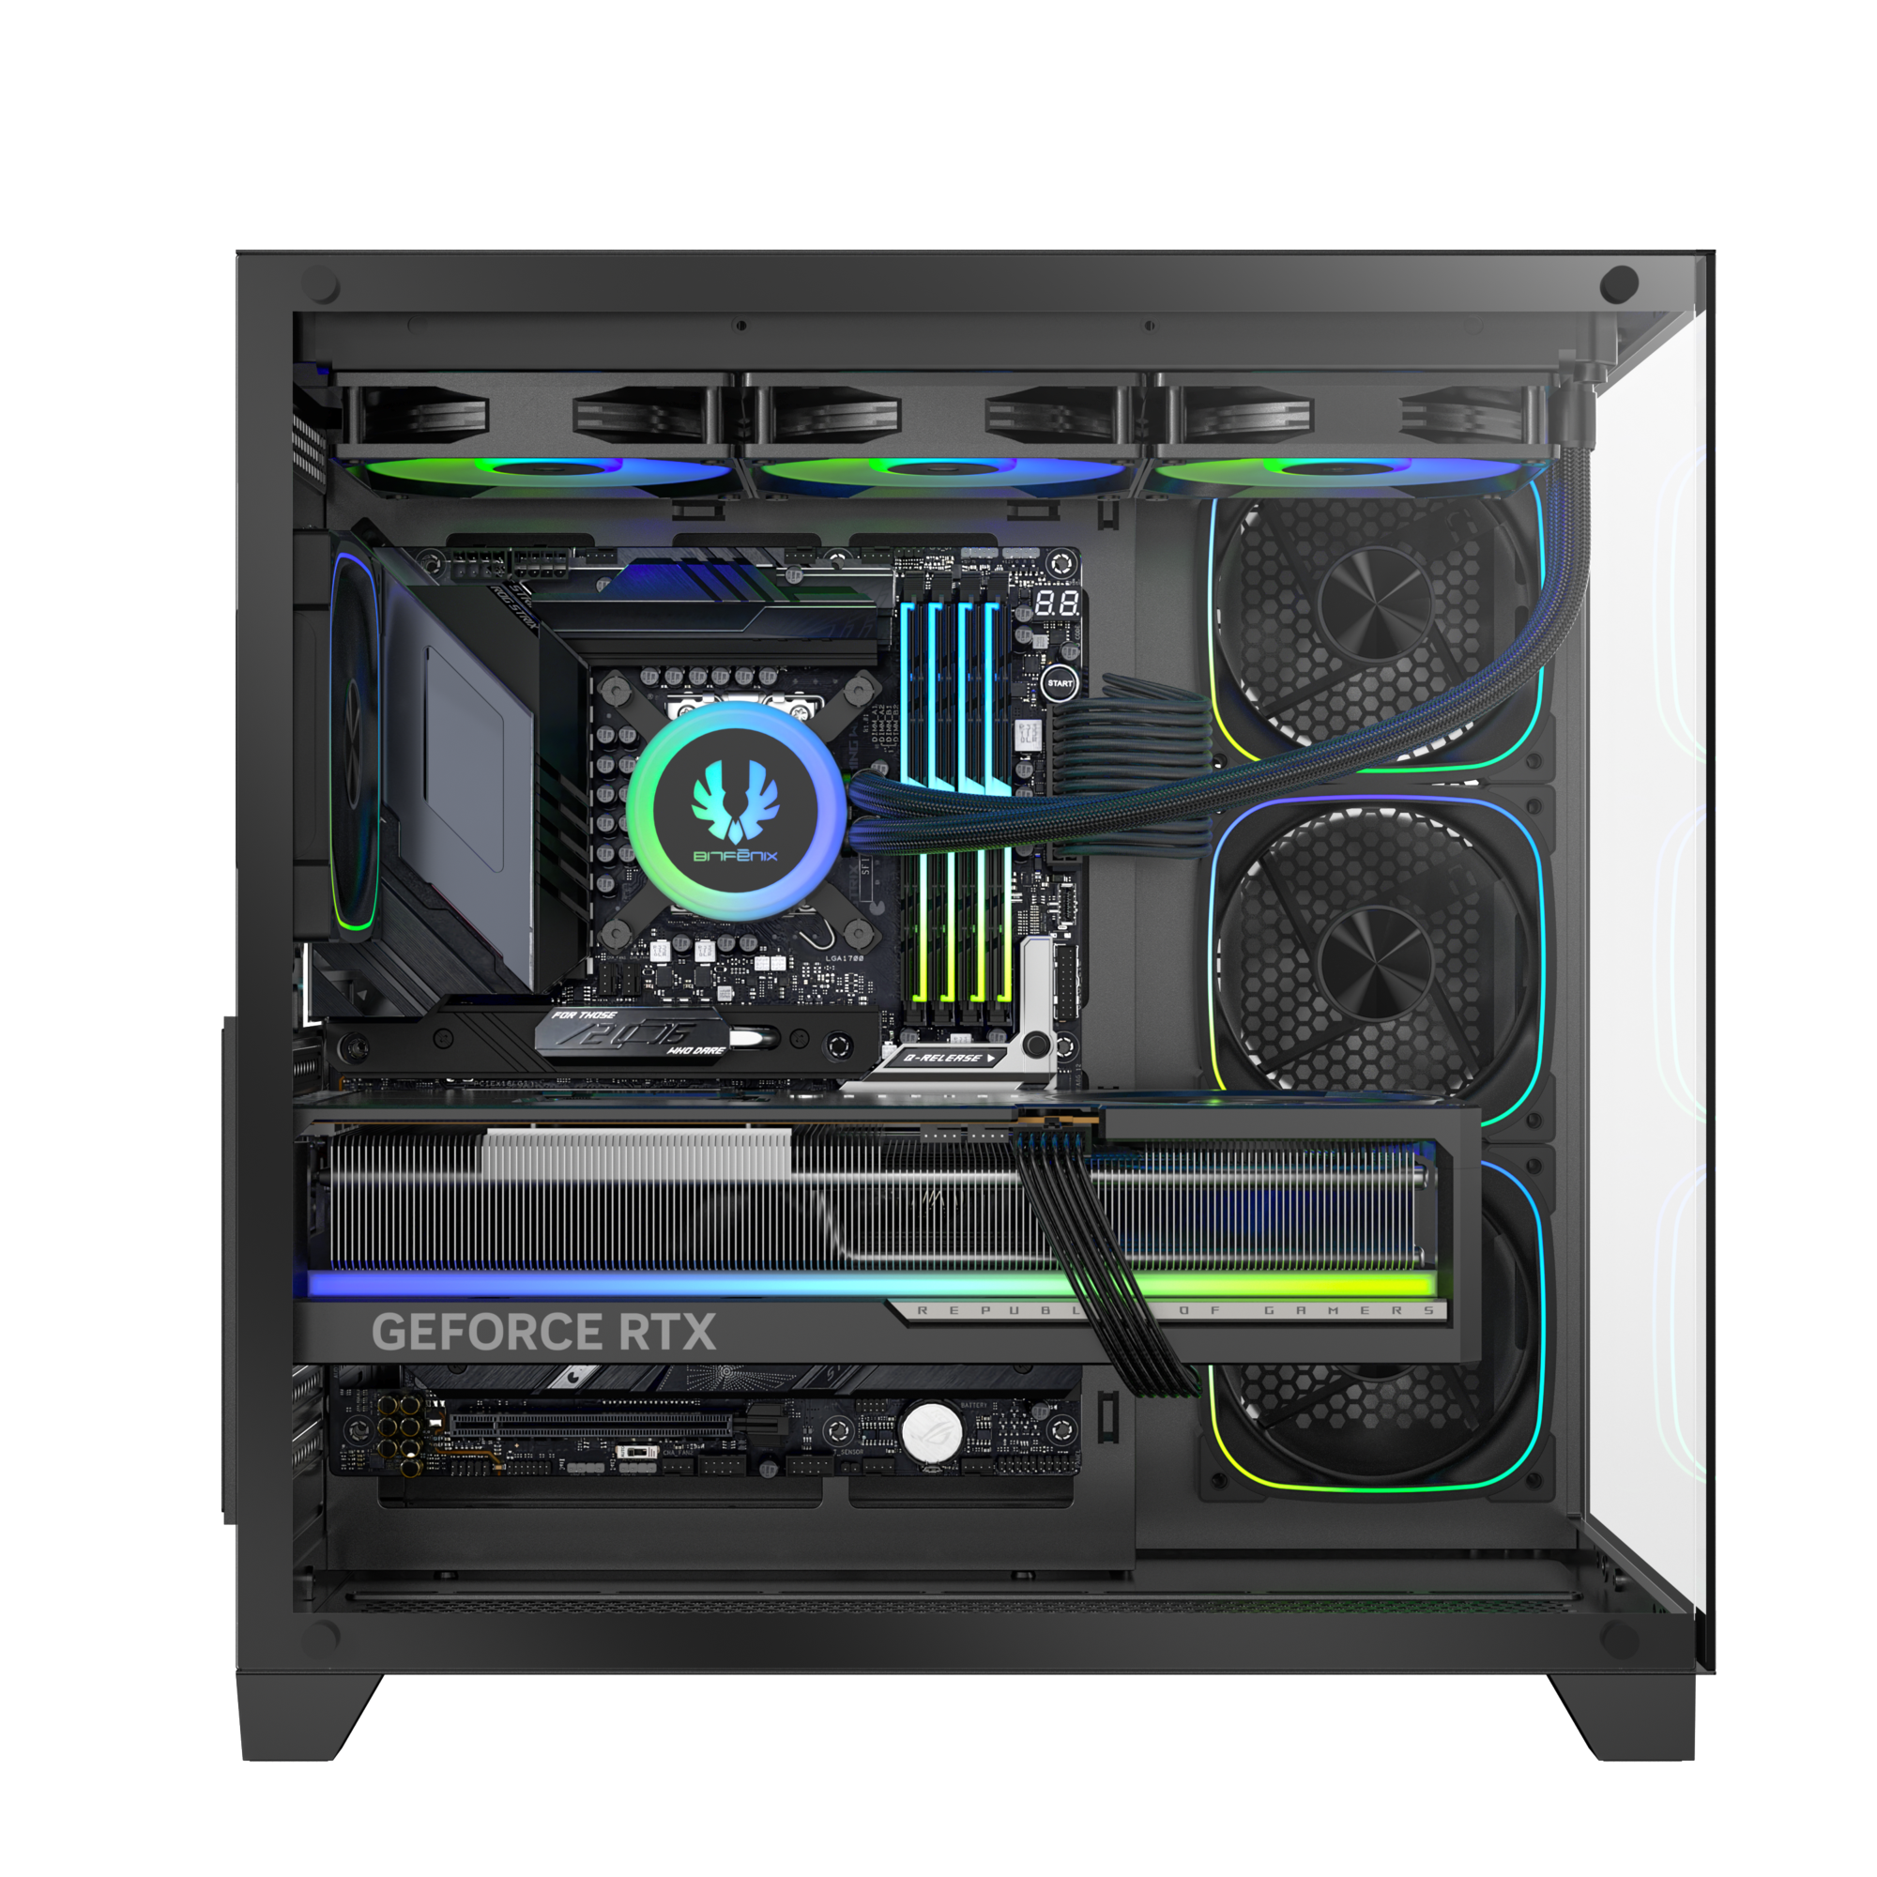
360mm AIO Support At Top
120mm
MB
120mm
120mm
120mm

Slide 3
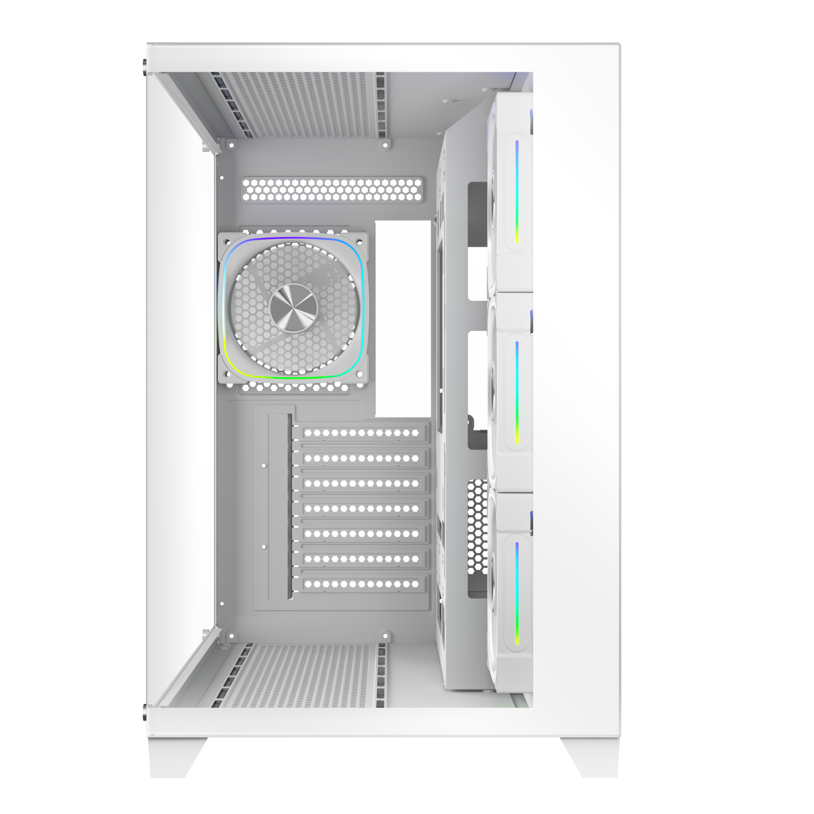
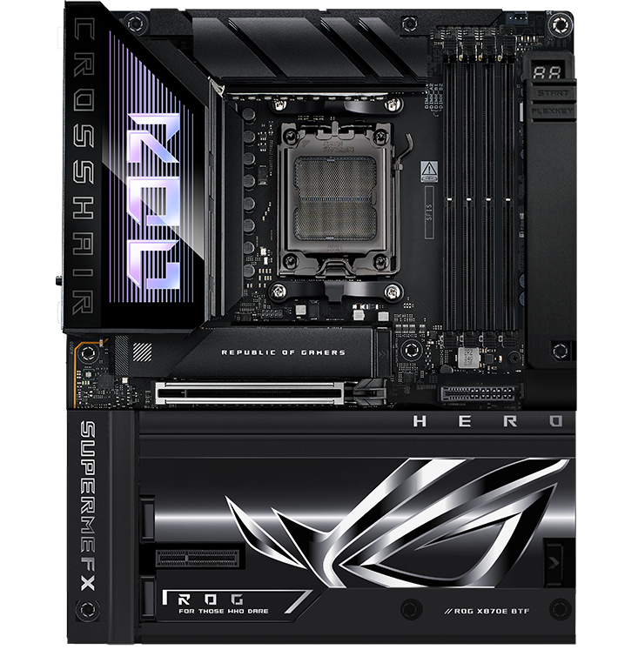
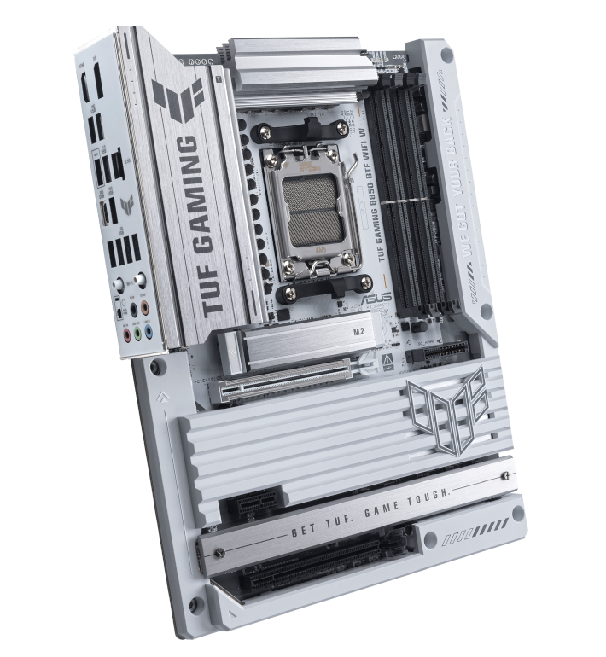
Supports BTF Back-Connect Motherboard
280mm
425mm
Maximun CPU
Cooler Height
Motherboard
Support
160mm
ITX
M-ATX
ATX
435mm
Cable Management Space 97mm
Maximun Graphics Card
Support
410mm
Back-Connect Motherboard

Slide 4
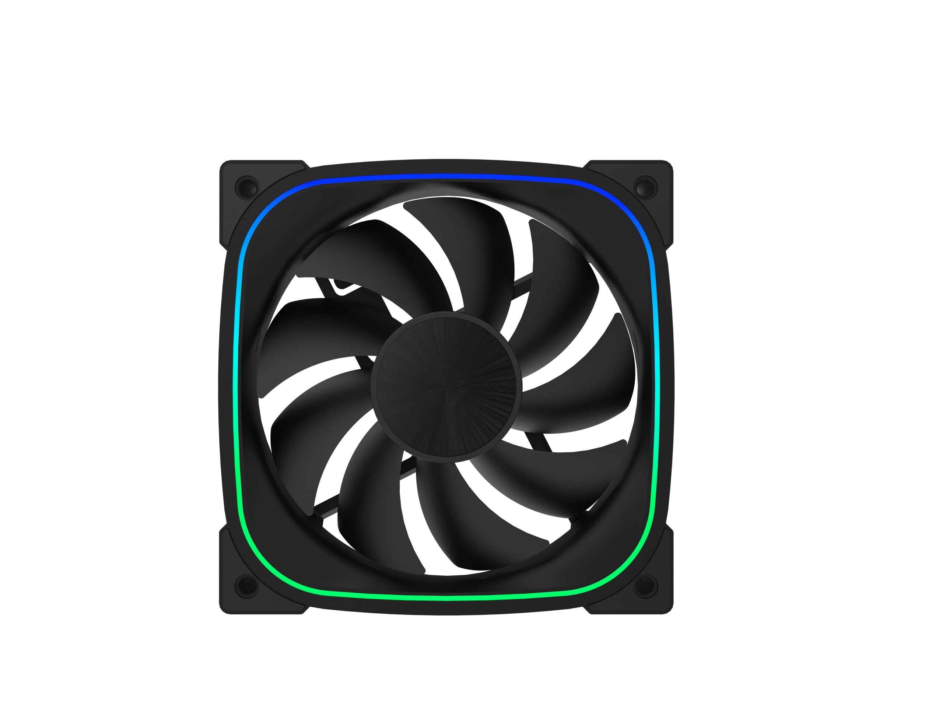
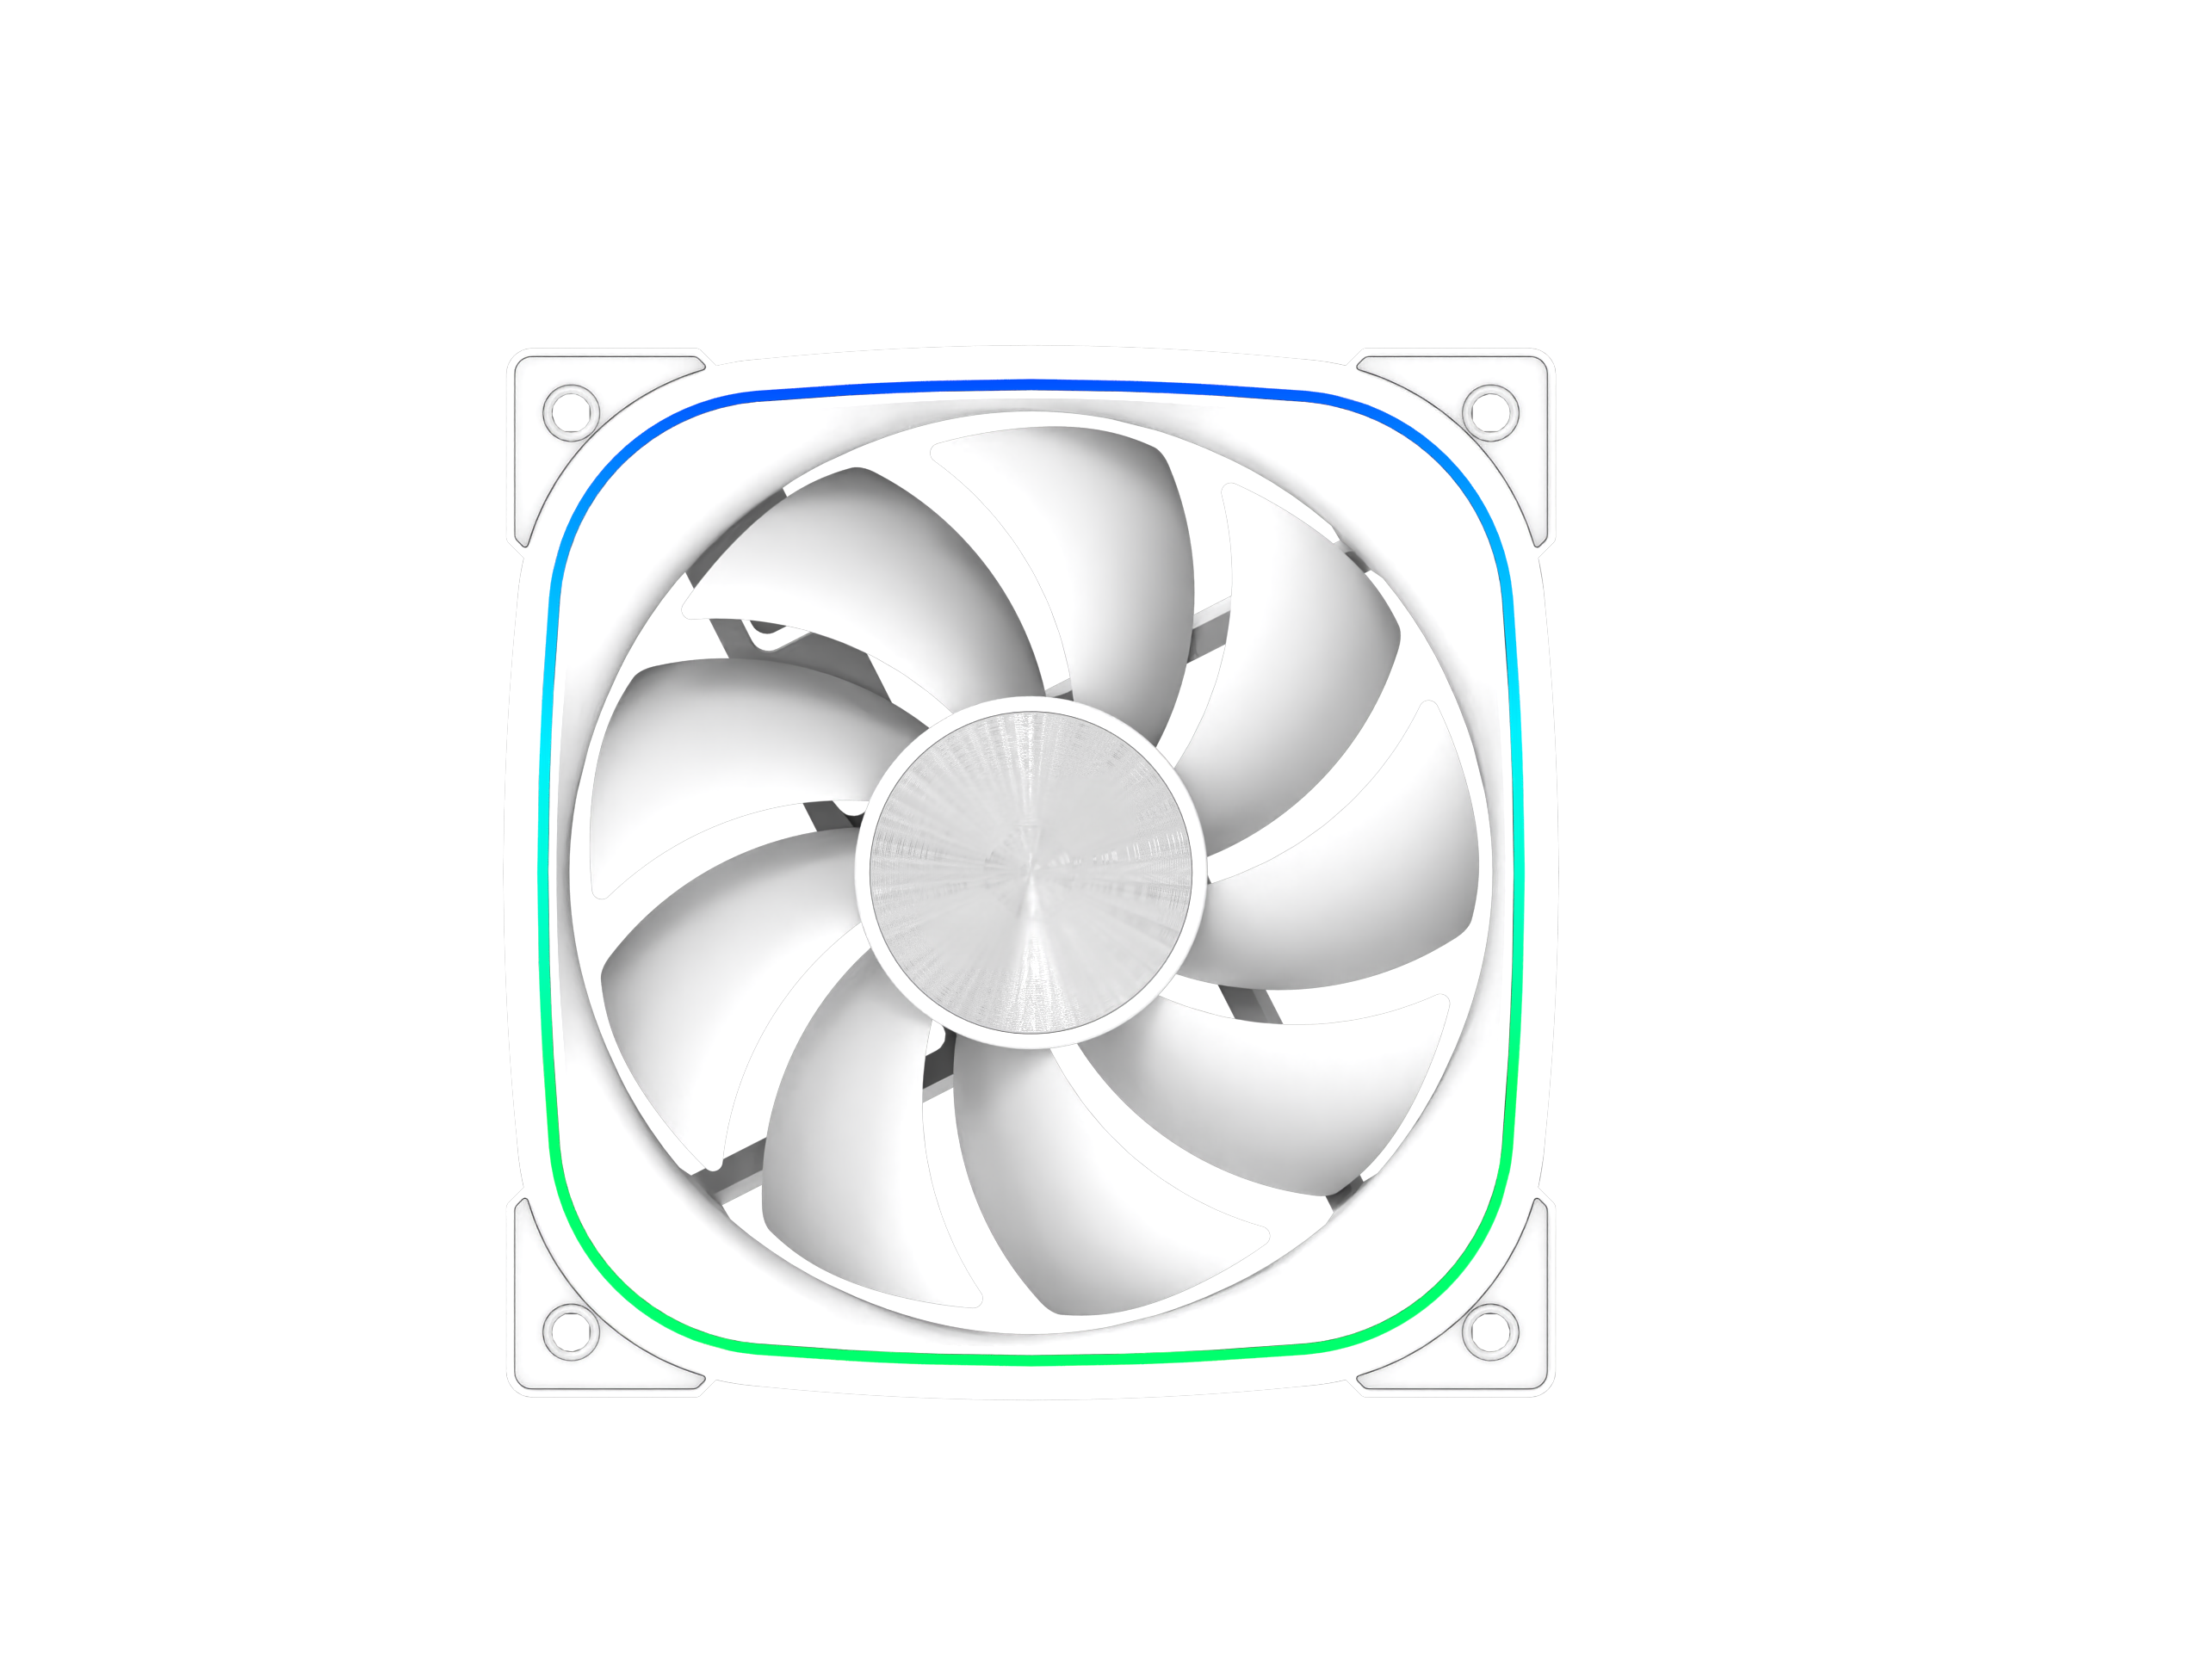
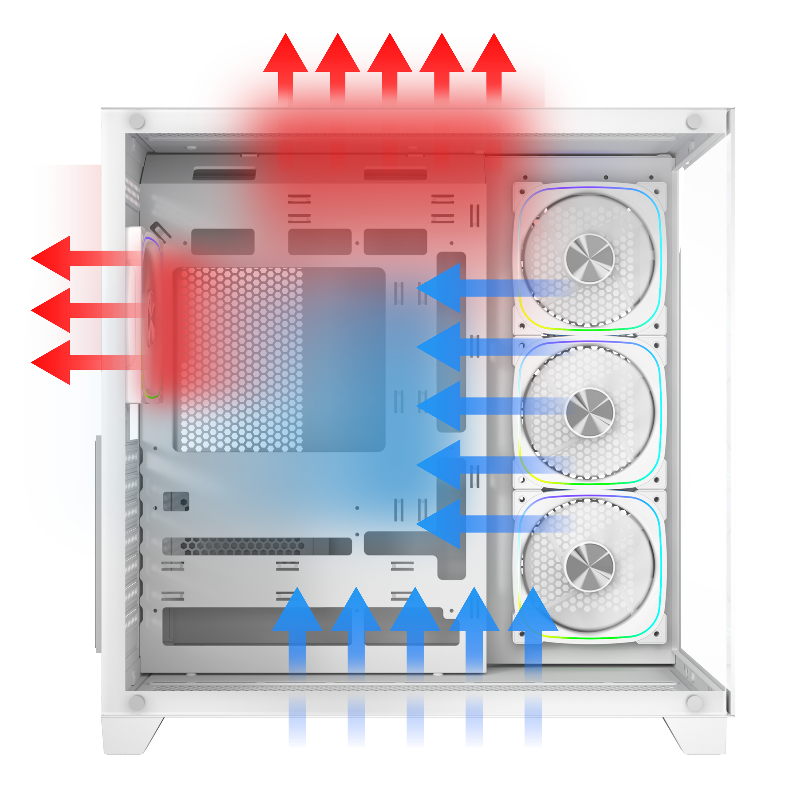
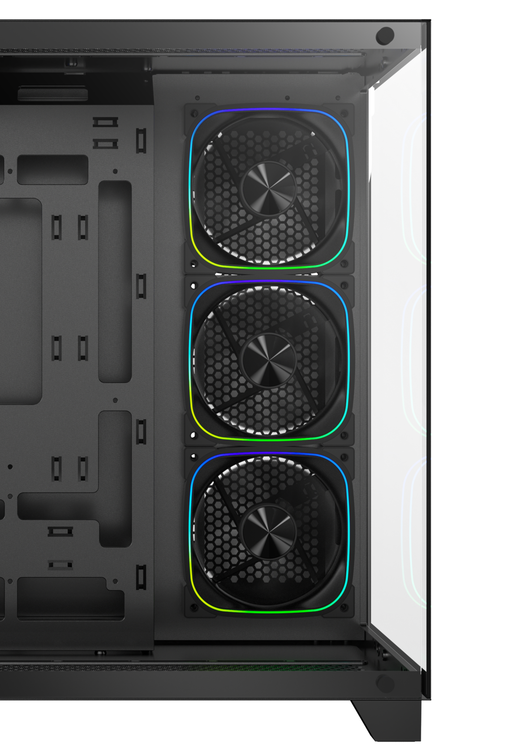

Reverse Infinity
Mirrors ARGB fans
3X
DUAL CHAMBER
HIGH
AIRFLOW PERFORMANCE

Slide 5
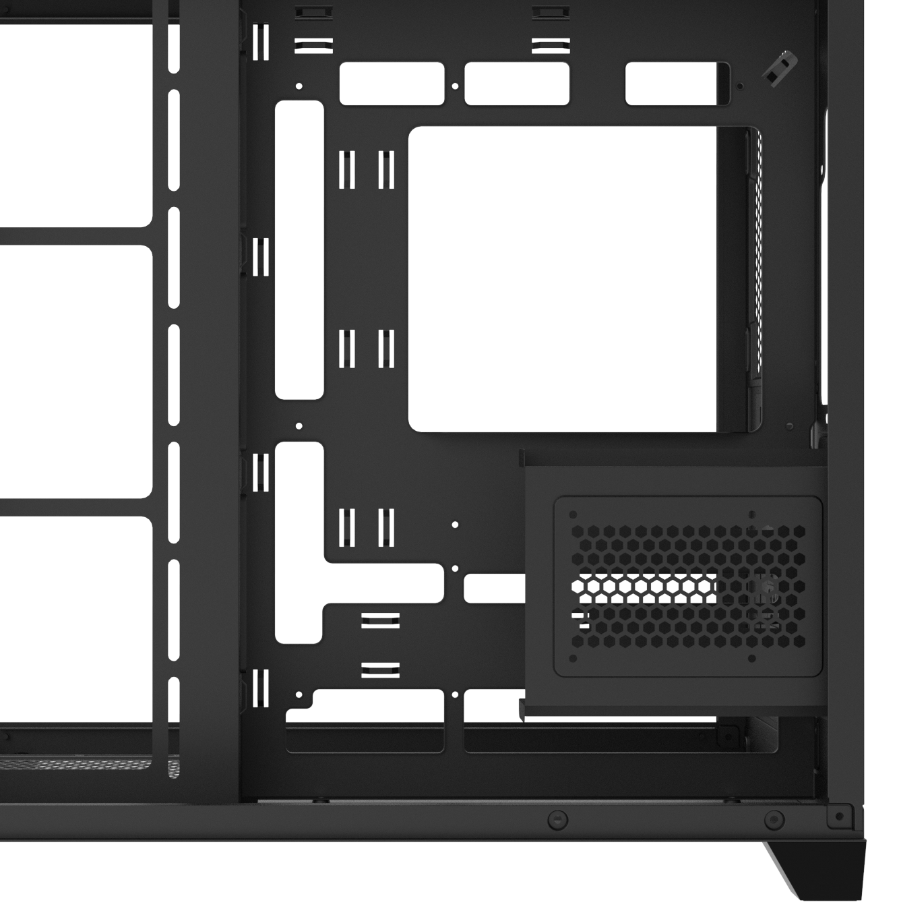
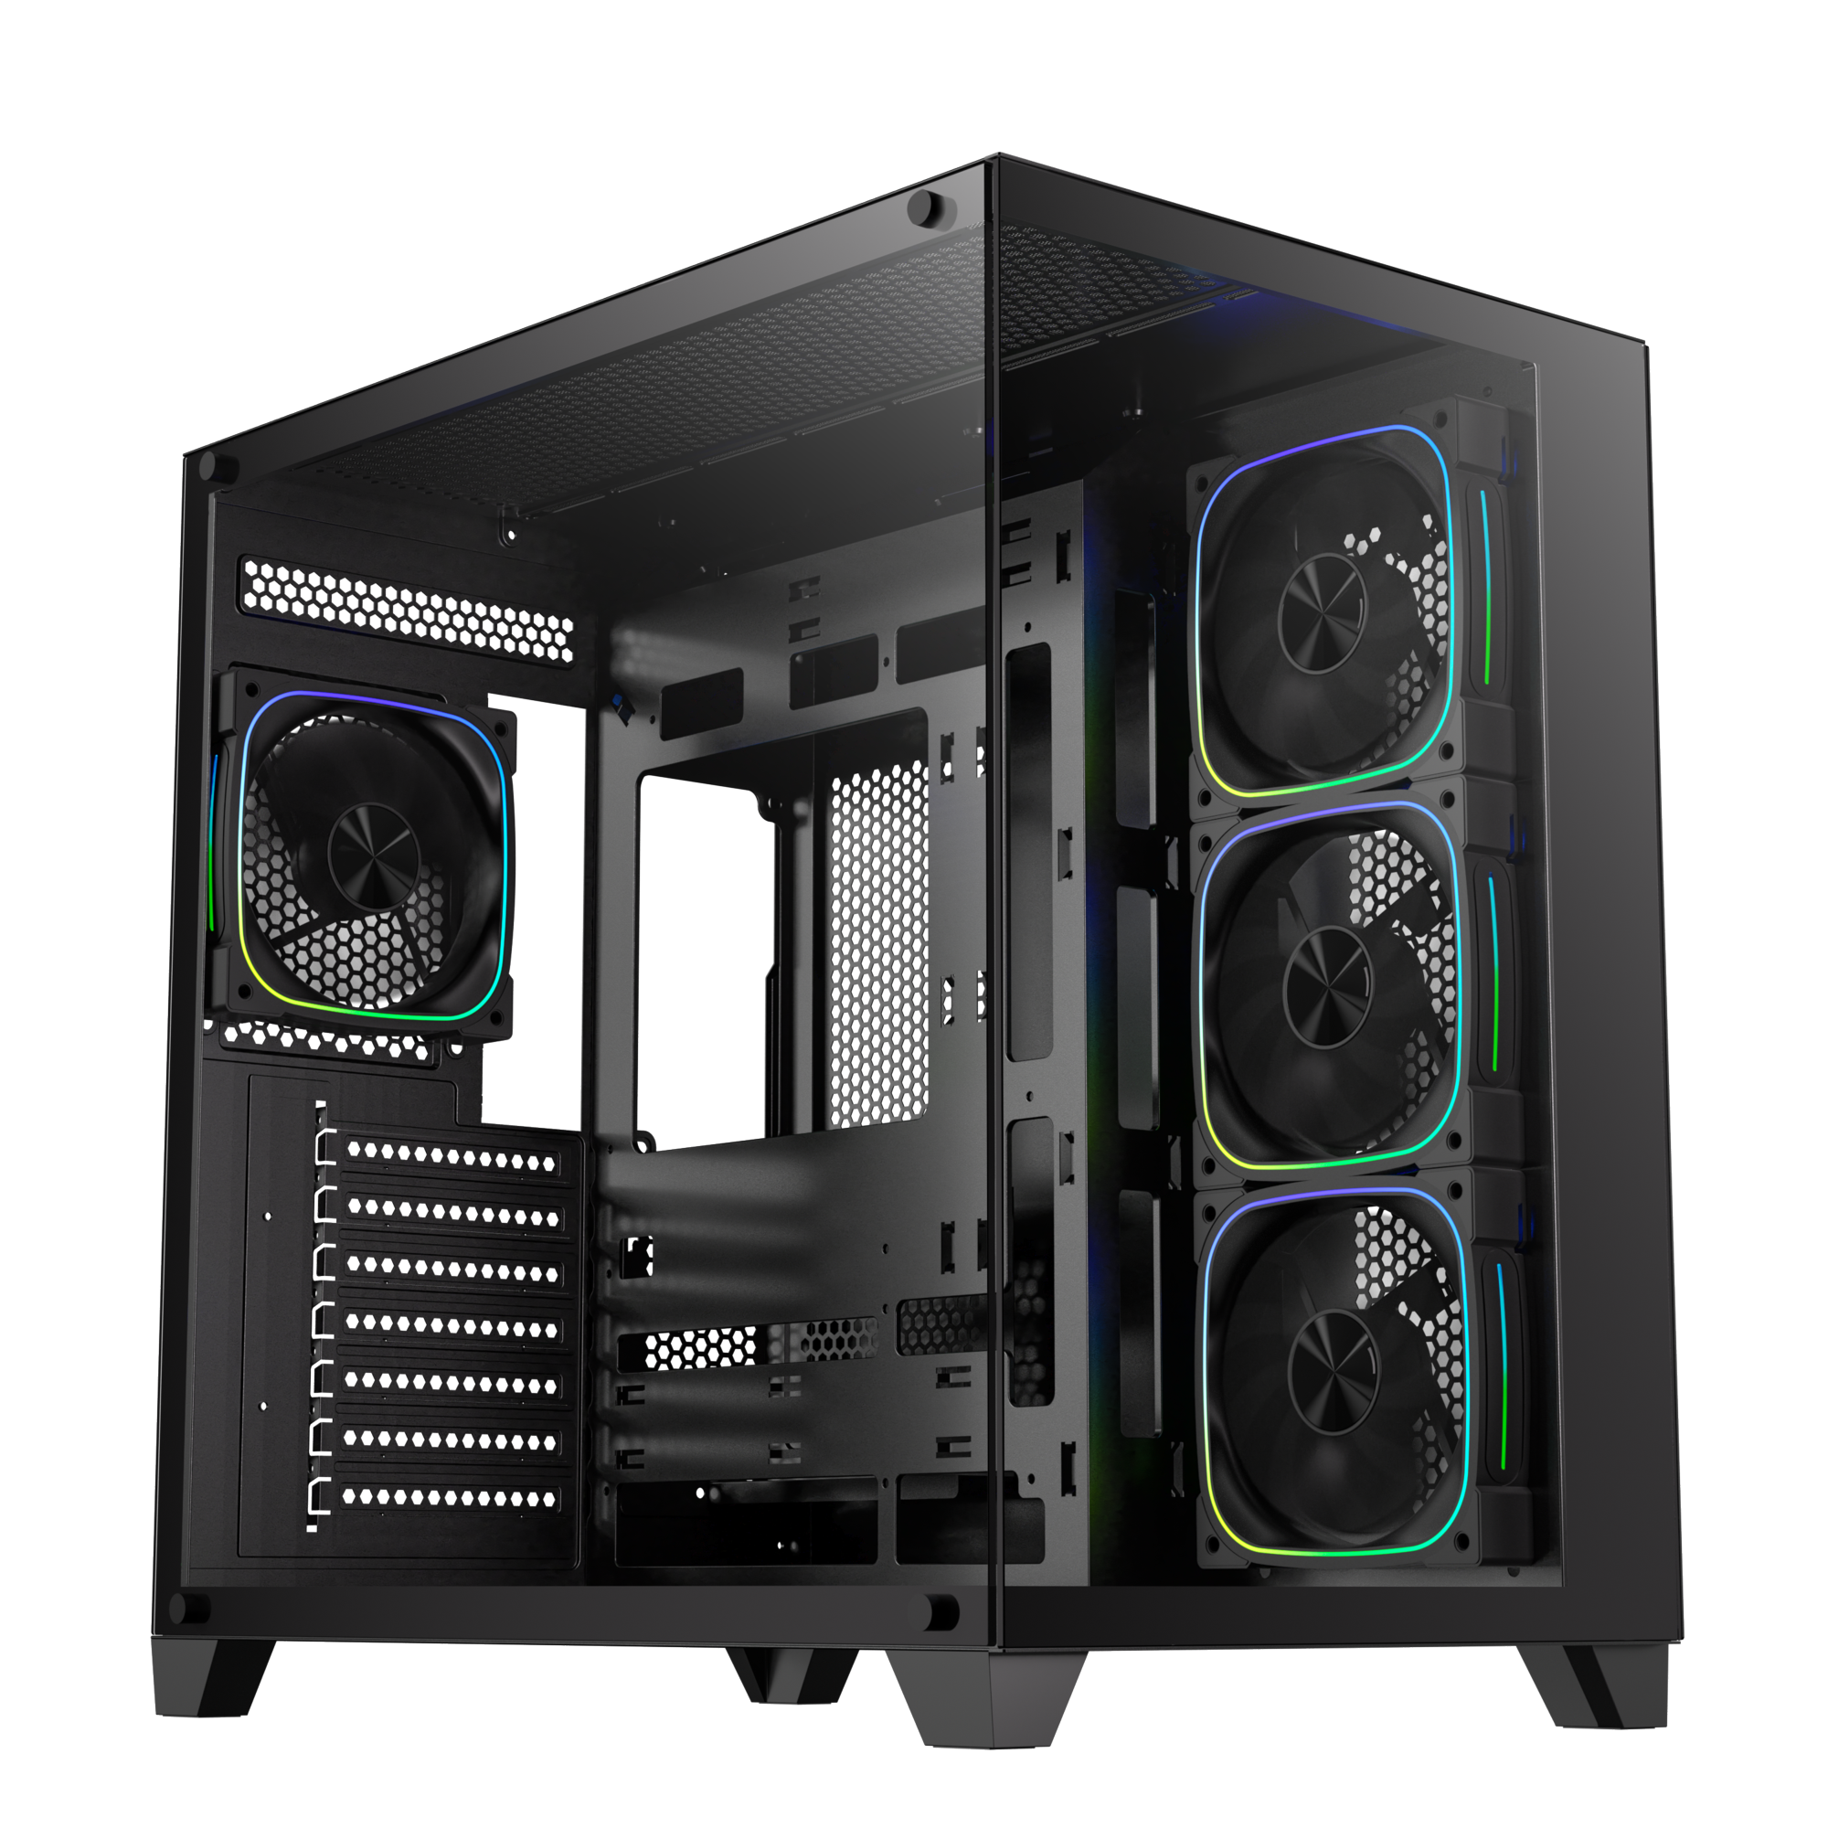
Power Supply
ATX & Standard /
up to 200mm
PSU
1X SSD & 1X HDD
1 X 3.5’’ Drive & 1 X 2.5’’Drive

Slide 6
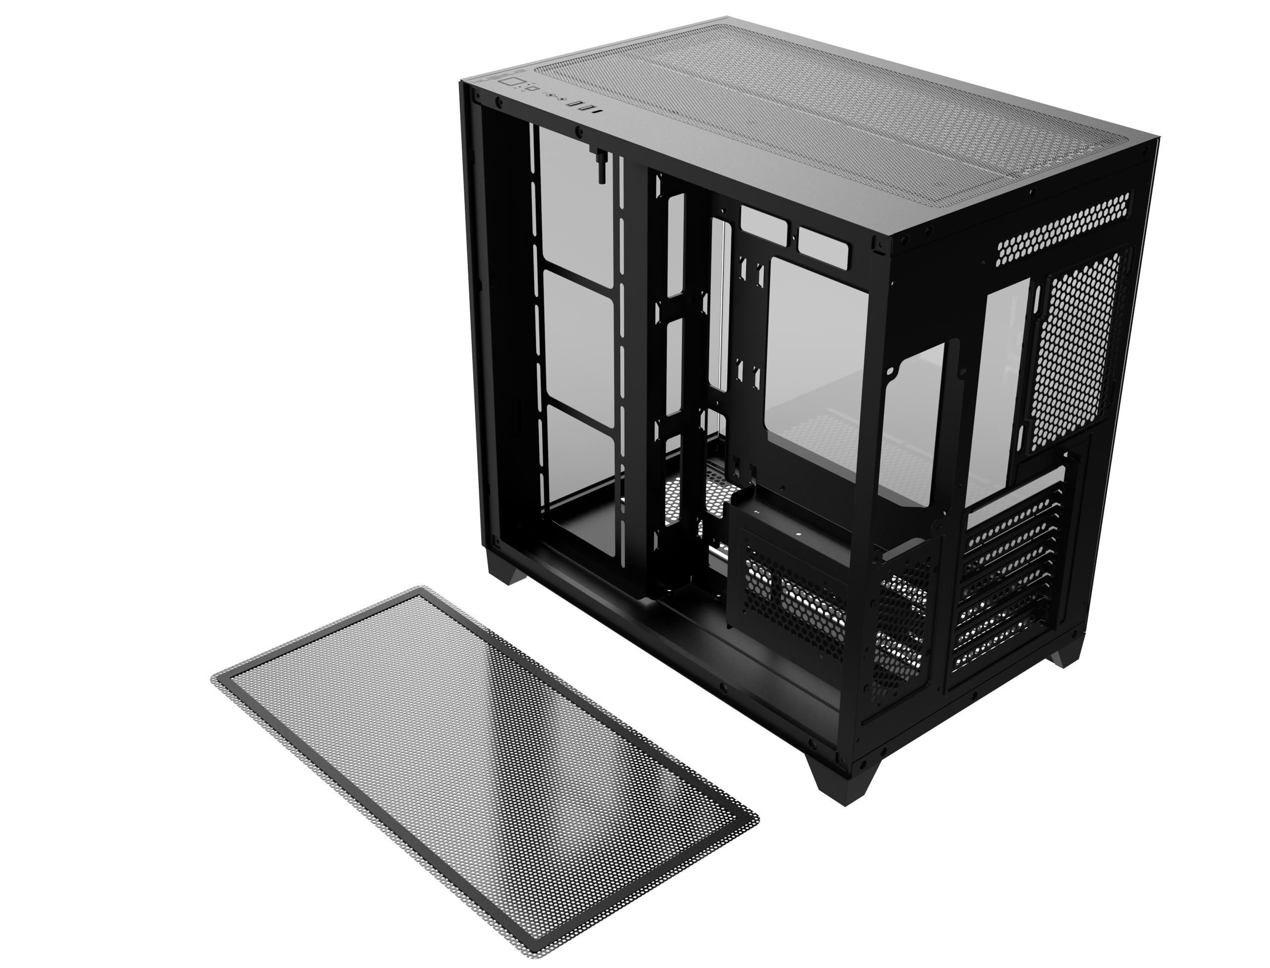
Top
Bottom
Easy Clean With Removable Dust Filters

Slide 7
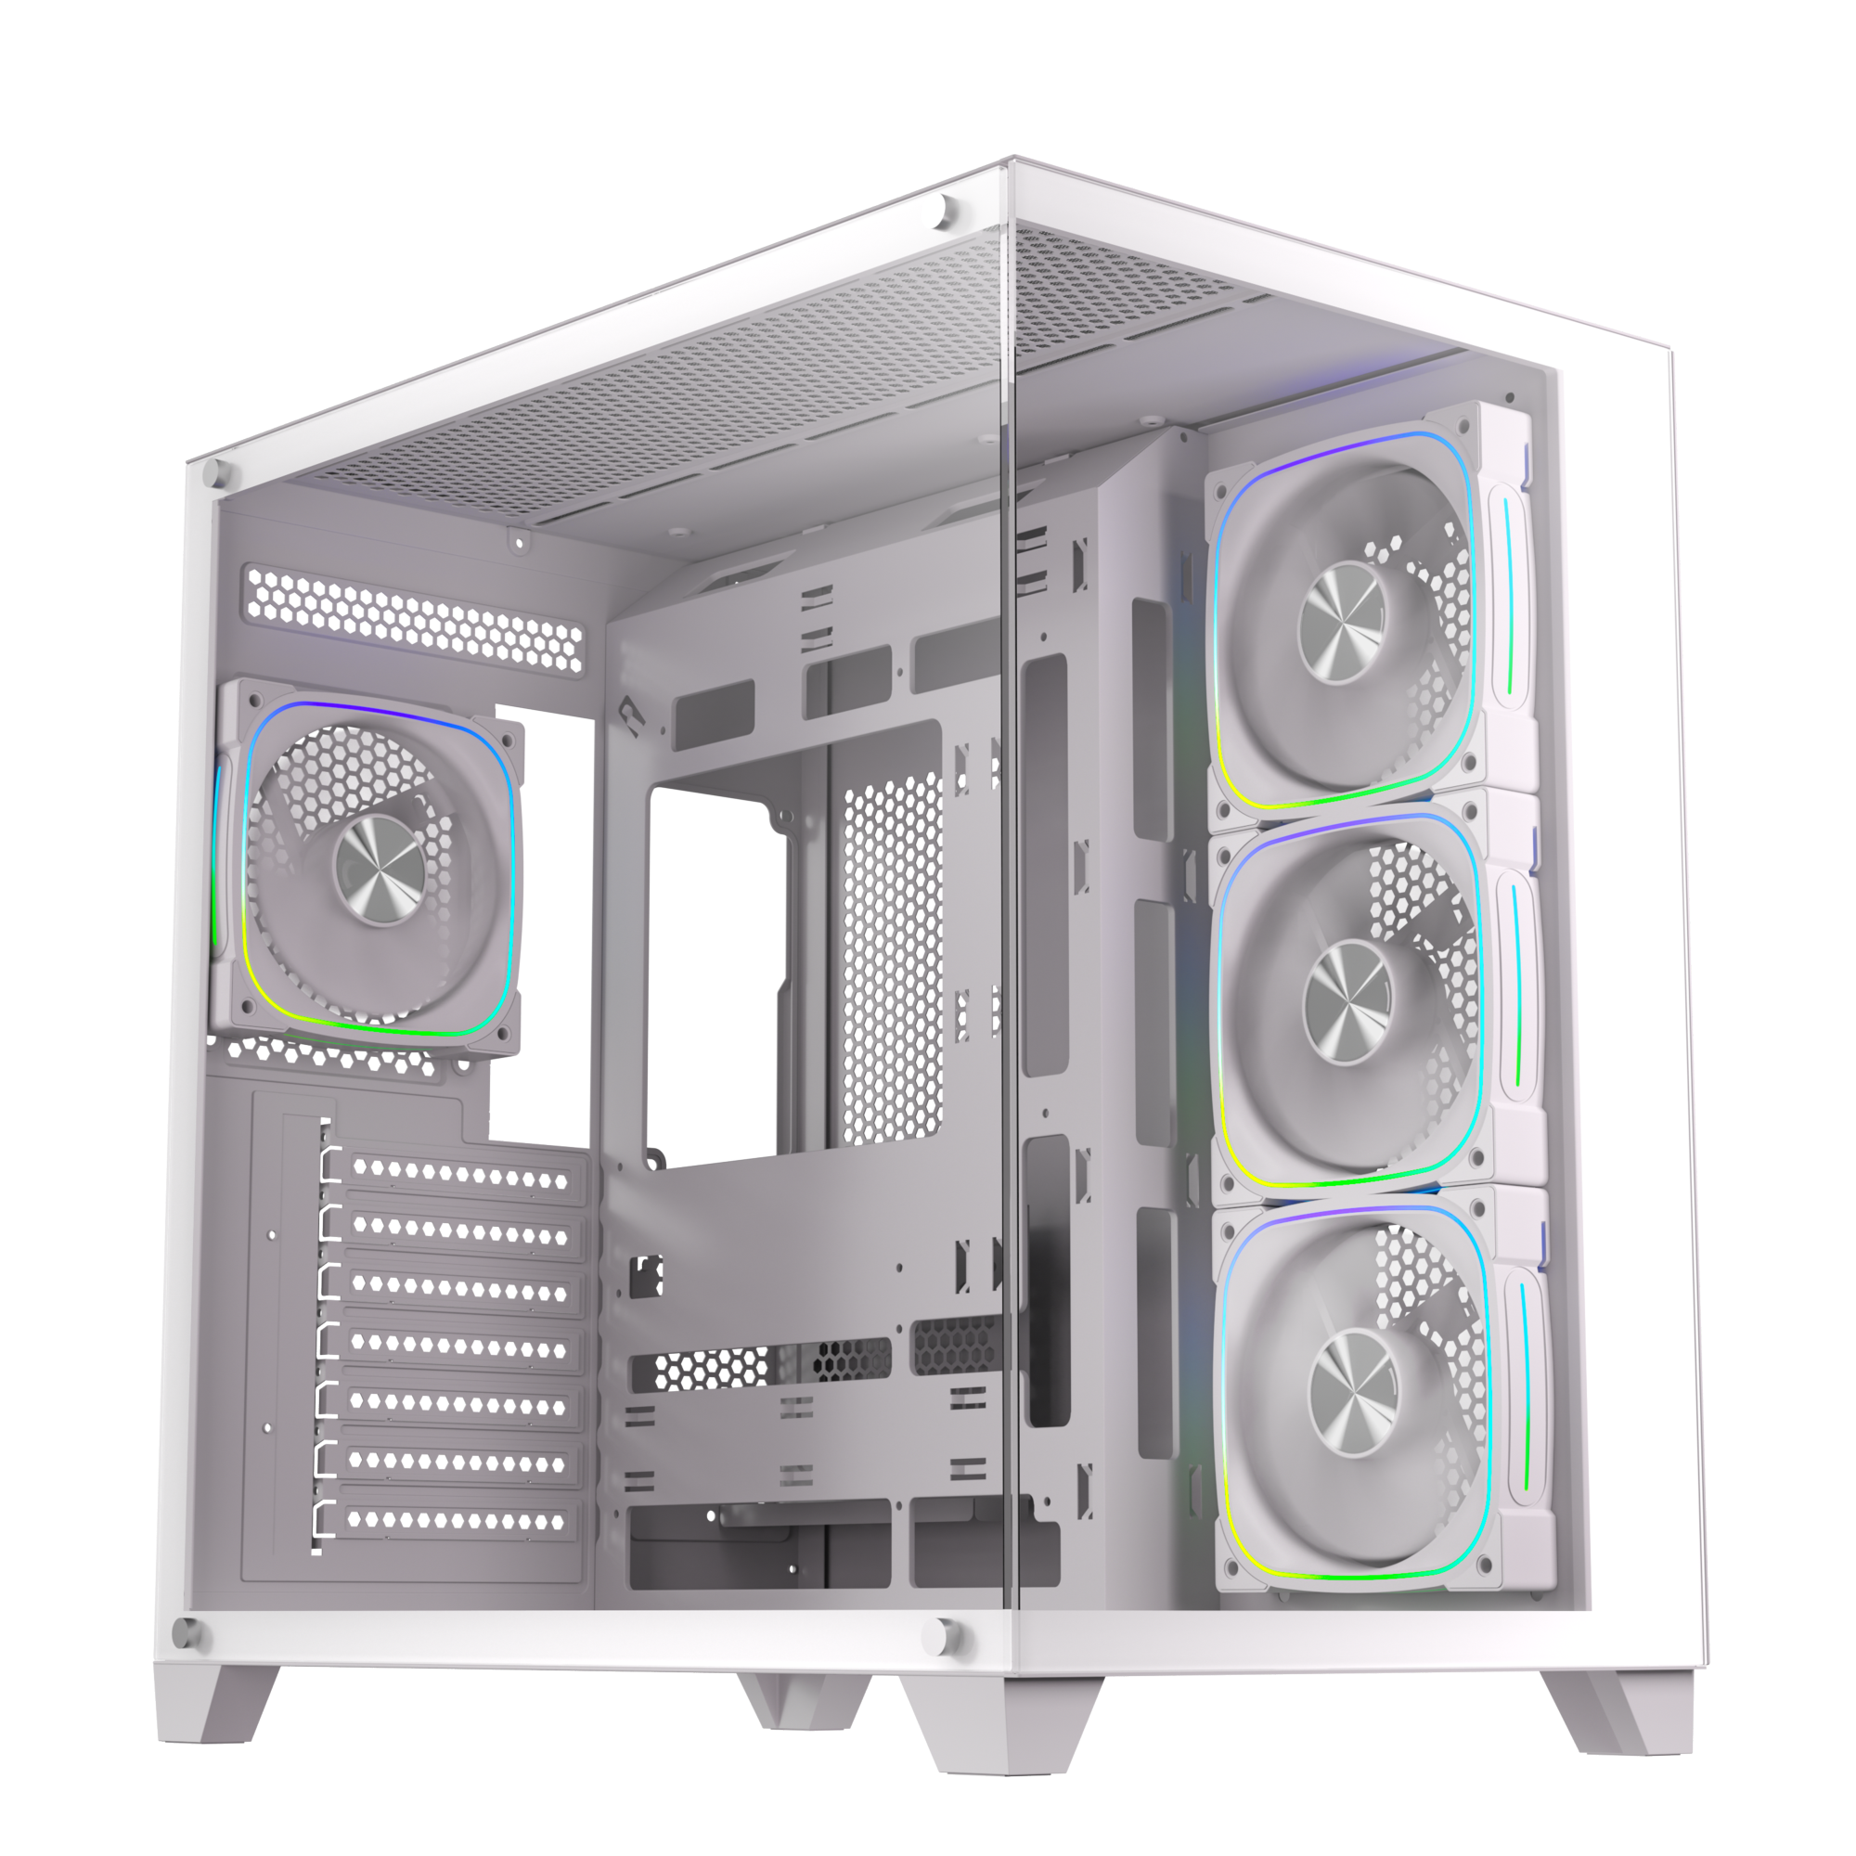
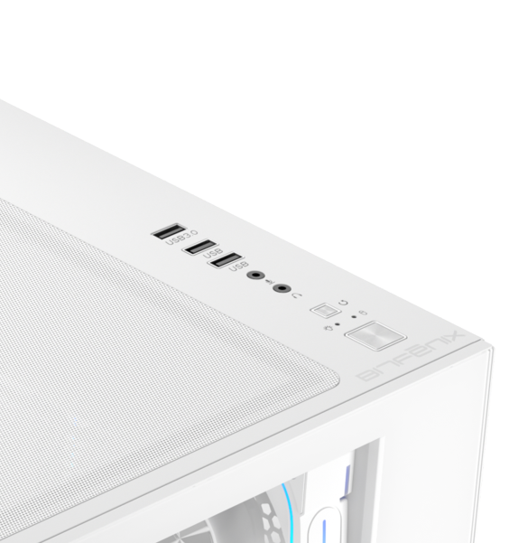
1X USB3.0 & 2X USB
1X USB 3.0
2X USB
Reset Button
Power Button
Tool-free Removal

Slide 8
T10 Digital ES 10.24 |  | Black | White
Part no. |  | BFC-COL-700-KKGXK-4A | BFC-COL-700-WWGXW-4A
EAN |  | 4712883211188 | 4712883211195
UPC
Net weight (NW) Gross weight (GW) |  | N.W: Kgs / G.W: Kgs | N.W: Kgs / G.W: Kgs
Materials |  | Steel, Mesh, Plastic, Tempered Glass
Chassis Dimensions (W x H x D) |  | 280 mm x 435 mm x 425
Motherboard Supports |  | Mini-ITX, MicroATX, ATX
Air Cooler Height Support |  | 160mm
VGA Length Support |  | 410mm
Cable Management Support |  | up to 97mm
2.5" / 3.5" Drive Bay |  | 1+1
Fan mounts | MB | 3 x 120mm
 | Top | 3 x 120mm
 | Rear | 1 x 120mm
 | Bottom | 3 x 120mm
Radiator Support | MB | 1 x 360mm/ 1 x 280mm/ 1 x 240mm (Thickness up to 27mm)
 | Top | 1 x 360mm/ 1 x 280mm/ 1 x 240mm (Thickness up to 27mm)
 | Bottom/ Rear | 1 x 280mm/ 1 x 240mm (Thickness up to 27mm) /1 x 120mm
PCI-E Slots |  | 7 Slots
I/O Ports |  | 1 x USB 3.0/ 2 x USB/ Audio I/O
Power Supply |  | ATX & Standard / up to 200mm

