Slide 1
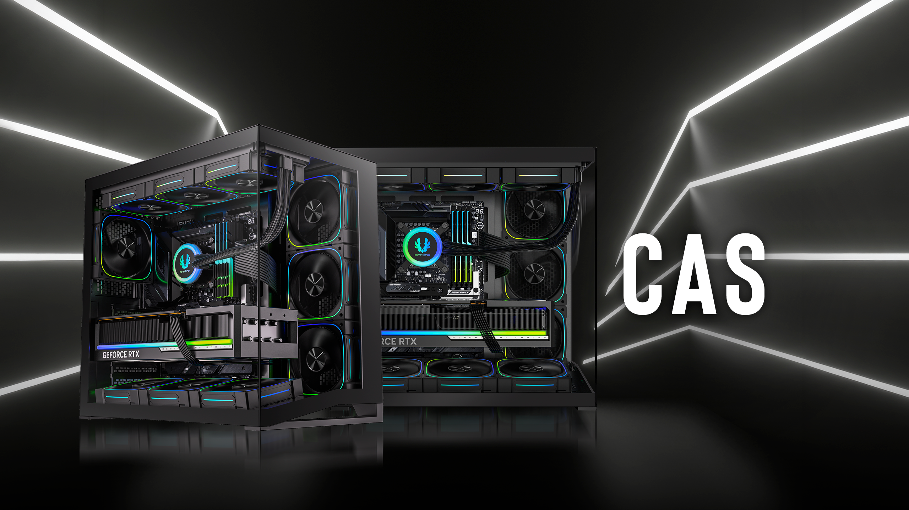

Slide 2
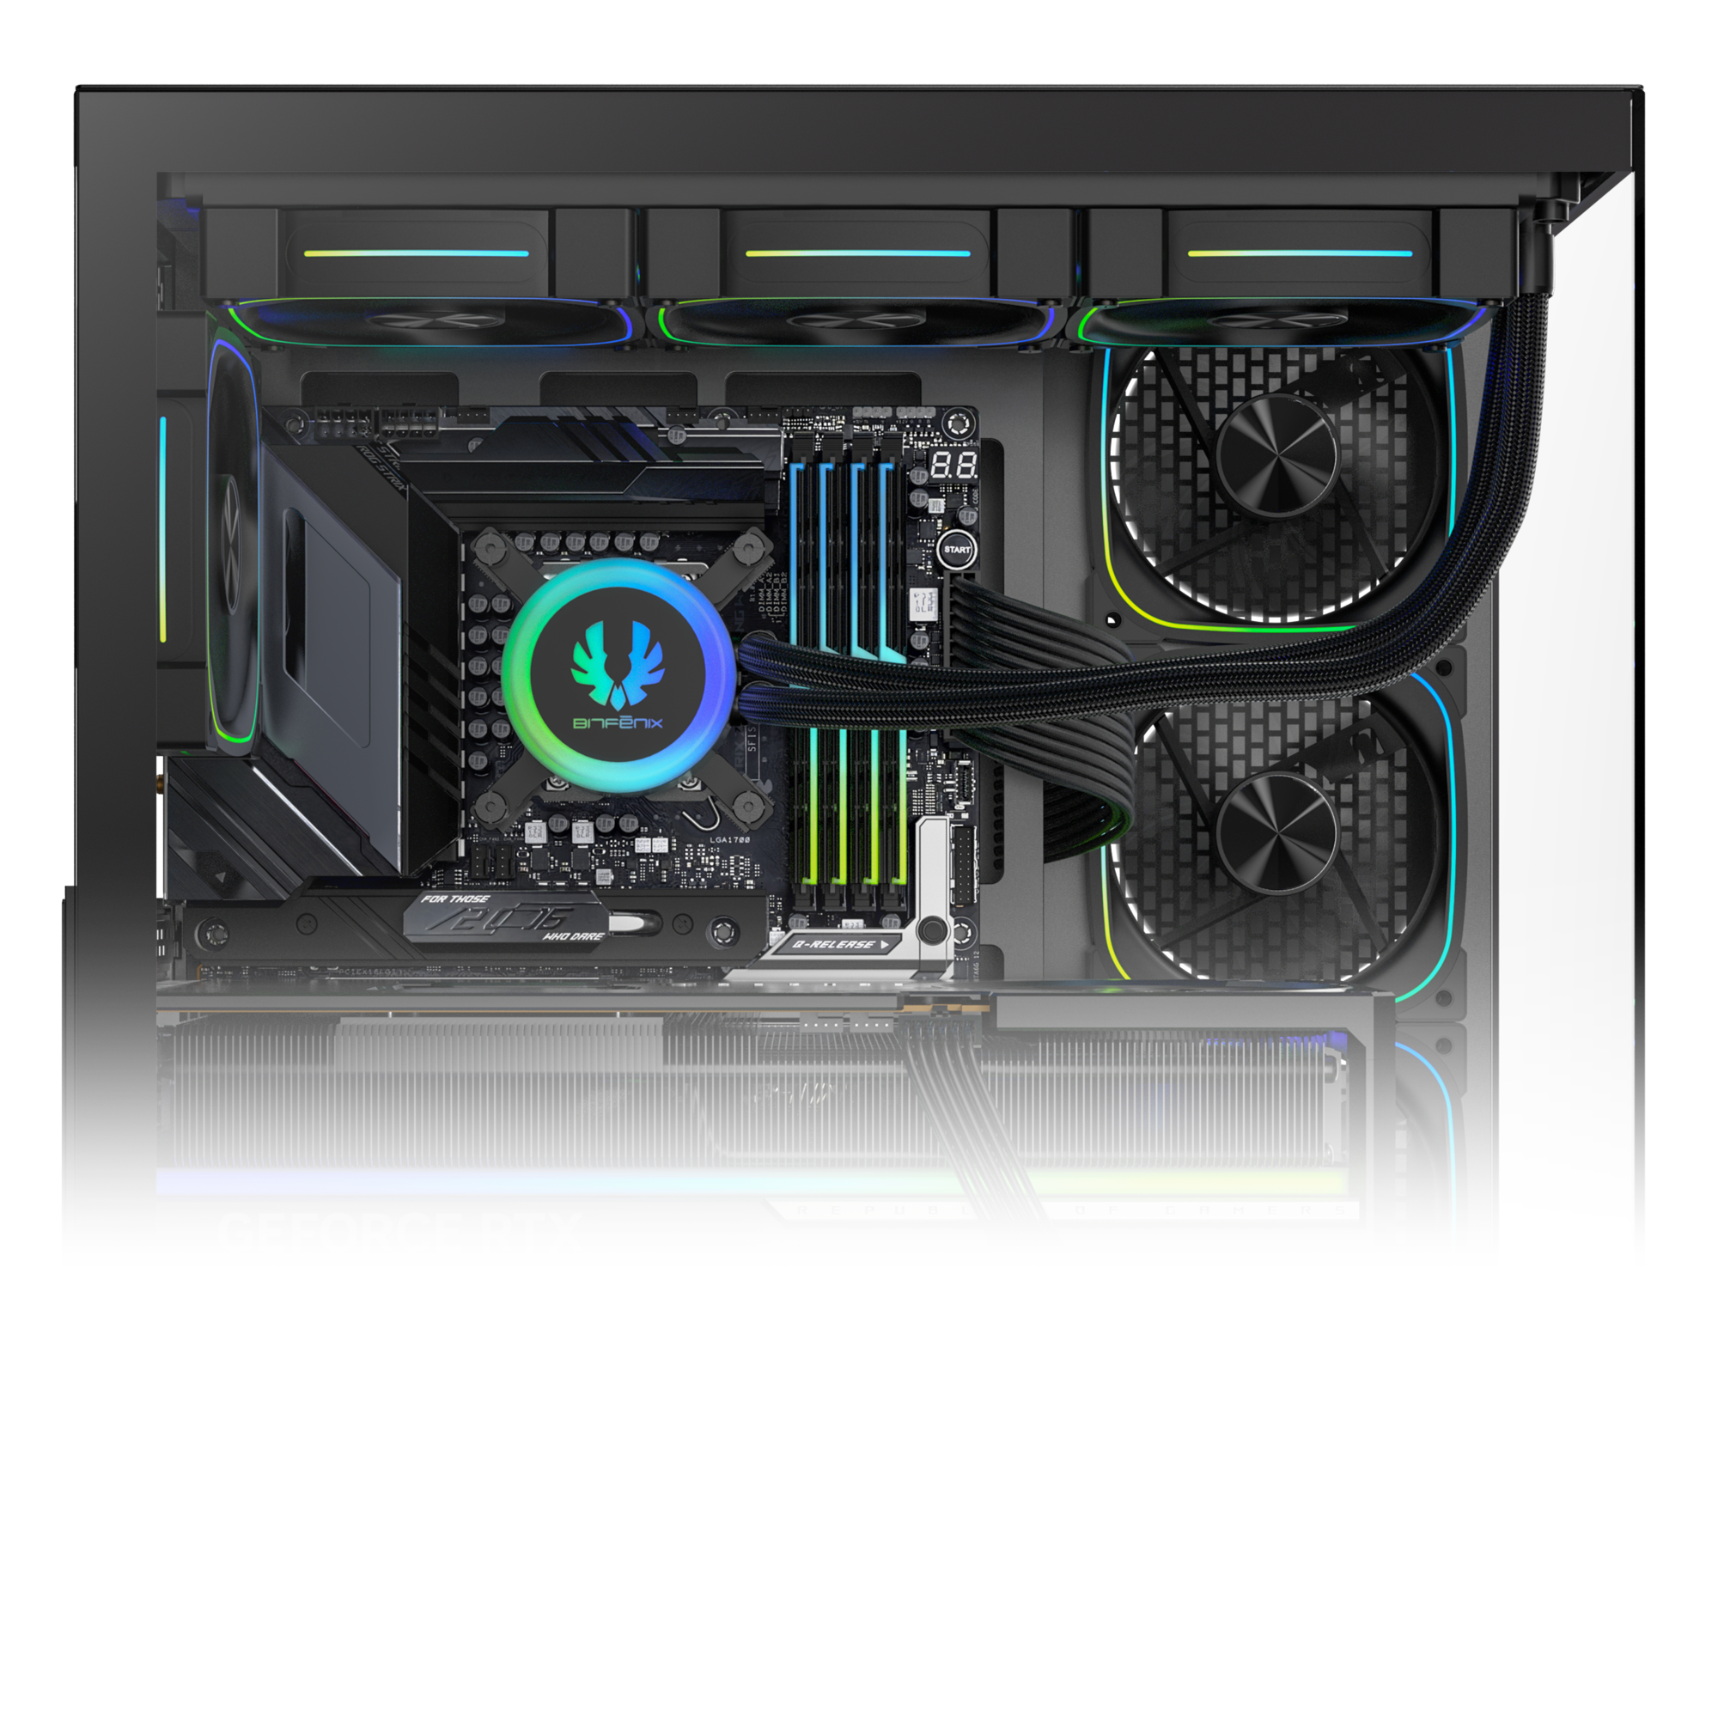
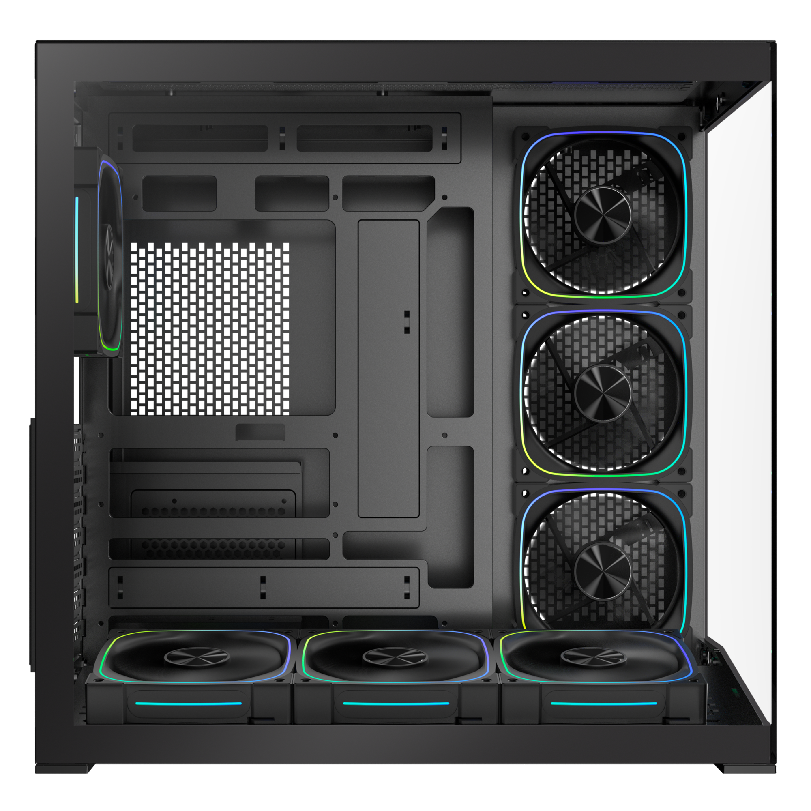
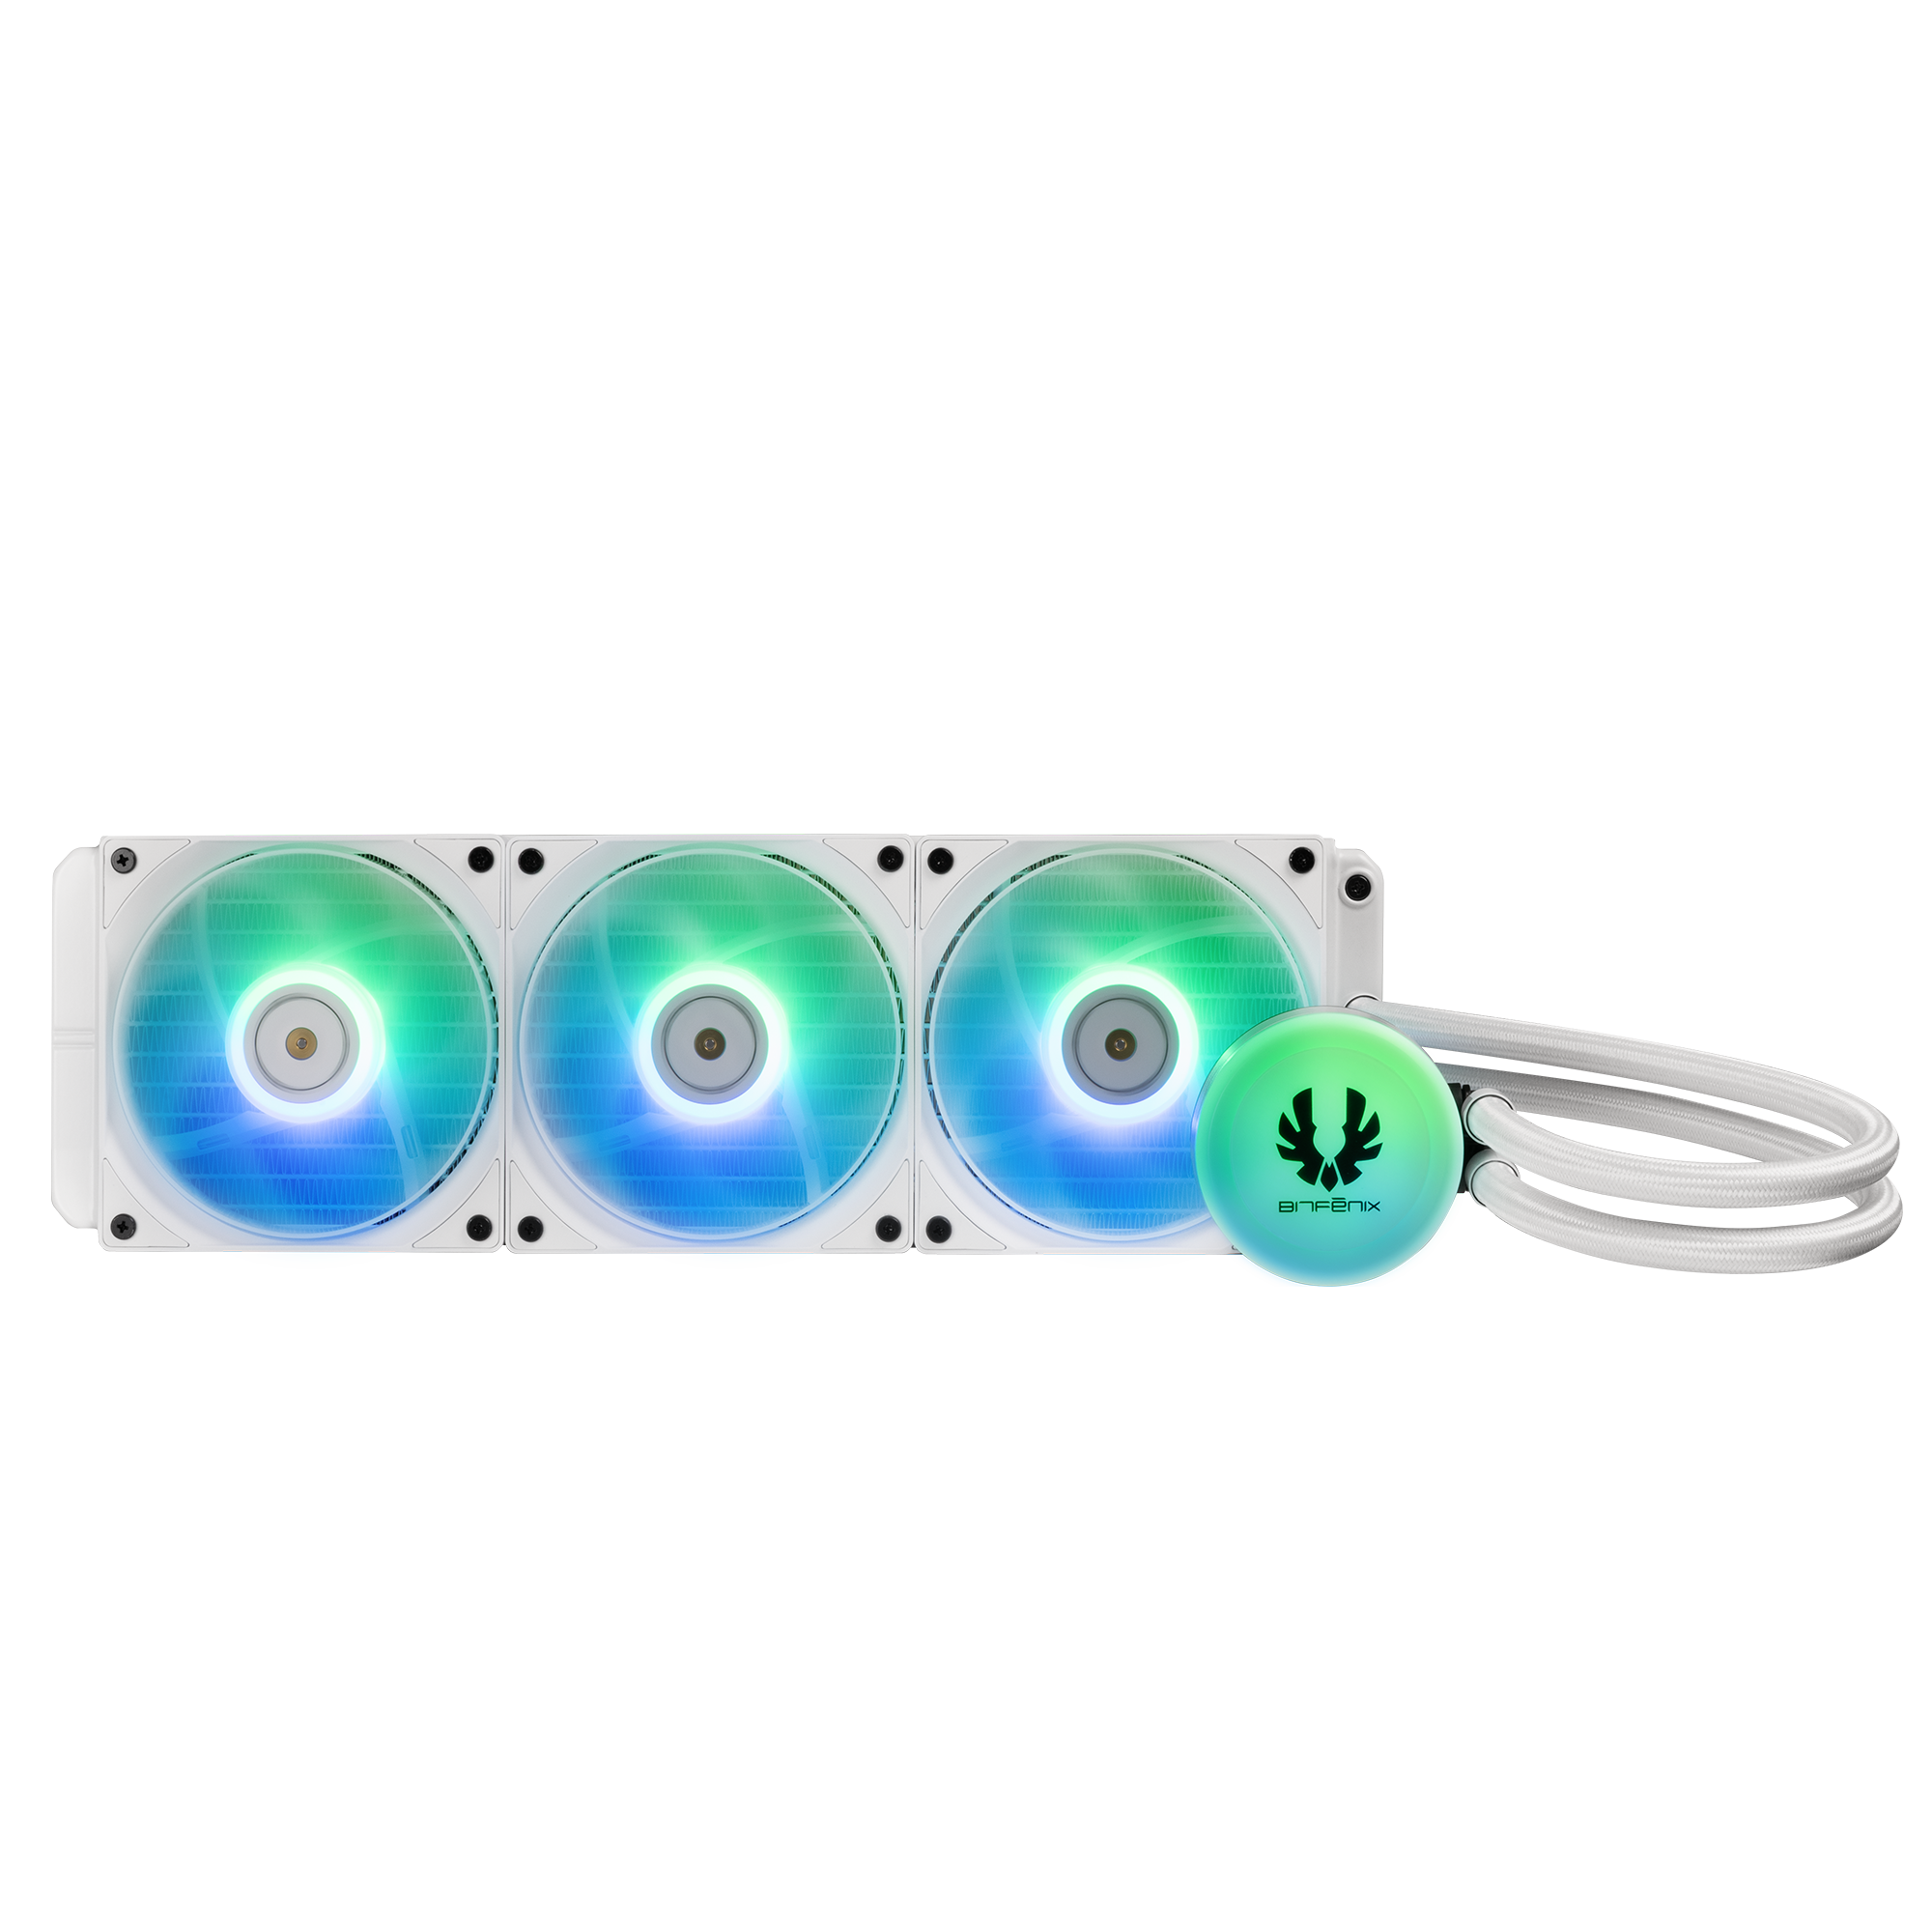
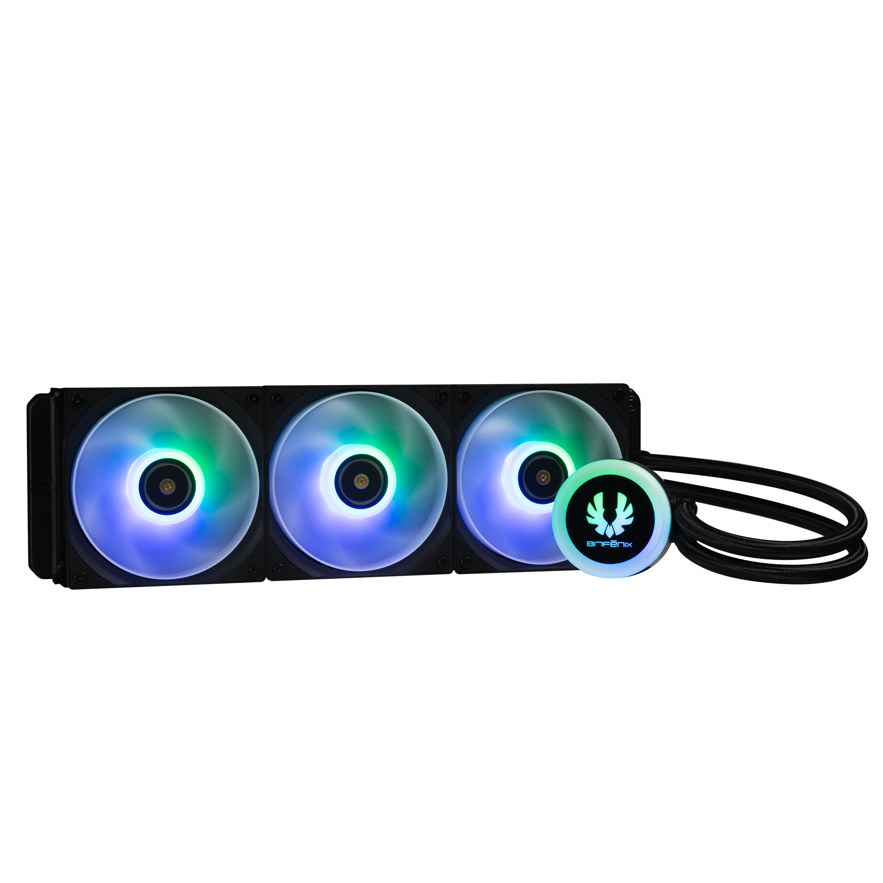
360mm AIO Support : Top
120mm
MB
120mm
120mm
120mm

Slide 3
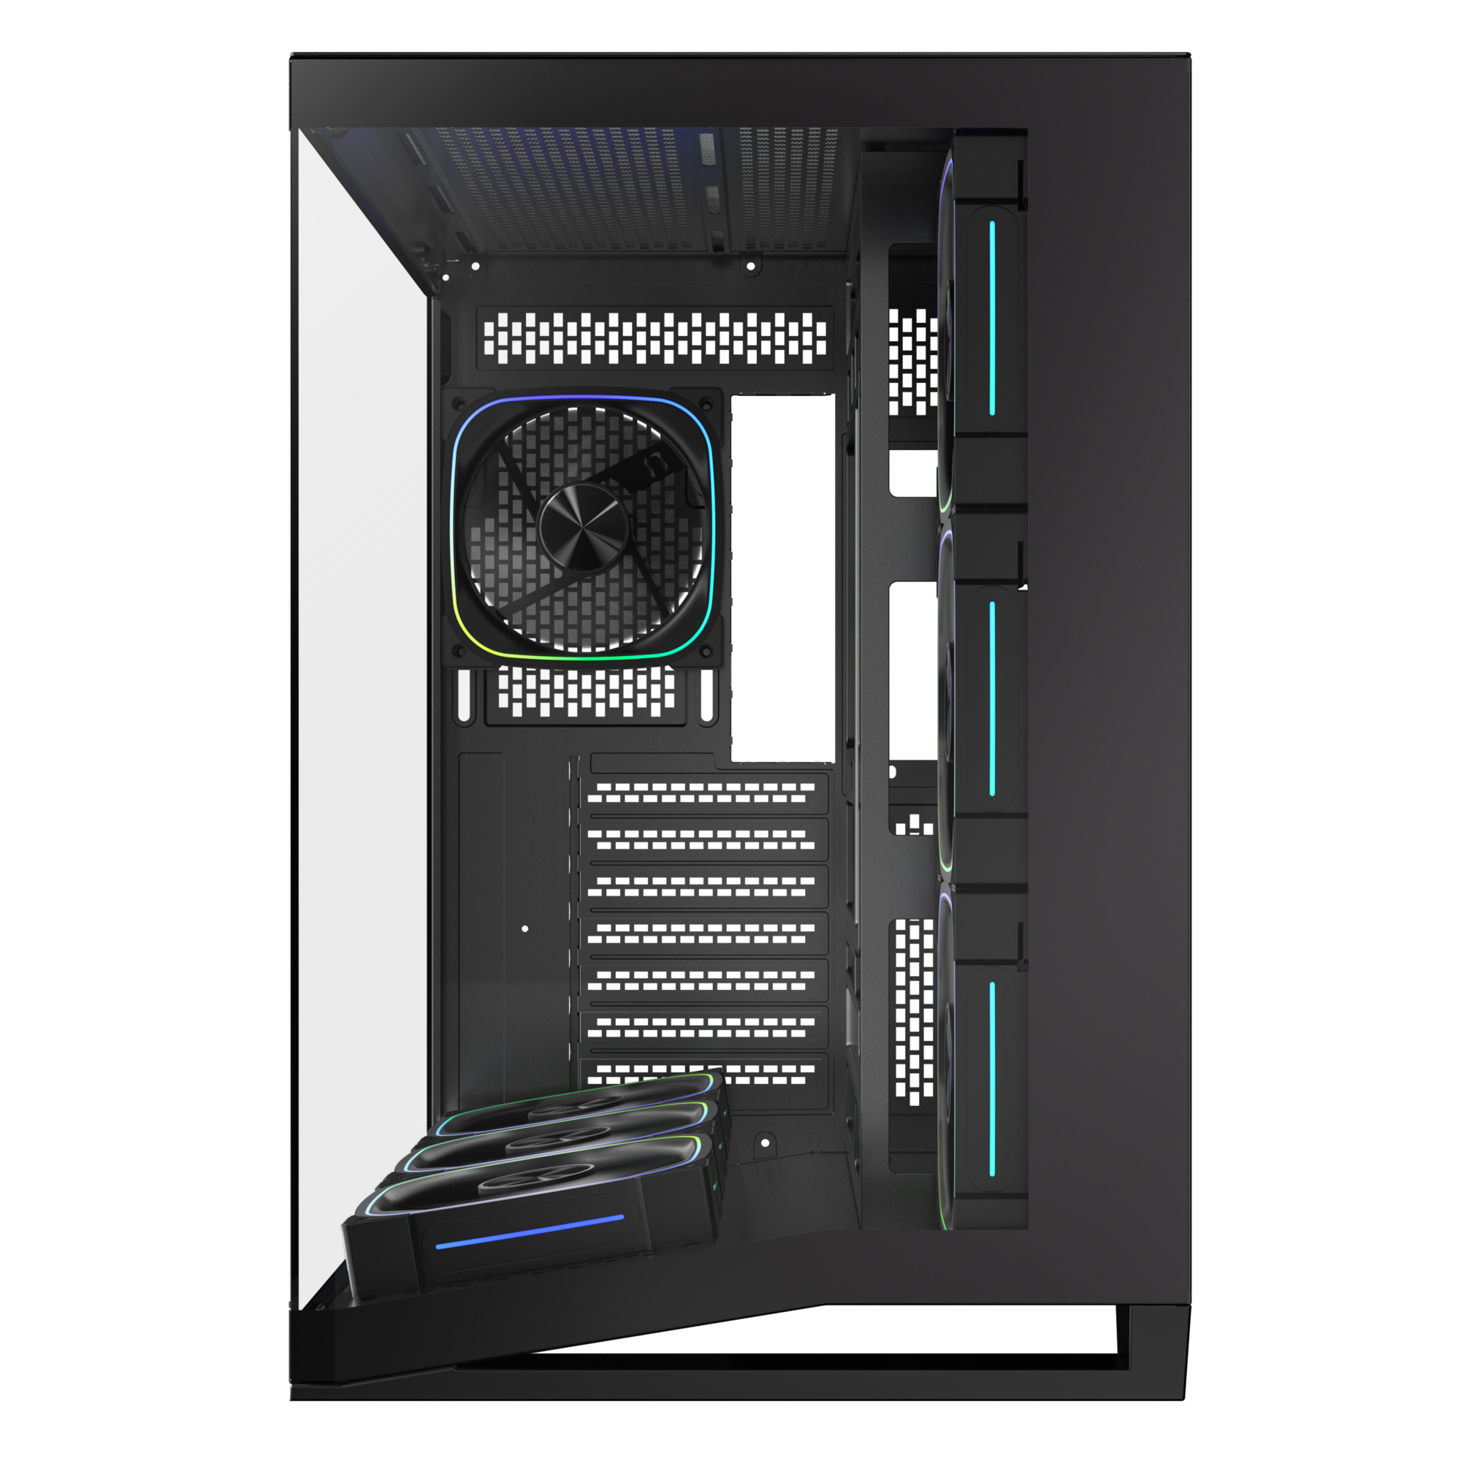
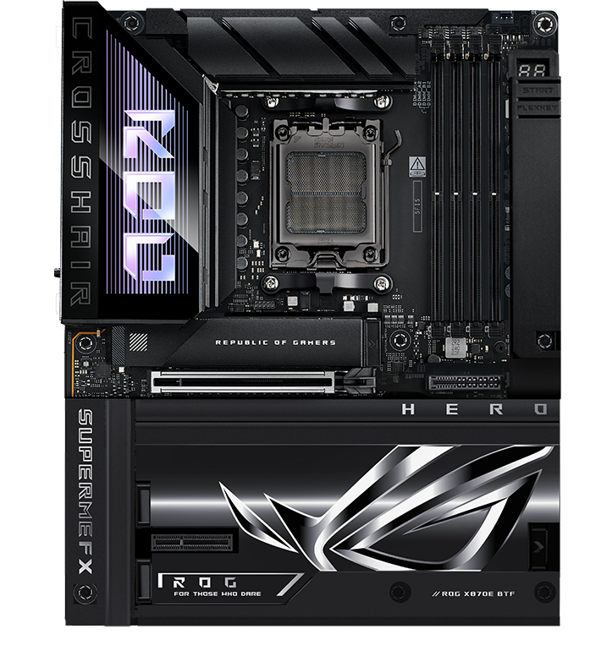
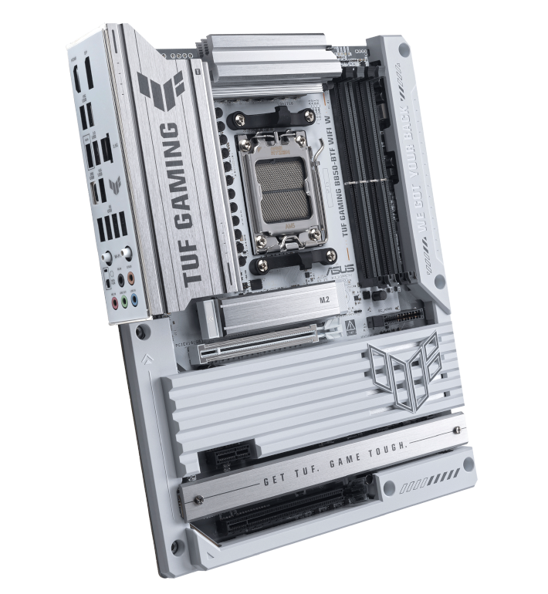
Supports BTF Back-Connect Motherboard
280mm
425mm
Maximun CPU
Cooler Height
Back-Connect Motherboard
Motherboard
Support
160
mm
ITX
M-ATX
ATX
420mm
Cable Management Space 95 mm
Maximun Graphics Card
Support
410
mm

Slide 4
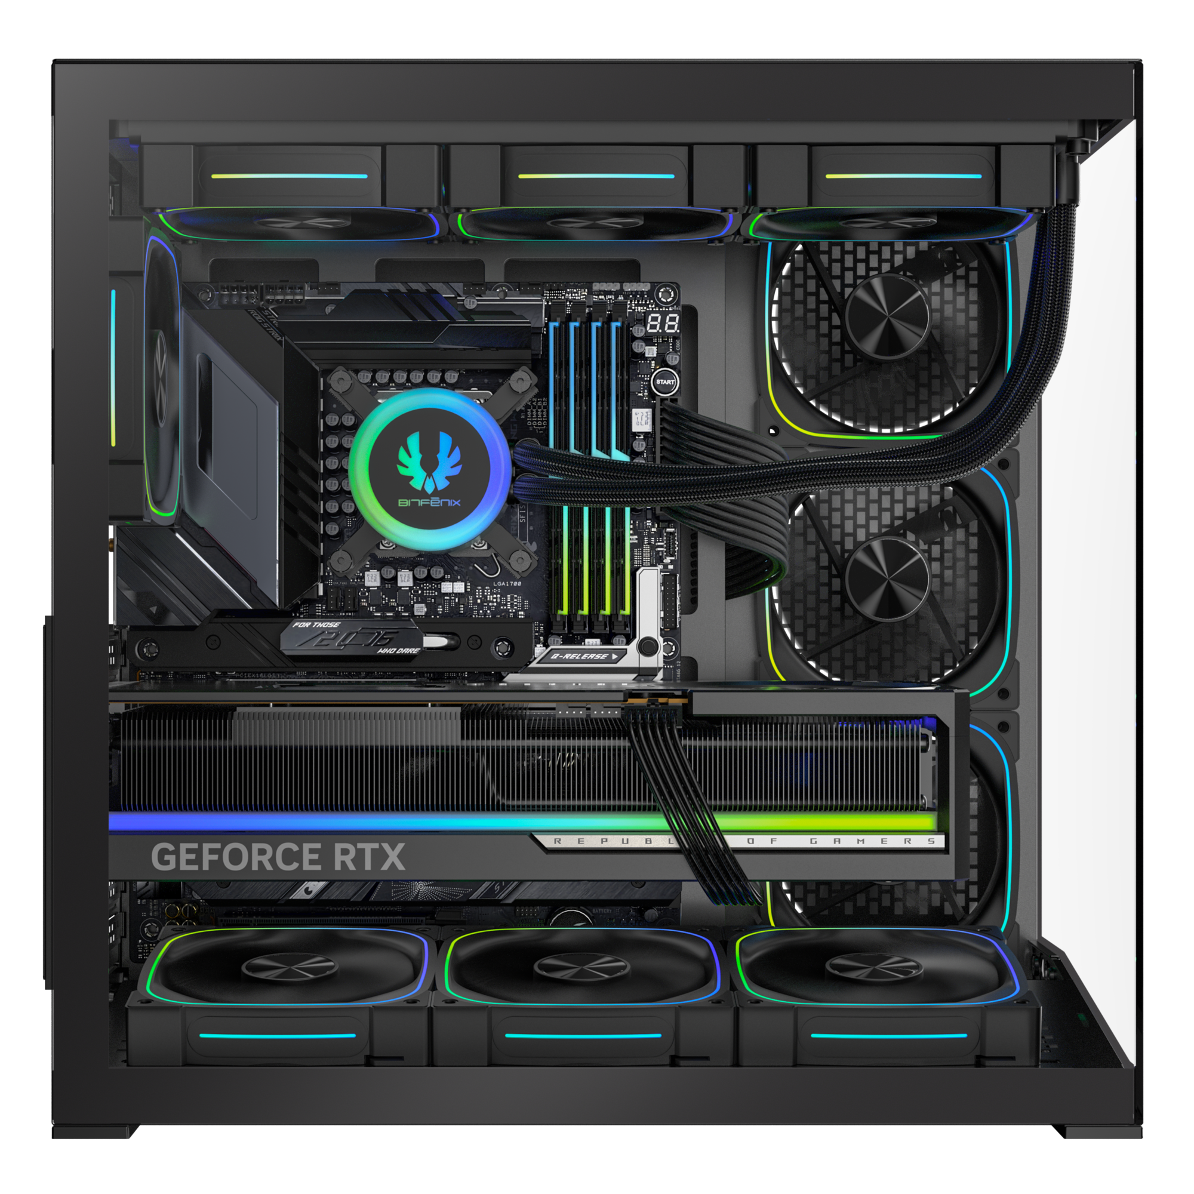
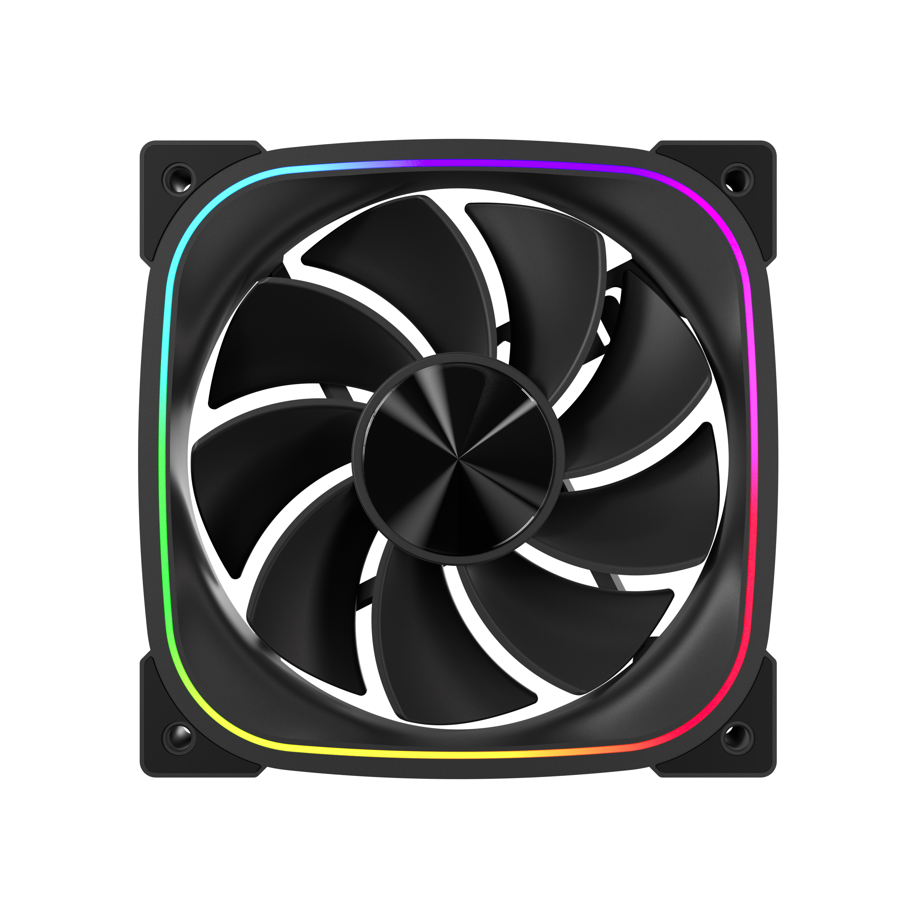
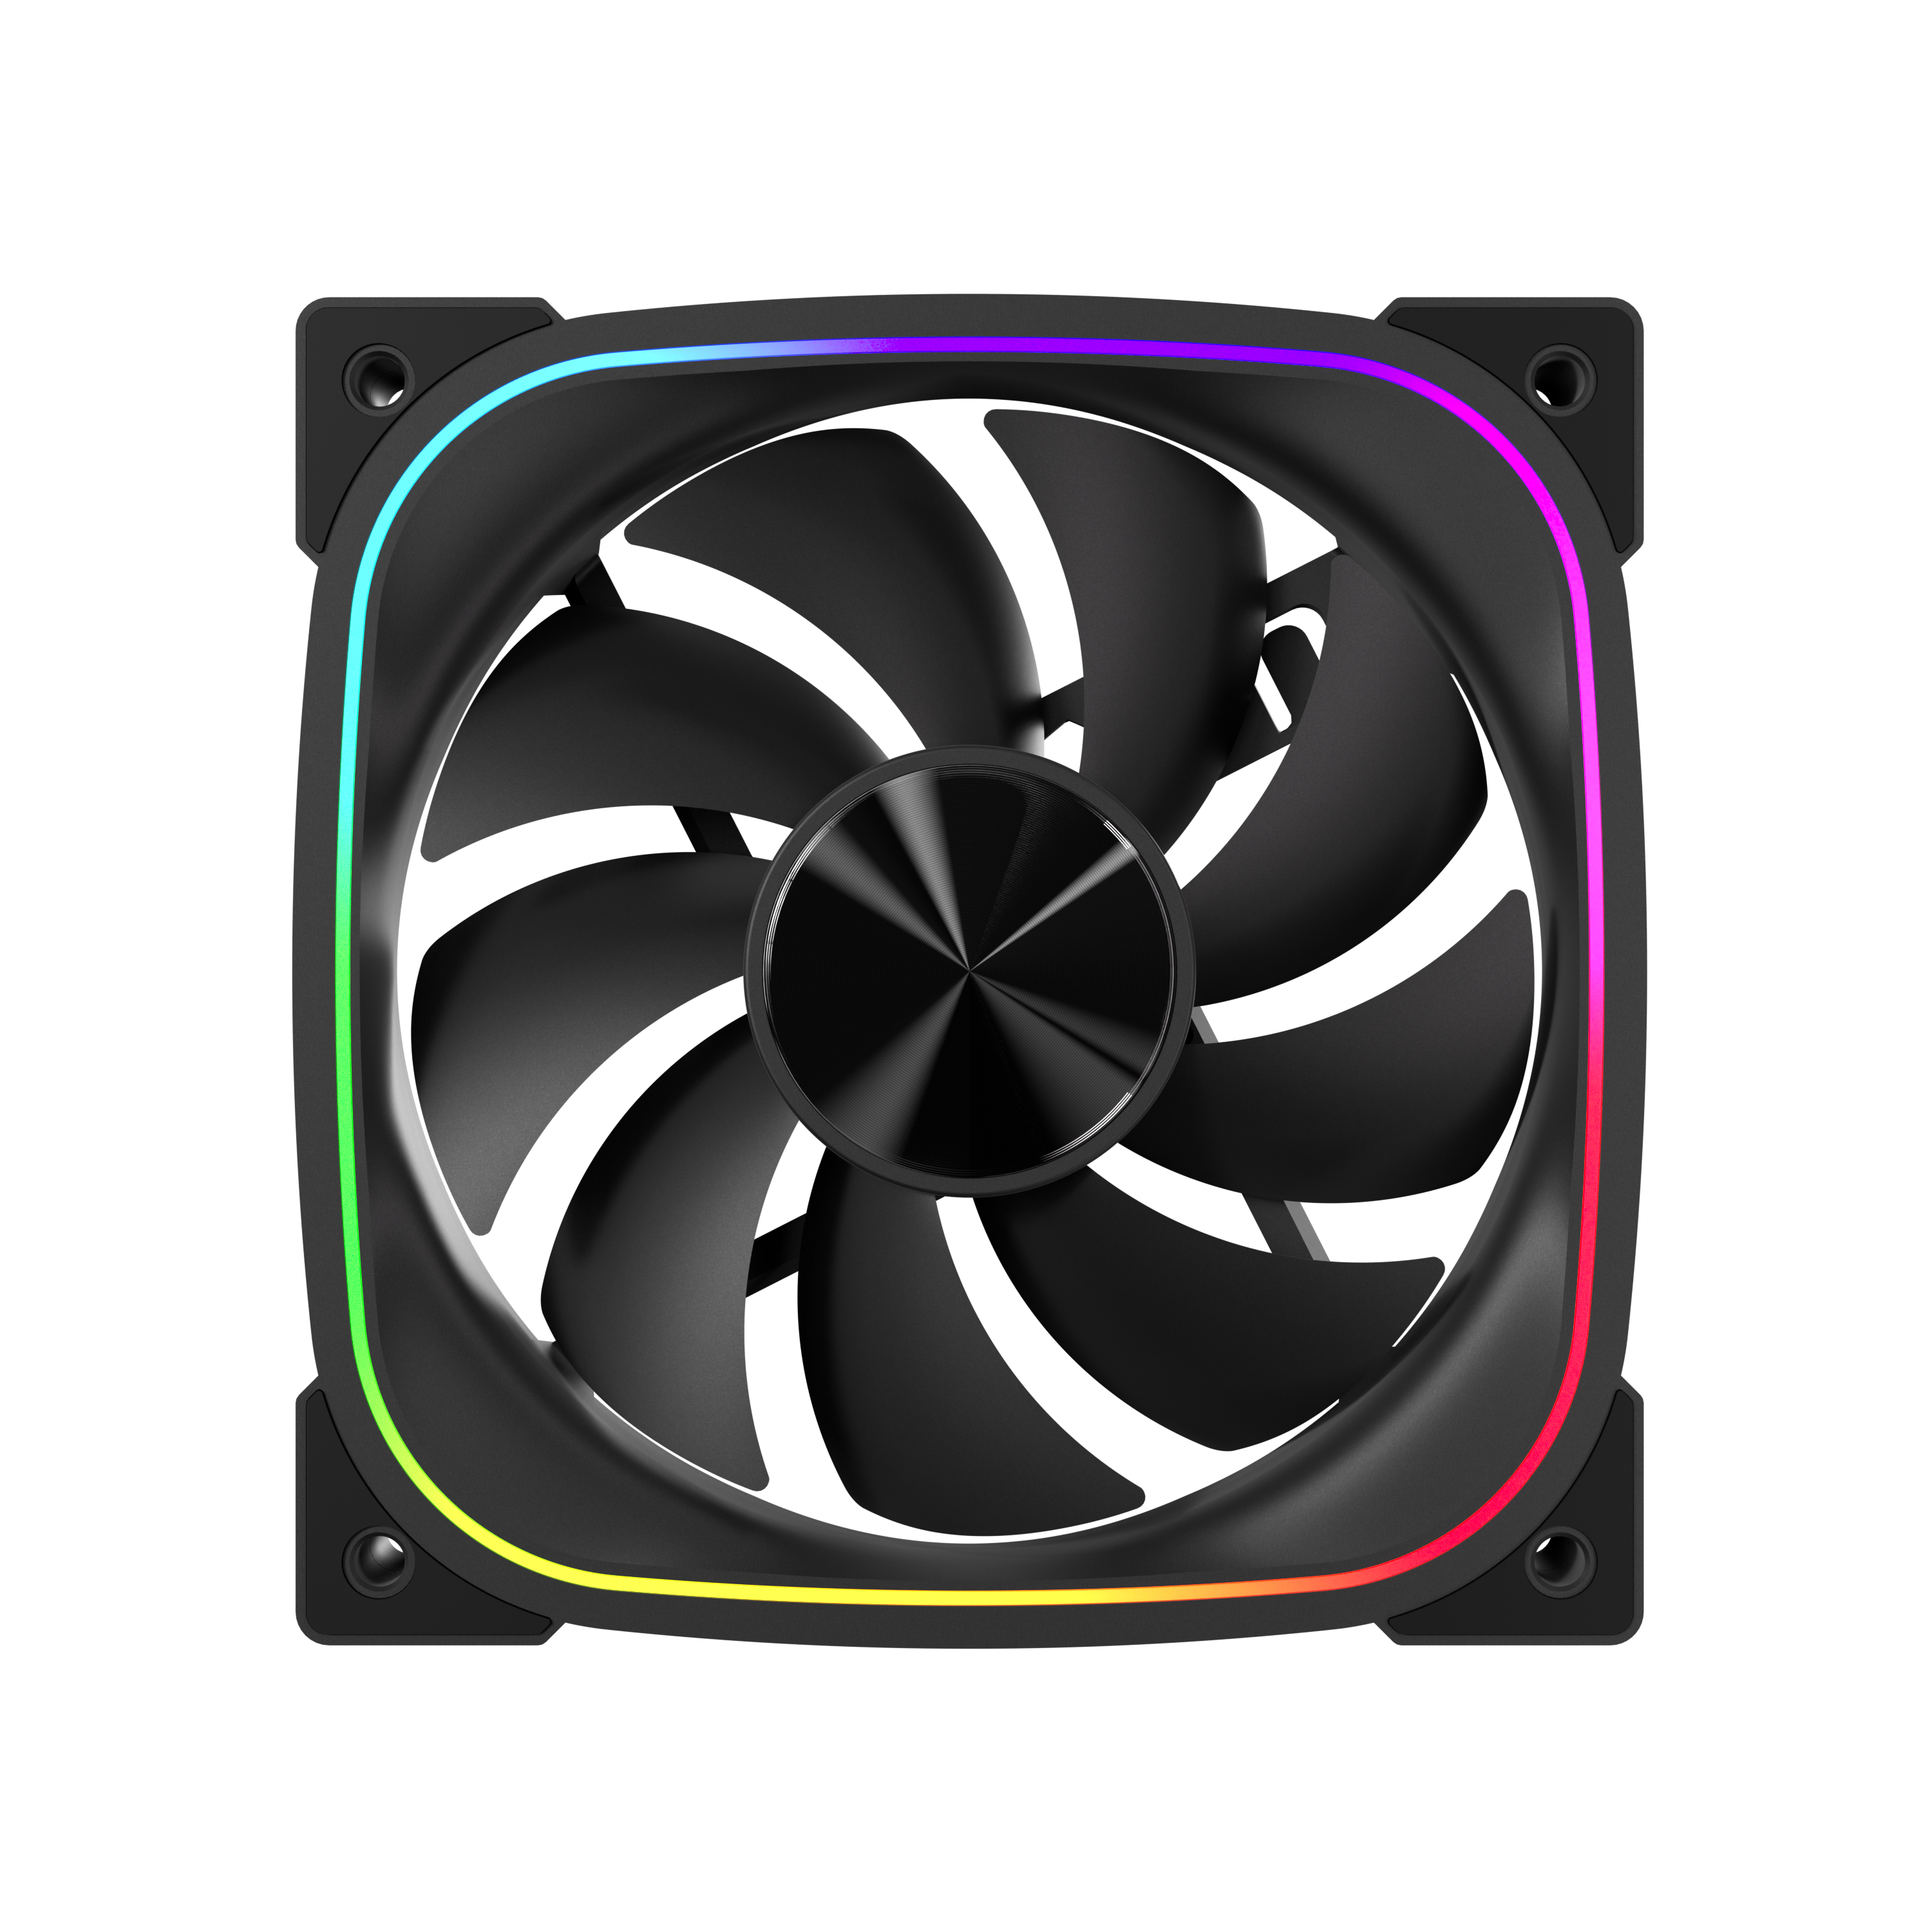
High-Performance
Reverse ARGB Fan
6X
1X
This model comes standard with 7 ARGB fans
(6 reverse-fans + 1 standard fan)
The raised bottom fan bracket increases intake airflow for the bottom fans.
High-Performance ARGB Fan

Slide 5
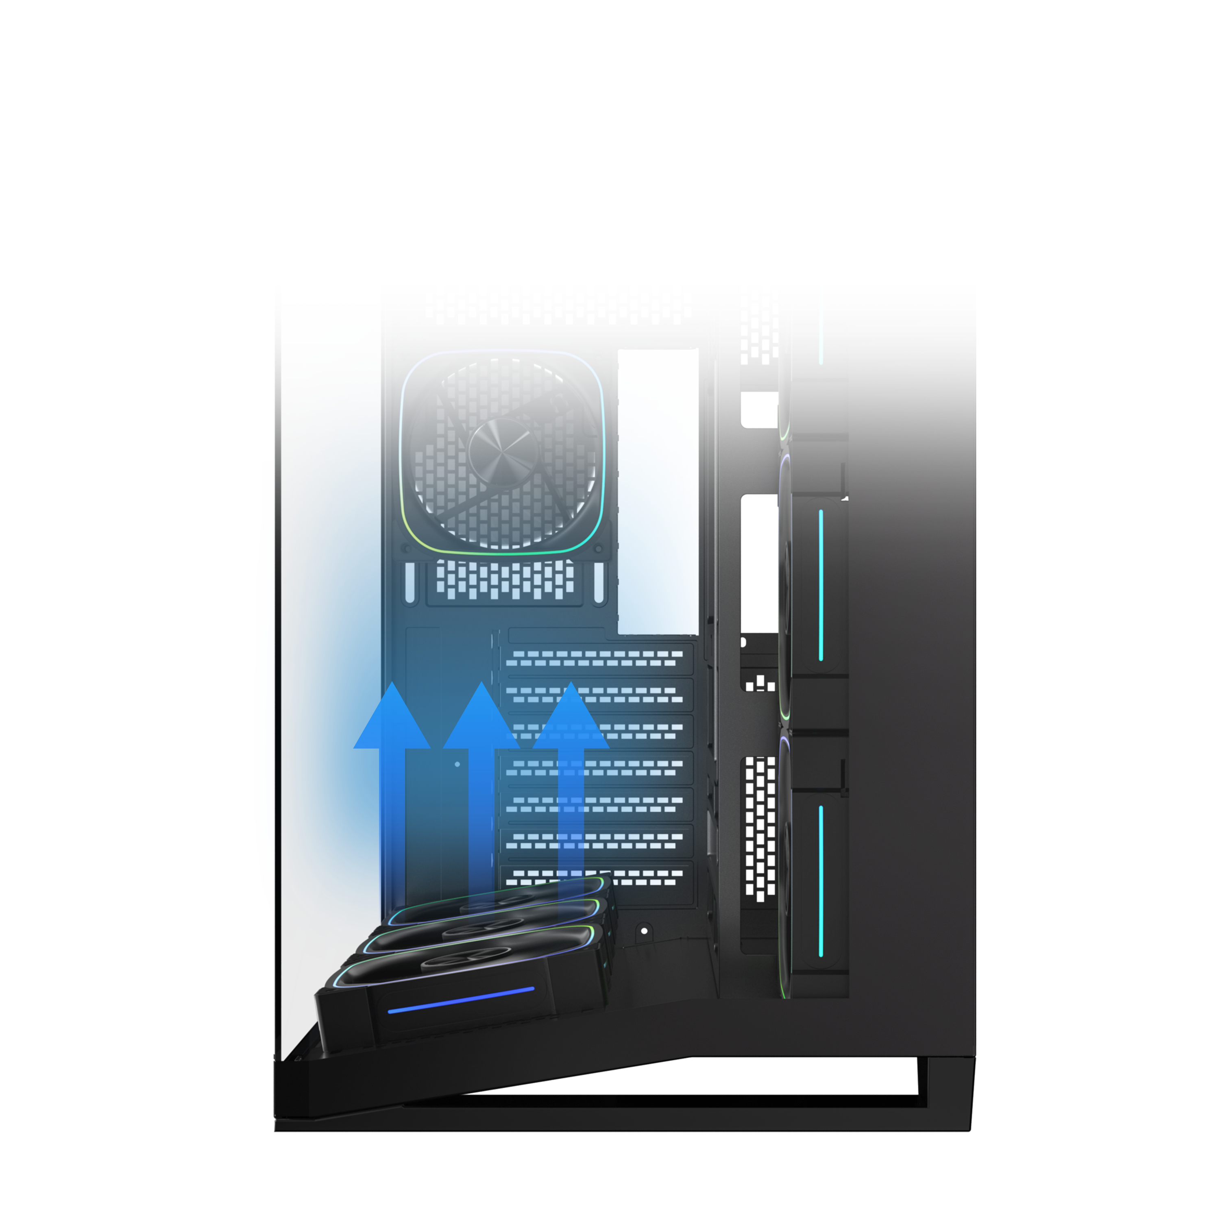
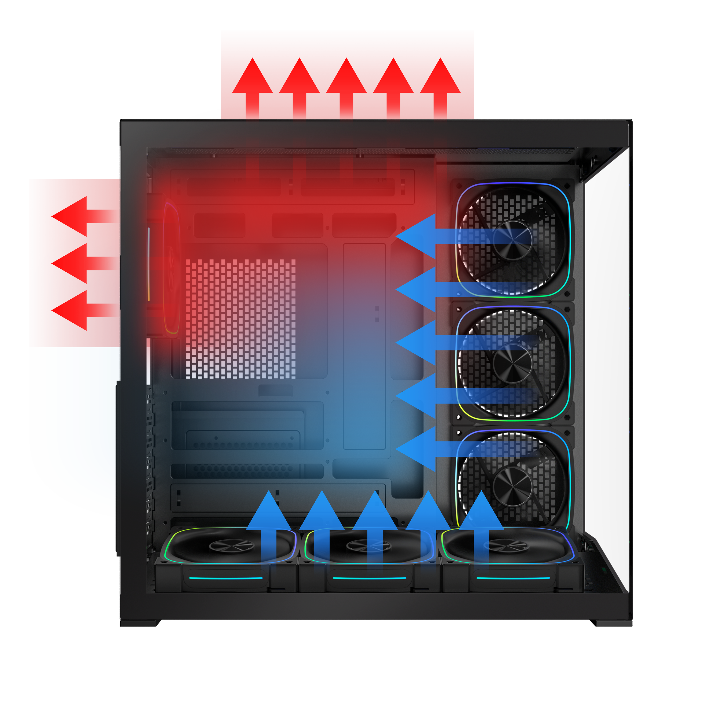
Dual Chamber High Airflow Performance

Slide 6
ATX & Standard /
up to 220mm
PSU
1 X 3.5’’ Drive & 3 X 2.5’’Drive

Slide 7
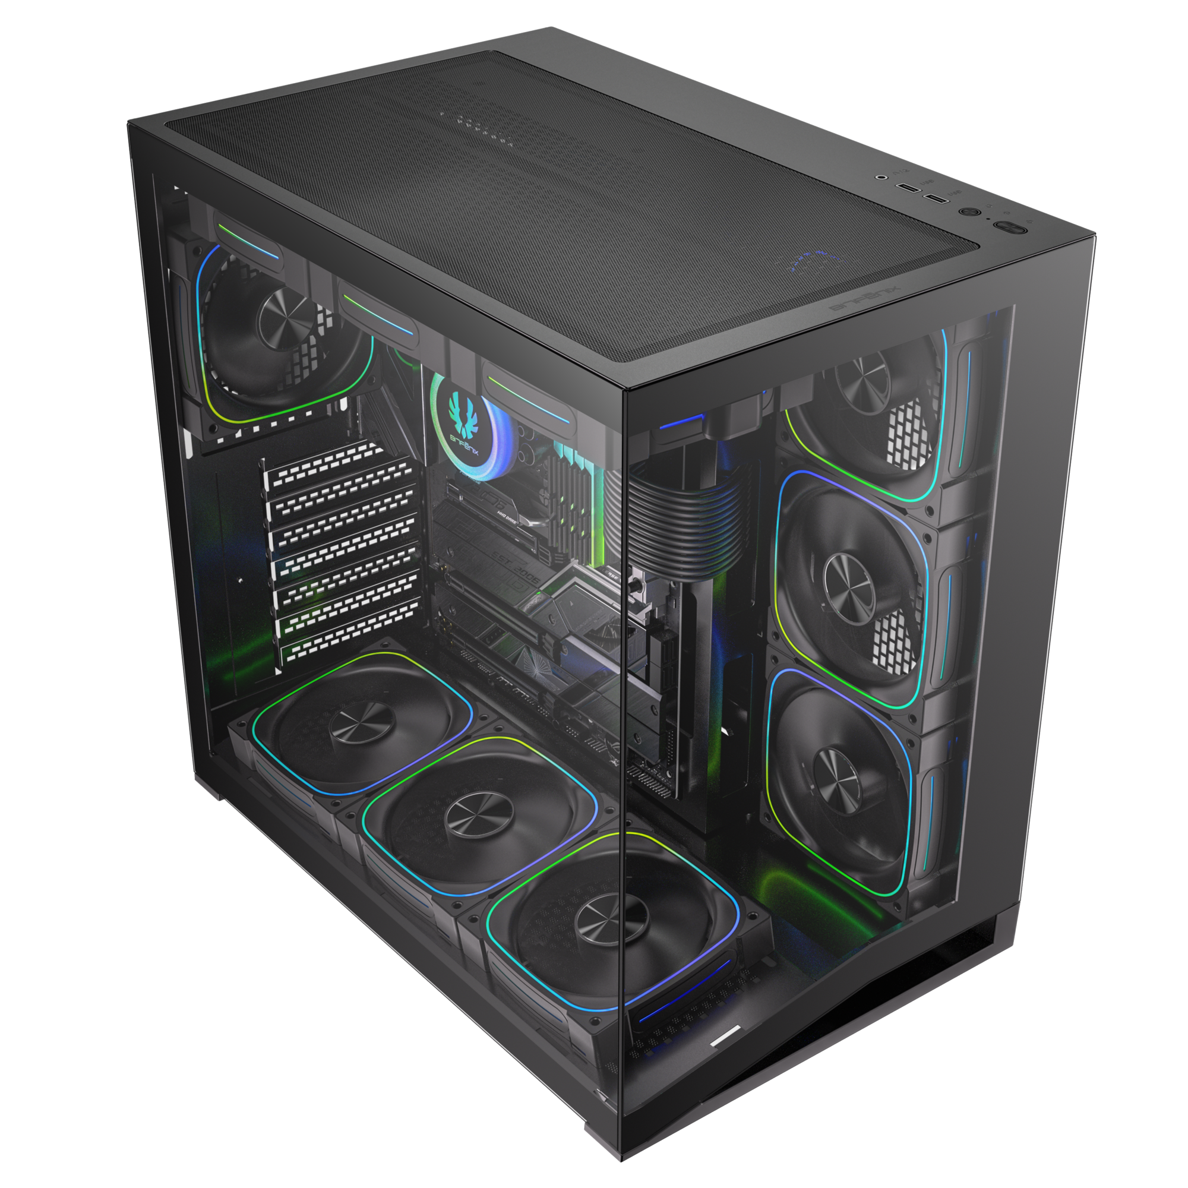
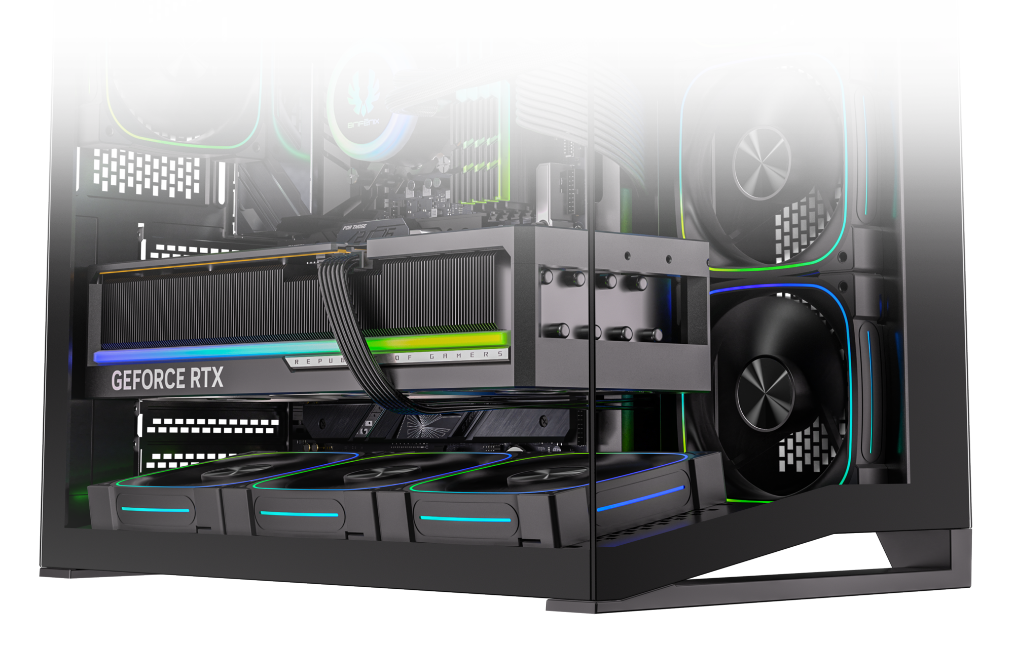
Top
Bottom
Easy Clean With Removable Dust Filters

Slide 8
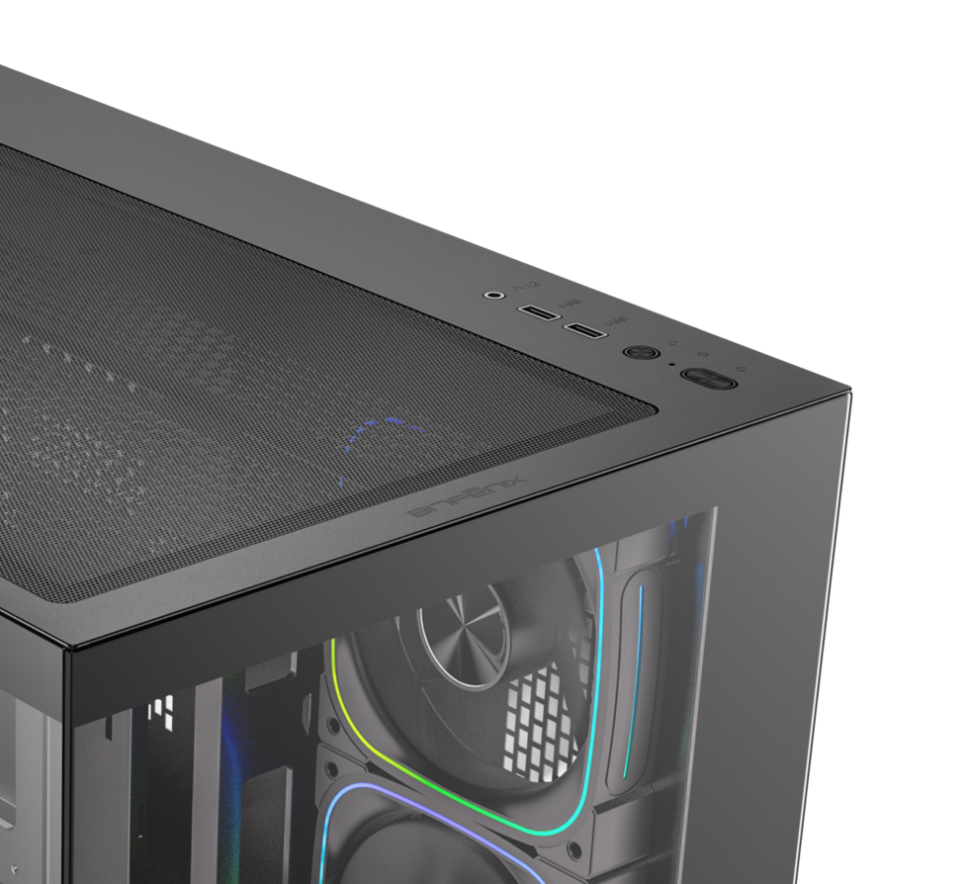

1X USB3.0 / 1X USB
Power Button
Reset Button
Tool-free Removal

Slide 9
Best |  | Black
Part no. |  | BFC-CAS-1000W-KKGXK-7A
EAN |  | 4712883213489
UPC |  | 886027010525
Net weight (NW) Gross weight (GW) |  | N.W: Kgs / G.W: Kgs
Materials |  | Steel, Mesh, Plastic, Tempered Glass
Chassis Dimensions (W x H x D) |  | 280 mm x 420 mm x 425 mm
Motherboard Supports |  | Mini-ITX, MicroATX, ATX
Air Cooler Height Support |  | 160mm
VGA Length Support |  | 410mm
Cable Management Support |  | up to 95 mm
2.5" / 3.5" Drive Bay |  | 3+2 / 3
Fan mounts | MB | 3 x 120mm
 | Top | 3 x 120mm
 | Rear | 1 x 120mm
 | Bottom | 3 x 120mm
Radiator Support | MB | 1 x 240mm (Thickness up to 27mm)
 | Top | 1 x 360mm/ 1 x 240mm (Thickness up to 27mm)
 | Rear | 1 x 120mm
 | Bottom | /
PCI-E Slots |  | 7 Slots
I/O Ports |  | 1 x USB3.0 / 1 x USB / HD Audio
Power Supply |  | ATX & Standard / up to 200mm
CAS

