Slide 1
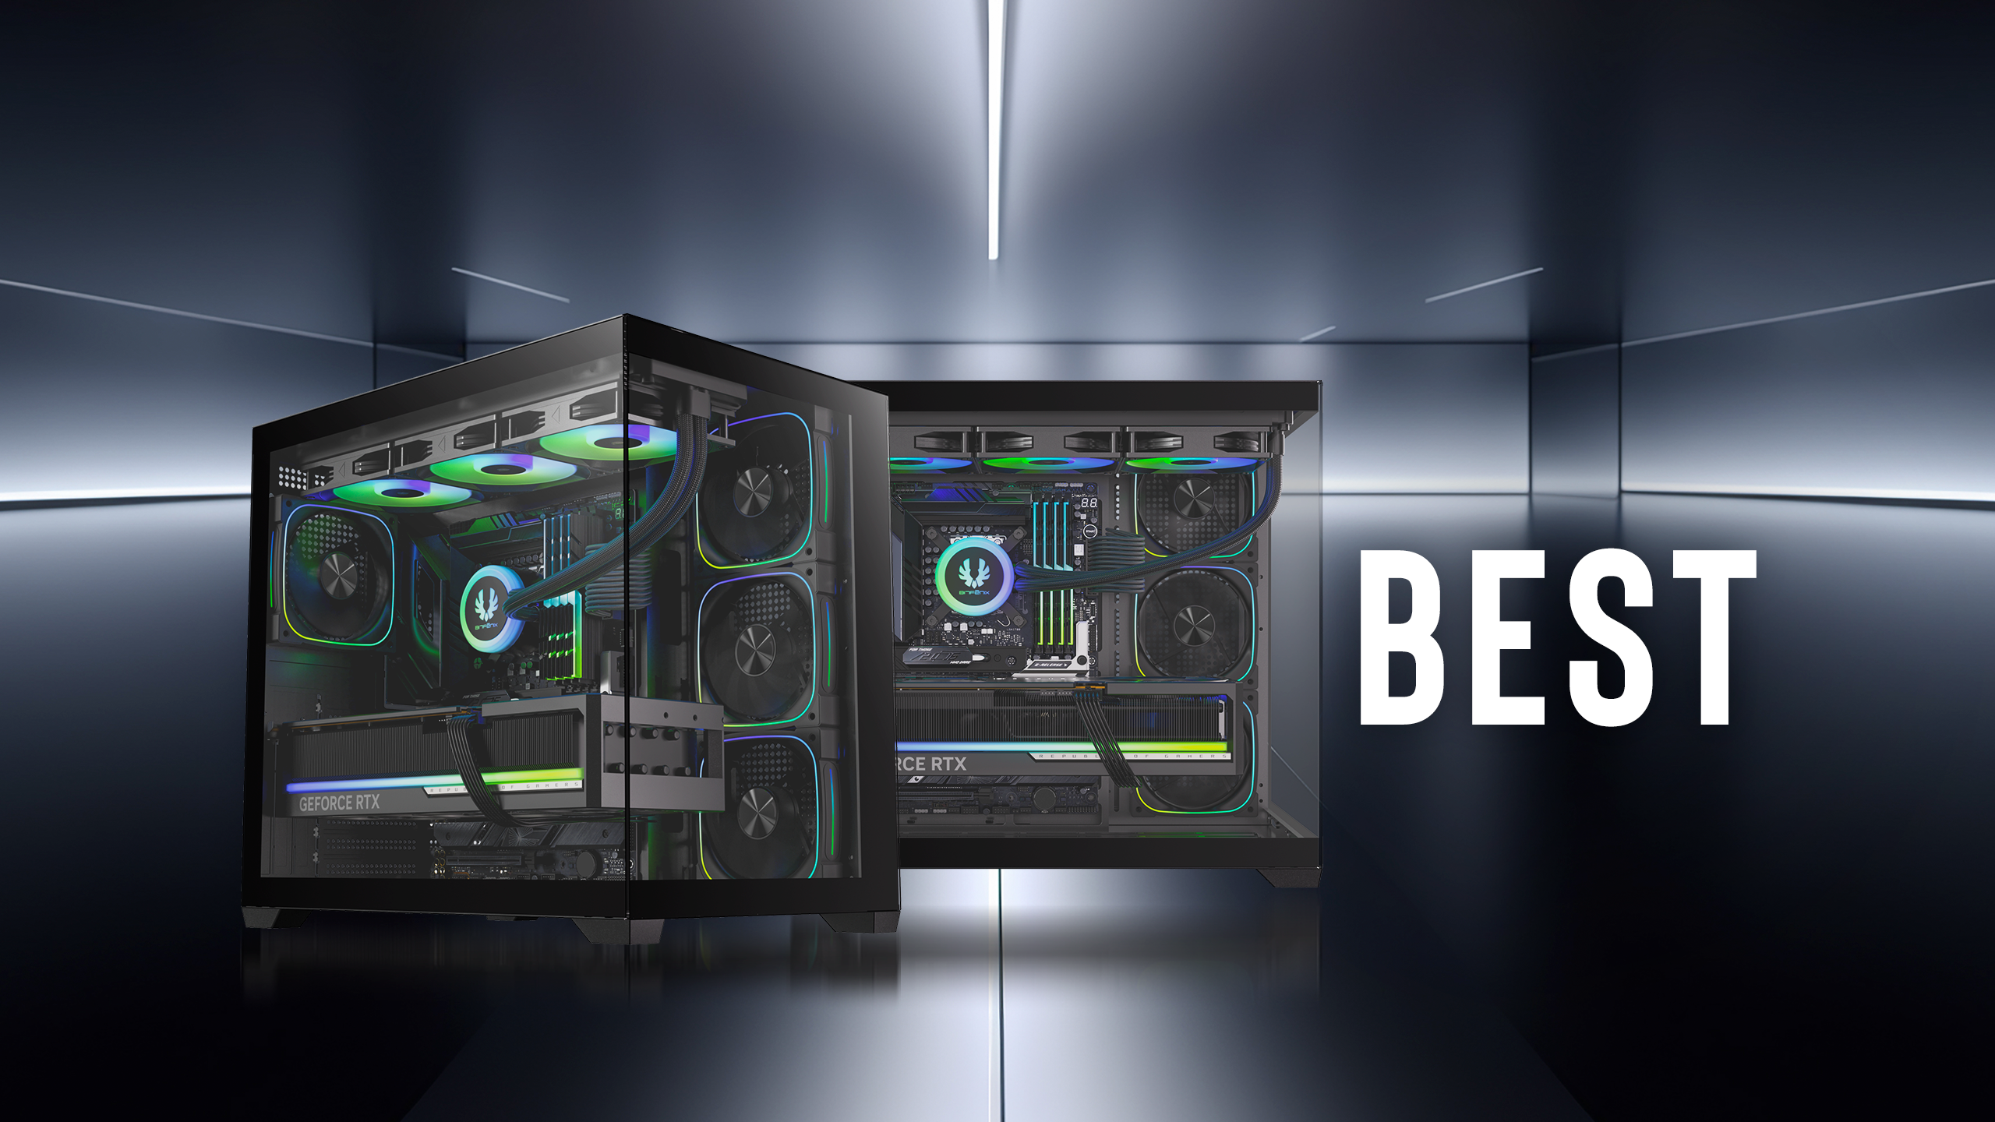

Slide 2
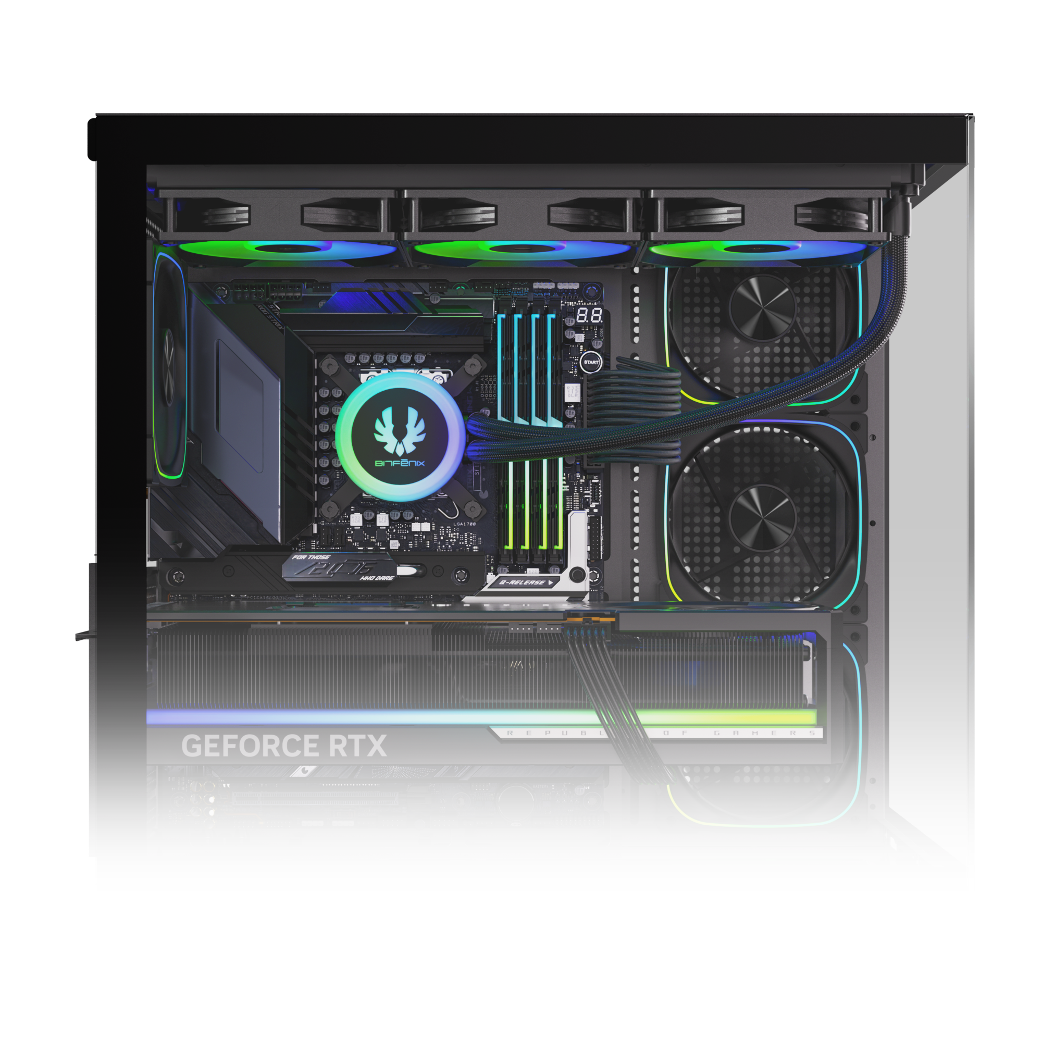
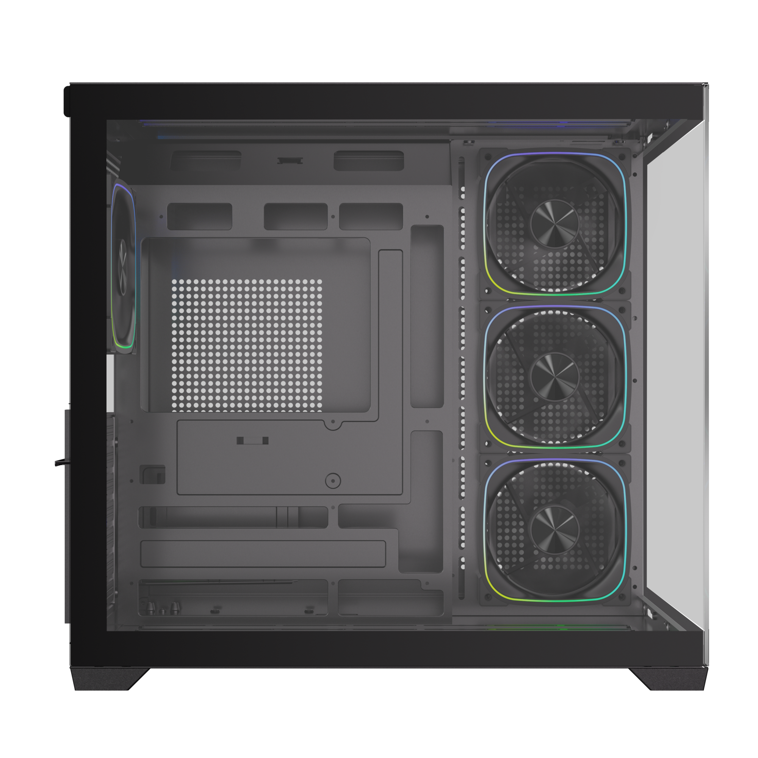
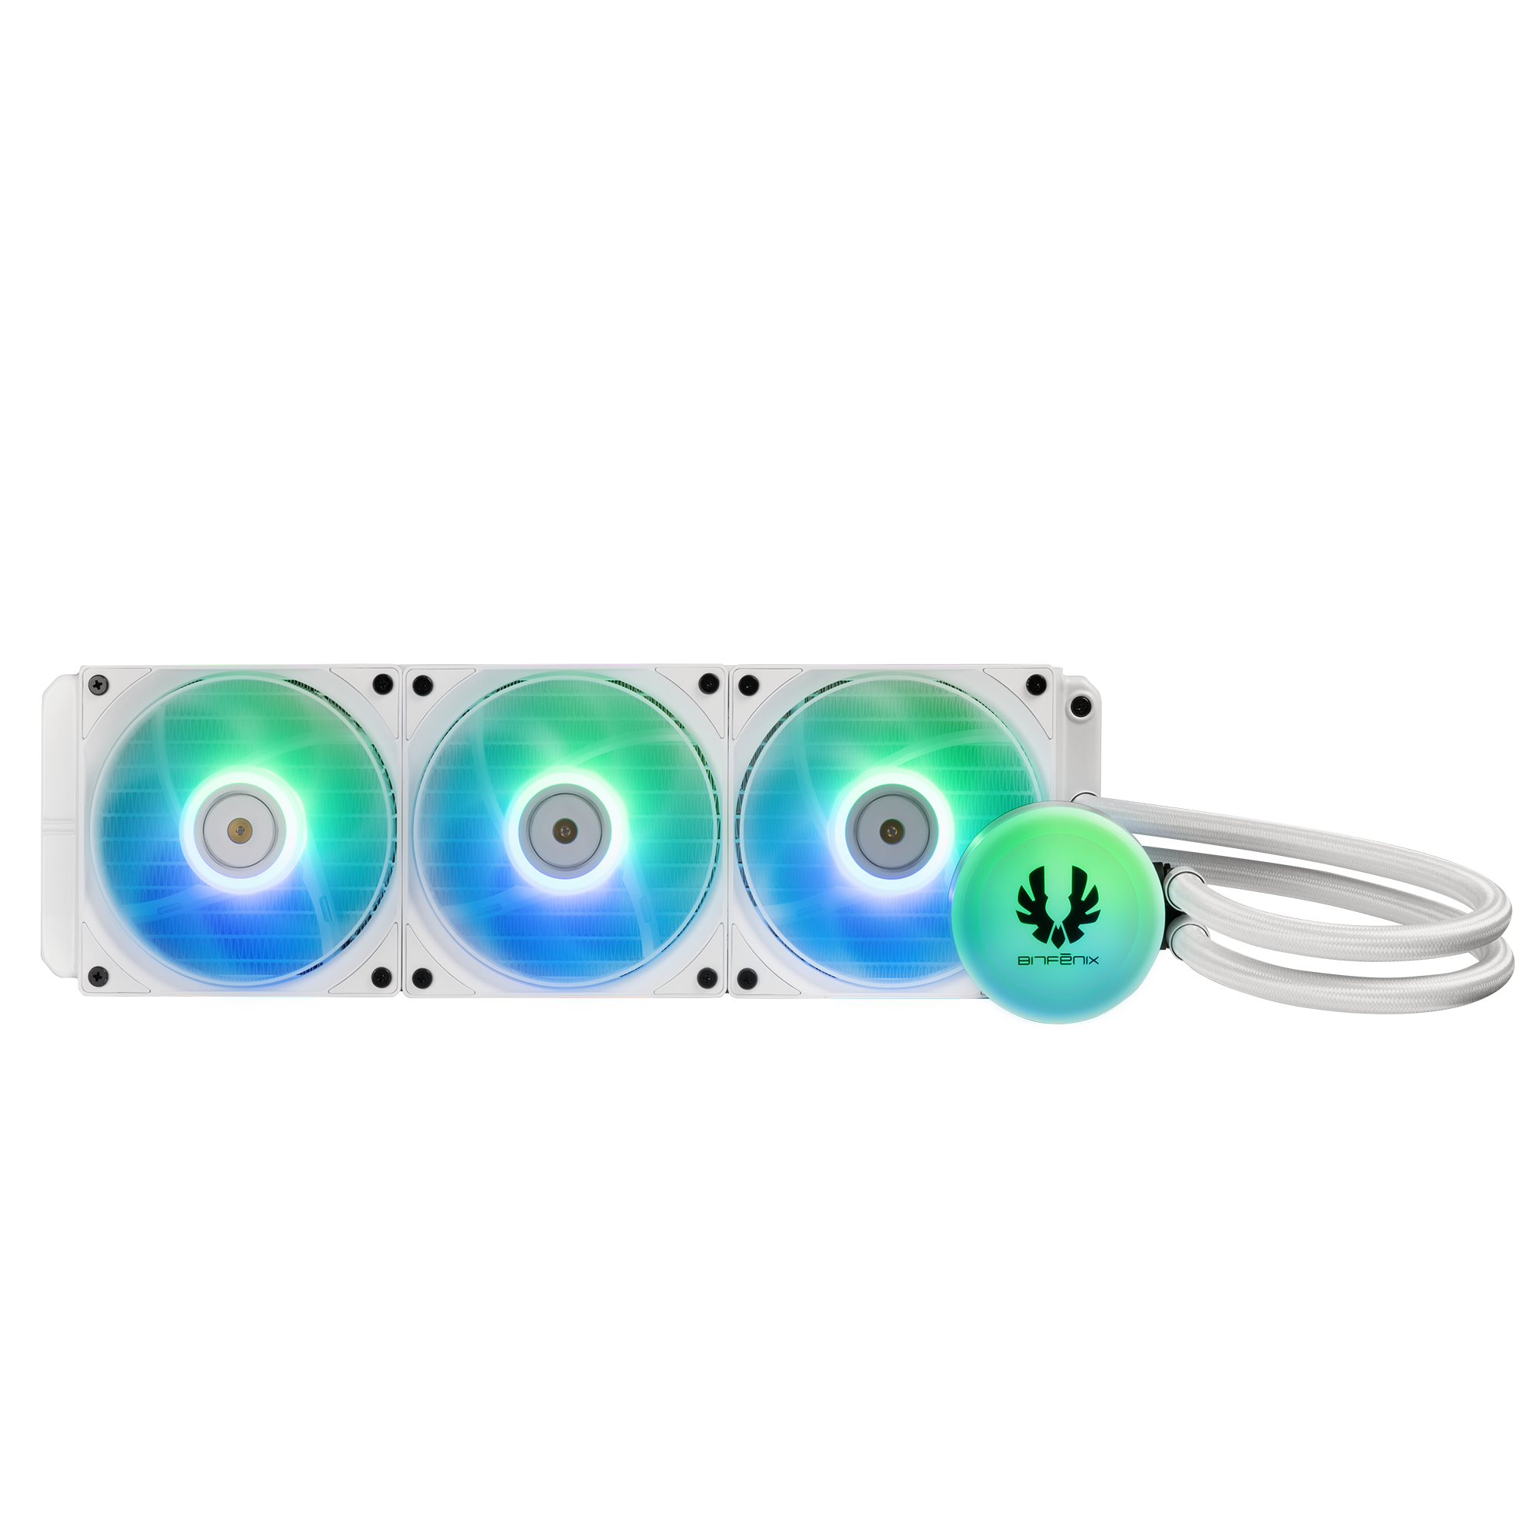
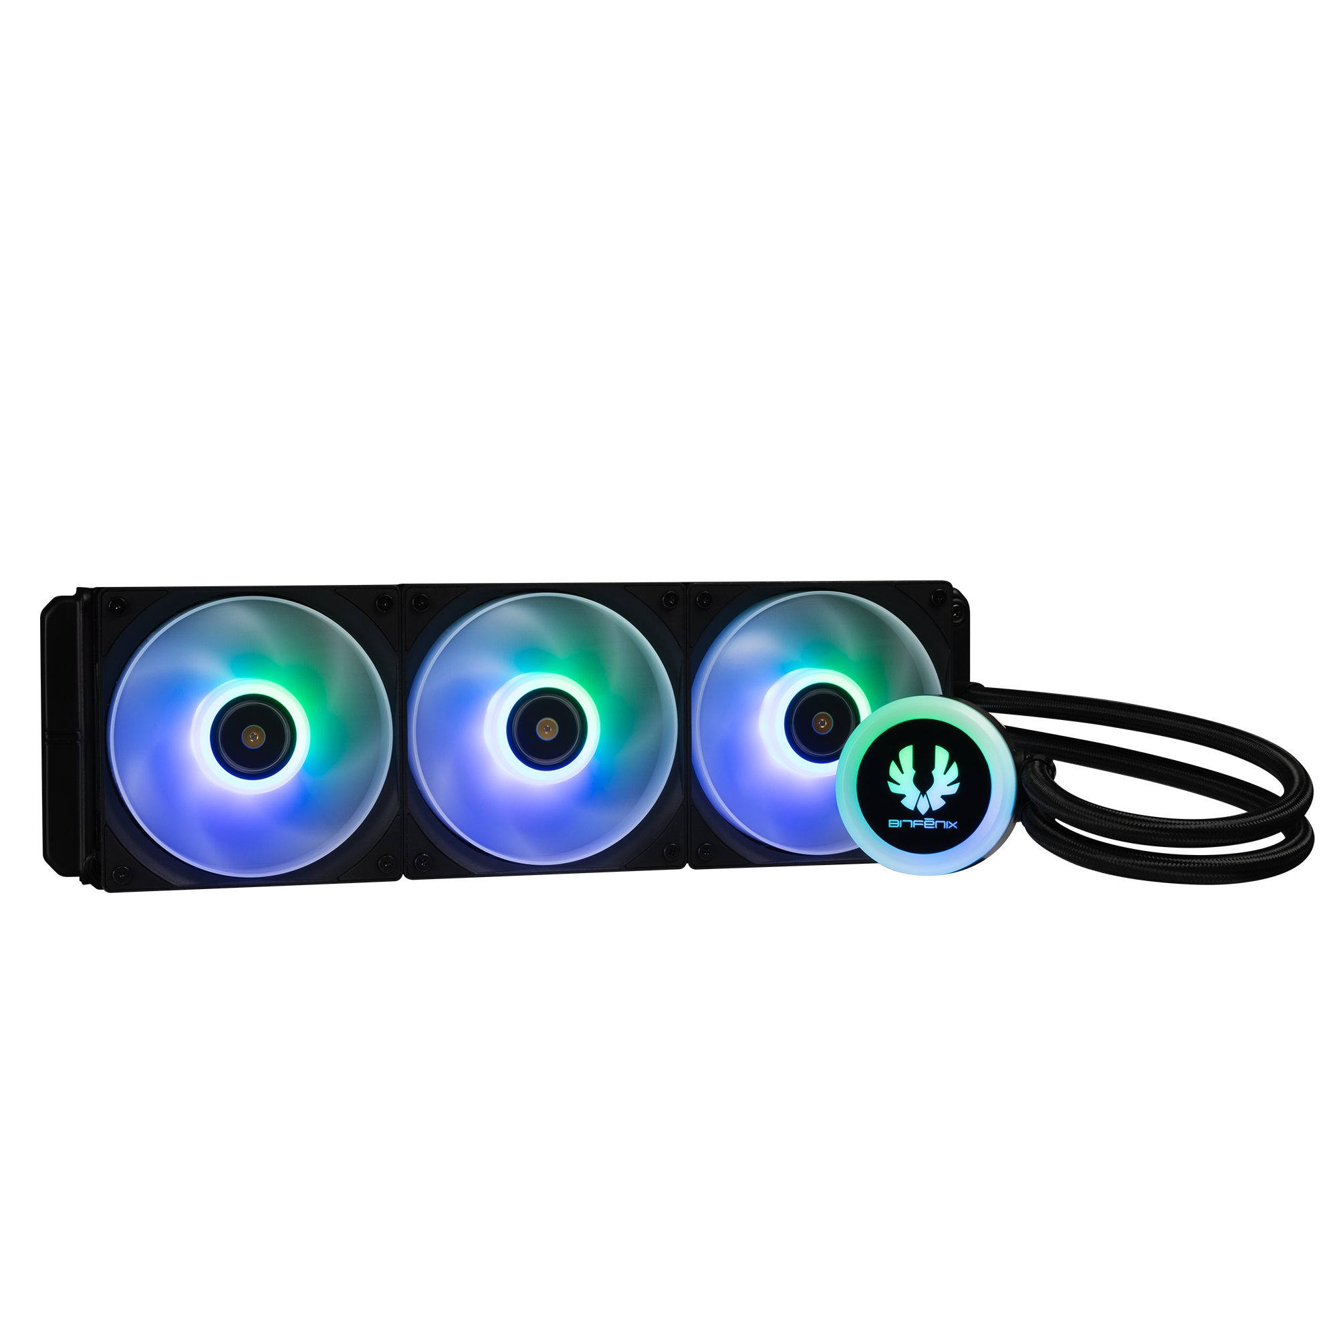
360mm AIO Support At MB Tray & Bottom
140mm
MB
120mm
120mm
120mm
120mm
140mm

Slide 3
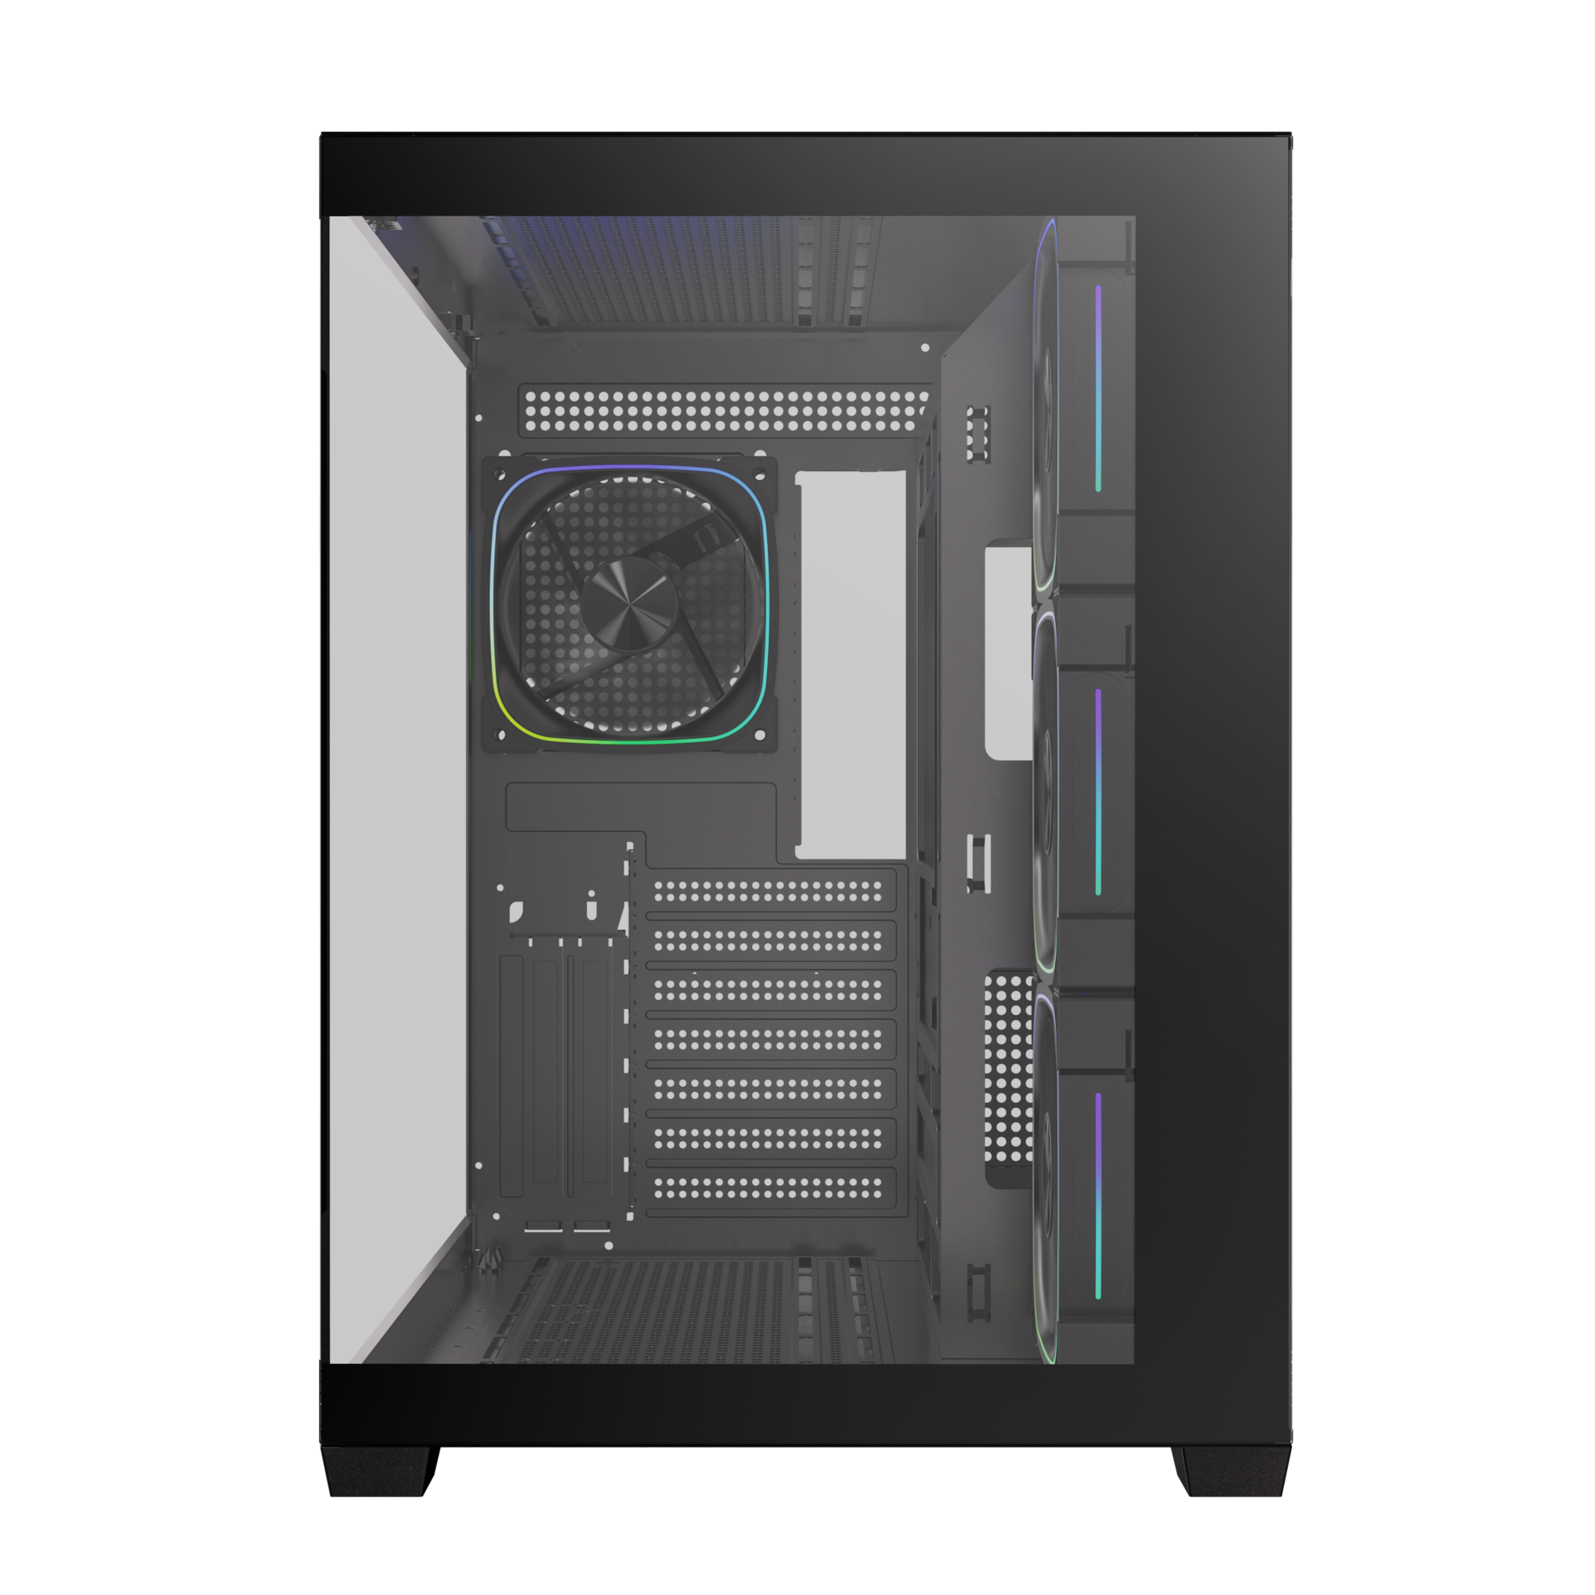
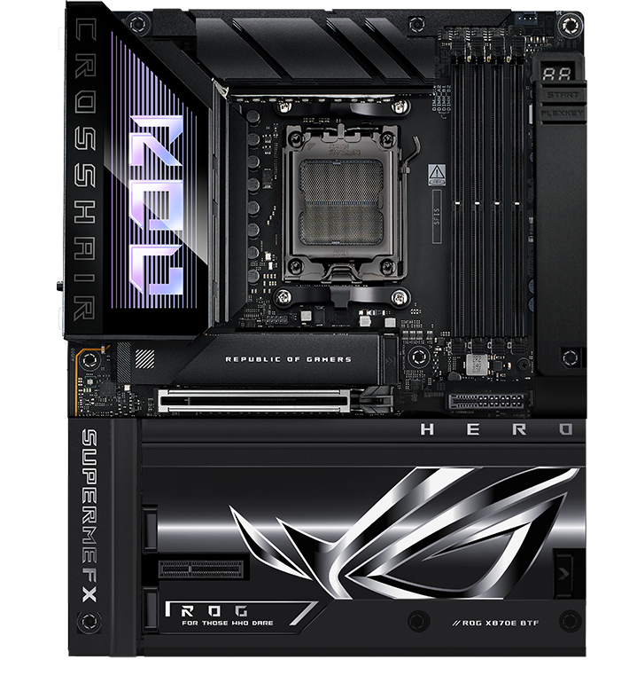
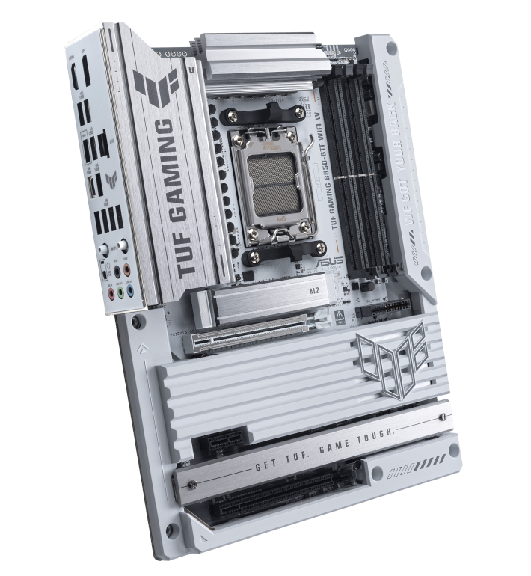
Supports BTF Back-Connect Motherboard
286mm
420mm
Back-Connect Motherboard
Maximun CPU
Cooler Height
Motherboard
Support
175
mm
ITX
M-ATX
ATX
Cable Management Space 90mm
400mm
Maximun Graphics Card
Support
400
mm

Slide 4
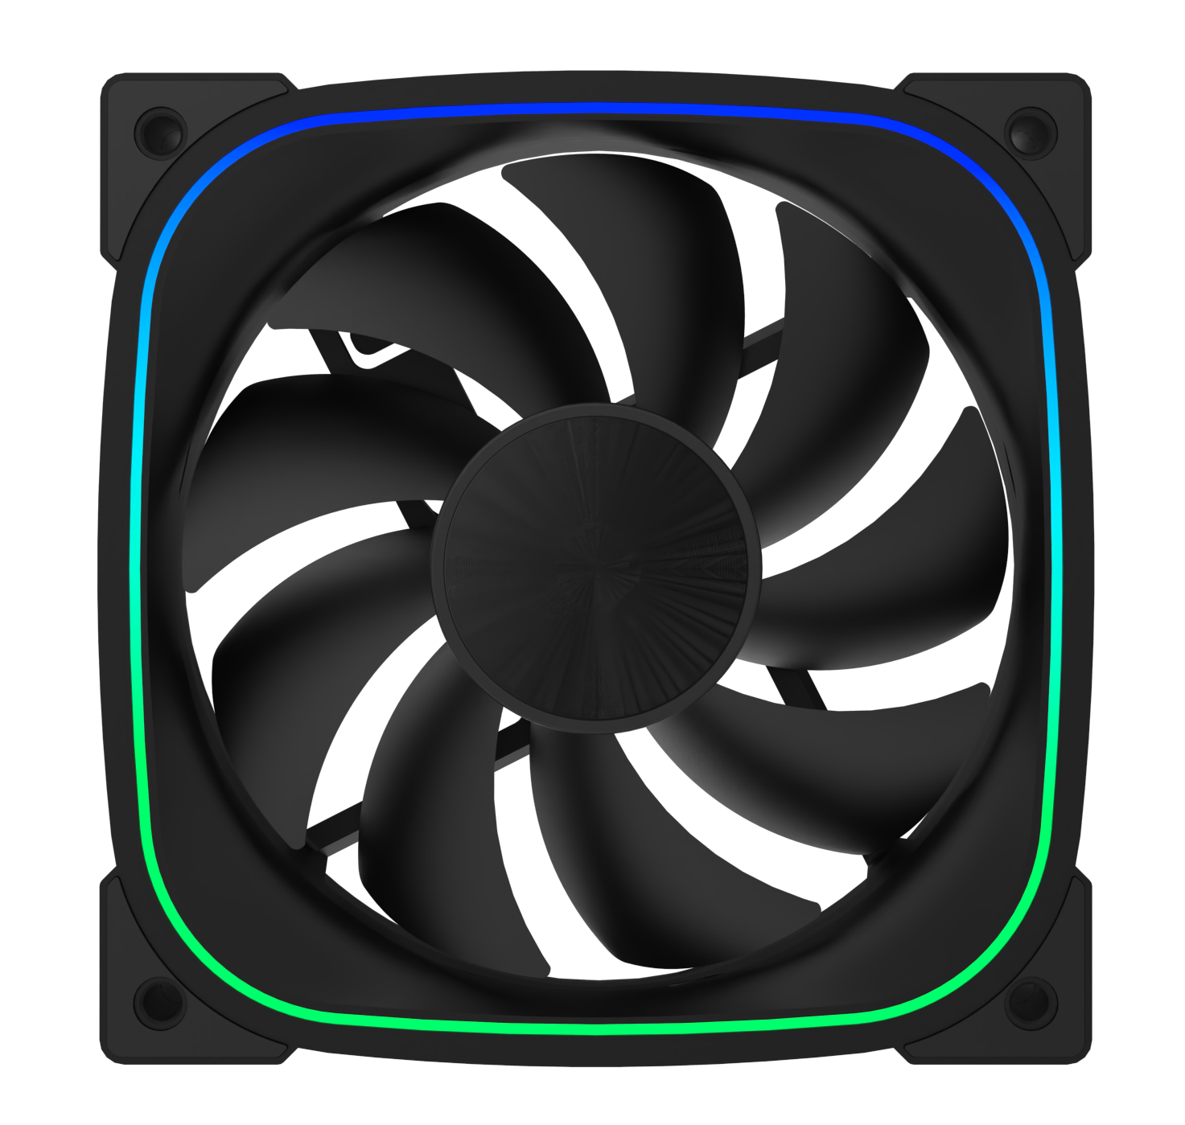
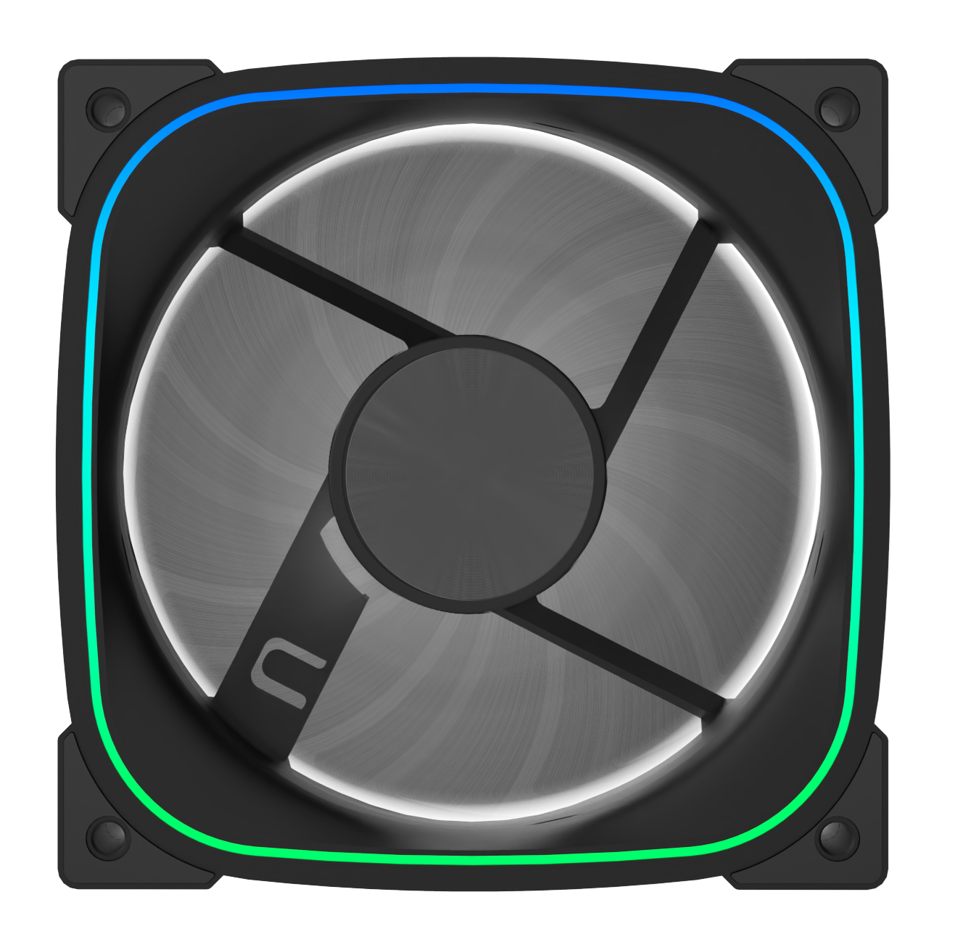

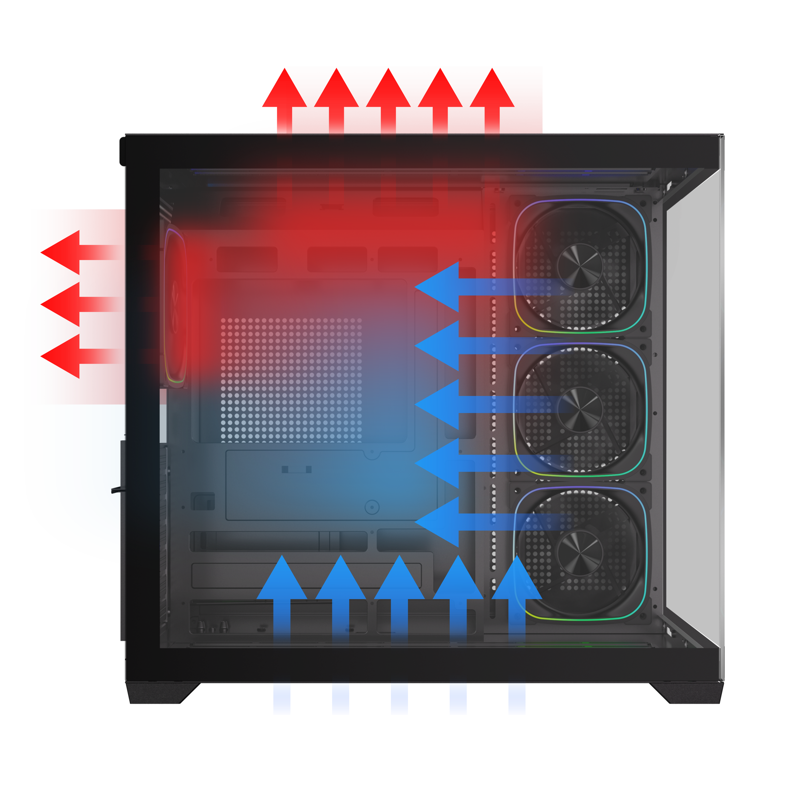
Reverse Infinity
Mirrors ARGB fans
DUAL CHAMBER
HIGH
AIRFLOW PERFORMANCE
3X

Slide 5
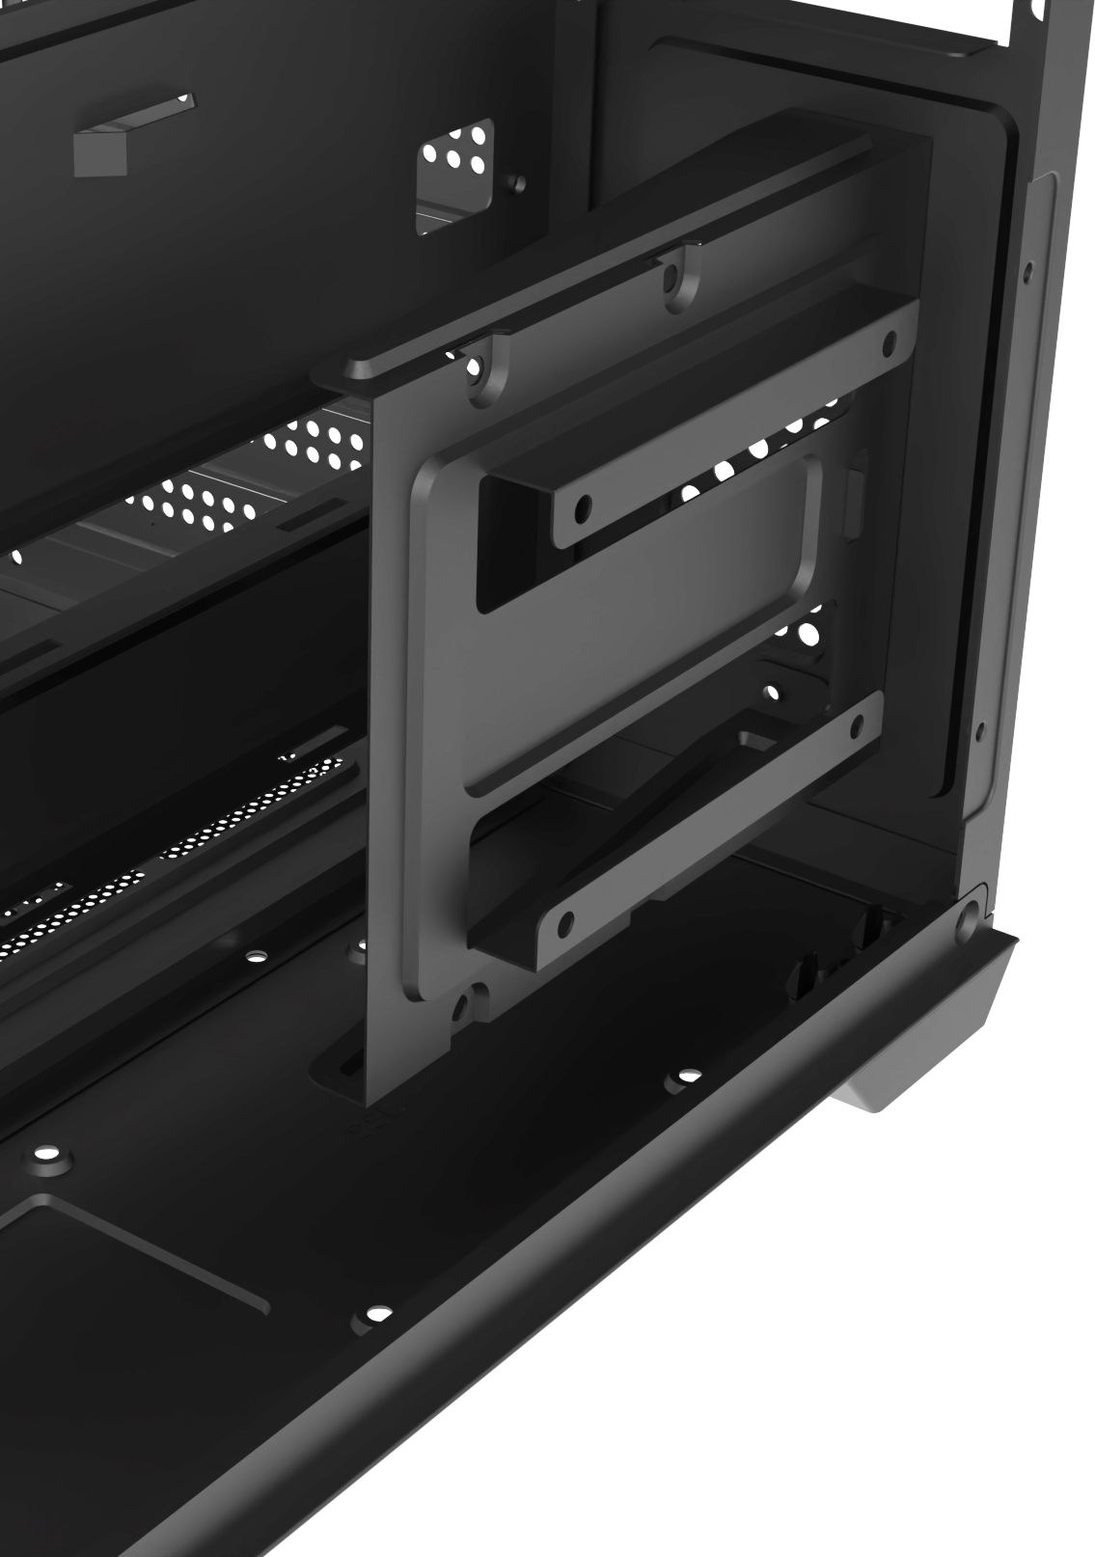
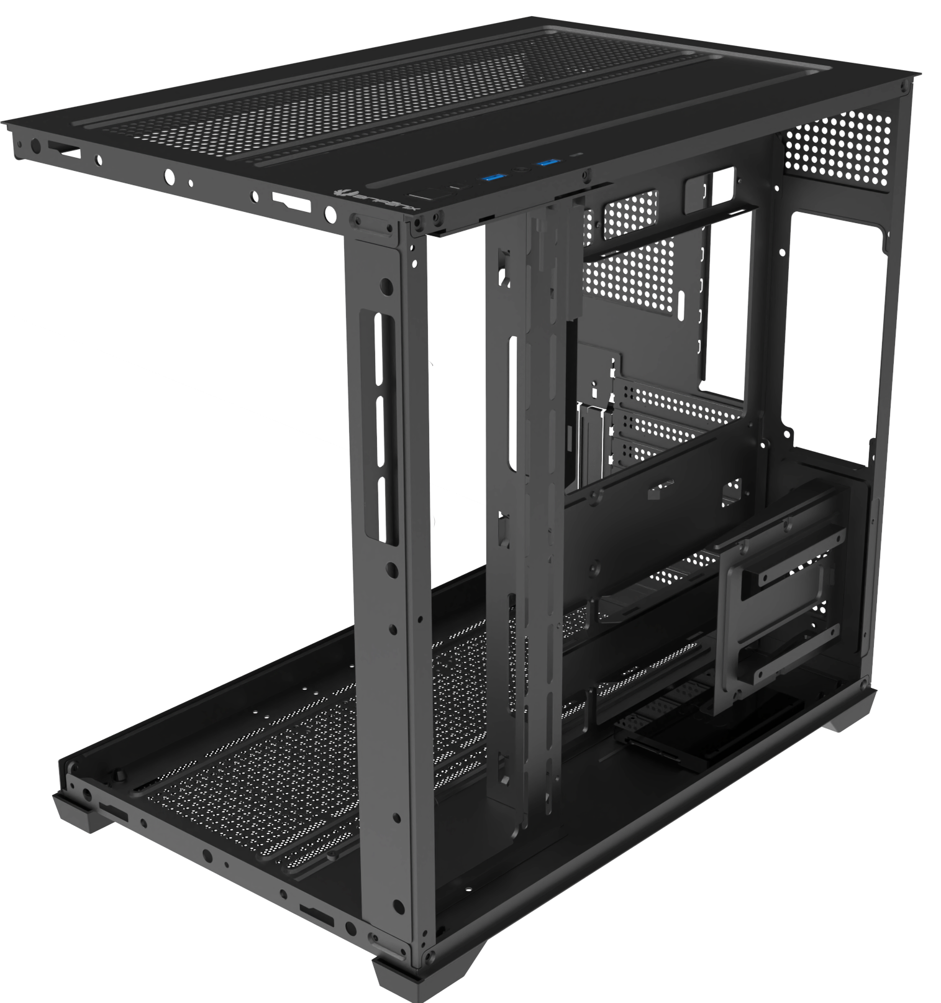
1X SSD & 1X HDD
PSU
ATX & Standard /
up to 190mm
1X SSD
1 X 3.5’’ Drive & 2 X 2.5’’Drive

Slide 6
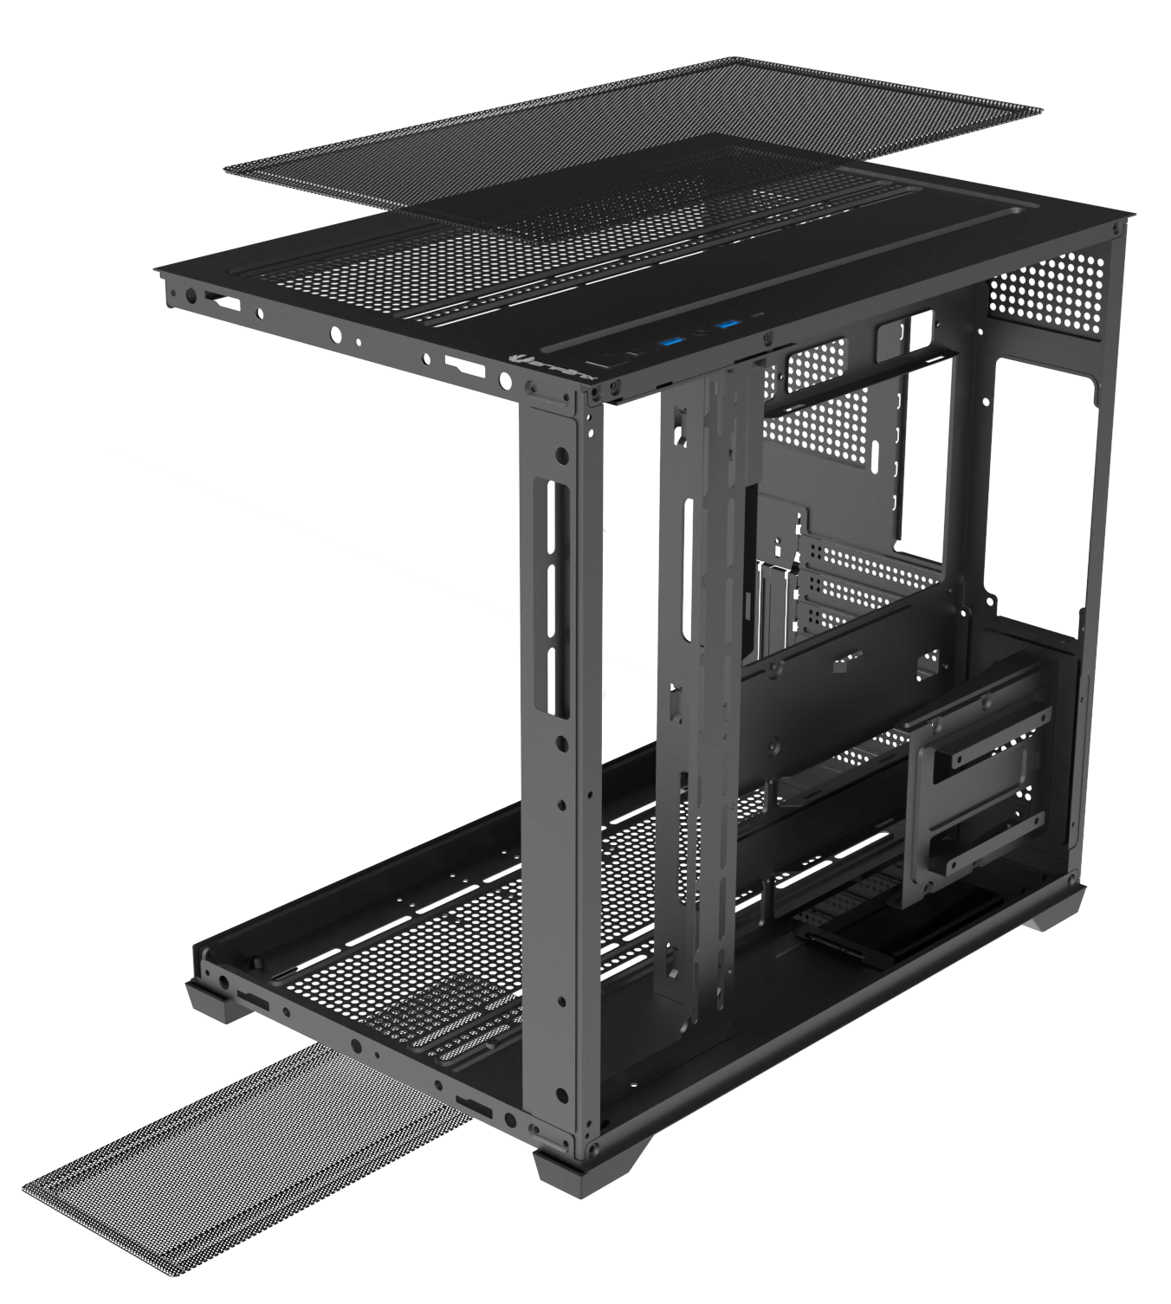
Top
Bottom
Easy Clean With Removable Dust Filters

Slide 7
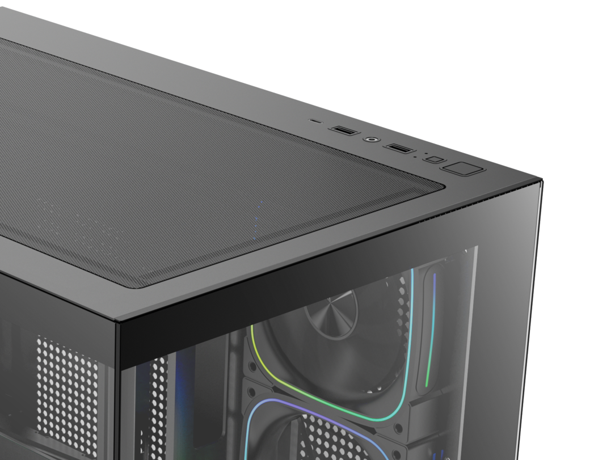
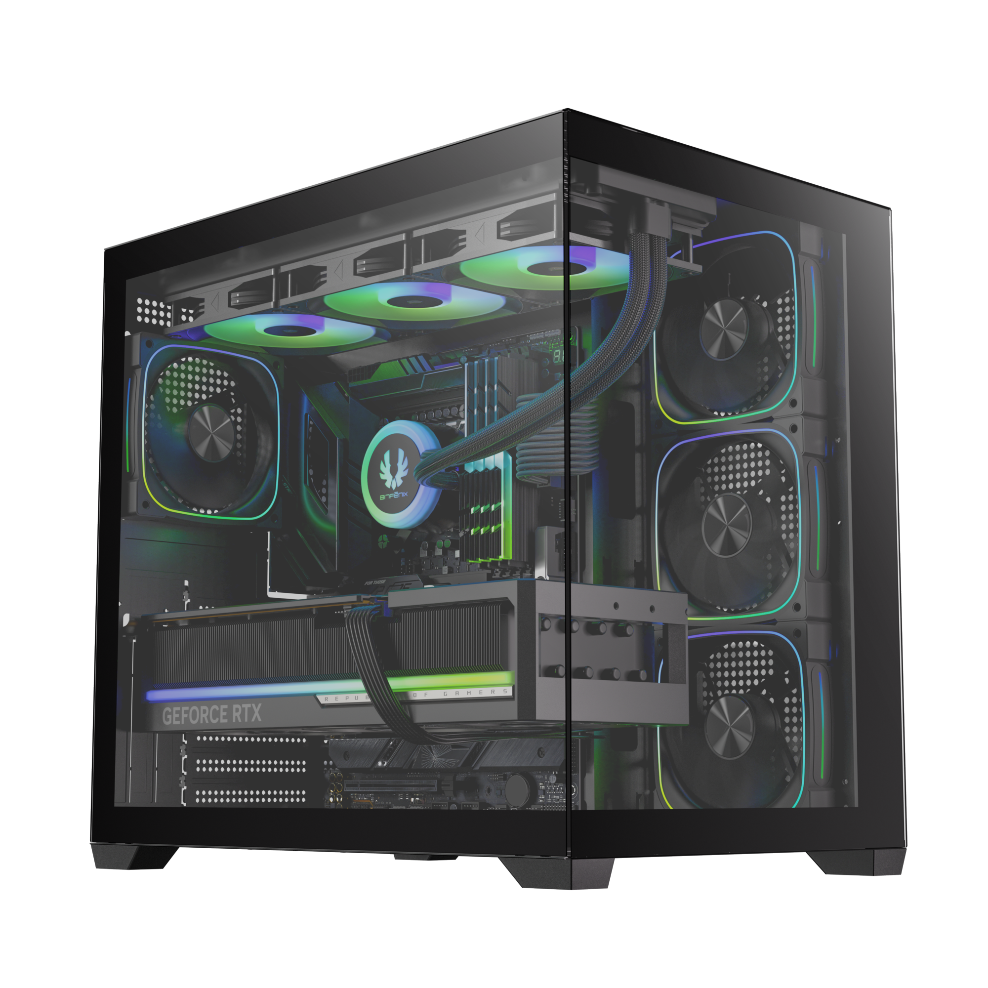
Tool-free Removal
1X USB 3.0 / 1X USB
Power Button
Reset Button

Slide 8
Best |  | Black
Part no. |  | BFC-BEST75KKGKK-4A
EAN |  | 4716779449068
UPC |  | 886027007402
Net weight (NW) Gross weight (GW) |  | N.W: Kgs / G.W: Kgs
Materials |  | Steel, Mesh, Plastic, Tempered Glass
Chassis Dimensions (W x H x D) |  | 280 mm x 400 mm x 420 mm
Motherboard Supports |  | Mini-ITX, MicroATX, ATX
Air Cooler Height Support |  | 175mm
VGA Length Support |  | 400mm
Cable Management Support |  | up to 90mm
2.5" / 3.5" Drive Bay |  | 2 / 1
Fan mounts | MB | 3 x 120mm
 | Top | 3 x 120mm or 2 x 140mm
 | Rear | 1 x 120mm
 | Bottom | 3 x 120mm or 2 x 140mm
Radiator Support | MB | 1 x 360mm/ 1 x 280mm/ 1 x 240mm (Thickness up to 27mm)
 | Top | 1 x 360mm/ 1 x 280mm/ 1 x 240mm (Thickness up to 27mm)
 | Bottom/ Rear | 1 x 360mm/ 1 x 280mm/ 1 x 240mm (Thickness up to 27mm) /1 x 120mm
PCI-E Slots |  | 7 Slots
I/O Ports |  | 1 x USB 3.0/ 1 x USB/ Audio I/O
Power Supply |  | ATX & Standard / up to 190mm
BEST
BEST

