Slide 1

SALES KIT

Slide 2
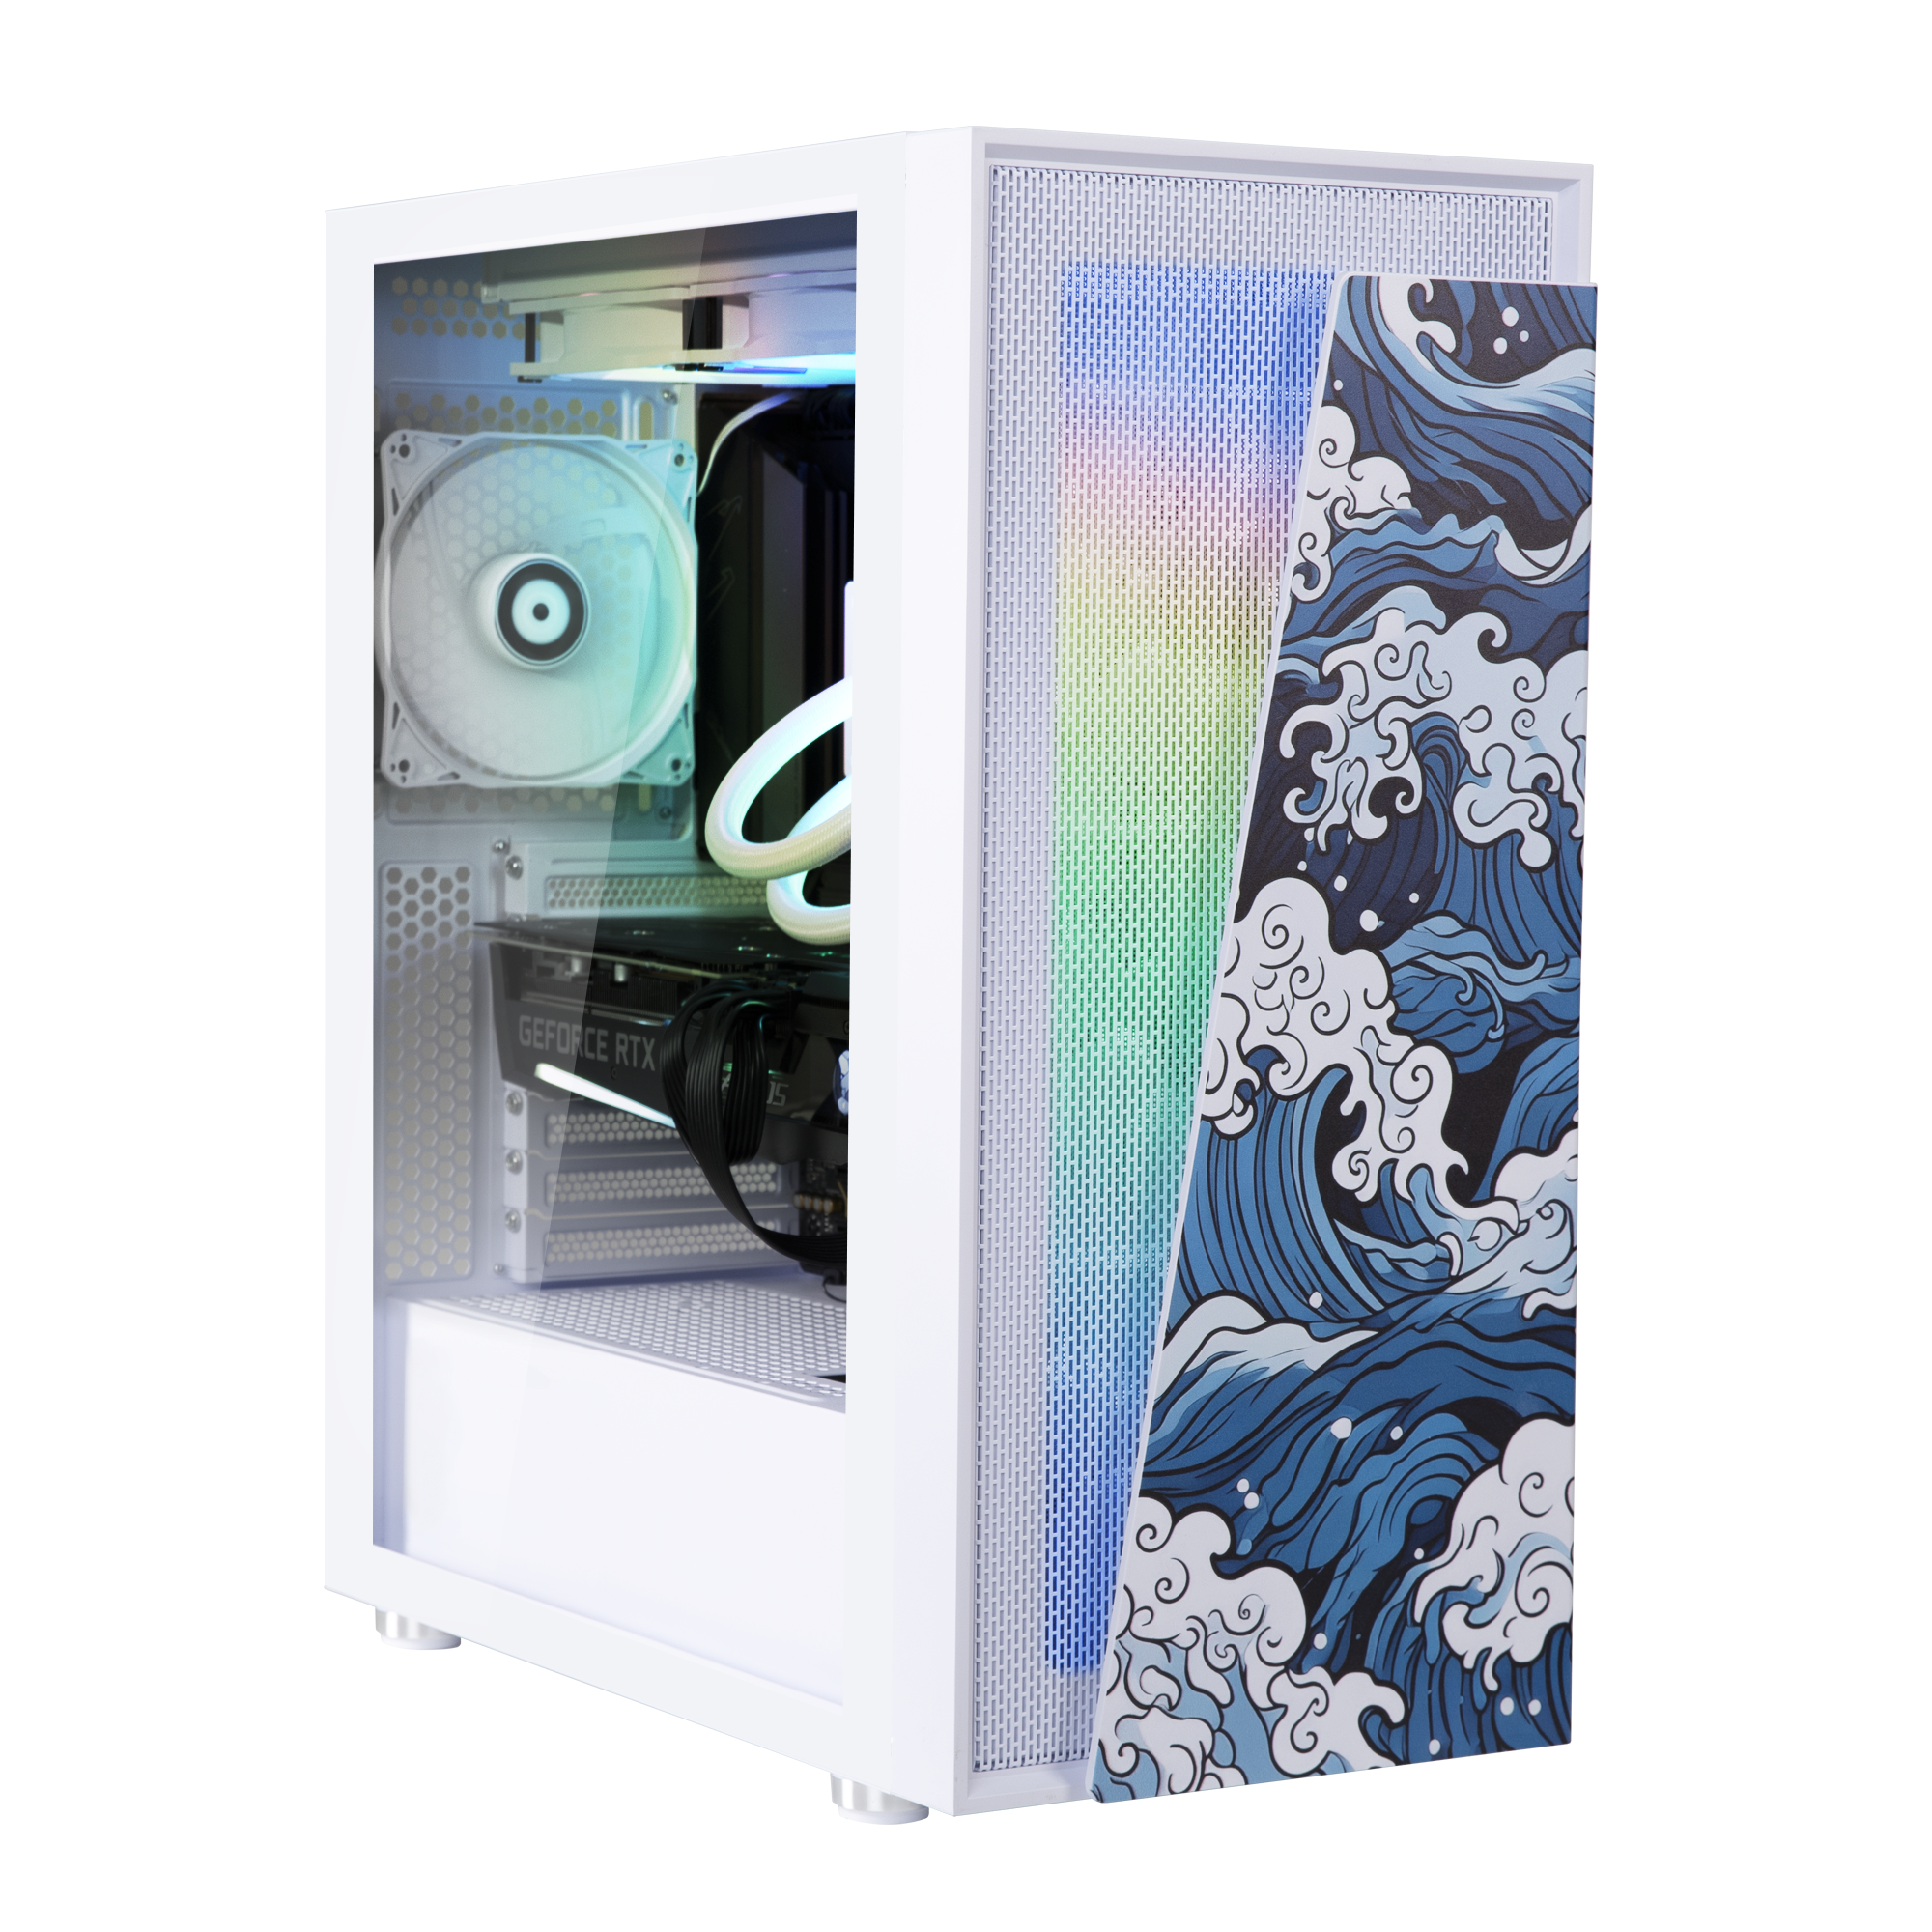
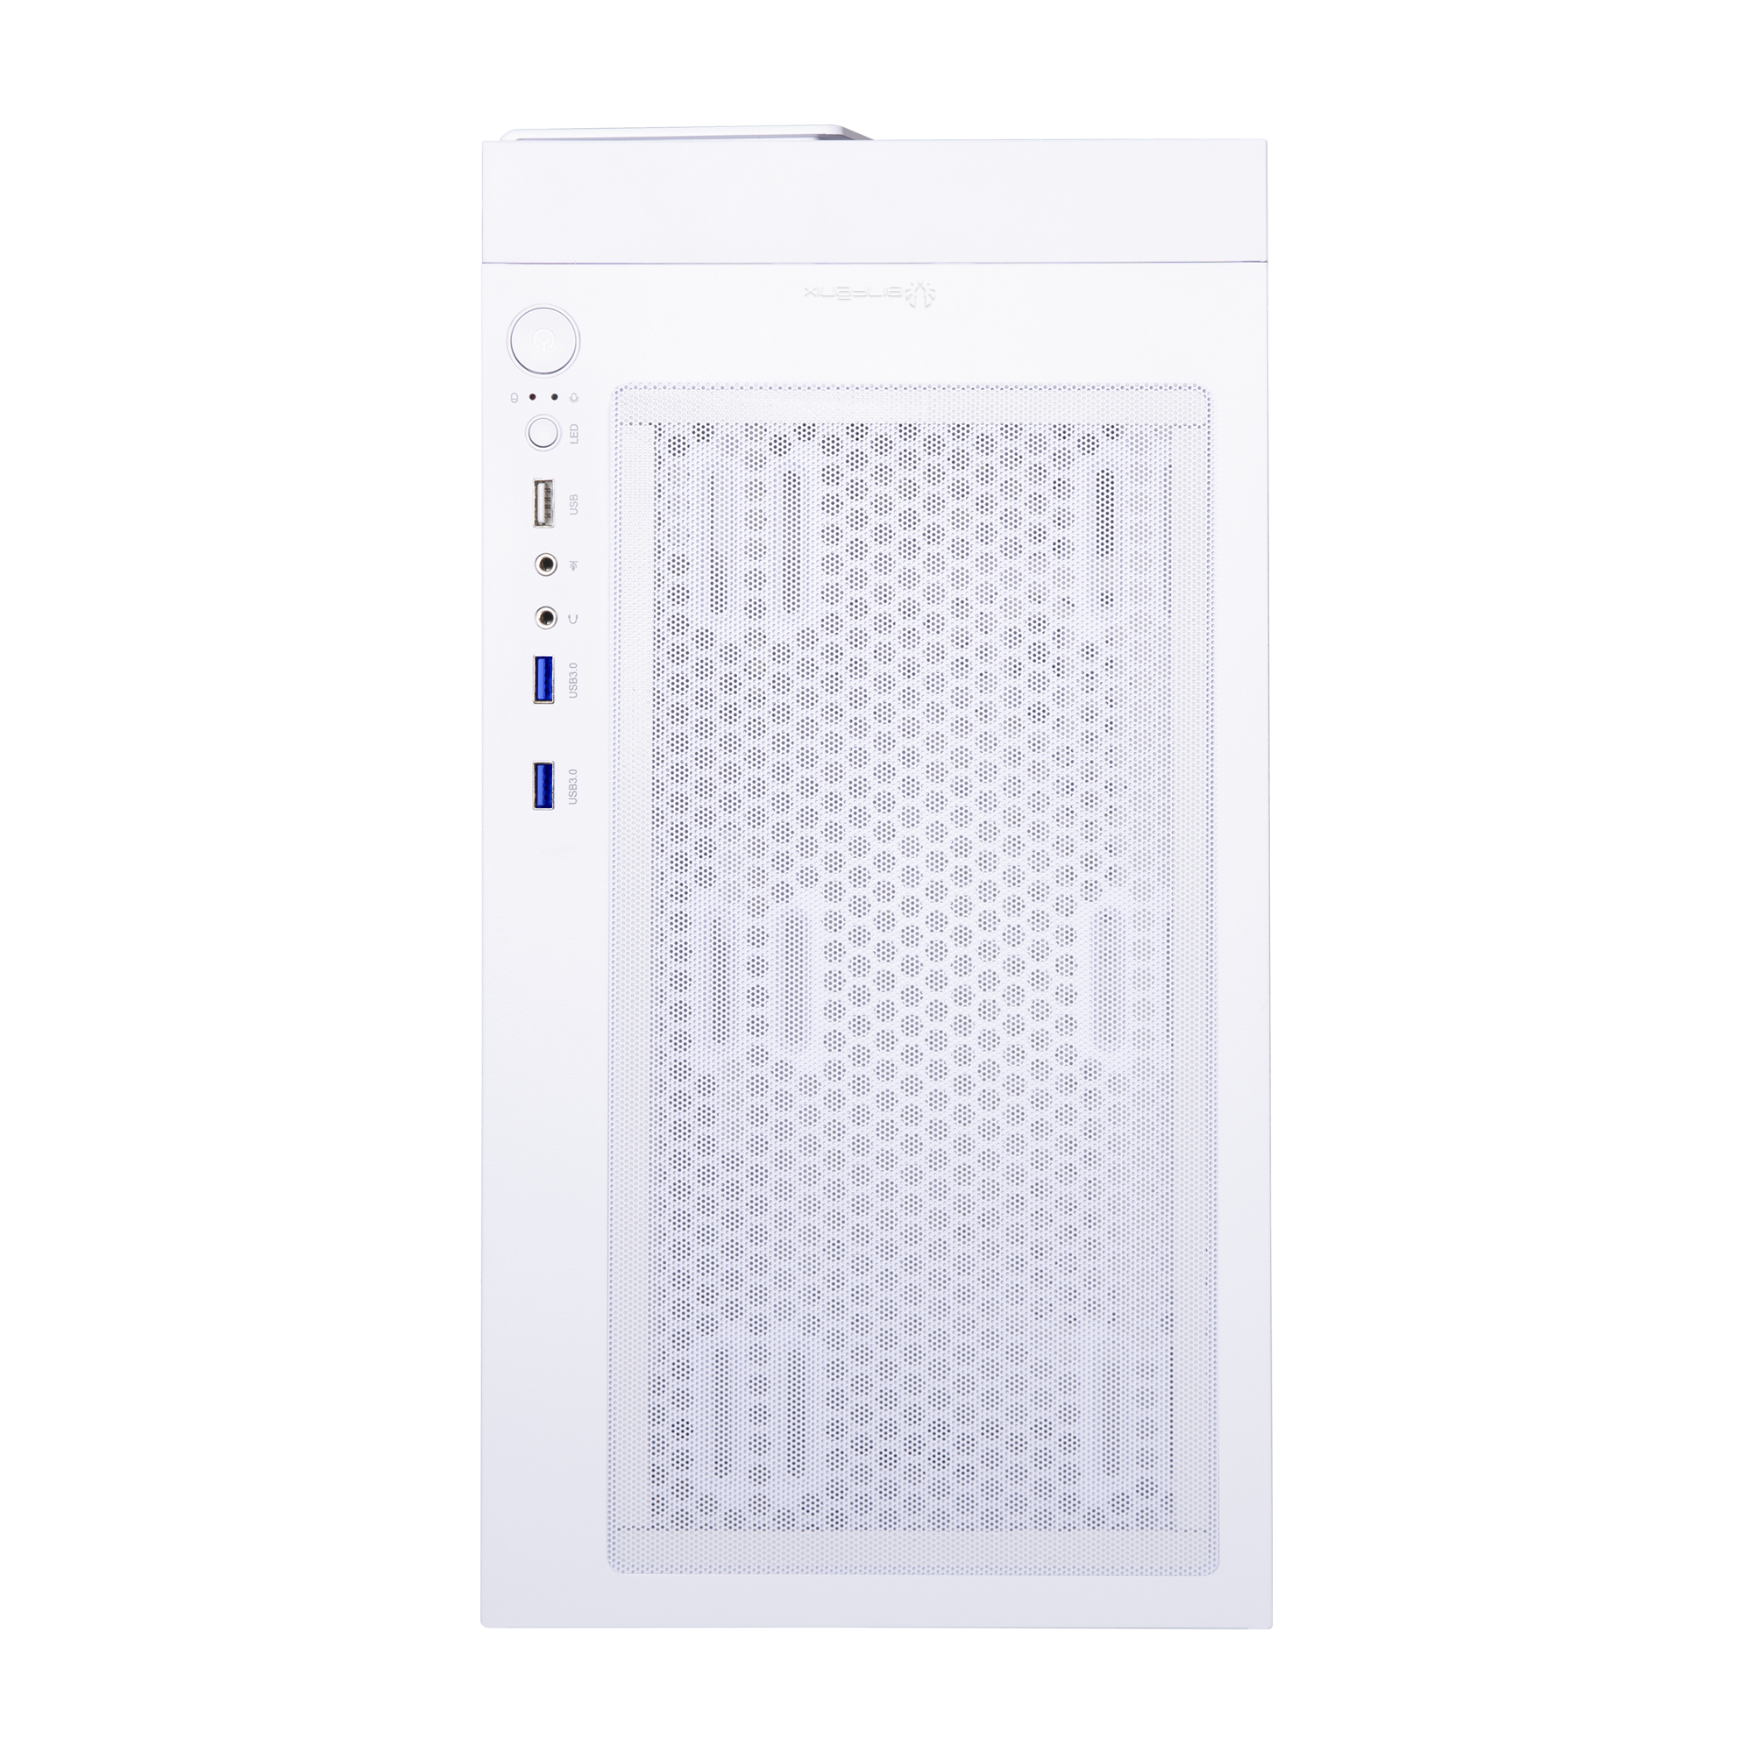
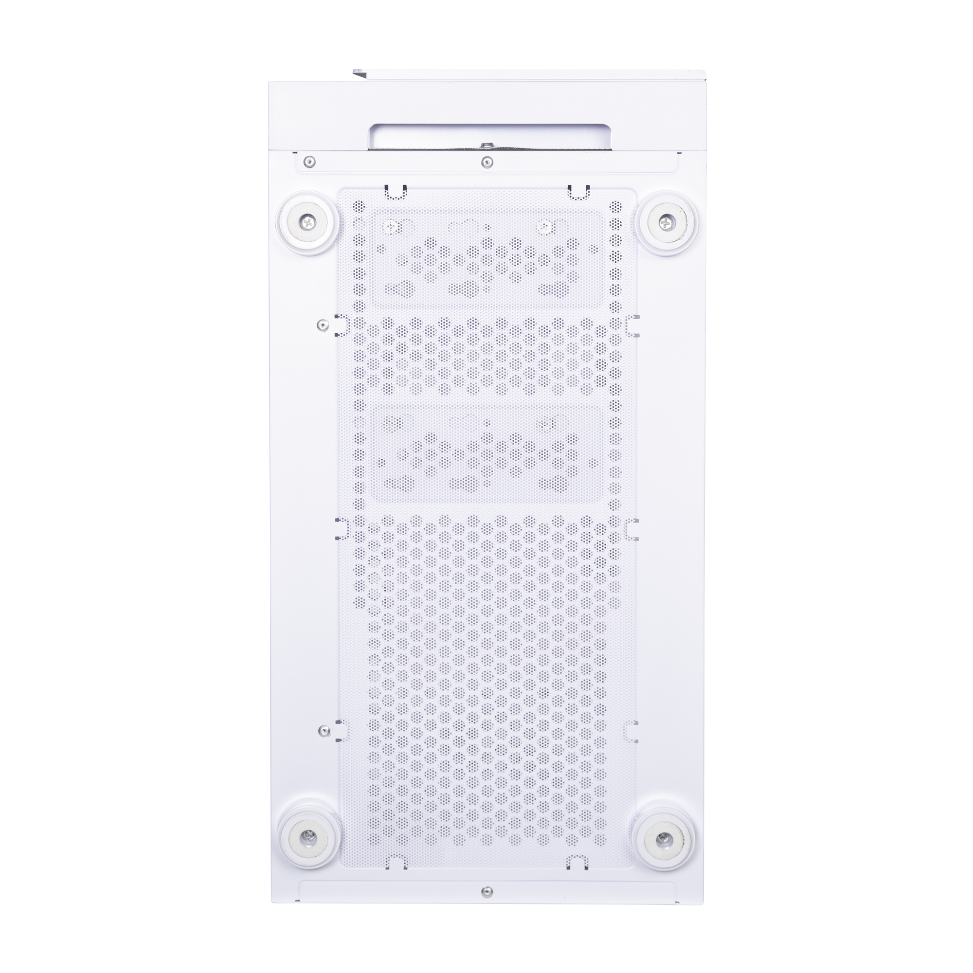
ABOUT
Dust Free Design With Dust Filters
215mm
TOP
BOTTOM
480mm
425mm

Slide 3
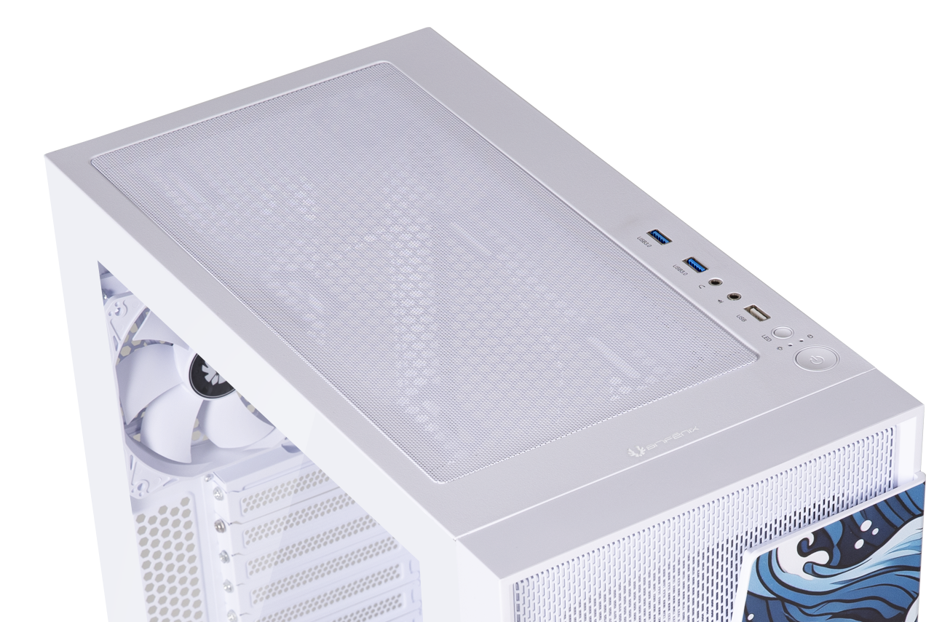
I/O Ports
HD AUDIO
MIC
2X
USB3.0
1XUSB
RESET
POWER

Slide 4
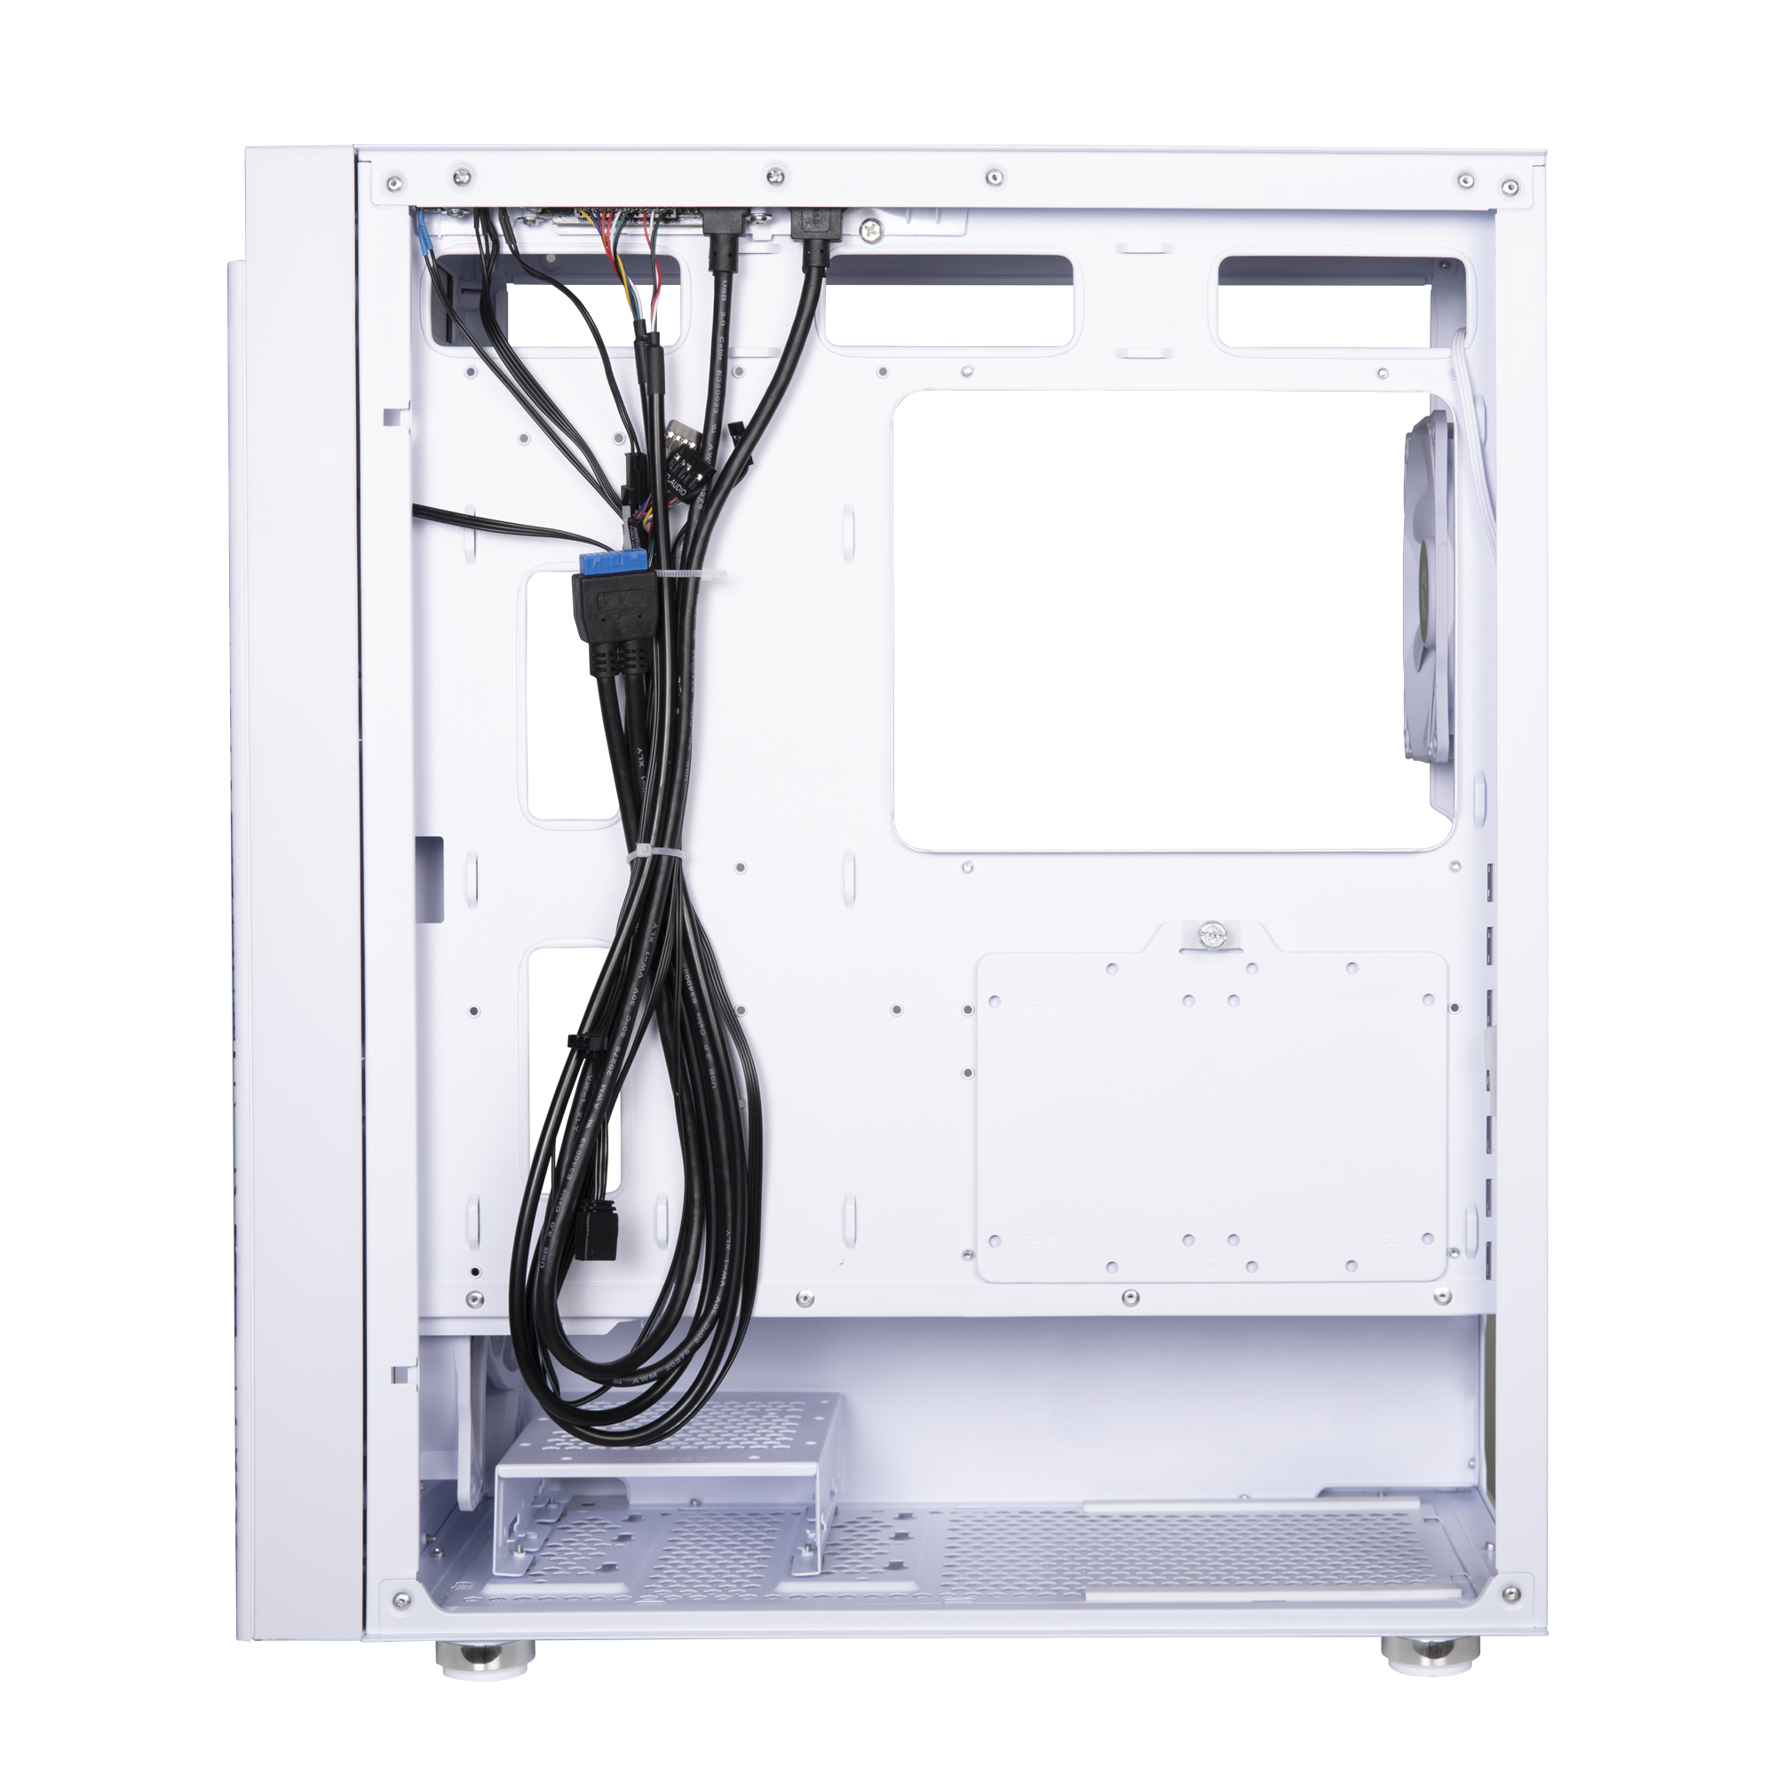
Space-Efficient Interior
A
2.5”SSD
OR
B
A
A
B
3.5”HDD
A
B
B
B

Slide 5
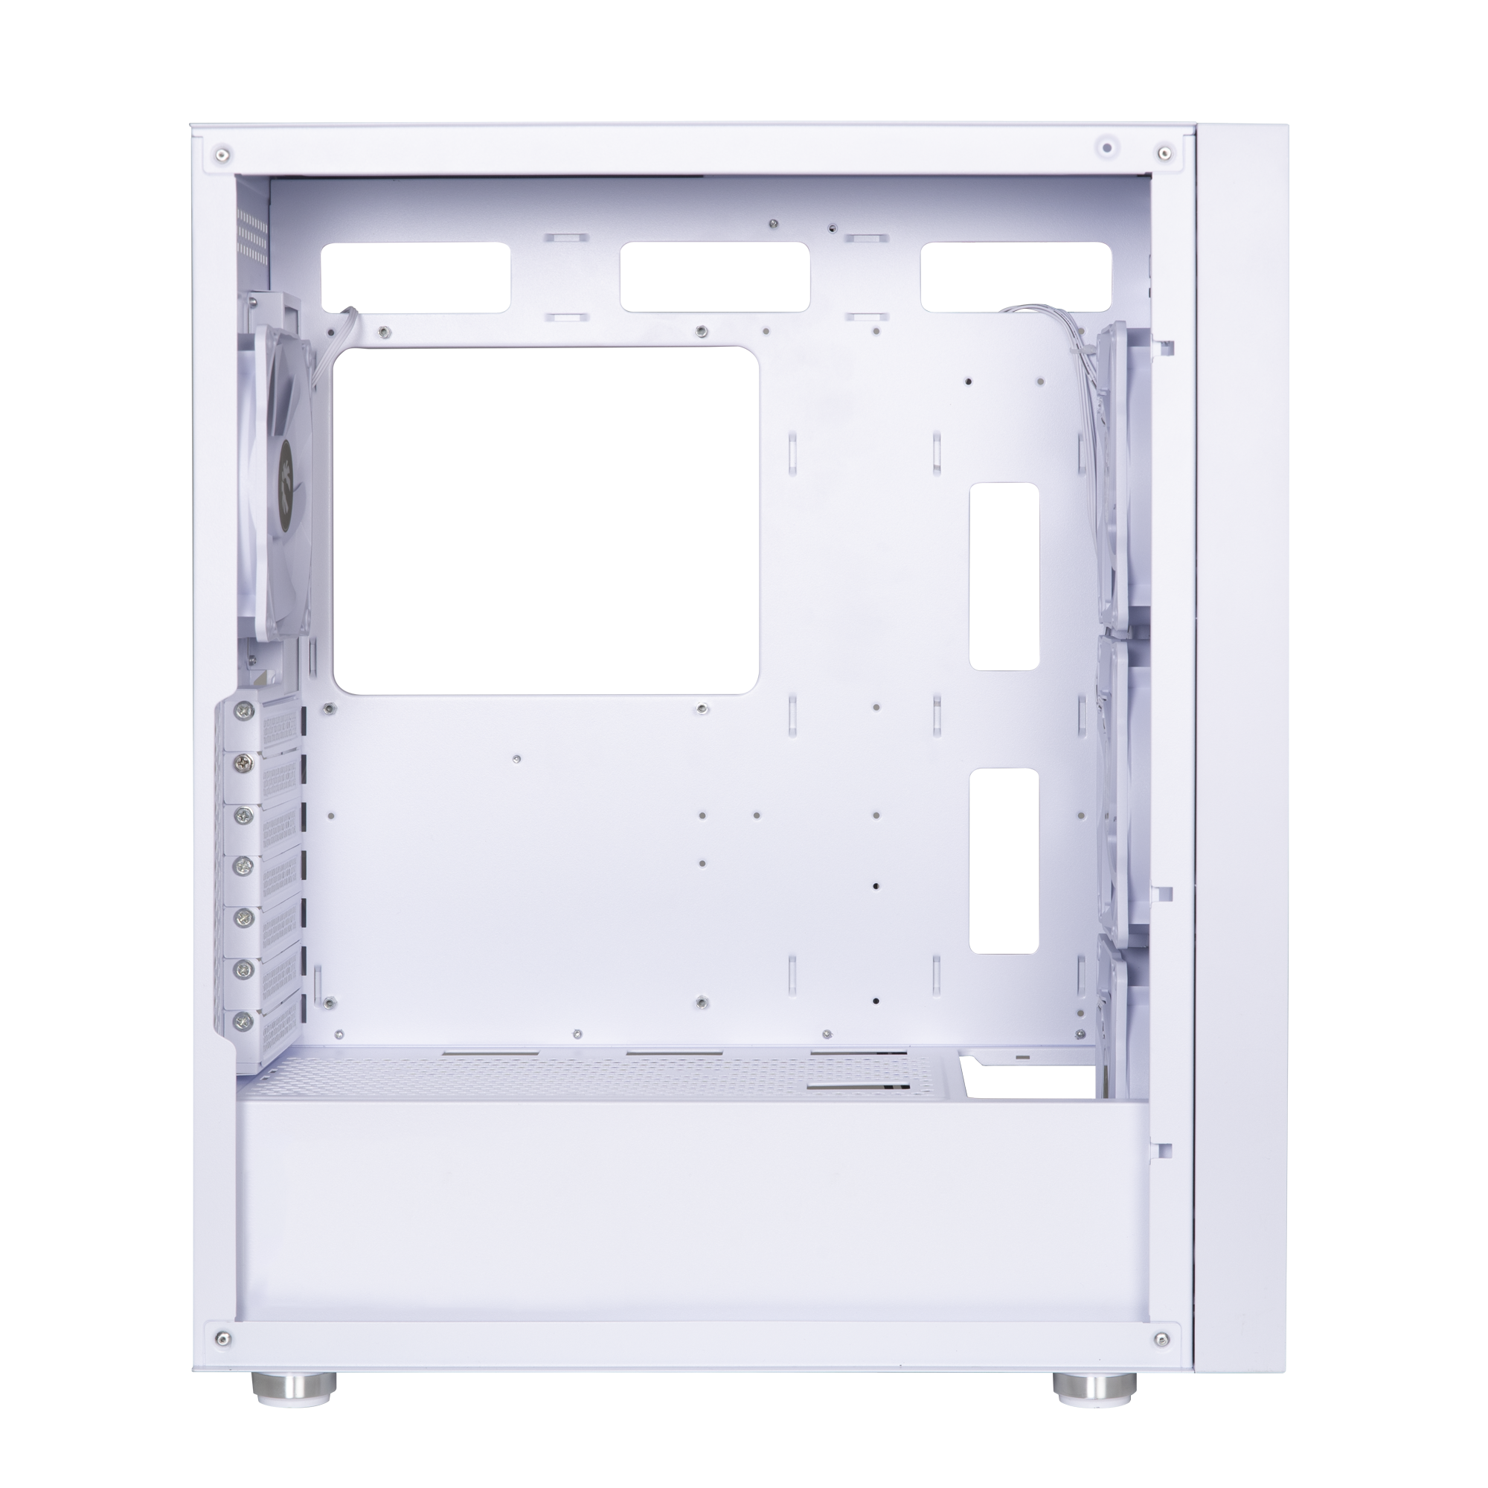
A
Motherboard Support
Mini-ITX, Micro ATX, ATX
A
D
B
CPU Cooler Height
B
≤ 165mm
C
C
Max. VGA Card Length
≤ 350mm
D
Front Radiator Space
Thickness up to 27mm

Slide 6
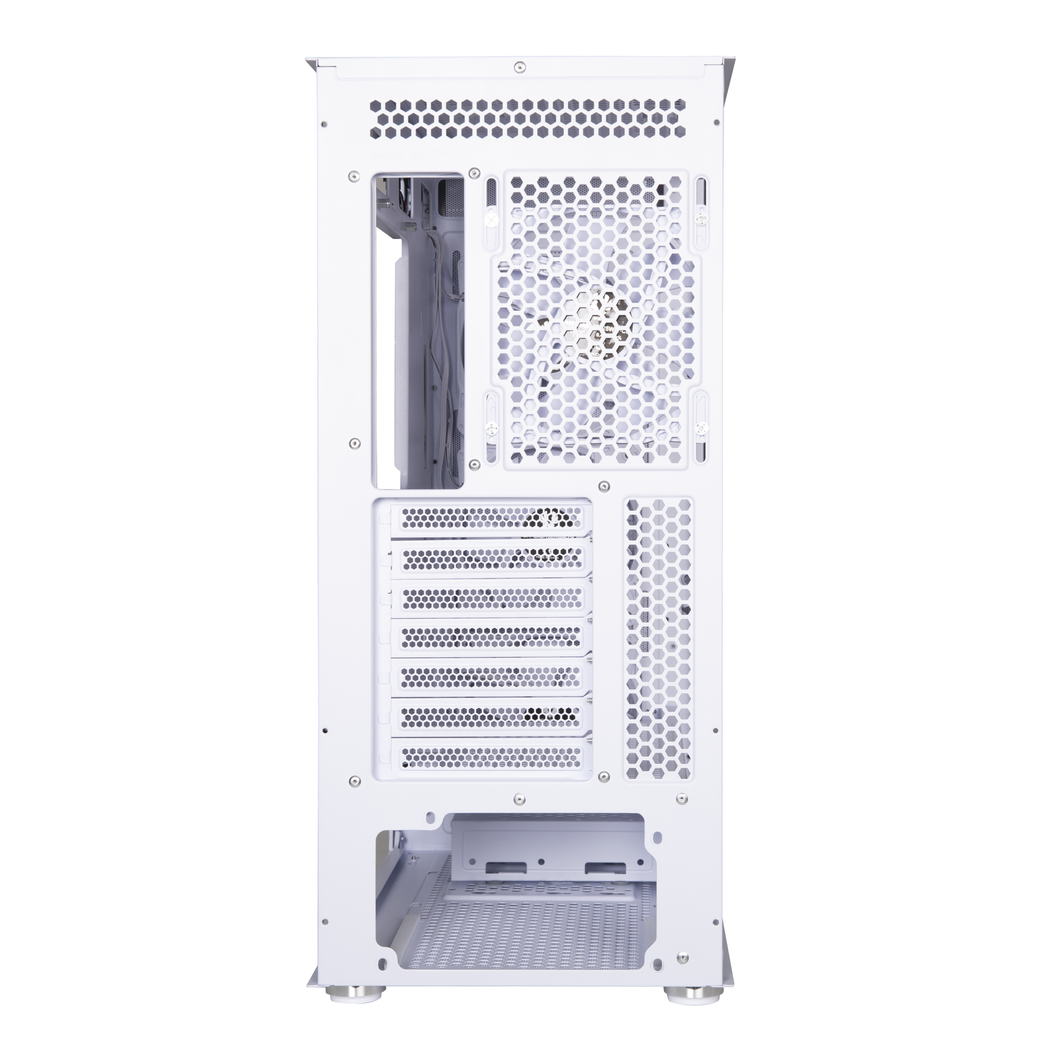
F
E
Max PSU Length
≤ 200mm
F
Cable management Space
up to 28mm
E

Slide 7


120 mm
140 mm
FRONT
3 x 120mm or 2 x 140mm
TOP
2 x 120mm or 2 x 140mm
REAR
1 x 120mm or 1 x 140mm

Slide 8





RADIATOR CAPACITY
240 mm
280 mm
240 mm
280 mm
360 mm
120 mm
140 mm
120 mm
240 mm
280 mm
360 mm

Slide 9
Artemis
Part no. |  | BFC-ATS-400-WWGXP-PC
EAN |  | 4712883219252
UPC |  | 886027160756
Net weight (NW) Gross weight (GW) |  | N.W:5.4Kgs / G.W:6.5Kgs
Materials |  | Steel, Mesh, Plastic, Tempered Glass
Chassis Dimensions (W x H x D) |  | L425*W215*H480 mm
Motherboard Supports |  | Mini-ITX, MicroATX, ATX
M-ATX Motherboard Supports |  | 305mm x244mm
Air Cooler Height Support |  | 165mm
VGA Length Support |  | 350mm
Cable Management Support |  | up to 28m
3.5" Drive Bay |  | 2+1
2.5" Drive Bay |  | 2+1
Fan mounts | Front | 3 x 120mm or 2 x 140mm
 | Top | 2 x 120mm or 2 x 140mm
 | Rear | 1 x 120mm or 1 x 140mm
Radiator Support | Front | 360mm x 1/280mm x 1/ 240mm x 1 (Thickness up to 27mm)
 | Top | 240mm x 1/ 280mm x 1 (Thickness up to 27mm)
 | Rear | 120mm x 1
PCI-E Slots |  | 7 Slots
I/O Ports |  | 2 x USB 3.0, 1 x USB, Audio I/O
Power Supply |  | ATX & Standard / up to 200mm (Suggest up to 200mm)

