Slide 1



Slide 2



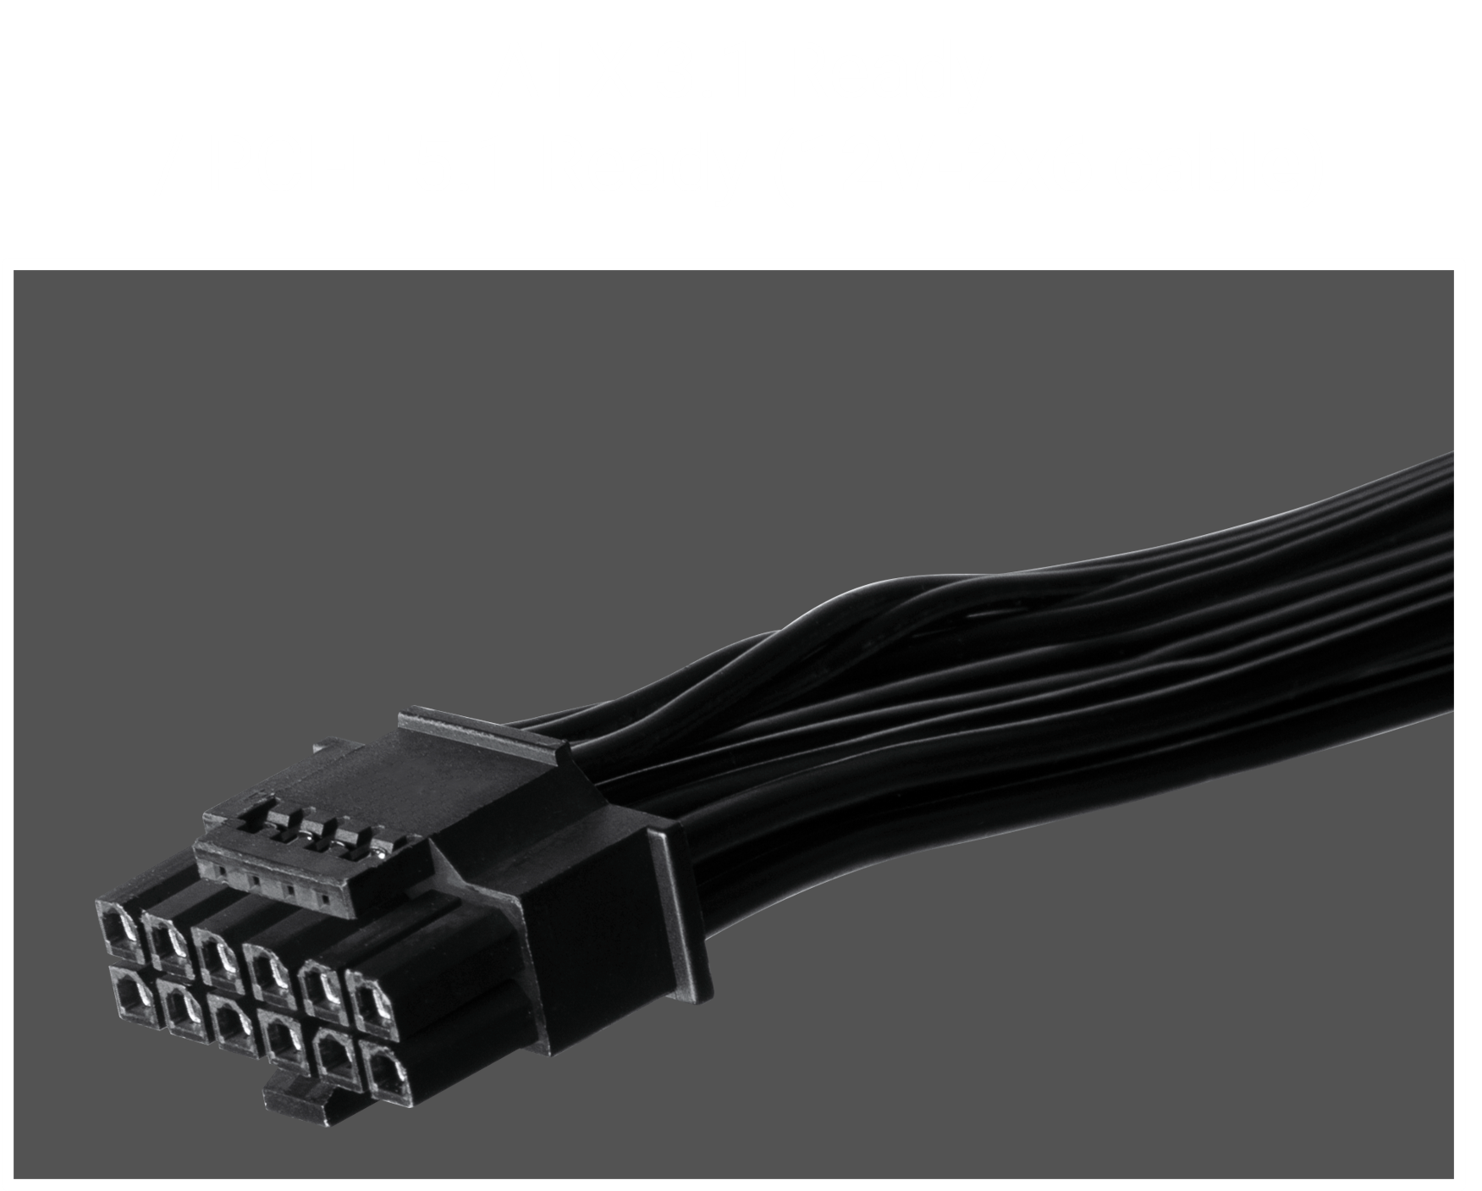
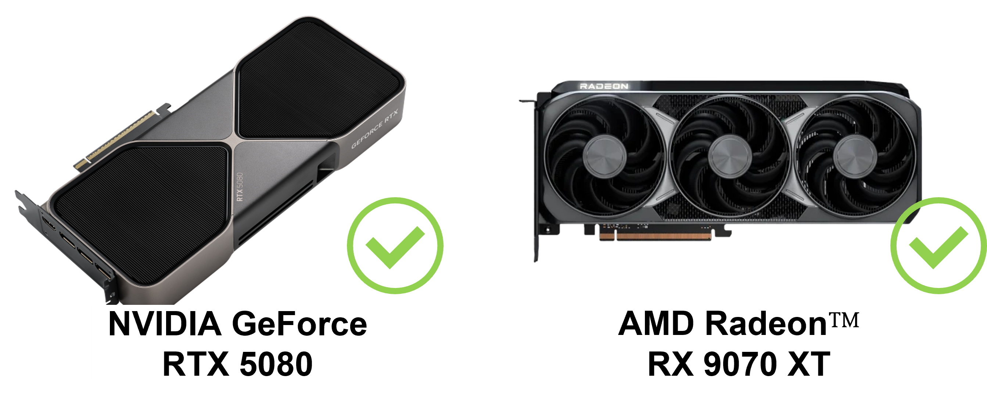
ATX 3.1 Support.
BAPB 3.1 850W & BPAB 3.1 750W
PCIe Gen 5.1 Support for NV 50+ & 9000 Series GPUs. ( BAPB 3.1 850W & BPAB 3.1 750W )
Please use the correct cable according to the requirements of the graphics card wattage, and must be correctly installed on the graphics card interface.

Slide 3
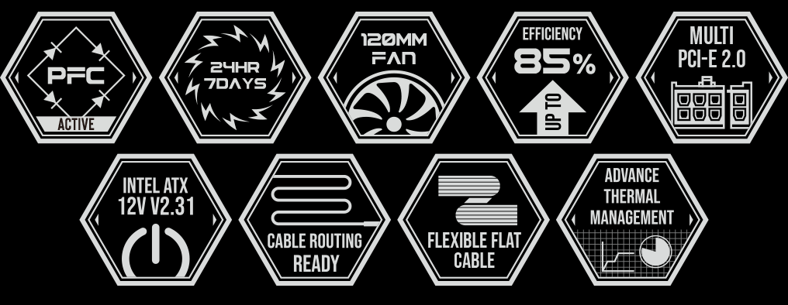

Slide 4
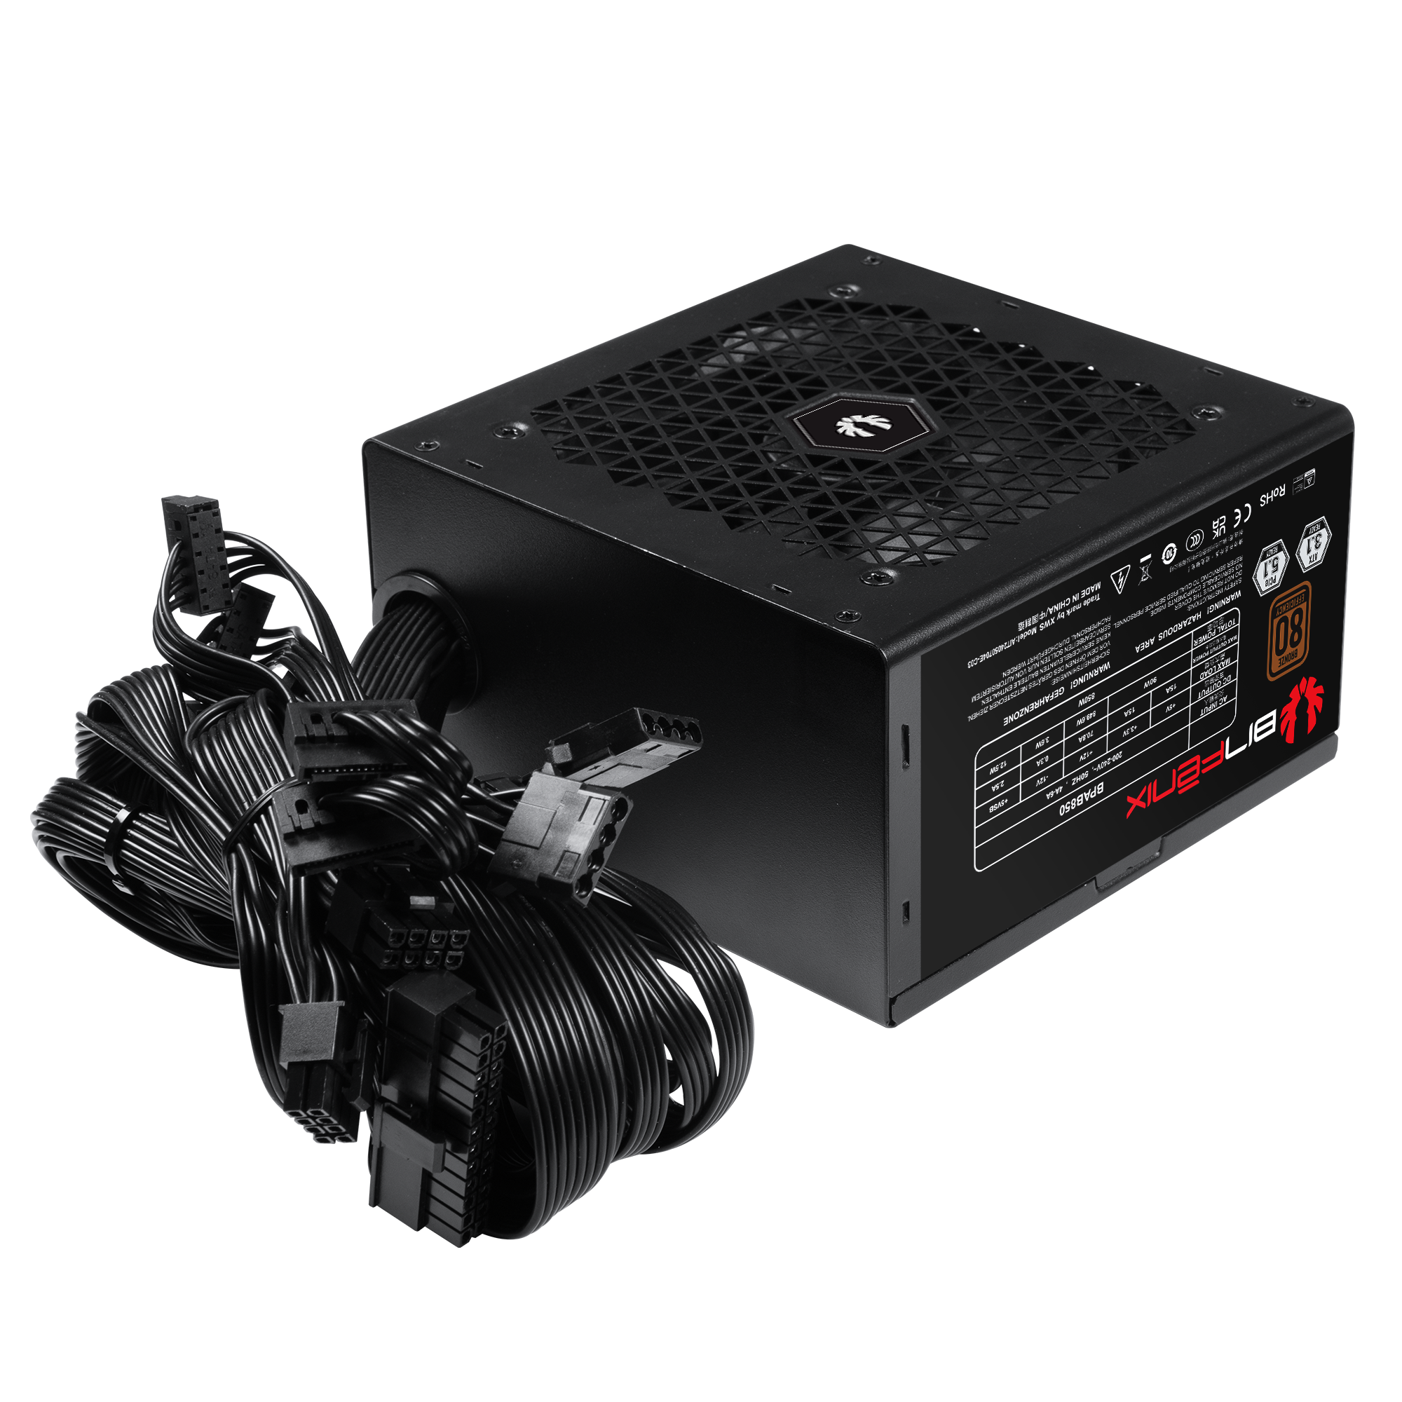
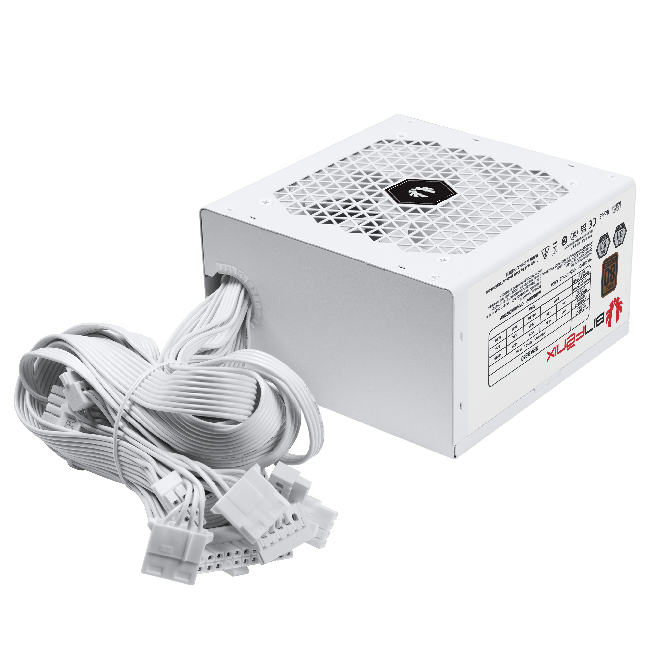

Introduction
The BitFenix BPAB power supply series provides the perfect balancerformance. The BPAB Series is a stable and efficient power source with an economical power demand, while providing the compatibility and reliability BitFenix is known and trusted for. The line-up includes of 750W /850W power supplies e between efficiency and performance.

Slide 5


High Efficiency
The BPAB series supports 200-240V and has received Bronze 80Plus certification. The standard BPAB series is guaranteed to have an efficiency of at least 85% at 50% of typical load during normal use.

Slide 6


Continuous Power
With an Active Power Factor of 0.96 a stable and continuous power output is assured, protecting the components from uneven power delivery and providing the wattage as rated on each model of the BPA Series.
Low Noise
The 120mm silent fan is controlled by BitFenix smart thermal management circuit, optimizing the fan curve and only spinningat maximum speed when the power supply is running at full load.

Slide 7
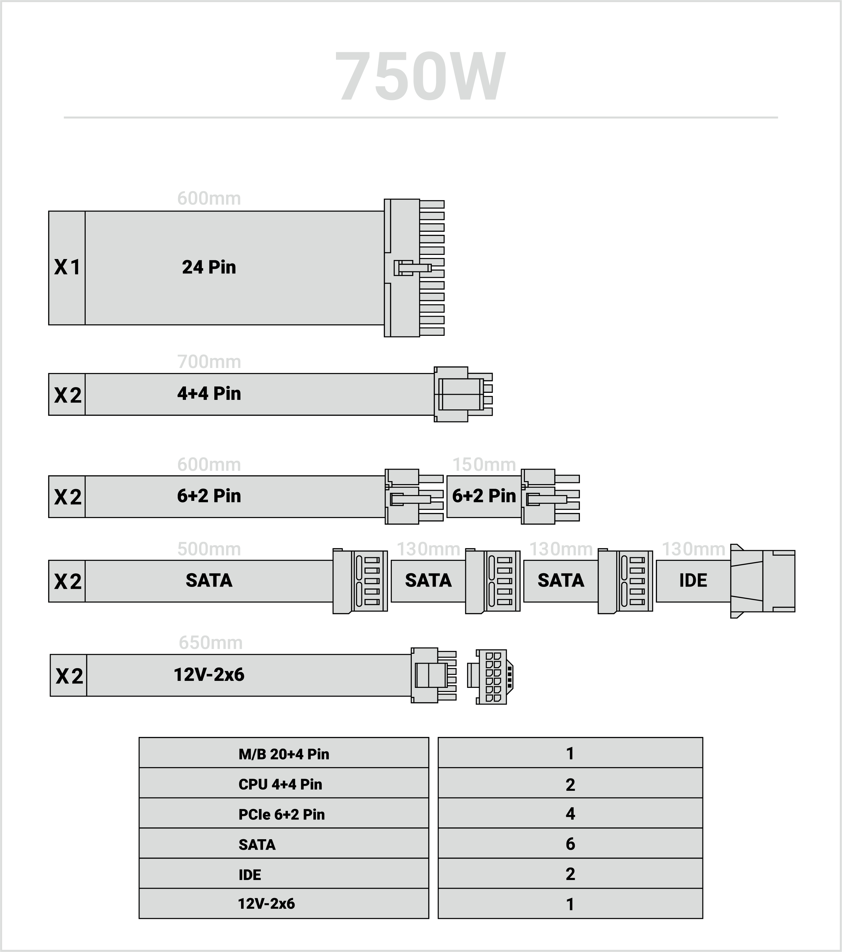
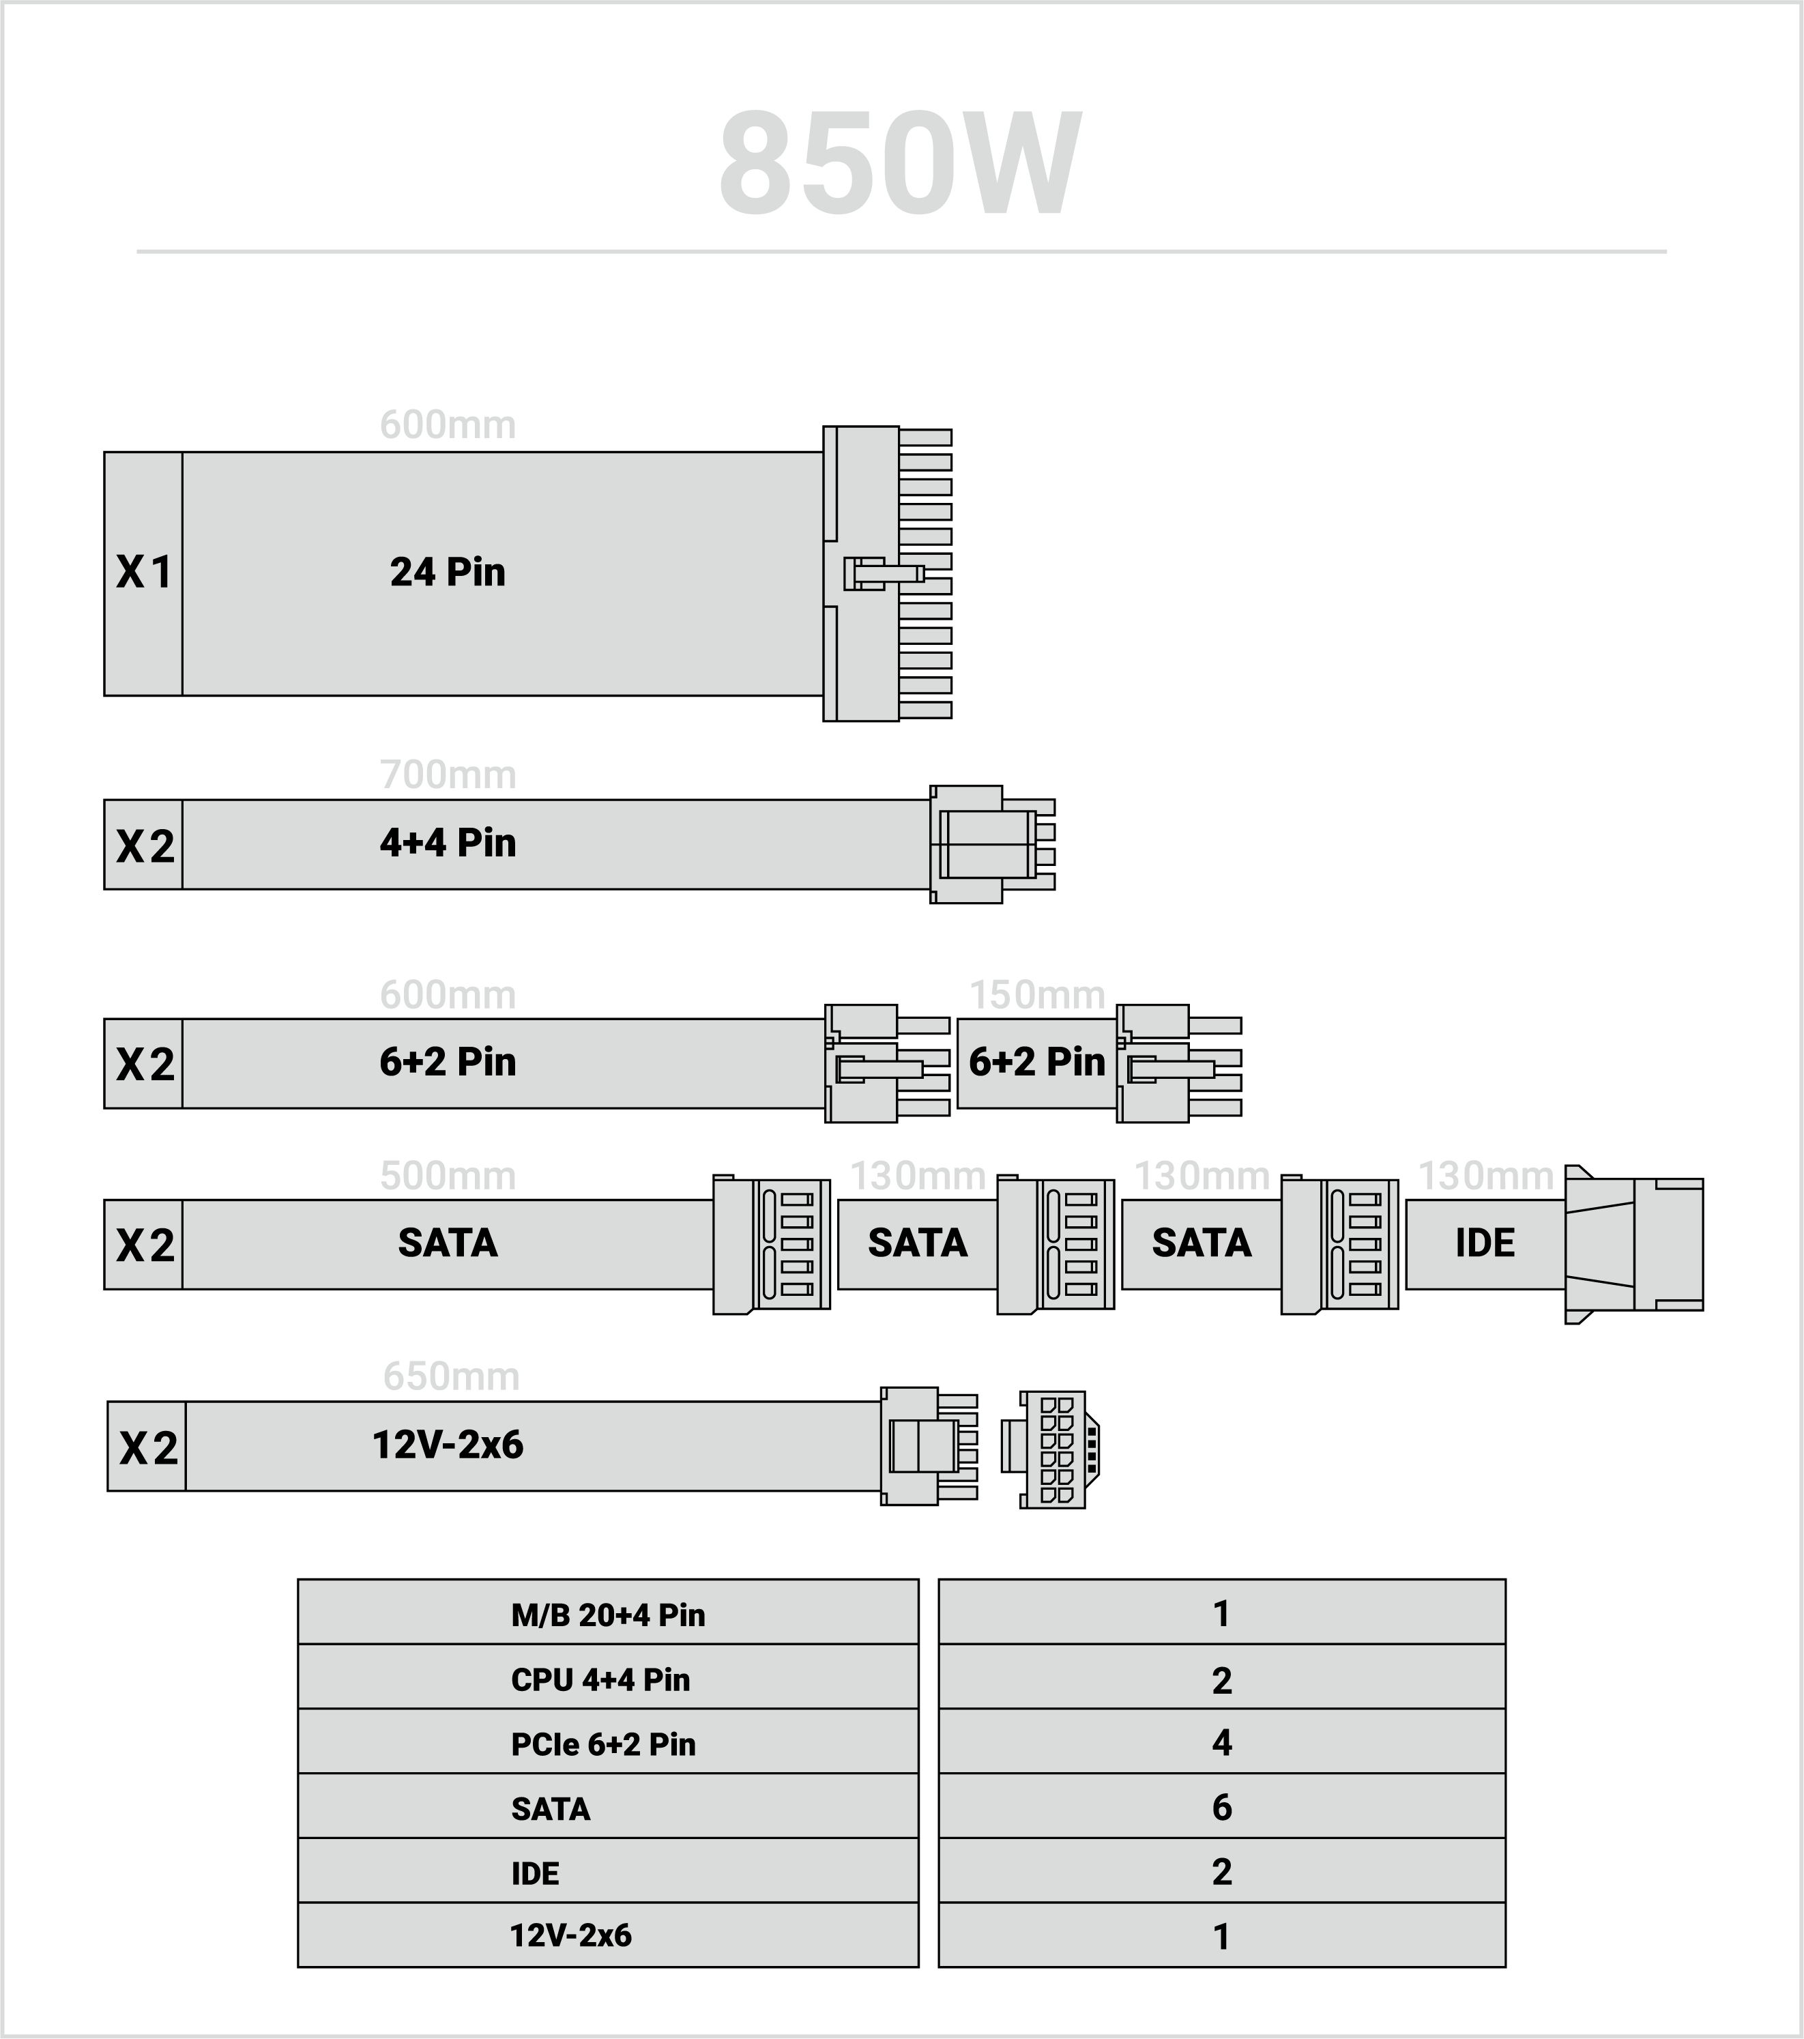
Cable Rounting
The black powder-coated enclosure and the long black-sleeved cables givs any system a polished look. The BPAB enables clean and sleek looking cable management, even in entry- to mid-level systems.

Slide 8

High Compatibility & Reliability
The BPAB Series offers a reliable power solution for office and home systems with a power demand up to 600W. The series is compatible with the latest Intel & AMD Chipsets and supports both, the latest Nvidie and AMD graphics cards. The BPAB series PSU is a great choice if you are building a office or home system with lower power requests, but you still request thecompatibility and reliability. The BPA series PSU is not only complies with Iatest Intel & AMD CPU but also supports Nividia & AMD graphic cards.

Slide 9
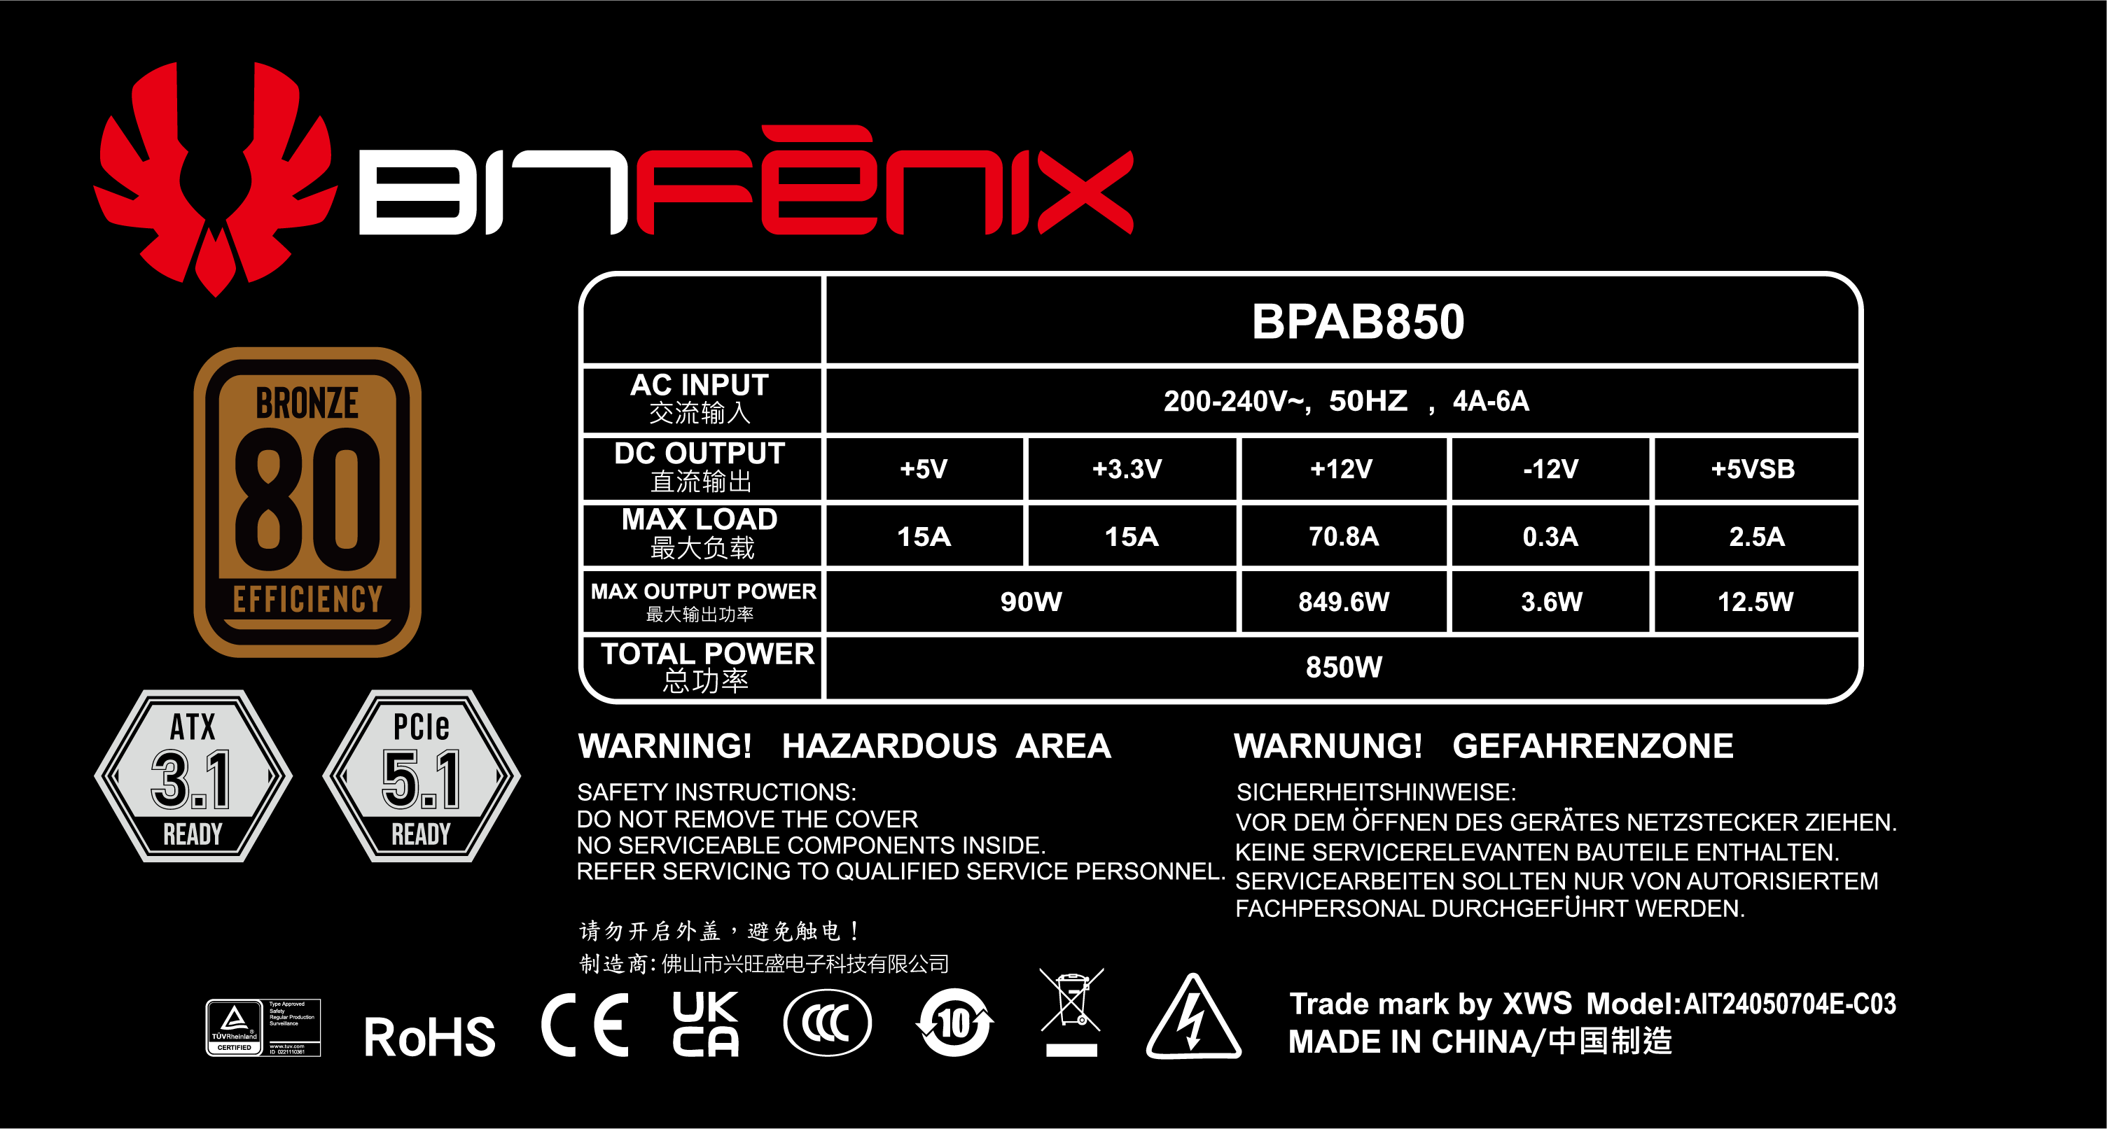
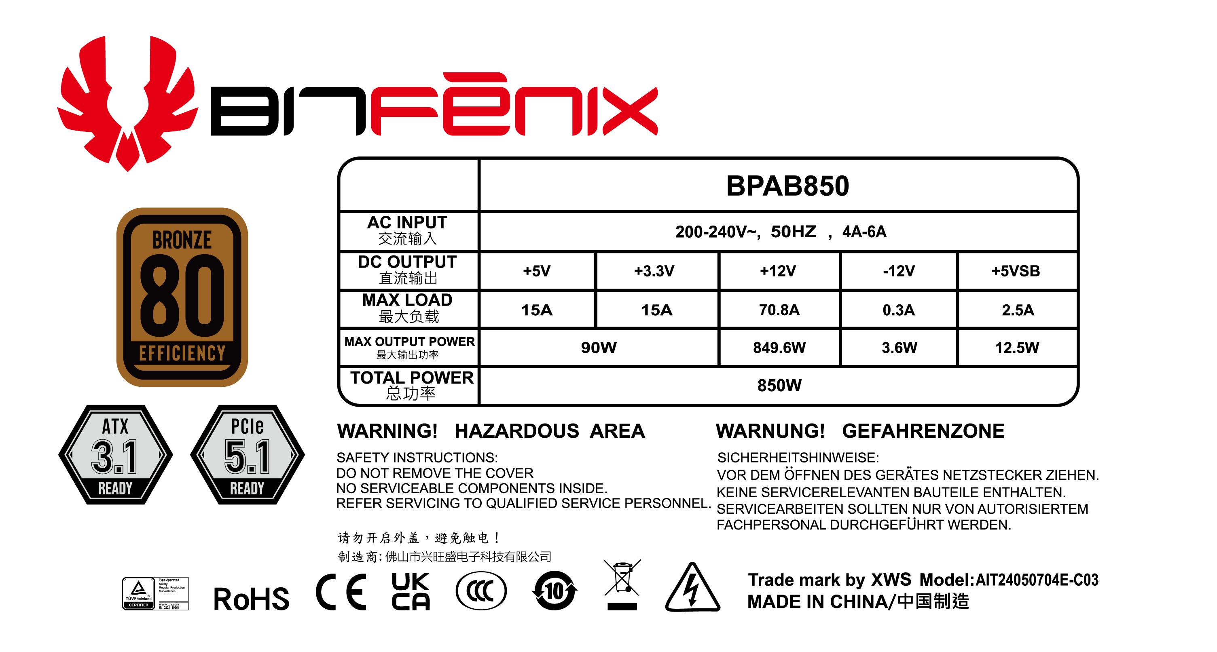

Slide 10
