Slide 1



Slide 2

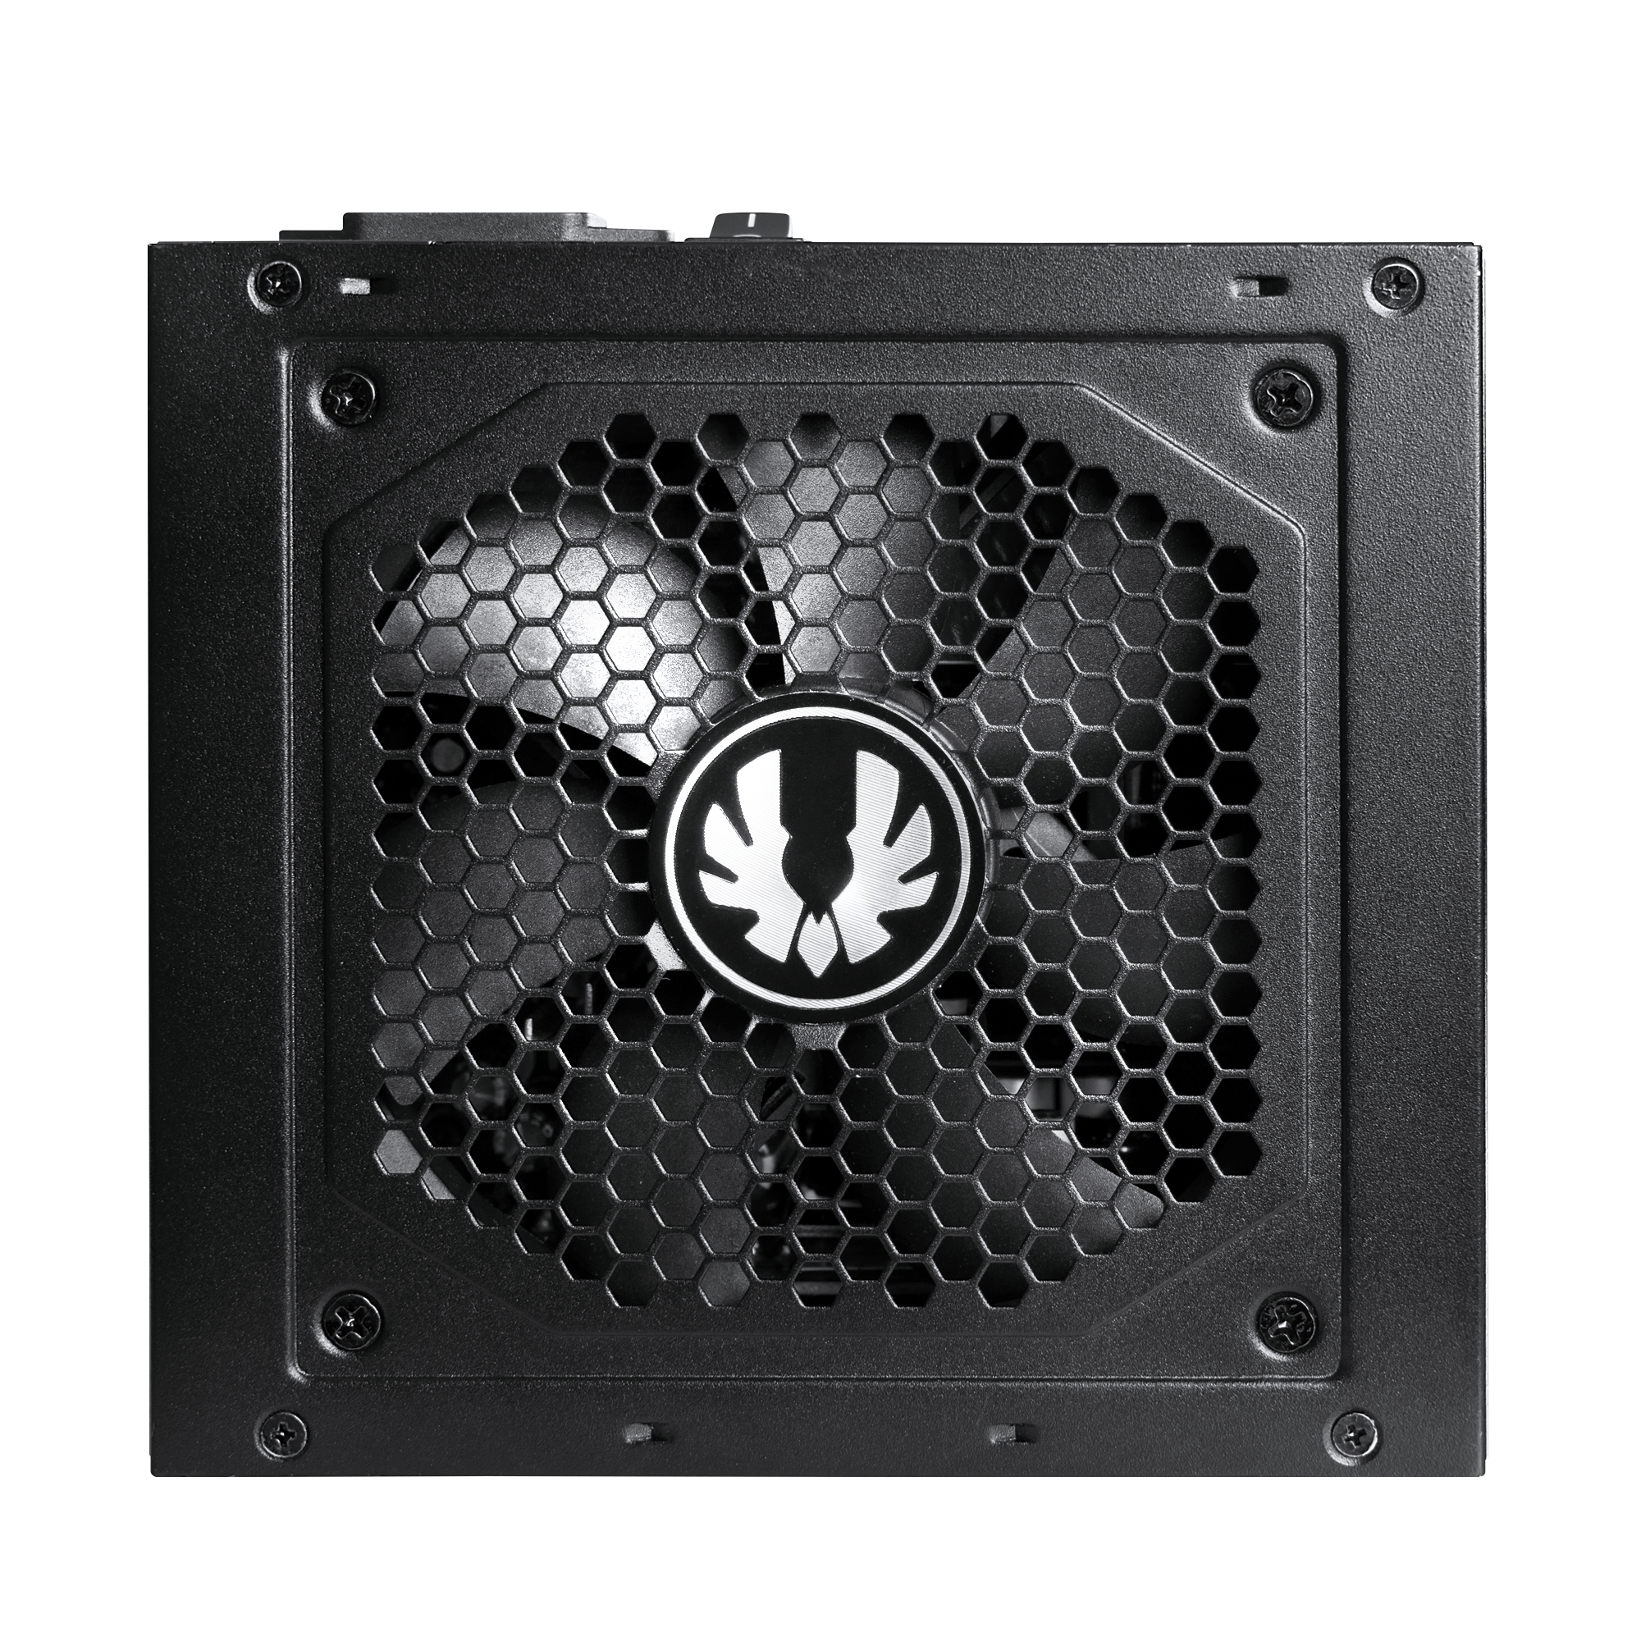


General Information
BFG GOLD ATX3.1/ BFG GOLD
The brand new BitFenix Gold 750W and 850W and 1000W ATX3.1 and PCIe Gen 5 certified power supplies bring smooth and stable power output in a compact form factor along with a slew of safety, efficiency and convenience features. Certified with an 80+ gold standard and with an efficiency level of over 90% under typical loading, these new PSUs are not only high-quality but also extremely efficient. Thanks to purposefully design circuitry, the output power is extremely smooth extending your PC's lifetime. The custom tuned low noise fan keeps your power supply whisper quiet throughout your gaming session.
A BitFenix Gold 550W/650W version is also available with same feature except for the ATX3.1 and PCIe Gen 5 support.
Model Name:
BGA1000W ,BGA850W, BGA750W
Max Wattage:
1000W, 850W, 750W
Type: ATX 3.1/ EPS12V 2.92
PFC: Active PFC
Efficiency: 80Plus Gold Certified
Model Name:
BGA650W, BGA550W
Max Wattage:
650W,550W
Type: ATX12V 2.4/ EPS12V 2.92
PFC: Active PFC
Efficiency: 80Plus Gold Certified

Slide 3



Features
PCIe Gen 5.1 Support for NV 40+ Series GPUs. (BGA1000W ,BGA850W, BGA750W)
Please use the correct cable according to the requirements of the graphics card wattage, and must be correctly installed on the graphics card interface.
ATX 3.1 Support.
(BGA1000W, BGA850W, BGA750W)
Full-bridge Resonant Converter Design Offer Highly Efficient and Low Noise Output Cost Effectively.
Due to the unique design, the Full-Bridge Resonant Converters can optimally utilize even 100V input to efficiently output high power levels at very low voltage and current ripple. They can operate extremely efficiently in high load scenarios. This leads to a budget friendly, efficient, high power PSUs with high reliability and component life at the cost of slightly lower efficiency at low load levels.

Slide 4




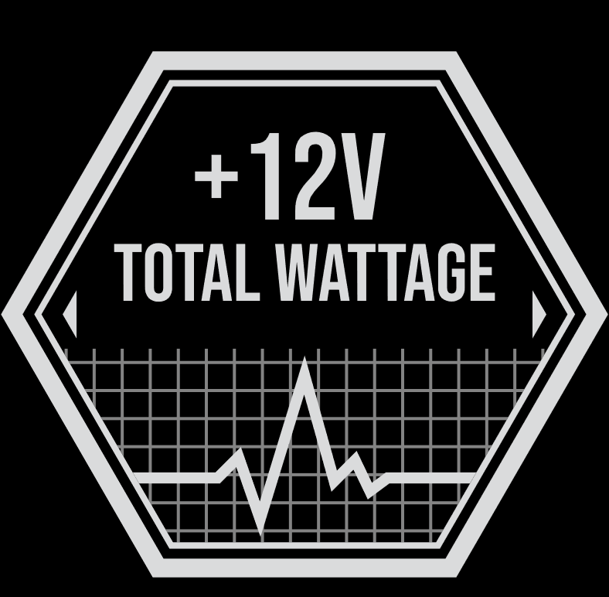


Features
Guaranteed Continuous Power Delivery with 24h/7d Operation.
LLC Resonant Topology Lowers Power Losses and Boosts Efficiency During AC-DC Voltage Switching.
PF value up to 0.96
>=0.96 at 115Vac/60 & 230Vac 50Hz (Full load)
Up To 90% Efficiency @ Typical Loading.
Advance Voltage Switching Circuit from +12V to Minor-rail to Provide the Best Stability and Output Quality.
Supports Industrial Servers/ Workstations with Dual CPU 4+4Pin.
High Power +12V Output Allows for any High-end Graphic Cards under all Power Requirements.

Slide 5







Features
120mm Fluid Dynamic Bearing Fan Optimized for Silence and Long Service Life.
Smart Fan Control Curve.
18AWG Long Output Cables: 650mm for CPU & PCI-E 2.0.
Ensure Tight DC Voltage Regulation and Extended Component Life.
Over-Current Protection (OCP) Over Voltage Protection (OVP)
Under Voltage Protection (UVP) Over Power Protection (OPP)
Short Circuit Protection (SCP) Over Temperature Protection (OTP)
No Load Operation (NLO) Surge & Inrush Protection (SIP)
6+2 Pin PCI-E 2.0 Connectors for Multi-GPU Support.
Complies with the Latest European Environmental Regulations.

Slide 6
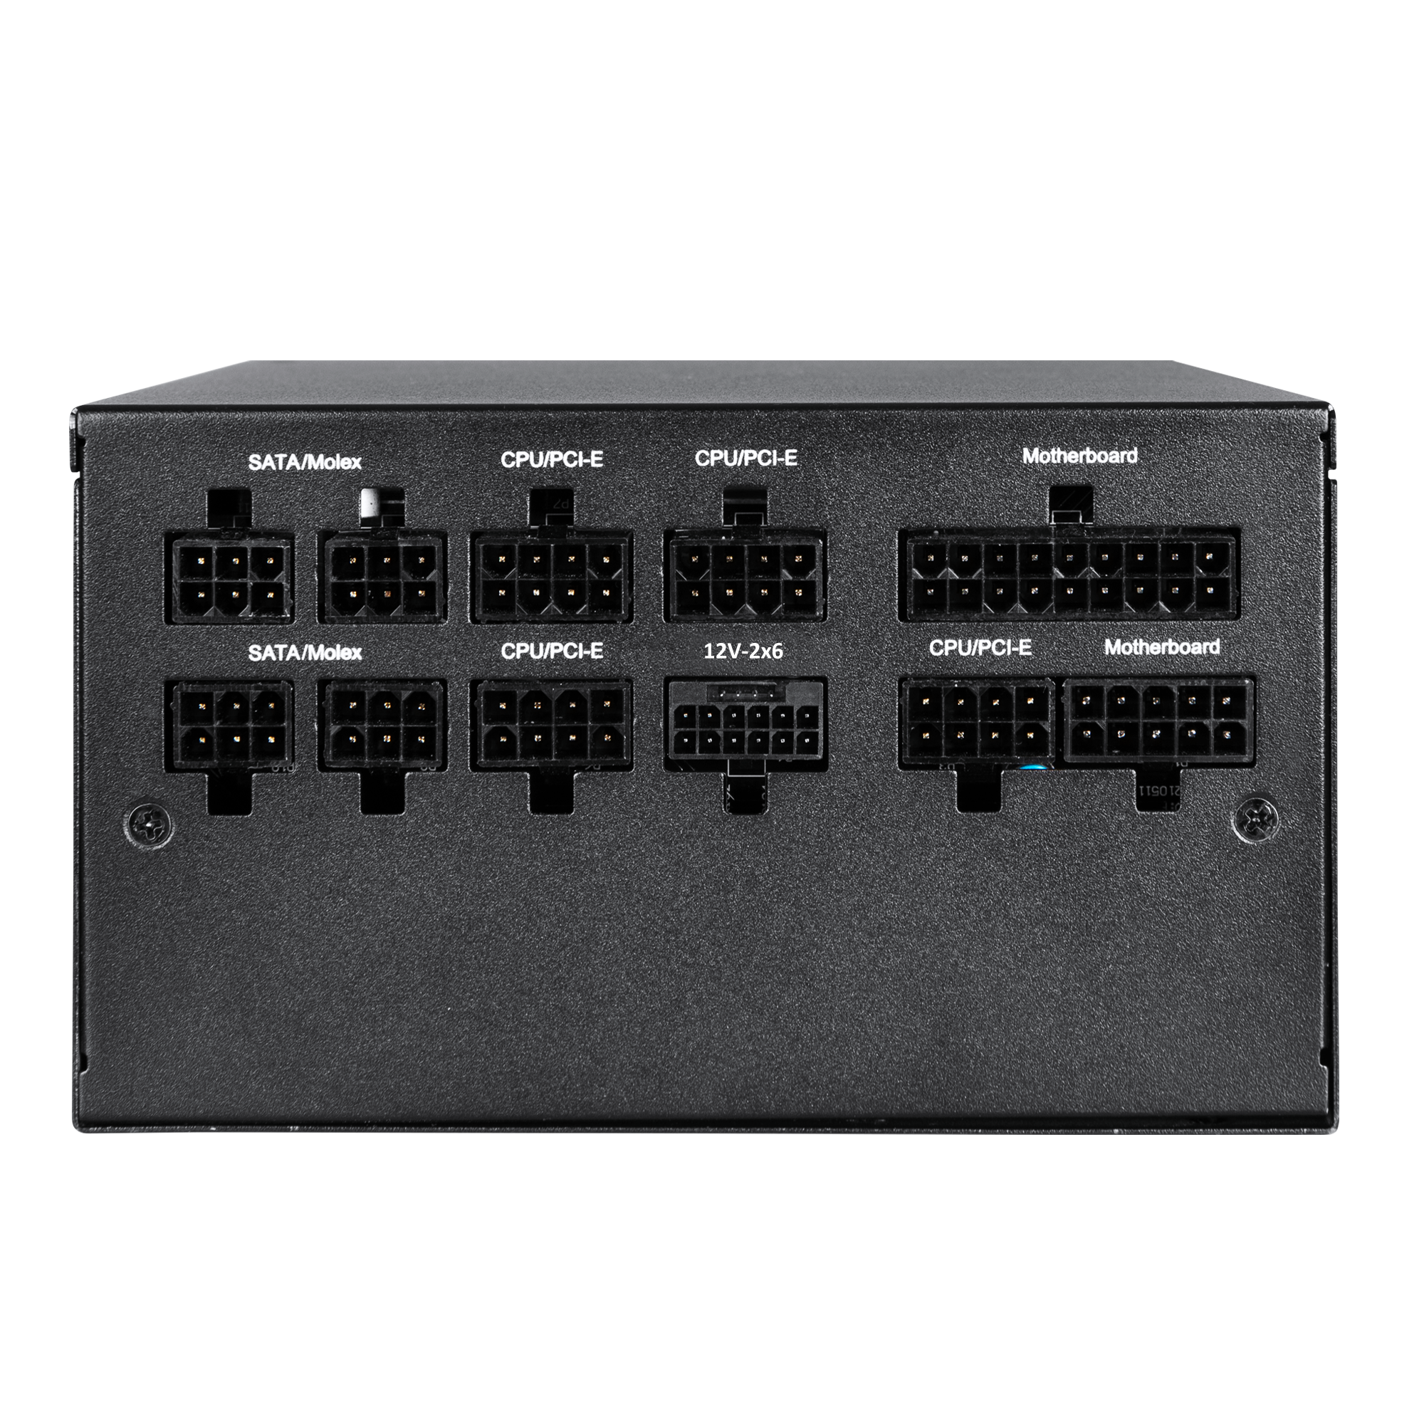
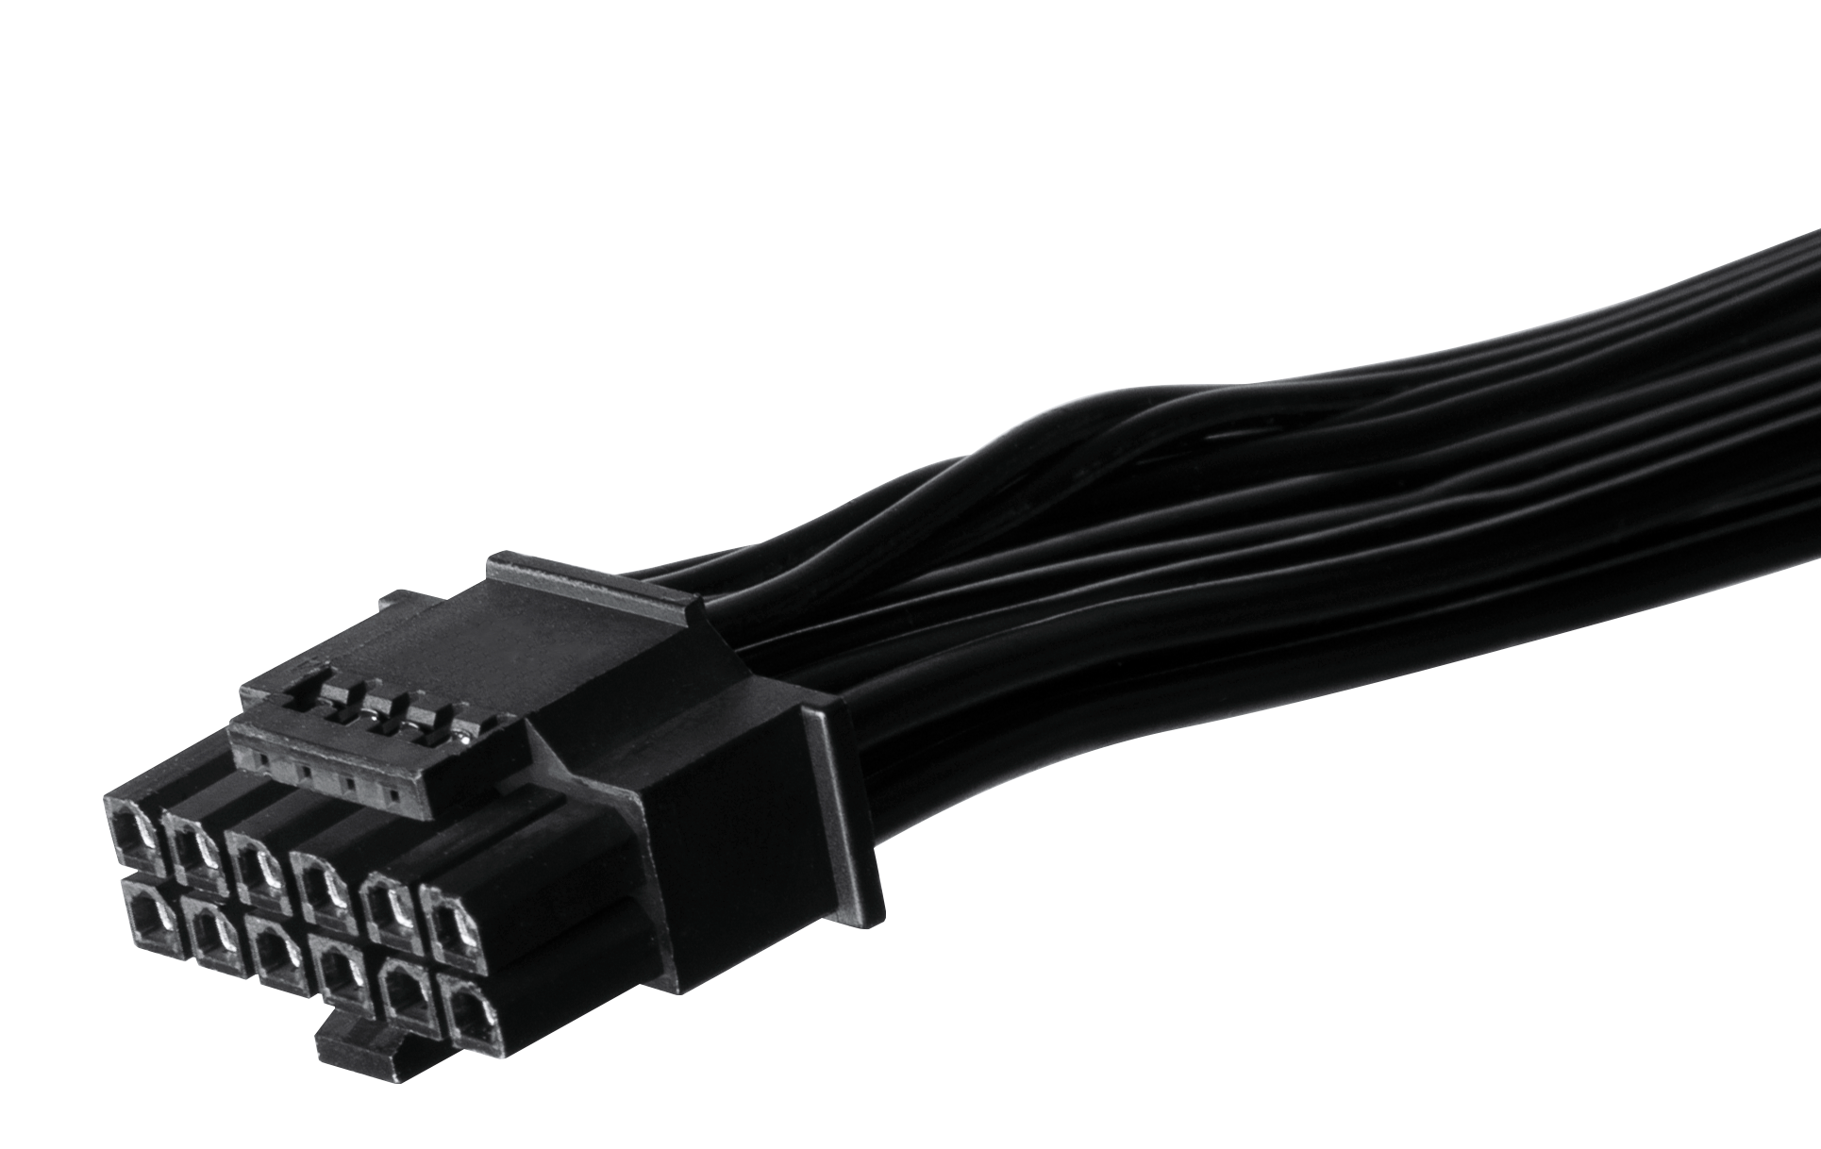
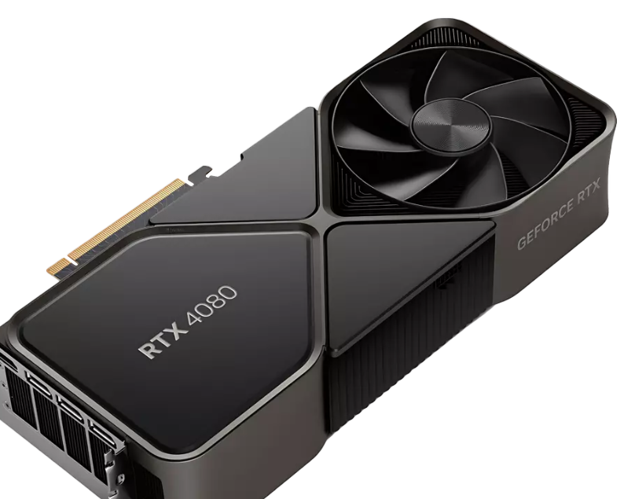
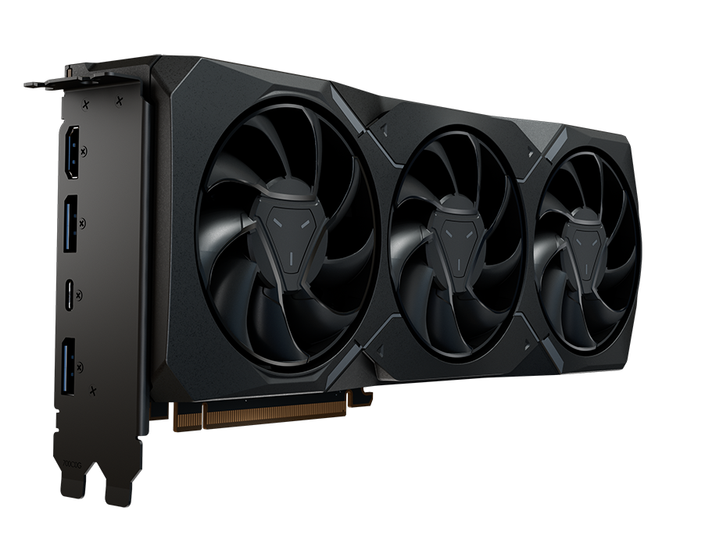



ATX 3.0 Ready / PCI-E 5.0 Ready (12V-2x6 cable)
The PCIe Gen 5 12+4Pin Modular Cable
The PCIe Gen 5 12+4Pin modular cable allows the power supply to support PCIe Gen 5 advanced graphics cards.
This cable conforms with the UL specifications for 16AWG - UL 1007 cable standard offering excellent conductivity and heat resistance. The terminals of the connectors are made of a high-quality copper alloy, which can carry a current of up to 9.2A per pin with minimum resistance resulting in excellent conductivity.
Our connectors are adopting the 4 Spring design as suggested by Intel. According to Intel, the advantage of the 4 SRPING design is that it is more reliable, durable, and it can provide a more secure connection compared to the traditional design.

Slide 7
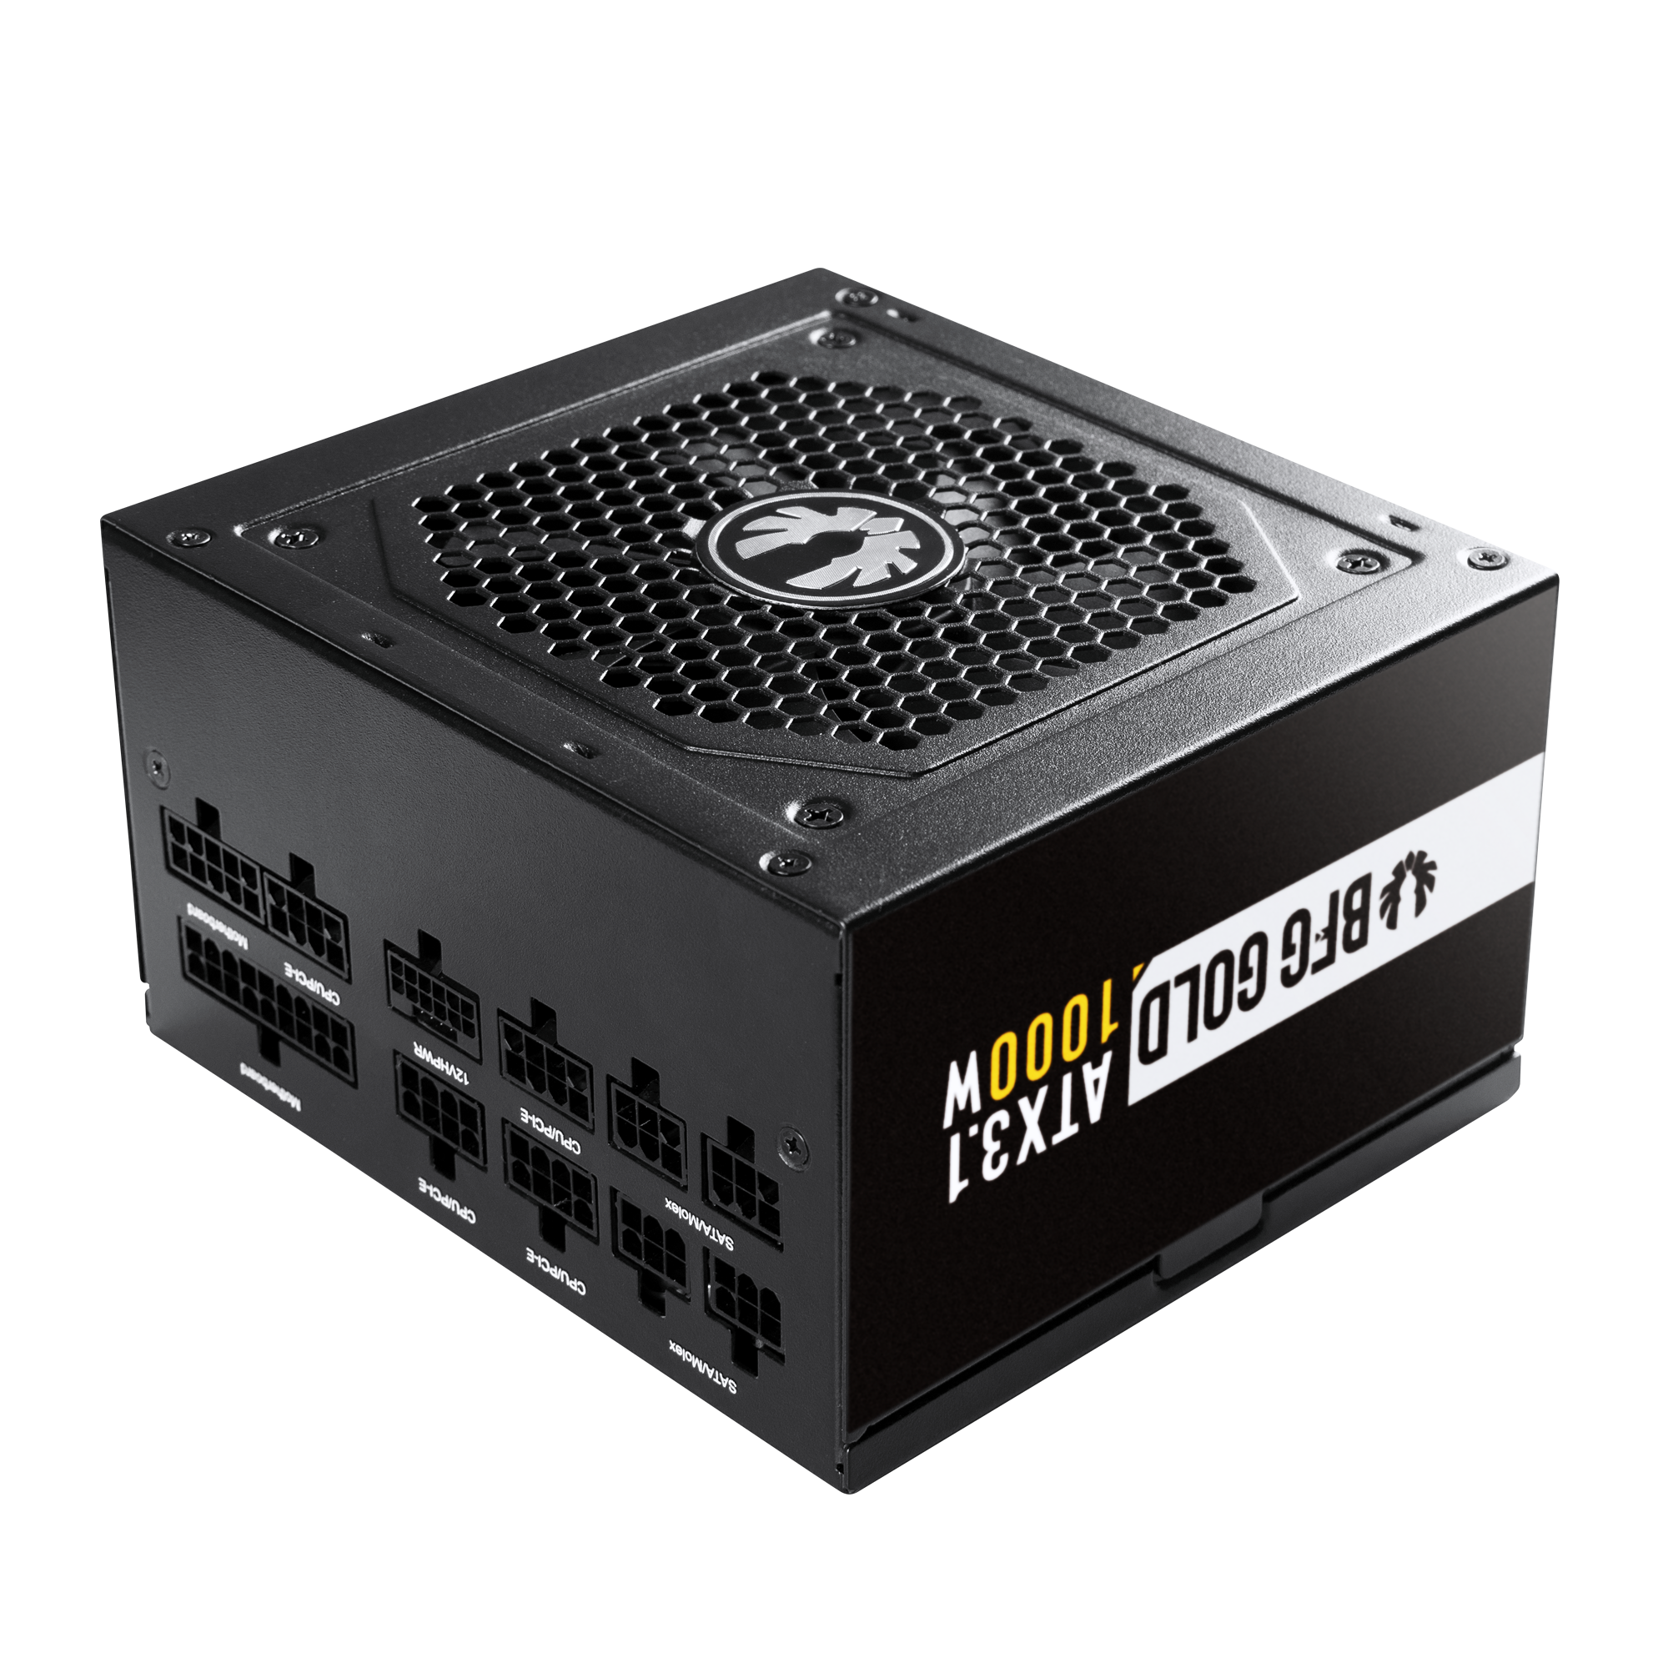
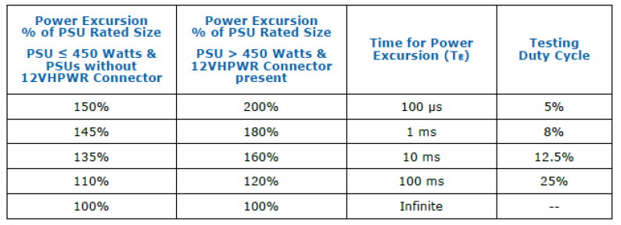

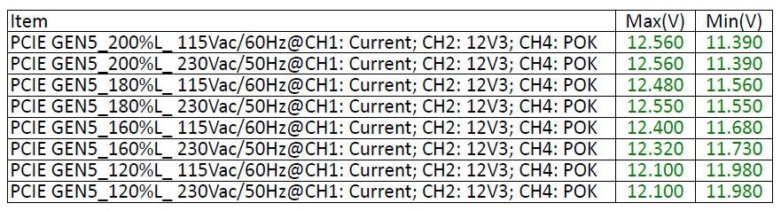
GEN 5 Test
ATX 3.0 Ready / PCI-E 5.0 Ready (12V-2x6 cable)
Test Condition
Table 3-1: PCIe* AIC and PSU Power Budget used for Peak Power Excursion
1. AC Input: 115Vac/60Hz, 230Vac/50Hz
2. Load slew rate is 5A/uS
3. Capacitive Load: 12V1/3,300uF, 12V2/3,300uF.
Voltage Regulation | 12.6V~11.2V
Test Result: PASS AMB: 25°C
Tested under the most rigorous conditions, the BitFenix 750W & 850W & 1000W has passed all the PCIe Gen 5 standards with flying colors. They support up to 2x power excursions for a duration of over 100µs guaranteeing stable power outputs for even the latest top tier graphic cards.
The 12VHPWR connector is also tested for reliability and low resistance to offer peace of mind.

Slide 8
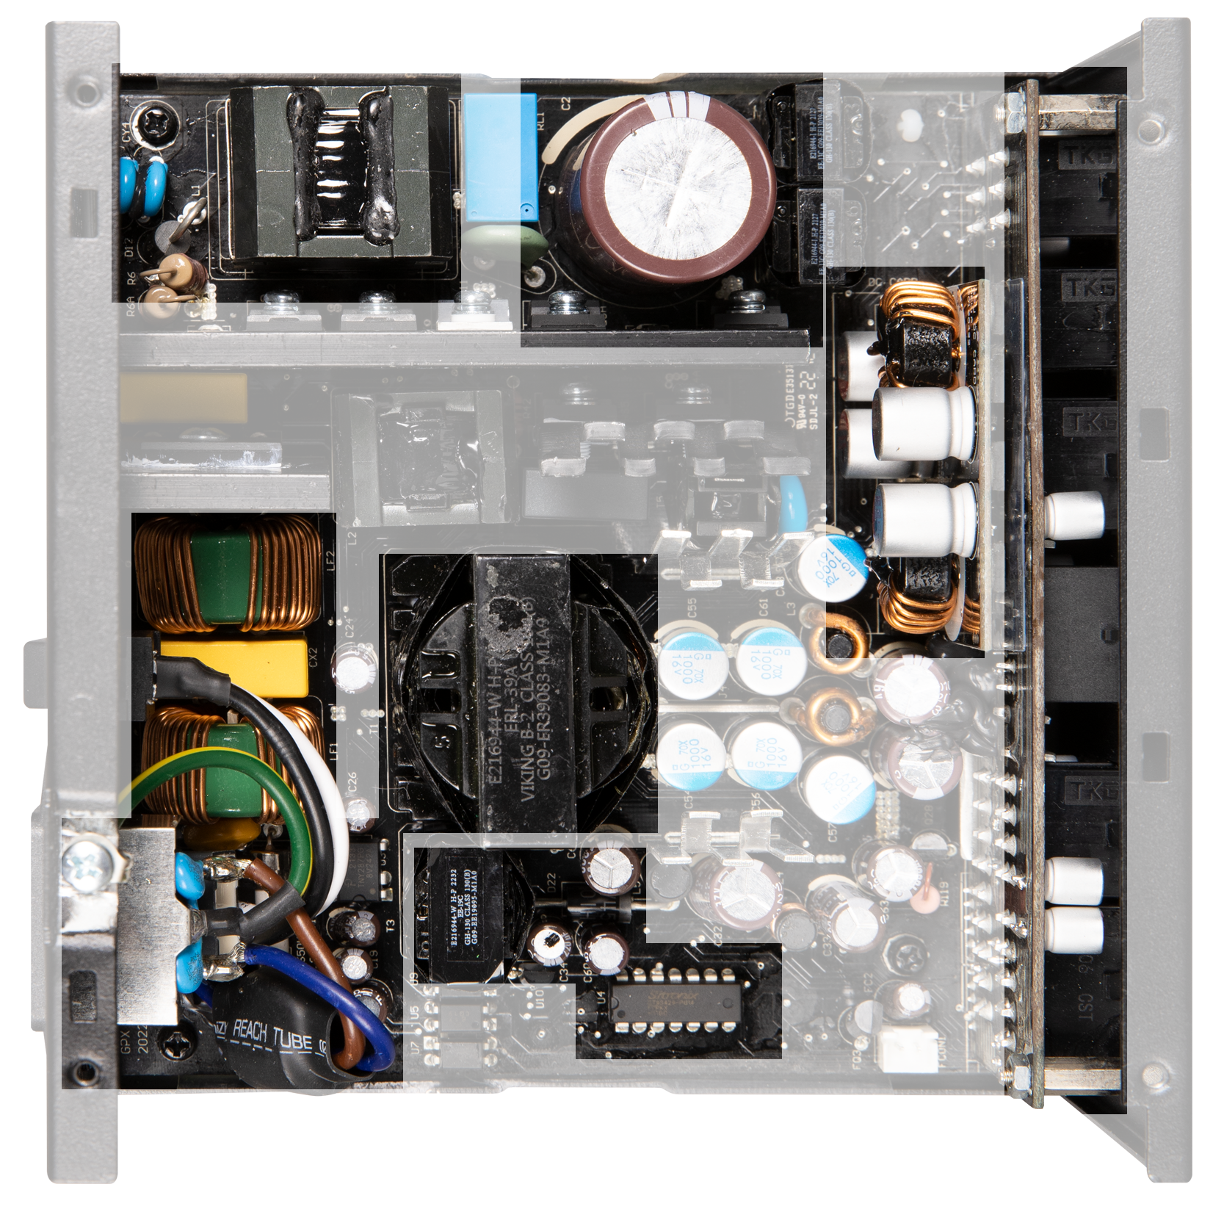
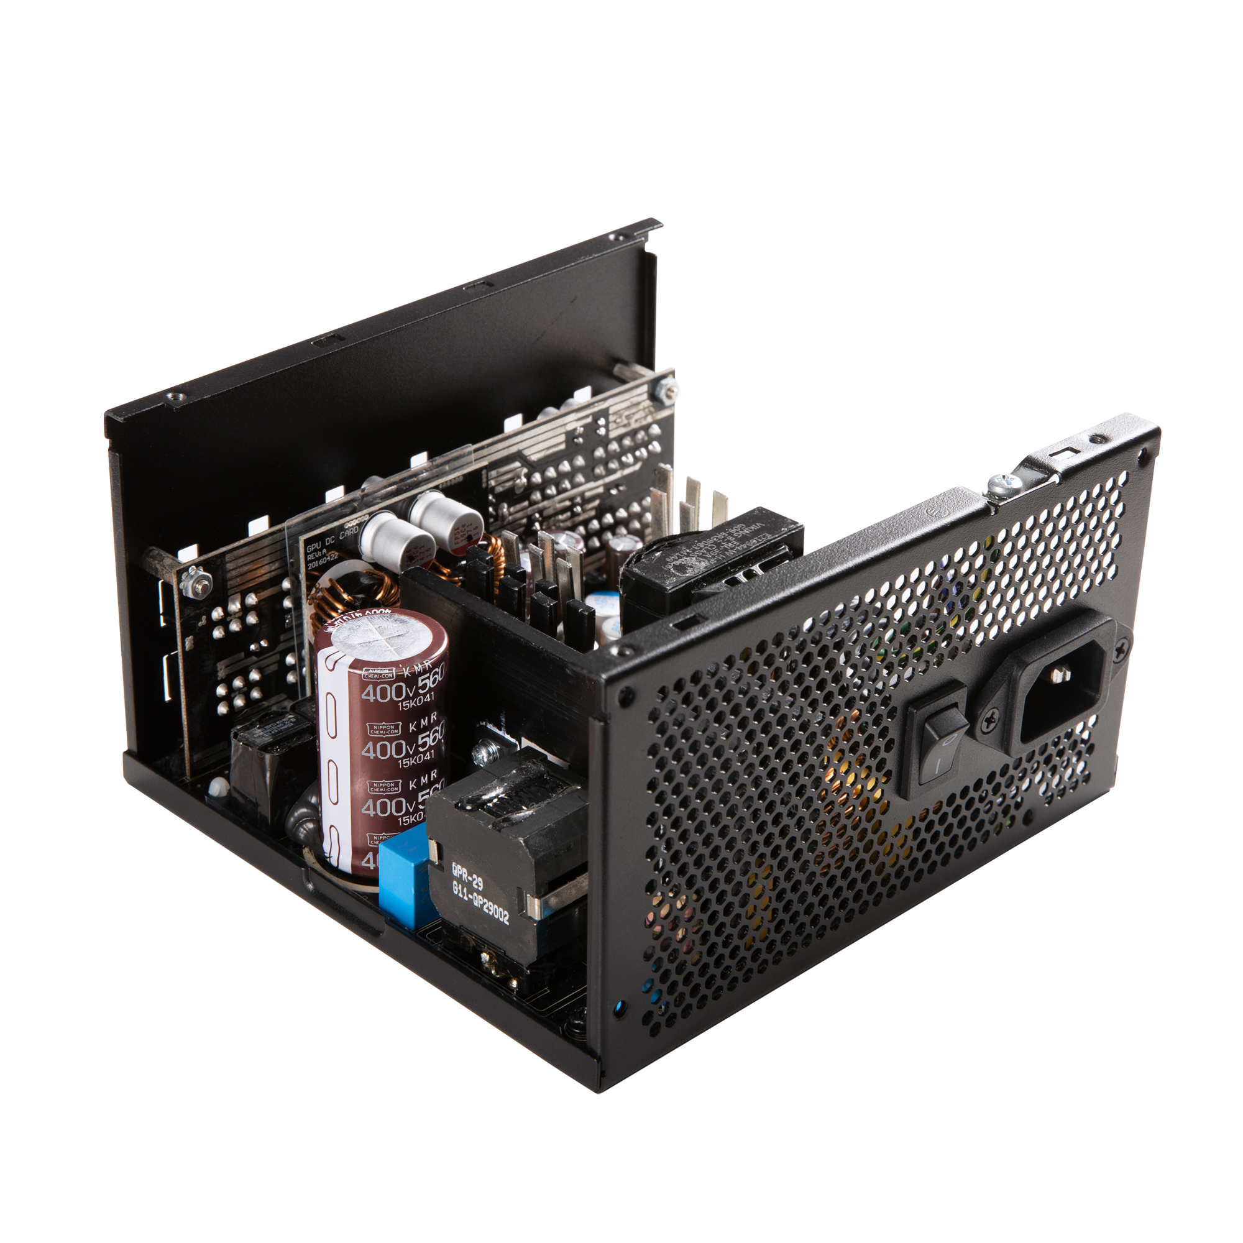
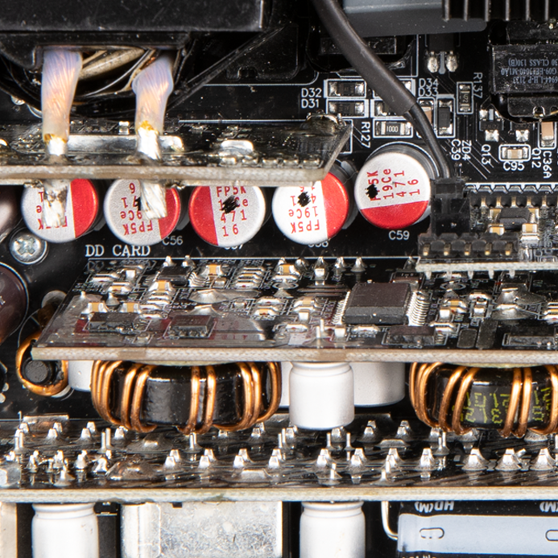
Active PFC
Main Capacitor
Modular PCB
Topology |
750W/850W/1000W
DC to DC Circuit
EMI Circuit 2
DC Output
Main Transformer
12V-2x6
Connector
All Japanese Capacitor
AC Input
+5V Stand by Circuit
Protection Circuit
EMI Circuit 1
Solid Capacitor
750W-1000W
Depending on the wattage of different PSUs, the main capacitor and related hardware will be different.

Slide 9
Active PFC
Main Capacitor
Modular PCB
Topology |
550W/650W
DC to DC Circuit
EMI Circuit 2
DC Output
Main Transformer
All Japanese Capacitor
AC Input
+5V Stand by Circuit
Protection Circuit
EMI Circuit 1
Solid Capacitor
550W-650W
Depending on the wattage of different PSUs, the main capacitor and related hardware will be different.

Slide 10
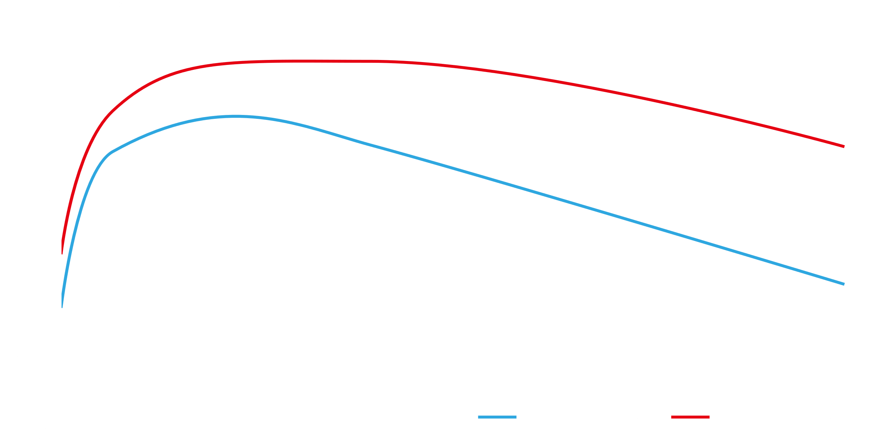
Loading | +12V | +5V | +3.3V | -12V | +5Vsb | Required minimum efficiency
20% | 12.33A | 2.32A | 2.32A | 0.05A | 0.44A | 87%
50% | 30.82A | 5.79A | 5.79A | 0.13A | 1.09A | 90%
100% | 61.64A | 11.59A | 11.59A | 0.26A | 2.19A | 87%
HIGH EFFICIENCY
The 87+ high efficiency circuit guarantees both energy and money savings for the end user with the added benefits of 80% less heat output and stable power output. This translates to over 30% less power consumption in comparison to standard PSUs.
*87+ ( 0% to 100% load)/ 90+ (40% to 70% load)
100-240V Full range design offer worldwide compatibility, and with high efficiency LLC, Active PFC, DC to DC circuits not only benefits you but also planet Earth with higher energy savings.

Slide 11
Model |  | BFG GOLD 850W (GPX850S)
AC Input Voltage & Temperature |  | 115Vac @ 25°C
Total Wattage |  | 850W
Combine Wattage |  | 846W | 110W |  | 3.6W | 12.5W
Rail |  | +12V | +5V | +3.3V | -12V | +5VSB
Max Current |  | 70.5A | 20A | 20A | 0.3A | 2.5A | DC Power in Total(W) | AC Power Readingl (W) | Efficiency(%)
20% Loading | Current(A) | 12.33 | 2.32 | 2.32 | 0.05 | 0.44 | 170.6 | 187.57 | 90.95%
 | Voltage(V) | 12.03 | 5.04 | 3.34 | -12.43 | 5.05
50% Loading | Current(A) | 30.82 | 5.79 | 5.79 | 0.13 | 1.09 | 426.21 | 467.55 | 91.16%
 | Voltage(V) | 12.03 | 5.03 | 3.3 | -12.67 | 5.02
100% Loading | Current(A) | 61.64 | 11.59 | 11.59 | 0.26 | 2.19 | 851.52 | 971.43 | 87.66%
 | Voltage(V) | 12.02 | 5.01 | 3.3 | -12.75 | 4.99
Efficiency
Model |  | BFG GOLD 750W (GPX750S)
AC Input Voltage & Temperature |  | 115Vac @ 25°C
Total Wattage |  | 750W
Combine Wattage |  | 744W | 110W |  | 3.6W | 12.5W
Rail |  | +12V | +5V | +3.3V | -12V | +5VSB
Max Current |  | 62A | 20A | 20A | 0.3A | 2.5A | DC Power in Total(W) | AC Power Readingl (W) | Efficiency(%)
20% Loading | Current(A) | 10.69 | 2.28 | 2.28 | 0.05 | 0.43 | 150.57 | 166.7 | 90.32%
 | Voltage(V) | 12.04 | 5.02 | 3.32 | -12.41 | 5.06
50% Loading | Current(A) | 26.72 | 5.71 | 5.71 | 0.13 | 1.08 | 375.77 | 412.5 | 91.09%
 | Voltage(V) | 12.02 | 5.01 | 3.31 | -12.65 | 5.03
100% Loading | Current(A) | 53.44 | 11.42 | 11.42 | 0.26 | 2.15 | 750.86 | 856.9 | 87.63%
 | Voltage(V) | 12.01 | 5.01 | 3.3 | -12.73 | 5.01

Slide 12
Model |  | BFG GOLD 650W (GPX650)
AC Input Voltage & Temperature |  | 115Vac @ 25°C
Total Wattage |  | 650W
Combine Wattage |  | 648W | 100W |  | 3.6W | 12.5W
Rail |  | +12V | +5V | +3.3V | -12V | +5VSB
Max Current |  | 54A | 20A | 20A | 0.3A | 2.5A | DC Power in Total(W) | AC Power Readingl (W) | Efficiency(%)
20% Loading | Current(A) | 9.19 | 2.05 | 2.05 | 0.05 | 0.43 | 130.39 | 144.62 | 90.16%
 | Voltage(V) | 12.02 | 5.04 | 3.34 | -12.46 | 5.05
50% Loading | Current(A) | 22.97 | 5.12 | 5.12 | 0.13 | 1.06 | 325.69 | 357.62 | 91.07%
 | Voltage(V) | 12.01 | 5.04 | 3.33 | -12.63 | 5.02
100% Loading | Current(A) | 45.94 | 10.25 | 10.25 | 0.26 | 2.13 | 650.11 | 741.25 | 87.70%
 | Voltage(V) | 11.99 | 5.03 | 3.32 | -12.65 | 4.95
Efficiency
Model |  | BFG GOLD 550W (GPX550)
AC Input Voltage & Temperature |  | 115Vac @ 25°C
Total Wattage |  | 550W
Combine Wattage |  | 546W | 100W |  | 3.6W | 12.5W
Rail |  | +12V | +5V | +3.3V | -12V | +5VSB
Max Current |  | 45.5A | 20A | 20A | 0.3A | 2.5A | DC Power in Total(W) | AC Power Readingl (W) | Efficiency(%)
20% Loading | Current(A) | 7.56 | 2 | 2 | 0.05 | 0.42 | 110.59 | 125.75 | 87.94%
 | Voltage(V) | 12.06 | 5.04 | 3.32 | -11.67 | 5.07
50% Loading | Current(A) | 18.9 | 5 | 5 | 0.12 | 1.04 | 276.12 | 304.57 | 90.66%
 | Voltage(V) | 12.05 | 5.03 | 3.3 | -11.83 | 5.04
100% Loading | Current(A) | 37.8 | 10.01 | 10.01 | 0.25 | 2.08 | 550.27 | 627.07 | 87.75%
 | Voltage(V) | 12.01 | 5.02 | 3.27 | -12.12 | 4.98

Slide 13

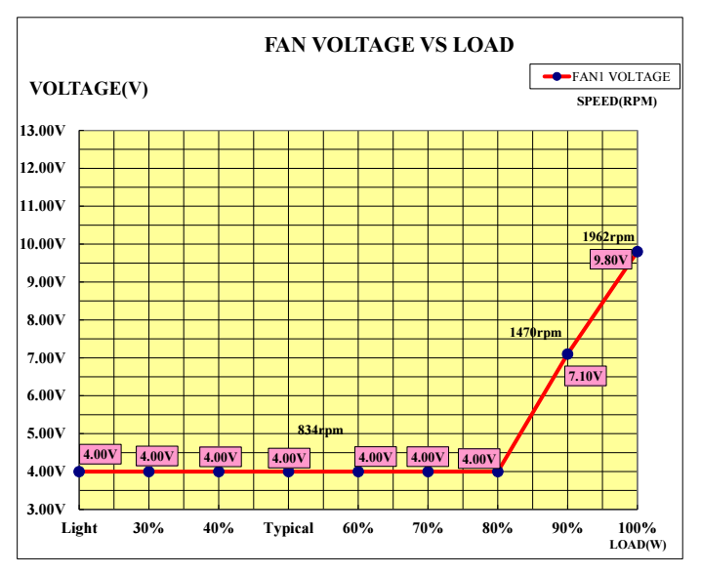
PSU Thermal Solution
The compact design of the 750W-1000W is complemented by a high CFM, high speed 120mm Fluid Dynamic Bearing fan optimized for low fan-noise.
A custom tuned fan curve allows these PSUs to operate at optimum levels throughout varying workloads.
With only 32dBA at a speed of 2000rpm and only 18dBA at typical loads(60%), this low noise fan keep the components optimally cooled at 25°C even under full gaming loads without overheating.

Slide 14




PSU Low Acoustic Solution
850 W
750 W
650 W
550 W

Slide 15
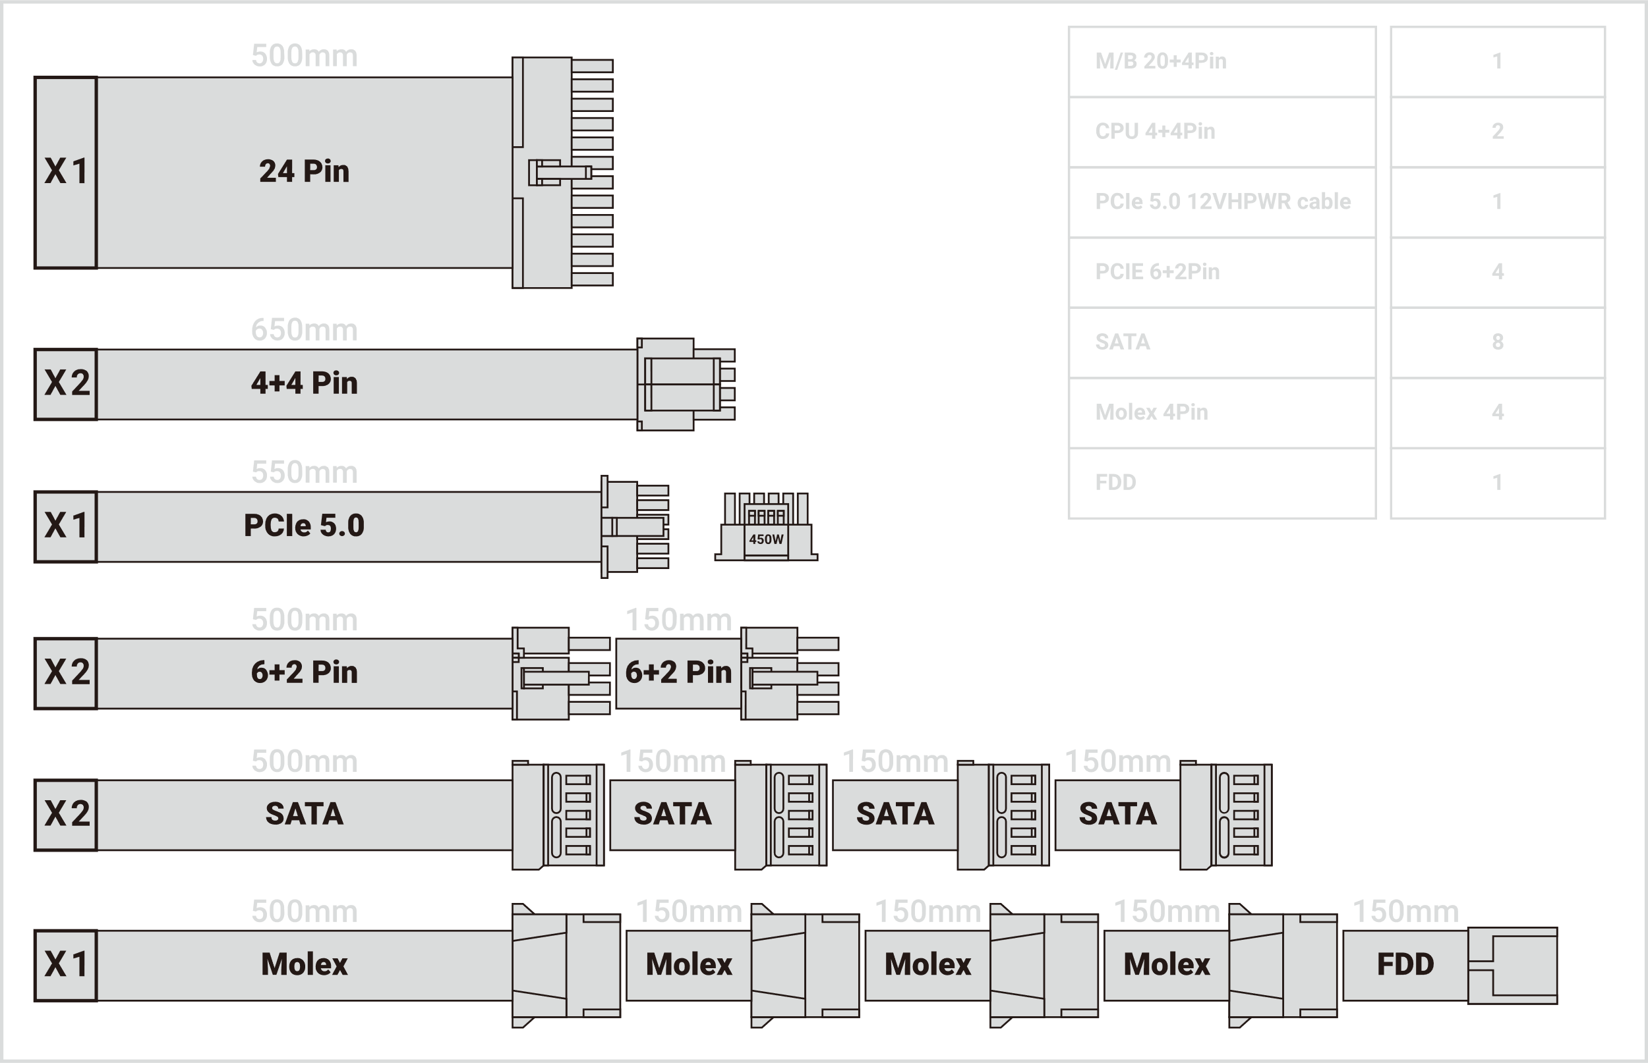
Output Cable-850W

Slide 16

Output Cable-750W

Slide 17
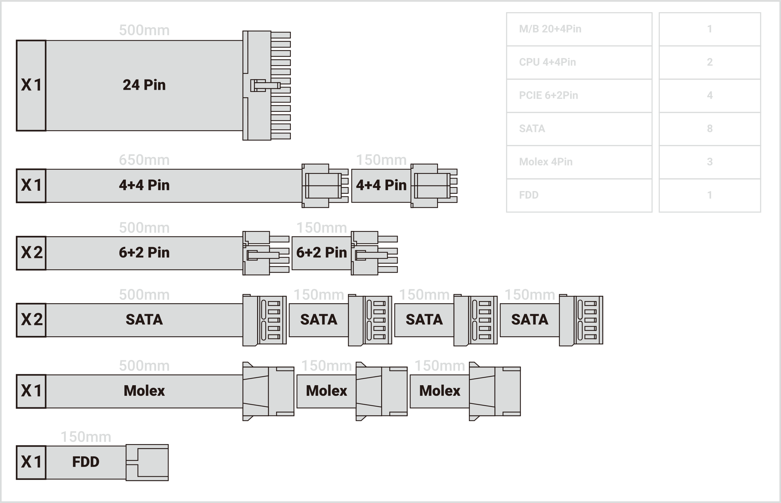
Output Cable-650W

Slide 18
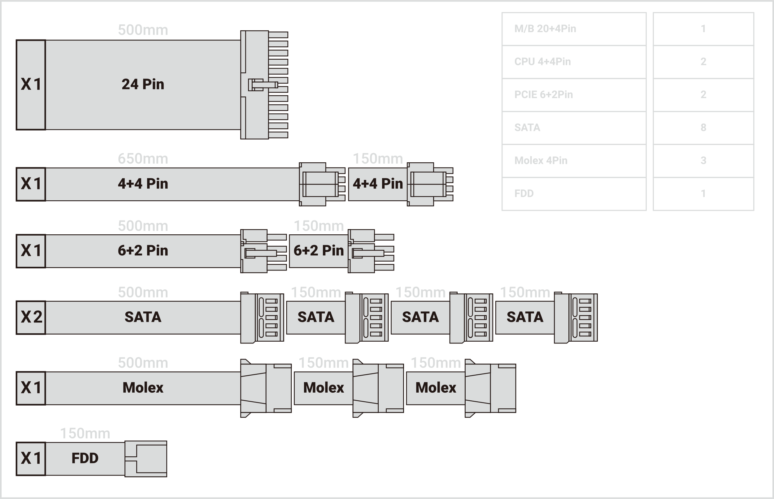
Output Cable-550W

Slide 19
Compact Dimension
Modular design
& cpu /pci-e mix
12V-2x6 Connector
High Quality
Aluminum BitFenix Logo
86 mm
150 mm
140 mm
1000W
850W
750W
Environment friendly,
Under RoHS &WEEE regulations
Housing

Slide 20
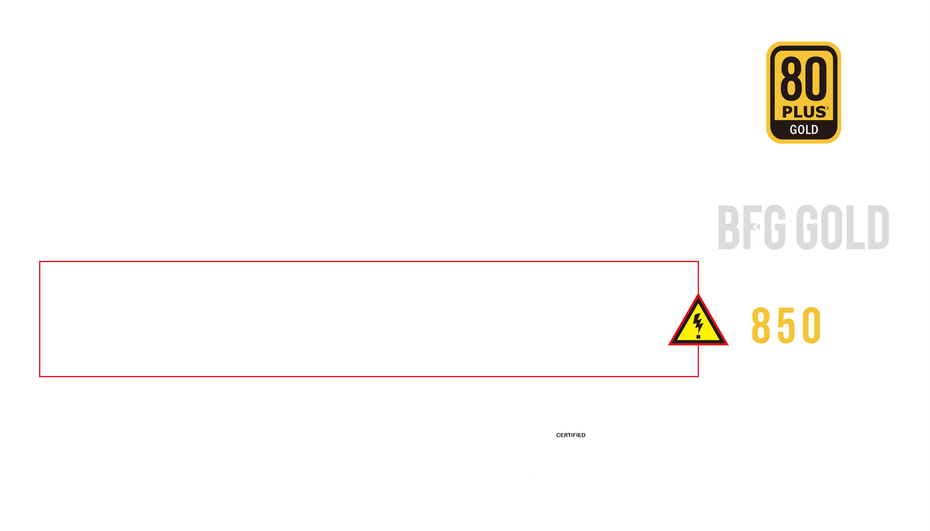
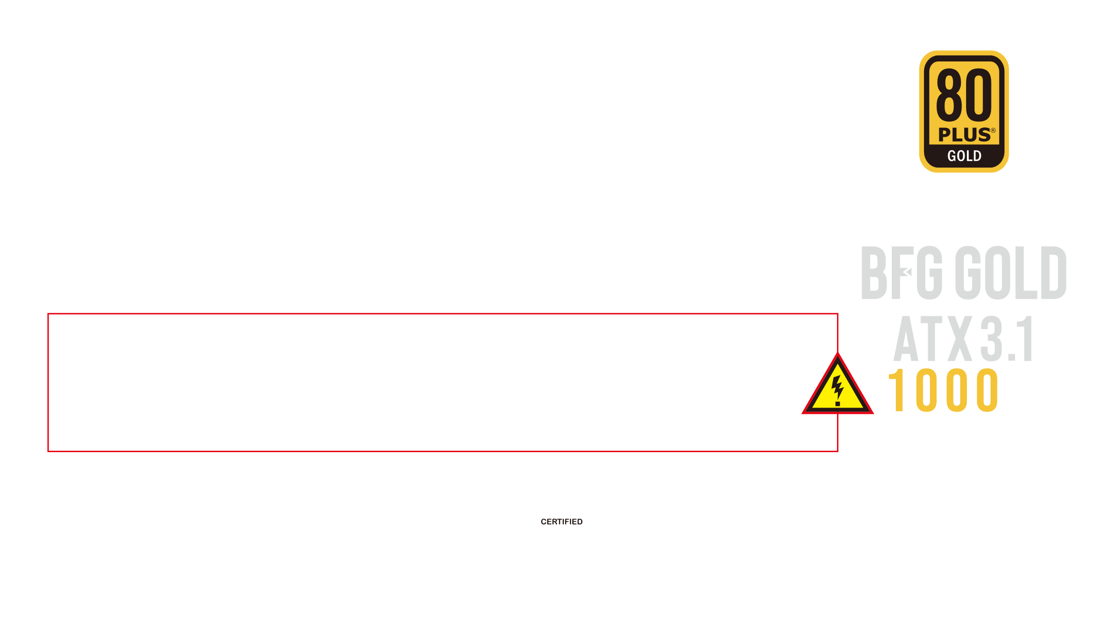

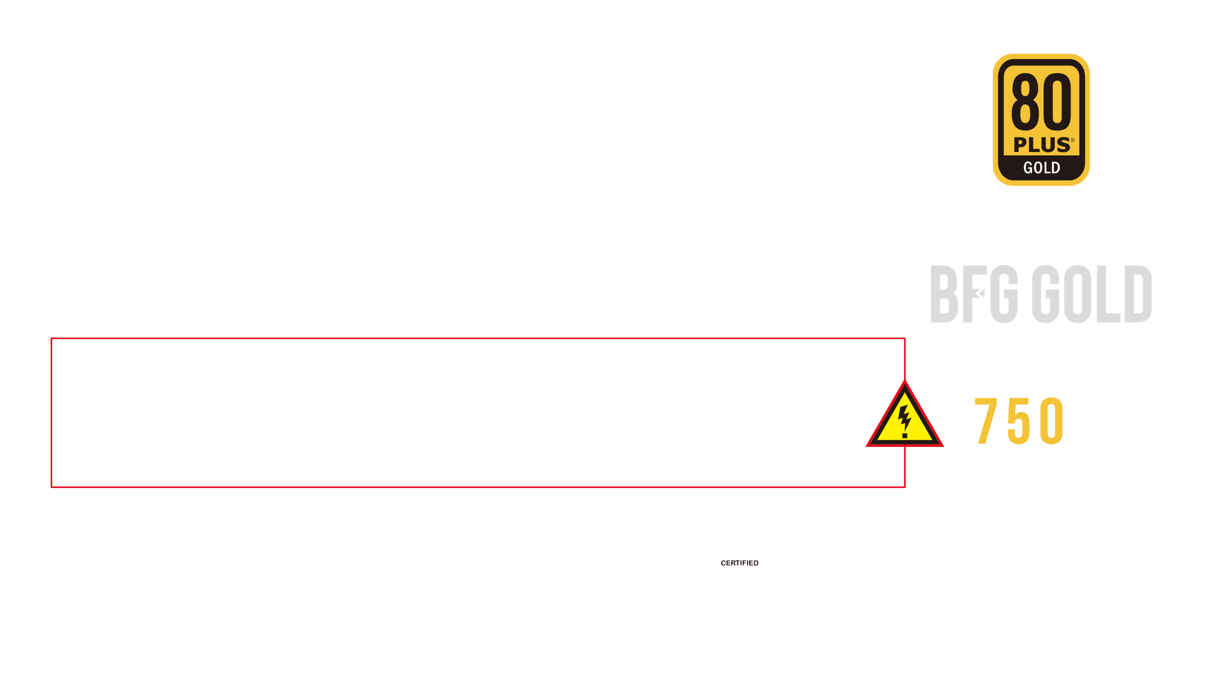
Spec Label

Slide 21

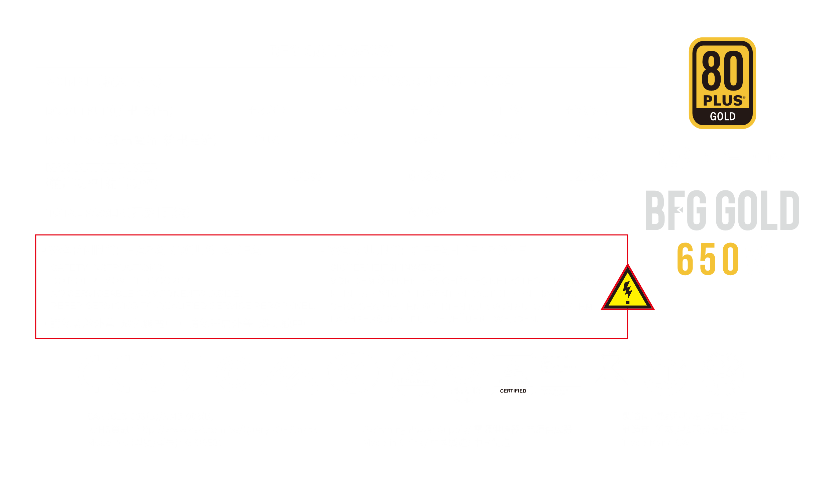

Spec Label

