Slide 1
Jan 08, 2016 – v0.4

Slide 2
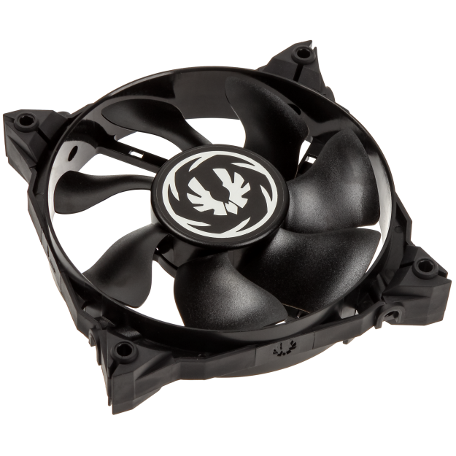
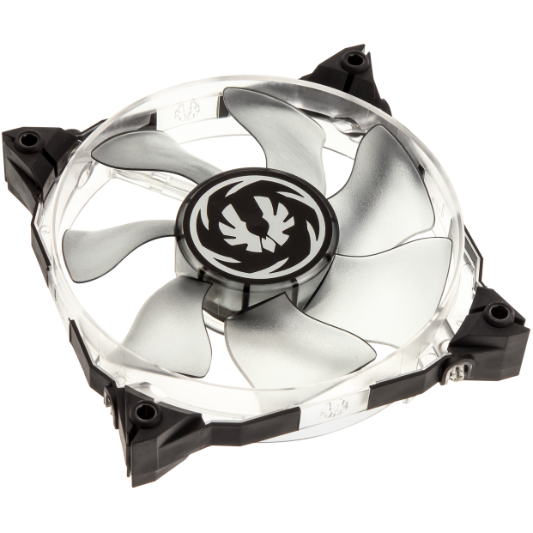
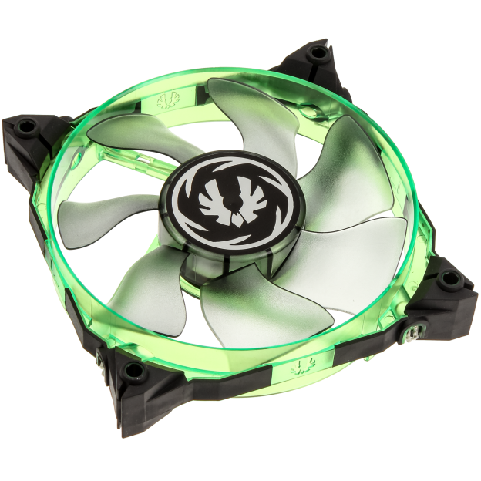
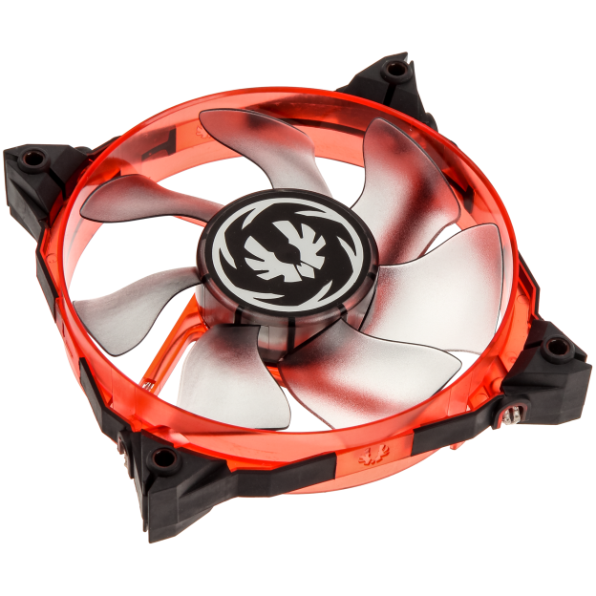
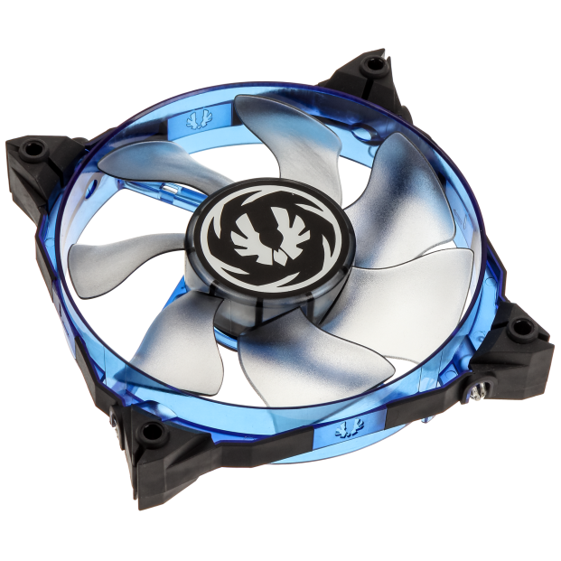
Spectre Xtreme
The BitFenix Spectre Xtreme is a versatile high-performance fluid dynamic bearing fan, with built in vibration damping – catering for PC enthusiasts in general, and users of water cooling in specific. The form factor is a standard 120x120x25mm, with a total of five different color options available, four with LEDs.

Slide 3
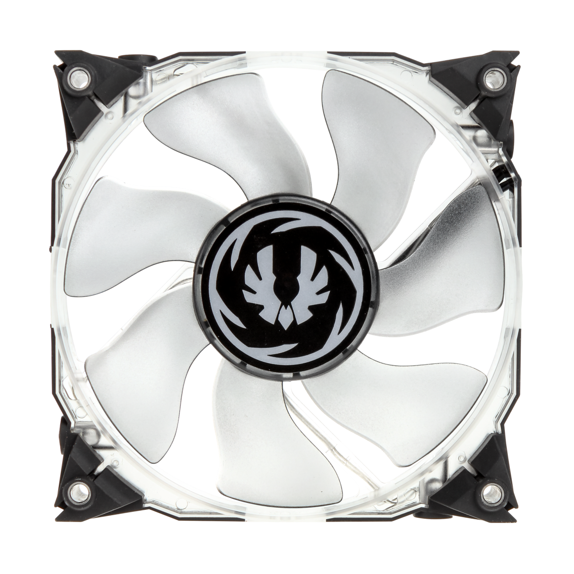
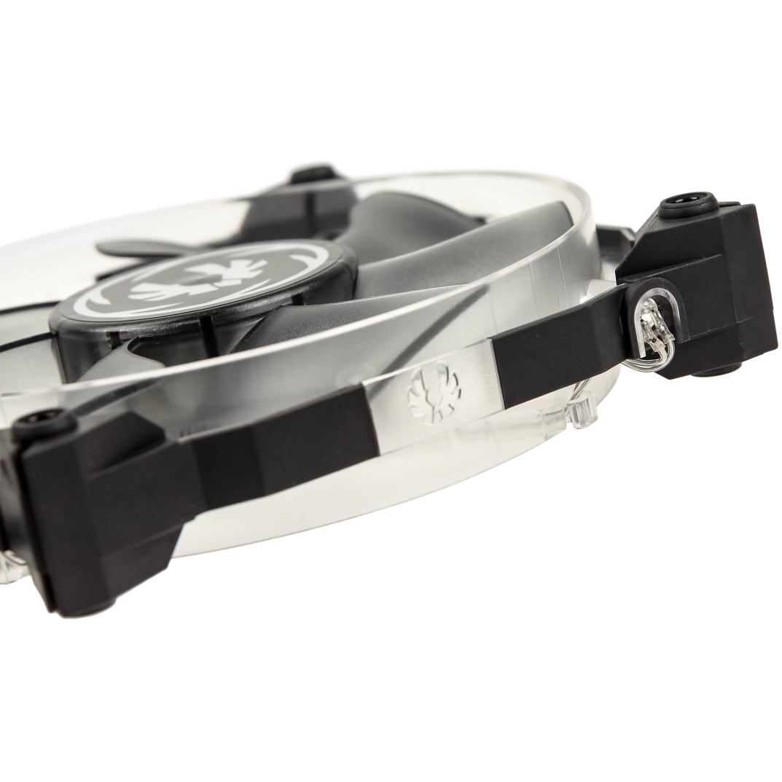
Spectre Xtreme– Design
When it comes to looking unique, the Spectre Xtreme has you covered. The rim and blades work effectively in unison to provide high air pressure, making the Spectre Xtreme optimal for use on radiators or CPU coolers. The mounting holes are placed in blocks of TPU, making the mounts flexible yet stiff, eliminating vibrations.

Slide 4
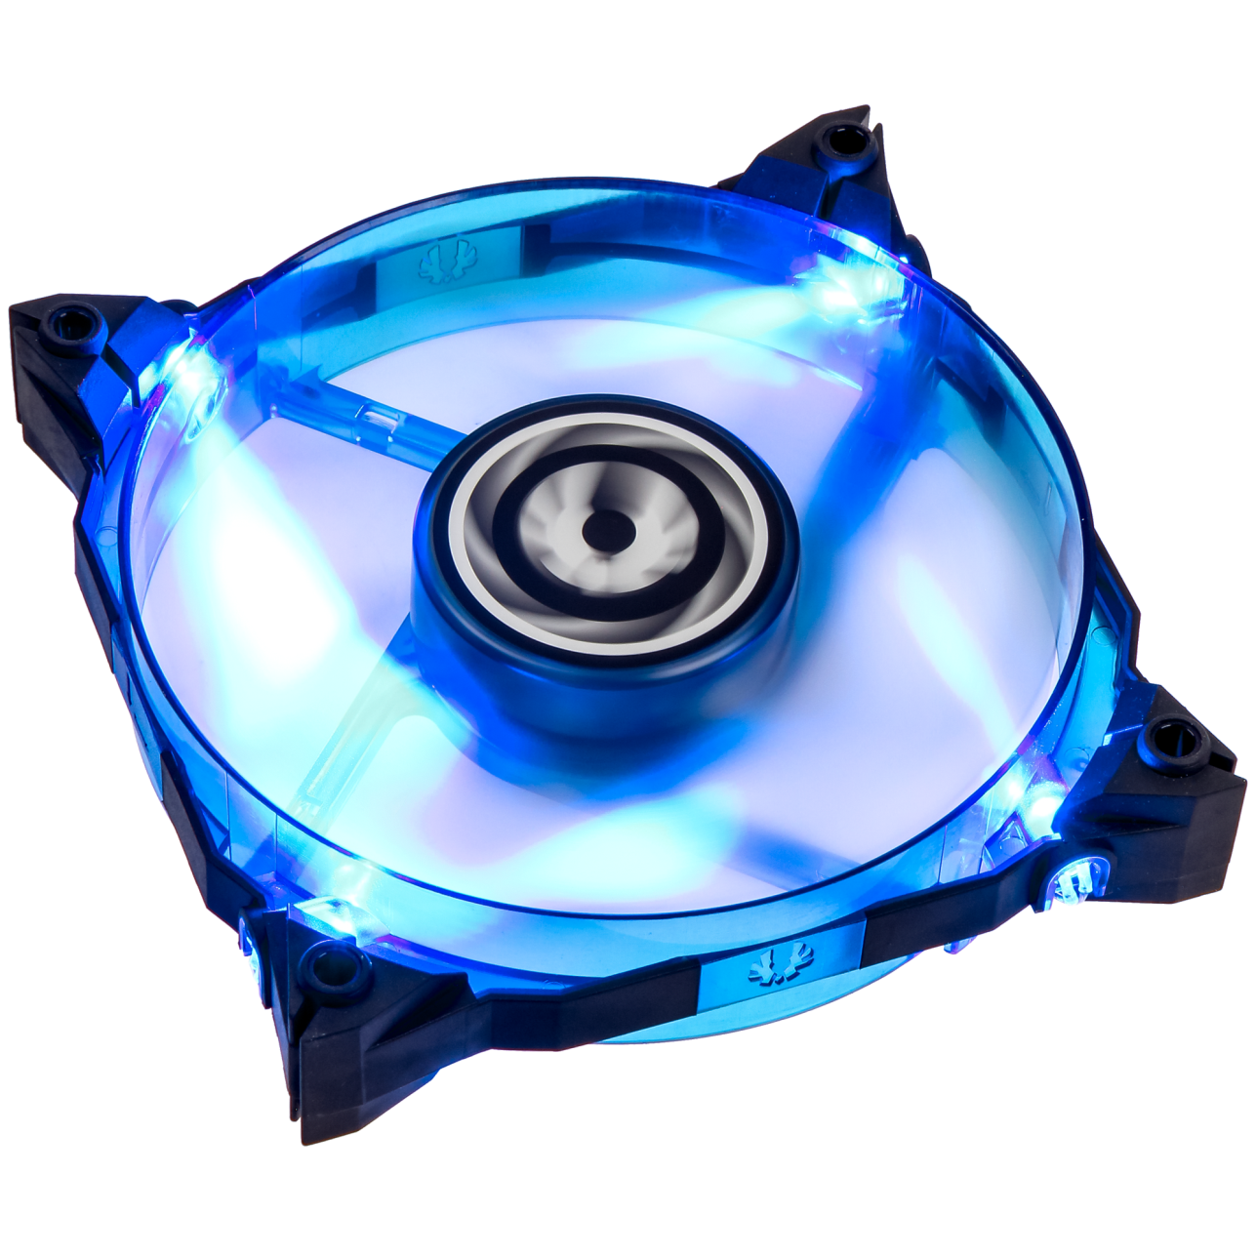
Spectre Xtreme – Airflow
High-speed operation, or low-speed, low-noise operation? Why not both? The Spectre Xtreme lets you choose yourself. The maximum possible airflow is achieved with 12V - 2000 RPM, 66CFM and 2.74mm/H₂O, but it will operate with as low input voltage as 5V – resulting in 950 RPM and tranquility. The choice is yours.

Slide 5
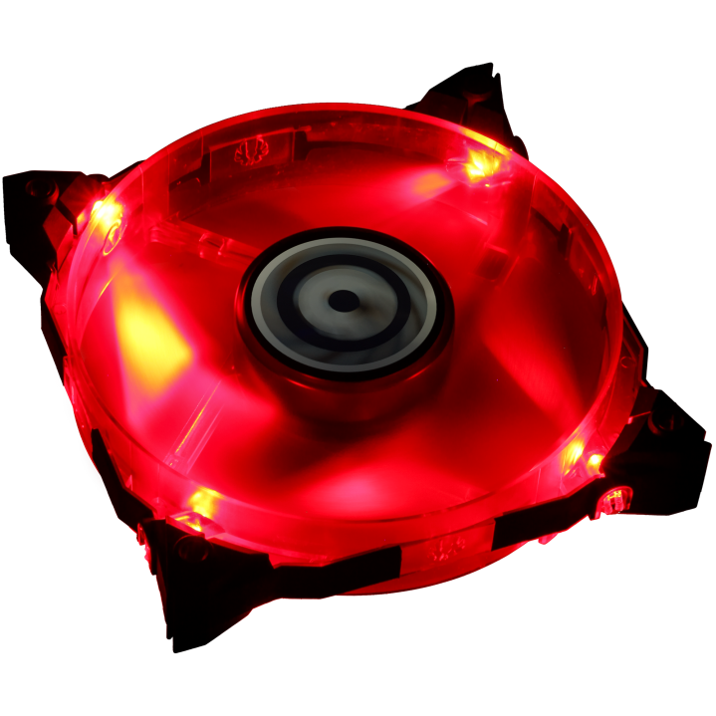
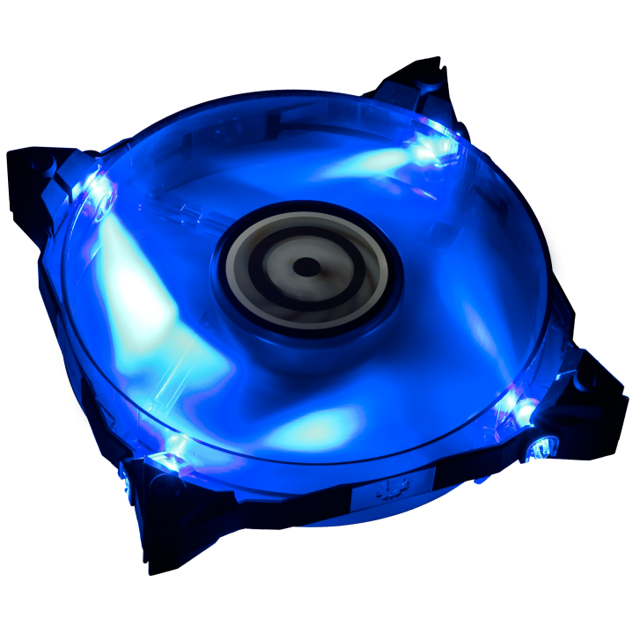
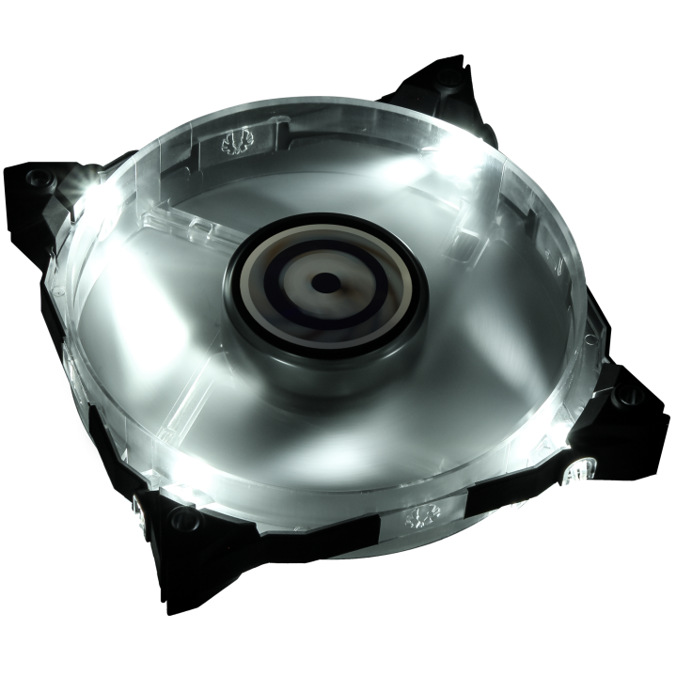
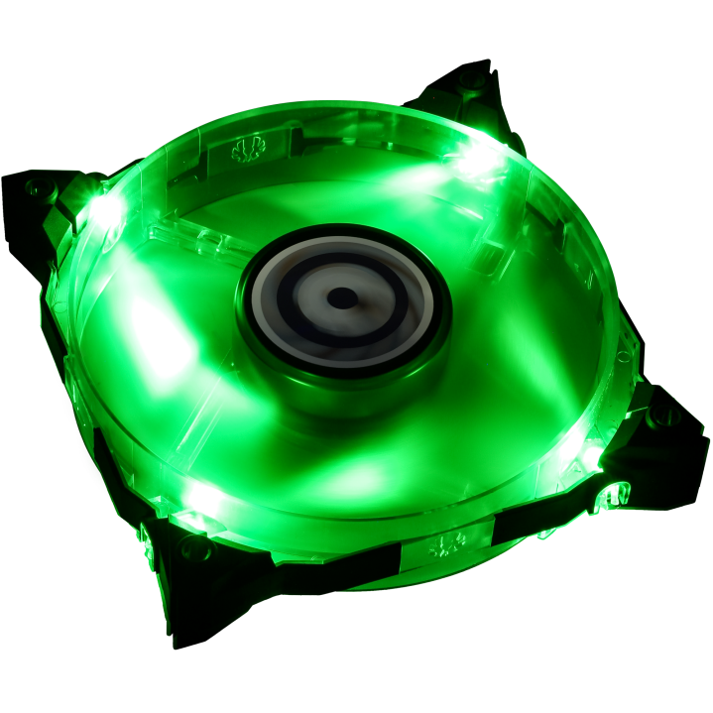
Spectre Xtreme – LEDs
To LED or not to LED – the choice is once again yours. The black Spectre Xtreme comes without any installed LEDs, while the Blue, Green, Red and White ones do. Special care has been taken to match the Green LED with the light emitted from NVIDIA GeForce GTX stock coolers. Even with the LED versions, you can easily turn the LEDs off with the jumper cable.

Slide 6
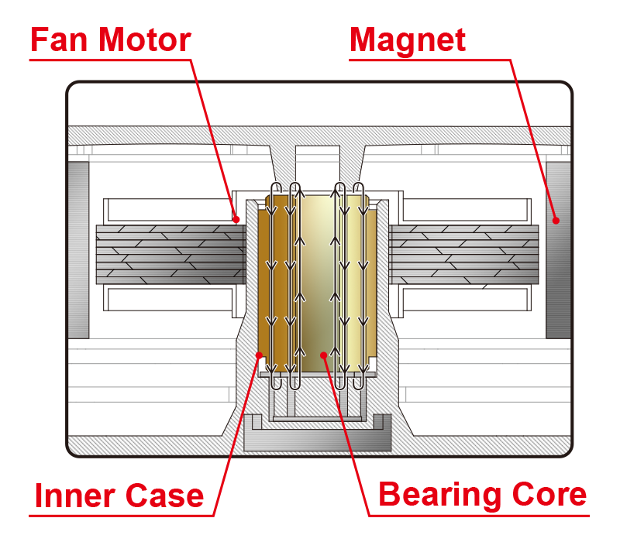
Spectre Xtreme – Fluid Dynamic Bearings
Low internal resistance is important – so the Spectre Xtreme utilizes Fluid Dynamic Bearings. This means that more of the power fed to the fan motor will be transferred to actually rotating the blades, lower noise levels, as well as a longer life expectancy thanks to optimal lubrication of the bearings. The technology was first utilized in hard drives, and has become a must-have feature on any high-end PC fan in latter years.
”Eliminating the bearing noise by use of FDB spindle motors reduces one area of the noise component that contributes to acoustic noise. In addition, the damping effect of the lubricant film further attenuates noise contributed from the spindle motor components. This results in lower acoustic noise from HDDs employing FDB spindle motors. Industry data has shown a 4dBA or more decrease in idle acoustic noise or some HDD designs.” - HGST Whitepaper on FDBs

Slide 7
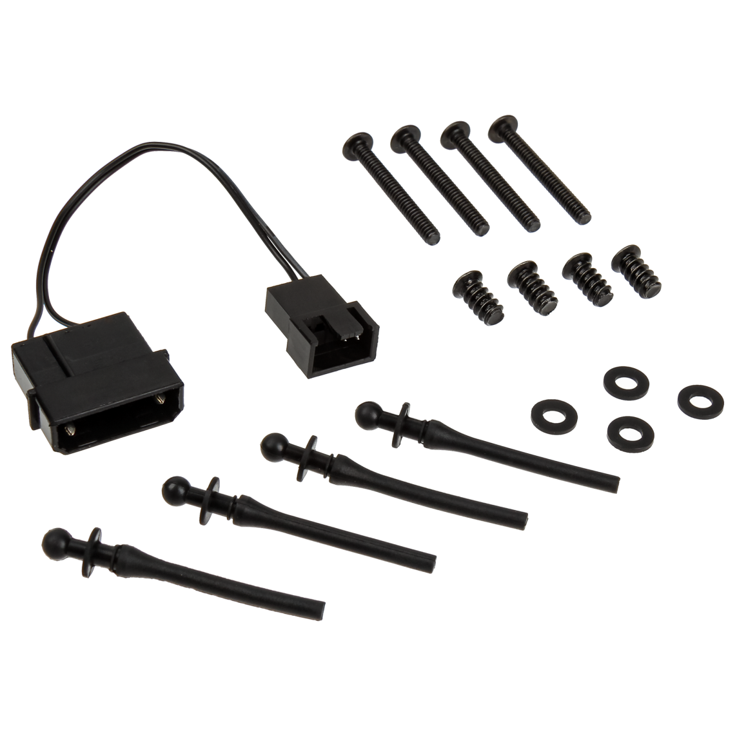
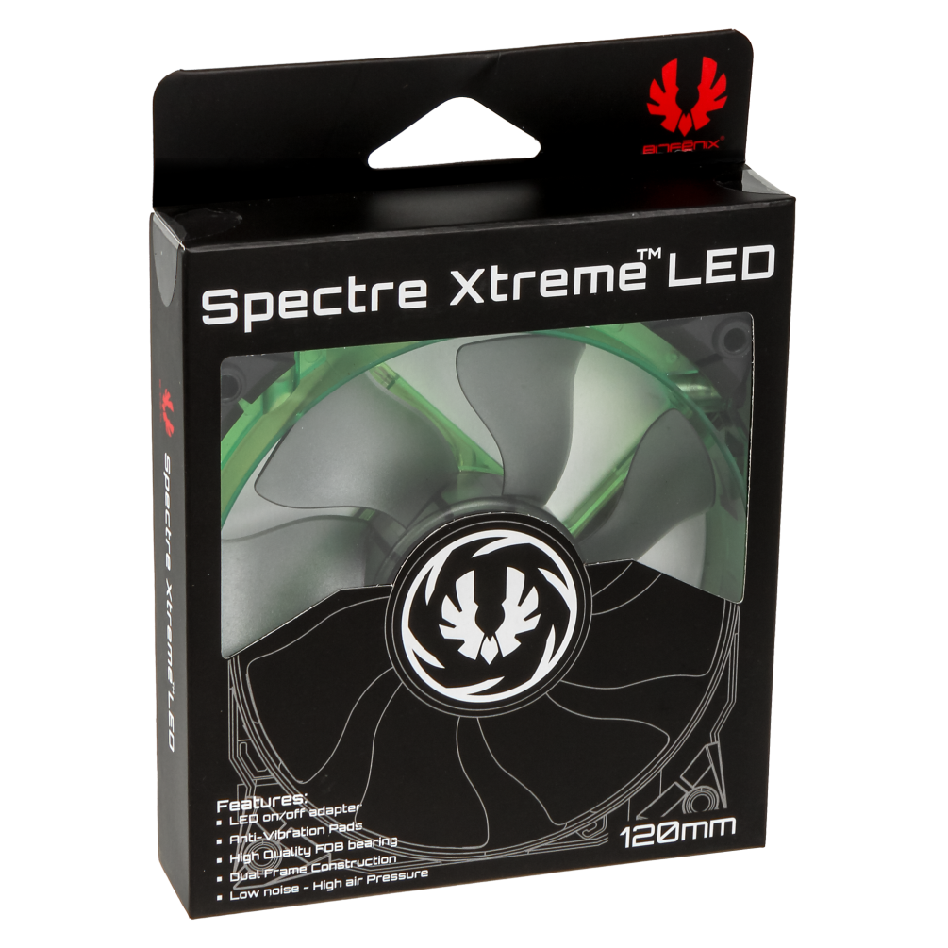
Spectre Xtreme – Accessories
Product packaging is important to us – we make sure to deliver the Spectre Xtreme in a cardboard box with a see-through front. Inside, you will find the fan, as well as all the accessories you’ll ever need to mount the fan to radiators or to your case. Also included is a 3-to-4-pin adaptor, if you’re out of 3-pin headers on your motherboard.

Slide 8
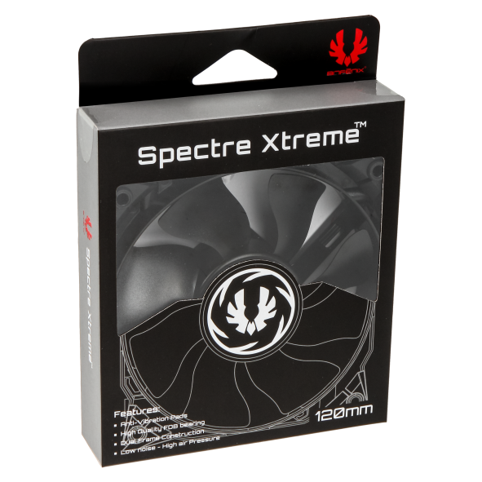
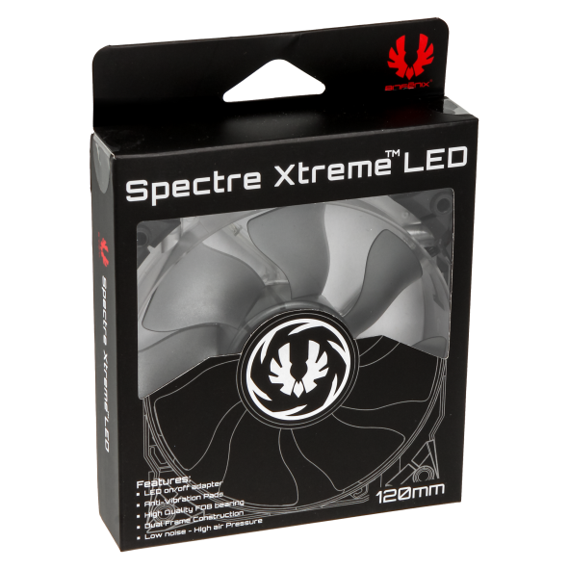
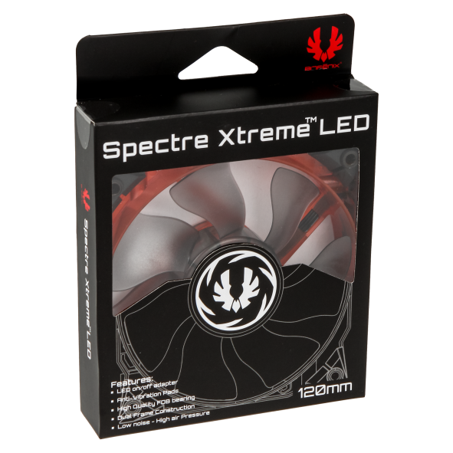
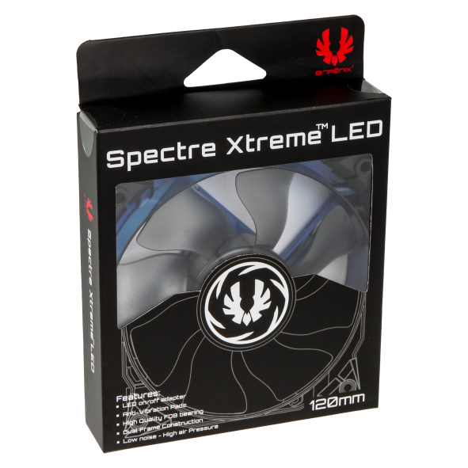
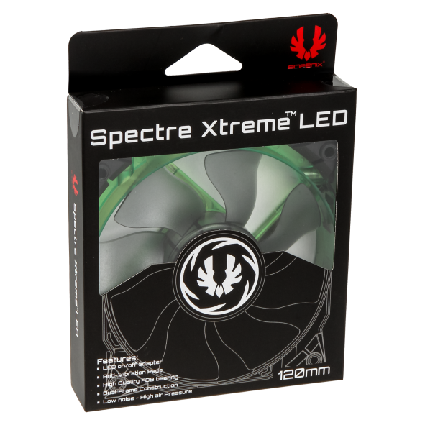
Spectre Xtreme - Specifications
 | Spectre Xtreme
Dimensions (W x D x H) | 120 x 120 x 25mm
Fan Speed | 950-2000 RPM (±5%)
Airflow | 66 CFM at 2000 RPM (±10%)
Air Pressure | 2.74mm H₂O at 2000 RPM (±10%)
Operating Voltage | 5-12 VDC (±5%)
Power Consumption | 3.36W at 2000 RPM, 0.28A 12VDC (±10%)
Noise Level | 30dB at 2000 RPM (±10%)
Bearing Type | Fluid Dynamic Bearing, FDB
Accessories | Anti-vibration grommets x 4 Case screws x 4 Radiator screws + washers x 4 3-to-4 pin power adaptor
Materials | Polycarbonate, TPU
Weight | TBD (net), TBD (gross)
P/N | Black: BFF-SPX-12025K-RP (BLK) White LED: BFF-SPX-12025W-RP Red LED: BFF-SPX-12025R-RP Blue LED: BFF-SPX-12025B-RP Green LED: BFF-SPX-12025G-RP
EAN | Black: 4712883214097 White LED: 4712883214103 Red LED: 4712883214110 Blue LED: 4712883214127 Green LED: 4712883214134
UPC | Black: 886027013205 White LED: 886027013212 Red LED: 886027013229 Blue LED: 886027013236 Green LED: 886027013243

